Slide 1
Moving to Frameworks….
Front-end
Back-end
Server-side

Slide 2
Front-end: part of a web application that users interact with directly. Including the User Interface (UI) and User Experience (UX)
Back-end: responsible for server-side logic, database interactions, and processing request from the front end.

Slide 3
Front-end: part of a web application that users interact with directly. Including the User Interface (UI) and User Experience (UX)
Back-end: responsible for server-side logic, database interactions, and processing request from the front end.

Slide 4
…..
Server-side: refers to the computing resources, hardware, and software responsible for handling client requests and serving web applications

Slide 5



Front-end:
React Angular Vue.js

Slide 6


Back-end - JavaScript:
Node.js Express.js

Slide 7
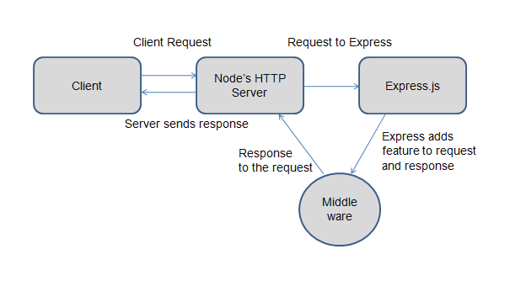

Slide 8

(Additional) Back-end – Python:
Flask Django

Slide 9

(Additional) Back-end – PHP:
Laravel CodeIgniter

Slide 10

(Additional) Back-end – Java:
Java EE Spring Boot

Slide 11
MIDTERM

Slide 12
NODE JS

Slide 13
INTRODUCTION NODEJS

Slide 14
NodeJS is built on Google’s V8 JavaScript engine
Server-side non blocking asynchronous JS
Perfect for “blood” of Web 2.0 apps (streams, comet, AJAX, etc) and scale

Slide 15
- Node.js is a back-end JavaScript runtime environment, runs on the V8 JavaScript engine, and executes JavaScript code outside a web browser.
- is a programming environment that can be used for building high-scale applications that need to support multiple concurrent requests.

Slide 16
Node.js uses asynchronous programming
(Concurrently) -> same time
PHP uses synchronous programming
(Sequentially) -> per order

Slide 17
KEY TERMS

Slide 18
Variables
Functions
Conditional Statements
Loops
Arrays
Objects
Promises and Asynchronous Programming
Module and Imports

Slide 19
CREATE THE FIRST PROGRAM

Slide 20
Importing the ‘http’ Module
const http = require('http');
Creating an HTTP Server
http.createServer(function (req, res) {
// ... server logic ...
}).listen(8080);
Handling HTTP Requests
Function (req,res){
//. . . Server logic . . .
}

Slide 21
Setting HTTP Response Headers
res.writeHead(200, {'Content-Type': 'text/plain’})
Sending an HTTP Response
res.end('Hello World!');
Listening on a Port
listen(8080);

Slide 22
hello world

