Slide 1
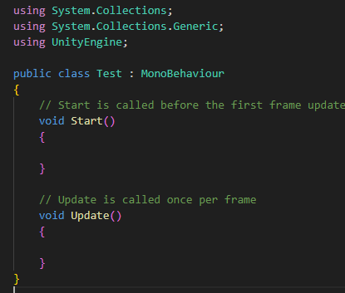

Slide 2
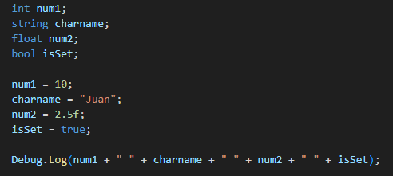
Debug.Log(“Print anything….”)
Variables & Data Types:

Slide 3
Moving Character
Flip from left to right
Moving Camera
Game Manager
Scoring
Basics of Collision

Slide 4
GetComponent<ComponentName>();
OnTriggerEnter2D
FindObjectOfType<Object>();

Slide 5
GetComponent
GetComponent<RigidBody2D>
GetComponent<SpriteRenderer>
etc. . . . . .

Slide 6
Sprite Renderer
Property:
flipX

Slide 7
OnCollision2D, OnEnter2D, OnTriggerEnter2D
other.CompareTag(“TagName”)
Destroy(gameObject)

Slide 8
Interact with Canvas or UI
public Text (← UI) nameOfText
using UnityEngine.UI;

Slide 9
GameManager
Start – Initialize the object game manager:
gameManager = FindObjectOfType<GameManager>();

Slide 10
Scene Transition
using UnityEngine.SceneManagement;
SceneManager.LoadScene(“SceneName");

