Slide 1

UNCLASSIFIED//FOUO
ELK Stack
Analyst Course
SSG Juarbe, Jeriel
Cyber Ops NCO
UNCLASSIFIED//FOUO

Slide 2
CPB ELK History
ELK Development over the past 15 months:
Ortiz, Jose (Army Reserves) – Introduced ELK to us back in April 2015
CPT Smith (Brigade) – Spearheaded the initial BRO Ruby Filters
MSG Bishop (Team 154) – Created Ubuntu ELK Linux Distribution **
MAJ Bailey (Team 152) – Developed DNS Server Filter, Cluster management, and advance Linux/python automation, Cluster Management, etc.
SSG Juarbe (Team 152) – syslog, Windows Event Logs, created ELK Developers Course and ELK Analyst Course, Red Hat (RHEL) Build, Clustering, Enterprise employment, Built new Bro Logstash Filters, etc.

Slide 3
Overview
In this class you will Learn:
What ELK is
Our current Infrastructure Build in USAREUR
How logs are indexed
What and how Clustering works
Conduct Analysis using Kibana Web App
Create Visualization/Dashboards using Kibana
Understand Critical services and processes
Troubleshoot the ELK stack
Modify a current Logstash configuration file
Advanced Linux ELK Management

Slide 4
Purpose
The intent for this course is to provide you with the knowledge necessary to have an effective and smooth transition (RIP) with the current Team out in USAREUR.

Slide 5
Week Schedule
July 5th – July 8th
Tuesday – Friday
Class Start Time: 0900
Class End Time: 1630 or UTC
Lunch 1130-1300

Slide 6
Agenda
Day 1 (July 5th)
Introductions
ELK 10,000 foot View
Intro to ELK Video
Sensor Build
Flow of Data across the Enterprise
CPT Current Infrastructure (NIPR)
Elasticsearch Deep Dive (Clustering)
Intro to Logstash Video
Logstash Deep Dive (Indexing Data)

Slide 7
Agenda
Day 2 (July 6th)
Bro Overview
Bro Intelligence Framework
Bro Resources
Kibana Intro Video
Apache Lucence Query Syntax
Kibana Analysis Discover Tab (Queries)
Kibana Analysis Visualizations
Kibana Dashboards

Slide 8
DAY 3 Agenda
Day 3 (July 7th)
Critical Services and Processes
Restarting the ElasticStack Cluster
Memory Optimization
Advanced Linux
Deleting Indexes (curator)
Troubleshooting 101
Modify a Logstash configuration
End of Course Exam

Slide 9
Agenda
Day 4 (July 8th)
Free Day to finish up labs if necessary
Questions/Answers Session
1 on 1 additional instruction if required
Exam Failures Retest

Slide 10
ELK Analyst Course
DAY 1
July 5th
ElasticStack Overview & CPT Infrastructure

Slide 11
Agenda
Day 1 (July 5th)
Introductions
ELK 10,000 foot View
Intro to ELK Video
Sensor Build
Flow of Data across the Enterprise
CPT Current Infrastructure (NIPR)
Elasticsearch Deep Dive (Clustering)
Intro to Logstash Video
Logstash Deep Dive (Indexing Data)

Slide 12
Introductions
What Team/Role?
What do you know about ELK?
What are your strengths?

Slide 13
Fact of Life
If I am the first to break it to you….
You are all Cyber Defense Analyst…
Meaning you all will be expected to perform analysis on Kibana in USAREUR

Slide 14



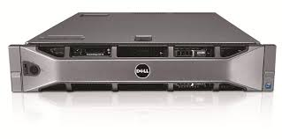
Laptop Layout
Vincent Hall Layer 3 Device
Ubuntu 16
Virtualbox
HOST OS:
Username: student#
Password: findaway
192.168.1.1
VM’s:
Username: jeriel
Password: password
Clustered ELK
192.168.1.0/24
Master/Data Node
Data Node
Data Node
Elastic1
Elastic2
Elastic3
192.168.1.10
192.168.1.12
192.168.1.13

Slide 15
LAB 1 VM Familiarization
Open Lab01.txt located in your student Folder:
Action: Familiarize Students with Laptop/VM environment
Condition: Given a classroom environment, student laptops, VM’s, and student handouts.
Standard: Gain Familiarization of how to login and utilize the resources provided to the students.

Slide 16
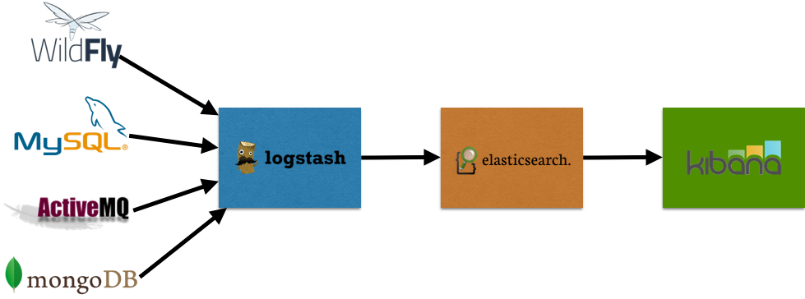
ELK High Level Overview
Web Application; Visualization of the stored data
Stores Data; Database
Ingests and parses data; outputs data to Elasticsearch

Slide 17
ELK High Level Overview
Why do you care?
Why is Log aggregation important for Defensive Cyberspace Operations (DCO)?
Gives you the ability to aggregate enterprise system logs from hosts, servers, routers, switches, IDS alerts, etc….to a centralized location to perform analysis/network/host forensics.
It is an Open canvas. You are the Artist . Full Customization of how to store and visualize data
And it is free…

Slide 18
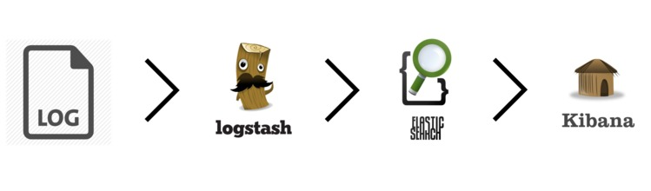
ELK High Level Overview
Windows Event Logs
Syslog
DNS Logs
Bro Logs
Snort Alerts

Slide 19
Intro to ELK Stack
An Introduction to the ELK stack
Video
Start: 00:00
End @ 11:14
https://www.elastic.co/webinars/introduction-elk-stack?baymax=default&elektra=videos&storm=cta2&rogue=stream/?view=1
Enter Bogus email

Slide 20




Sensor Build
RSS is the name of the Sensor
Contains:
Operating System is RHEL 6
BRO (current)
SNORT (current)
Uses Rysnc to send data to RCC Data Miner
What is RSYNC?
Is a utility to keep copies of a file on two computer systems. It is commonly found on Unix-like systems and functions as both a file synchronization and file transfer program. The rsync algorithm is a type of delta encoding, and is used to minimize network usage.
Port 22, Requires User Account and an authentication Key on remote host

Slide 21
Sensor Build Manager
RSS Manager
- Custom Web Design by RCC engineers
Centralized management system for all sensors
Snort Configuration Files are done here
Snort alerts and snort rules managed here for all sensors

Slide 22







CPT 152 ElasticStack Cluster Diagram
RSYNC
RSYNC
RSYNC
SENSOR (RSS)
RSS Manager
DATA MINER
RSYNC
ELK Laptop
ANALYST
DDI KIT

Slide 23
Break
Break

Slide 24

Elasticsearch Deep Dive
ELASTICSEARCH 2
Apache Lucene -> powerful Java Search Library (used by Twitter, LinkedIn, etc)
Java 7 and up
JSON - JavaScript Object Notation
Interaction with RESTful API URL based
Understanding Lucene: Recommend looking at this video
https://www.youtube.com/watch?v=vLEvmZ5eEz0
Lucence Query Syntax:
https://lucene.apache.org/core/2_9_4/queryparsersyntax.html
https://www.elastic.co/guide/en/elasticsearch/reference/current/query-dsl-query-string-query.html

Slide 25
Elasticsearch Deep Dive
TERMS that you need to know:
Cluster => multiple nodes
Node => a single server
Index => Collection of documents (example WEV)
Type=> category/partition of your index
Document => basic unit of info that is indexed in JavaScript Object Notation (JSON)
Shards => subdivided pieces of an Index that can be stores across multiple nodes or the same node
Replicas => one or more copies of your index’s shard

Slide 26
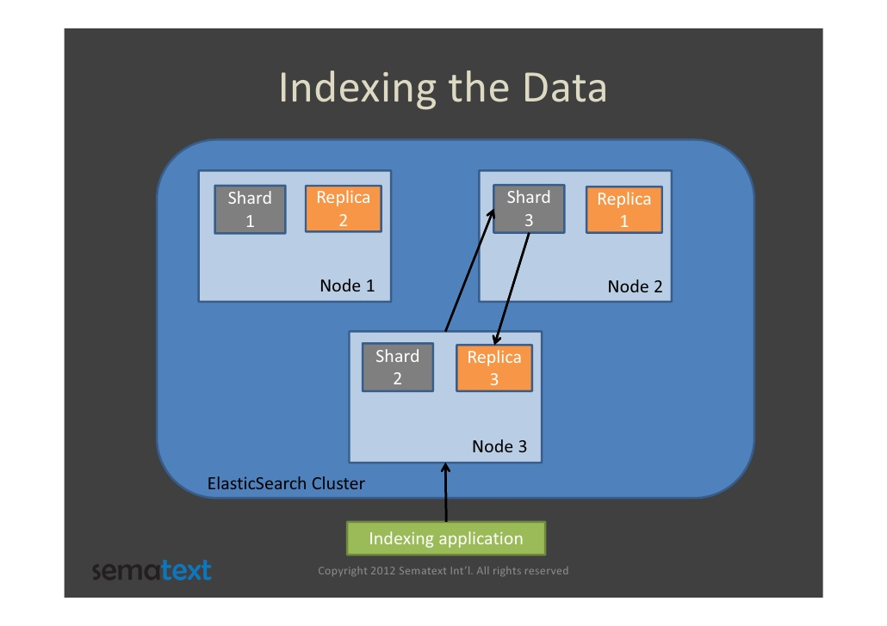
Elasticsearch In the Weeds
Cluster -> Node -> Index -> Documents
-> Shards -> Documents
-> Replicas -> Documents

Slide 27
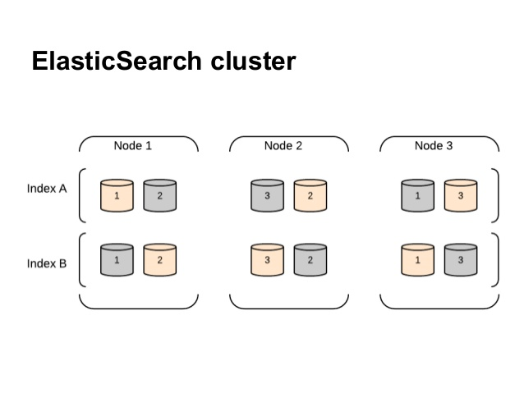
Elasticsearch Deep Dive
Cluster -> Node -> Index -> Documents
-> Shards -> Documents
-> Replicas -> Documents

Slide 28
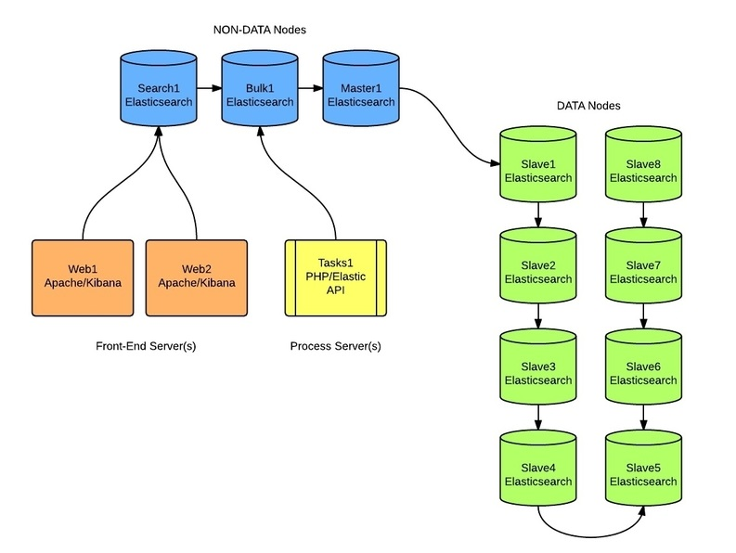
Elasticsearch Weeds

Slide 29
Elasticsearch Deep Dive
Why Shards?
An index can store a large amount of data that can exceed the hardware limits of a single node
Each shard is in itself a fully-functional and independent "index" that can be hosted on any node in the cluster.
Sharding is important for two primary reasons:
It allows you to horizontally split/scale your content volume
It allows you to distribute and parallelize operations across shards (potentially on multiple nodes) thus increasing performance/throughput

Slide 30
Elasticsearch Deep Dive
By default, each index in Elasticsearch is allocated 5 primary shards and 1 replica which means that if you have at least two nodes in your cluster, your index will have 5 primary shards and another 5 replica shards (1 complete replica) for a total of 10 shards per index.
Elasticsearch requires at least Java 7. Specifically it is recommended that you use the Oracle JDK version 1.8.0_72. Java

Slide 31
CPT 152 ElasticStack Cluster Diagram
Master/Data Node
DATA MINER
Data Node
CLIENT Node
ELK Laptop
AZ, DPTA
ELK Laptop
MK, NS, JMTG-U, RK, TP
RSYNC
Data Node
Data Node
Data Node
ANALYST
DDI KIT
Master/Data Node

Slide 32
LAB 2: Elasticsearch Cluster 101
Open Lab02.txt located in your student Folder:
Action: Familiarize Students with Elasticsearch HQ plugin to view the Elasticsearch Cluster; location of important Elasticsearch configuration files and commands to check the health of Elasticsearch via CLI.
Condition: Given a classroom environment, student laptops, VM’s, and student handouts.
Standard: Gain Familiarization of how to access and view the state of the Elasticsearch Cluster via the HQ plugin; run CLI commands.

Slide 33
BREAK
BREAK

Slide 34
Intro to Logstash
Logstash Overview Video
00:00 - 22 minute
AND
Logstash Parsing Example Using Grok
27:00- 30:50
https://www.elastic.co/webinars/logstash-0-60-in-60

Slide 35
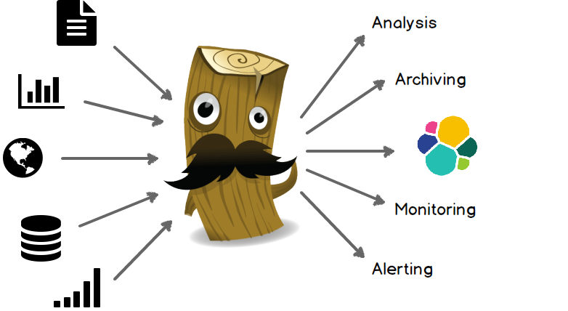
Logstash Deep Dive
Uses JRuby under the hood
Package with Java Runtime
Extended with Ruby

Slide 36
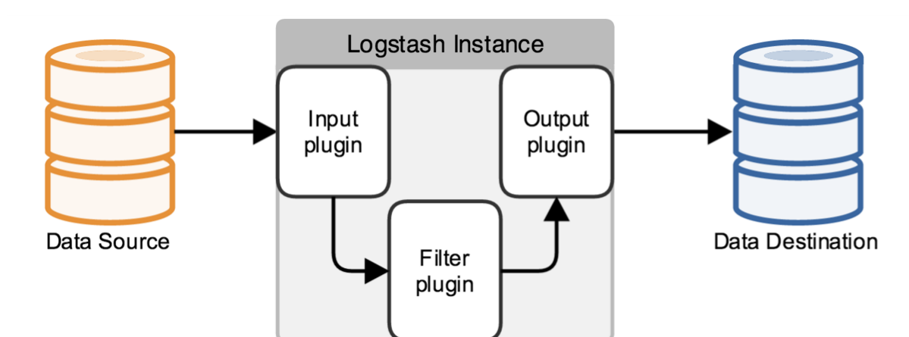
Logstash Deep Dive
What is Logstash’s logical flow?

Slide 37
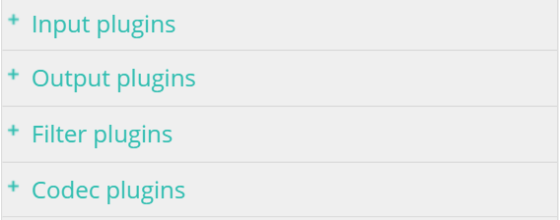
Logstash Deep Dive
Plugins ARE your Best Friend:
There are many plugins available that come by default when installed. There are also 3rd Party Plugins
Go to this website for Logstash Guide:
https://www.elastic.co/guide/en/logstash/current/input-plugins.html

Slide 38
Logstash Deep Dive
How does Logstash get the Logs?
TCP/UDP
Files
Syslog
STDIN
WebSocket
Much More

Slide 39
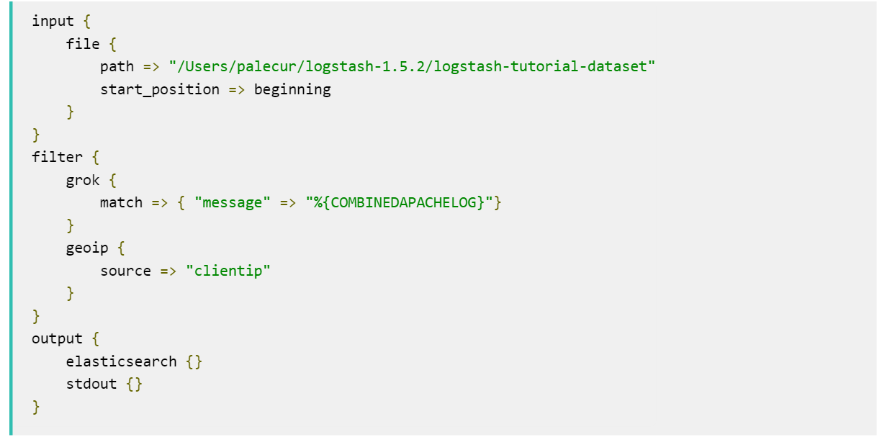
Logstash Deep Dive
Logical flow of data:
INPUT -> FILTER -> OUTPUT

Slide 40
Logstash In the Weeds
Parsing the Input
JSON
CSV
Xml
REGEX
GROK (Regex on steroids)
Etc….

Slide 41
Logstash Deep Dive
How can Logstash output data
TCP/UDP
Email
Files
HTTP
Nagios
Etc….

Slide 42
Logstash Deep Dive
What is Logstash’s logical flow?

Slide 43
Logstash Deep Dive
CPT 152 Logstash Layout:
Main configuration directory:
/etc/Logstash/
Location of Filters/config files
/etc/Logstash/policy/new_bro/
Location of active config files in use
/etc/Logstash/conf.d/

Slide 44
LAB 3: Logstash 101
Open Lab03.txt located in your student Folder:
Action: Familiarize Students with where Logstash binary and configuration files reside; how Logstash service operates in Linux.
Condition: Given a classroom environment, student laptops, VM’s, and student handouts.
Standard: Successfully stop and restart Logstash service; locate binaries; locate layout of configuration files.

Slide 45
ELK Analyst Course
DAY 2
July 6th
In-Depth Analysis using Kibana

Slide 46
Agenda
Day 2 (July 6th)
Bro Overview
Bro Intelligence Framework
Bro Resources
Kibana Intro Video
Apache Lucence Query Syntax
Kibana Analysis Discover Tab (Queries)
Kibana Analysis Visualizations
Kibana Dashboards

Slide 47

Bro Logs
Powerful NSM Tool
Separates Logs by Protocol (IE: HTTP, SSL, FTP)

Slide 48
Bro Network Security Monitoring
Do you BRO, bro?

Slide 49
Bro Overview
Open the “BroOverview2015.pdf” in the student folder
Navigate to the following link:
https://www.bro.org/

Slide 50
Bro Intelligence Framework
Navigate to the following link:
https://www.bro.org/sphinx-git/frameworks/intel.html
- Open the PDF called “Intel-Framework.pdf” in your student Folders

Slide 51
Broala Bro Log Cheat Sheet
Open the PDF called “broalaBroLogCheatSheet.pdf”, in your student Folders

Slide 52
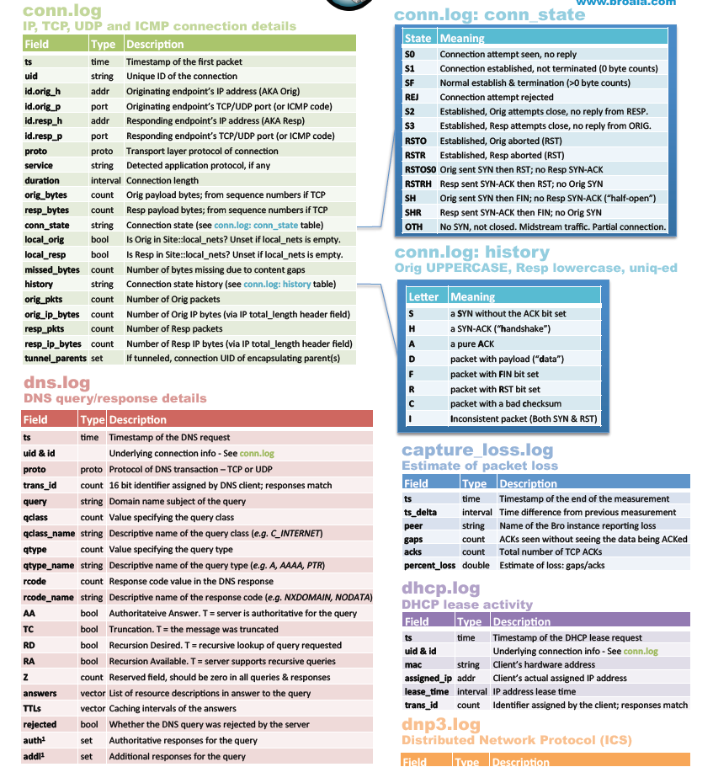
Broala Bro Log Cheat Sheet

Slide 53
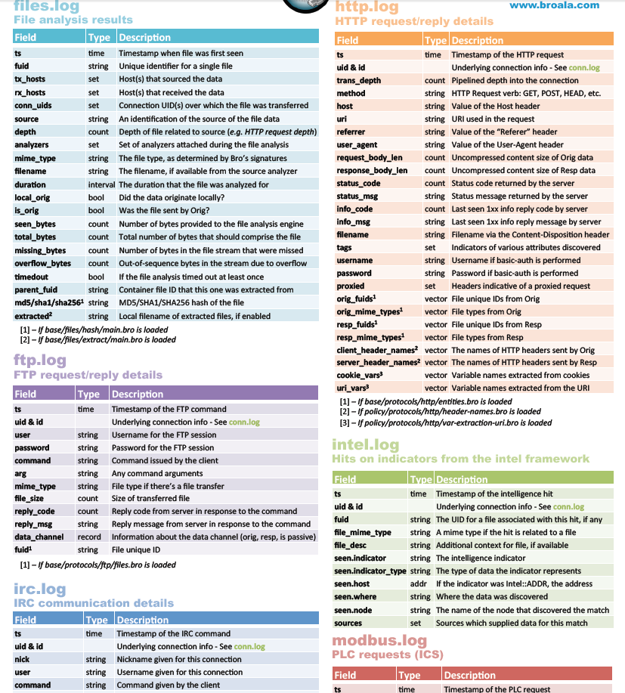
Broala Bro Log Cheat Sheet

Slide 54
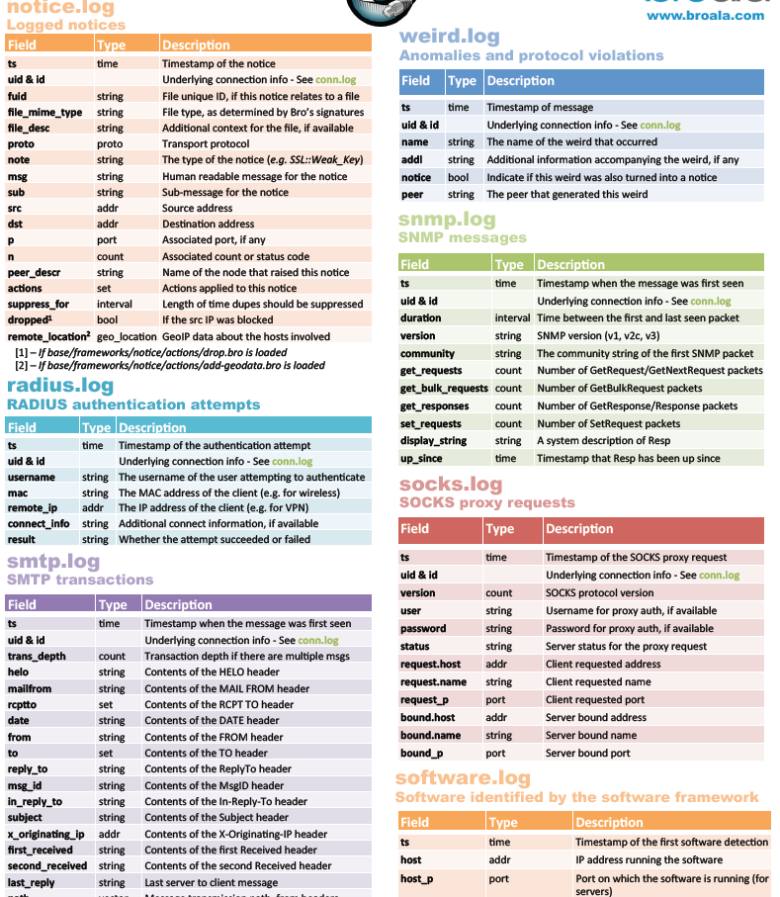
Broala Bro Log Cheat Sheet

Slide 55
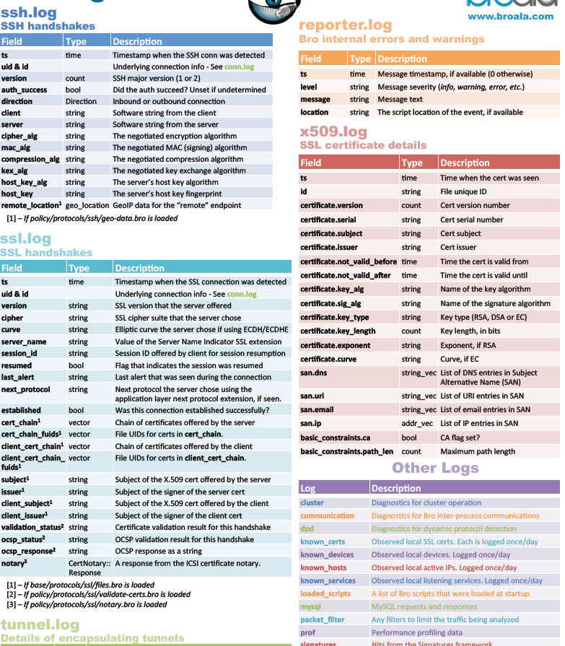
Broala Bro Log Cheat Sheet

Slide 56
LAB 4: BRO LOGS
Open Lab04.txt located in your student Folder:
Action: Familiarize Students with where bro logs are placed after RSYNC from Data Miner; view bro logs via CLI; view the different types of bro logs generated by network traffic.
Condition: Given a classroom environment, student laptops, VM’s, and student handouts.
Standard: located bro logs; view bro logs via CLI; and learn the types of bro logs generated.

Slide 57
Break
Break

Slide 58
KIBANA
Kibana Video (start 4:00 min – End at 40 min)
https://www.elastic.co/webinars/getting-started-with-kibana
&
https://www.elastic.co/webinars/kibana-101-get-started-with-visualizations

Slide 59
Apache Lucene
Using a browser go here:
https://www.elastic.co/guide/en/kibana/current/discover.html
&&
https://lucene.apache.org/core/2_9_4/queryparsersyntax.html

Slide 60
BREAK
BREAK

Slide 61
LAB 5: Kibana Discover Tab/Queries
Open Lab05.txt located in your student Folder:
Action: Familiarize Students with Kibana Queries in the Discover Tab of Kibana; build custom queries; save queries; analyze bro logs. Students will demonstrate to class at least 5 custom query to the class.
Condition: Given a classroom environment, student laptops, VM’s, and student handouts.
Standard: successfully create, save, and edit custom 5 queries for Bro Logs. Conduct Analysis and demonstrate a query to the class.

Slide 62
LAB 5: Kibana Queries
Guide on how to build queries located at this link:
https://www.elastic.co/guide/en/kibana/current/discover.html

Slide 63
Break
Break

Slide 64
LAB 6: Kibana Visualizations
Open Lab06.txt located in your student Folder:
Action: Familiarize Students with Kibana visualizations (graphs, pie charts, etc.). Build, save, and edit custom visualizations using the saved queries from previous lab.
Condition: Given a classroom environment, student laptops, VM’s, and student handouts.
Standard: Successfully create, save, and edit custom visualizations for Bro Logs. Demonstrate at least 3 custom visualizations to the class.

Slide 65
LAB 6: Kibana Visualizations
Guide on how to build visualizations located at this link:
https://www.elastic.co/guide/en/kibana/current/visualize.html

Slide 66
BREAK
BREAK

Slide 67
LAB 7: Kibana Dashboards
Open Lab07.txt located in your student Folder:
Action: Familiarize Students with Kibana Dashboards. Build, save, and edit custom dashboards using the saved visualizations from previous lab.
Condition: Given a classroom environment, student laptops, VM’s, and student handouts.
Standard: Successfully create, save, and edit custom Dashboards for Bro Logs. Demonstrate at least 1 custom Dashboards to the class.

Slide 68
LAB 7: Kibana Dashboards
Guide on how to build Dashboards located at this link:
https://www.elastic.co/guide/en/kibana/current/dashboard.html

Slide 69
ELK Analyst Course
DAY 3
July 7th
ElasticStack Cluster Management and Advanced Techniques

Slide 70
DAY 3 Agenda
Day 3 (July 7th)
Critical Services and Processes
Restarting the ElasticStack Cluster
Memory Optimization
Advanced Linux
Deleting Indexes (curator)
Troubleshooting 101
Modify a Logstash configuration
End of Course Exam

Slide 71
Critical Services/Processes
The following are some on the critical services & processes for the ELK Cluster:
Elasticsearch
Logstash
Kibana
SSH
Cron Jobs
RSYNC
BASH and Python Scripts

Slide 72
LAB 8: Critical Processes/Services
Open Lab08.txt located in your student Folder:
Action: Familiarize Students with checking the status of services and processes.
Condition: Given a classroom environment, student laptops, VM’s, and student handouts.
Standard: Successfully check the status of services and processes.

Slide 73
Restarting the Cluster
It is crucial to be methodical when restarting the cluster. The specific instructions are in the Lab09 document.
Best practice is to restart the Elasticsearch service in the following order:
Non-Master/Data Nodes (3)
Master Node/Master Eligible Nodes (2)
Client Node (1)

Slide 74
LAB 9: Restarting the Cluster
Open Lab09.txt located in your student Folder:
Action: Familiarize Students with the process to restart the Cluster gracefully.
Condition: Given a classroom environment, student laptops, VM’s, and student handouts.
Standard: Successfully restart the cluster.

Slide 75
BREAK
BREAK

Slide 76
Memory Optimization
Elasticsearch is Memory Intensive.
Configuration of Elasticsearch memory consumption is crucial to smooth cluster
The key configuration file locations are as follows:
/etc/elasticsearch/elasticsearch.yml
/etc/sysctl.conf

Slide 77
LAB 10: Memory Optimization
Open Lab10.txt located in your student Folder:
Action: Familiarize students on where to make OS and Elasticsearch memory configuration changes to improve performance of the cluster.
Condition: Given a classroom environment, student laptops, VM’s, and student handouts.
Standard: Successfully make changes and restart the cluster.

Slide 78

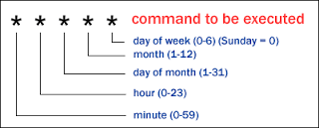
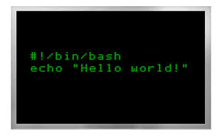
Advanced Linux
Usage of Native Linux tools:
RCC Data Miner drops compressed BRO logs via RSYNC to several of our ELK nodes.
We then use a combination of Python and BASH scripts to uncompressed the files, create a new directory for new sensors if needed, move all the bro logs to their appropriate directory based of sensor name, delete BRO logs, and delete system logs.
We also use Rsync to move data to other nodes.
We use Cron Jobs to automate all of the above.

Slide 79
LAB 11: Advanced Linux
Open Lab11.txt located in your student Folder:
Action: Familiarize students with python scripts, bash scripts, rsync, and cron jobs.
Condition: Given a classroom environment, student laptops, VM’s, and student handouts.
Standard: Successfully create a BASH script and setup a new cron job.

Slide 80
BREAK
BREAK

Slide 81


Deleting Indices
The purpose of deleting indices is to manage your storage capacity for your cluster:
There are several ways to delete indexes in Elasticsearch
One method is to use Curator. Curator is a CLI product made by Elastic.co to manage and delete indices.
Another method is to use the sense plugin on a chrome browser. Sense is viewed on your browser and interacts with your Elasticsearch cluster via JSON entries.
Another method is to use the HQ Plugin.

Slide 82
LAB 12: Deleting Indices
Open Lab12.txt located in your student Folder:
Action: Familiarize students the several methods to delete indices to ensure the Cluster does not run out of storage.
Condition: Given a classroom environment, student laptops, VM’s, and student handouts.
Standard: Successfully delete a index.

Slide 83
Troubleshooting 101
The fact of life when it comes to ELK is that you will find your self constantly troubleshooting.
It is imperative that you understand the inner workings of a Linux host and ELK services to properly identify the problem and find a quick solution.

Slide 84
LAB 13:Troubleshooting 101
Open Lab13.txt located in your student Folder:
Action: Familiarize students the basics of troubleshooting Linux and ELK.
Condition: Given a classroom environment, student laptops, VM’s, and student handouts.
Standard: Successfully execute commands to check what may be causing issues with ELK or the Linux Host.

Slide 85
BREAK
BREAK

Slide 86

Modify a Logstash Configuration
There are many reasons to edit a Logstash configuration file. For the scope of this course we will be modifying the current configuration file to add a new sensor the cluster.
-We will be using the native Linux command “sed” to modify the files.

Slide 87
LAB 14: Modify Logstash Configuration
Open Lab14.txt located in your student Folder:
Action: Familiarize students modifying a Logstash configuration file using sed.
Condition: Given a classroom environment, student laptops, VM’s, and student handouts.
Standard: Successfully modify the Logstash conf for the addition of a new sensor.

Slide 88
BREAK
BREAK

Slide 89
End of Course EXAM
You have 30 minutes to complete the Exam

Slide 90
ELK Analyst Course
DAY 4
July 8th
Q/A, Re-Test, 1-on-1 Instruction

Slide 91
Agenda
Day 4 (July 8th)
Free Day to finish up labs if necessary
Questions/Answers Session
1 on 1 additional instruction if required
Exam Failures Retest

Slide 92
Questions
QUESTIONS?

