Slide 1

UNCLASSIFIED//FOUO
ELK Stack
Developers Course
UNCLASSIFIED//FOUO

Slide 2
Introductions
INTRODUCTIONS
What Team/Role?
Syslog or Windows Event Log Knowledge
Strength….. Windows or Linux?

Slide 3
CPB Historical Knowledge
ELK Development over the past Year:
Ortiz, Jose & Dustin Lee– Introduced ELK to us back in April 2015
CPT Smith (Brigade) – Spearheaded the Ruby Filters
SFC Bishop (Team 154) – Debian Linux Distribution **
MAJ Bailey (Team 152) – Developed DNS Server (windows) Filter
SSG Clasen (Brigade) – Docker/BRO/ELK combo
SSG Juarbe (Team 152) – syslog, WEV, how-to documentation, RHEL, Clustering, Enterprise employment

Slide 4
Overview
In this class you will Learn how to :
Build an Open Source Log Aggregation Server
Aggregate Windows Events Logs
Aggregate Syslog
Aggregate Bro Logs
Build custom scripts in Ruby
Manage/configure Elasticsearch Database
Visualize Data for Analysis in Kibana
Get intimate with RHEL

Slide 5
Overview
The intent is for you to:
Walk away with a tool that you can use for your team’s mission set.
To provide your Network Traffic analyst’s with a powerful method to identify enemy presence and pivoting on the network.

Slide 6
Week Schedule
February 16th – February 19th
Tuesday – Friday
Class Start Time: 0900
Class End Time: 1600
Lunch 1130-1300

Slide 7
Agenda
Day 1
Introductions
ELK 10,000 foot View
Intro to ELK Video
Intro to Logstash Video
Elasticsearch Deep Dive
Logstash Deep Dive
Build ELK using CentOS7 (LAB 1)
Demo pre-configured ELK

Slide 8
Agenda
Day 2
Syslog
Grok Basics
LAB 2 - Syslog
Kibana Intro Video
Apache Lucence Query Syntax
LAB 3 - Visualize Syslog in Kibana
LAB 4 – Build Windows Domain, GPO, & Collector

Slide 9
DAY 3 Agenda
Day 3
NXLOG
LAB 5 - nxlog
Lab 6 – WEV on ELK
LAB 6 Part 2- Visualization of Windows Event Logs in Kibana
BRO Logs
LAB 7 – Security Onion Setup
LAB 8 – ELK setup for BRO
LAB 9 – Syslog-ng configuration
LAB 10 – Visualize BRO in Kibana
LAB 11 - Curator

Slide 10
Agenda
Day 4
Ubuntu Distro (SFC Bishop)
Filter Development and Debugging
Practical: Build and test your own filter
Discuss DNS Logs
Demonstrate DNS Filter {Maj Bailey}
WINRM overview and Risk Mitigation Strategy
Export Images
The way ahead for the CPB

Slide 11
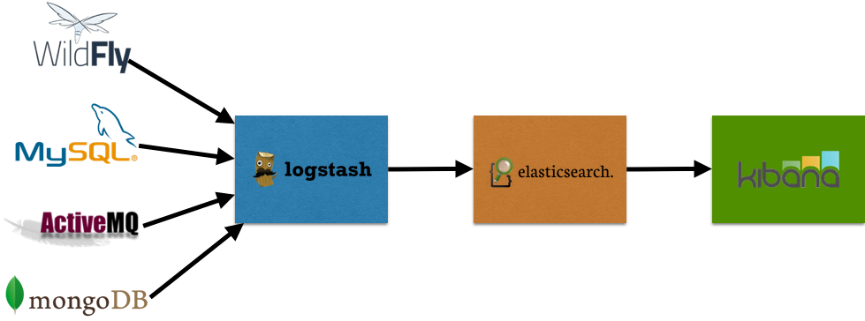
ELK High Level Overview
Web Application; Visualization of the stored data
Stores Data; Database
Ingests and parses data; outputs data to Elasticsearch

Slide 12
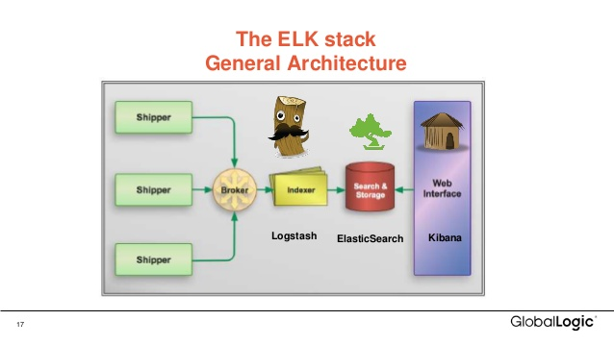
ELK High Level Overview

Slide 13
ELK High Level Overview
Why do you care?
Why is Log aggregation important for Defensive Cyberspace Operations (DCO)?
Gives you the ability to aggregate enterprise system logs from hosts, servers, routers, switches, IDS alerts, etc….to a centralized location to perform analysis/network/host forensics.
It is an Open canvas. You are the Artist . Full Customization of how to store and visualize data
And it is free…

Slide 14
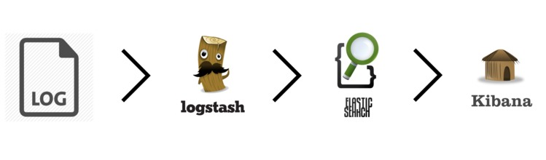
ELK High Level Overview
Windows Event Logs
Syslog
DNS Logs
Bro Logs
Snort Alerts

Slide 15
Intro to ELK Stack
An Introduction to the ELK stack
Video
Start: 00:00
End @ 11:14
https://www.elastic.co/webinars/introduction-elk-stack?baymax=default&elektra=videos&storm=cta2&rogue=stream/?view=1
Enter Bogus email

Slide 16
Break
10 Minute Break

Slide 17

Elasticsearch Deep Dive
ELASTICSEARCH 2
Apache Lucene -> powerful Java Search Library (used by Twitter, LinkedIn, etc)
Java 7 and up
JSON - JavaScript Object Notation
Interaction with RESTful API URL based
Understanding Lucene: Recommend looking at this video
https://www.youtube.com/watch?v=vLEvmZ5eEz0
Lucence Query Syntax:
https://lucene.apache.org/core/2_9_4/queryparsersyntax.html
https://www.elastic.co/guide/en/elasticsearch/reference/current/query-dsl-query-string-query.html

Slide 18
Elasticsearch Deep Dive
TERMS that you need to know:
Cluster => multiple nodes
Node => a single server
Index => Collection of documents (example WEV)
Type=> category/partition of your index
Document => basic unit of info that is indexed in JavaScript Object Notation (JSON)
Shards => subdivided pieces of an Index that can be stores across multiple nodes or the same node
Replicas => one or more copies of your index’s shard

Slide 19
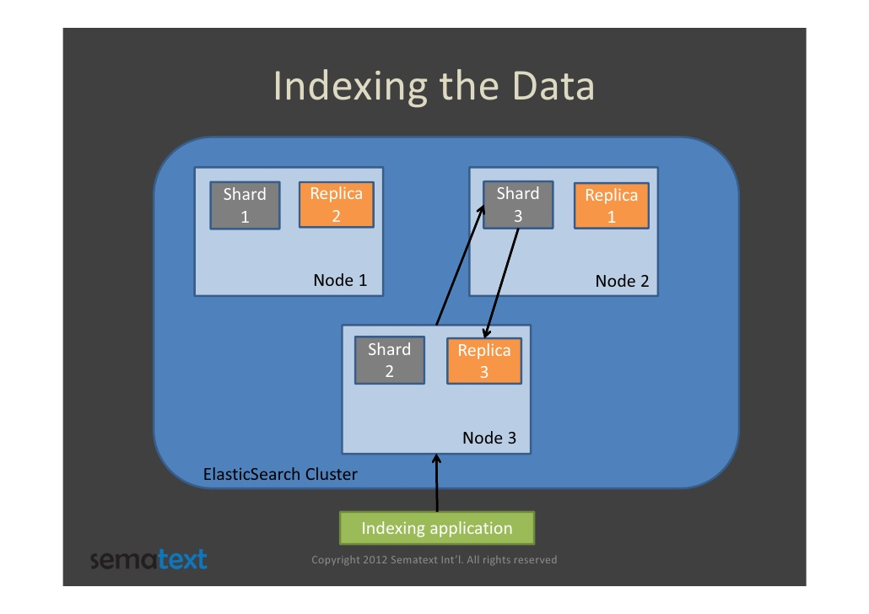
Elasticsearch In the Weeds
Cluster -> Node -> Index -> Documents
-> Shards -> Documents
-> Replicas -> Documents

Slide 20
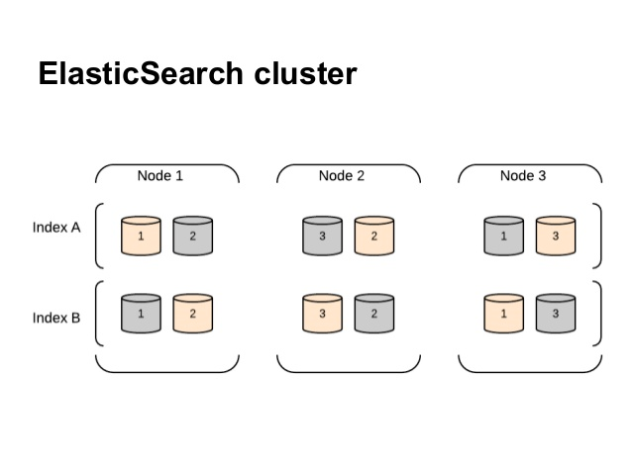
Elasticsearch Deep Dive
Cluster -> Node -> Index -> Documents
-> Shards -> Documents
-> Replicas -> Documents

Slide 21
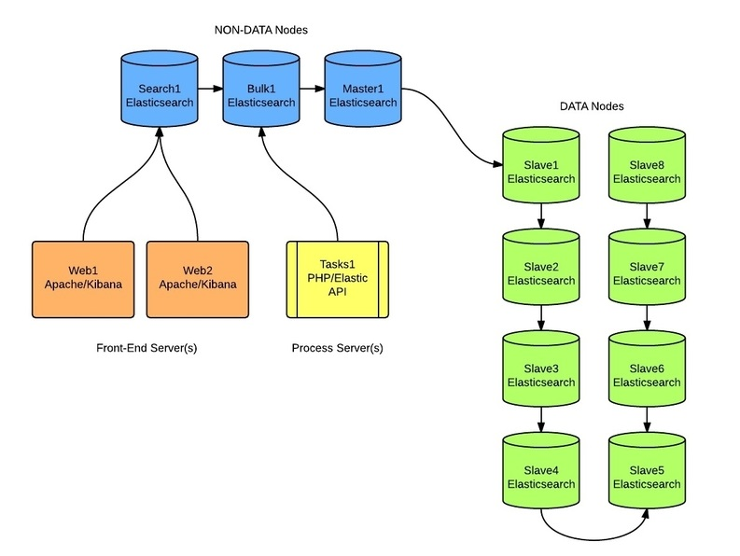
Elasticsearch Weeds

Slide 22
Elasticsearch Deep Dive
Why Shards?
An index can store a large amount of data that can exceed the hardware limits of a single node
Each shard is in itself a fully-functional and independent "index" that can be hosted on any node in the cluster.
Sharding is important for two primary reasons:
It allows you to horizontally split/scale your content volume
It allows you to distribute and parallelize operations across shards (potentially on multiple nodes) thus increasing performance/throughput

Slide 23
Elasticsearch Deep Dive
By default, each index in Elasticsearch is allocated 5 primary shards and 1 replica which means that if you have at least two nodes in your cluster, your index will have 5 primary shards and another 5 replica shards (1 complete replica) for a total of 10 shards per index.
Elasticsearch requires at least Java 7. Specifically it is recommended that you use the Oracle JDK version 1.8.0_72. Java

Slide 24
Intro to Logstash
Logstash Overview Video
00:00 - 22 minute
AND
Logstash Parsing Example Using Grok
27:00- 30:50
https://www.elastic.co/webinars/logstash-0-60-in-60

Slide 25
BREAK
BREAK

Slide 26
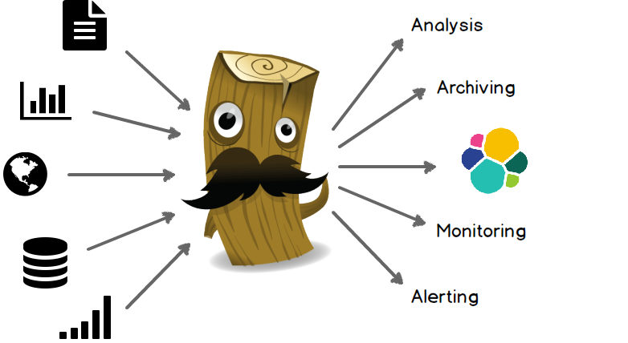
Logstash Deep Dive
Uses JRuby under the hood
Package with Java Runtime
Extended with Ruby

Slide 27
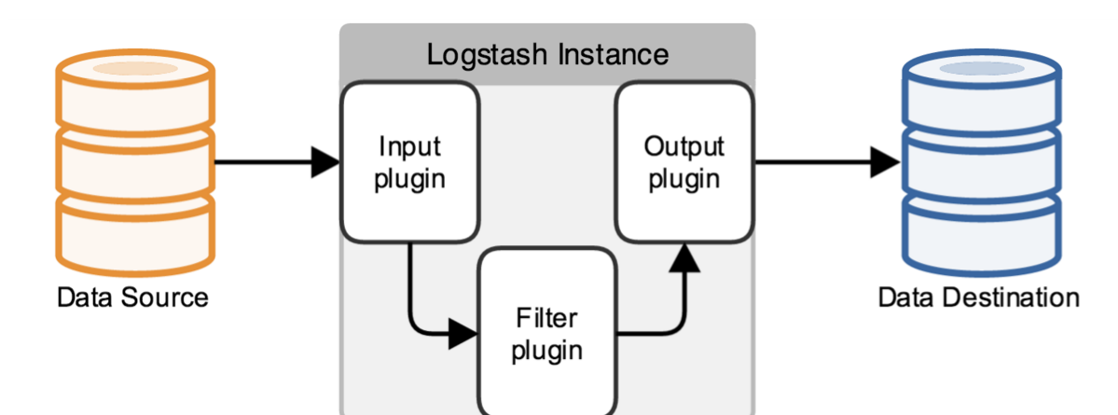
Logstash Deep Dive
What is Logstash’s logical flow?

Slide 28
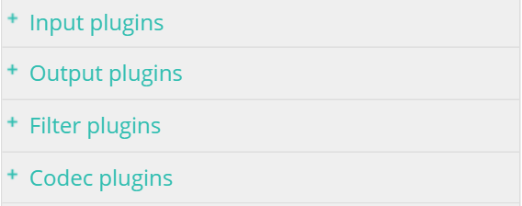
Logstash Deep Dive
Plugins ARE your Best Friend:
There are many plugins available that come by default when installed. There are also 3rd Party Plugins
Go to this website for Logstash Guide:
https://www.elastic.co/guide/en/logstash/current/input-plugins.html

Slide 29
Logstash Deep Dive
How does Logstash get the Logs?
TCP/UDP
Files
Syslog
STDIN
WebSocket
Much More

Slide 30
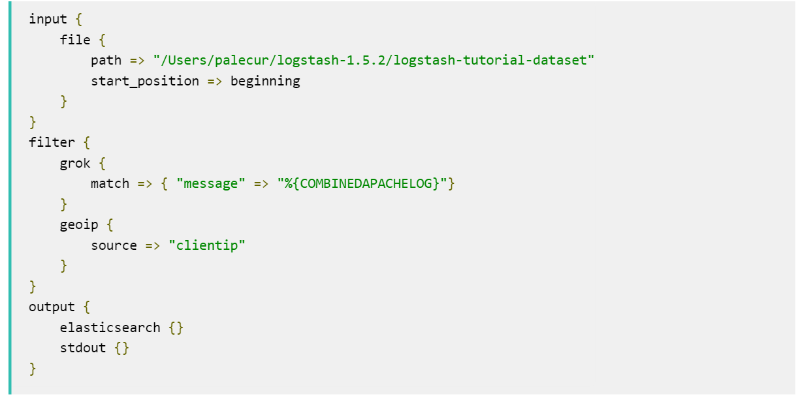
Logstash Deep Dive
Logical flow of data:
INPUT -> FILTER -> OUTPUT

Slide 31
Logstash In the Weeds
Parsing the Input
JSON
CSV
Xml
REGEX
GROK (Regex on steroids)
Etc….

Slide 32
Logstash Deep Dive
How can Logstash output data
TCP/UDP
Email
Files
HTTP
Nagios
Etc….

Slide 33


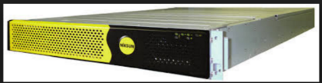
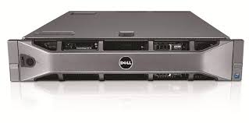
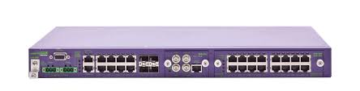


Range Setup
Niksun IDS
Security Onion IDS
DC
WIN7
Debian Linux
CentOS/RHEL ELK

Slide 34
LUNCH
LUNCH

Slide 35
Range Setup
Niksun IDS
Security Onion IDS
DC
WIN7
Debian Linux
CentOS/RHEL ELK

Slide 36
Logstash Deep Dive
LAB 1
Let’s Build ELK

Slide 37
DEMO ELK
DEMO ELK that instructor built

Slide 38
ELK Developers Day2
DAY 2

Slide 39
Agenda
Day 2
Syslog
Grok Basics
LAB 2 - Syslog
Kibana Intro Video
Apache Lucence Query Syntax
LAB 3 - Visualize Syslog in Kibana
LAB 4 – Build Windows Domain, GPO, & Collector

Slide 40
Syslog
Syslog is a way for network devices to send event messages to a logging server – usually known as a Syslog server.
The Syslog protocol is supported by a wide range of devices and can be used to log different types of events.
For example, a router might send messages about users logging on to console sessions, while a web-server might log access-denied events

Slide 41
Syslog
There are 3 different types of log managers:
Syslog (1980) – default in common Linux distros; Light-weight and not very flexible
Syslog-ng (1998) – “Next-Gen”; everything is object (src, dst, filter)
Rsyslog (2004) – advanced version; more bells and whistles
FUNCTIONALITY is the same

Slide 42
Syslog
Why do we care about syslog for DCO?
Many devices/hosts use syslog natively. Leveraging this functionality for Analysis and Forensics is very important in identifying facts for the Kill Chain.

Slide 43
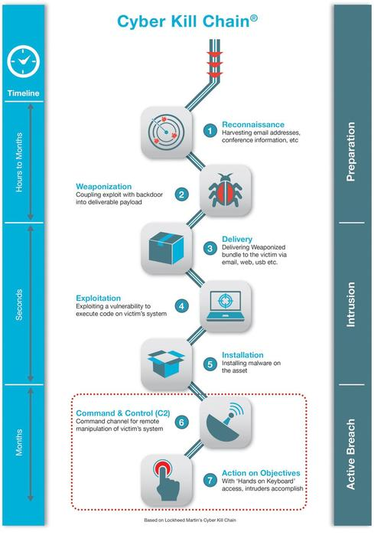
Syslog

Slide 44
GROK Basics
GROK
Default directory for grok patterns
/opt/logstsh/vendor/bundle/jruby/1.9/jems/logstash-patterns-core/grok-patterns
https://www.elastic.co/guide/en/logstash/current/plugins-filters-grok.html

Slide 45
Grok Basics
The syntax for a grok pattern is %{SYNTAX:SEMANTIC}
The SYNTAX is the name of the pattern that will match your text.
For example, 3.44 will be matched by the NUMBER pattern and
55.3.244.1 will be matched by the IP pattern. The syntax is how you match.
The SEMANTIC is the identifier you give to the piece of text being matched.
For example, 3.44 could be the duration of an event, so you could call it
simply duration. Further, a string 55.3.244.1 might identify the client making a request.
For the above example, your grok filter would look something like this:
%{NUMBER:duration} %{IP:client}

Slide 46
Grok Basics
EXAMPLE 2:
55.3.244.1 GET /index.html 15824 0.043
%{IP:client} %{WORD:method} %{URIPATHPARAM:request} %{NUMBER:bytes} %{NUMBER:duration}

Slide 47
Grok Basics
Grok sits on top of regular expressions, so any regular expressions are valid in grok as well. The regular expression library is Oniguruma
(?<queue_id>[0-9A-F]{10,11})

Slide 48
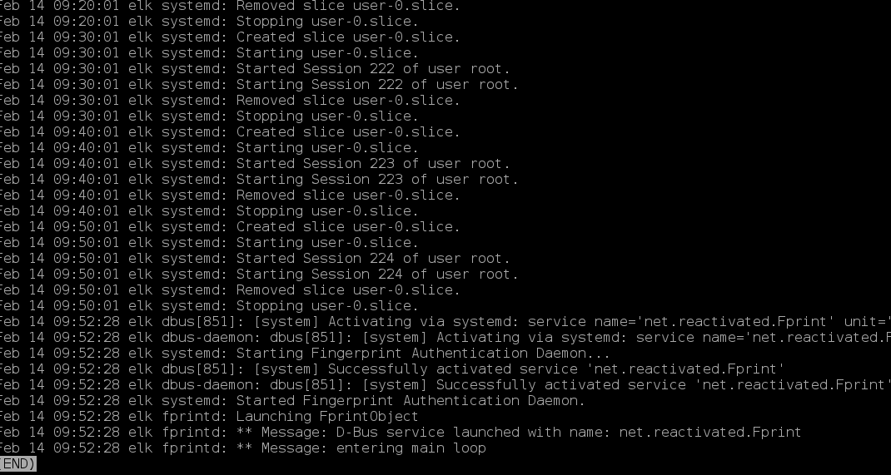
Syslog from /var/log/messages

Slide 49
Syslog Filter
input {
tcp {
port => "5000"
type => "syslogs"
tags => "system_logs"
}
}

Slide 50
Syslog Filter
filter {
if [type] == "syslogs"{
grok { match => { "message" => "%{SYSLOGTIMESTAMP:syslog_timestamp} %{SYSLOGHOST:syslog_hostname} %{DATA:syslog_program}(?:\[%{POSINT:syslog_pid}\])?: %{GREEDYDATA:syslog_message}" }
add_field => [ "received_at","%{@timestamp}" ]
add_field => [ "received_from", "%{host}" ] }
syslog_pri { } date { match => [ "syslog_timestamp", "MMM d HH:mm:ss", "MMM dd HH:mm:ss" ] }
}
}

Slide 51
Syslog Filter
output {
if [type] == "syslogs"{
elasticsearch{
index => "logstash-syslog-%{+YYYY.MM.dd}"
hosts => ["localhost:9200"] }
}
}

Slide 52
Logstash Deep Dive
What is Logstash’s logical flow?

Slide 53
BREAK
BREAK

Slide 54
Syslog
We will be sending Syslog from a Debian based distro (Ubuntu)
LAB 2- Syslog

Slide 55
KIBANA
Kibana Video (start 4:00 min – End at 40 min)
https://www.elastic.co/webinars/getting-started-with-kibana

Slide 56
LUNCH
LUNCH

Slide 57
Apache Lucene
Using a browser go here:
https://www.elastic.co/guide/en/kibana/current/discover.html
&&
https://lucene.apache.org/core/2_9_4/queryparsersyntax.html

Slide 58
KIBANA
LAB 3:
Discover and Visualize Syslog Using Kibana
OBJECTIVES for LAB:
Build a custom search and save the template
Build 3 visualizations
Build 1 dashboard

Slide 59
BREAK
BREAK

Slide 60
Windows Event Logs
NSA published a document on how to spot the adversary with Windows Event Log monitoring
Get this document at :
https://www.nsa.gov/ia/_files/app/spotting_the_adversary_with_windows_event_log_monitoring.pdf
{page 33 and 34}
Go to this link:
http://www.redblue.team/2015/09/spotting-adversary-with-windows-event.html

Slide 61
Windows Event Logs
Lab 4:
Configure Domain (Part1)
Configure GPO (Part2)
Setup the Windows Event Log Collector (Part3)

Slide 62
DAY 3 Agenda
Day 3
NXLOG
LAB 5 - nxlog
Lab 6 – WEV on ELK
LAB 6 Part 2- Visualization of Windows Event Logs in Kibana
BRO Logs
LAB 7 – Security Onion Setup
LAB 8 – ELK setup for BRO
LAB 9 – Syslog-ng configuration
LAB 10 – Visualize BRO in Kibana
LAB 11 - Curator

Slide 63
Nxlog
http://nxlog-ce.sourceforge.net/
NXLOG = Open source
Similar to Filebeat by elasticsearch
Can be put on multiple OS
Key is that it must be installed on the host that is set up as the Collector {subscribed host}.

Slide 64
Nxlog
Lab 5:
Install Nxlog
Configure Nxlog

Slide 65
Windows Event Logs
Lab 6
Go over the WEV Filter
Setup Filter
Build 1 custom search
Build 4 visualizations
Build 1 Dashboard

Slide 66
Lunch
Lunch

Slide 67

Bro Logs
Powerful NSM Tool
Separates Logs by Protocol (IE: HTTP, SSL, FTP)

Slide 68
Security Onion
What is Security Onion?
Open source IDS/IPS
-Uses Snort, Suricata, BRO, etc
We will utilize install snort and bro on security onion

Slide 69
Security Onion
LAB 7 –
Setup Security Onion with BRO and SNORT

Slide 70
Security Onion
LAB 8 –
Setup ELK for Bro logs

Slide 71
Security Onion
LAB 9 –
Setup Syslog-ng on security onion

Slide 72
Security Onion
LAB 10 –
Visualize Bro in KIBANA

Slide 73
CURATOR
LAB 11 –
Curator – deleting Indices

Slide 74
Agenda
Day 4
Kibana Management
Exporting/Importing Saved Kibana Dashboard
Firewall Rules in CentOS7
Ubuntu Distro (SFC Bishop)
Filter Development and Debugging
Practical: Build and test your own filter
Discuss DNS Logs
Demonstrate DNS Filter {Maj Bailey}
WINRM overview and Risk Mitigation Strategy
Export Images
The way ahead for the CPB

Slide 75
Ubuntu Distro
SFC Bishop built a distro with a custom BASH script to automate the installation and configuration for the ELK stack.
LAB 12-
Install DISTRO

Slide 76
BREAK
BREAK

Slide 77
Practical Exercise
Filter Development and Debugging
Build your own filter:
-use an existing filter and improve it
-build a custom filter for other logs in your ELK stack like your NGINX logs
TEST the Filter
Visualize the data in KIBANA

Slide 78
Lunch
LUNCH

Slide 79
DNS Logs
DNS Logs from Windows Server {Maj Bailey}

Slide 80
WinRM Overview and Risk Mitagation
{Maj Bailey}

Slide 81
EXPORT VM’s
EXPORT VM’s
Contributions and colaborations moving forward?
Ways ahead for the CPB?

Slide 82
Questions
QUESTIONS?

