Slide 1

«Jesus said to her:
“Give me a drink.”»
(Jn 4:7)
Word of Life - January 2015

Slide 2
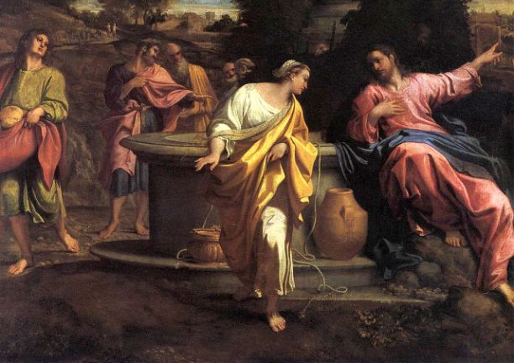
“Give me a drink.”

Slide 3
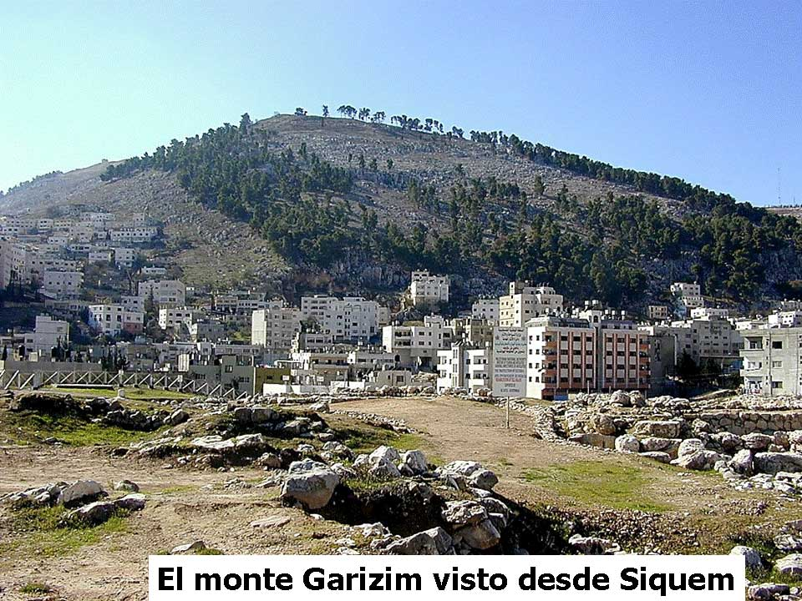
Jesus left Judea to go to Galilee. His route took him through Samaria.

Slide 4
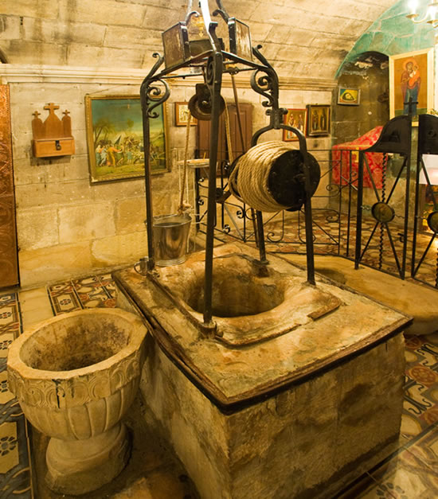
At midday, with the sun beating down, he was tired from the walk and sat next to the well built by the Patriarch Jacob 1700 years before.

Slide 5
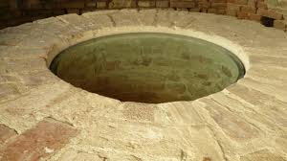
He was thirsty, but he had no bucket to draw up the water. The well was deep, 35 metres, as can be seen still today.

Slide 6
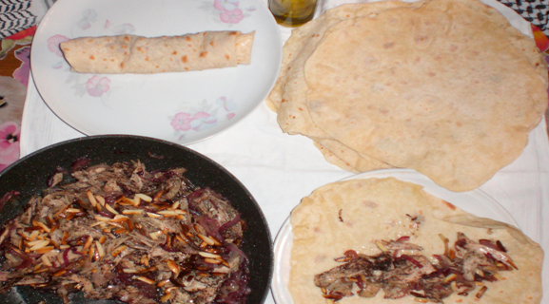
The disciples had gone into the town to buy something to eat.

Slide 7
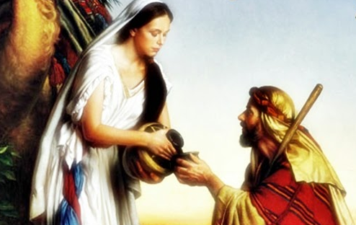
Jesus was alone. A woman bearing a water-jug arrived and he, with simplicity, asked her for a drink. It was a request that went against the customs of the times. A man didn’t speak directly to a woman, especially if she wasn’t known to him.

Slide 8
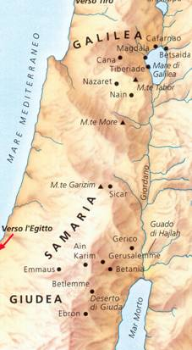
More than that, there were tensions and religious prejudices between Jews and Samaritans, and Jesus was a Jew and the woman a Samaritan. The strain, and even hatred, between the two peoples had deep roots, historically and politically. There was a further wall between the woman and Jesus: a moral one. She had had many men and was living in an irregular situation.

Slide 9

Maybe this was why she did not come to draw water together with other women in the morning or the evening, but at an unusual time, in the middle of the day. She was avoiding their remarks.

Slide 10
Jesus did not let himself be influenced by any kind of barrier and began a conversation with the unknown woman. He wanted to enter into her heart and he said to her:
“Give me a drink.”

Slide 11
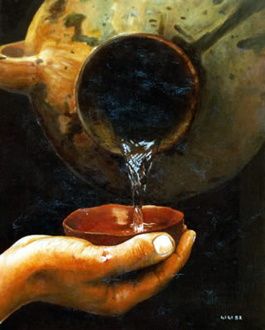
He had a gift in store for her, the gift of living water. ‘Let anyone who is thirsty come to me, and let the one who believes in me drink’ (Jn 7:37-38), we later hear him cry out in Jerusalem.

Slide 12
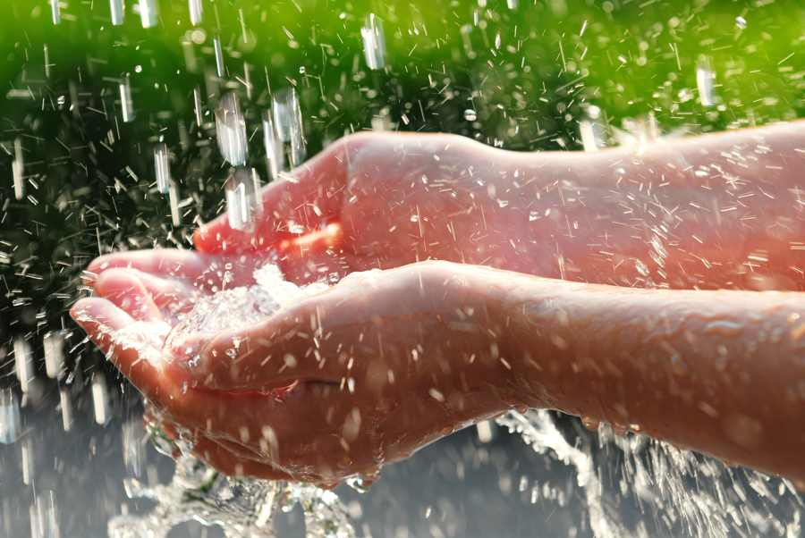
Water is essential for any kind of life and it seems even more valuable in arid places like Palestine.

Slide 13

What Jesus wants to give is ‘living’ water, symbolizing the revelation of a God who is Father and who is love, the Holy Spirit, the divine life he came to bring.

Slide 14
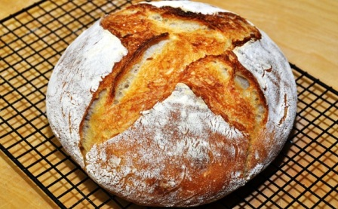
Everything he gives is living and is life-giving. He himself is the ‘living’ bread (cf Jn 6:51ff), the Word who gives life (cf Jn 5:25), or simply the Life (cf Jn 11:25-26).

Slide 15
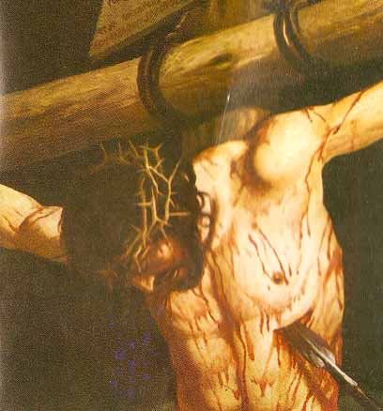
On the cross, John, who was a witness of it, says that when one of the soldiers pierced his side with a spear ‘at once blood and water came out’ (Jn 19:34). It is the most extreme and total gift of self.

Slide 16
But Jesus does not force himself on others. He does not even reprove the woman for her irregular cohabitation. He who can give everything, asks, because he had real need of her gift:
“Give me a drink.”

Slide 17
He asks because he’s tired. He, the Lord of Life, becomes a beggar and doesn’t hide his genuine humanity. He asks also because he knows that if the other person gives, that person can open up more easily and in turn be ready to welcome a gift.

Slide 18
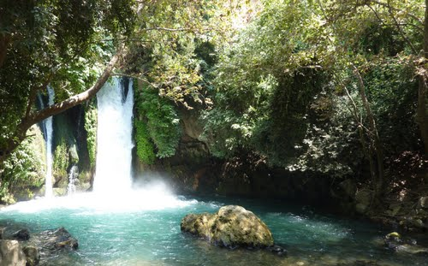
From this request began a conversation consisting in argument, misunderstanding, and in the end a deeper comprehension that allowed Jesus to reveal his identity. Their talk overcame the woman’s defensive barriers and brought her to discover the truth, that is, the water he came to bring.

Slide 19
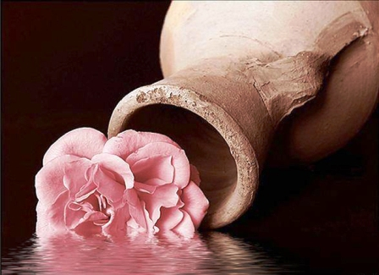
In that moment the woman left the most precious thing she had, her water-jug, because she had found very different riches, and she ran to the town to begin, in turn, a conversation with her neighbours.

Slide 20
She too did not force herself on others, but she told the story of what had happened, beginning with her own experience, and asking the question as to who this person was saying:
“Give me a drink.”

Slide 21
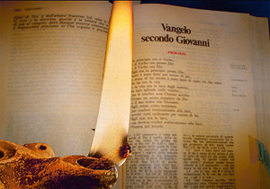
It seems to me that we can see here an explanation of how to go about ecumenical dialogue which, every year in this month, we are urged to remember.

Slide 22
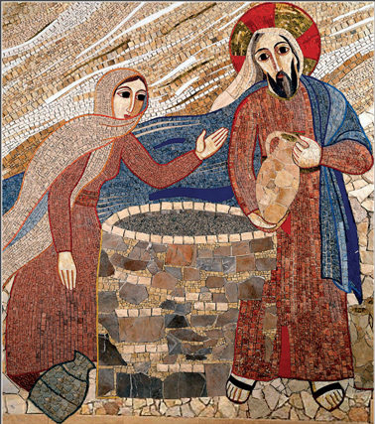
“Give me a drink.” (Jn 4:7)
The Week of Prayer for Christian Unity makes us aware of the scandalous division between the Churches that, sadly, has gone on for too many years. It invites us to hasten the time when we reach a profound communion beyond every barrier, just as Jesus overcame the rifts between Jews and Samaritans.
Week of Prayer for Christian Unity 2015

Slide 23
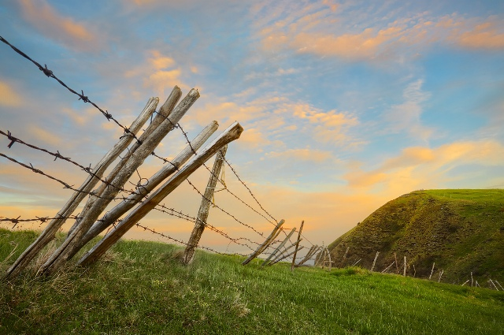
The division between Christians is just one of the many divisions that lacerate relations in the most varied contexts, as a result of misunderstandings, disagreements in families or among neighbours, tensions at work, bitterness towards immigrants.

Slide 24
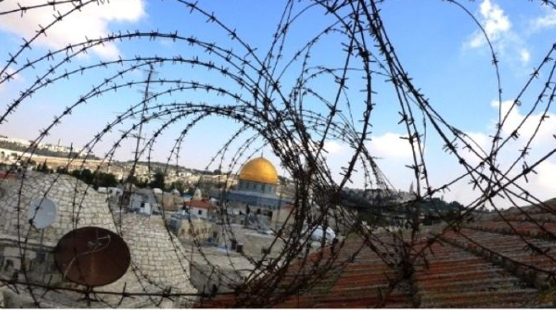
The barriers that divide us can be social in nature, political, religious or simply the fruit of different cultural habits that we don’t know how to accept.

Slide 25
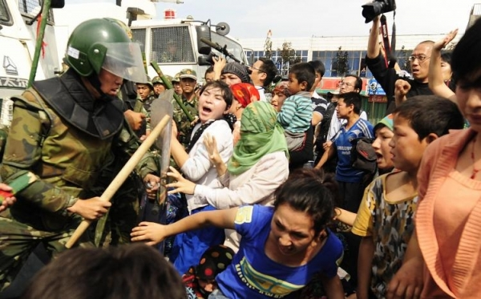
They are things that stir up conflict between nations and ethnic groups, but also hostility right here where we live.

Slide 26
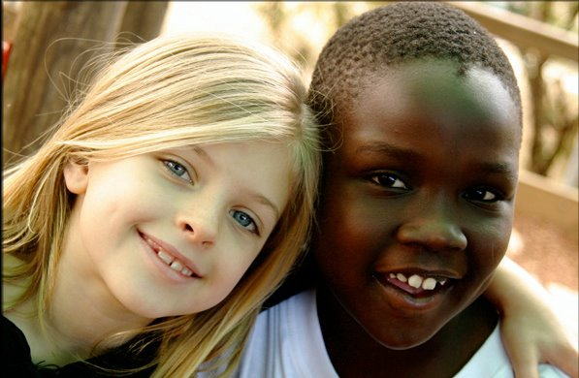
Couldn’t we, like Jesus, open ourselves up to the other, overcoming diversity and prejudice? Why not listen, no matter how things are said, to the appeal for understanding, for help, for a little bit of attention?

Slide 27
Also in the person from a rival area or from a different cultural, religious or social origin, there is hiding a Jesus who turns to us and says:
“Give me a drink.”

Slide 28
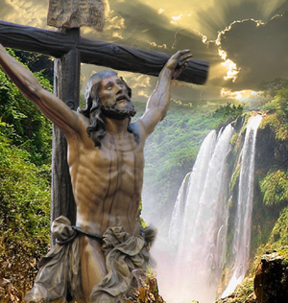
We think spontaneously of a similar word uttered by Jesus, when he was on the cross, again part of John’s witness in his Gospel: ‘I am thirsty’ (Jn 19:28). It is a primordial need, the expression of every other need.

Slide 29
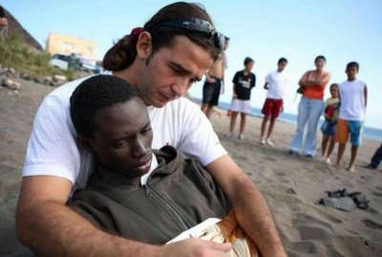
In each person who requires something, whether that person is unemployed, lonely, foreign, maybe with a different creed or religious conviction, or even hostile, we can recognize Jesus who says to us: ‘I am thirsty,’ and who asks us: ‘Give me a drink.’

Slide 30
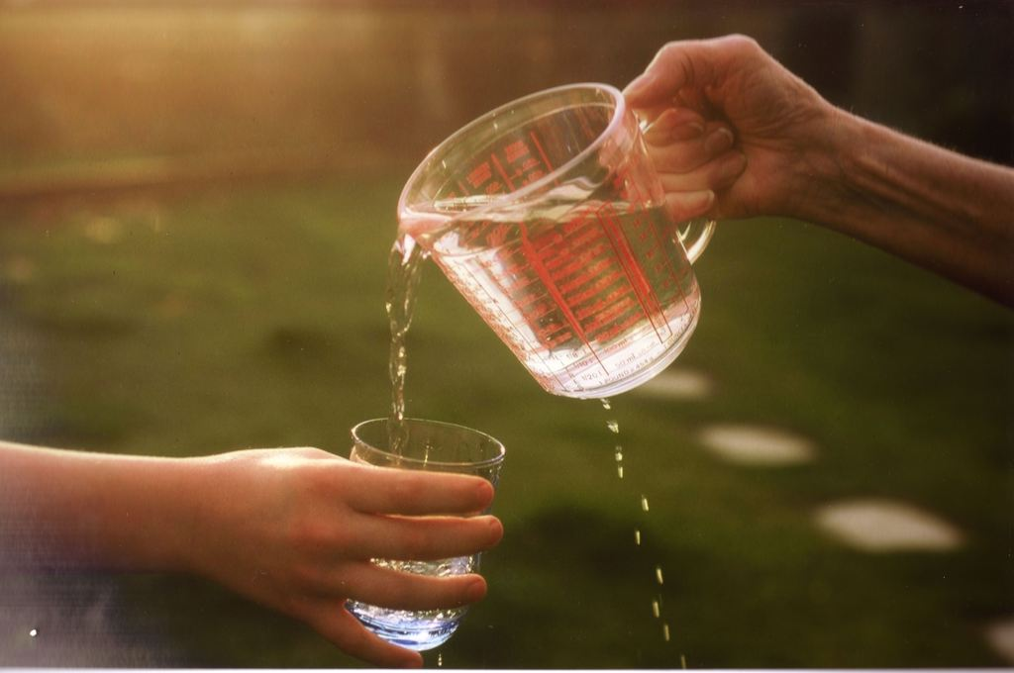
All we have to do is offer a glass of water, the Gospel tells us, to have our reward (cf Mt 10:42), to begin that dialogue which rebuilds fraternity.

Slide 31
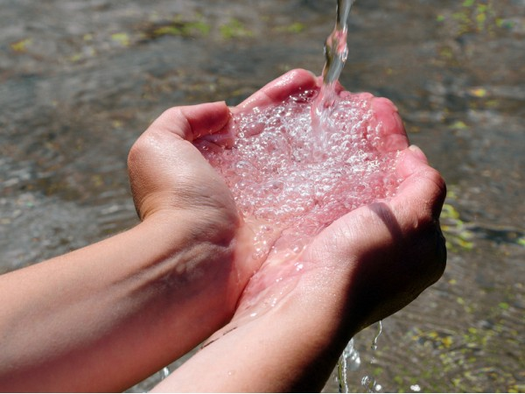
We too, when it is our turn, can express our needs, without feeling shame at ‘being thirsty’ and asking: ‘Give me a drink.’

Slide 32
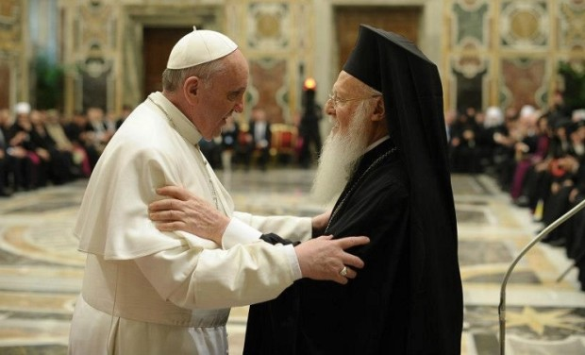
Then a sincere dialogue and a real communion can begin, without fear of diversity, or of the risk of sharing our opinions, or of welcoming those of the other.

Slide 33
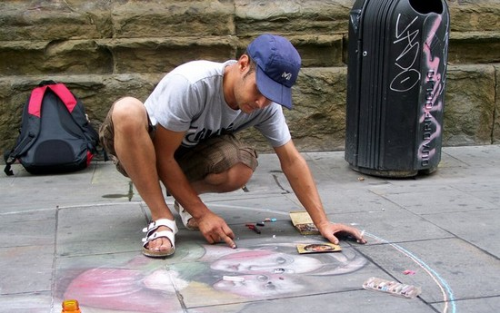
Taking advantage above all of the potential of the person before us, of that person’s value, even if hidden, as Jesus did when he knew how to recognize something in the woman that he could not do, namely, draw the water.

Slide 34
«Jesus said to her:
“Give me a drink.”»
(Jn 4:7)
Written by Fr. Fabio Ciardi, OMI

