Slide 1
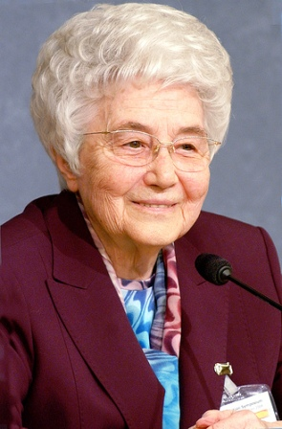
Word
of
Life
December 2014

Slide 2
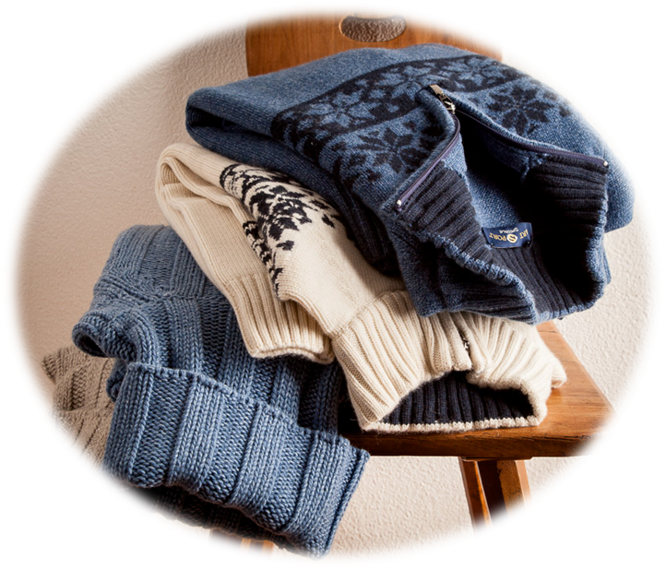
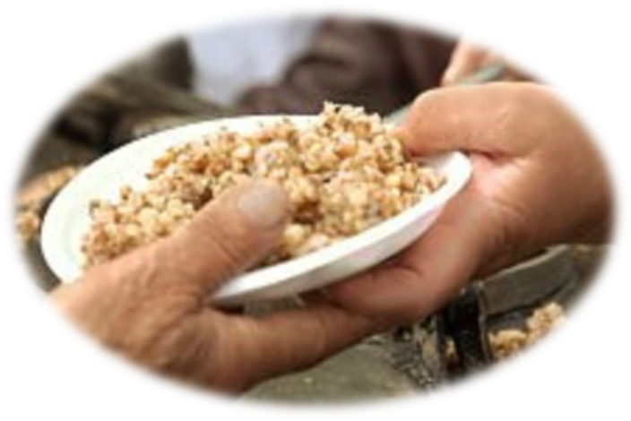
“Whoever has two coats must share with anyone who has none; and whoever has food must do likewise.” (Lk 3:11)

Slide 3
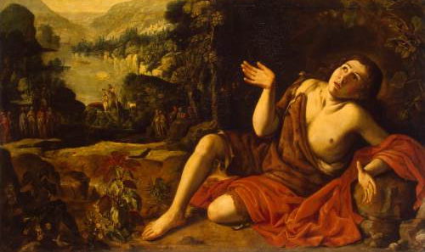
In this period of Advent, our time of preparation for Christmas, the figure of John the Baptist comes into light once again. He was sent by God to prepare the way for the coming of the Messiah.

Slide 4
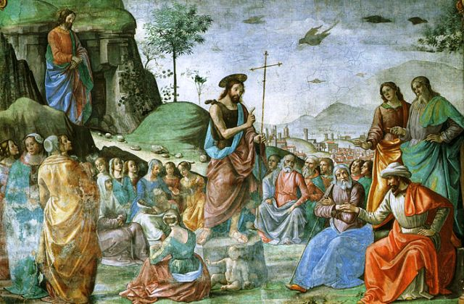
To those crowding around to hear him, he strongly urged a change in their lives: ‘Bear fruits worthy of repentance.’ And to those who asked: ‘What then should we do?’ he replied:

Slide 5
“Whoever has two coats must share with anyone who has none; and whoever has food must do likewise.”

Slide 6
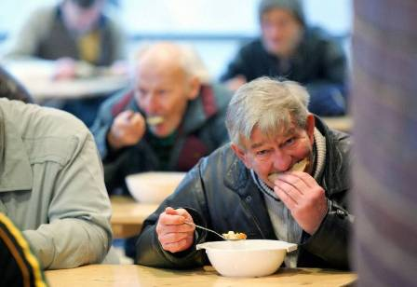
Why should I give what is mine to another? Since we were both created by God, the other person is my brother, my sister; therefore, he or she is part of me.

Slide 7
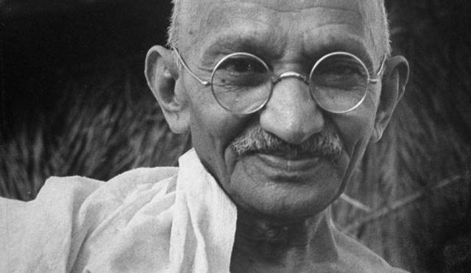
‘I cannot hurt you without harming myself,’ Gandhi once said.

Slide 8
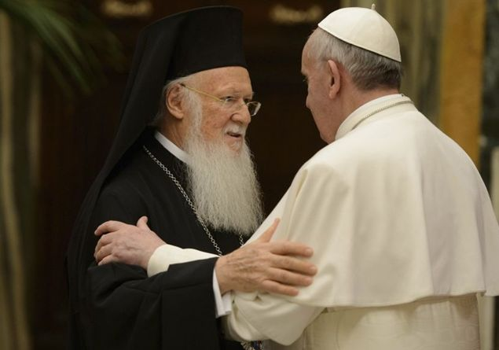
We were created as a gift for one another, in the image of God who is Love. We have the divine law of love in our blood.

Slide 9
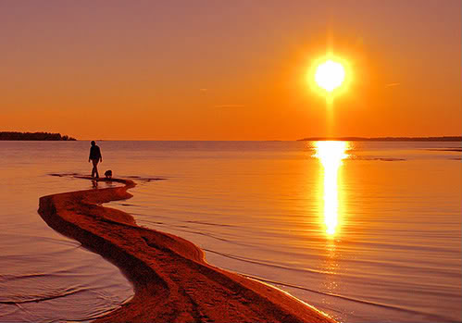
When he came among us, Jesus explained it very clearly in his new commandment: ‘Just as I have loved you, you also should love one another.’

Slide 10
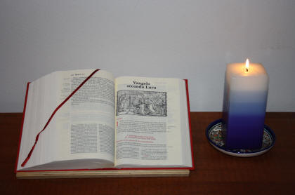
It is the ‘law of heaven’, the life of the Holy Trinity brought down on earth, the heart of the Gospel.

Slide 11
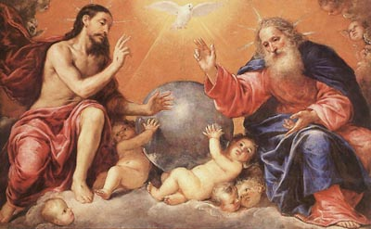
As the Father, Son and Holy Spirit live in full communion in heaven, to the point of being one, we on earth are truly ourselves to the extent that we live the reciprocity of love.

Slide 12
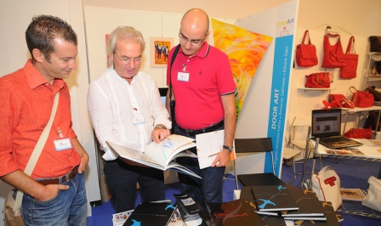
And just as the Son says to the Father: ‘All that is mine is yours, and what is yours is mine’, so too our love reaches fulfilment when we share with one another not only spiritual goods, but also material goods.

Slide 13
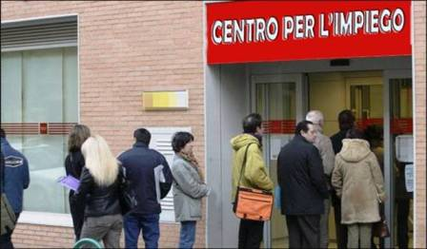
The needs of our neighbour are the needs of all of us. Is someone unemployed? I am unemployed.

Slide 14
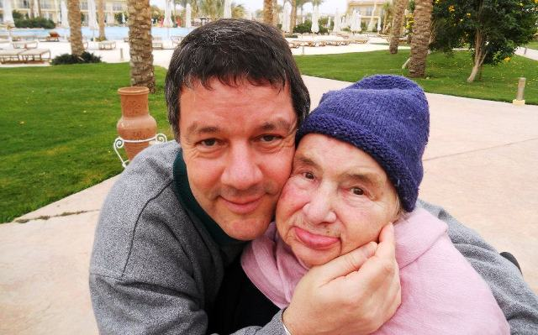
Is someone’s mother sick? I help her as if she were my own. Are there others who are hungry? It’s as if I myself were hungry and I try to find food for them as I would for myself.

Slide 15
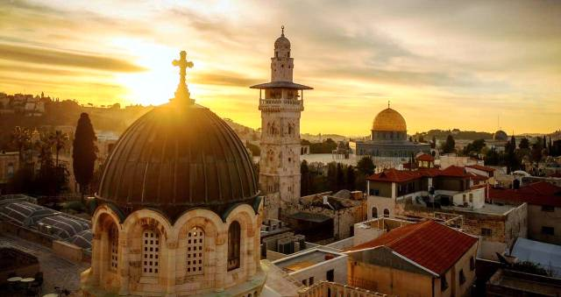
This is the experience of the first Christians in Jerusalem: ‘The whole group of those who believed were of one heart and soul, and no one claimed private ownership of any possessions, but everything they owned was held in common’. This communion of goods was not obligatory, and yet they practised it intensely.

Slide 16
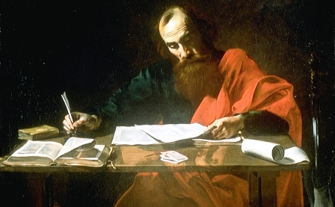
As the apostle Paul explained it was not a matter of making someone go without so as to give relief to others but of ‘a fair balance’.

Slide 17
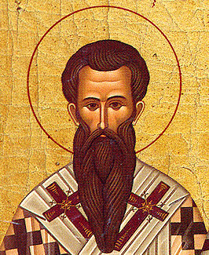
Basil the Great says: ‘The bread you set aside belongs to the hungry; the coat you store in your chest belongs to the naked; the money you keep hidden belongs to the needy.’

Slide 18
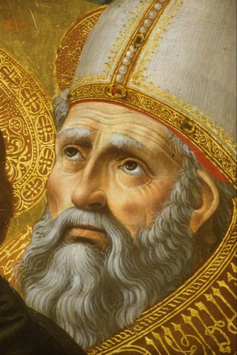
And Augustine says: ‘The surplus of the rich belongs to the poor.’
‘Even the poor can help one another. One can offer legs to the other, another eyes to guide the blind, and another can visit the sick.’

Slide 19
“Whoever has two coats must share with anyone who has none; and whoever has food must do likewise.”

Slide 20
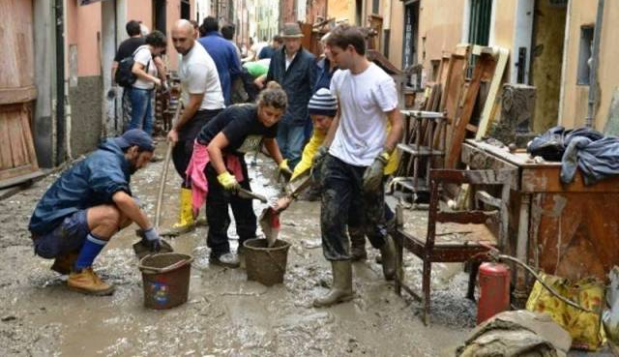
Today too we can live like the early Christians.

Slide 21

The Gospel is not a never-never land. This is shown, for example, by the new ecclesial Movements. The Holy Spirit has given rise to them in the Church to help revive, in all its freshness, the passionate gospel-based drive of the early Christians and to respond to the huge challenges of present society where there is such great injustice and poverty.

Slide 22
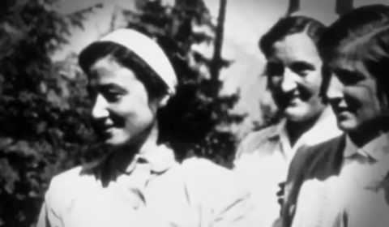
I remember that in the early days of the Focolare Movement the new charism filled our hearts with an exceptionally powerful love for the poor. Whenever we came across people in poverty, we wrote down their addresses in a notebook so that we could visit them later and help them. They were Jesus: ‘You did it to me’.

Slide 23
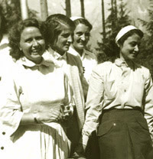
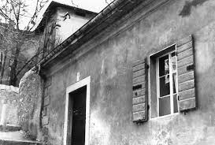
After visiting them in the run-down places they lived, we invited them to share a meal with us. For them we got out our best tablecloth, our best cutlery, the tastiest food. All around the table, in that first focolare, sat a focolarina then someone poor, a focolarina then someone poor…

Slide 24
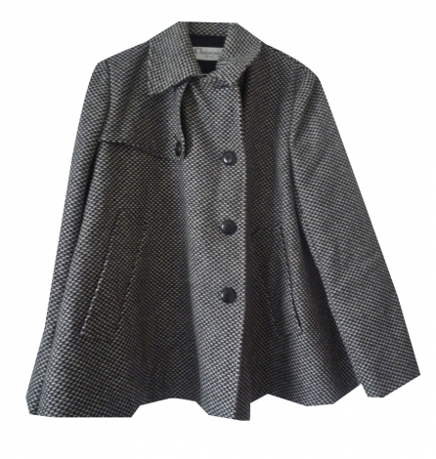
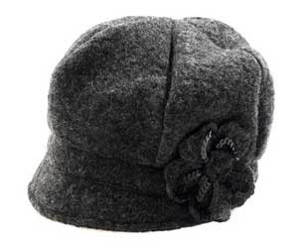
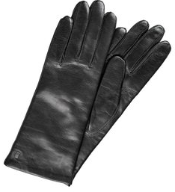
At one point it seemed to us that the Lord was asking us in particular to become poor so as to serve both the poor and everyone else as well. There, in the living room of that first focolare house, each one put in a pile on the floor whatever she felt was extra: an overcoat, a pair of gloves, a hat, even a fur coat…

Slide 25
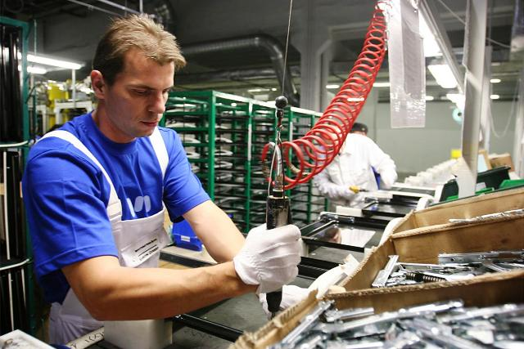
And today, in order to give to the poor, we have businesses that give employment and their profits to share out! But there is still a great deal to do to help ‘the poor.’

Slide 26
“Whoever has two coats must share with anyone who has none; and whoever has food must do likewise.”

Slide 27
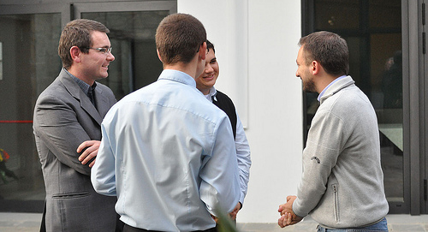
We might not realize it, but we have many riches that we can put into common with others. We have our sensitivity that we need to sharpen and things we need to learn so that we can help concretely, we can find out how to live real fraternity.

Slide 28
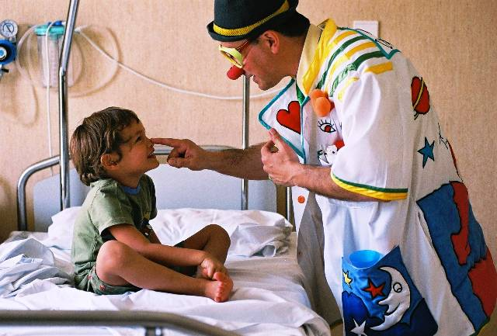
We have love in our hearts to give, warmth of feeling to turn into action, joy to pass on. We have time to put at others’ disposal, prayers, inner riches to put in common through the spoken or written word. And at times we have things that we can offer: purses, pens, books, money, houses, cars…

Slide 29
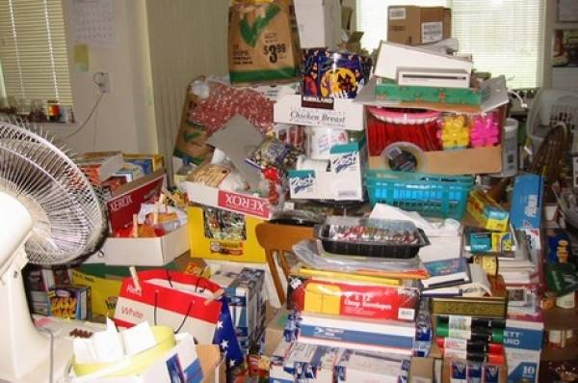
It may be that we accumulate many things thinking that one day they could be useful, but in the meantime there are people nearby who need them urgently.

Slide 30

Just as a plant absorbs from the soil only the amount of water it needs, so we should try to have only what we need. Actually it’s better every now and then to realize something is lacking; it’s better to be a little poor than to be a little rich.

Slide 31
‘If we were all content with what’s necessary and we gave our surplus to those in need,’ Basil says, ‘there would no longer be the rich and the poor.’

Slide 32
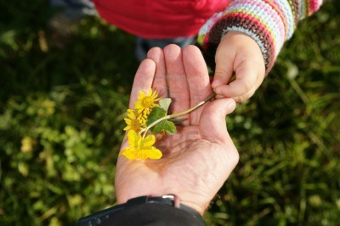
Let’s try. Let’s begin to live like this. Jesus will not fail to send us the hundredfold, and we will be able to continue giving. In the end, he will tell us that whatever we have given, to whoever it might be, we have given it to him.

Slide 33
“Whoever has two coats must share with anyone who has none; and whoever has food must do likewise.” (Lk 3:11)
Text by Chiara Lubich

