Slide 1

JOYB PUB
Business Running Case
Team 4
Olinda Cifuentes, Yantong Li, Biqing Yue, John Omokore
Lobster Land
Marketing Proposal
Jiaxun Wang, Yantong Li, Qian Liu, Cong Duan

Slide 2

Contents
Data Visualization
PART 01
PART 02
PART 03
PART 04
PART 05
PART 06
Summary Stats
A/B Testing
Segmentation & Targeting
Forecasting & Total Spending
Classification
Upmarket Pricing
Conclusions

Slide 3

Data Visualization
1

Slide 4
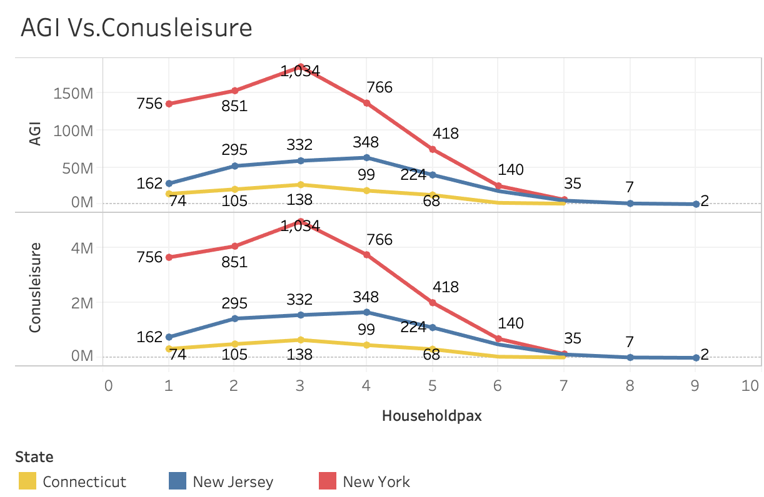
Data Visualization
Variables:
State
County
Householdpax
AGI
Conuleisure
Leisureavg
Children
Family size of Three is the most common in NY.

Slide 5
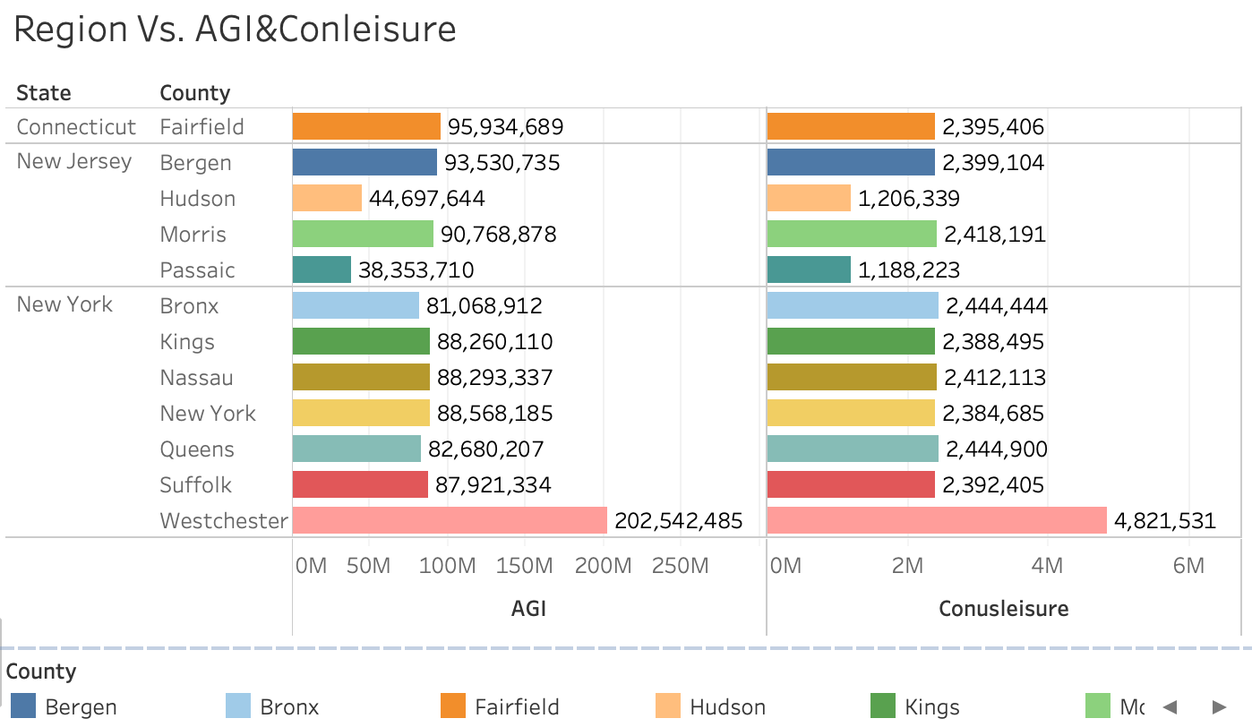
Data Visualization
AGI and Conuleisure in Westchester are about twice that of other county.

Slide 6
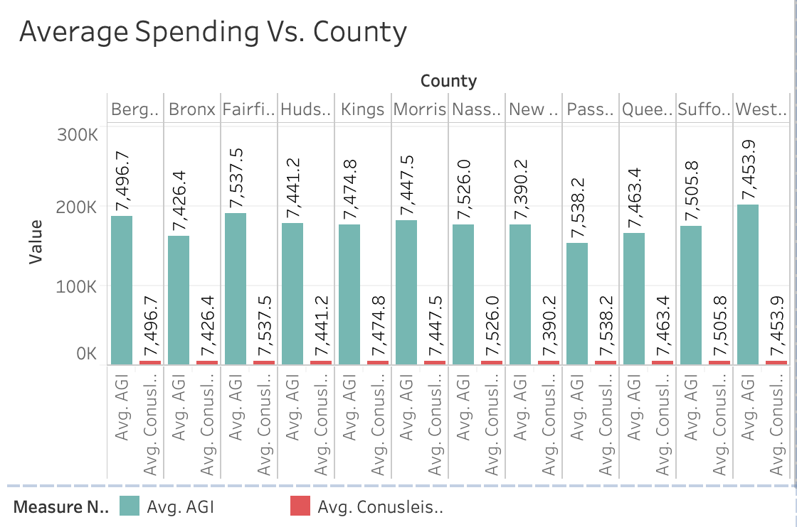
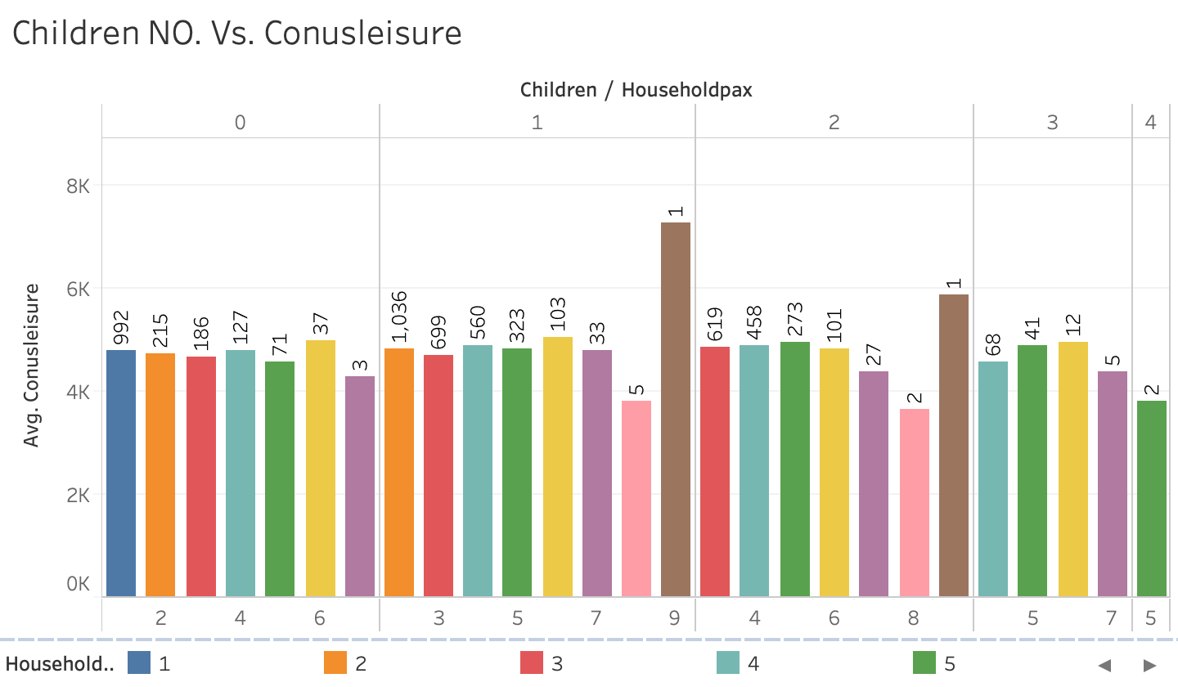
Data Visualization
Their Incomes are different, but Leisure Spending are similar.
Families: 0 children Vs. 1 children Leisure Spending are similar.

Slide 7
Summary Stats
2

Slide 8
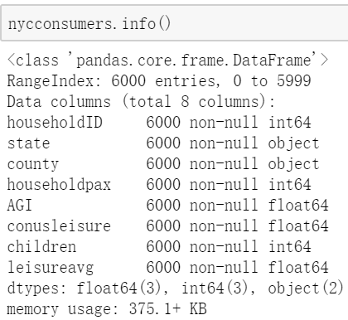
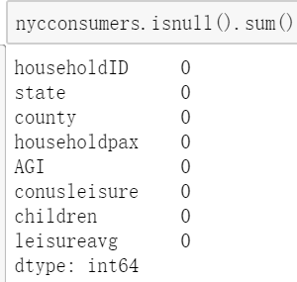
Summary Stats
No null value in this dataset.

Slide 9
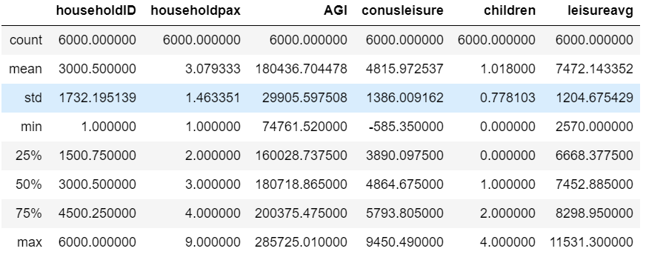
Summary Stats
The means can represent the most common situation.
The Household’s Adjusted Gross Income shows huge difference between families.

Slide 10

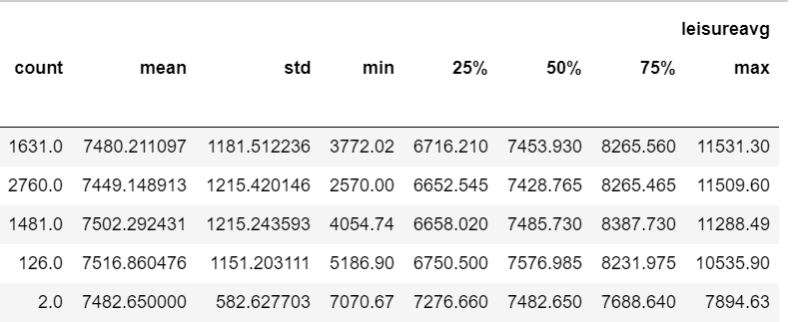
Summary Stats
Group by children number in one household.

Slide 11
A/B - Testing
3

Slide 12
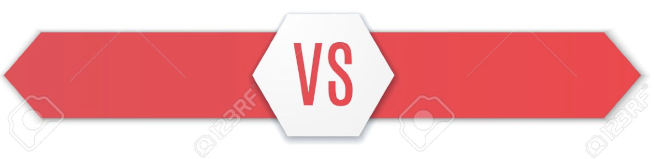
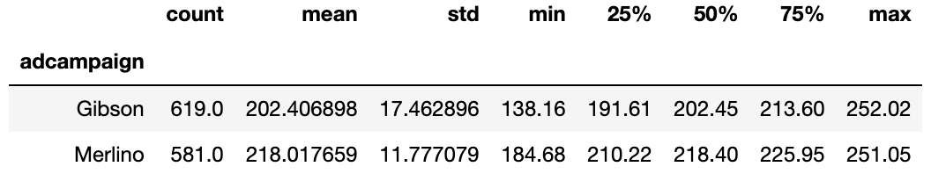
A/B - Testing
Gibson
Merlino
Group Size Similar
G_Mean < M_Mean
Statistically Significant ?

Slide 13

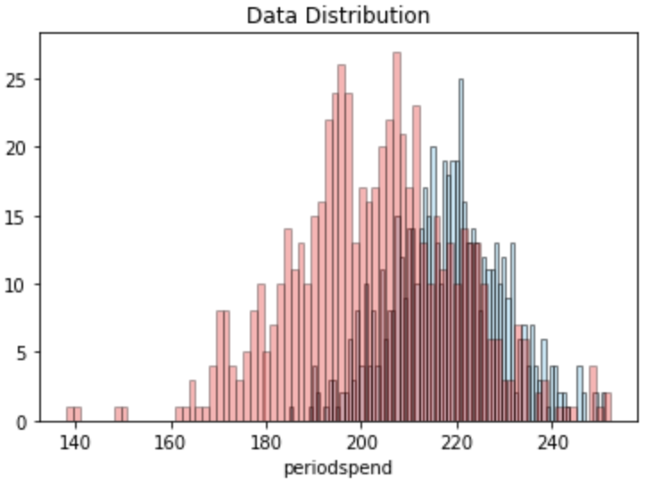
A/B - Testing
T - Test:
Random sampling
Normal distribution
Gibson
Merlino
P value < 0.05 reject Ho, accept H1.
Yes ! There is a meaningful difference between Gibson and Merlino.

Slide 14
Segmentation & Targeting
4

Slide 15
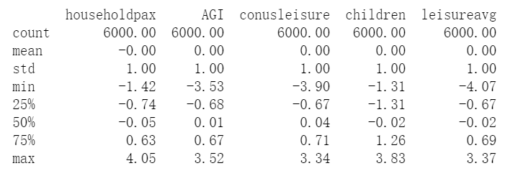
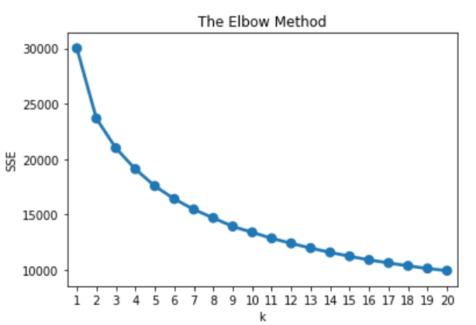
Segmentation and Targeting----K Means
← STEP 1
Data Standardization
STEP 2 →
Build an Elbow Chart

Slide 16
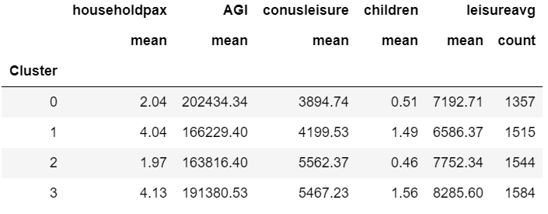
Segmentation and Targeting----K Means
Cluster 0: High-paid class who like to travel abroad
Cluster 1: Family with heavy learning tasks
Cluster 2: Couple in the playground
Cluster 3: Big family happy hour

Slide 17
Forecasting Total Spending
5

Slide 18
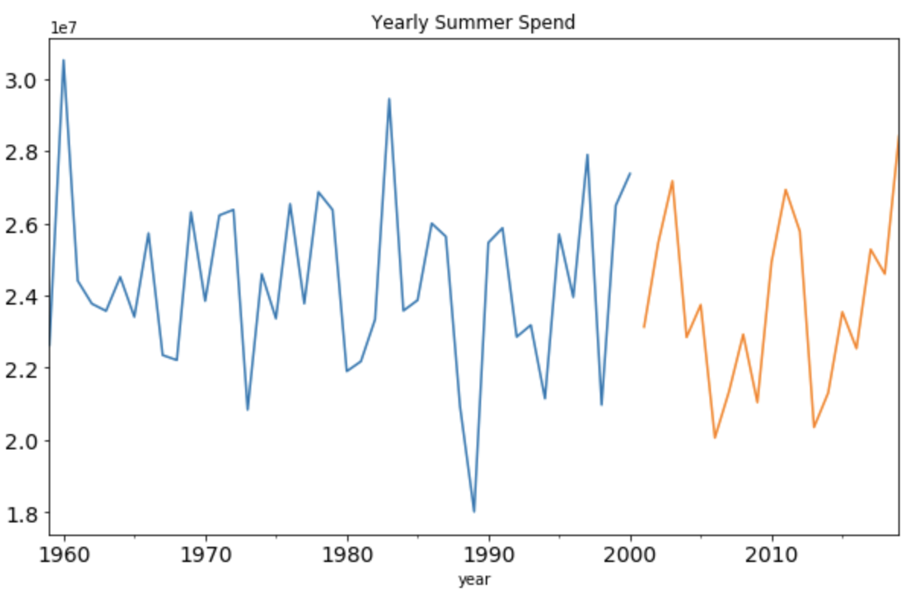
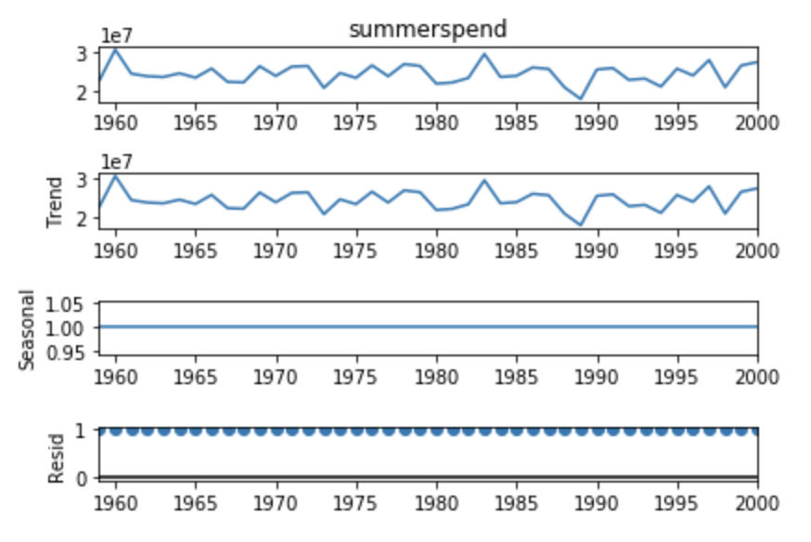
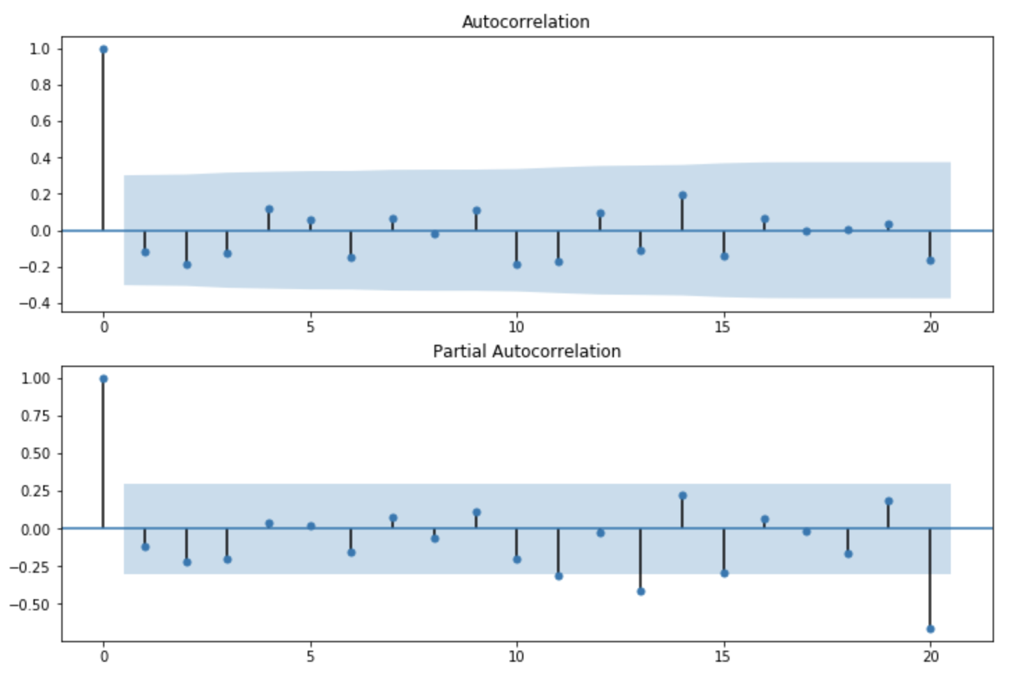
Forecasting Total Spending
Splitting Data
Training Data: 70% older data
Test Data: 30% newer data
Stationary Time Series
Data Preparation & Exploration
Time Series Decomposition
No seasonality No trend
Plot ACF & PACF
ACF and PACF "cuts off" after the 1nd lag

Slide 19
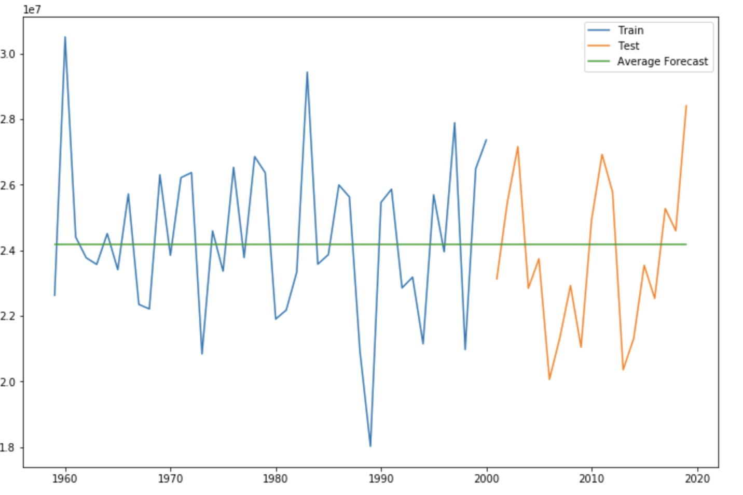
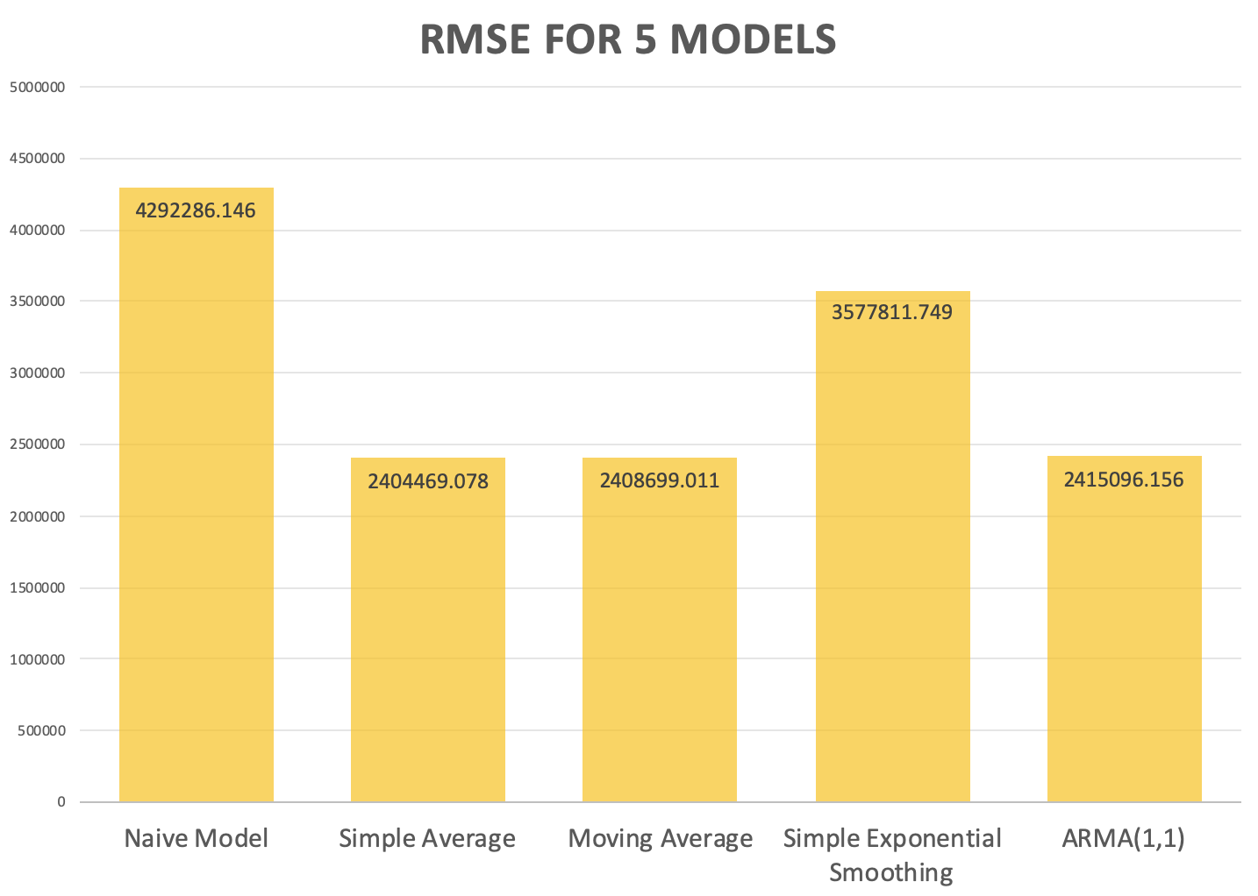
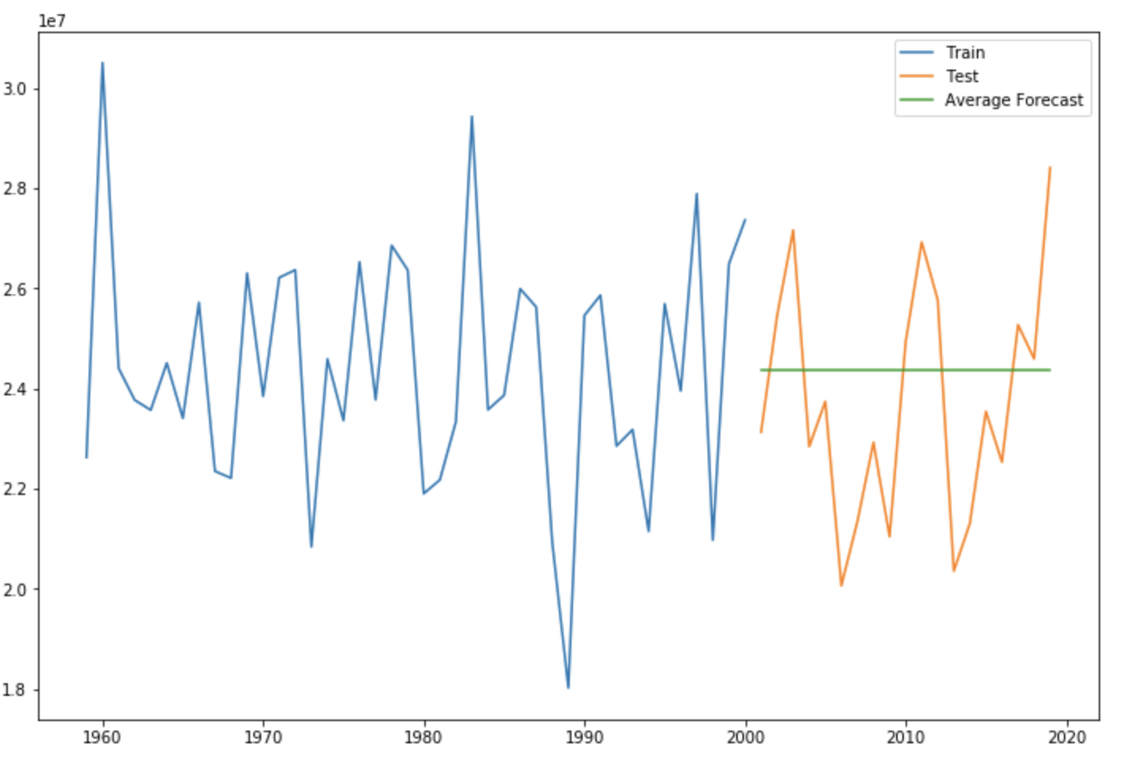
Forecasting Total Spending
3. Use total data to build new simple average model to predict spending in future 5 years
24,185,805.88 dollars
RMSE of Simple Average Model is minimized
2. Apply RMSE, AIC, BIC to measure model performance in test dataset
1. Build 5 possible models with training data

Slide 20
Classification
6

Slide 21
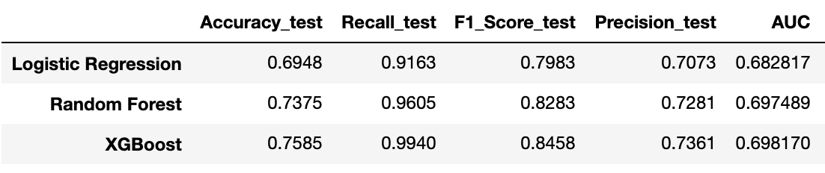
Classification
Predict Whether Customers Renew Passes or Not
Logistic Regression
Random Forest
XGBoost
Already know whether these customers renew or not in this season
Situations are quite distinct in next seasons.
Use data from last year?
Good Model? But not quite useful !
why?
‹#›

Slide 22
Classification
Apply Feature Importance to Target Potential Customers
Three models show homestate_NJ is important, but both homestate_NJ and homestate_NY have negative coefficients in Logistics Regression
Customers in New York and New Jersey are busy with works.
Fewer family members in New Jersey and New York families
Promote to customers living in Connecticut but no family season passes
Homestate is CT
Three models show own_car is important
Convenience
More beneficial for big families
Promote to families with cars but no family season passes
...
If Customers...
own cars
XGBoost and Random Forest show visits is important
Amusement park lovers
Promote to someone visits a lot times but no family season passes
Visits frequently
‹#›

Slide 23
Upmarket Pricing
7

Slide 24
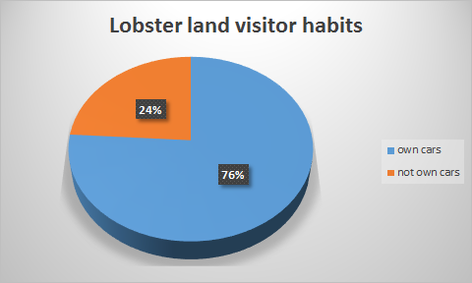
Upmarket Pricing
We decided to waive the parking fee for FP customers, which will boost the sales of FP tickets from another dimension.
And give a free FP trial to our subscribed members on their birthdays, so that they could experience the privileges if they haven’t tried before.
Most customers who has come to Lobster Land drive their own cars .
Notes:
We suggest that Lobster Land can add the FP as a new ticketing strategy,which will sell tickets with different prices in different time ways and among different visitors’ convenient factors and offer “fast passes” for 1.5+ the regular per-day pass rate.

Slide 25
Upmarket Pricing
USA
Tokyo
Less than a quarter of the guests who came to Walt Disney World utilized FastPass
HongKong
Notes:
We decide The FP ticket would be set 1.5 times of the price as the regular ticket at Lobster Land. It is super helpful for Lobster Land to shrink the waiting line during the peak operation hours, which also enable our big fans to enjoy their privileges. Yet, we need to limit a specific number of times to every single entertaining facility for FP tickets customers in case of disorder. Besides that, we need to limit the real-time number of in-land FP customers in order to make sure the quality of customer experiences.

Slide 26
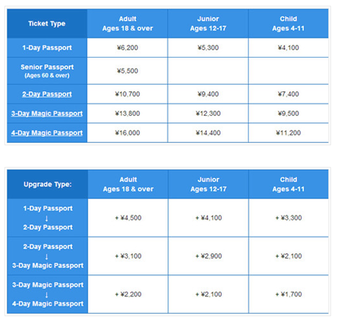
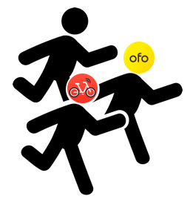

Upmarket Pricing
Sell by time
Special time discount
four kinds of price from 1-day to 4-day. For 3-day and 4-day pass
‹#›
Notes:
Tokyo Disney Resort has really sophisticated pricing strategy. It has four kinds of price from 1-day to 4-day. For 3-day and 4-day pass, which we can learn and design our own selling by time pricing strategy to encourage more visitors enter and return lobster land and at the same time, when tourists have a longer ticket time, they can help us avoid and ease the pressure on the park during peak pressure from park visitors.

Slide 27
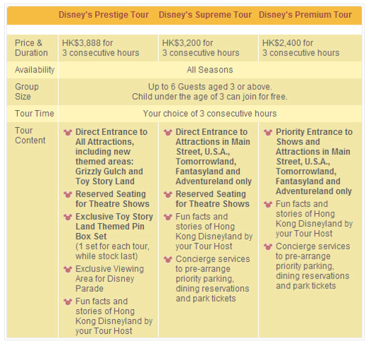
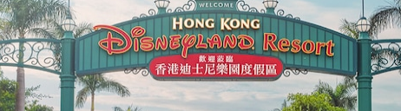
Upmarket Pricing
3prices for3h
Unlock
difference
Hong Kong Disney designs Disney tour which is a three-hour trip in the park
‹#›
Notes:
Hong Kong Disney designs Disney tour which is a three-hour trip in the park, besides, the 3hours’ fast pass is also divided into 3 levels by unlocking different services, gifts and permits. Hong Kong pricing strategy not only gives customers who do not want to queue up a time-saving channel, but the 3-hour time limit will not affect the queue time of tourists who do not buy fast pass online. It makes the system fairer to everyone, and visitors don’t have to choose ride times before they get to the park. Lobster land can also sale tickets with different levels by grouping people by age and by days visit. And the more consecutive days is, the lower the price is. The higher the price, the more fun they have.

Slide 28
Upmarket Pricing
Nonphysical rate fences
Physical Rate Fences
A convenient price system for all kinds of visitors
The number of rides can take and the number of meal provided could be the physical rate fences in the theme park industry.
Convenience of car parking,gifts...cooperate with a credit card company to offer users discount
Pricing by day/time
We want more and more visitors no matter they are couples, big families, family with own cars,children or students can enter and visit our lobster land at anytime they want and with a convenient price
Notes:
However, Fast Pass can be changed based on availability, which would waste the chance for entrance and rise the managing pressure, we decide to add additional value for the canceling fee.

Slide 29
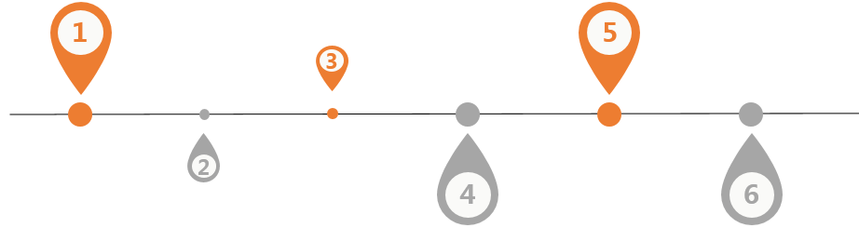
Conclusions
A/B Testing
Statistically significant, but need deeper delving...
Forecasting
Analysis on Competitors
Classification
Targeting Potential Customers
Data Exploration
Summary stats
Data Visualization
Relationships, trends
Segmentation & Targeting
We got 4 clusters so as to design targeted strategy...
Upmarket Pricing
price by time,price by local cultures
Notes:
With our feature importance property of classification model to target potential customers and with XGBoost final model and upmarket strategies I believe that we can attract more families to become our targeted customers in the future!

Slide 30
THANKS!
Any questions?

