Slide 1

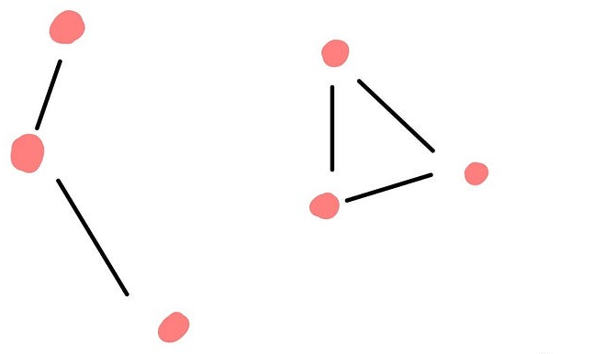
Graph Theory
Topic: Disconnected Graph
Presented To:
Professor Dr. Selina Sharmin,
Dept. of Computer Science and Engineering, Jagannath University.
Presented by: Jerin Tesnim
ID : M240205005 ( 16 batch)
Course Code: CSE-5306
Course Title: Special Topics Related to Computer Science and Engineering (Graph Theory).
Date: 14-11-2025

Slide 2
#Definition
Edges E
Vertices V
B
A
C
D
E
there exists at least one pair of
vertices where, no path connects them.
F
C
D
F
Disconnected
Graph
G (V,E)
E
A
B
Component-2 {D,E,F}
Component-1 {A,B,C}

Slide 3
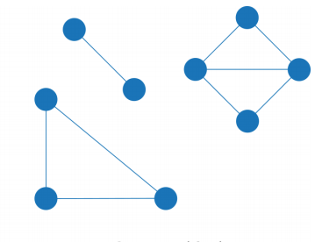
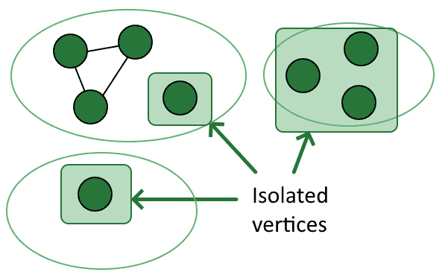
Properties of Disconnected Graphs
Vertex
Edge
component
component
component
Multiple components.
No path between all vertices.
Edge & Vertex connectivity -
Graph traversal algorithms -
-
(vertices with a degree of 0)

Slide 4
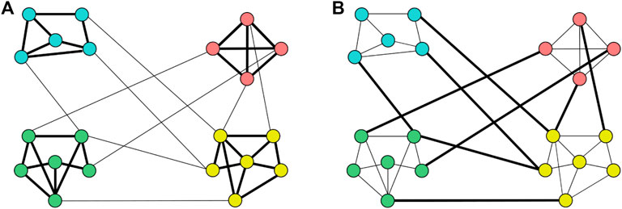

#Applications
Network analysis –
Social network analysis -
3. Faulty connections – etc.
Component : B
Component : A
No roads,bridges or ferry services connect the two islands
#Real time examples
Cities and roads -
Social media groups.
Communication etc.
Island : x
Island : y
A Country with two main Islands (x,y)

Slide 5
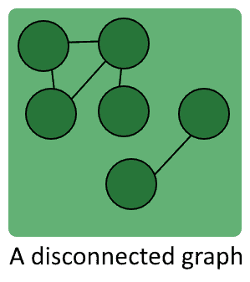
Conclusion
network failures
communication gaps
system isolation

Slide 6
C
D
F
E
THE END
A
Component-2 {D,E,F}
B
Component-1 {A,B,C}

