Slide 1
Developing an Automated Bangla Sign Language Translation System
Presented by :
Sabrina Sultana
ID: 1204070
Supervised by:
Lamia Alam
Lecturer
Department of CSE, CUET
Notes:
1/12/17

Slide 2
Contents
        Introduction
        Motivation
        Objectives
        Literature Survey
        Challenges
        Methodology
        Implementation
        Performance Analysis
        Limitations
        Conclusion
        Future Recommendations
        References

Slide 3
Introduction
Sign Language
  Communicating language used especially by people with the inability to speak or hear
  About 70 million deaf people in the world who use sign language as their first language.
  Only way to communicate with each other
  Almost 2.6 million deaf people are living in Bangladesh.
  Bangla Sign Language is the first language of these people.

Slide 4
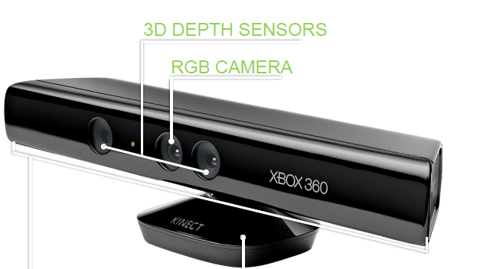
Introduction (Cont.)
About Kinect.
Developed by Microsoft and PrimeSense and was released on November 2010
Features an "RGB camera, depth sensor and multi-array microphone
Provide full-body 3D motion Capture
Detect 20 skeletal joint of human body
Calculating the position of each joint at a fixed interval of time can sense the body movement

Slide 5
Motivation
Reduce the communication gap between the deaf people and the rest of the people in our country
Many of these people are intelligent enough to share their opinions
If they get chance to participate in different organizations, they will be able to contribute in country

Slide 6
Objectives
  Design a system that will use Bangla Sign Language as input to
      Capture the gesture in Kinect motion sensor device
      Converts it into corresponding text.
To implement the system by evaluating some design parameters.
To evaluate the system performance in real environment

Slide 7
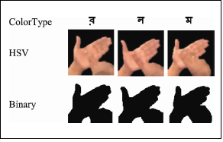
Literature Survey
[ Rahaman, Jasim, Ali and Hasanuzzaman, 2014]
  Proposed computer vision based Bangla Sign Language Recognition System
Limitations:
  Can only recognize 6 Vowels and 30 consonants of BdSL.
  Cannot properly distinguish some signs because of their similarity among their
  binary images

Slide 8
Literature Survey (Cont.)
[Sangeetha and Krishna,2014]
  Proposed Android based GESTURE DETECTION FOR DEAF AND DUMB PEOPLE
Limitations:
  Skin detection problems, some background is also skin-like in color.

Slide 9
Literature Survey (Cont.)
[Karmokar, Alam and Siddiquee,2012]
  Proposed Webcam based Bangladeshi Sign Language Recognition employing Neural Network Ensemble
Limitations:
Gesture captured by webcam which was little bit cumbersome and tedious
Any color in the experimental environment which conflicts with human skin color.

Slide 10
Challenges
  Variant of the body structure of different user
  Handling the Kinect motion sensor devices
  Similarities between different gestures
  Need to work with skeleton joint point of Kinect real time depth value.
  After detecting the region of interest, motion is another issue to keep in mind.

Slide 11
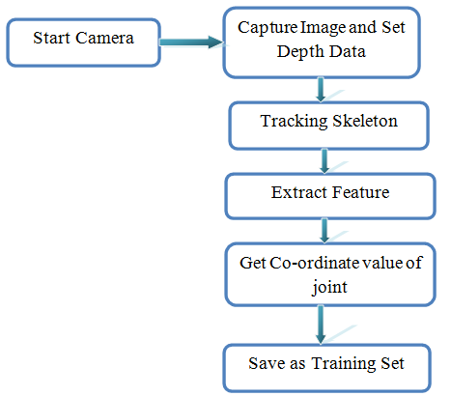
Methodology
Figure : System Overview

Slide 12
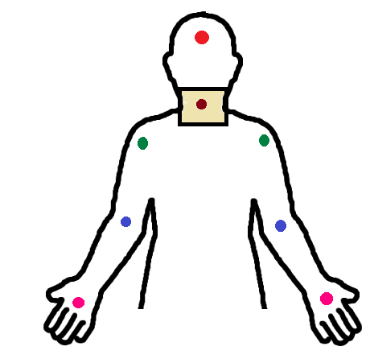
Methodology(cont.)
Skeleton Tracking

Slide 13
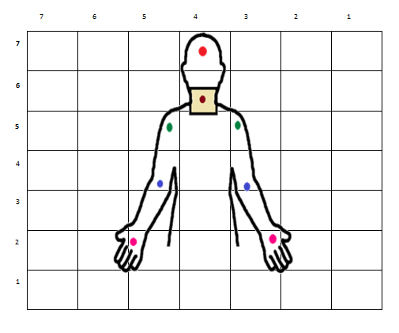
Methodology(cont.)
Extracting Feature
  7*7 Square Graph Created Behind the Body

Slide 14
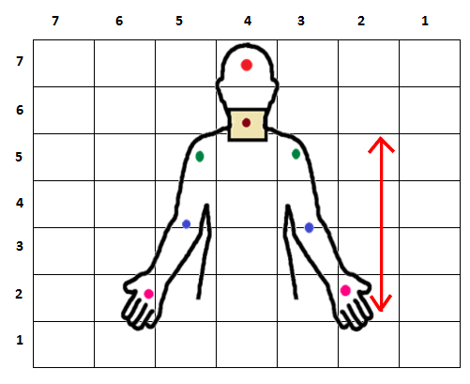
Methodology(cont.)
Extracting Feature
  Calculation of height

Slide 15
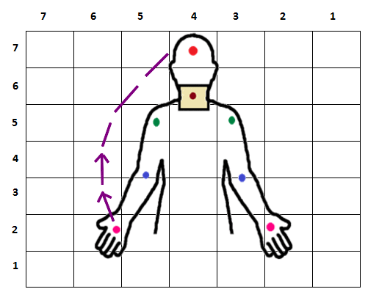
Methodology(cont.)
Extracting Feature
  Sequence of Right Hand Movement

Slide 16
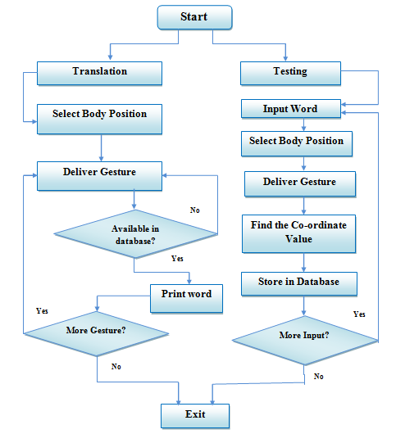
Methodology (Cont.)
Figure : System Architecture

Slide 17
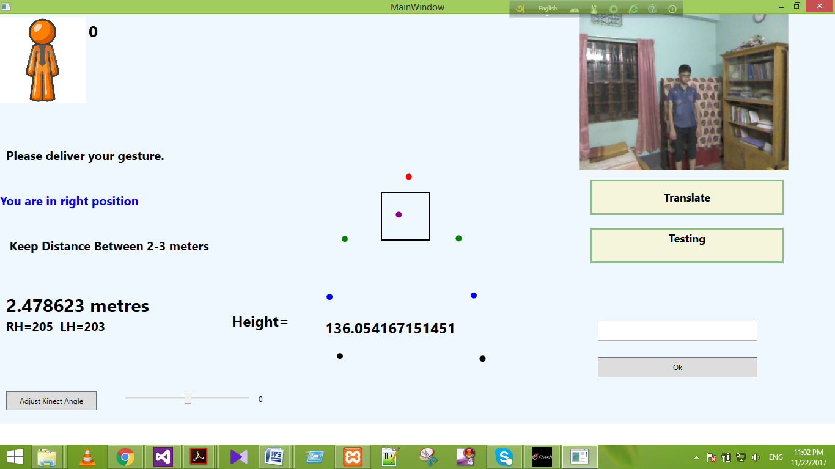
Implementation
User Interface
Of
System Home

Slide 18
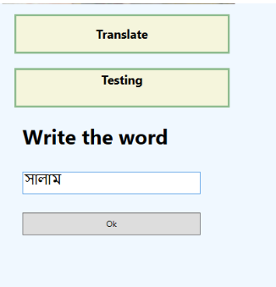
Implementation (Cont.)
Choosing the
Testing Button
Input the word

Slide 19

Implementation (Cont.)
Initial Body Position
Selection

Slide 20

Implementation (Cont.)
Deliver Gesture

Slide 21
Implementation (Cont.)
Choosing the
Translate Button

Slide 22
Implementation (Cont.)
Initial Body Position
Selection

Slide 23
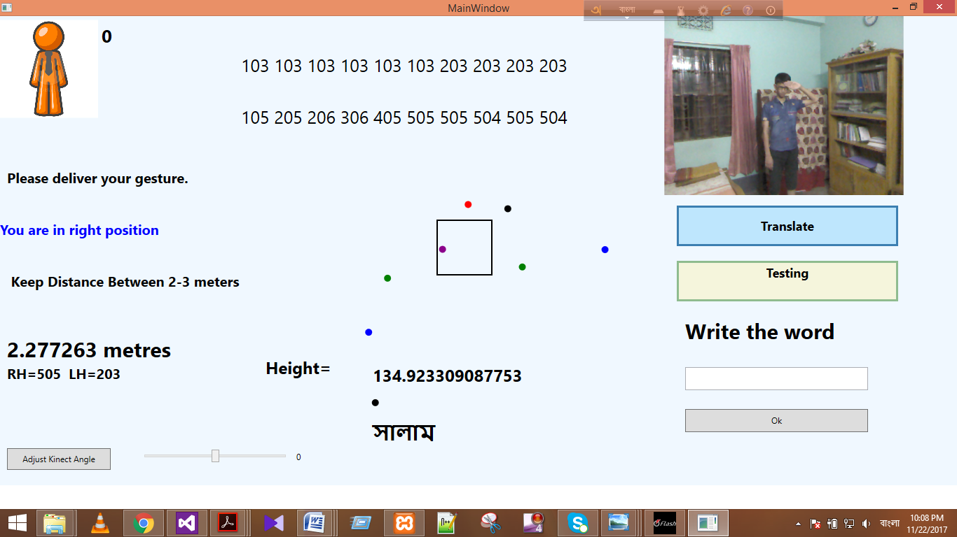
Implementation (Cont.)
Show the Respective Word

Slide 24
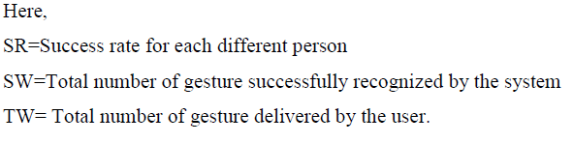
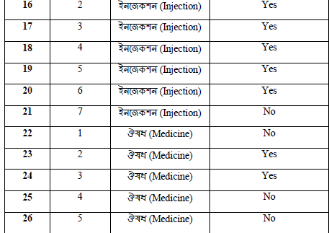
Performance Analysis
SR = SW/TW*100%
Table : Portion of successful rate of different gesture of different user

Slide 25
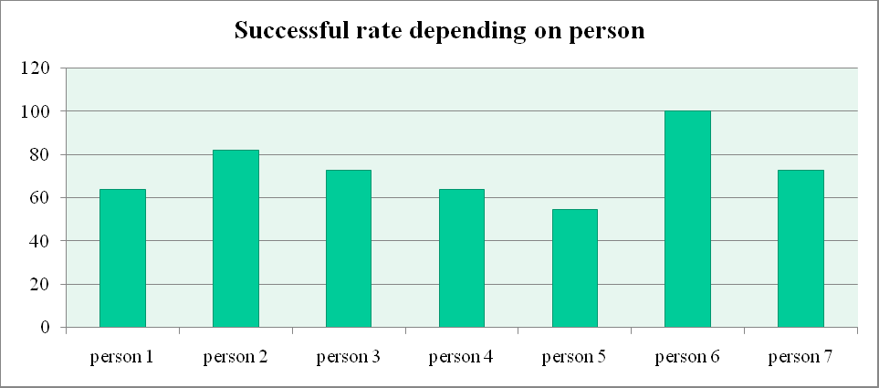
Performance Analysis (Cont.)
Person | Total Number of Given Gesture | Total Number of Given Successful Gesture | Successful Rate (%)
1 | 11 | 7 | 63.63
2 | 11 | 9 | 81.81
3 | 11 | 8 | 72.72
4 | 11 | 7 | 63.63
5 | 11 | 6 | 54.54
6 | 11 | 11 | 100.00
7 | 11 | 8 | 72.72
Obtained System
Accuracy = 72.71%
Accuracy Graph

Slide 26
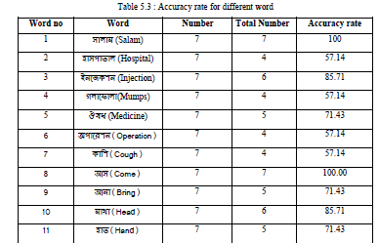
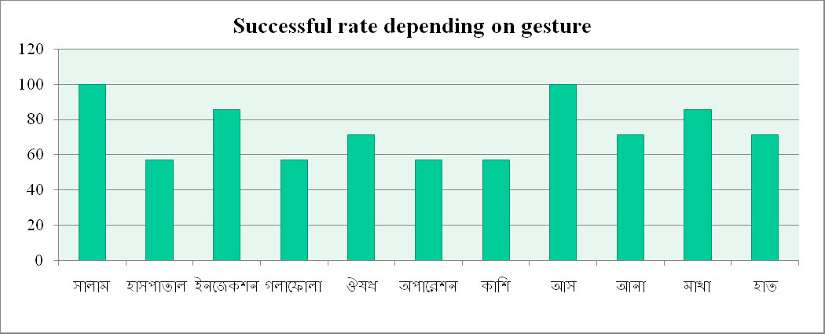
Performance Analysis (Cont.)
Obtained System
Accuracy = 74.02 %
Accuracy Graph

Slide 27
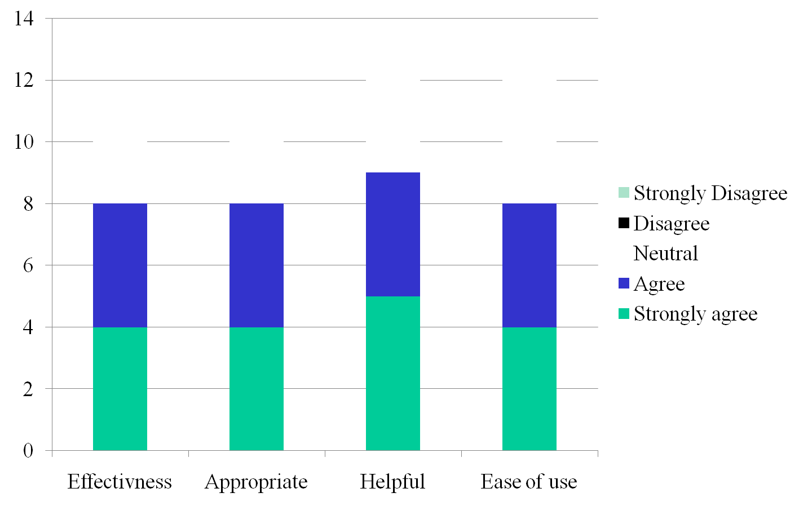
Evaluation

Slide 28
Limitation
    Only works with simple gestures
    Much complex gestures is neglected
    Variation of output for
    System is not intelligent

Slide 29
Conclusion
System can translates Sign languages into texts
Developed system met all the major initial requirements
We have conducted tests to evaluate the system
System performance is in an acceptable range

Slide 30
Future Recommendations
Detection of finger.
Output in voice.
Make the gesture detection more accurate
Working with much larger training dataset
Developing more efficient algorithm for the calculation procedure
Upgrading the procedures of fetching and analyzing data

Slide 31
Reference
[1] M. T.Hoque, Md. R.Tauwaby, Md. F. Kabirz, F. Sarkerx, M.N. Huda and K. A.Mamunk, “Automated Bangla Sign Language Translation System : Prospects, Limitations and Applications” In Proc. 5th International Conference on Informatics, Electronics and Vision (ICIEV,2016)
[2] M. A.Rahim , “Visual Recognition of Bengali Sign Language using Local Binary Pattern Compared with ANN” ,In Proc Global Journal of Computer Science and Technology: F Graphics & Vision , Vol. 14,no.2 ,2014
[3] D. M. Capilla, MSC Thesis On Sign Language Translator Using Microsoft Kinect XBOX 360, University of Tennessee (Knoxville - USA).
[4] F. M. Rahim, T. E. Mursalin, N. Sultana, “Intelligent Sign Language Verification System – Using Image Processing, Clustering and Neural Network Concepts” International Journal of Engineering Computer Science and Mathematics, Vol.1 No.1,2010.
[5] D. S. H. Pavel, T.Mustafiz, A. I. Sarkar, and M. Rokonuzzaman, “Geometrical Model Based Hand Gesture Recognition for Interpreting Bengali Sign Language Using Computer Vision”, in Proc International Conference on Computers and Information Technology, 2003.

Slide 32
Reference(Cont.)
[6] Parton and B. Sue. "Sign Language Recognition and Translation: A Multidisciplined Approach From the Field of Artificial Intelligence." Journal of Deaf Studies and Deaf Education (Oxford Journals), vol. 11, no. 1, 2005.
[7] T. E. Starner, MSC Thesis on Visual Recognition of American Sign Language Using Hidden Markov Models, Massachusetts Institution of Technology.
[8] K. Deb, H. P. Mony & S. Chowdhury. "Two-Handed Sign Language Recognition for Bangla Character Using Normalized Cross Correlation.” Global Journal of Computer Science and Technology,Vol.12, no. 3, 2012.
[9] D. S. H.Pavel, T. Mustafiz , A.I.Sarkar, M.Rokonuzzaman. "Modeling of Bengali sign language expression as dynamic 3D polygons for developing a vision based intelligent system for dumb people” In Proc. National Conference on Computer Processing of Bangla, 2004.
[10] S. Rahman, N. Fatema, and M. Rokonuzzaman, "Intelligent Assistants for Speech Impaired People," In: International Conference on Computer and Information Technology, East West University, Dhaka, Bangladesh. 2002.

Slide 33
Reference(Cont.)
[11] A.M. Jarman, S. Arshad, N. Alam and Md J. Islam, “An Automated Bengali Sign Language Recognition System Based on Fingertip Finder Algorithm” In: International Journal of Electronics & Informatics, ISSN: 2186-0114, Vol.4, No.1, 2015.
[12] S. Begum and M. Hasanuzzaman, “Computer vision-based Bangladeshi Sign Language recognition system”, MS thesis, Department of CSE, Dhaka University, Bangladesh, and ICCIT- 2009, 2009, p. 414.
[13] “Sign Language”[Online].Available : https://www.britannica.com/topic/sign-language WRITTEN BY The Editors of Encyclopædia Britannica
[14] “Sign Language” [Online].Available : http://en.wikipedia.org/wiki/Sign_language.
[15] N. S. Juthy, B. G.Shaham and M. S. A.Shojol. “Ishara Bhashay Jogajog (Communicating through Sign Language),” Dhaka: Center for Disability inDevelopment, 2005.
[16] “Bengali language - wikipedia, the free encyclopedia,” [Online].Available: https://en.wikipedia.org/wiki/Bengali language, (Visited on 09/30/2015).

Slide 34
Reference(Cont.)
[17] Z. Halim PhD & G. Abbas PhD, “A Kinect-Based Sign Language Hand Gesture Recognition System for Hearing- and Speech-Impaired: A Pilot Study of Pakistani Sign Language” Assistive Technology,The Official Journal of JRESNA, (Online) ournal homepage: http://www.tandfonline.com/loi/uaty20
[18] “Kinect” [Online].available : https://en.wikipedia.org/wiki/Kinect
[19] Bangladesh Sign Language committee. “Bangla Sign Language Dictionary”.Dhaka: National centre for special education & Ministry of social welfare, 1994.
[20] “ Kinect skeleton tracking” [Online].available: https://msdn.microsoft.com/en-us/library/
[21]”Static gesture recognition” [Online]. available: http://www.sciencedirect.com/science/article/pii/S0031320316000157
[22] “Dynamic gesture of sign word” [Online]. available: https://www.speechbuddy.com/blog/language-development/5-ways-sign-language-benefits-the-hearing/
[23] S.S.Hazari,Asaduzzaman,L.Alam,N.A.Goni, “Designing a sign language translation system using kinect motion sensor device” ,In Proc. Electrical, Computer and Communication Engineering (ECCE), INSPEC Accession Number: 16851191, 2017

Slide 35


