Slide 1

vectors
mathematics

Slide 2
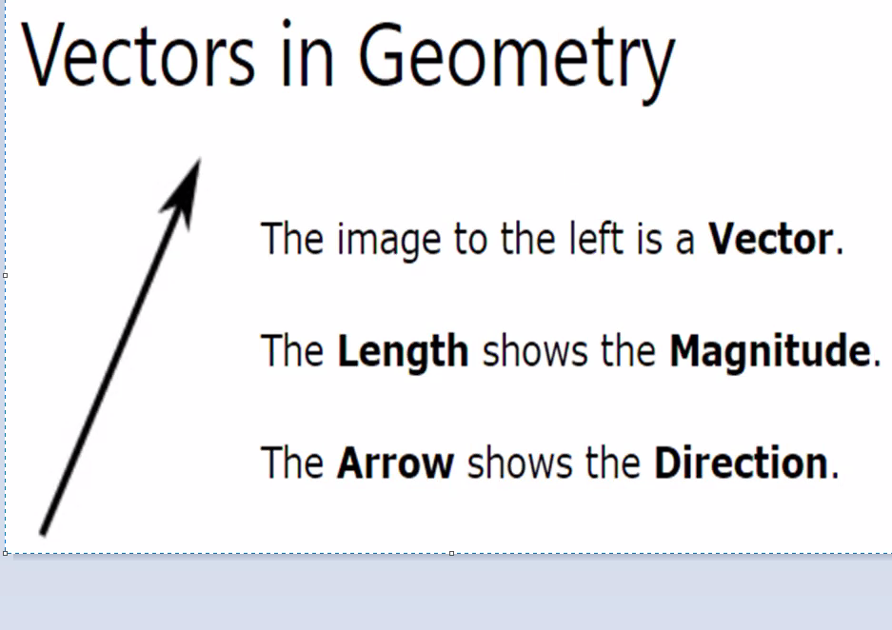

Slide 3
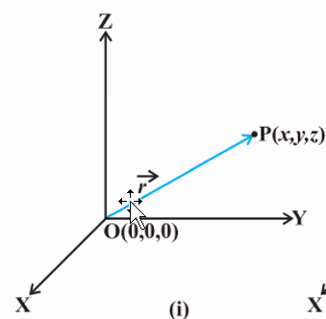
Position vectors
Consider a point P in space,having coordinates (x,y,x) with respect to the origin(0,0,0).Then,the vector having 0 and p as its initial and terminal points,respectively is called the position vector of the point P with respect to 0

Slide 4
Types of Vectors
Unit vector-A vector whose magnitude is unity(ie 1 unit) is called a unit vector. The unit vector in the direction of a given vector is a
Coinitial vector- two or more vectors are said to be colinear if they are parallel to the same line,irrespective of their magnitudes and directions
Collinear vectors-two or more vectors a and b are said to be equal ,if they have the same magnitude and direction regardless of the positions of their initial points

Slide 5
Continuation…..
Negative of a vector- a vector whose magnitude is the same as that of a given vector (say,ab),but direction is opposite to that of it ,is called negative of the given vector

Slide 6
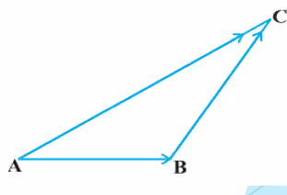
Addition of vectors
A vector simply means the displacement from a point A to the point B.Now consider a situation that a girl moves from A to B then from B to C.The net displacement made by the girl from point A to C ,is given by the vector and expressed as a commulative property
This is known as triangle law of vector
addition

Slide 7
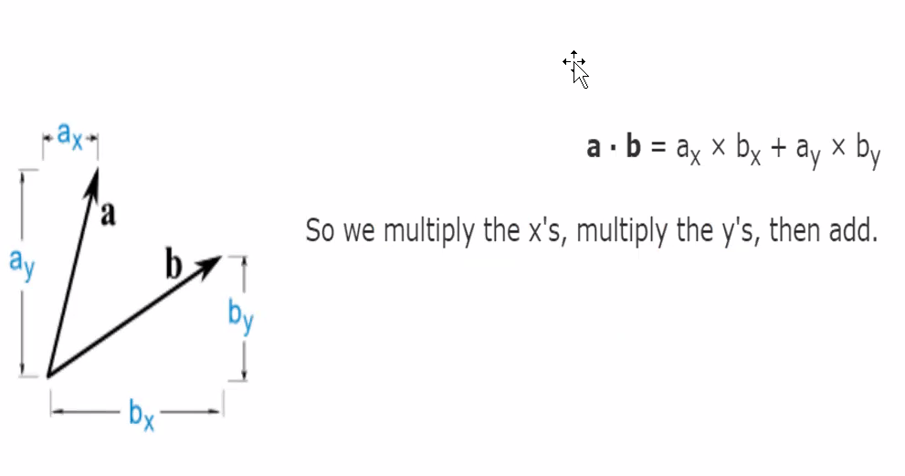
Dot product of 2 vectors

Slide 8
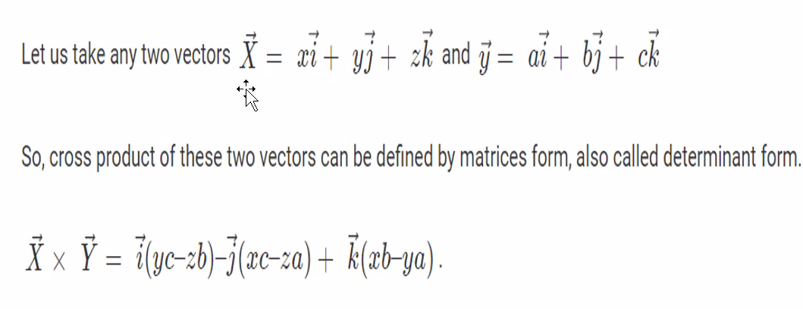
Cross product of two vectors

Slide 9
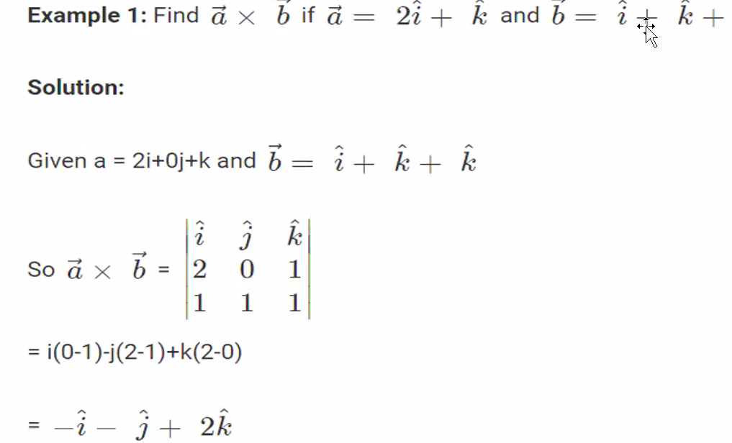

Slide 10
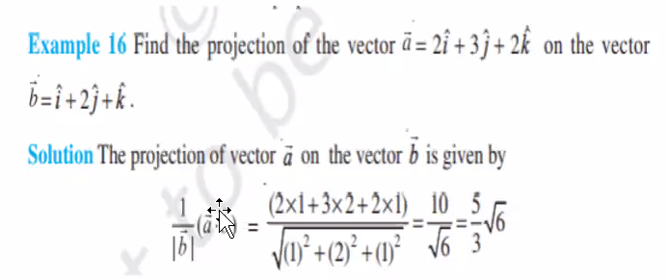
example

