Slide 1
Probability
Data science

Slide 2
Probabilty
A probability is a number that represents the chance or likelihood that a particular event will occur
Probability ranges between 0 and 1

Slide 3
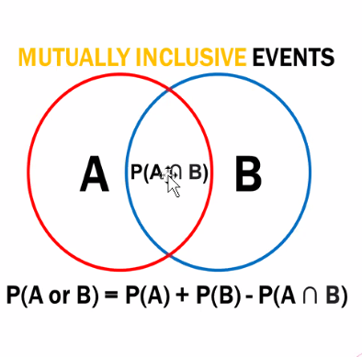
Mutual inclusive and exclusive
Mutual exclusive event are the events If they both cannot occur at the same time,a clear example is the set of outcomes of a single coin toss,which can result in either a head or a tail but ever both
For mutually exclusive events the additive theory of probability states if A and B are two mutually exclusive events then the probability of either A or B is given by
P(A OR B)=p(A)+P(B)
Mutually inclusive events allow both events to happen at the same time to occur in a single trial

Slide 4
Dependent and independent events
Two events are dependent if the outcome of the first event affects the outcome of the second event,so that the probability is changed is called dependent event
Two events are independent if the result of the second event is not affected by the result of the first event

Slide 5
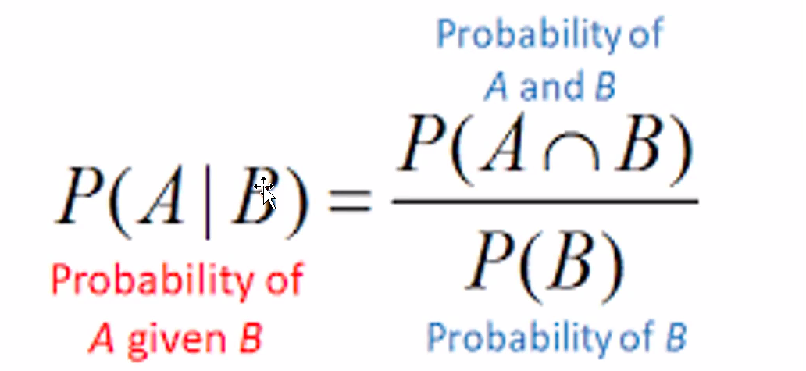
Conditional probability
Conditional probability refers to the chances that some outcome occurs given that another event has also occured

Slide 6
Bayes theorem
Another way of calculating conditional probability is by using the bayes theorem. The theorem can be used to determine the conditional probability of event A, given that event B has occurred by knowing the conditional probability of event b =, given the event a has occurred, as well as the individual probabilities of events A and B

Slide 7
Q1, what is the probability of spinning a prime number or an odd number on a spinner numbered 1 to 8
Ans1,
S=(1,2,3,4,5,6,7,8)
P(prime number)=4/8=1/2(not including 1)
P(Odd number)=4/8=1/2
P(prime and odd)=3/8(not including 1) so
P(prime or odd)=1/2+1/2-3/8=5/8

Slide 8
Q2, For numbers ,one to nine get the probability of getting a number less than 4 or 2 ans2,
(P<4)= 3/9=1/3
(P<2)=1/9
Mutual inclusive =1/9
1/3+1/9-1/9=3/9

Slide 9
Q3,Let X and Y are two independent events such as p(X)=0.3 and P(Y)=0.7,find P(x and Y)?and p(x or y)
ans3
p(x and y)=P(x)*p(y)
=0.3*0.7
=0.21
P(x or b)=p(x)+p(y)
=0.3+0.7
=1

Slide 10
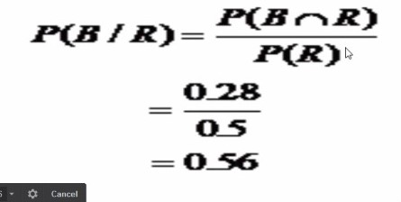
Q4,A bag contains red and blue marbles. Two marbles are drawn without replacement. The probability of selecting a red marble and then a blue marble is 0.28.the probability of selecting a red marble on the first draw is 0.5.what is the probability of selecting a blue marble on the second draw, given that the first marble drawn was red

