Slide 1
NUBI – Artificial Intelligence voice Assistant
Jerin Joy Pinhero
Roll No : 20
MCA S6

Slide 2
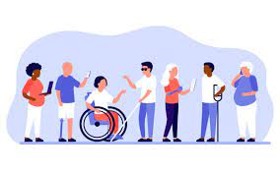
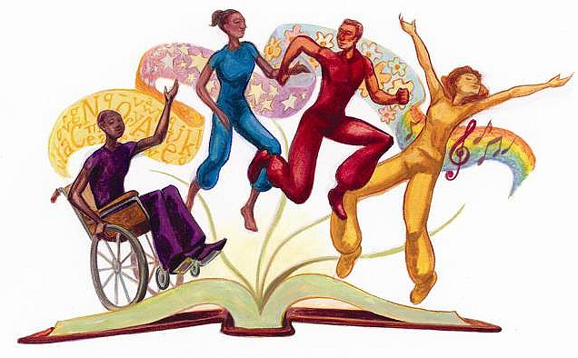
Intro
Most visually impaired, crippled, and elderly people are socially isolated; a voice assistant system could assist them in overcoming their challenges and working independently rather than relying on others..

Slide 3
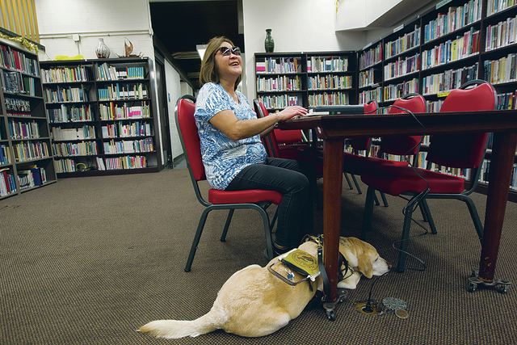
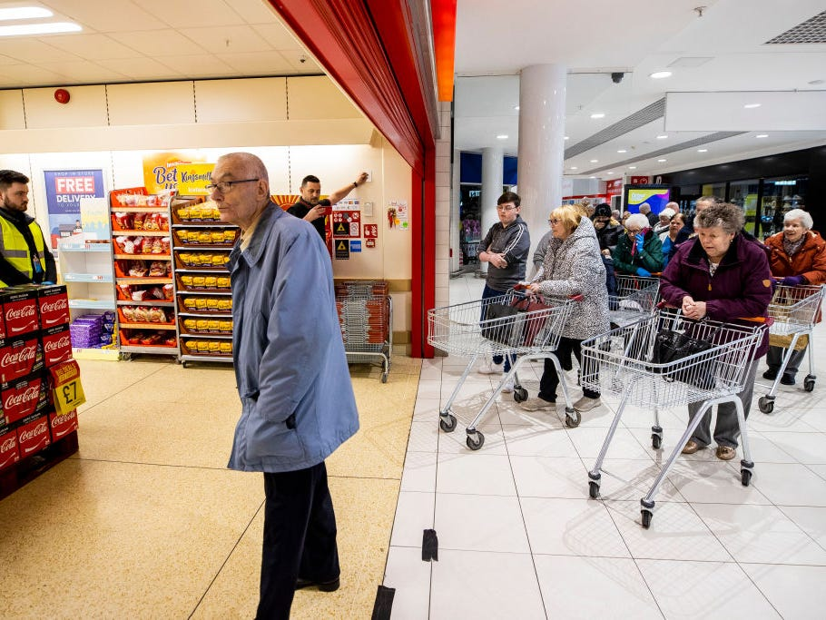
challenges that is faced by disabled people .
01. Feeling of being ignored
When we interact with a physically challenged person, it does not mean that, he is also suffering from visual or hearing impairment. This thought process often stops us from interacting and communicating with such people

Slide 4
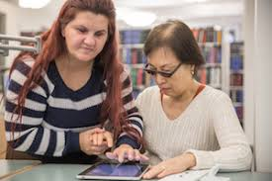
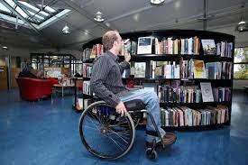
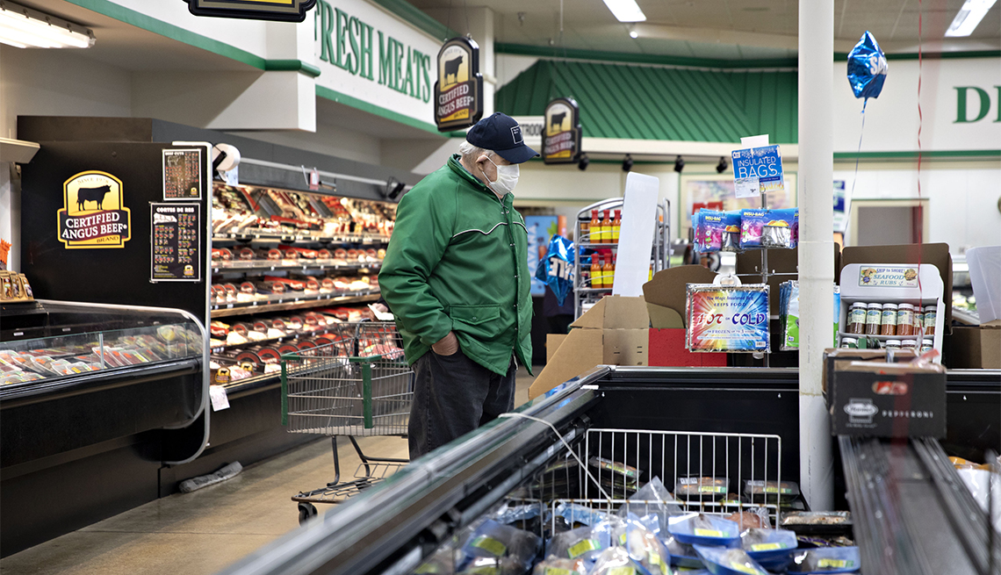
02. Lack of Employees
The lack of employees in aiding the customers who are handicapped, By making sure that they are able to carry out their tasks without any hurdles

Slide 5
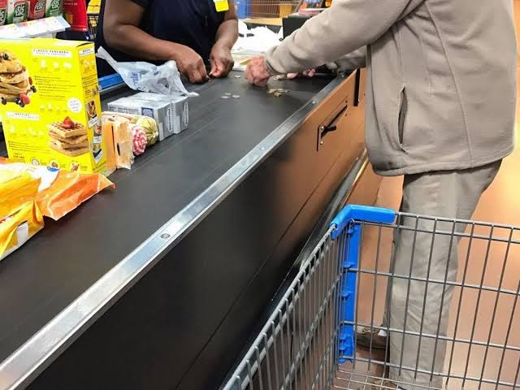
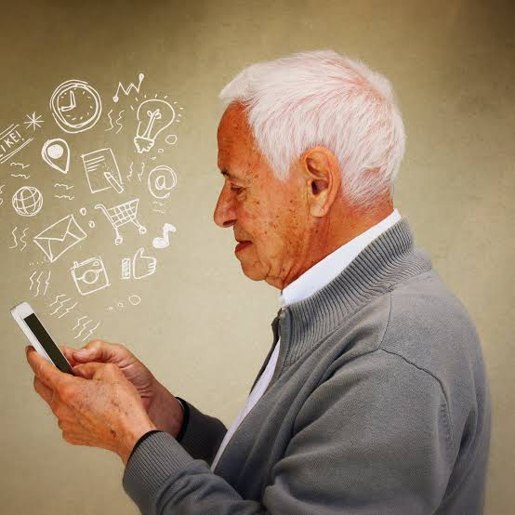
03. Feeling of being incompetent
Disabled people need more time to do a particular work than other normal people. The disability barriers stop him from performing basic tasks with ease. This makes the person with disabilities that he is pulling his mates down and if filled with sorrow and anger

Slide 6
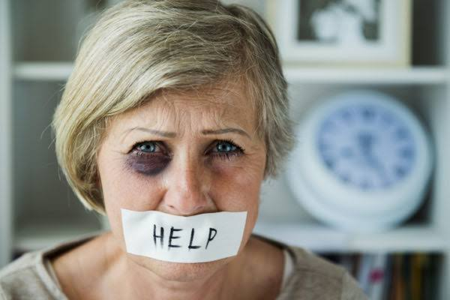
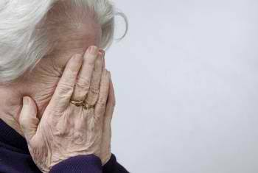
04. Teased and abused
Often people find satisfaction in putting others down. They find superiority in bullying the weak and underprivileged. Disabled people often find themselves at the receiving end of such violent and disgusting actions.

Slide 7
Advantages in the new implementing system
In this project, developed to keep blind, elderly, and handicapped persons engaged and working independently
NUBI voice assistant assists physically handicapped people in a better way
3. NUBI voice assistant authenticates the handicapped people by face recognition and then assist them based on the emotion recognised.
4. The AI assistant interprets the sign language of blind people to understand what they recquire and assist them

Slide 8
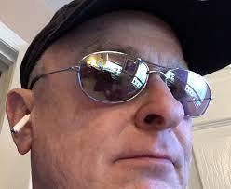
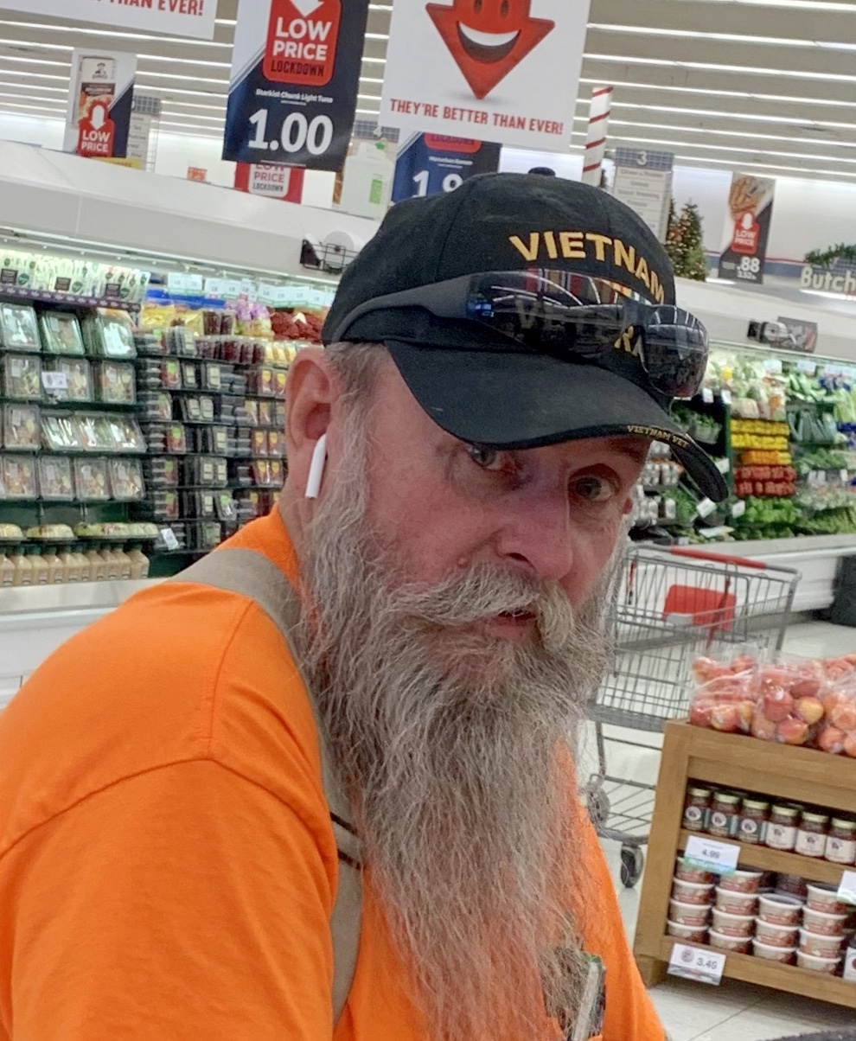
Implementation

Slide 9
THANK YOU

