Slide 1
DIGITAL PORTFOLIO

Slide 2
DIGITAL PORTFOLIO
STUDENT NAME: JERINKUMAR.M
REGISTER NUMBER AND NMID: 2422K1574& asbru4q2422k1574
DEPARTMENT: COMPUTER SCIENCE
COLLEGE AND UNIVERSITY: K.S.G.COLLEGE OF ARTS AND SCIENCE, BARATHIYAR UNIVERSITY.

Slide 3
DIGITAL PORTFOLIO
USING FRONTEND DEVELOPMENT

Slide 4
AGENDA
1.Problem Statement 2.Project Overview 3. End Users 4. Tools and Technologies 5.Portfolio design and Layout 6. Features and Functionality 7.Results and Screenshots 8.Conclusion 9.Github Link

Slide 5
PROJECT STATEMENT
“To design and develop a visually appealing and user-friendly digital portfolio that effectively showcases my skills, experience, and accomplishments as a [web developer/designer/etc.], while also demonstrating my ability to create a professional online presence.” 1. Showcasing skills and experience: Highlighting your technical skills and experience in web development, design, or other relevant areas. 2. User-friendly interface: Creating an intuitive and easy-to-use interface that allows visitors to navigate and explore your portfolio with ease. 3. Visual appeal: Incorporating visually appealing design elements, such as typography, colour schemes, and imagery, to create a cohesive and engaging visual identity. 4. Professional online presence: Demonstrating your ability to create a professional online presence that showcases your work and provides a positive representation of your skills and experience.

Slide 6
PROJECT OVERVIEW
Project Title: DIGITAL PORTFOLIO Project Description: Briefly describe the project, including its purpose, goals, and key features. Technologies Used, List the technologies, tools, and programming languages used in the project. Key Features: Highlight the project’s most notable features, such as: - Interactive elements - Responsive design - Dynamic content

Slide 7
WHO ARE THE END USERS
1. Potential Employers: Hiring managers, recruiters, or talent acquisition specialists looking to assess your skills and experience. 2. Clients: Potential clients or customers interested in your services, such as web development, design, or consulting. 3. Peers and Colleagues: Fellow professionals, colleagues, or industry peers who want to learn from your experiences, share knowledge, or collaborate on projects. 4. Mentors or Coaches: Career coaches, mentors, or advisors who can provide guidance and support based on your portfolio. 5. Academic or Research Institutions: Universities, research institutions, or academic programs that may be interested in your work, skills, or research.

Slide 8
TOOLS AND TECHNIQUES
Tools 1. *Website builders*: Wix, Squarespace, WordPress, Webley 2. *Portfolio platforms*: Enhance, GitHub Pages, Carbon made, Format 3. *Design and prototyping tools*: Adobe XD, Sketch, Figma, In Vision 4. *Content management systems*: WordPress, Joomla, Drupal 5. *Version control systems*: Git, GitHub, Techniques 1. *Responsive web design*: Ensure your portfolio is accessible and looks great on various devices. 2. *User experience (UX) design*: Create an intuitive and user-friendly interface. 3. *Search engine optimization (SEO)*: Optimize your portfolio for search engines to improve visibility. 4. *Content creation*: Develop high-quality content that showcases your skills and experience. 5. *Regular updates*: Regularly update your portfolio with new projects, skills, and experiences.

Slide 9
PORTFOLIO DESIGN AND LAYOUTS
Design Principles 1. Clean and minimalistic: Avoid clutter and focus on showcasing your work. 2. Consistent branding: Use a consistent color scheme, typography, and visual identity. 3. Responsive design: Ensure your portfolio looks great on various devices. Layout Ideas 1. Grid-based layout: Use a grid to organize your projects and make it easy to scan. 2. Hero section: Use a prominent hero section to showcase your best work or introduction. 3. Project showcases: Use images, videos, or live demos to showcase your projects. 4. About page: Include a brief bio, contact information, and relevant links. 5. Blog or news section: Share your thoughts, experiences, and industry insights.

Slide 10
FEATURES AND FUNCTIONALITY
Features 1. *Project showcases*: Detailed showcases of your projects, including images, videos, and descriptions. 2. *Filtering and categorization*: Allow visitors to filter and categorize projects by type, technology, or industry. 3. *Search functionality*: Include a search bar to help visitors find specific projects or information. 4. *Contact information*: Make it easy for visitors to get in touch with you. 5. *Social media integration*: Link to your social media profiles to expand your online presence. Functionality 1. *Responsive design*: Ensure your portfolio looks great on various devices and screen sizes. 2. *Easy updates*: Make it easy to add, remove, or update projects and information. 3. *Customizable*: Allow for customization of layout, design, and content. 4. *SEO optimization*: Optimize your portfolio for search engines to improve visibility. 5. Analytics*: Track visitor behavior and analytics to understand your audience.

Slide 11
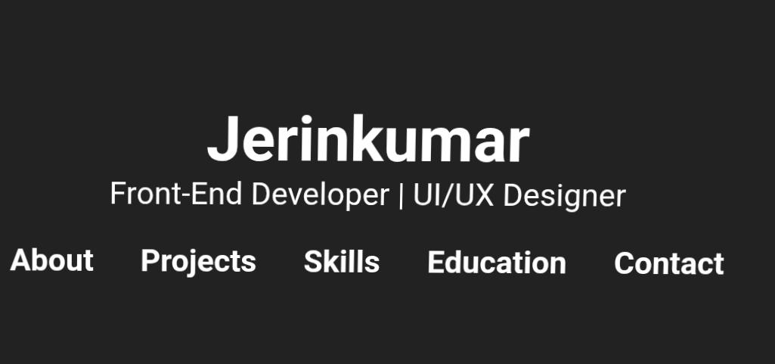
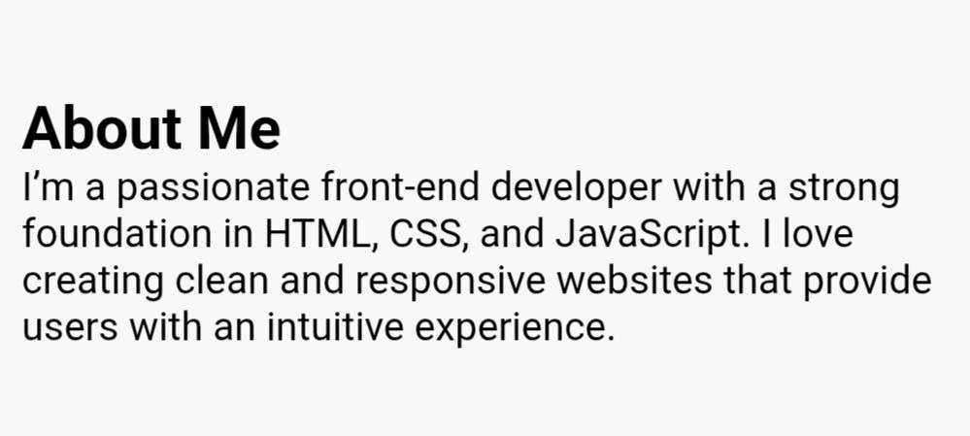
RESULTS AND SCREENSHOTS

Slide 12
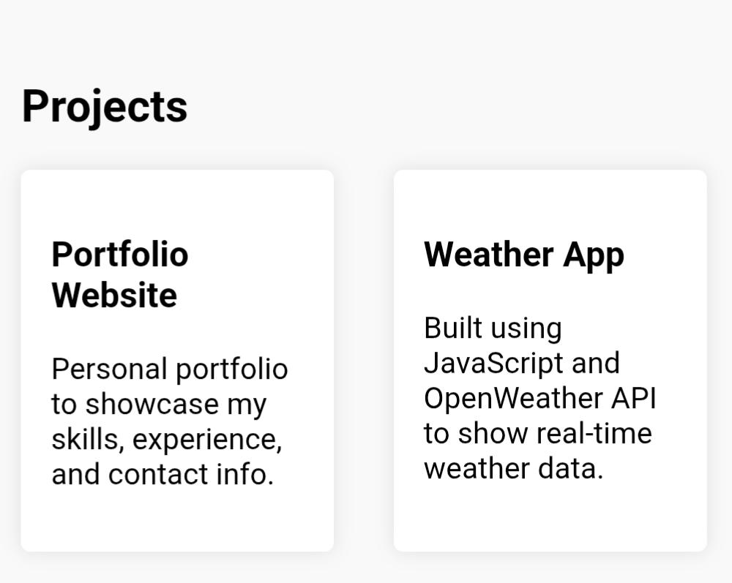
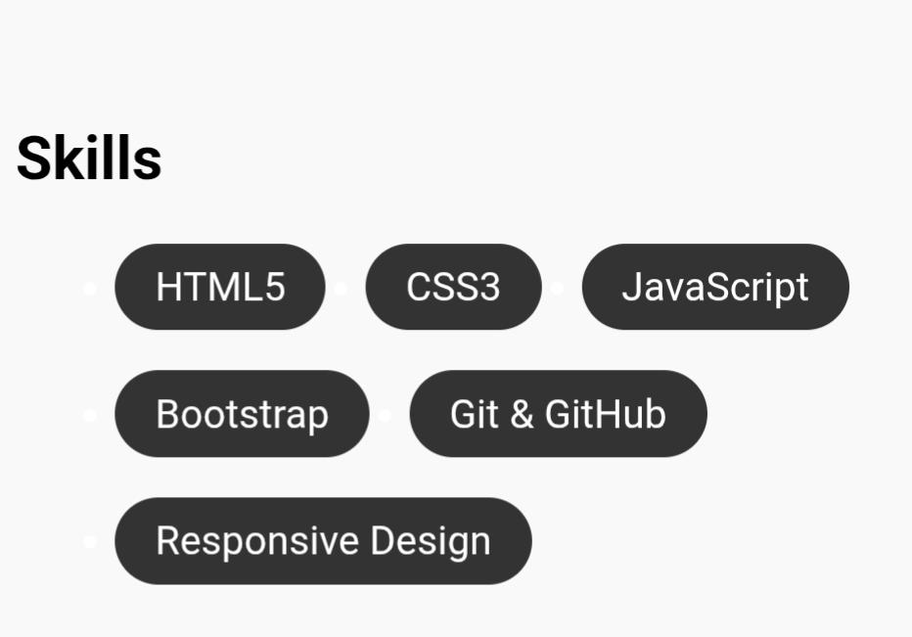
RESULTS AND SCREENSHOTS

Slide 13
CONCLUSION
Thank you for exploring my digital portfolio! I’m excited to showcase my skills, experience, and projects in a way that’s easy to navigate and engaging to view. I’m always looking for new opportunities to grow and collaborate, so feel free to reach out if you’d like to discuss a project or idea.

