Slide 1
Data Science
MSCI:6070 Spring 2017
Lecture 10 (4/3/17)

Slide 2
Outline
Exercise on clustering with Rattle
-- K-means
-- Hierarchical clustering
Association Analysis
-- Problem definition
-- Frequent itemset
-- Association rule

Slide 3
Exercise on clustering with Rattle

Slide 4
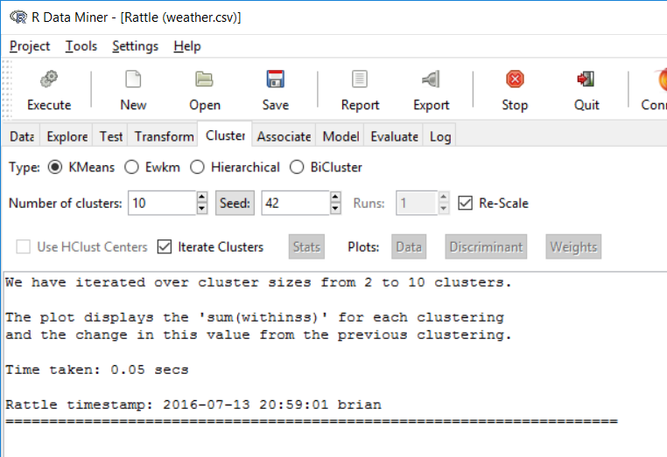
Different seeds result in different selection of initial centroids
Normalization
Iteratively perform K-means with K=2, 3, …, 10, and generate a plot for choosing the “best” K with elbow method

Slide 5
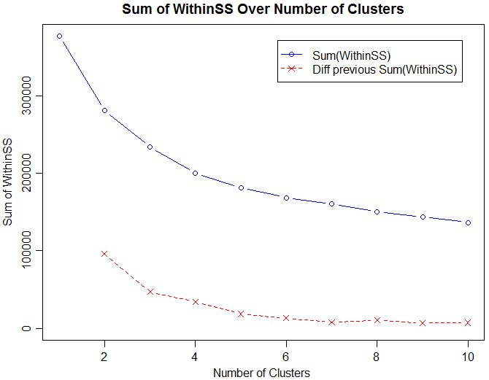
Elbow method

Slide 6
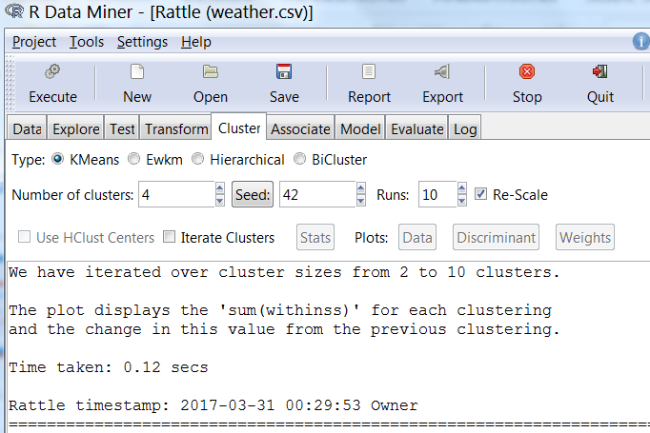
Multiple runs
Set K=4
Uncheck “Iterate Clusters”

Slide 7
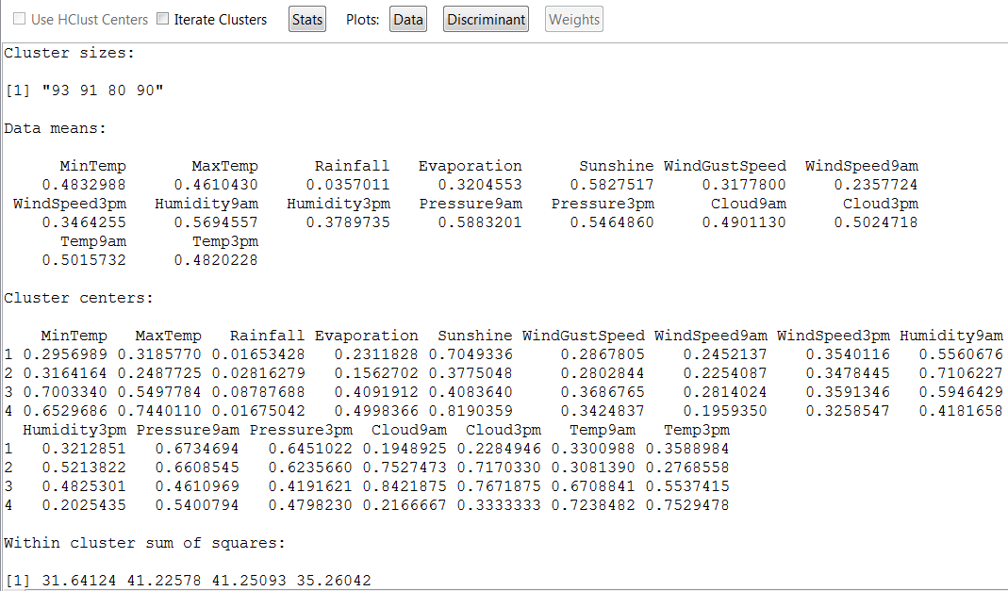
Well-balanced in size (good)
Find patterns/characteristics of individual clusters
WSS (i.e., SSE): quality measure

Slide 8
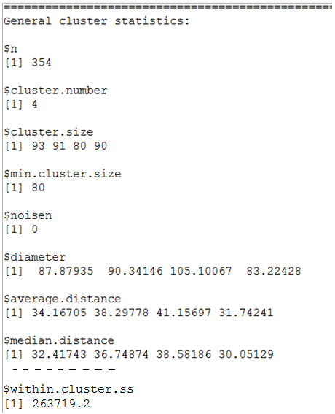
Additional cluster statistics and measures of the goodness of the clustering

Slide 9
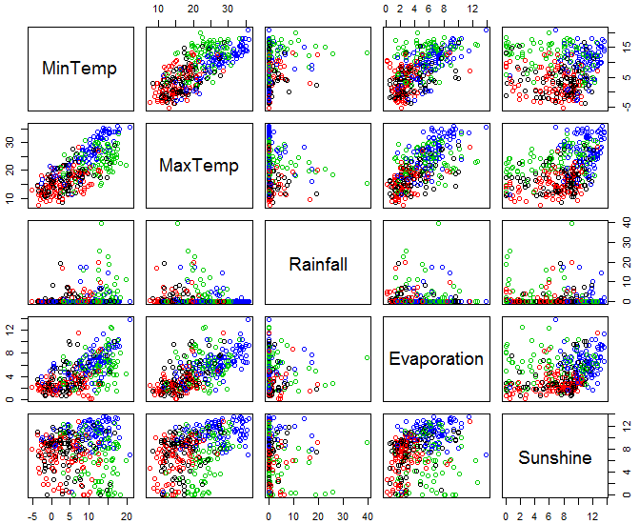
Illustrate how the clusters are distributed across different pairs of attributes

Slide 10
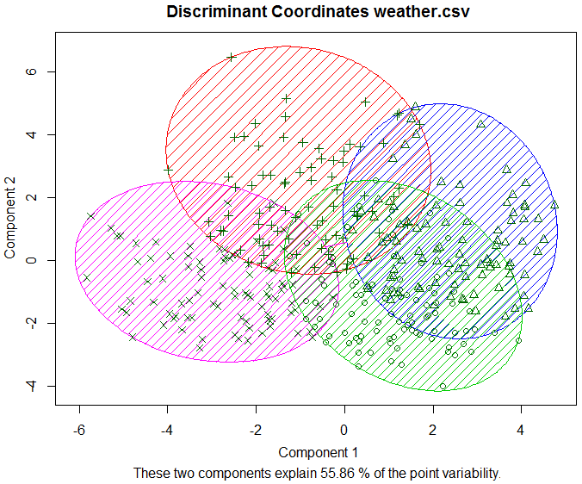
Project the data points into the space of two most discriminant components to display the cluster distribution

Slide 11
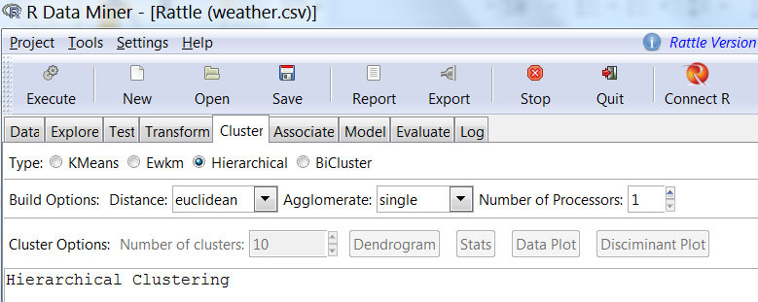
Single link (MIN)

Slide 12
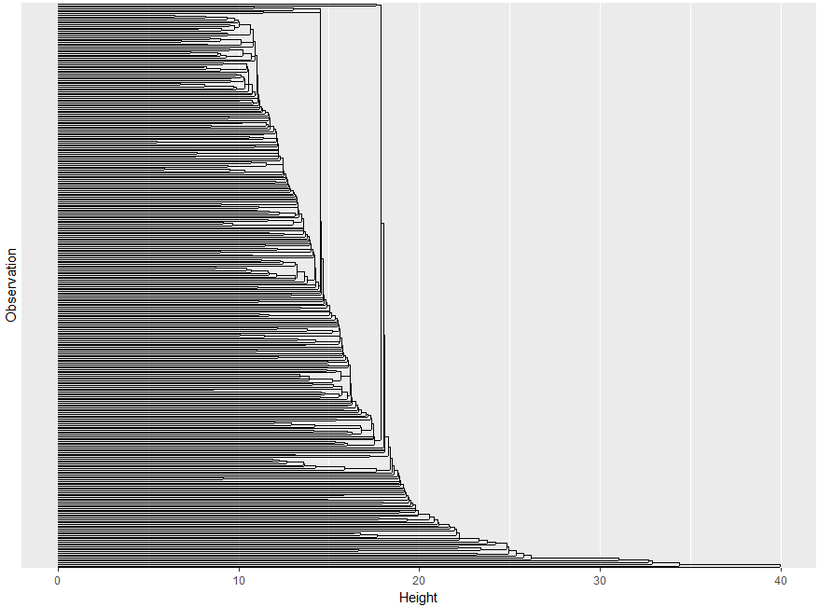
Check against K=4 in K-means

Slide 13
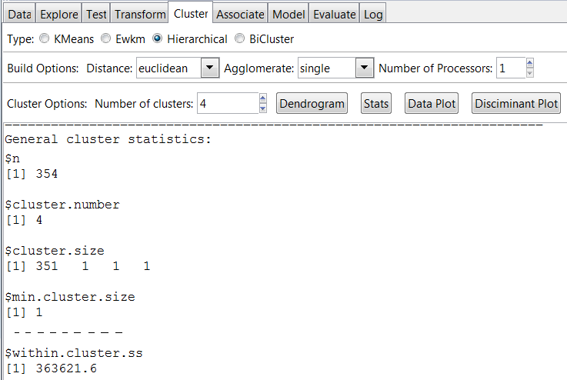


Slide 14
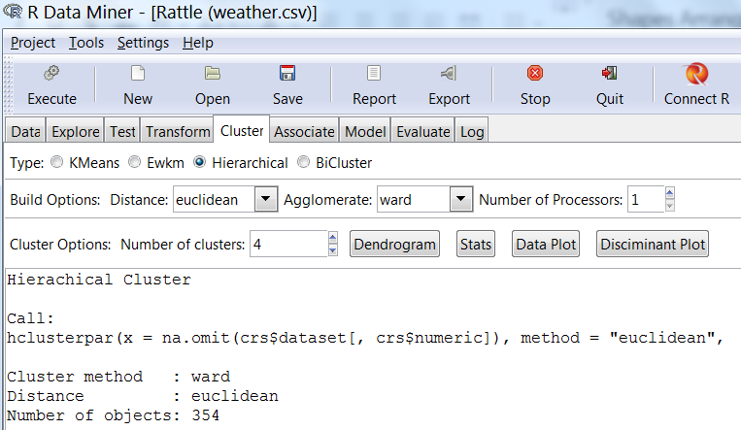
Ward’s method

Slide 15
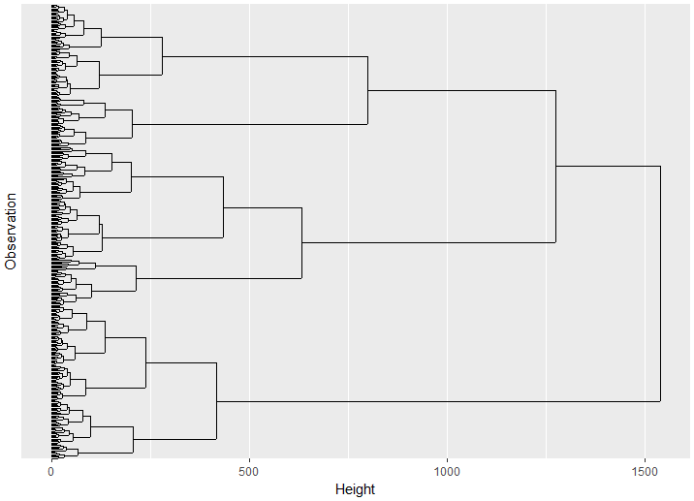
Check against K=4 in K-means

Slide 16
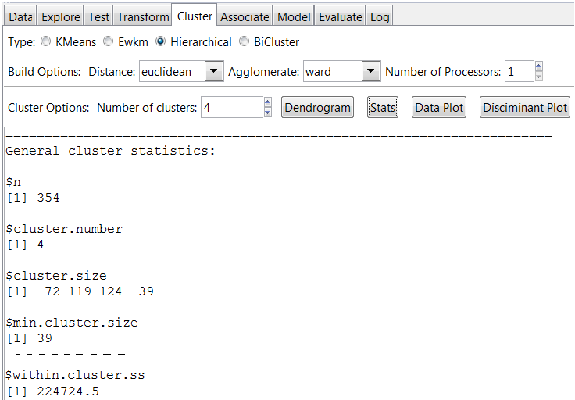
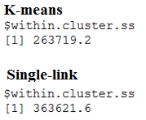
Lowest SSE among the three clusterings

Slide 17
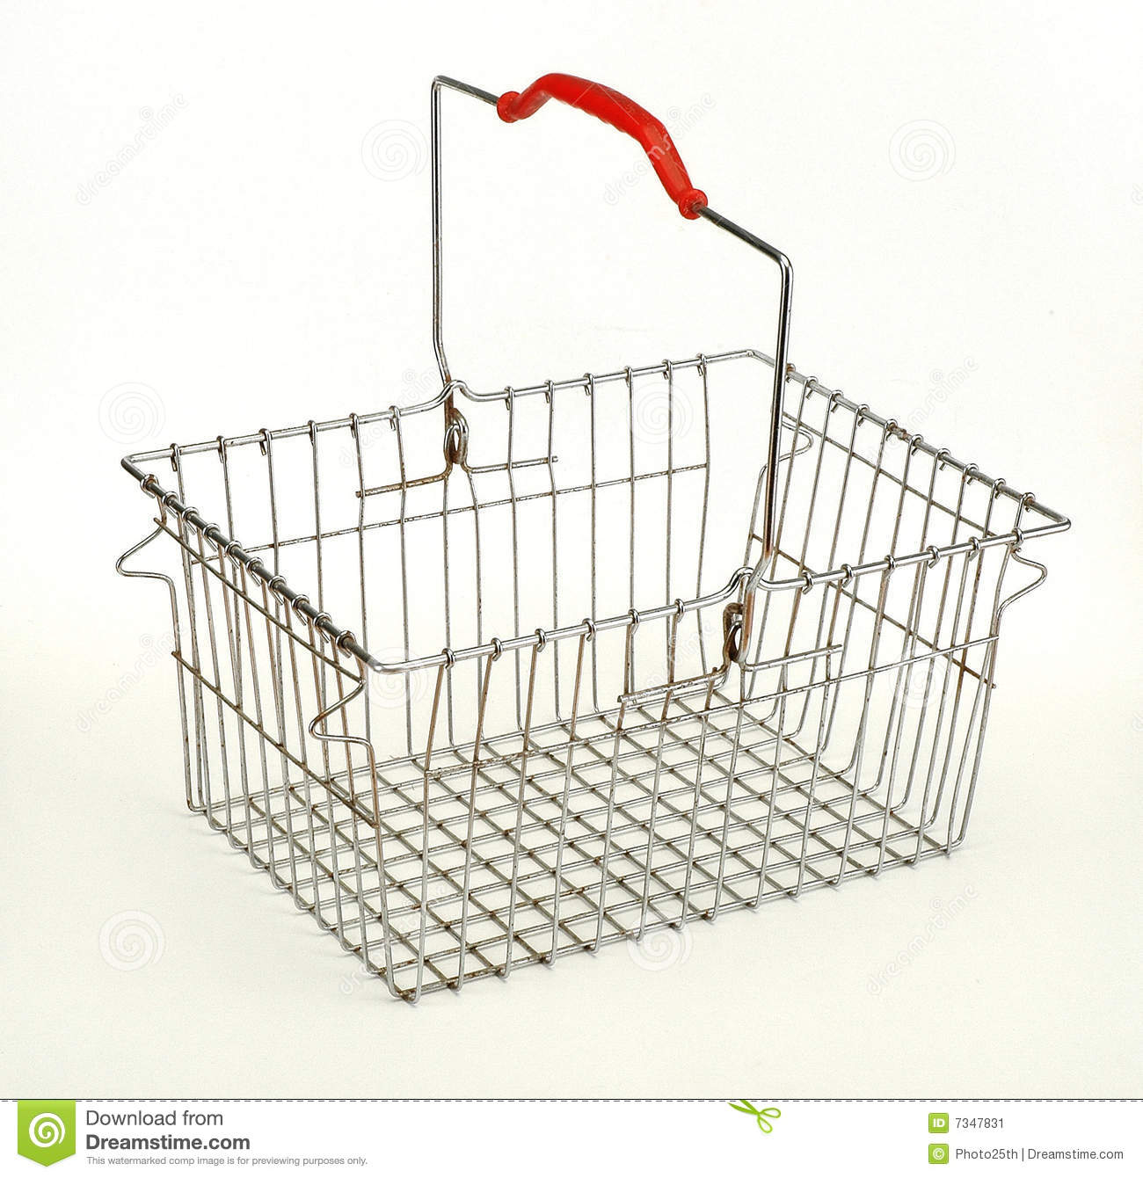
Association Analysis
a.k.a. Association Rule Mining or Co-occurrence Grouping or Affinity Analysis
Market Basket Analysis → find items that frequently go together
Each transaction (receipt) contains a number of items
When one buy A, how likely would she also want to buy B?
{Bread} → {butter}
{Paper plates, plastic forks} → {napkins}
{Data Science for Business} → {Data Mining with Rattle and R}
Some of them might be trivial
Finding unknown association rules may help
improve sales and increase revenue → cross-selling

Slide 18
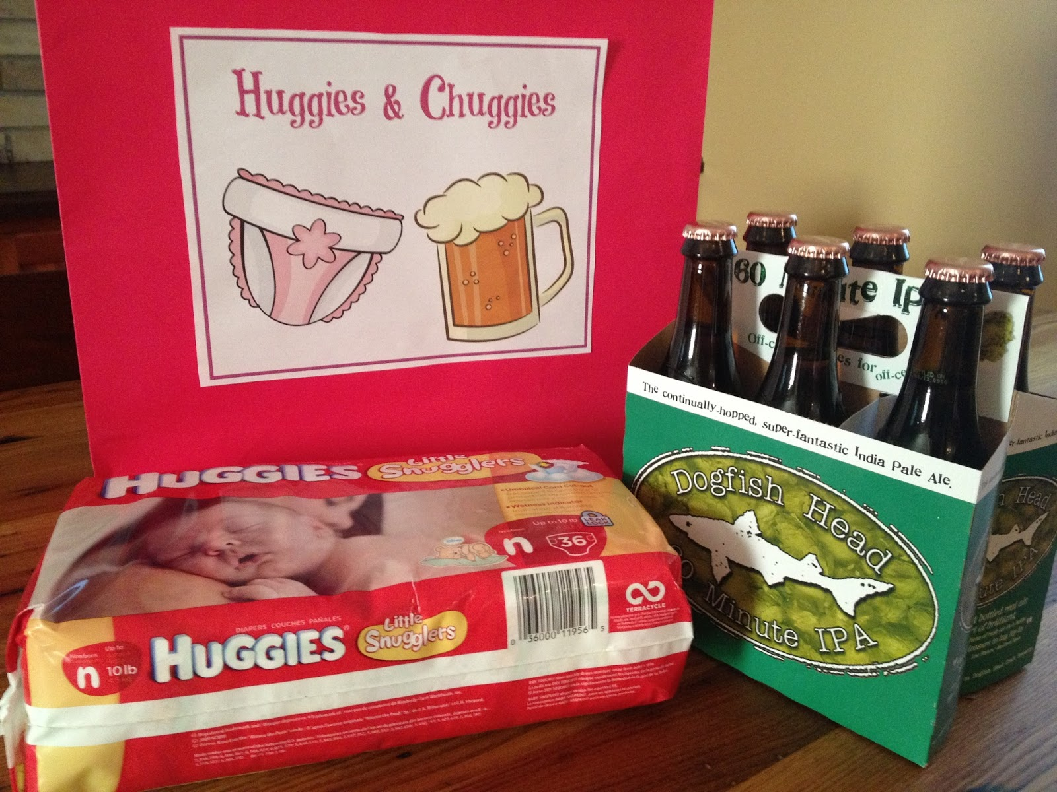
Diaper and Beer

Slide 19
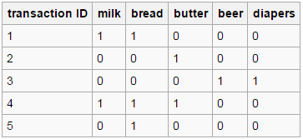
Market Basket
a.k.a Shopping Cart
TID | Items
1 | milk, bread
2 | butter
3 | beer, diaper
4 | Milk, bread, butter
5 | Bread

Slide 20
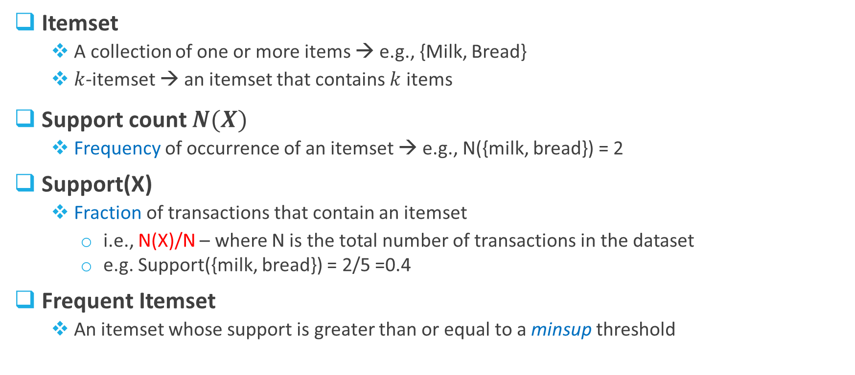
Frequent Itemset
Itemset
A collection of one or more items → e.g., {Milk, Bread}
$k$-itemset → an itemset that contains $k$ items
Support count $N(X)$
Frequency of occurrence of an itemset → e.g., N({milk, bread}) = 2
Support(X)
Fraction of transactions that contain an itemset
i.e., N(X)/N – where N is the total number of transactions in the dataset
e.g. Support({milk, bread}) = 2/5 =0.4
Frequent Itemset
An itemset whose support is greater than or equal to a minsup threshold

Slide 21
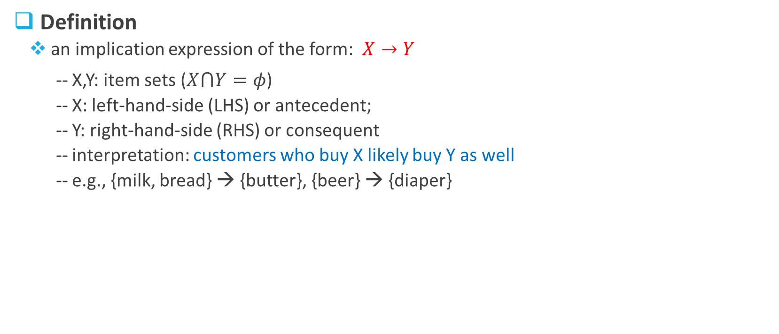
Association Rule (1)
Definition
an implication expression of the form: $X→Y$
-- X,Y: item sets ($X⋂Y=φ$)
-- X: left-hand-side (LHS) or antecedent;
-- Y: right-hand-side (RHS) or consequent
-- interpretation: customers who buy X likely buy Y as well
-- e.g., {milk, bread} → {butter}, {beer} → {diaper}
Note –
A rule needs a support of hundred/thousand transactions to be considered statistically significant
Implication means co-occurrence (although directional), instead of causality!

Slide 22
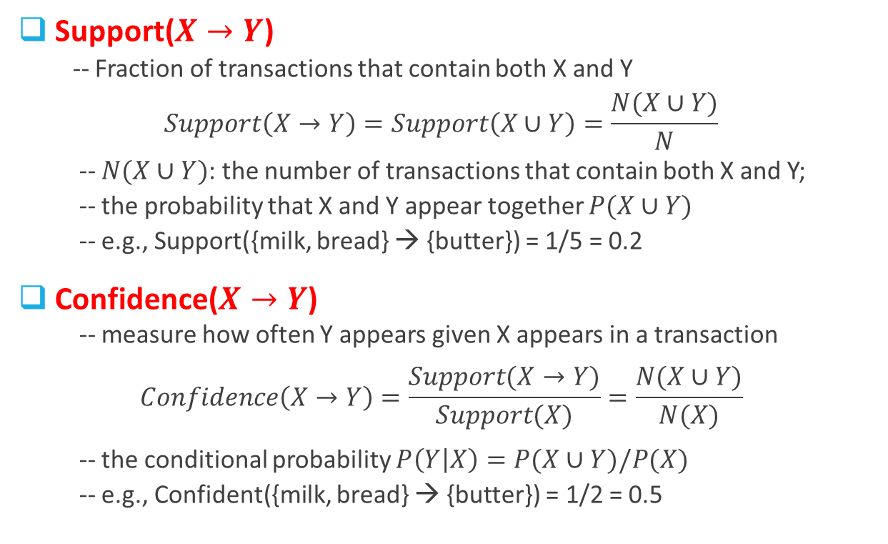
Rule Evaluation Metrics (1)
Support($X→Y$)
-- Fraction of transactions that contain both X and Y
$$Support\left(X→Y\right)=Support\left(X∪Y\right)=\frac{N(X∪Y)}{N}$$
-- $N(X∪Y)$: the number of transactions that contain both X and Y;
-- the probability that X and Y appear together $P(X∪Y)$
-- e.g., Support({milk, bread} → {butter}) = 1/5 = 0.2
Confidence($X→Y$)
-- measure how often Y appears given X appears in a transaction
$$Confidence\left(X→Y\right)=\frac{Support(X→Y)}{Support(X)}=\frac{N(X∪Y)}{N(X)}$$
-- the conditional probability $P\left(Y | X\right)=P(X∪Y)/P(X)$
-- e.g., Confident({milk, bread} → {butter}) = 1/2 = 0.5

Slide 23


Rule Evaluation Metrics (2)
→ A problem with Confidence($X→Y$)
Example: verify the association rule Tea → Coffee
-- Support({Tea} → {Coffee}) = 15/100 = 0.15
-- Confidence({Tea} → {Coffee}) = 15/20 = 0.75
-- Support({Coffee}) = 90/100 = 0.9
-- $P\left(Coffee | \overline{Tea}\right)$ = 0.9375
 | $$Coffee$$ | $$\overline{Coffee}$$
$$Tea$$ | 15 | 5 | 20
$$\overline{Tea}$$ | 75 | 5 | 80
 | 90 | 10 | 100
Contingency table
Both are pretty high. Is the rule verified?
The rule is misleading!

Slide 24
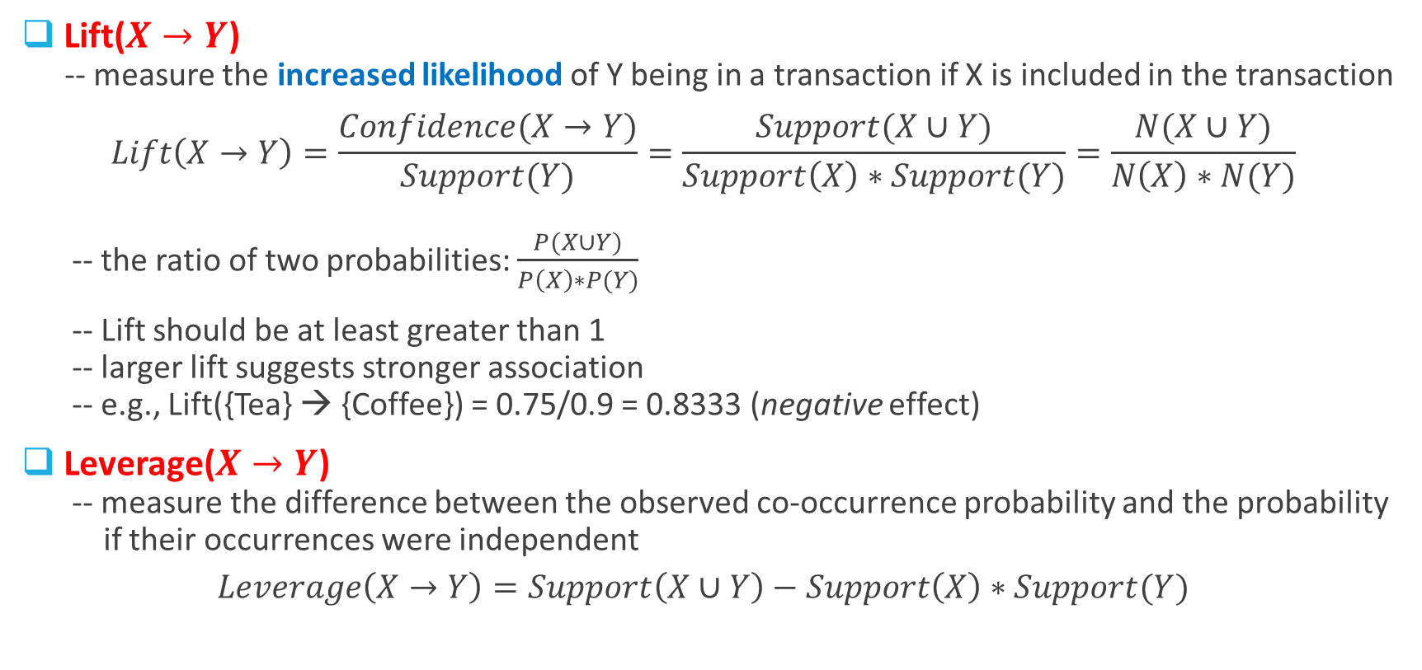
Rule Evaluation Metrics (3)
Lift($X→Y$)
-- measure the increased likelihood of Y being in a transaction if X is included in the transaction
$$Lift\left(X→Y\right)=\frac{Confidence(X→Y)}{Support(Y)}=\frac{Support(X∪Y)}{Support\left(X\right)∗Support(Y)}=\frac{N(X∪Y)}{N\left(X\right)∗N(Y)}$$
-- the ratio of two probabilities: $\frac{P(X∪Y)}{P\left(X\right)∗P(Y)}$
-- Lift should be at least greater than 1
-- larger lift suggests stronger association
-- e.g., Lift({Tea} → {Coffee}) = 0.75/0.9 = 0.8333 (negative effect)
Leverage($X→Y$)
-- measure the difference between the observed co-occurrence probability and the probability
if their occurrences were independent
$$Leverage\left(X→Y\right)=Support\left(X∪Y\right)−Support\left(X\right)∗Support(Y)$$
Ratio of observed co-occurrence probability to the probability if their occurrences were independent

Slide 25
Exercise
For each association rule below, calculate the support, confidence, and lift
a) Item 3 → Item 5; b) Item 4 → Item 5;
c) Item 2 → Item 1; d) Item 5 → Item 3.

Slide 26

Association Rule Mining
Problem Description
Given a set of transactions T, the goal of association rule mining is to find all rules
that satisfy the following two conditions:
-- support ≥ minsup threshold
-- confidence ≥ minconf threshold
Brute-force Approach
-- List all possible association rules
-- For each rule, compute the support and confidence
-- Eliminate rules that fail the minsup or minconf thresholds
⇒ Computationally prohibitive!
minsup and mincof are user-specified parameters
$R=3^{d}−2^{d+1}+1$ [e.g., when d=10, R=57,002]

Slide 27
An Important Observation
For itemset {Milk, Diaper, Beer}, we have 6 rules as follows:
{Milk,Diaper} → {Beer} (s=0.4, c=0.67) {Milk,Beer} → {Diaper} (s=0.4, c=1.0)
{Diaper,Beer} → {Milk} (s=0.4, c=0.67)
{Beer} → {Milk,Diaper} (s=0.4, c=0.67) {Diaper} → {Milk,Beer} (s=0.4, c=0.5)
{Milk} → {Diaper,Beer} (s=0.4, c=0.5)
Observation: Rules originating from the same itemset have identical support
but may have different confidence
→ Strategy: Decouple the support and confidence requirements

Slide 28
Two-Step Approach
Step 1: Frequent-Itemset Generation
Find all itemsets whose support ≥ minsup
⇒ Frequent-itemset generation is still computationally expensive!
Step 2: Association-Rule Generation
From the frequent itemsets found in Step 1,
extract all association rules whose confidence ≥ minconf
-- each rule is a binary partitioning of a frequent itemset
The # of candidate itemsets is: $M=2^{d}−1$ [e.g., when d=10, M=1,023]

Slide 29
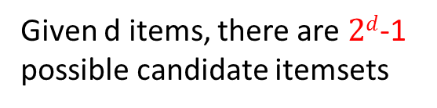
Itemset lattice (with 5 items)
Given d items, there are $2d$-1 possible candidate itemsets

Slide 30
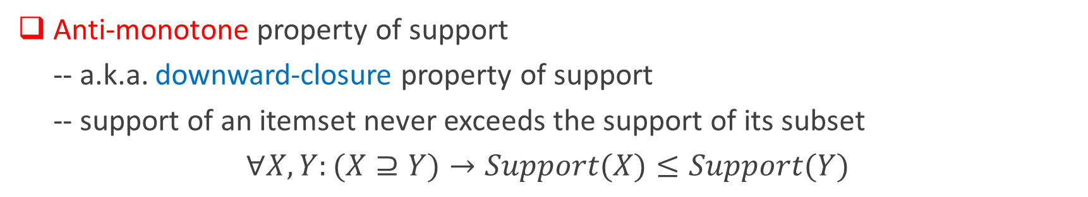
An Important Property
Anti-monotone property of support
-- a.k.a. downward-closure property of support
-- support of an itemset never exceeds the support of its subset
$∀X,Y:(X⊇Y)→Support(X)≤Support(Y)$
Apriori principle:
-- if an itemset is frequent, then all of its subsets must also be frequent
→ Conversely, if an itemset is infrequent, then all of its supersets must be infrequent

Slide 31
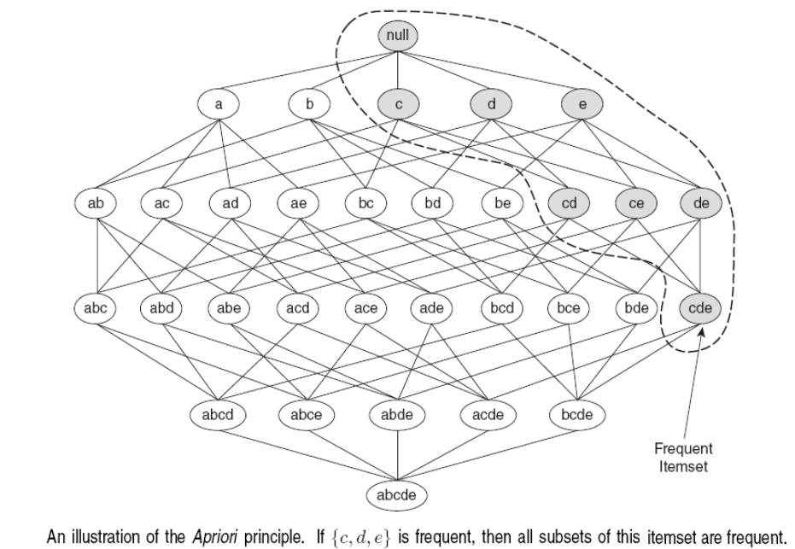

Slide 32
Support-based pruning
Found to be Infrequent
Pruned supersets
32

Slide 33
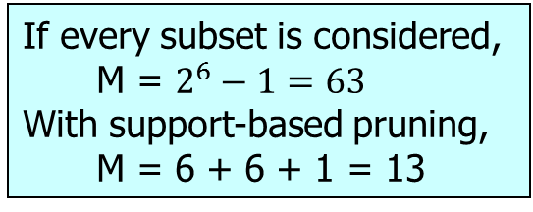
Example
Assume: Minimum Support Count = 3
Items (1-itemsets)
Pairs (2-itemsets)
(No need to generate candidates involving Coke or Eggs)
If every subset is considered,
M = $2^{6}−1=63$
With support-based pruning,
M = 6 + 6 + 1 = 13
Triplets (3-itemsets)

Slide 34
Apriori Algorithm
Frequent-Itemset Generation
Let k=1
Generate frequent itemsets of length 1
Repeat until no new frequent itemsets are identified
Generate length (k+1) candidate itemsets from length k frequent itemsets
Prune candidate itemsets containing subsets of length k that are infrequent
Count the support of each candidate by scanning the dataset
Eliminate candidates that are infrequent, leaving only those that are frequent

Slide 35
Association-Rule Generation
Given a frequent itemset L, find all subsets f ⊂ L such that the rule f → L – f
satisfies the minimum confidence requirement
-- e.g. If {A,B,C,D} is a frequent itemset, candidate rules:
ABC →D, ABD →C, ACD →B, BCD →A, AB →CD, AC → BD, AD → BC, BC →AD, BD →AC, CD →AB, A →BCD, B →ACD, C →ABD, D →ABC
-- If |L| = k, then there are 2^{k} – 2 candidate rules (ignoring L → ∅ and ∅ → L)
⇒ Association-rule generation is also computationally expensive!

Slide 36
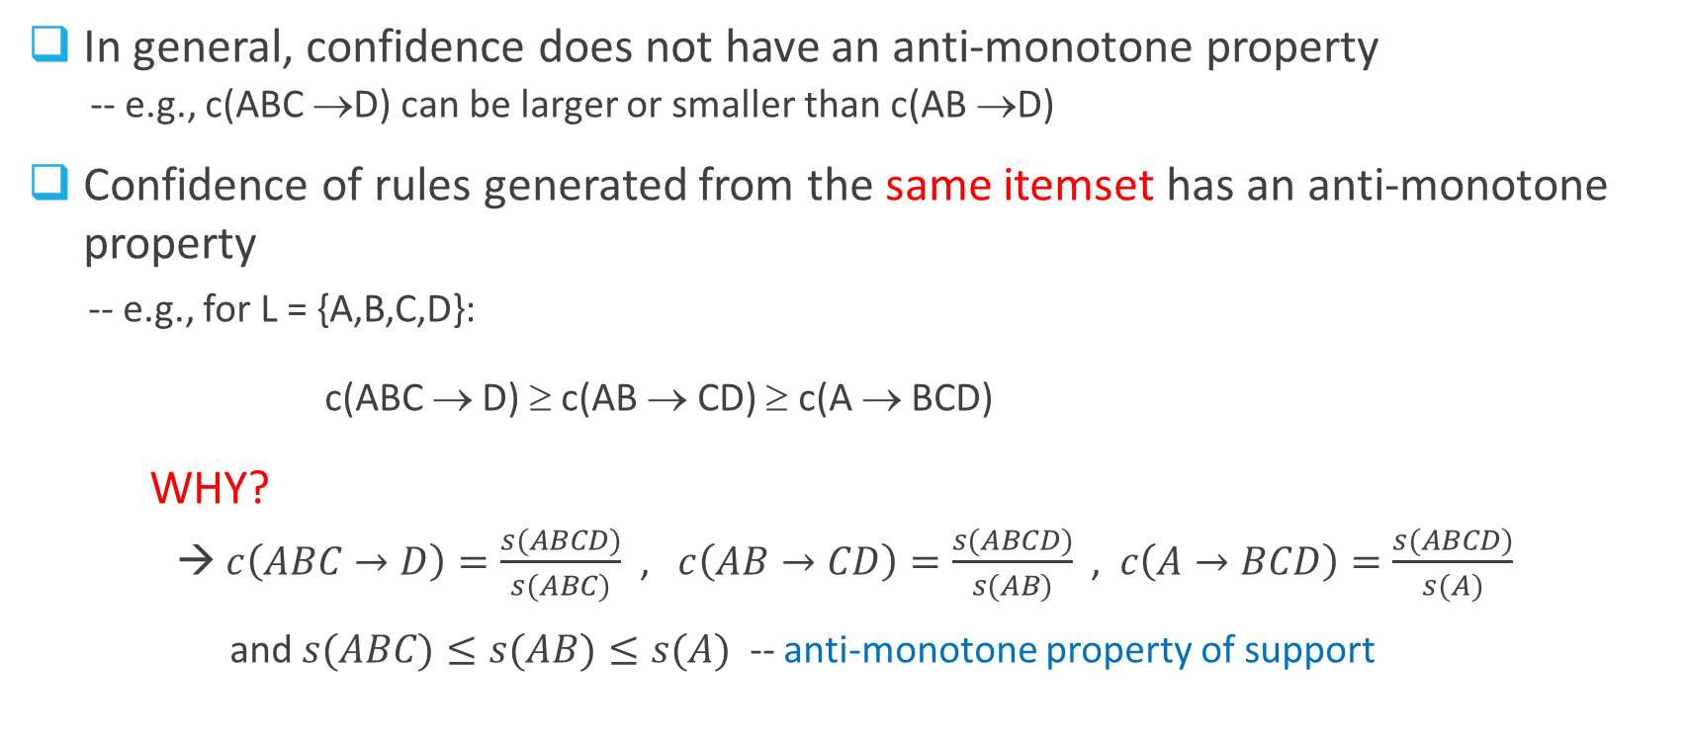
Anti-monotone Property
In general, confidence does not have an anti-monotone property
-- e.g., c(ABC →D) can be larger or smaller than c(AB →D)
Confidence of rules generated from the same itemset has an anti-monotone
property
-- e.g., for L = {A,B,C,D}: c(ABC → D) ≥ c(AB → CD) ≥ c(A → BCD)
WHY?
→ $c\left(ABC→D\right)=\frac{s(ABCD)}{s(ABC)}$ , $c\left(AB→CD\right)=\frac{s(ABCD)}{s(AB)}$ , $c\left(A→BCD\right)=\frac{s(ABCD)}{s(A)}$
and $s(ABC)≤s(AB)≤s(A)$ -- anti-monotone property of support

Slide 37
Confidence-based pruning
Low Confidence Rule
Pruned Rules
37

Slide 38
Apriori Algorithm
Association-Rule Generation
For each frequent k-itemset
Let m = 1
Generate 1-item-consequent rules
Repeat until no new rules are identified
Generate (m+1)-item-consequent candidate rules from m-item consequent rules
Prune candidate rules using the confidence-based pruning strategy
Calculate the confidence of each candidate rule
Eliminate candidates whose confidence is less then minconf

Slide 39
Broader Use of Association Rule Mining
In many other applications, you may apply this analysis
Movie database: how often some actors collaborate?
Social network: user groups who view/like/dislike the same posts
Variations
Spatio-temporal association patterns (co-location / cascading patterns)
Different stores often located in close proximity to each other
Gas stations (Kum-Go vs. Casey's, competitors)
Walmart vs. Subways (collaborators)
Animals habitats
Bird nests + specific tree types
Predators and preys (fox vs. Rabbits)
Unknown associations......
Crimes: Bar closing --> crimes
Note: association rules do not necessarily indicate causality. We are observing high-frequency co-occurrences of events but that does not tell us if they are cause-effect related (although sometimes very likely)

Slide 40
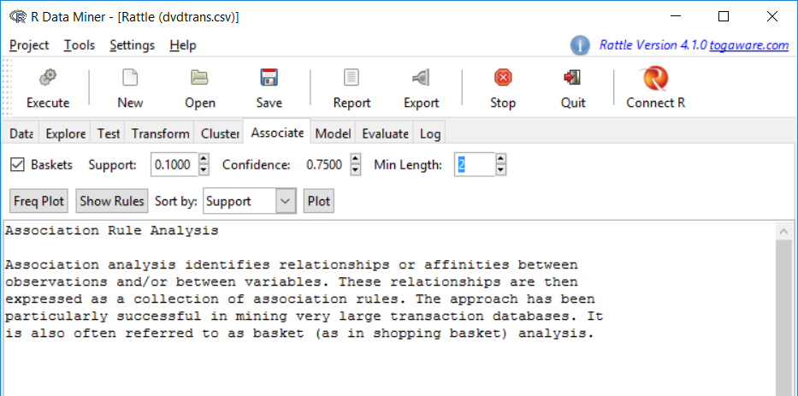
Quick example using DVD basket
You may lower support while raising Confidence in order to gain more rules, and sort by confidence or support or lift

Slide 41
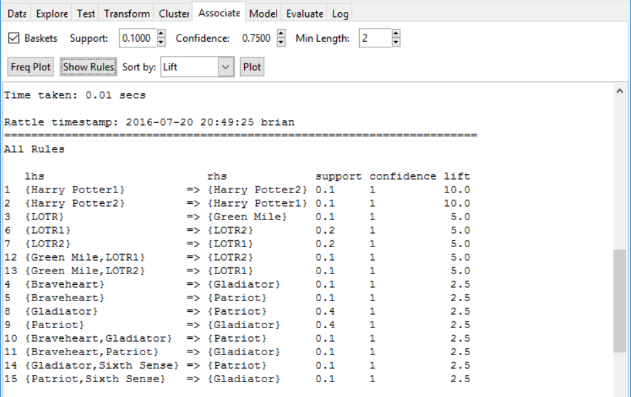
Quick example using DVD basket

