Slide 1
Data Science
MSCI:6070 Spring 2017
Lecture 11 (4/10/17)

Slide 2
Outline
Bias vs. Variance
Nearest Neighbor Classifier
Feature Selection
Final-exam Review

Slide 3
Bias vs. Variance

Slide 4
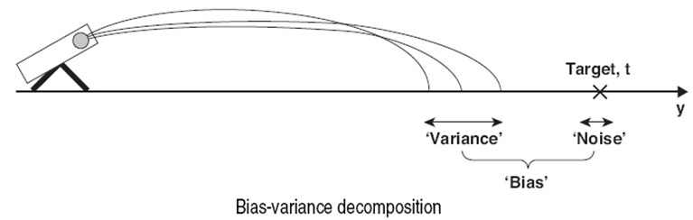
Bias-Variance Decomposition (1)
A formal method for analyzing the prediction error of a predictive model
Bias: distance between the target position and the average location where the projectile hits the floor
Variance: deviation of each launch from the average location
Noise: variability/uncertainty of the target position

Slide 5
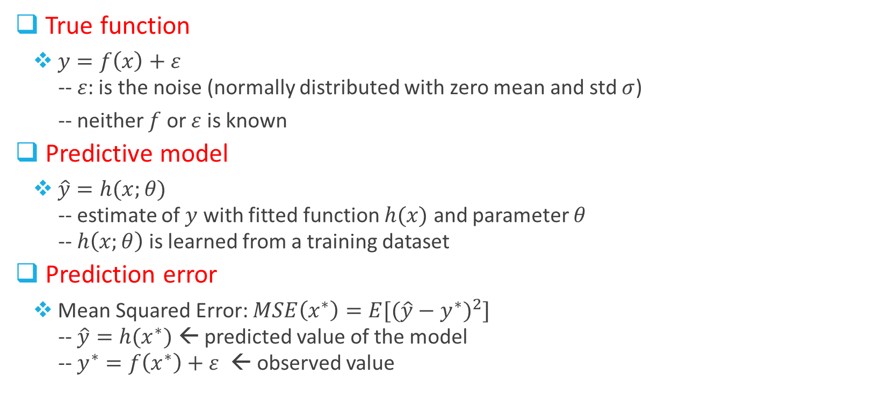
Bias-Variance Decomposition (2)
True function
$y=f\left(x\right)+ε$
-- $ε$: is the noise (normally distributed with zero mean and std $σ$)
-- neither $f$ or $ε$ is known
Predictive model
$\hat{y}=h(x;θ)$
-- estimate of $y$ with fitted function $h(x)$ and parameter $θ$
-- $h\left(x;θ\right)$ is learned from a training dataset
Prediction error
Mean Squared Error: $MSE\left(x^{∗}\right)=E[({\hat{y}−y^{∗})}^{2}]$
-- $\hat{y}=h(x^{∗})$ ← predicted value of the model
-- $y^{∗}=f\left(x^{∗}\right)+ε$ ← observed value

Slide 6
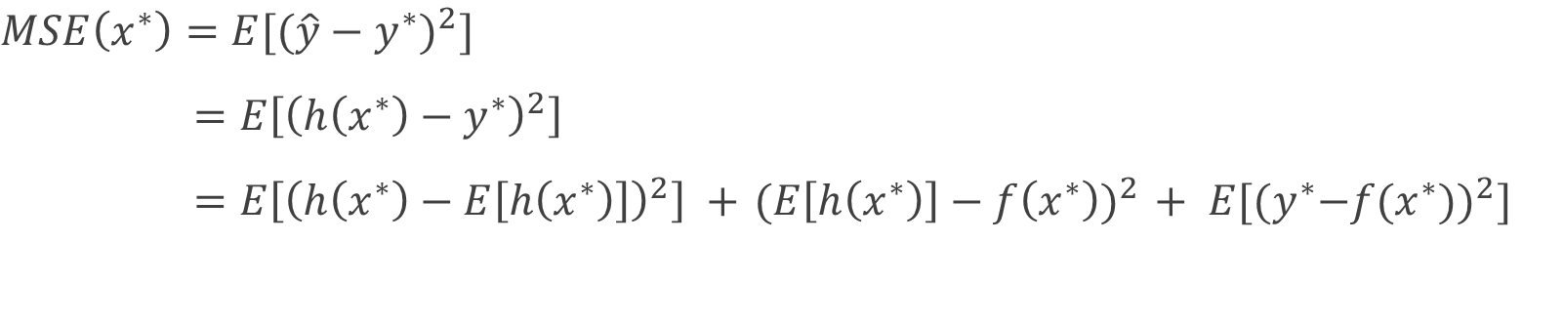
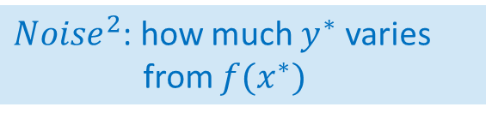
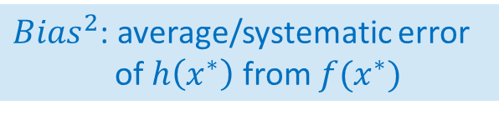
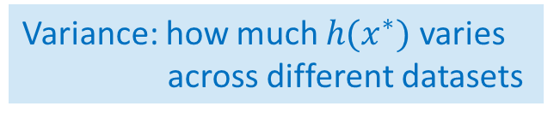
Bias-Variance Decomposition (3)
$$MSE\left(x^{∗}\right)=E[({\hat{y}−y^{∗})}^{2}]$$
$=E\left[{\left(h\left(x^{∗}\right)−y^{∗}\right)}^{2}\right]$
$=E\left[{\left(h\left(x^{∗}\right)−E\left[h\left(x^{∗}\right)\right]\right)}^{2}\right] +{ (E\left[h\left(x^{∗}\right)\right]−f\left(x^{∗}\right))}^{2} + E[{{(y}^{∗}−f(x^{∗}))}^{2}]$
Variance: how much $h(x^{∗})$ varies
across different datasets
${Bias}^{2}$: average/systematic error
of $h\left(x^{∗}\right)$ from $f(x^{∗})$
${Noise}^{2}$: how much $y^{∗}$ varies
from $f(x^{∗})$

Slide 7
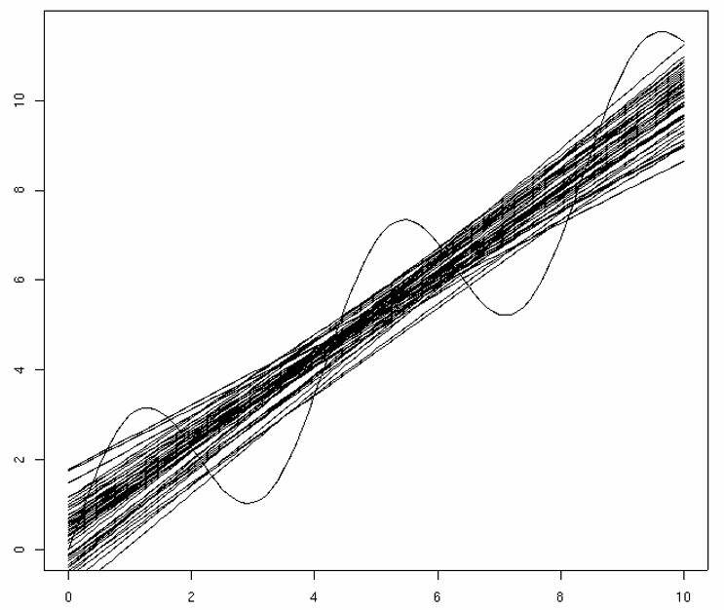
Example

Slide 8
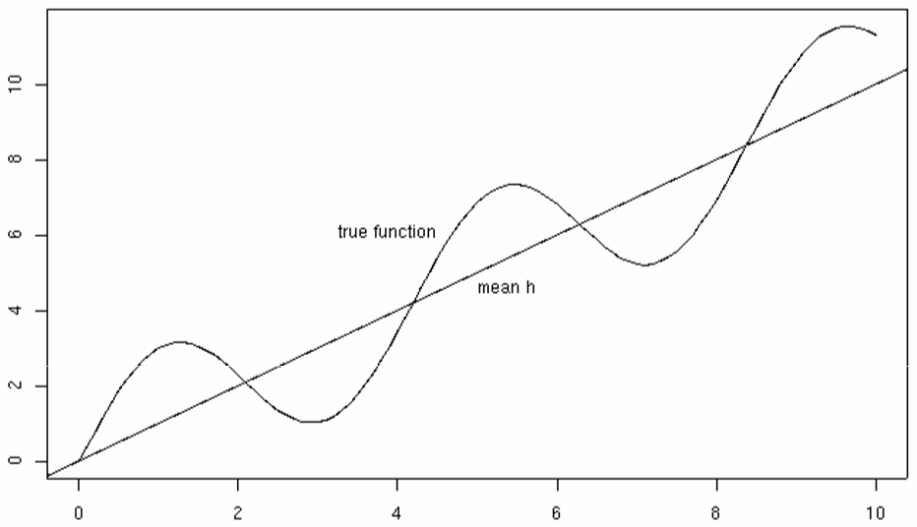
Bias

Slide 9
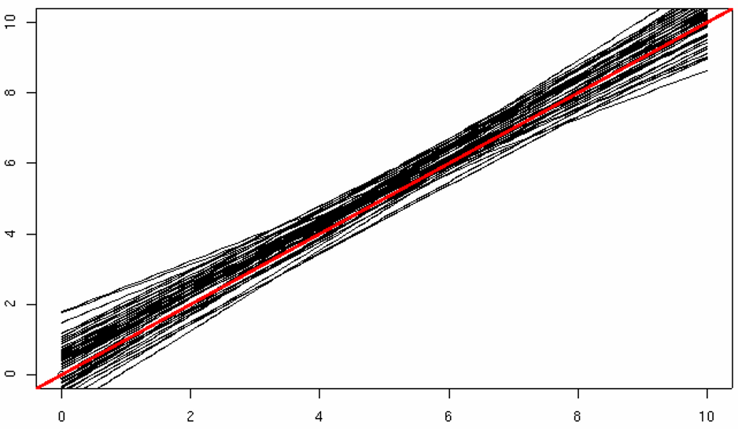
Variance

Slide 10
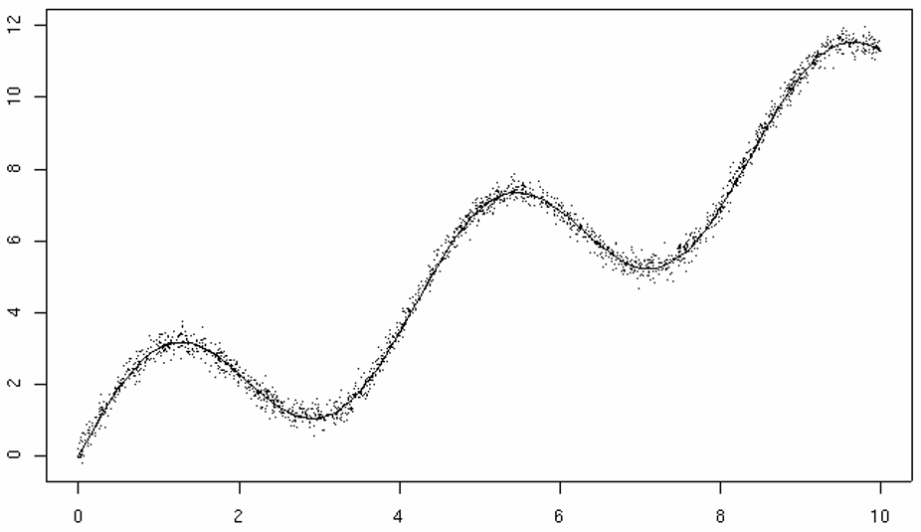
Noise

Slide 11
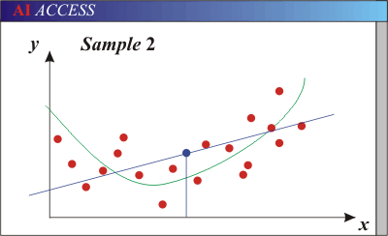
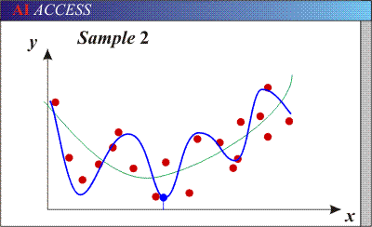
Bias-Variance Trade-off (1)
Models with too few parameters are inaccurate because of a large bias (not enough flexibility)
Models with too many parameters are inaccurate because of a large variance (too much sensitivity to the sample)

Slide 12
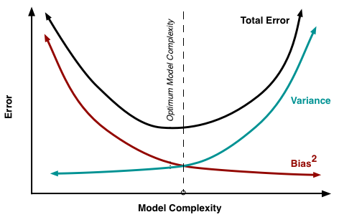
Bias-Variance Trade-off (2)
“simple” model → low variance, but
high bias
“complex” model → low bias, but
high variance

Slide 13
Bias-variance tradeoff (3)
Fixed training data
Underfitting
Overfitting
Error
Test error
Training error
High Bias
Low Variance
Complexity
Low Bias
High Variance

Slide 14
Bias-variance tradeoff (4)
In general, more training data
→ lower bias, lower variance
→ lower generalization error
Few training examples
Test Error
Many training examples
High Bias
Low Variance
Complexity
Low Bias
High Variance

Slide 15
Effect of Training Size
Fixed prediction model
Error
Testing
Generalization Error
Training
Number of Training Examples

Slide 16
Nearest Neighbor Classifier

Slide 17
KNN
Requires three things
The set of training data points
Distance metric to compute distance between points
The value of k, the number of nearest neighbors
To classify a new data point
Compute distance to all training points
Identify k nearest neighbors
Use class labels of nearest neighbors to determine the class label (e.g., majority vote)
Lazy learner (vs. eager learner)

Slide 18
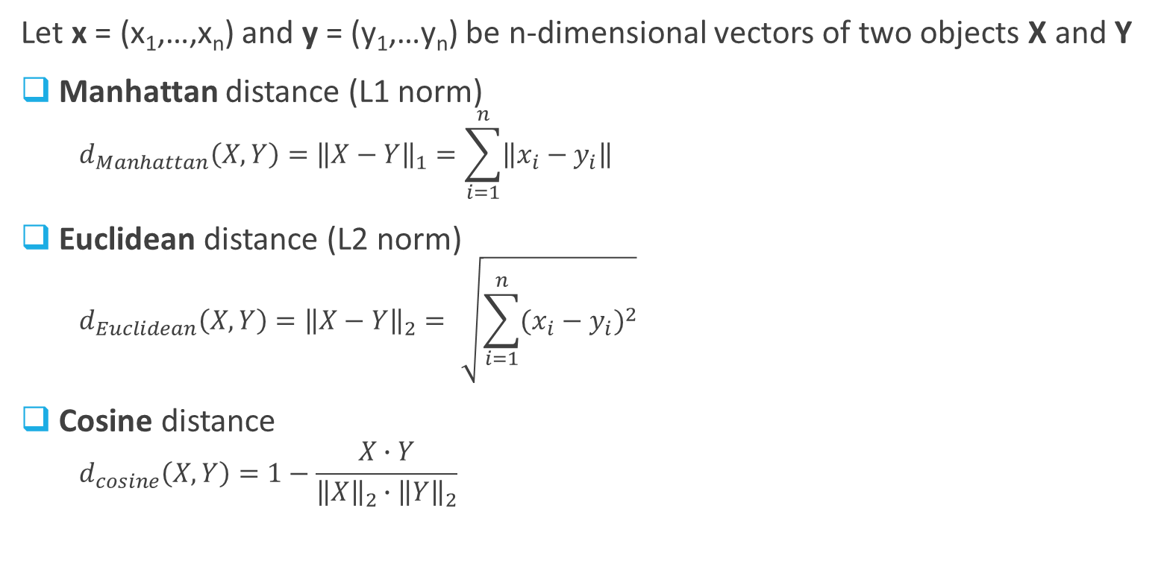
Distance Metrics
Let x = (x₁,…,x_{n}) and y = (y₁,…y_{n}) be n-dimensional vectors of two objects X and Y
Manhattan distance (L1 norm)
$$d_{Manhattan}\left(X,Y\right)={\left\|X−Y\right\|}_{1}=\sum_{i=1}^{n}{\left\|x_{i}−y_{i}\right\|}$$
Euclidean distance (L2 norm)
$$d_{Euclidean}\left(X,Y\right)={\left\|X−Y\right\|}_{2}=\sqrt{\sum_{i=1}^{n}{{(x_{i}−y_{i})}^{2}}}$$
Cosine distance
$$d_{cosine}\left(X,Y\right)=1−\frac{X∙Y}{{\left\|X\right\|}_{2}∙{\left\|Y\right\|}_{2}}$$
_{Cosine}
D₂
Y
_{Euclidian}
X
_{Manhattan}
Cosine similarity
D₁

Slide 19
K Nearest Neighbors
K-nearest neighbors of x are the K closest data points to x (based on the distance metric)

Slide 20
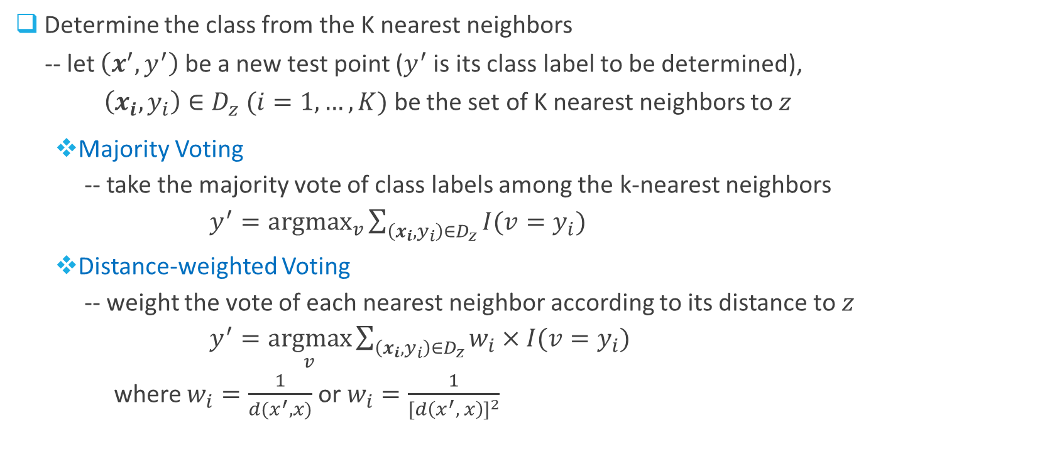
KNN Classification
Determine the class from the K nearest neighbors
-- let $\left(x^{′},y^{′}\right)$ be a new test point ($y^{′}$ is its class label to be determined),
$\left(x_{i},y_{i}\right)∈D_{z} (i=1,…,K)$ be the set of K nearest neighbors to $z$
Majority Voting
-- take the majority vote of class labels among the k-nearest neighbors
$y^{′}=\underset{v}{argmax}{\sum_{\left(x_{i},y_{i}\right)∈D_{z}}{I(v=y_{i})}}$
Distance-weighted Voting
-- weight the vote of each nearest neighbor according to its distance to $z$
$y^{′}=\underset{v}{argmax}{\sum_{\left(x_{i},y_{i}\right)∈D_{z}}{w_{i}×I(v=y_{i})}}$
where $w_{i}=\frac{1}{d(x^{′}, x)}$ or $w_{i}=\frac{1}{{[d\left(x^{′}, x\right)]}^{2}}$
Indicator function

Slide 21
Choose K
If K is too small, sensitive to noise points
If K is too large, neighborhood may include points from other classes
error
Tuning k: start w/ k=1, 3, 5
n
Complexity “k”
1

Slide 22
Characteristics of KNN
An instance-based learning
→ prediction based on specific training points
An lazy learner
→ no model is built until classifying a data point
→ testing is quite expensive
Prediction based on local info
→ without building a global model
→ susceptible to noise
Arbitrarily shaped decision boundaries
→ high variability
Appropriate distance measure
→ sensitive; wrong prediction
Scaling issues
→ normalize attributes (e.g., height vs. income)
-
X₂
+
+
+
+
-
-
+
-
-
-
-
+
-
-
-
X₁

Slide 23
Another Issue…
Curse of Dimensionality
-- high dimensional data can produce counter-intuitive results
-- dimensionality increases → data becomes increasingly sparse in the instance space
-- many classification/clustering algorithms have trouble with high-dimensional data
1 1 1 1 1 1 1 1 1 1 1 0
1 0 0 0 0 0 0 0 0 0 0 0
vs
0 1 1 1 1 1 1 1 1 1 1 1
0 0 0 0 0 0 0 0 0 0 0 1
d = 1.4142
d = 1.4142
Solution 1: Normalize the vectors to unit length
Solution 2: Feature Selection

Slide 24
Feature Selection

Slide 25
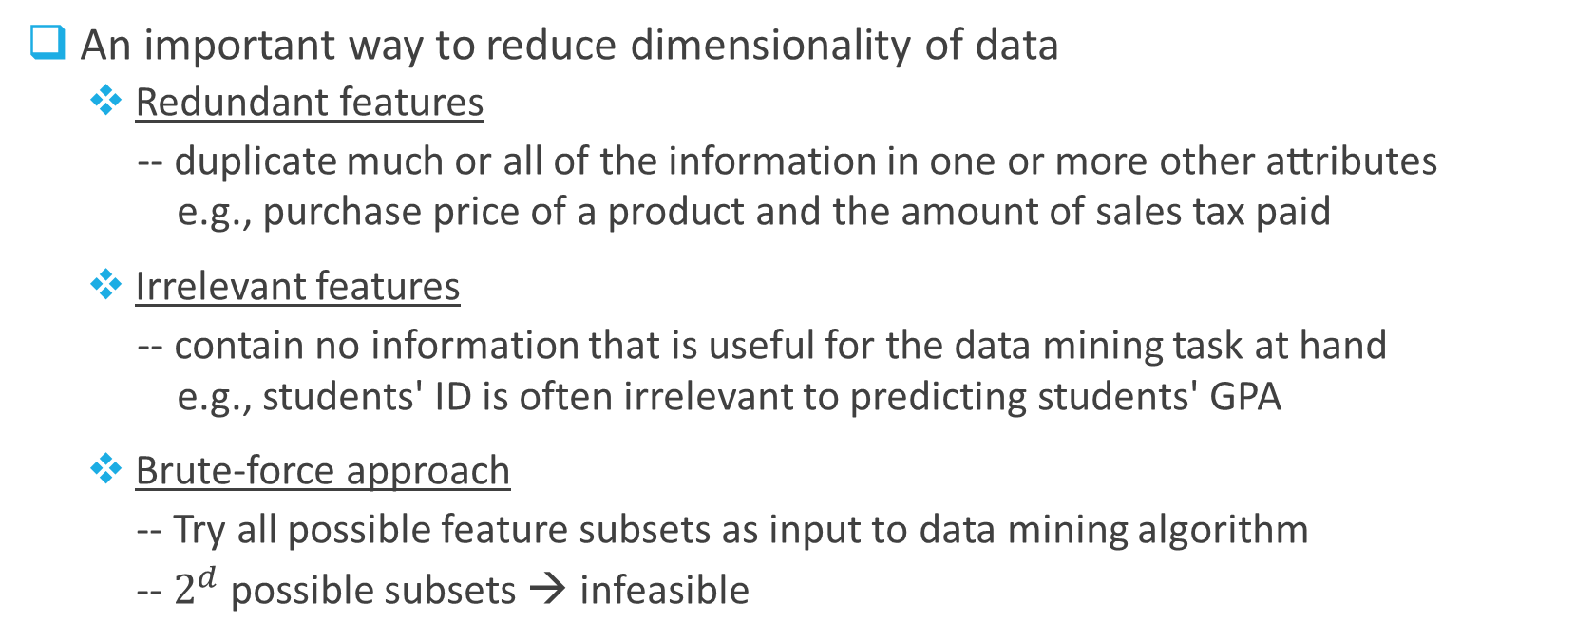
Approaches (1)
An important way to reduce dimensionality of data
Redundant features
-- duplicate much or all of the information in one or more other attributes
e.g., purchase price of a product and the amount of sales tax paid
Irrelevant features
-- contain no information that is useful for the data mining task at hand
e.g., students' ID is often irrelevant to predicting students' GPA
Brute-force approach
-- Try all possible feature subsets as input to data mining algorithm
-- $2^{d}$ possible subsets → infeasible

Slide 26
Approaches (2)
Embedded approach
-- Features are selected naturally as part of the data mining algorithm (e.g., DT)
Filter approach
-- Features are selected before data mining algorithm is run (e.g., pairwise correlation analysis)
Wrapper approach
-- Use the data mining algorithm as a black box to find best subset of attributes
sequential forward selection (SFS)
-- starting with an empty feature set, recursively add the “best” feature
until no improvement of generalization accuracy on the validation set
sequential backward elimination (SBE)
-- starting with a full feature set, continue to discard features one at a time
until no performance loss

Slide 27
Final-exam Review

Slide 28
Final Exam (1)
Time
4/17/17 (Monday)
120 minutes (from 6:30 pm – 8:30 pm)
Location
In class
Format
Close book, close notes: One cheat sheet (A4 size, two-sided)
No electronic devices except a calculator
Focus on 2nd half (materials after midterm, but may touch some concepts/algorithms from the 1st half)
T/F questions
Multiple-choice questions
Short-answer questions
Some computation questions

Slide 29
Final Exam (2)
Everything from the first half
ONLY basic concepts/algorithms
Model-performance visualization
Profit curves
ROC
CR curve
Lift curve
Given a cutoff (threshold) value, calculate the expected profit and lift value
Draw ROC and calculate AUC by hand

Slide 30
Final Exam (3)
Ensemble methods
Logical view, necessary conditions on base classifiers
Bagging vs. Boosting
→ understand how/why they work as well as their characteristics
Random Forests
→ how it works; what techniques are used
Cluster Analysis
Fundamental concepts: unsupervised/descriptive model; types of clustering/clusters
Distance metrics: Manhattan, Euclidean, cosine
K-means
→ how it works (clustering by hand)
→ how to choose initial centroids
→ how to choose K (elbow method)
→ how to interpret (English description)
Agglomerative hierarchical clustering
→ how it works
→ cluster proximity metrics: MIN, MAX,
Group Average, Ward’s method
→ draw dendrogram

Slide 31
Final Exam (4)
Association Analysis
Frequent itemset,
→ definition; support(X)
Association rule
→ definition; support(X→Y); confidence(X→Y); lift(X→Y); leverage(X→Y)
→ Anti-monotone property; Apriori principle; support/confidence-based pruning
Today’s lecture
Bias, variance: decomposition, trade-off
KNN
→ how it works
→ voting schemes; characteristics
Feature selection
→ different approaches

