Slide 1
Data Science
MSCI:6070 Spring 2017
Lecture 2 (1/30/17)

Slide 2
R/RStudio/Rattle
R
A sophisticated statistical software package (http://www.r-project.org/)
-- easy to install, state-of-the art, free and open source
Install package: Install.packages(“packagename”)
Load package: library(packagename)
RStudio
A nice integrated development environment (IDE) for R (http://www.rstudio.com/)
Many appealing features, e.g. syntax-highlighting editor, tools for plotting and debugging, etc.
Rattle
A powerful DM tool built on R (http://rattle.togaware.com/)
It has a simple tab-based user interface, mimicking the CRISP-DM

Slide 3
R/RStudio/Rattle
Starting RStudio
Console window
-- aka command window: type your commands after the “>” prompt
Enviroment/History window
-- show the data/values in the memory or what has been typed before
Files/Plots/Packages/Help window
-- open files, view plots, install and load packages or use the help function
Starting Rattle
Load Rattle into the R library
-- library(rattle)
Run Rattle
-- rattle()

Slide 4
Rattle GUI
A simple, tab-based GUI to a powerful suite of tools for DM
Menus
Project
-- a packaging of a dataset, variable selections, and models
-- open and save a project for future resumption of the work
-- typically saved to a binary file with a rattle extension
-- Access to the Open/Save options: the Project menu or buttons on the toolbar
Tools
-- provide alternative access to those tabs (as well as Execute and Export buttons)
Settings
-- check out the difference with “Advanced Graphics" on and off (for plots)
-- use the more modern “Cairo Graphics Device”
Help
-- extensive help is available

Slide 5
Rattle GUI
Toolbar
Execute
-- All action is initiated with an Execute
-- Always make sure you have clicked the Execute button
-- F2 key is the keyboard shortcut for Execute
New
-- clear current project/dataset to have a fresh Rattle
Quit
-- exit from Rattle
-- won’t terminate R
-- To quit R, type q() in RStudio Console window

Slide 6
Rattle GUI
Tabs
-- working from Data to Evaluate completes 3 phases of CRISP-DM
-- Today we focus on exploratory data analysis (EDA)
to get a basic understanding of the data through variable summaries and plots
Data
-- load a dataset into Rattle
-- Spreadsheet option allows us to load data from a CSV file
-- CSV: simplest and most commonly used data format
downside - no explicit metadata
HW1 adult dataset – you need to add the header line – listing variable names
Explore
-- Summary: textual summaries of the dataset (basic summaries, skewness, Kurtosis)
-- Distributions: various plots to explore the distribution of each variable
box plot, histogram, bar plot, dot plot, etc.
-- Correlation: pairwise correlations between numeric variables
Log
-- record the R code Rattle passes on to R [copy/paste to R console or export it as an R script file

Slide 7
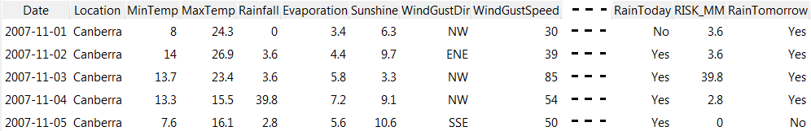
Sample Dataset: weather.csv
Historic data from a weather monitor station in Canberra, Australia
General Info
-- 366 observations
-- 24 variables
-- Goal: use this dataset to build a model that predicts whether it will rain tomorrow
-- R commands: dim(weather), weather[1:5, 3:7]

Slide 8
Load Data
If you know where the dataset is located
-- Use the Spreadsheet option under Data tab to load from a CSV file
-- Click the Filename button
-- Browse to the CSV file, and click the Open button
-- Click Execute to load the data into Rattle
You might not know where it is…
-- Click the Execute button
-- Rattle notices that no CSV file has been specified
-- It asks whether you wish to use the sample dataset
-- Click on Yes
system.file("csv", "weather.csv", package="rattle")
[1] "C:/Users/wangw/Documents/R/win-library/3.3/rattle/csv/weather.csv"

Slide 9
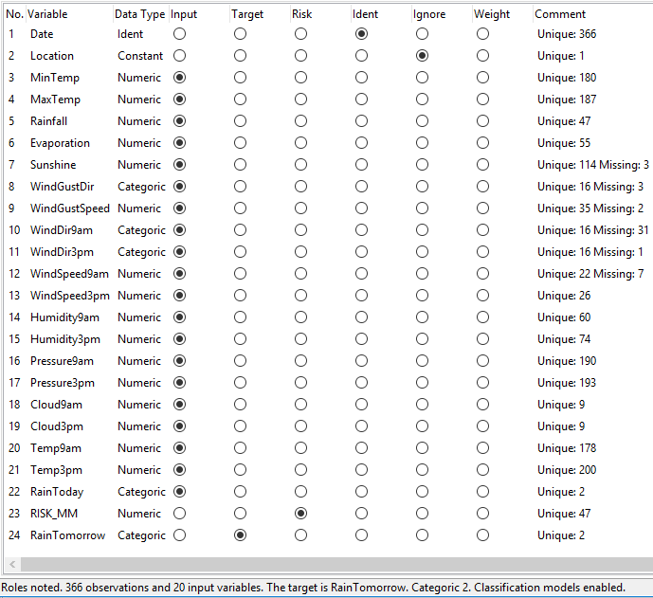
Simple Summary
Status bar
Variables
name (from header line)
data type
roles (Help→Data→Roles)
-- Date (identifier)
-- Location (constant, ignore)
-- MinTem (numeric, input)
-- WindGustDir (categoric, input)
-- RainTomorrow (categoric, target)
comment
-- # of unique values
-- # of missing values
--- Click View to show the data

Slide 10
Data Partitioning
3 independent subsets
training dataset
-- build the model
validation dataset
-- assess the performance of the model
-- fine-tune the model
testing dataset
-- reevaluate the model
-- also called holdout or out-of-sample dataset
-- provide an unbiased estimate of the true performance
Random numbers
-- used to select samples for data partitioning (and reduction)
-- different seeds generate different sequences of random numbers
-- use different seeds to explore sensitivity of the model
-- Each of you selects a different seed for HW1 (record the seed in your report)
Important notes:
Validation dataset can NOT be used for final testing;
Training dataset can NOT be used for testing or validation

Slide 11
Explore Data: Summary (1)
Summary
Numeric variables
-- min, 1st quartile, median, mean, 3rd quartile, max
Categorical variables
-- show all different levels
-- List the top few most frequent levels with
their frequency counts
Missing values (NAs)
-- counted and reported
Describe
-- install.packages(“Hmisc”), library(Hmisc)
-- more detailed summary: 5%, 10%, 90%, 95%
Basics
-- install.packages(“fBasics”), library(fBasics)
-- even more detailed summary of numeric variables
q% - quantile (0<=q<=100): The value for which q% of the values are smaller and 100-q% are larger. The median is the 50% quantile
Quartiles: 25%-quantile (1st), median (2nd), 75%-quantile (3rd)
Interquartile range: 3rd quantile - 1st quantile (the middle half)
> summary(weather)
> describe(weather[3])
> basicStats(weather[3])

Slide 12
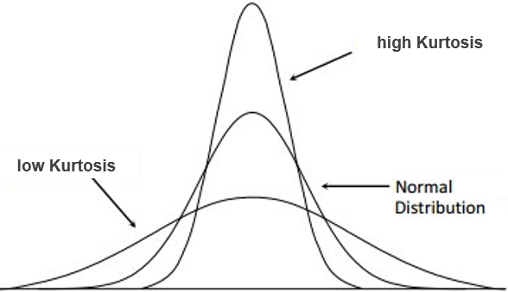
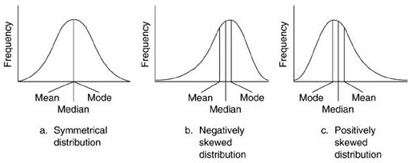
Explore Data: Summary (2)
Kurtosis
nature of the peaks of distribution
A larger value indicates
-- sharper peak
-- smaller variance and/or fewer extreme values
-- positive value: acute peak
-- negative value: flat peak
Skewness
how asymmetrically the data is distributed
When it is greater than 1,
-- quite an obvious extended spread in one direction
-- positive: the spread is more to the right (longer right tail)
-- negative: more to the left (longer left tail)
-- the greater skewness, the greater distortion
(the worse for DM in generally)

Slide 13
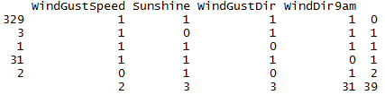
Explore Data: Summary (3)
Missing Values
present challenges to DM
many reasons for missing values
-- not recorded purposely (e.g., spouse income for a housewife)
-- not available when recording
-- hard to collect (e.g., an expensive medical test)
knowing the reason is important
-- help guide us in dealing with the missing values
> install.packages("mice")
> library(mice)
> md.pattern(weather[,7:10]
# of rows
# of missing entries
a pattern of missing values

Slide 14
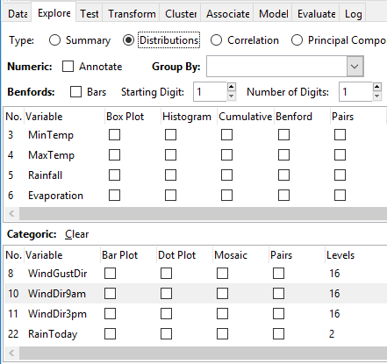
Visualizing Distributions
For numeric attributes:
Box Plot
Histogram
For categorical attributes:
Bar Plot
Dot Plot
Mosaic Plot
Scatter Plots

Slide 15
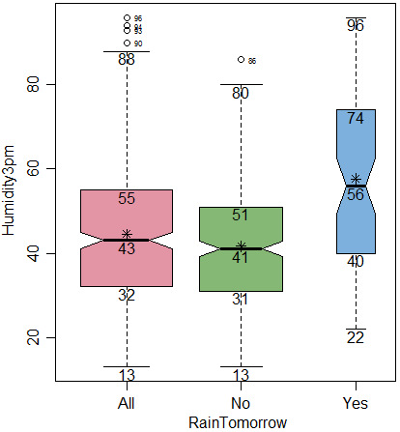
Box Plot
You can save the plot to an image file using “Export” in RStudio
Provide a graphical overview of the basic summaries
of data distribution
-- aka box-and-whisker plot
-- bottom extent: 1st quartile (25th quantile)
-- top extent: 3rd quartile (75th quantile)
-- extent: interquartile range (Q3-Q1)
-- thicker horizontal line: mean
-- minimum: mean – 1.5x(Q3-Q1)
-- maximum: mean + 1.5x(Q3-Q1)
-- outliers: “<min” or “>max”
-- notch: 95% CI for the median
-- asterisk: mean
-- width: proportional to size of respective subsets
large gap between median and mean is
an indicator of skewed distribution
median-YES is significantly different
from median-NO → Humidity3pm is an indictor

Slide 16
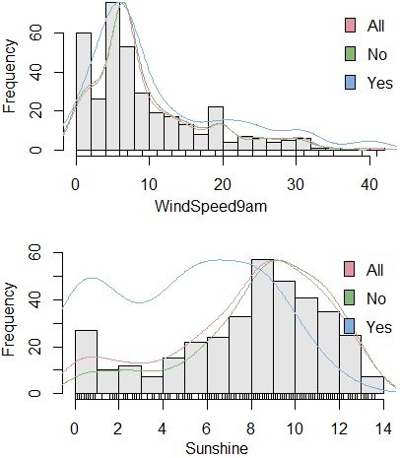
Histogram (1)
Provide a graphical view of the spread of the data,
including an idea of its skewness and kurtosis
Vertical bars
-- range of variable: equal-length intervals
-- the frequency of each interval is displayed as the bar
-- R chooses both the partitioning and the label
Line plot
-- show so-called density estimate
-- smooth out the bars
-- display a more accurate distribution
Rug plot
-- a single-dimensional plot of data along the number line
-- show exactly where data points lie
both clearly skewed:
-- longer right/left tail, positive/negative? [Check]
Kurtosis:
-- WindSpeed9am: sharper peak, larger? [check]
-- Sunshine: more spread-out peak, smaller? [check]

Slide 17
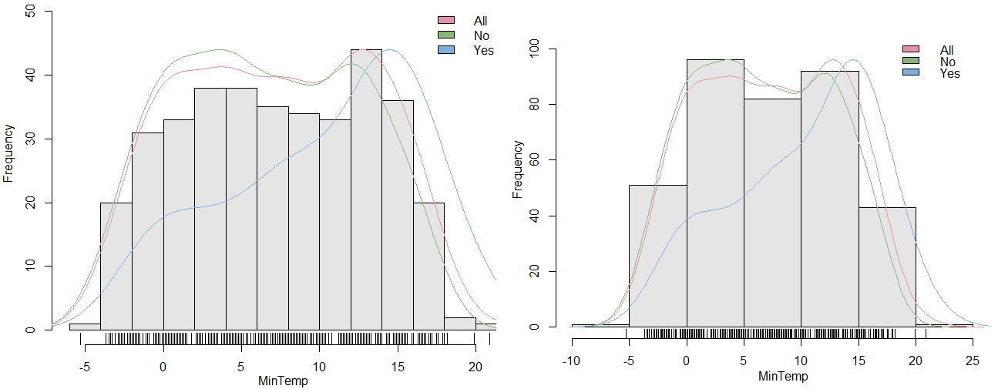
Histogram (2)
The number of bins/intervals is an important parameter
Exercise: using Log tab → copy/paste the command → customize it → compare results
hist(…, ylim=c(0, 56.13), breaks=“fd”, …)
hist(…, ylim=c(0, 100), breaks=5, …)

Slide 18
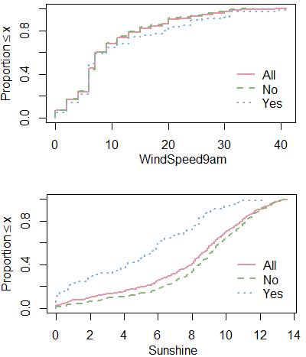
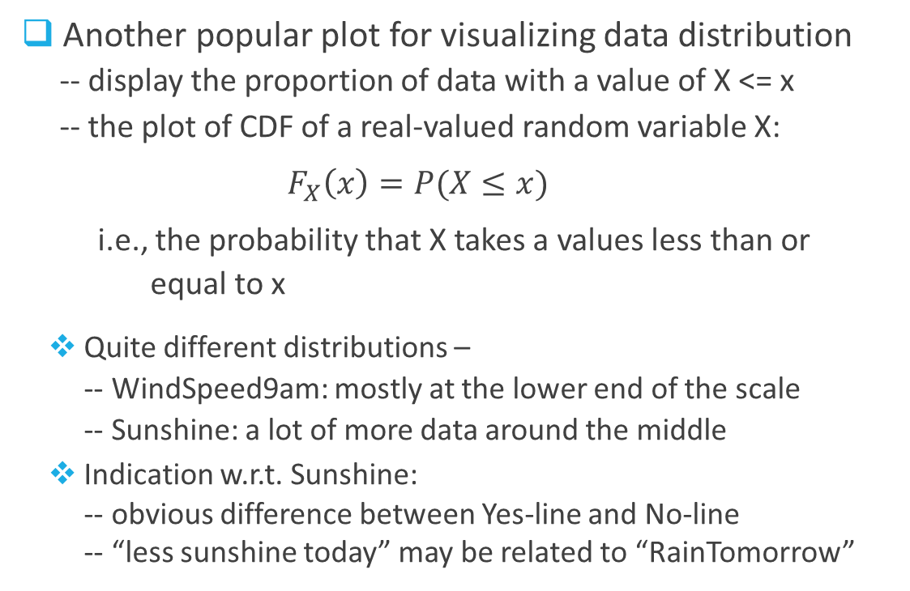
Cumulative Distribution Plot
Another popular plot for visualizing data distribution
-- display the proportion of data with a value of X <= x
-- the plot of CDF of a real-valued random variable X:
$F_{X}\left(x\right)=P(X≤x)$
i.e., the probability that X takes a values less than or
equal to x
Quite different distributions –
-- WindSpeed9am: mostly at the lower end of the scale
-- Sunshine: a lot of more data around the middle
Indication w.r.t. Sunshine:
-- obvious difference between Yes-line and No-line
-- “less sunshine today” may be related to “RainTomorrow”

Slide 19
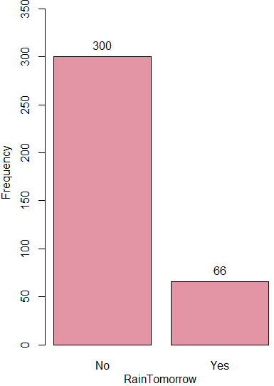
Bar Plot (1)
Much like a histogram, but for categoric variables
-- X-axis: all values of the categoric variable
-- Y-axis: count of observations of each value
-- When target variable is active, additional bars are
drawn for each value of the target variable
Target variable
-- set the role RainTomorrow to Input
-- highly skewed: >80% have “No RainsTomorrow”
-- Typical issue in DM: imbalanced class distribution
e.g., spam detection (< 1% are spams)
Note: 1. most data mining algorithms work best for relatively balanced classes;
2. Strategies: oversample the minority class and/or undersample the majority class

Slide 20
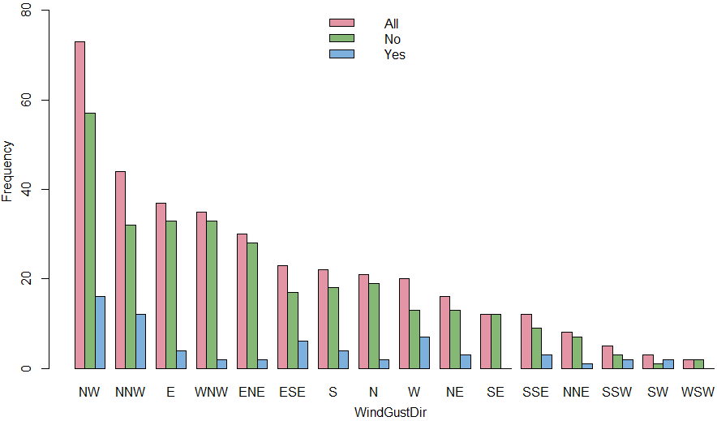
Bar Plot (2)
WindGustDir
-- set the role RainTomorrow
back to Target
-- 16 different values/levels
-- the bars are sorted
from left to right
in descending order of
the frequency

Slide 21
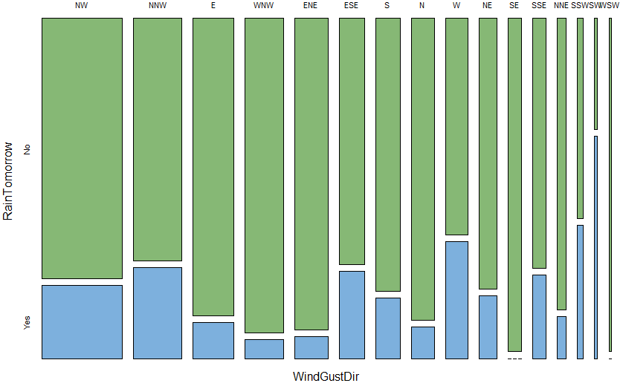
Mosaic Plot
An effective way to visualize the
distribution of the data of one
variable (V1) over the values of
another variable (V2)
-- find out any relationship between
these variables
-- V1 and V2 are categrical
-- V2 is usually the target variable
-- area of each bar is proportional to
the frequency of the corresponding
value/level of V1
-- split in each bar is proportional to
the frequency of the corresponding
value/level of V2
insight:
-- Wind gust of SW has the highest
proportion of YES (RainTomorrow),
followed by SSE, then W

Slide 22
Correlation
Correlation Analysis
A tool used to examine the statistical relationship between two sets of data
e.g., Does the price of product increase when there are more demands?
Do people with higher age also have higher income?
Does house rent decrease when the distance to downtown increases?
Can indicate a predictive relationship or a causal relationship
e.g., electricity demand and weather - extreme weather leads to higher electricity demand
Correlation does NOT mean causality
i.e., correlation between A and B does not imply A leads to B or vice versa
e.g., the size of a person’s palm is negatively correlated with how long he/she will live
(True/False?)

Slide 23
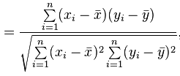
Correlation Measure
Pearson Correlation Coefficient (PCC)
Corr(A, B) > 0 means A and B have the same trend (positively correlated)
Corr(A, B) = 0 means no correlation – A and B are independent of each other
Corr(A, B) < 0 means A and B have opposite trend (negatively correlated)
Corr(A, B) is in between -1 and 1.
Corr(A, B)

Slide 24
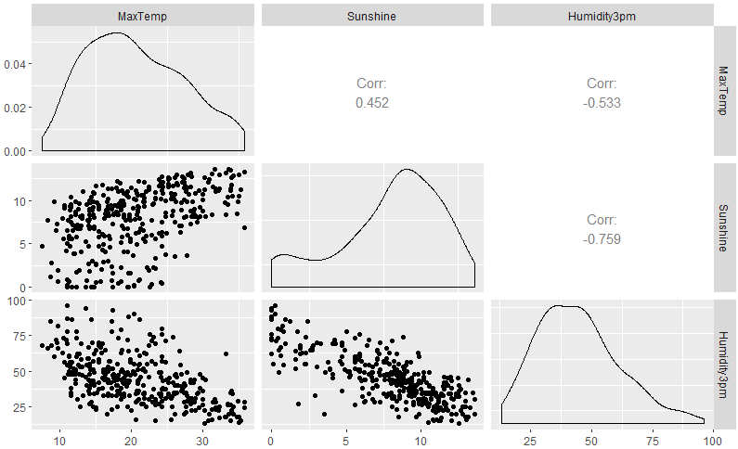
Pairs/Scatter Plot
Compare variables pairwise to
explore for interesting
correlations among them
diagonal
-- density plot
lower left
-- pairwise scatter plots
upper right
-- correlation coefficients
insights:
-- positive correlation between
Sunshine and MaxTemp
-- stronger (negative) correlation
between Sunshine and
Humidity3pm

Slide 25

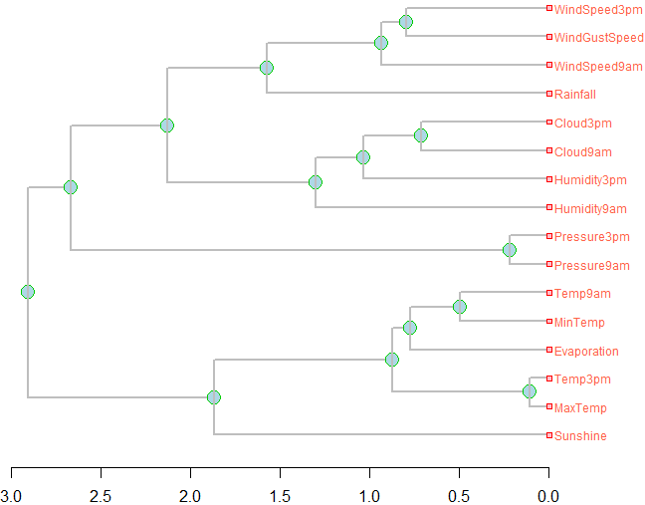
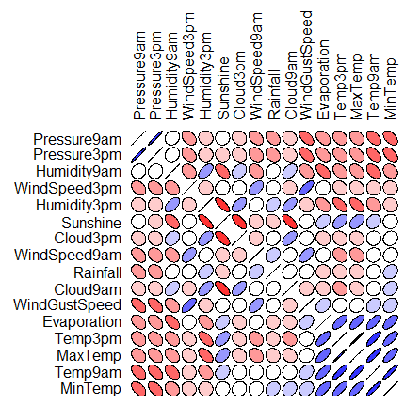
Correlation Plot
Calculate the correlation between each pair of numeric variable
text window: numerical values of the correlation coefficients [a symmetric matrix]
graphic plot: shape and color indicating the degree of correlation
dendrogram: hierarchical correlation

Slide 26

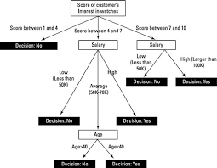


Predictive Modeling
Input (X)
Model (f(X))
Output (Y)
X: features
attributes
explanatory
independent
Y: target
dependent
Modeling
(induction)
X
Xold
A formula learned from old data for estimating the unknown value of interest for some new data
Predicting
(deduction)
Xnew

Slide 27
Supervised Segmentation
Classification
Given a set of training data with known labels for the target variable (usually a nominal variable),
generate a predictive model (classifier) to predict which class an unseen/new data belongs to
e.g., Will the customer churn or not when her contract expires?
Is this email a spam?
Which customers are likely not to pay off their account balance (write-offs)?
Name | Balance | Age | Employed | Write-off?
Mike | $200,000 | 42 | no | yes
Mary | $35,000 | 33 | yes | no
Claudio | $115,000 | 40 | no | no
Robert | $29,000 | 23 | yes | yes
Dora | $72,000 | 31 | no | no
Tim | $60,000 | 36 | yes | ?
Binary classification problem

Slide 28
Supervised Segmentation
Observations
-- the value of the target variable is determined by the input attributes
-- only attributes that are correlated with the target variable contain the information
about the value of the target variable
-- different attributes provide different amount of information about the target variable
Fundamental concepts
-- identify informative attributes w.r.t the target variable
-- segment data by progressive attribute selection
Questions
-- Whether an attribute contains important info about the target variable?
-- If yes, how much info does it contain (so that we can rank the attributes)?

Slide 29
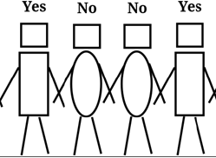

Select Informative Attributes
Attributes:
head-shape: square, circle
body-shape: rectangle, oval
body-color: black, white
Target variable:
write-off: Yes, No
Information is a quantity that reduces uncertainty about something
Which attribute is most informative or most useful for distinguishing between “Yes” and “No”?
If we split our data according to this attribute, we would like the resulting subsets to be as pure (homogenous) as possible w.r.t. the target variable.
29

Slide 30
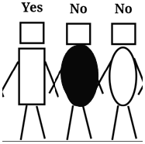

Select Informative Attributes
we obtain two subsets (one is pure, the other is impure) by splitting the set of people according to attribute head shape
What if the attribute body color?
head shape = square
head shape = circle
30

Slide 31
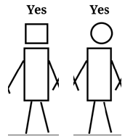
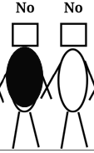
Select Informative Attributes
we obtain two pure subsets by splitting the set of people according to attribute body shape
body shape = rectangle
body shape = oval
31

Slide 32
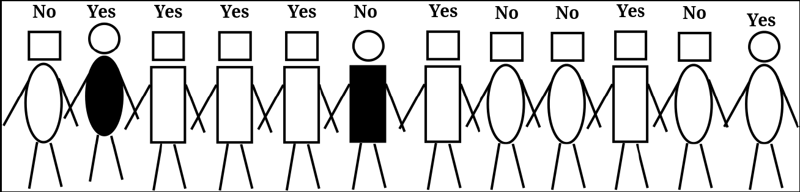

Impure Segments (1)
body shape = rectangle
5 Yes
1 No
body shape = oval
2 Yes
4 No
32

Slide 33
Impure Segments (2)
5 Yes
4 No
head shape = rectangle
head shape = circular
2 Yes
1 No
Compared with splitting on body shape, which one is better (purer)?

Slide 34

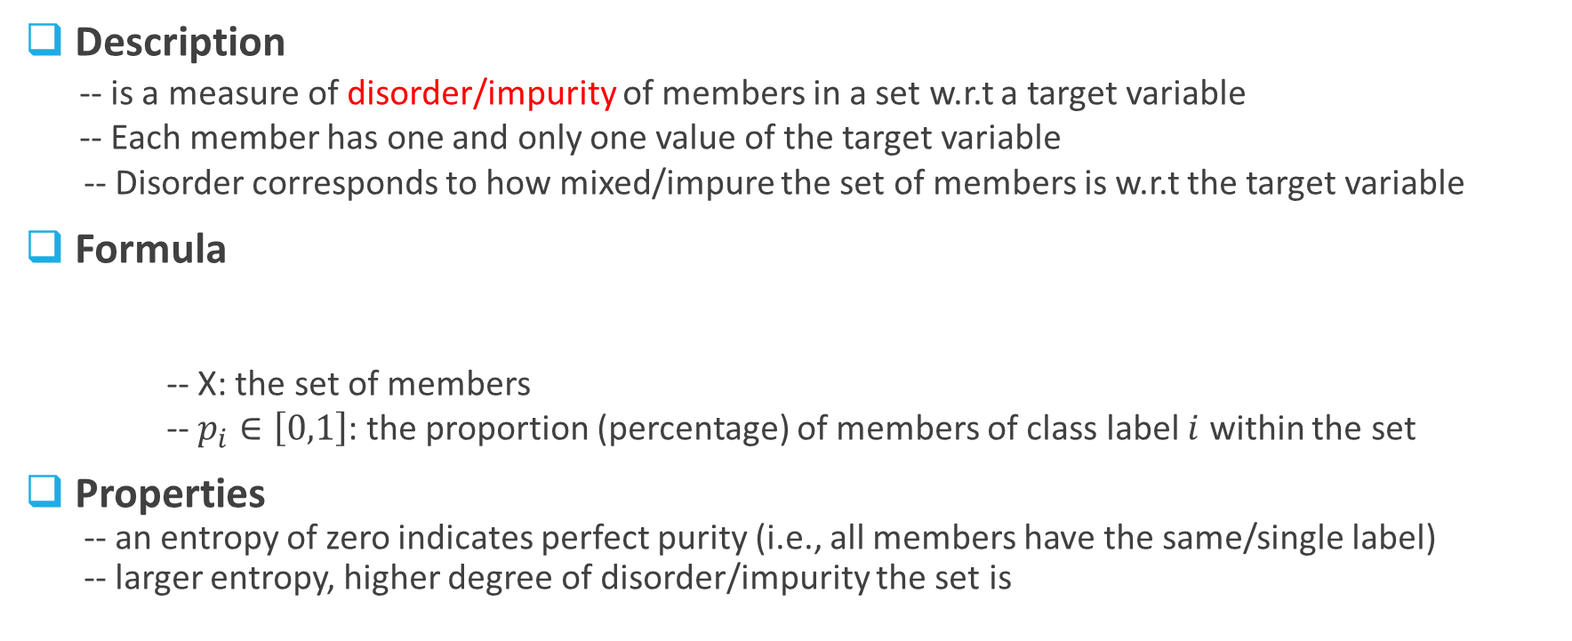
Entropy (1)
Description
-- is a measure of disorder/impurity of members in a set w.r.t a target variable
-- Each member has one and only one value of the target variable
-- Disorder corresponds to how mixed/impure the set of members is w.r.t the target variable
Formula
-- X: the set of members
-- $p_{i}∈\left[0,1\right]$: the proportion (percentage) of members of class label $i$ within the set
Properties
-- an entropy of zero indicates perfect purity (i.e., all members have the same/single label)
-- larger entropy, higher degree of disorder/impurity the set is

Slide 35
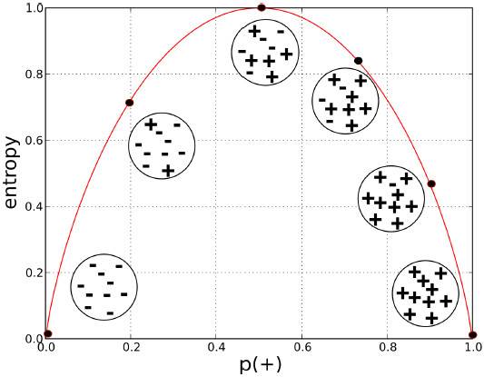


Entropy (2)
For a two-class set
$H\left(S\right)=−p_{+}\log_{2}{p_{+}−p_{−}\log_{2}{p_{−}}}$
-- $p_{+}=1−p_{−}$
-- $H(S)$ ranges from 0 to 1
-- When $p_{+}=0 \left(or 1\right), H\left(S\right)=0$ (pure)
-- When $p_{+}=0.5, H\left(S\right)=$1 (maximal disorder)
Check
-- when $p_{+}=0.5, p_{−}=0.3$

Slide 36




Exercise
H(X) = 0.98 ?
body shape = rectangle
5 Yes
1 No
body shape = oval
2 Yes
4 No
32

Slide 37
More Practice
The weather forecast says with a probability of 80% it will rain tomorrow.
What is the entropy of this forecast?
In a medical study, Group A has 70 smokers and 30 non-smokers and Group B has 85 smokers and 15 non-smokers. Without computing them, can you tell which group has larger entropy?
Jim is inviting a few friends to his house and he wants to collect information
about their attendance. Mike says he will come for 100% sure, Emily says she
has 50% chance of coming and John says he is busy and only has 20% chance
of coming. Whose answer should a host like Jim hate most?

