Slide 1
Data Science
MSCI:6070 Spring 2017
Lecture 3 (2/6/17)

Slide 2

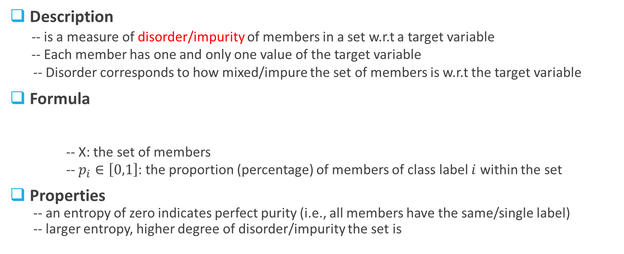
Entropy (1)
Description
-- is a measure of disorder/impurity of members in a set w.r.t a target variable
-- Each member has one and only one value of the target variable
-- Disorder corresponds to how mixed/impure the set of members is w.r.t the target variable
Formula
-- X: the set of members
-- $p_{i}∈\left[0,1\right]$: the proportion (percentage) of members of class label $i$ within the set
Properties
-- an entropy of zero indicates perfect purity (i.e., all members have the same/single label)
-- larger entropy, higher degree of disorder/impurity the set is

Slide 3
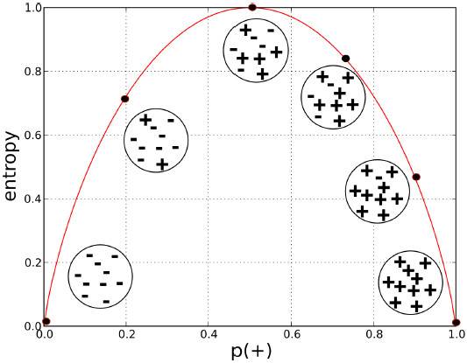


Entropy (2)
For a two-class set
$H\left(S\right)=−p_{+}\log_{2}{p_{+}−p_{−}\log_{2}{p_{−}}}$
-- $p_{+}=1−p_{−}$
-- $H(S)$ ranges from 0 to 1
-- When $p_{+}=0 \left(or 1\right), H\left(S\right)=0$ (pure)
-- When $p_{+}=0.5, H\left(S\right)=$1 (maximal disorder)
Check
-- when $p_{+}=0.7, p_{−}=0.3$

Slide 4

Entropy (3)
For a two-class set
$H\left(S\right)=−p_{+}\log_{2}{p_{+}−p_{−}\log_{2}{p_{−}}}$
-- $p_{+}=1−p_{−}$
-- $H(S)$ ranges from 0 to 1
-- When $p_{+}=0 \left(or 1\right), H\left(S\right)=0$ (pure)
-- When $p_{+}=0.5, H\left(S\right)=$1 (maximal disorder)
Check
-- when $p_{+}=0.7, p_{−}=0.3$
en <- function(y,n) {
if(y == 0)
{
e <- 0
}
else if(n == 0)
{
e <- 0
}
else
{
t <- y+n
py <- y/t
pn <- n/t
e <- 0 - (py*log(py,2) + pn*log(pn,2))
}
return(e)
}

Slide 5

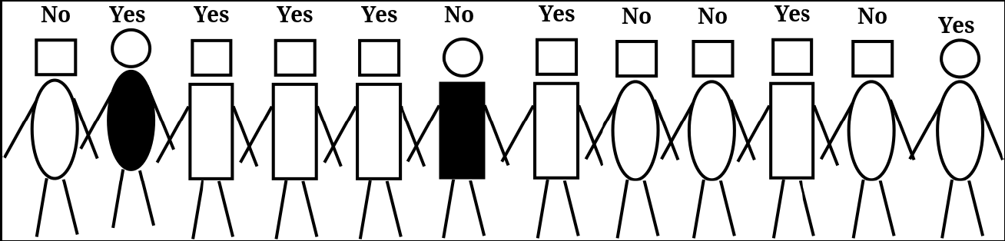




Impure Segments (1)
H(X) = -7/12*log(7/12,2)
-5/12*log(5/12,2)
= 0.98
body shape = rectangle
5 Yes
1 No
body shape = oval
2 Yes
4 No
32

Slide 6
Impure Segments (2)
H(X) = -5/9*log(5/9,2)
-4/9*log(4/9,2)
= 0.99
head shape = rectangle
head shape = circular
5 Yes
4 No
2 Yes
1 No
H(X) = -2/3*log(3/3,2)
-1/3*log(1/3,2)
= 0.92

Slide 7
Which is more informative?
body shape = rectangle
body shape = oval
head shape = rectangle
head shape = circular
5 Yes
1 No
2 Yes
4 No
5 Yes
4 No
2 Yes
1 No
H(X) = 0.65
H(X) = 0.92
H(X) = 0.99
H(X) = 0.92

Slide 8
Wait a minute…
Which one is better or more informative?
body shape = rectangle
body shape = oval
body color = white
body color = black
5 Yes
1 No
1 Yes
4 No
6 Yes
4 No
0 Yes
1 No
H(X) = 0.65
H(X) = 0.72
H(X) = 0.92
H(X) = 0

Slide 9
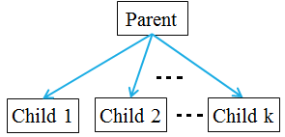
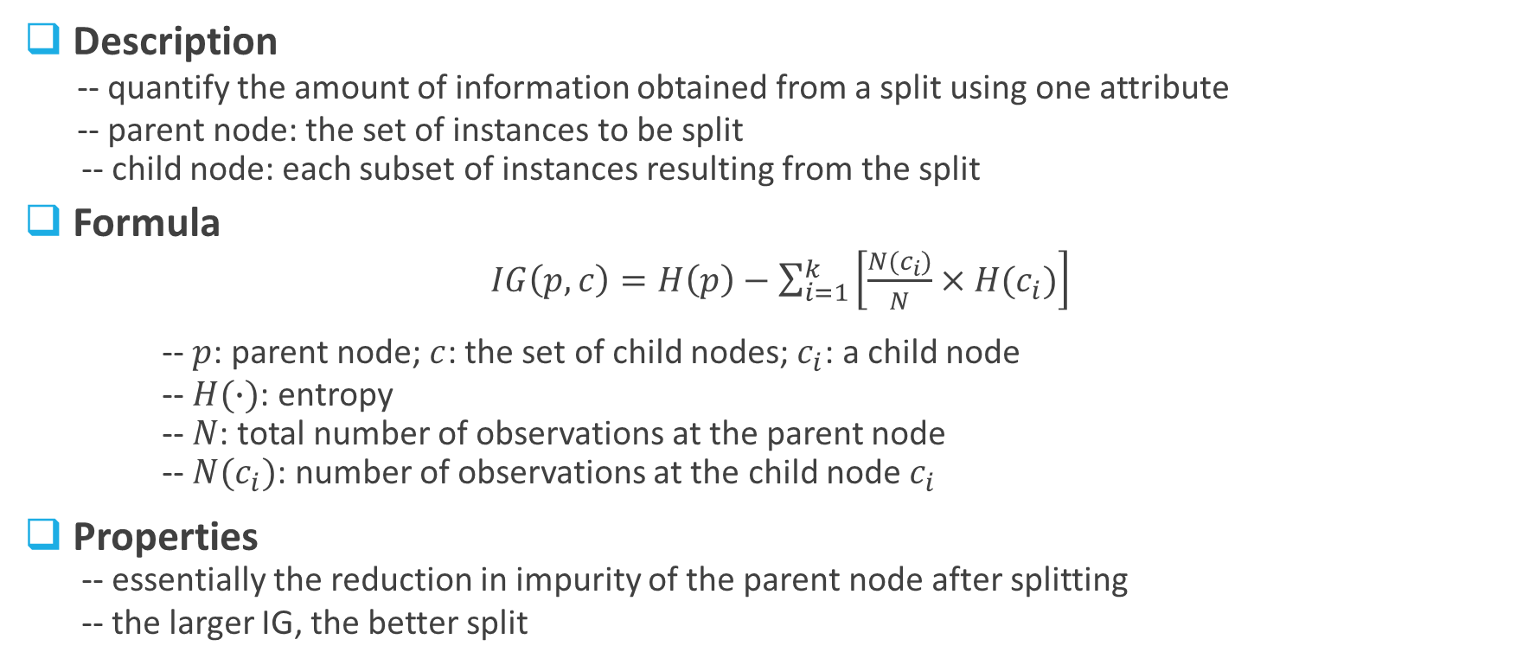
Information Gain
Description
-- quantify the amount of information obtained from a split using one attribute
-- parent node: the set of instances to be split
-- child node: each subset of instances resulting from the split
Formula
$IG\left(p, c\right)=H\left(p\right)−\sum_{i=1}^{k}{\left[\frac{N(c_{i})}{N}×H(c_{i})\right]}$
-- $p$: parent node; $c$: the set of child nodes; $c_{i}$: a child node
-- $H(∙)$: entropy
-- $N$: total number of observations at the parent node
-- $N(c_{i})$: number of observations at the child node $c_{i}$
Properties
-- essentially the reduction in impurity of the parent node after splitting
-- the larger IG, the better split
weighted average entropy

Slide 10
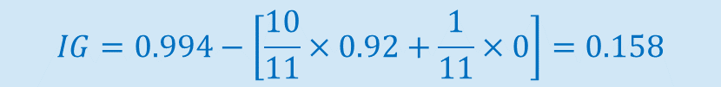
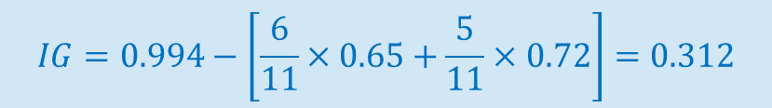
Try it out
H(p) = 0.994
body shape = rectangle
body shape = oval
body color = white
body color = black
5 Yes
1 No
1 Yes
4 No
6 Yes
4 No
0 Yes
1 No
H(c1) = 0.65
H(c2) = 0.72
H(c1) = 0.92
H(c2) = 0
$$IG=0.994−\left[\frac{6}{11}×0.65+\frac{5}{11}×0.72\right]=0.312$$
$$IG=0.994−\left[\frac{10}{11}×0.92+\frac{1}{11}×0\right]=0.158$$

Slide 11
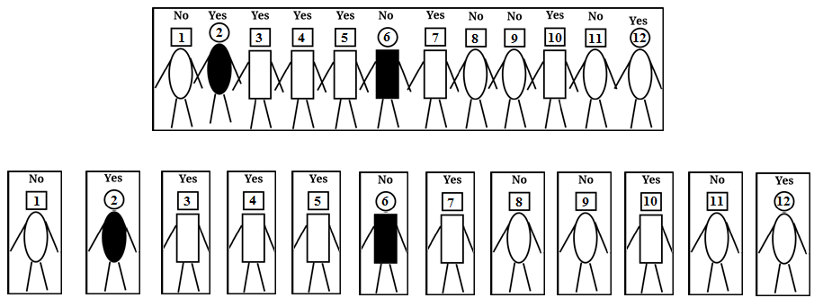
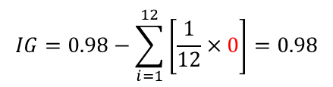
Potential Issue
Number of children
-- categorical attribute with many levels/values, e.g., WindGustDir (16 levels)
-- numeric attribute with many integers or even continuous values, e.g., Age, Sunshine
-- IG undesirably favors attributes with many values if you make a segment/child for each value
Example
$$IG=0.98−\sum_{i=1}^{12}{\left[\frac{1}{12}×0\right]}=0.98$$
head #
Great IG,
but useless
[Overfitting]

Slide 12
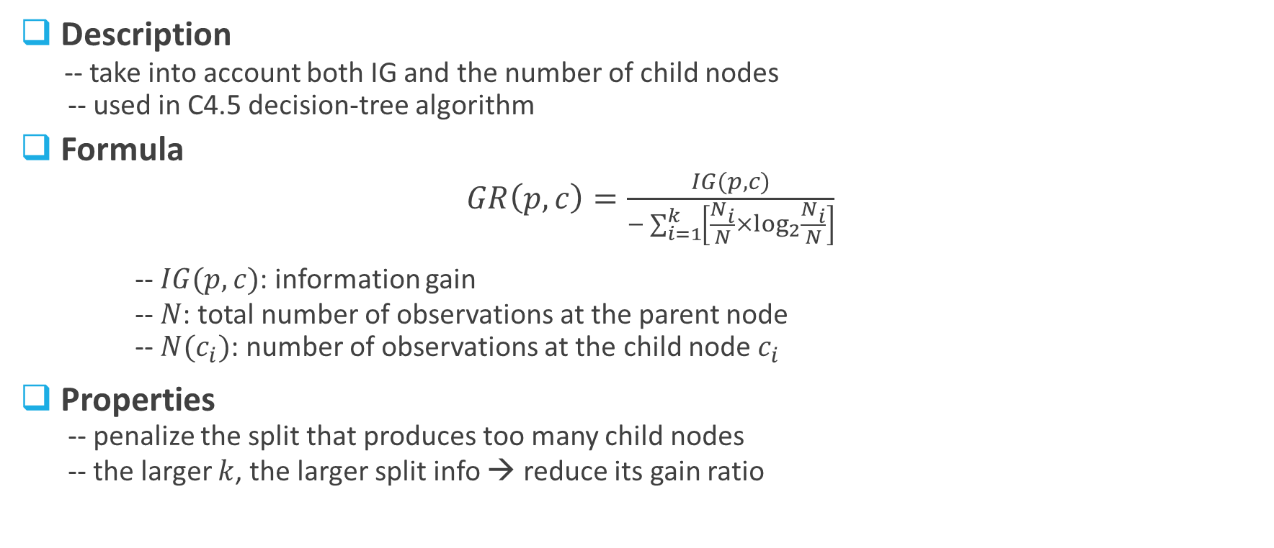
Gain Ratio
Description
-- take into account both IG and the number of child nodes
-- used in C4.5 decision-tree algorithm
Formula
$GR\left(p, c\right)=\frac{IG(p,c)}{−\sum_{i=1}^{k}{\left[\frac{N_{i}}{N}×\log_{2}{\frac{N_{i}}{N}}\right]}}$
-- $IG(p,c)$: information gain
-- $N$: total number of observations at the parent node
-- $N(c_{i})$: number of observations at the child node $c_{i}$
Properties
-- penalize the split that produces too many child nodes
-- the larger $k$, the larger split info → reduce its gain ratio
Split info

Slide 13
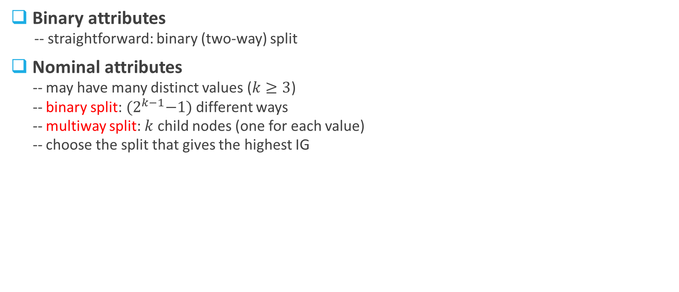
Splitting of Attributes (1)
Binary attributes
-- straightforward: binary (two-way) split
Nominal attributes
-- may have many distinct values ($k≥3$)
-- binary split: ${(2}^{k−1}−1)$ different ways
-- multiway split: $k$ child nodes (one for each value)
-- choose the split that gives the highest IG
Marital Status
{single}
{married}
{divorced}
Marital Status
Marital Status
Marital Status
{single}
{married, divorced}
{married}
{single, divorced}
{divorced}
{single, married}

Slide 14

Splitting of Attributes (2)
Ordinal attributes
-- may have many distinct values ($k≥3$) of natural order
-- grouping can NOT violate the order!
-- binary split: $(k−1)$ different ways
-- multiway split: $k$ child nodes (one for each value)
-- choose the split that gives the highest IG
Shirt Size
{small}
{medium}
{large}
Shirt Size
Marital Status
Marital Status
{small}
{medium, large}
{small, medium}
{large}
{small, large}
{medium}

Slide 15
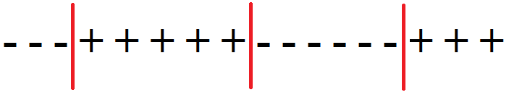
Splitting of Attributes (3)
Numeric attributes
-- may have TOO MANY distinct values (either integers or real numbers)
-- does NOT make sense to split on every numeric value!
-- discretization: choose one or many thresholds (split points)
-- sort the data points in ascending order of their numeric values
-- identify adjacent data points that differ in their target values
-- each mid point is a candidate threshold
-- treat the results as an ordinal attribute
-- choose the split that gives the highest IG
Annual income
Annual income
Annual income
……
{<=50K}
{>50K}
{<=75K}
{>75K}
{<=25K}
{>50K}
{>80K}

Slide 16
Decision Tree
Basic idea
-- divide-and-conquer approach (greedy)
-- recursive partitioning
Algorithm
-- start with the whole dataset as a group in a root node
-- recursively to find the most informative attribute (interior node) to partition the current group
into subgroups that are as pure as possible w.r.t. the target variable
-- this recursive process ends up with a set of leaf nodes with specific class determination
Characteristics
-- easy to interpret (can be expressed as a set of easy-to-understand rules)
-- model construction is computationally inexpensive even for a large dataset
-- classifying a new data point is extremely fast
-- quite robust to the presence of noise

Slide 17
Dataset
20 observations
Attribute
Target Variable
person id | Age | Gender | Residence | Balance | Write-off
123213 | 55 | F | Own | $200,000 | Yes
17824 | 33 | M | Own | $35,000 | No
232897 | 40 | F | Rent | $115,000 | No
288822 | 23 | M | Other | $29,000 | Yes
…. | …. | …. | …. | …. | ….

Slide 18


Tree Induction (1)
Information Gain
Balance
(16 Yes,14 No)
Information Gain
$$<50K$$
$≥50K$
Information Gain
Residence
(4 Yes, 12 No)
Age
(12 Yes, 2 No)
Own
Rent
Other
<50
≥ 50
Class: No
(0 Yes, 5 No)
Class: No
(1 Yes, 5 No)
Class: Yes
(3 Yes, 2 No)
Class: No
(1 Yes, 2 No)
Class: Yes
(11 Yes, 0 No)

Slide 19
Tree Induction (2)
Root node:
at the top (upside-down tree);
contains the most informative attribute evaluated on the entire dataset
Interior node:
contains the most informative attribute evaluated on the current set of data points;
Each branch represents a distinct value, pointing downwards to another interior node or a leaf node
Balance
(16 Yes,14 No)
$$<50K$$
$≥50K$
Leaf node:
a.k.a terminal node;
contains some specific class determination
Residence
(4 Yes, 12 No)
Age
(12 Yes, 2 No)
Own
Rent
Other
<50
≥ 50
Class: No
(0 Yes, 5 No)
Class: No
(1 Yes, 5 No)
Class: Yes
(3 Yes, 2 No)
Class: No
(1 Yes, 2 No)
Class: Yes
(11 Yes, 0 No)

Slide 20
Tree Induction (3)
Check your understanding
-- Are there any cycles in the DT?
-- Are there any parent nodes share descendants (child
nodes)?
-- Can an attribute be selected (show up) multiple times
in the DT?
-- Can an attribute be selected multiple times along the
same/single path?
-- Does every no-missing-value data point end up at one
and only one leaf node?
-- Does every no-missing-value data point end up at a leaf
node that correctly classify that data point?
-- Can we build a DT that correctly classify all data points
in the training dataset?
-- When do we stop recursive partitioning (to avoid
overfitting)?

Slide 21
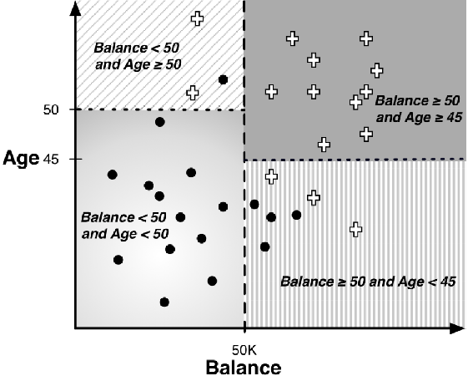
Geometric Perspective
Feature space
-- consist of all features/attributes; each represents one dimension
-- each split on an interior node is a decision boundary separating the feature space
-- decision line/plane/hyperplane
-- each leaf node represents a final/unsplit region of the space

Slide 22
Decision Boundaries
There exist a lot of datasets whose
“true” decision boundaries are neither
horizontal or vertical
It could be still a straight line but is not
perpendicular to the axes, or it might
not be a line at all
This is one of the reasons that DT
models do not always perform well
Age
Balance

Slide 23
Trees as Sets of Rules
Every decision tree can be expressed as an equivalent set of rules (logical statements)
Each rule consists of the conditions along a single path from the root node to a leaf node,
connected with AND
Rules are unordered in the set
IF (Balance<50k) AND (Age<50) THEN class = Write-off
IF (Balance<50k) AND (Age≥50) THEN class = No Write-off
IF (Balance≥50k) AND (Age≥45) THEN class = = No Write-off
IF (Balance≥50k) AND (Age<45) THEN class = = Write-off

Slide 24
Classify New Data
→ Starting from the root node
→ Choose the branch based on the specific attribute value of the data point
→ Descend through the interior nodes until reaching a leaf node
→ Assign the class label associated with that leaf node to the data point
E.g., for a new data point
person id | Age | Gender | Balance | Write-off
666666 | 58 | M | $70,000 | ?
999999 | 26 | F | $32,000 | ?

Slide 25

Probability Estimation (1)
Objective
-- Provide a more informative prediction than just a classification
-- Give not only a class label but also the estimate of class membership probability
Probability Estimation Tree
-- an easy/straightforward extension from a label-only DT
-- frequency-based estimate
p(c): estimate of membership probability of class c
n: # of data points belonging to class c
m: # of data points not belonging to class c
-- potential issue: overly optimistic (especially when (n+m) is small, e.g., n=2, m=0)

Slide 26
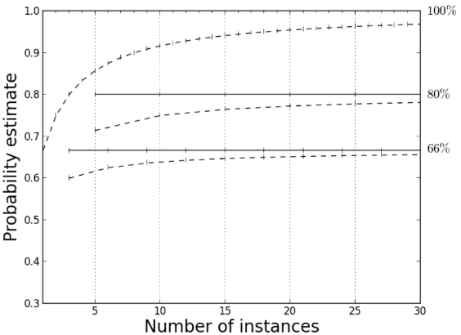

Probability Estimation (2)
Laplace Correction
-- a.k.a. “smoothed” version of the frequency-based estimate
-- moderate the influence of leaves with only a few data points
-- For binary classification
frequency based
laplace correction
Example:
(2 positive, 0 negative): 1 → 0.75
(20 positive, 0 negative): 1 → 0.95

Slide 27
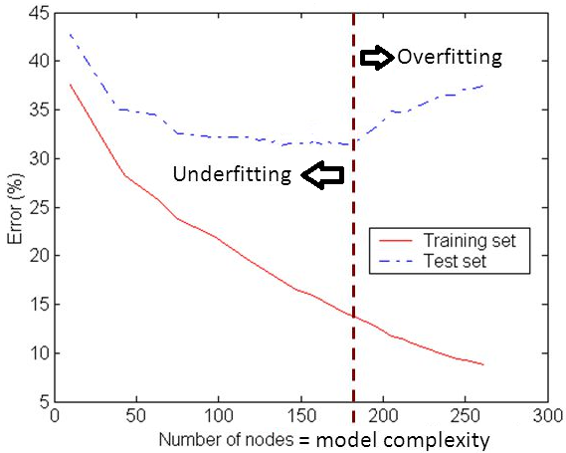
When to Stop?
Recursive partitioning stops when
-- data points in a child node are pure
-- run out of attributes to split on
Overfitting
-- main problem with tree induction
-- we can keep growing the tree to fit the training data until all leaf nodes are pure
-- result in large, overly complex tree with poor generalization/prediction power
Underfitting
-- implying too tight stopping rules tends to create small trees
that may underfit the training data
-- difficult to choose the right threshold for early termination

Slide 28
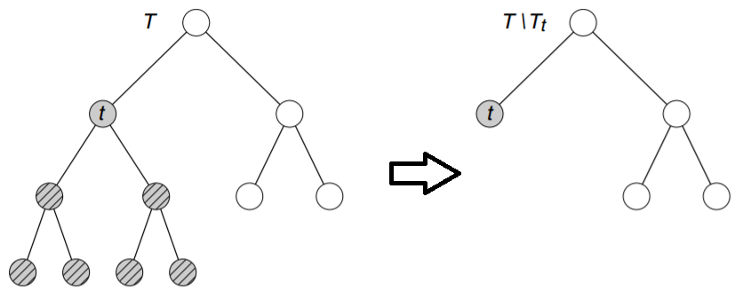
Tree Pruning
Goal
-- find the best size of the tree
-- avoid overfitting (and underfitting)
-- reduce the estimated generalization error
Prepruning
-- Max depth: maximum number of depth of the tree (depth of root node = 0)
-- Min Split: minimum number of observations that must exist in a node in order
for a split to be attempted
-- Min Bucket: minimum number of observations in any leaf node
Post-pruning
-- initially grow the tree to its maximum size
-- prune it back by replacing a subtree with a new leaf node or the most frequently used
branch of the subtree [in a bottom-up fashion]
-- continue pruning until no further improvement is observed

Slide 29
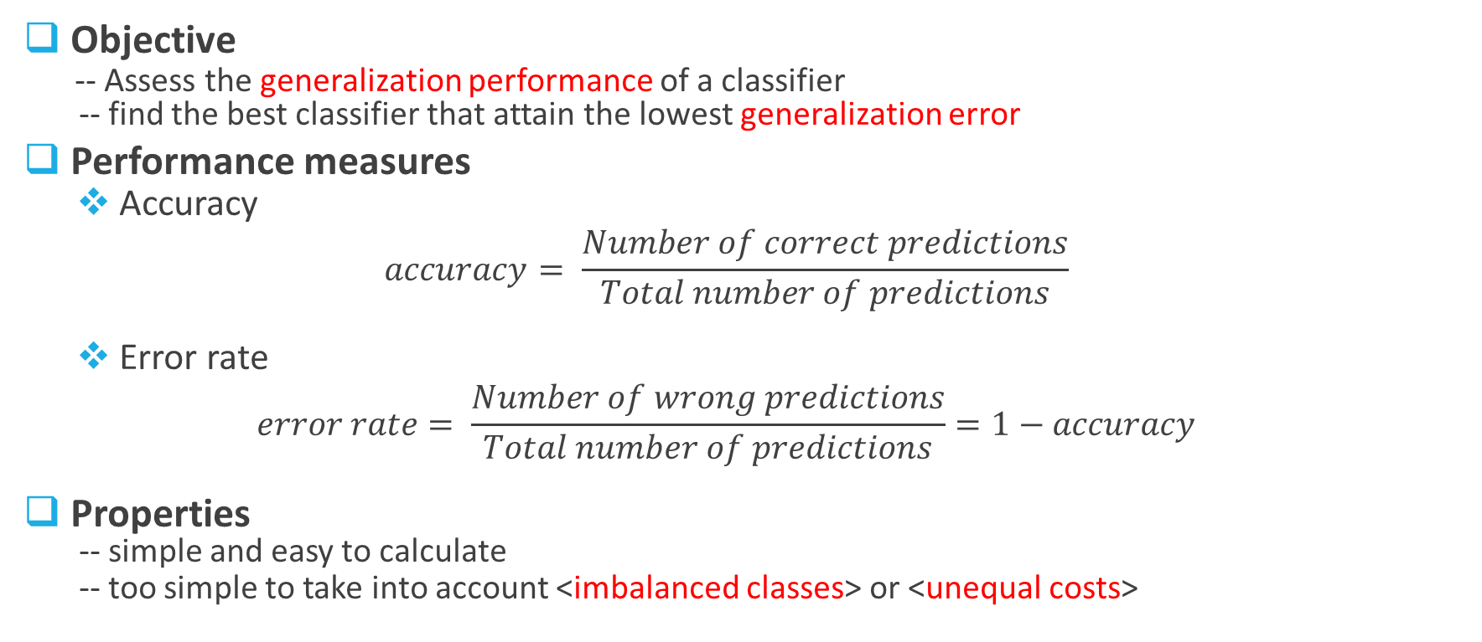
Evaluate a Classifier
Objective
-- Assess the generalization performance of a classifier
-- find the best classifier that attain the lowest generalization error
Performance measures
Accuracy
$$accuracy= \frac{Number of correct predictions}{Total number of predictions}$$
Error rate
$$error rate= \frac{Number of wrong predictions}{Total number of predictions}=1−accuracy$$
Properties
-- simple and easy to calculate
-- too simple to take into account <imbalanced classes> or <unequal costs>

Slide 30
Limitation of Accuracy
Problems with imbalanced classes
-- Accuracy treats every class as equally important
-- Not suitable for analyzing the rare class [that is often more interesting than the majority class]
-- e.g., consider a terrorist-detection problem
an imbalanced population of 10,000 with 9,990 in “-” class and only 10 in “+” class
A model simply predicting everything to be “-” attains an accuracy of 99.9%
The model of no use since it does not help detect any terrorists (“+” instances)
Problems with unequal costs
-- there are two different types of errors: false positive and false negative
-- Accuracy treats both errors as equally important
-- in reality, this is rarely the case
-- e.g., consider a cancer-diagnosis problem [“+”: Yes; “-”: No cancer]
False positive: a person is wrongly diagnosed he has cancer while he does not
False negative: a patient who has cancer is wrongly diagnosed he does not
Unequal costs: <stressful, inconvenient, expensive> vs. <life threatening>

Slide 31
Confusion Matrix
For binary classification, the class that is more interesting is often denoted as the positive (+) class
True Positive (TP)
-- the number of positive instances correctly
predicted as positive
False Positive (FP)
-- the number of negative instances wrongly
predicted as positive
False Negative (FN)
-- the number of positive instances wrongly
predicted as negative
True Positive (TN)
-- the number of negative instances correctly
predicted as negative
Actual
 | + | -
+ | True Positives (TP) | False Positives (FP)
- | False Negatives (FN) | True Negatives (TN)
Predicted

Slide 32
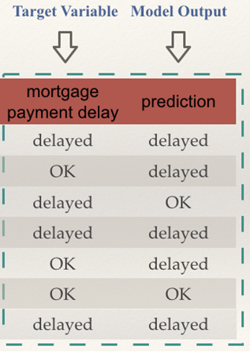
CM Practice
+ delayed
- OK
Actual
 | + | -
+ | 3 | 2
- | 1 | 1
Predicted

Slide 33
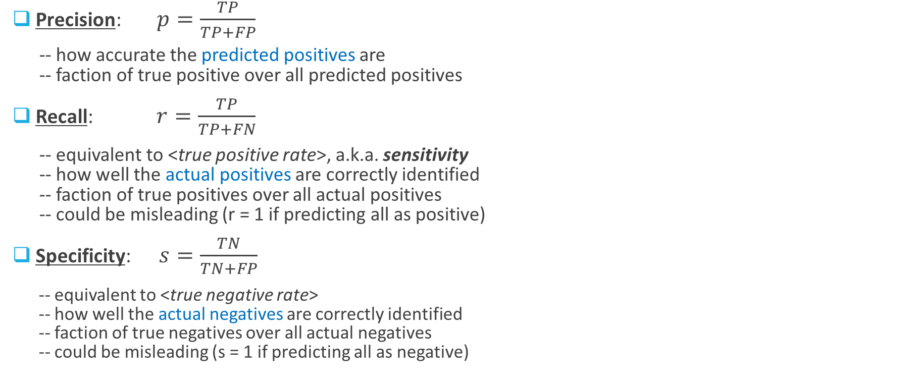
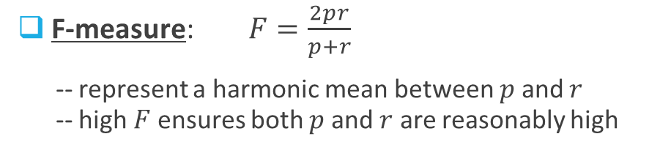
Important Metrics
What is the formula for “Accuracy”?
Actual
Precision: $p=\frac{TP}{TP+FP}$
-- how accurate the predicted positives are
-- faction of true positive over all predicted positives
Recall: $r=\frac{TP}{TP+FN}$
-- equivalent to <true positive rate>, a.k.a. sensitivity
-- how well the actual positives are correctly identified
-- faction of true positives over all actual positives
-- could be misleading (r = 1 if predicting all as positive)
Specificity: $s=\frac{TN}{TN+FP}$
-- equivalent to <true negative rate>
-- how well the actual negatives are correctly identified
-- faction of true negatives over all actual negatives
-- could be misleading (s = 1 if predicting all as negative)
 | + | -
+ | True Positives (TP) | False Positives (FP)
- | False Negatives (FN) | True Negatives (TN)
Predicted
F-measure: $F=\frac{2pr}{p+r}$
-- represent a harmonic mean between $p$ and $r$
-- high $F$ ensures both $p$ and $r$ are reasonably high

Slide 34
Cost-benefit Matrix
Distinguish unequal costs between FP
and FN, as well as possible unequal
benefits between TP and TN
benefit b(+|+)
-- benefit from TP
cost c(+|-)
-- cost due to FP
cost c(-|+)
-- cost due to FN
benefit b(-|-)
-- benefit from TN
Actual
 | + | -
+ | b(+|+) | c(+|-)
- | c(-|+) | b(-|-)
Predicted

Slide 35
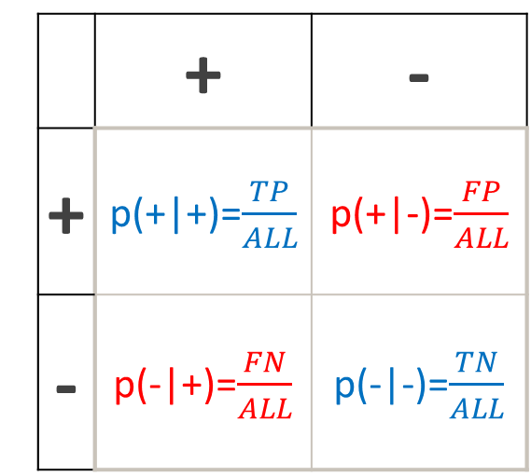
Expected Profit
This could be the comprehensive evaluation metric
Actual
Actual
 | + | -
+ | p(+|+)=$\frac{TP}{ALL}$ | p(+|-)=$\frac{FP}{ALL}$
- | p(-|+)=$\frac{FN}{ALL}$ | p(-|-)=$\frac{TN}{ALL}$
 | + | -
+ | b(+|+) | c(+|-)
- | c(-|+) | b(-|-)
Predicted
Predicted
Expected profit = $p\left(+ | +\right)∙b\left(+ | +\right)+p\left(+ | −\right)∙c\left(+ | −\right)+p\left(− | +\right)∙c\left(− | +\right)+p\left(− | −\right)∙b\left(− | −\right)$

Slide 36
Exercise
Model X is developed to help doctors diagnose breast cancer. Its performance was evaluated over a test data set of 1000 patients. Model X diagnosed 20 of them with breast cancer, 16 out of which really had breast cancer. But Model X misclassified 3 patients who had breast cancer as healthy. We assume that correct diagnosis have no cost, but failing to identify a real patient will cause $10,000 loss. Besides, identifying a healthy person with breast cancer will cause $500 loss.
1. generate the confusion matrix
2. calculate precision, recall, specificity, and F-measure
3. generate the cost-benefit matrix
4. calculate the expected cost

Slide 37
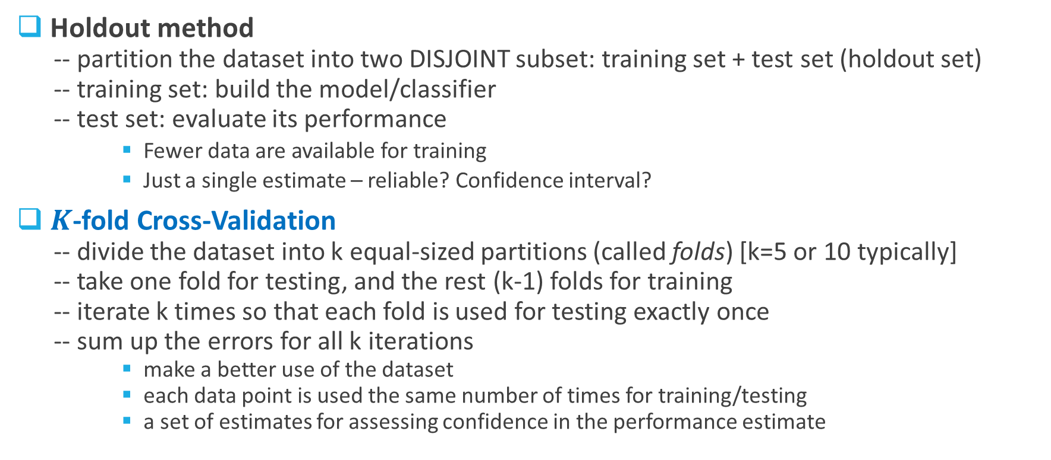
Methods for Evaluating a Classifier
Holdout method
-- partition the dataset into two DISJOINT subset: training set + test set (holdout set)
-- training set: build the model/classifier
-- test set: evaluate its performance
Fewer data are available for training
Just a single estimate – reliable? Confidence interval?
$K$-fold Cross-Validation
-- divide the dataset into k equal-sized partitions (called folds) [k=5 or 10 typically]
-- take one fold for testing, and the rest (k-1) folds for training
-- iterate k times so that each fold is used for testing exactly once
-- sum up the errors for all k iterations
make a better use of the dataset
each data point is used the same number of times for training/testing
a set of estimates for assessing confidence in the performance estimate

Slide 38
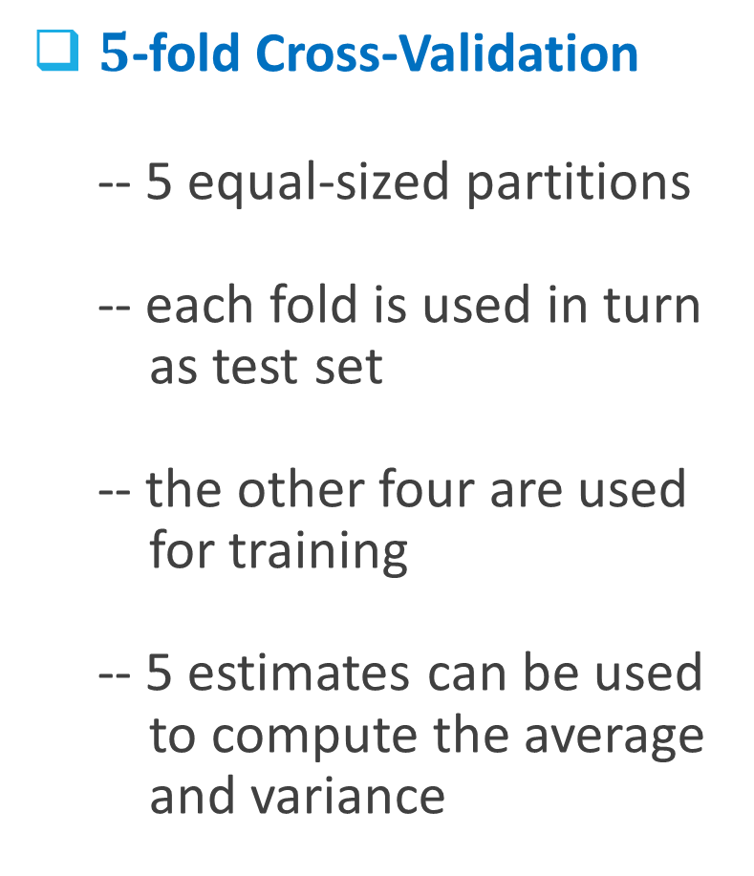
$5$-fold Cross-Validation
-- 5 equal-sized partitions
-- each fold is used in turn
as test set
-- the other four are used
for training
-- 5 estimates can be used
to compute the average
and variance

Slide 39
# of data points used for building the tree
Legend –
node: node index
split: test condition
n: # of data points in that node
loss: # of data points wrongly classified
yval: default class label for that node
yprobs: class distribution (fixed order)
*: terminal/leaf-node indicator

Slide 40
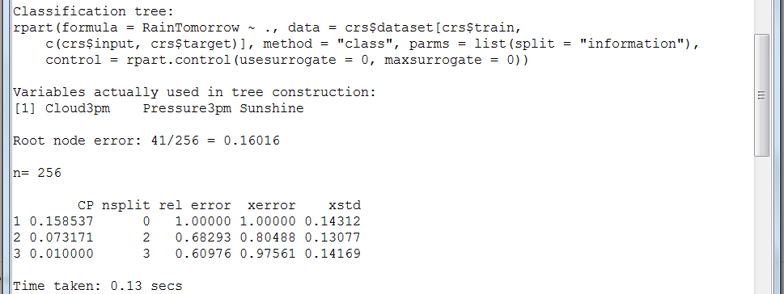
Function call –
formula: target variable + dataset
method: classification
parms: information gain
Baseline error: over the whole dataset
Performance evaluation –
CP: complexity parameter (reduced) – indicate the
maximum benefit one can gain for future splits
nsplit: # of splits
error: relative reduction in training error
xerror: relative reduction in the
cross-validation-based error
xstd: cross-validation-based standard deviation

Slide 41
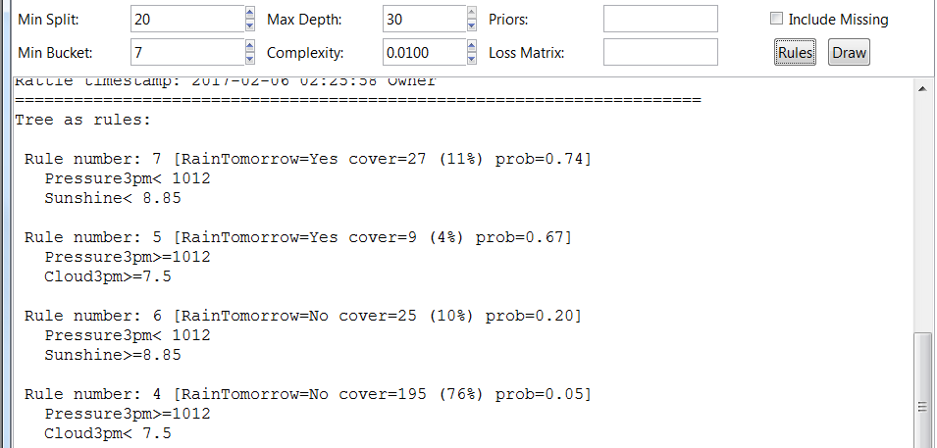
Translate the DT into a set of rules: 4 rules correspond to the 4 leaf nodes

Slide 42
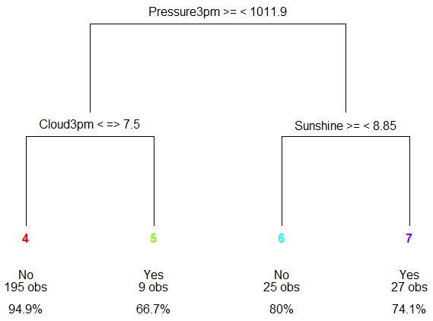
Display a visual representation of the DT

Slide 43
Set the class proportion in the training dataset in order to reflect the true proportion in the population or boost a particular class of interest
Weight different types of errors differently in the form of [0, FN, FP, 0]
Minimum # of data points that must exist at a node before it is considered for splitting
Minimum “benefit” that must be gained at each split
Set it to zero will build a tree to its maximum depth (depending on the values of MinSplit and MinBucket)
Find the best size of the tree: look for the CP value (cp_min) where the sum of xerror and xstd is minimum, then set this complexity parameter to be slightly larger than cp_min
Minimum # of data points in any leaf node

Slide 44
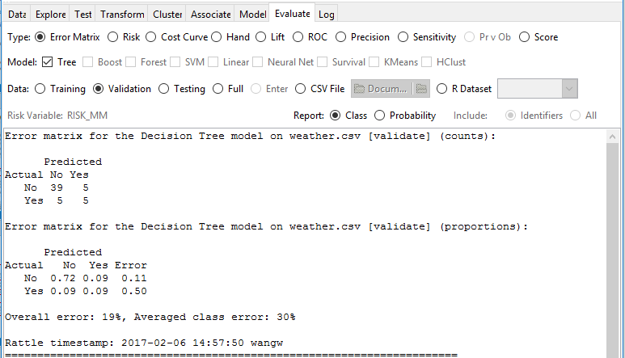
Confusion matrix
Error rate

