Slide 1
Data Science
MSCI:6070 Spring 2017
Lecture 4 (2/13/17)

Slide 2
Confusion Matrix
For binary classification, the class that is more interesting is often denoted as the positive (+) class
True Positive (TP)
-- the number of positive instances correctly
predicted as positive
False Positive (FP)
-- the number of negative instances wrongly
predicted as positive
False Negative (FN)
-- the number of positive instances wrongly
predicted as negative
True Positive (TN)
-- the number of negative instances correctly
predicted as negative
Actual
 | + | -
+ | True Positives (TP) | False Positives (FP)
- | False Negatives (FN) | True Negatives (TN)
Predicted

Slide 3
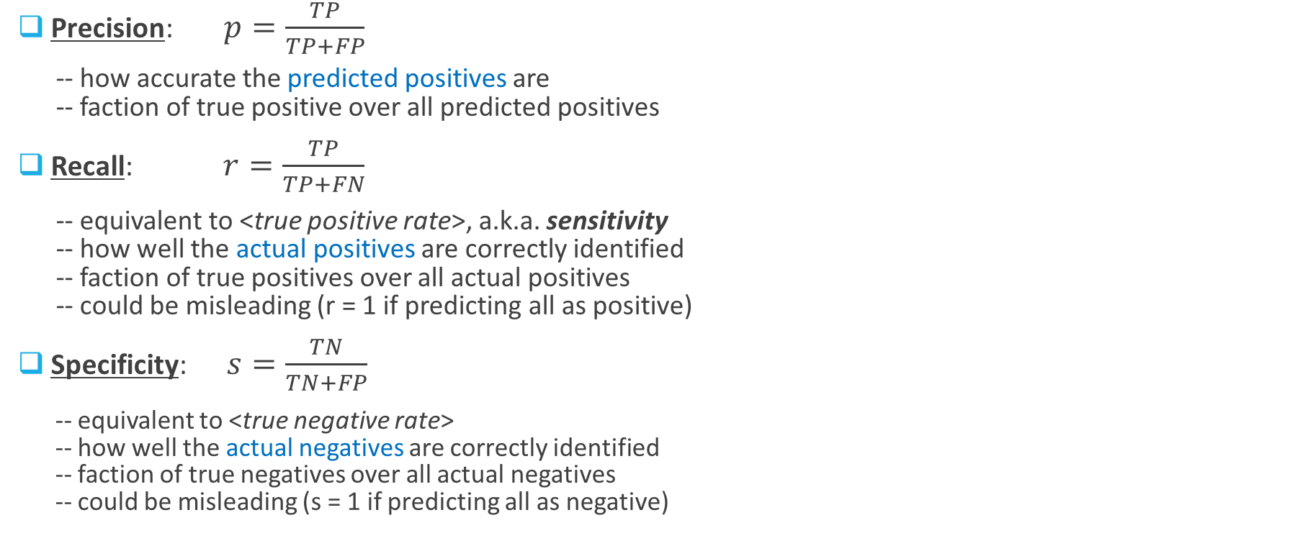
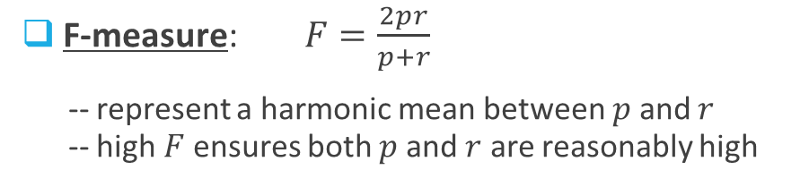
Important Metrics
What is the formula for “Accuracy”?
Actual
Precision: $p=\frac{TP}{TP+FP}$
-- how accurate the predicted positives are
-- faction of true positive over all predicted positives
Recall: $r=\frac{TP}{TP+FN}$
-- equivalent to <true positive rate>, a.k.a. sensitivity
-- how well the actual positives are correctly identified
-- faction of true positives over all actual positives
-- could be misleading (r = 1 if predicting all as positive)
Specificity: $s=\frac{TN}{TN+FP}$
-- equivalent to <true negative rate>
-- how well the actual negatives are correctly identified
-- faction of true negatives over all actual negatives
-- could be misleading (s = 1 if predicting all as negative)
 | + | -
+ | True Positives (TP) | False Positives (FP)
- | False Negatives (FN) | True Negatives (TN)
Predicted
F-measure: $F=\frac{2pr}{p+r}$
-- represent a harmonic mean between $p$ and $r$
-- high $F$ ensures both $p$ and $r$ are reasonably high

Slide 4
Cost-benefit Matrix
Distinguish unequal costs between FP
and FN, as well as possible unequal
benefits between TP and TN
benefit b(+|+)
-- benefit from TP
cost c(+|-)
-- cost due to FP
cost c(-|+)
-- cost due to FN
benefit b(-|-)
-- benefit from TN
Actual
 | + | -
+ | b(+|+) | c(+|-)
- | c(-|+) | b(-|-)
Predicted

Slide 5
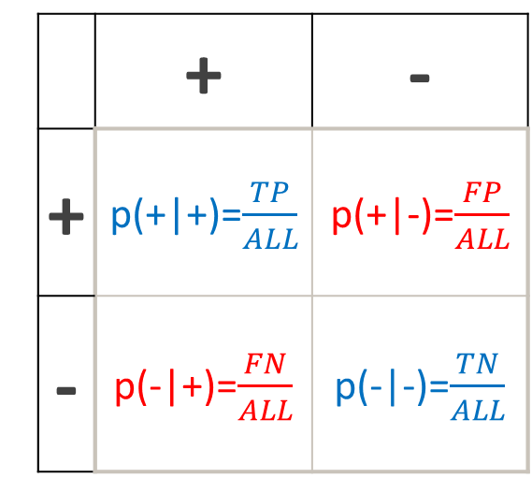
Expected Profit
This could be the comprehensive evaluation metric
Actual
Actual
 | + | -
+ | p(+|+)=$\frac{TP}{ALL}$ | p(+|-)=$\frac{FP}{ALL}$
- | p(-|+)=$\frac{FN}{ALL}$ | p(-|-)=$\frac{TN}{ALL}$
 | + | -
+ | b(+|+) | c(+|-)
- | c(-|+) | b(-|-)
Predicted
Predicted
Expected profit = $p\left(+ | +\right)∙b\left(+ | +\right)+p\left(+ | −\right)∙c\left(+ | −\right)+p\left(− | +\right)∙c\left(− | +\right)+p\left(− | −\right)∙b\left(− | −\right)$

Slide 6

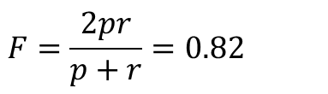
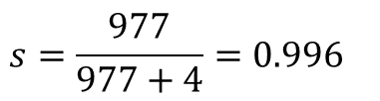
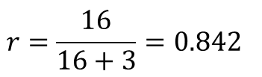
Exercise
Actual
 | + | -
+ | 16 | 4
- | 3 | 977
$$p=\frac{16}{16+4}=0.8$$
$$r=\frac{16}{16+3}=0.842$$
Predicted
$$s=\frac{977}{977+4}=0.996$$
$$F=\frac{2pr}{p+r}=0.82$$
Model X is developed to help doctors diagnose breast cancer. Its performance was evaluated over a test data set of 1000 patients. Model X diagnosed 20 of them with breast cancer, 16 out of which really had breast cancer. But Model X misclassified 3 patients who had breast cancer as healthy. We assume that correct diagnosis have no cost, but failing to identify a real patient will cause $10,000 loss. Besides, identifying a healthy person with breast cancer will cause $500 loss.
1. generate the confusion matrix
2. calculate precision, recall, specificity, and F-measure
3. generate the cost-benefit matrix
4. calculate the expected cost
Actual
 | + | -
+ | 0 | 500
- | 10,000 | 0
Predicted
Expected cost = $0.004×500+0.003×10,000=\$32$

Slide 7
Geometric Perspective (1)
Decision boundaries of a DT are always axis-parallel. WHY?
Write-off
Age
No write-off
50
45
50k
Balance

Slide 8


Geometric Perspective (2)
Are there any alternatives to axis-parallel decision boundaries?
Write-off
Age
No write-off
60
linear decision boundary
$$Age=\left(−1.5\right)×Balance+60$$
linear classifier
linear discriminant function
Balance
40

Slide 9

Predictive Modeling
Mapping function
Input (X)
Model (f(X))
Output (Y)
A formula that we learn from old/training data to map from a set of input attributes onto the target variable
X: features
attributes
explanatory
independent
Y: target
dependent
Modeling
(induction)
X
Xold
……
……

Slide 10
Nonparametric vs. parametric
Non-parametric model
-- no prior knowledge or strong assumptions about the form of the mapping function
-- e.g., DT, K-Nearest Neighbors (KNN), etc.
-- has the potential to learn any functional form in terms of various patterns
-- require a lot more training data to estimate the underlying mapping function
Parametric model
-- pre-specify the form of the mapping function (with a set of “unknown” numeric parameters)
-- learn the parameters for the function from the training data
(tune the parameters to fit the model to the data)
-- e.g., Linear Discriminant Analysis, Logistic Regression, etc.
-- require less training data and learn fast
-- highly constrained to the specified form

Slide 11
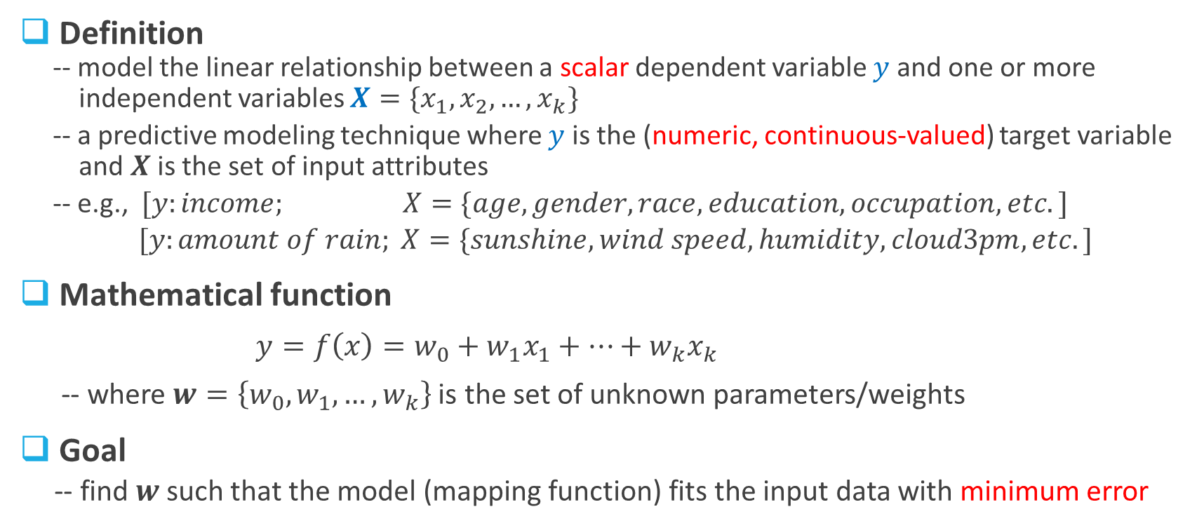
Linear Regression (1)
Definition
-- model the linear relationship between a scalar dependent variable $y$ and one or more
independent variables $X=\{x_{1},x_{2},…,x_{k}\}$
-- a predictive modeling technique where $y$ is the (numeric, continuous-valued) target variable
and $X$ is the set of input attributes
-- e.g., $[y:income; X=\{age, gender, race, education, occupation, etc.]$
$[y:amount of rain; X=\{sunshine, wind speed, humidity, cloud3pm, etc.]$
Mathematical function
$y=f\left(x\right)=w_{0}+w_{1}x_{1}+…+w_{k}x_{k}$
-- where $w=\left\{w_{0},w_{1},…,w_{k}\right\}$ is the set of unknown parameters/weights
Goal
-- find $w$ such that the model (mapping function) fits the input data with minimum error
Weighted sum of attribute values

Slide 12
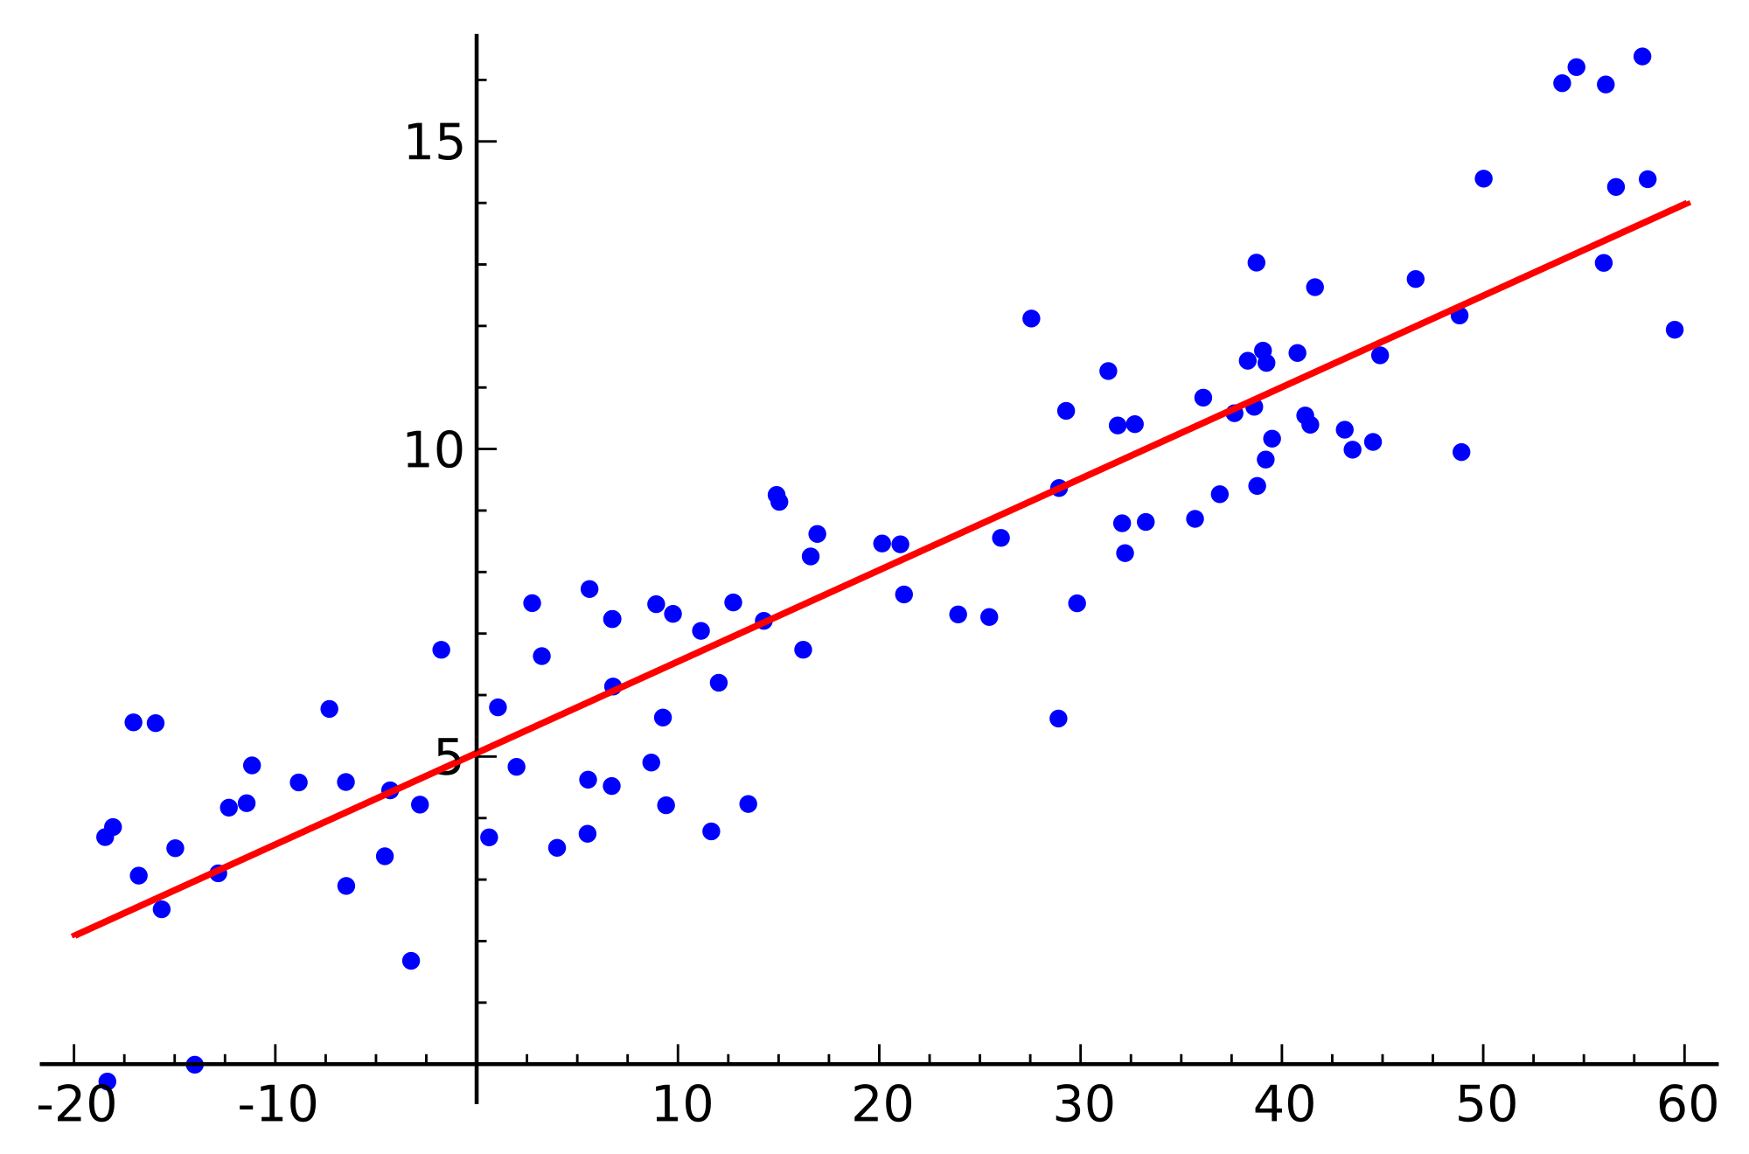


Linear Regression (2)
Objective/Loss Function
-- An important fundamental idea in DM
-- Many DM tasks are essentially
optimization problems, in which we
optimize an objective function
-- For linear regression, we minimize the
error that can be expressed in terms of a
loss function such as
Y
real value
predicted value
X
An example of simple linear regression

Slide 13
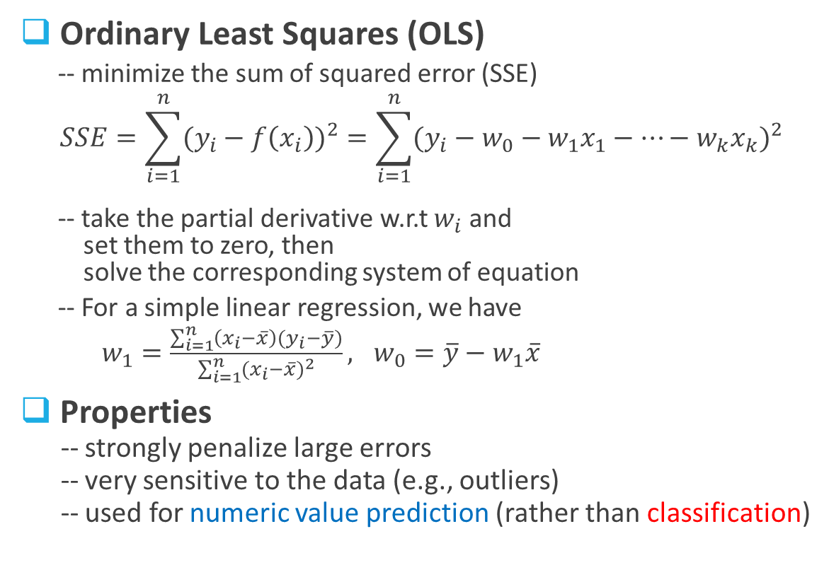
Linear Regression (3)
Ordinary Least Squares (OLS)
-- minimize the sum of squared error (SSE)
$$SSE=\sum_{i=1}^{n}{{(y_{i}−f\left(x_{i}\right))}^{2}}=\sum_{i=1}^{n}{{(y_{i}−w_{0}−w_{1}x_{1}−…−w_{k}x_{k})}^{2}}$$
-- take the partial derivative w.r.t $w_{i}$ and
set them to zero, then
solve the corresponding system of equation
-- For a simple linear regression, we have
$w_{1}=\frac{\sum_{i=1}^{n}{\left(x_{i}−\overline{x}\right)}(y_{i}−\overline{y})}{\sum_{i=1}^{n}{{(x_{i}−\overline{x})}^{2}}}, w_{0}=\overline{y}−w_{1}\overline{x}$
Properties
-- strongly penalize large errors
-- very sensitive to the data (e.g., outliers)
-- used for numeric value prediction (rather than classification)
Outlier
Y
real value
predicted value
X
An example of simple linear regression
Why?

Slide 14
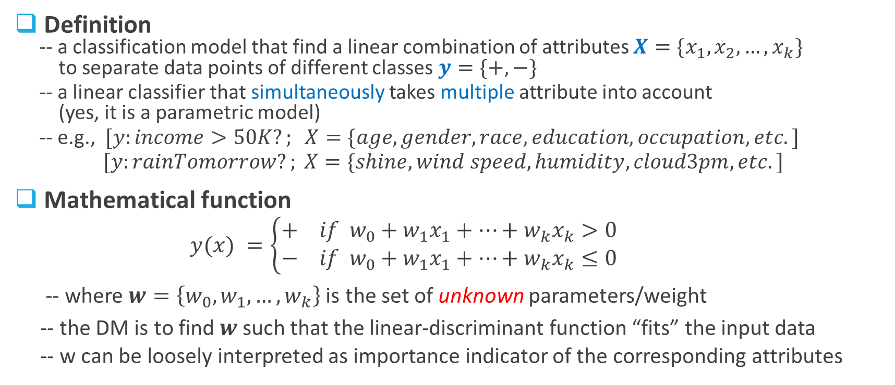
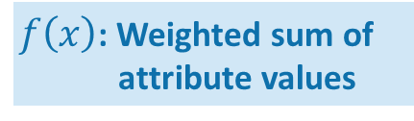
Linear Discriminant (1)
Something is missing!
Definition
-- a classification model that find a linear combination of attributes $X=\{x_{1},x_{2},…,x_{k}\}$
to separate data points of different classes $y=\{+,−\}$
-- a linear classifier that simultaneously takes multiple attribute into account
(yes, it is a parametric model)
-- e.g., $[y:income>50K?; X=\{age, gender, race, education, occupation, etc.]$
$[y:rainTomorrow?; X=\{shine, wind speed, humidity, cloud3pm, etc.]$
Mathematical function
$y(x) =\left\{\begin{aligned}+ if w_{0}+w_{1}x_{1}+…+w_{k}x_{k}>0 \\ − if w_{0}+w_{1}x_{1}+…+w_{k}x_{k}≤0\end{aligned}\right.$
-- where $w=\left\{w_{0},w_{1},…,w_{k}\right\}$ is the set of unknown parameters/weight
-- the DM is to find $w$ such that the linear-discriminant function “fits” the input data
-- w can be loosely interpreted as importance indicator of the corresponding attributes
$f\left(x\right)$: Weighted sum of
attribute values

Slide 15
Linear Discriminant (2)
How to choose the parameters?
-- there may infinitely many linear discriminants
that classify the training data perfectly
-- Which one should we choose?
-- Which one is the best?
Objective function
-- need to be defined appropriately (nontrivial)
-- find the best values for the parameters by
optimizing the objective function
-- different models use different objective functions,
and arrive at different linear discriminants
e.g., SVM, Logistic Regression, etc.

Slide 16
Linear Discriminant (3)
Dataset (http://archive.ics.uci.edu/ml/datasets/Iris)
-- original: 3 species of iris + 4 attributes
-- simplified: 2 species + 2 attributes
Two models
Support Vector Machine (SVM)
-- maximize the margin between the 2 classes
-- decision boundary is almost midway
between the two clumps
-- misclassifies one data point
Logistic Regression
-- maximize the likelihood that a labeled data
point belongs to the class of its label
-- separates the two classes perfectly
Versicolor
Setosa
Which one do you think is better?

Slide 17
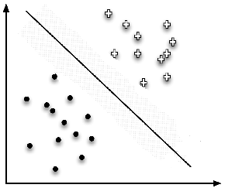
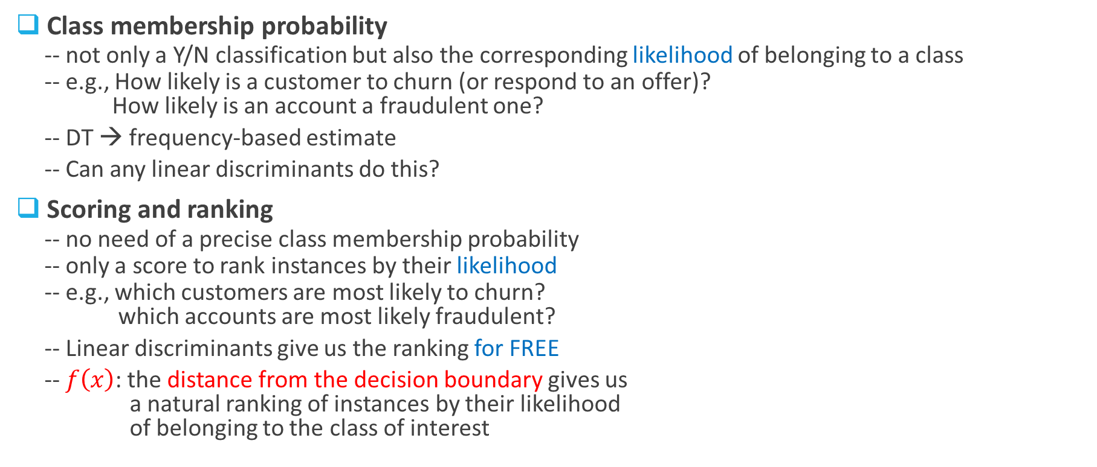

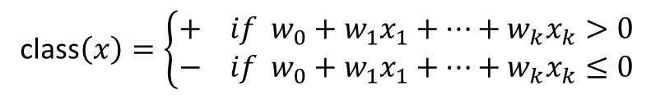
Linear Discriminant (4)
Q1: Can we use f(x) for class probability estimation?
Q2: Can we use f(x) to find the best decision boundary?
Class membership probability
-- not only a Y/N classification but also the corresponding likelihood of belonging to a class
-- e.g., How likely is a customer to churn (or respond to an offer)?
How likely is an account a fraudulent one?
-- DT → frequency-based estimate
-- Can any linear discriminants do this?
Scoring and ranking
-- no need of a precise class membership probability
-- only a score to rank instances by their likelihood
-- e.g., which customers are most likely to churn?
which accounts are most likely fraudulent?
-- Linear discriminants give us the ranking for FREE
-- $f\left(x\right)$: the distance from the decision boundary gives us
a natural ranking of instances by their likelihood
of belonging to the class of interest
$$f\left(x\right)$$
class$\left(x\right)=\left\{\begin{aligned}+ if w_{0}+w_{1}x_{1}+…+w_{k}x_{k}>0 \\ − if w_{0}+w_{1}x_{1}+…+w_{k}x_{k}≤0\end{aligned}\right.$
Logistic regression

Slide 18
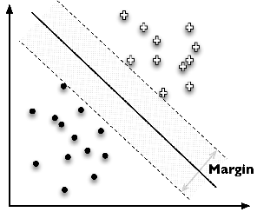


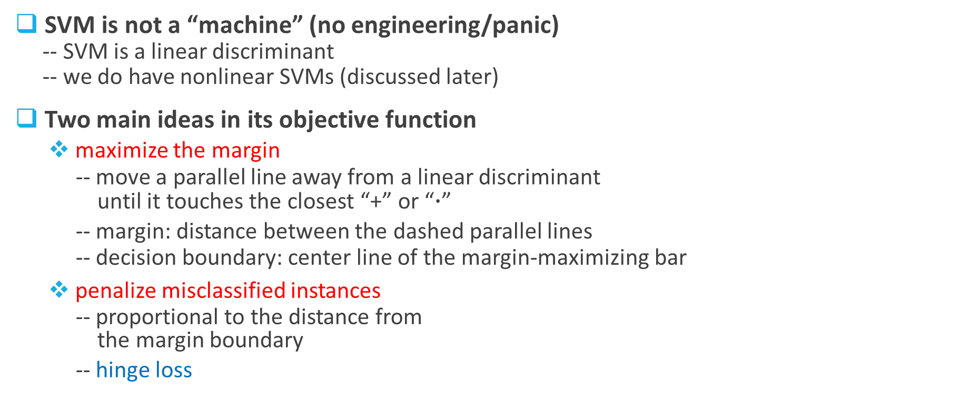
Support Vector Machine (SVM)
$$d_{2}$$
$$d_{1}$$
SVM is not a “machine” (no engineering/panic)
-- SVM is a linear discriminant
-- we do have nonlinear SVMs (discussed later)
Two main ideas in its objective function
maximize the margin
-- move a parallel line away from a linear discriminant
until it touches the closest “+” or “$∙$”
-- margin: distance between the dashed parallel lines
-- decision boundary: center line of the margin-maximizing bar
penalize misclassified instances
-- proportional to the distance from
the margin boundary
-- hinge loss
Support vector
Maximal leeway

Slide 19
Logistic Regression (1)
Is logistic regression a regression model or a classification model?
Distinction between regression and
classification
-- regression: target variable is numeric
-- classification: target variable is categorical
Logistic regression – a linear discriminant
-- produce a numeric estimate, but the
target variable is categorical
-- a classifier and estimates the class
membership probability
-- widely used in both academia and industry

Slide 20
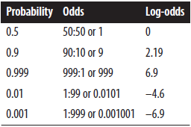


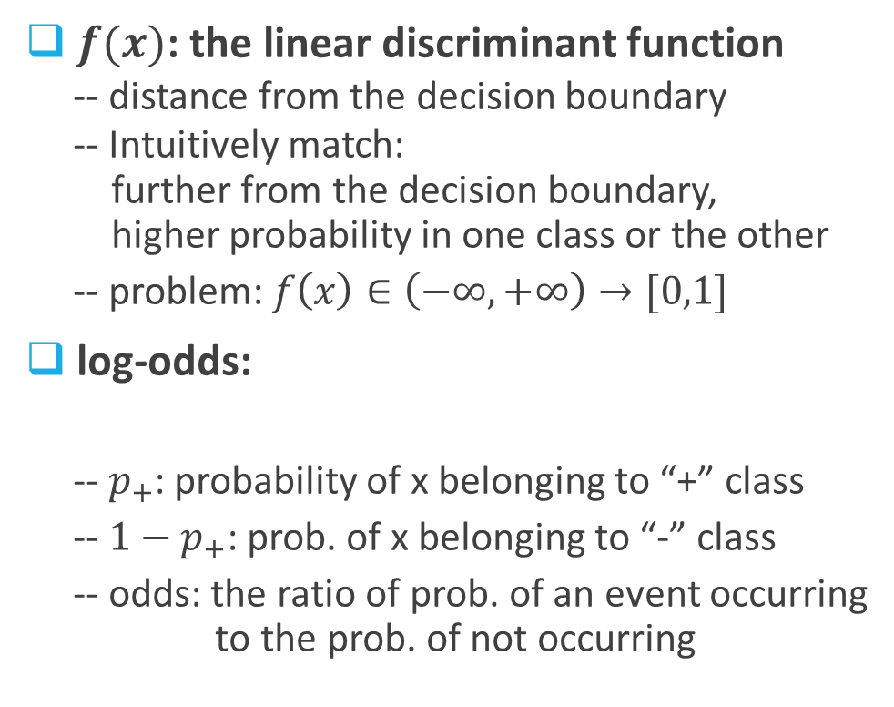
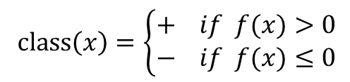

Logistic Regression (2)
$f(x)$: the linear discriminant function
-- distance from the decision boundary
-- Intuitively match:
further from the decision boundary,
higher probability in one class or the other
-- problem: $f\left(x\right)∈\left(−∞,+∞\right)→[0,1]$
log-odds:
-- $p_{+}$: probability of x belonging to “+” class
-- $1−p_{+}$: prob. of x belonging to “-” class
-- odds: the ratio of prob. of an event occurring
to the prob. of not occurring
$${f\left(x\right)=w}_{0}+w_{1}x_{1}+…+w_{k}x_{k}$$
$class\left(x\right)=\left\{\begin{aligned}+ if f(x)>0 \\ − if f(x)≤0\end{aligned}\right.$
likelihood

Slide 21



Logistic Regression (3)
log-odds linear function
-- log-odds of x in “+” class is equal to f(x)
logistic function
-- sigmoid function
-- “S”-shaped curve
-- larger f(x) → higher $p_{+}$
-- $f(x)=0$(at the boundary) → $p_{+}=0.5$
$${=f\left(x\right)=w}_{0}+w_{1}x_{1}+…+w_{k}x_{k}$$

Slide 22

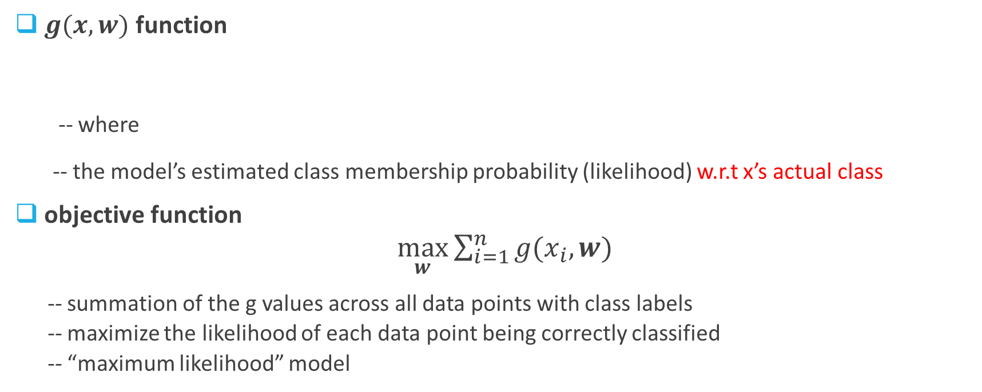

Logistic Regression (4)
Something is missing!
What is the objective function?
$g(x,w)$ function
-- where
-- the model’s estimated class membership probability (likelihood) w.r.t x’s actual class
objective function
$\max_{w}{\sum_{i=1}^{n}{g(x_{i},w)}}$
-- summation of the g values across all data points with class labels
-- maximize the likelihood of each data point being correctly classified
-- “maximum likelihood” model
$$p_{+}=\frac{1}{1+e^{−f(x)}}=\frac{1}{1+e^{−(w_{0}+w_{1}x_{1}+…+w_{k}x_{k})}}$$

Slide 23
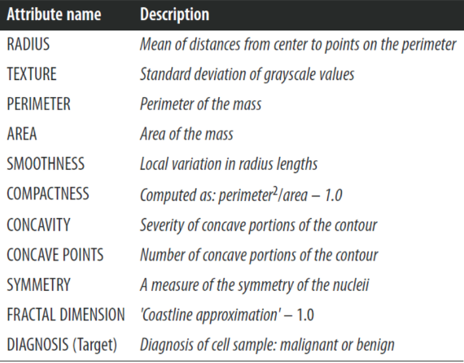
Wisconsin Breast Cancer Dataset (1)
Popular dataset
-- Each observation describes characteristics
of a cell nuclei image
-- target variable: benign or malignant
357 benign + 212 malignant
-- 10 characteristics:
mean, standard error, worst or largest
→ 30 measured attributes

Slide 24
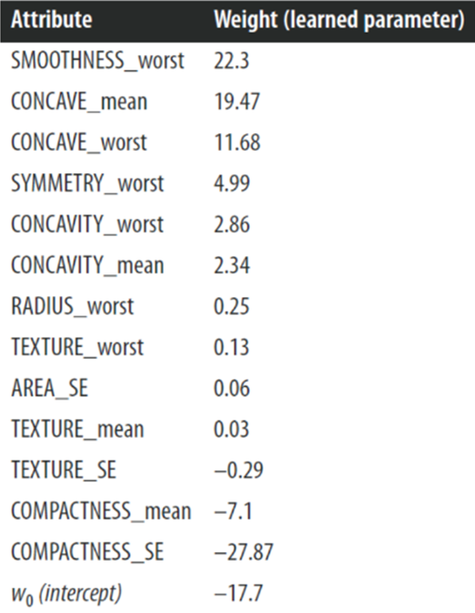
Wisconsin Breast Cancer Dataset (2)
Decision tree
Accuracy: 99.1%
Logistic regression
Accuracy: 98.9%

Slide 25
Decision Trees (DT) vs Linear Discriminants (LD)
Orientation of decision boundaries
-- DT: always axis-parallel/perpendicular
since it selects a single attribute at a time
-- LD: any direction
since it is a combination of all attributes with respective weights
Number of decision boundaries
-- DT: multiple “piecewise” segments
which can be arbitrarily fine into small regions
-- LD: single decision boundary
which splits the instance space into two segments
Which one is better?
Often advantageous to build different sorts of models to gain insights and find the best

Slide 26
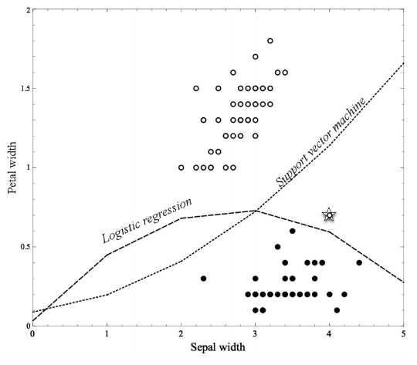


Non-linear Discriminant Functions
Linear functions can actually represent nonlinear models, if we include more complex
features in the functions
$${f\left(x\right)=w}_{0}+w_{1}×SepalWidth+w_{2}×PedalWidth$$
$${f\left(x\right)=w}_{0}+w_{1}×SepalWidth+w_{2}×PedalWidth$$
$$+w_{3}×{SepalWidth}^{2}$$
$$x_{3}$$

Slide 27
Overfitting in Linear Discriminants
Yes – like decision trees, linear discriminants may overfit data as well
Original Iris dataset
Iris dataset with
a single new Setosa added
Iris dataset with
a single new Versicolor added
LR changes its function considerably to accommodate the outliers – a sign of overfitting!
Why SVM does not have this issue?
– complexity control

Slide 28
Overfitting and Its Avoidance

Slide 29
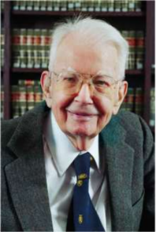
Overfitting (1)
Two fundamental notions of data science
Generalization
-- the property of a model or modeling process, whereby the model is
applied to data that were not used to build the model
-- we need a model that not only fits the training data but also generalizes
Overfitting
-- the tendency of data mining procedures to tailor models to the training data,
at the expense of generalization to previously unseen data points
-- test error rate begins to increase even though its training error rate continues to decrease
-- a fundamental trade-off between model complexity and overfitting
-- best strategy: recognize overfitting and manage complexity to cope with it
“If you torture the data long enough, it will confess” – Renald Coase

Slide 30
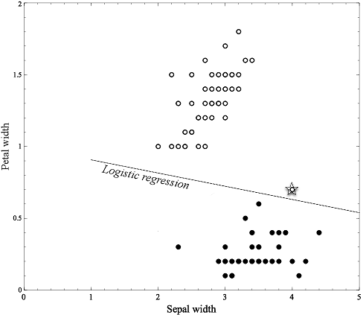
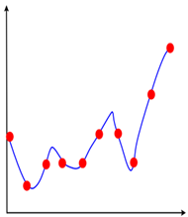
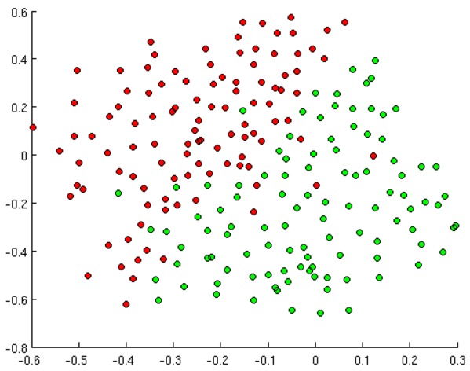
Overfitting (2)
all data-mining procedures have the tendency to overfit

Slide 31
Overfitting (3)
Due to presence of noise/outliers
-- noise: mislabeled training data
-- outlier: exceptional data points
-- often unavoidable in real-life applications
Due to lack of representative training data
-- when the training dataset is too small,
it lacks of characteristics of the general population
-- class imbalance: inadequate data from the rare class
Due to high level of model complexity
-- the more complex, the higher chance for overfitting
Decision tree: when the tree is too large (too many nodes)
Linear discriminant: too many variables or unnecessary nonlinear terms
Domain knowledge
Exploratory data analysis
Get more training data
Stratified sampling
Complexity control

Slide 32
Examine Overfitting
Holdout data
-- divide the original training dataset into two subsets --
* sub-training set: build the model
* validation set: evaluate the model (estimate the generalization error)
-- the validation set is the holdout data (not used for building the model)
Fitting graph
-- illustrate how the generalization error varies with the model complexity

Slide 33
Avoid Overfitting (1)
Control the model complexity
Occam’s Razor
-- given two models with the same generalization errors, the simpler model is preferred
over the more complex model set
General method (nested holdout procedure)
-- divide the original training set into a sub-training set and a validation set
-- generate a set of models at different levels of complexity using the sub-training set
-- estimate the generalization error for each model using the validation set
-- draw the fitting graph and find the “best” model with lowest generalization error
-- choose the corresponding complexity and use the entire training set
(subtraining + validation sets) to generate the “final” model

Slide 34

Avoid Overfitting (2)
Use the nested holdout procedure
Decision trees
-- prepruning
-- post-pruning
Linear discriminants
-- sequential forward selection (SFS)
starting with an empty feature set, recursively add the “best” feature
until no improvement of generalization accuracy on the validation set
-- sequential backward elimination
starting with a full feature set, continue to discard features one at a time
until no performance loss
-- regularization
optimize both fit to the data and simplicity of the model
by adding to the objective function a penalty for complexity

Slide 35
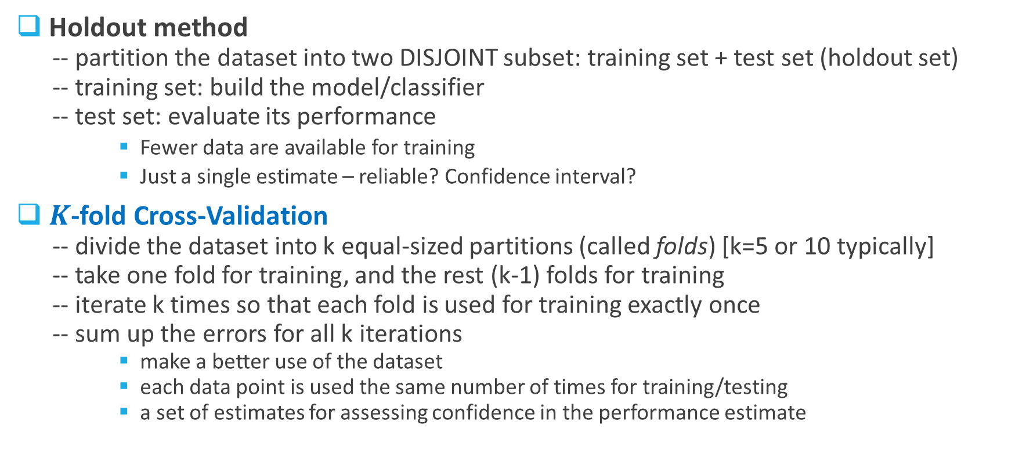
Methods for Evaluating a Classifier
Holdout method
-- partition the dataset into two DISJOINT subset: training set + test set (holdout set)
-- training set: build the model/classifier
-- test set: evaluate its performance
Fewer data are available for training
Just a single estimate – reliable? Confidence interval?
$K$-fold Cross-Validation
-- divide the dataset into k equal-sized partitions (called folds) [k=5 or 10 typically]
-- take one fold for training, and the rest (k-1) folds for training
-- iterate k times so that each fold is used for training exactly once
-- sum up the errors for all k iterations
make a better use of the dataset
each data point is used the same number of times for training/testing
a set of estimates for assessing confidence in the performance estimate

Slide 36
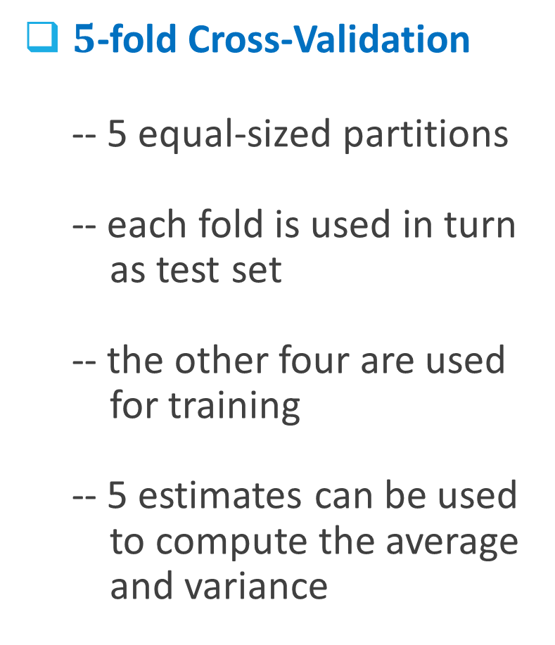
$5$-fold Cross-Validation
-- 5 equal-sized partitions
-- each fold is used in turn
as test set
-- the other four are used
for training
-- 5 estimates can be used
to compute the average
and variance

Slide 37
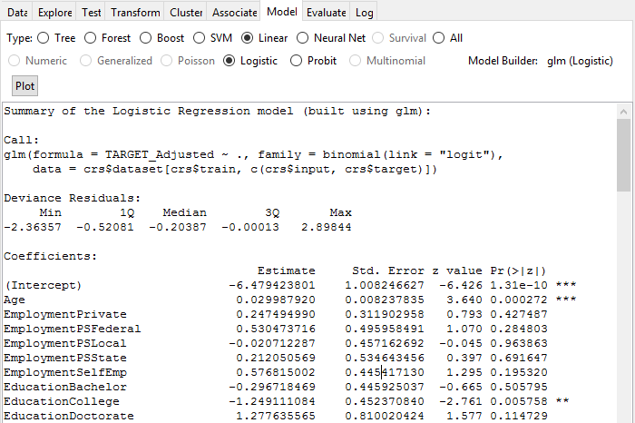
R function that builds the model
A measure of model fit that shows the distribution of the deviance residuals for individual instance used in the model
Coefficients, SE, z-statistic, and the associated p-value.
For p-value <= 5% (significance level), it suggests rejecting the null hypothesis → the value of the variable is said to be statistically significant

