Slide 1
Data Science
MSCI:6070 Spring 2017
Lecture 5 (2/20/17)

Slide 2
Decision Tree for PlayTennis
Attributes and their values:
Outlook: Sunny, Overcast, Rain
Humidity: High, Normal
Wind: Strong, Weak
Temperature: Hot, Mild, Cool
Target variable - Play Tennis: Yes, No

Slide 3
Training Examples
Day
Outlook
Temp.
Humidity
Wind
Play Tennis ?
D1
Sunny
Hot
High
Weak
No
D2
Sunny
Hot
High
Strong
No
D3
Overcast
Hot
High
Weak
Yes
D4
Rain
Mild
High
Weak
Yes
D5
Rain
Cool
Normal
Weak
Yes
D6
Rain
Cool
Normal
Strong
No
D7
Overcast
Cool
Normal
Weak
Yes
D8
Sunny
Mild
High
Weak
No
D9
Sunny
Cool
Normal
Weak
Yes
D10
Rain
Mild
Normal
Strong
Yes
D11
Sunny
Mild
Normal
Strong
Yes
D12
Overcast
Mild
High
Strong
Yes
D13
Overcast
Hot
Normal
Weak
Yes
D14
Rain
Mild
High
Strong
No

Slide 4
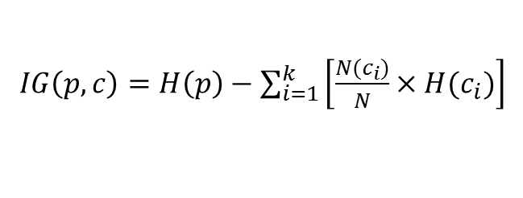

Select Attribute (1)
$H\left(S\right)=−p_{+}\log_{2}{p_{+}−p_{−}\log_{2}{p_{−}}}$
$IG\left(p, c\right)=H\left(p\right)−\sum_{i=1}^{k}{\left[\frac{N(c_{i})}{N}×H(c_{i})\right]}$
S=[9+,5-]
E=0.940
S=[9+,5-]
E=0.940
Humidity
Wind
High
Normal
Weak
Strong
[3+, 4-]
[6+, 1-]
[6+, 2-]
[3+, 3-]
E=0.985
E=0.592
E=0.811
E=1.0
IG(S,Humidity)
=0.940-(7/14)*0.985
– (7/14)*0.592
=0.151
IG(S,Wind)
=0.940-(8/14)*0.811
– (6/14)*1.0
=0.048
Humidity provides greater info. gain than Wind, w.r.t target classification.

Slide 5
Select Attribute (2)
Note: 0Log₂0 =0
Log₂ (x) = Log₁₀ (x) / Log₁₀ (2)
Log₂ (x) = Ln(x) / Ln(2)
S=[9+,5-]
E=0.940
S=[9+,5-]
E=0.940
Outlook
Temperature
Sunny
Rain
Hot
cool
Overcast
mild
[2+, 3-]
[4+, 0]
[3+, 2-]
[2+, 2-]
[4+, 2-]
[3+, 1-]
E=0.971
E=0.0
E=0.971
E=1.0
E=0.92
E=0.971
IG(S,Outlook)
=0.940 - (5/14)*0.971 - (4/14)*0.0 - (5/14)*0.971
=0.247
IG(S, Temperature)
=0.940 - (4/14)*1.0 - (6/14)*0.92 - (4/14)*0.971
=0.03

Slide 6
Select Attribute (3)
The information gain values for the 4 attributes are:
Gain(S,Outlook) =0.247
Gain(S,Humidity) =0.151
Gain(S,Wind) =0.048
Gain(S,Temperature) =0.029
Outlook is the most informative attribute,
and so is selected as the test condition for the root node

Slide 7
Continue...
[D1,D2,…,D14]
[9+,5-]
Outlook
Sunny
Rain
Overcast
[D1,D2,D8,D9,D11]
[2+,3-]
[D3,D7,D12,D13]
[4+,0-]
[D4,D5,D6,D10,D14]
[3+,2-]
?
Yes
?
Test for this node
Test for this node as well
Gain(S_{sunny} , Humidity) = 0.970 - (3/5)*0.0 – (2/5)*0.0 = 0.970
Gain(S_{sunny} , Temp.) = 0.970 - (2/5)*0.0 –2/5*(1.0) - (1/5)*0.0 = 0.570
Gain(S_{sunny} , Wind) = 0.970 - (2/5)*1.0 – 3/5*(0.918) = 0.019

Slide 8
Decision Tree
Note: in each decision node, it should be a test condition based on some specific attribute instead of the value of the attribute, which is denoted on the branch
Outlook
Sunny
Overcast
Rain
Humidity
Yes
Wind
[D3,D7,D12,D13]
[4+, 0-]
High
Normal
Strong
Weak
No
Yes
No
Yes
[D1,D2,D8]
[0+,3-]
[D9,D11]
[2+,0-]
[D6,D14]
[0+,2-]
[D4,D5,D10]
[3+,0-]

Slide 9
Artificial Neural Network (ANN)

Slide 10
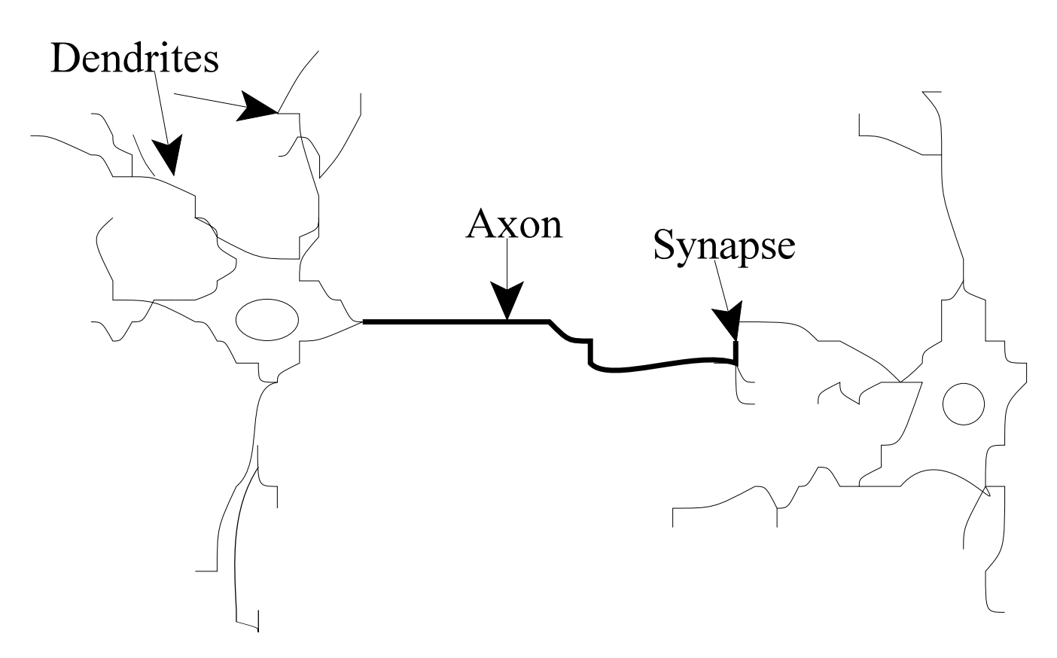
How the human brain learns
neuron
Our brains use extremely large interconnected networks of neurons to process information
Electrical inputs are passed through this network of neurons which result in an output being
produced. Natural neurons receive signals through synapses located on the dendrites of the
neuron. When the signals received are strong enough (surpass a certain threshold), the neuron
is activated and emits a signal through the axon. This signal might be sent to another synapse,
and might activate other neurons.

Slide 11
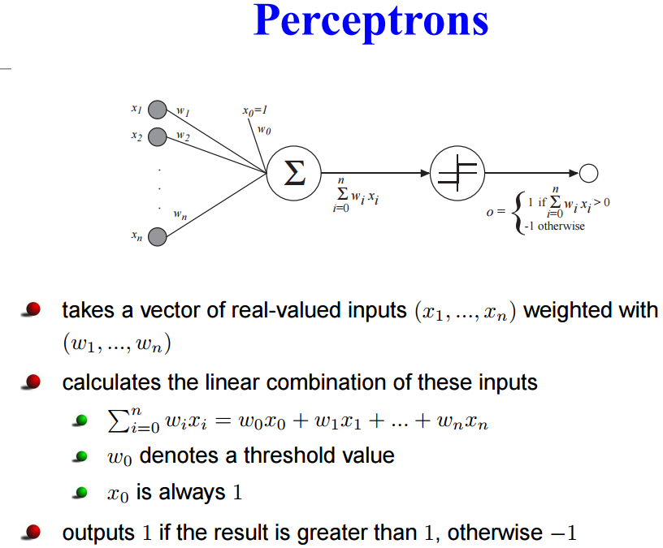

Slide 12
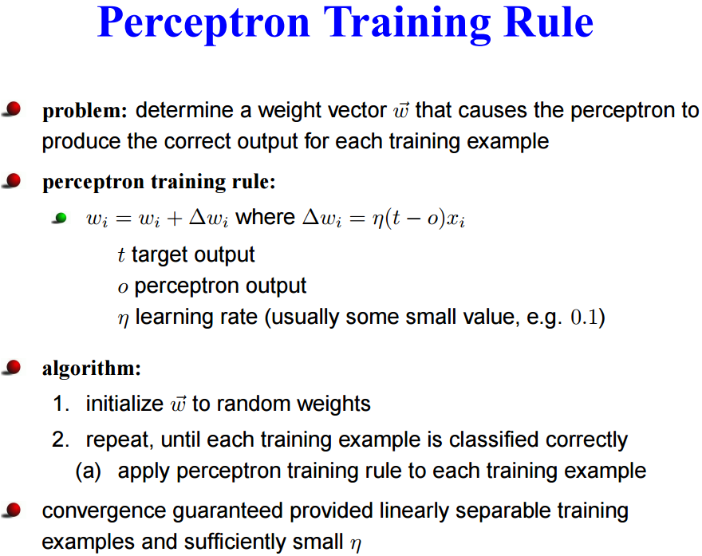

Slide 13
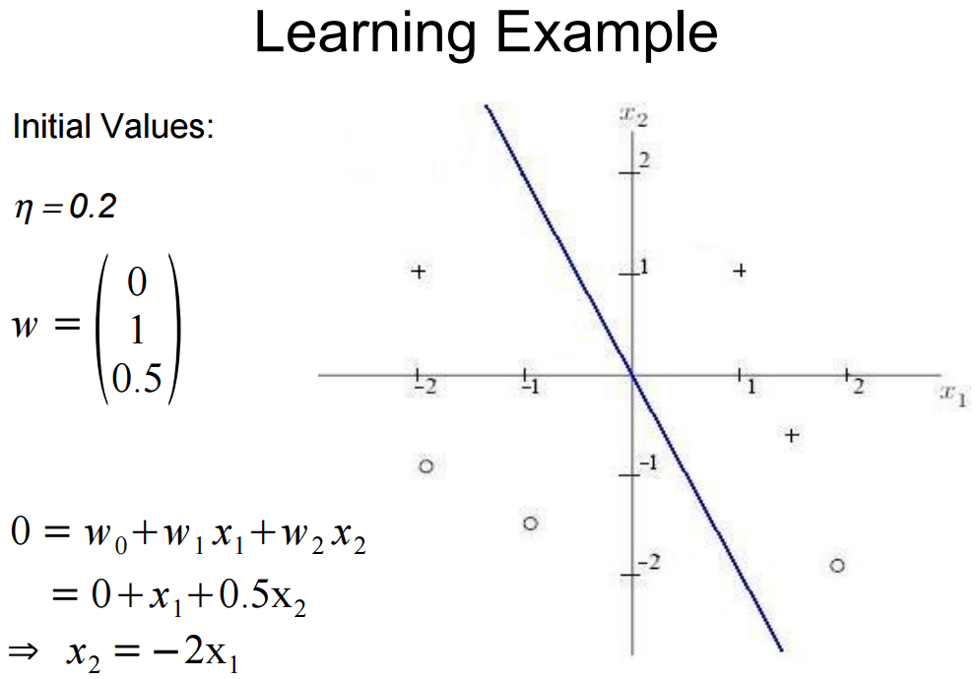

Slide 14
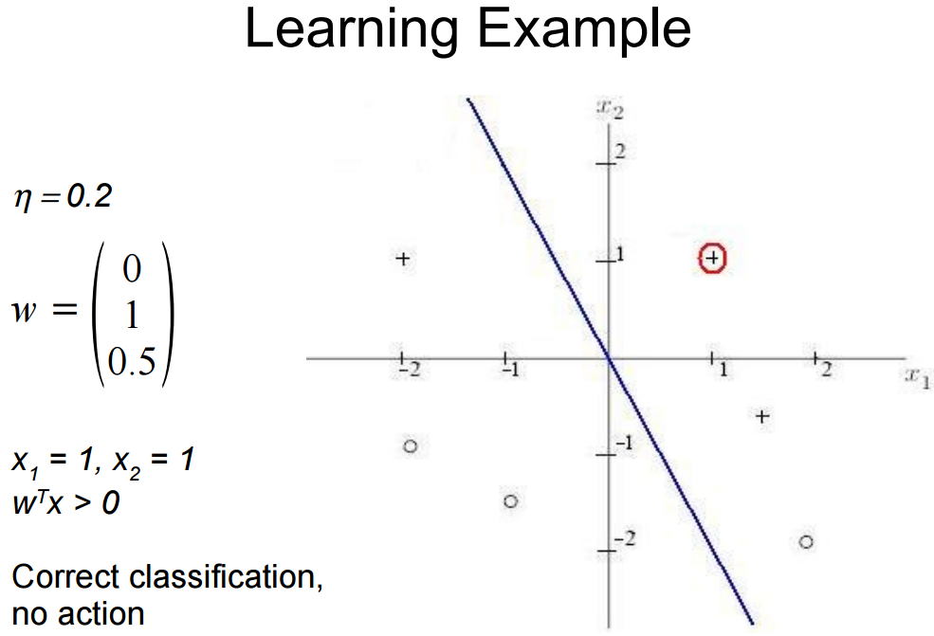

Slide 15
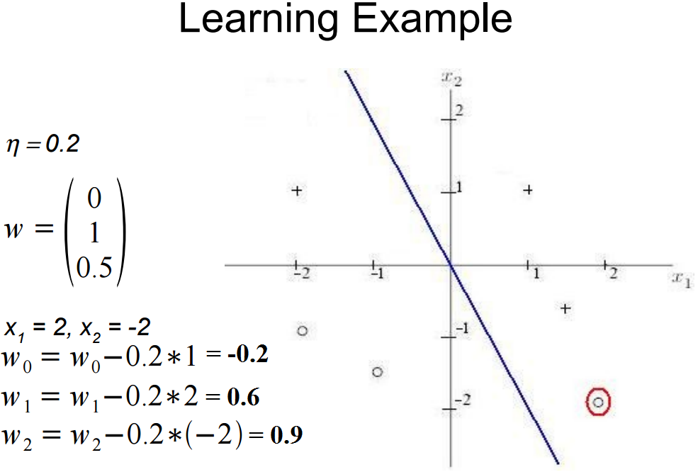

Slide 16
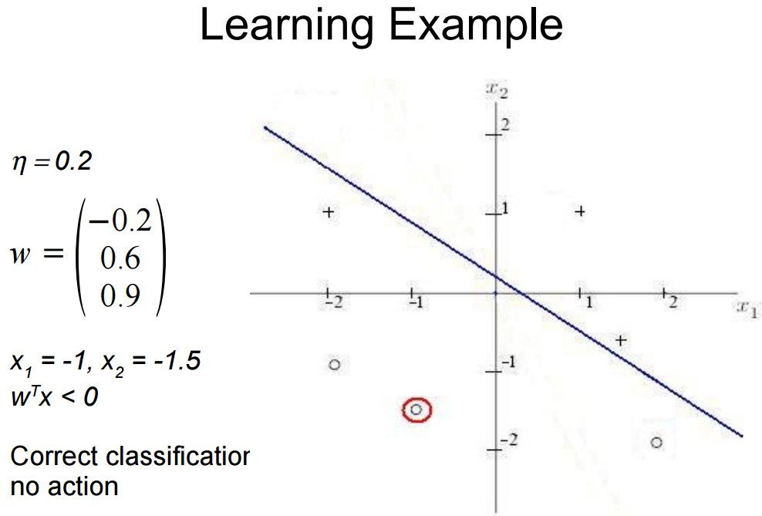


Slide 17
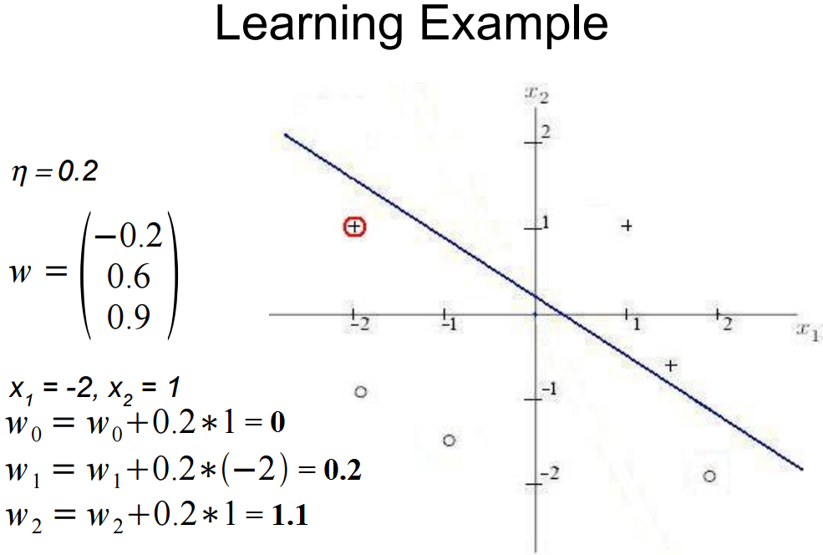

Slide 18
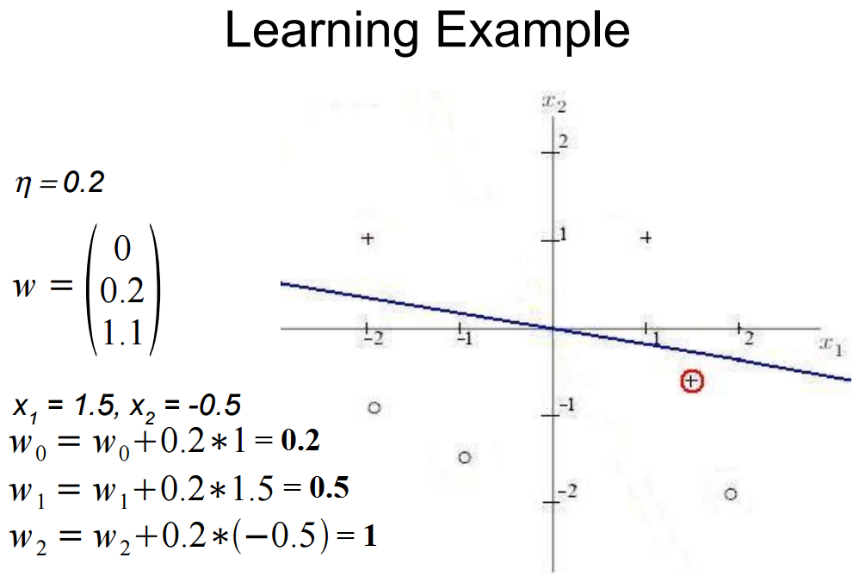

Slide 19
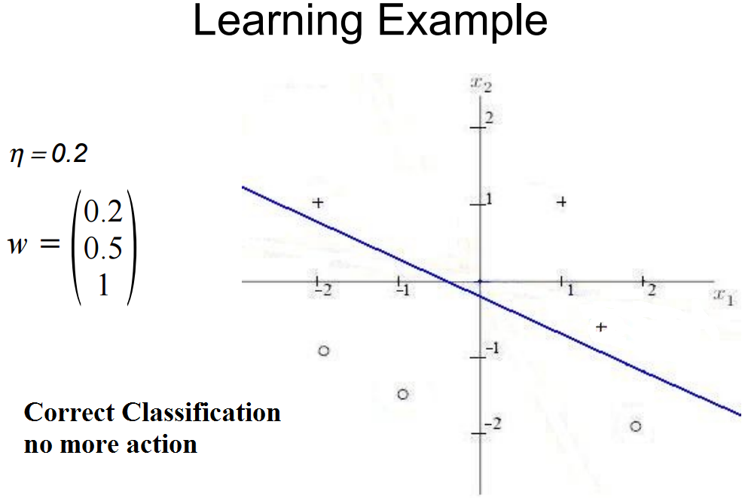

Slide 20
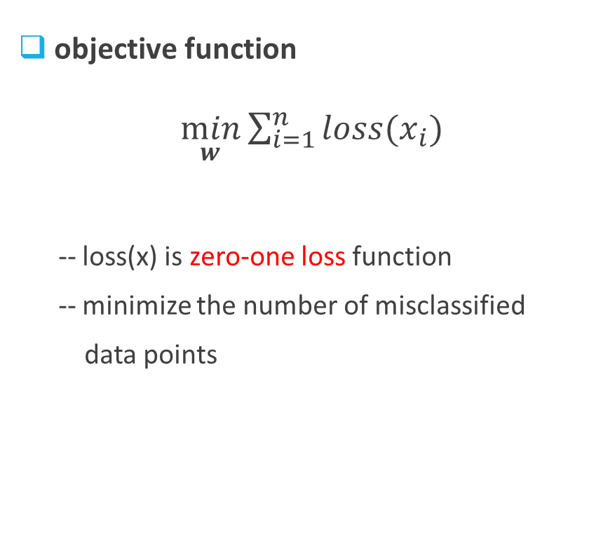
Perceptron
objective function
$\min_{w}{\sum_{i=1}^{n}{loss(x_{i})}}$
-- loss(x) is zero-one loss function
-- minimize the number of misclassified
data points

Slide 21
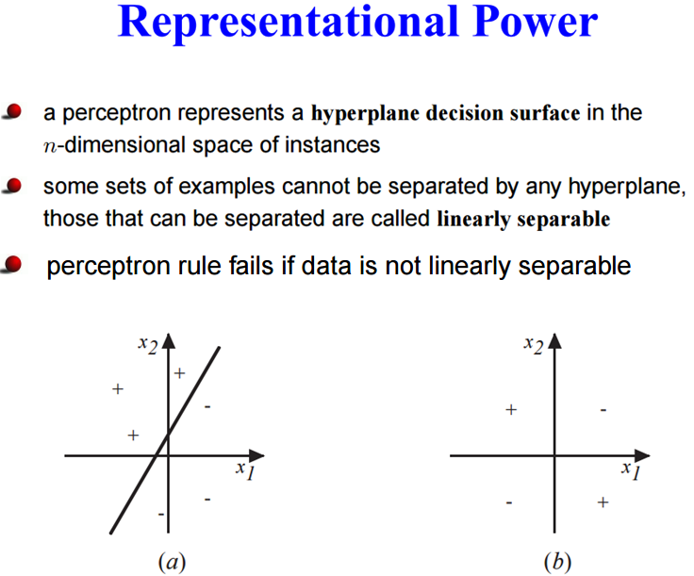

Slide 22
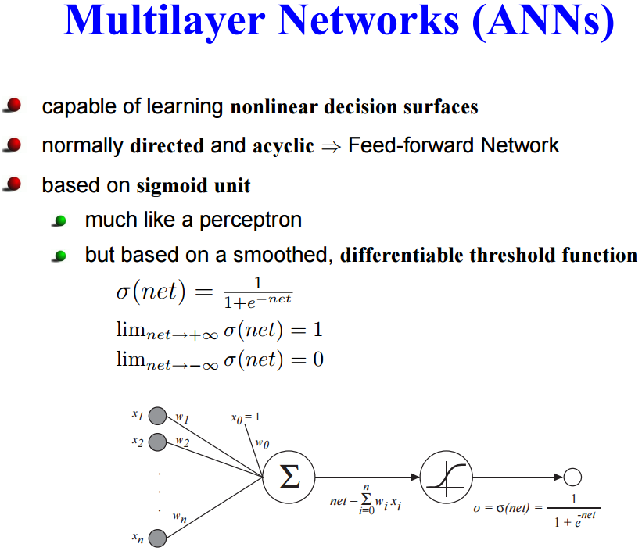

Slide 23
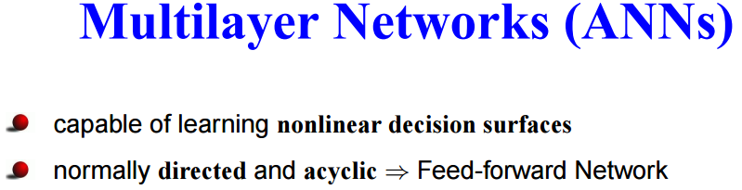
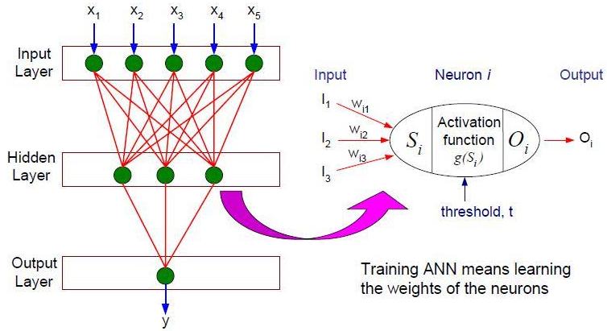

Slide 24
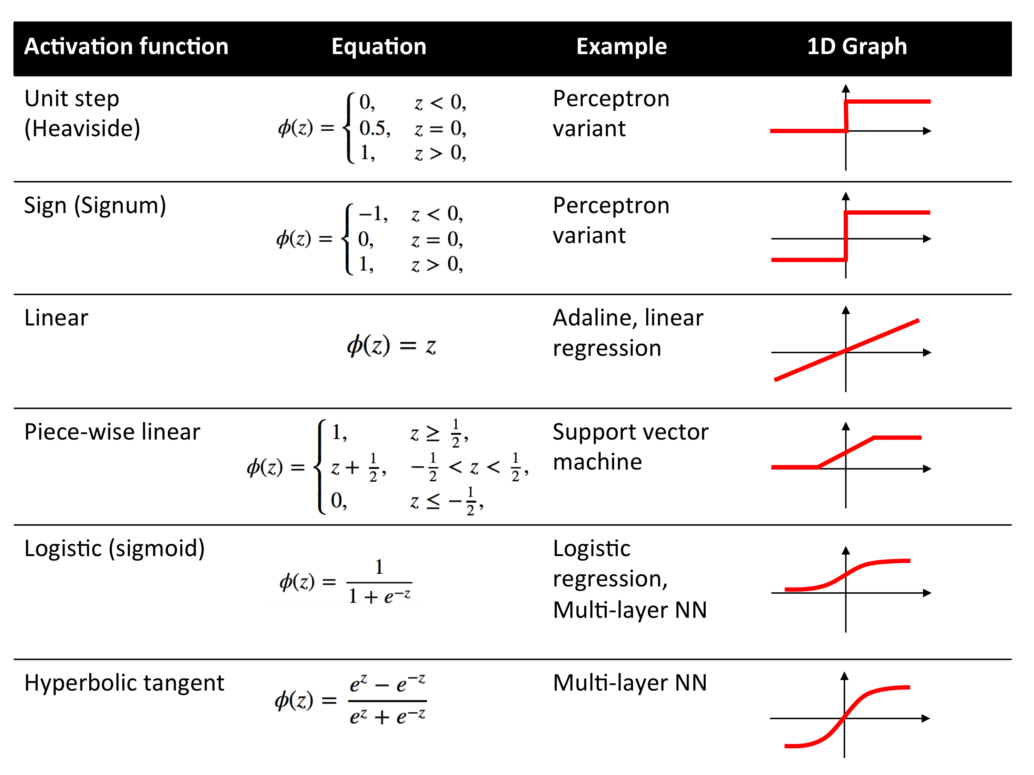

Slide 25
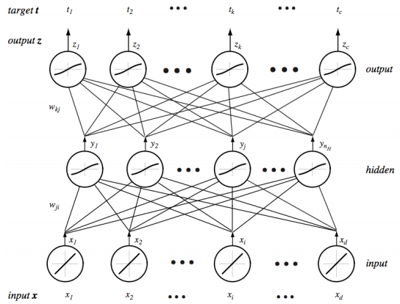
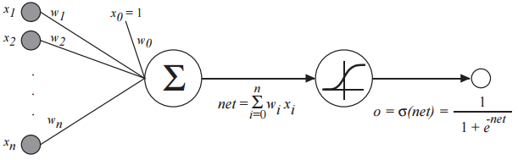

Slide 26
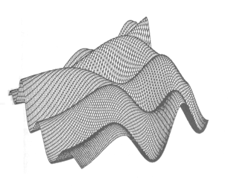
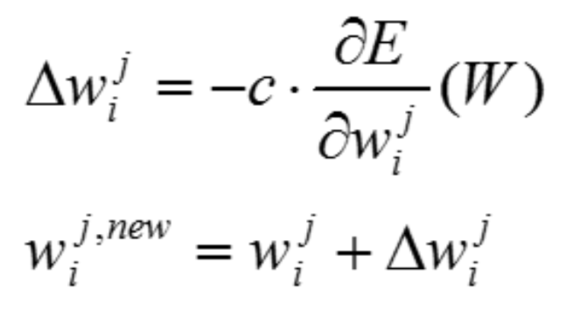
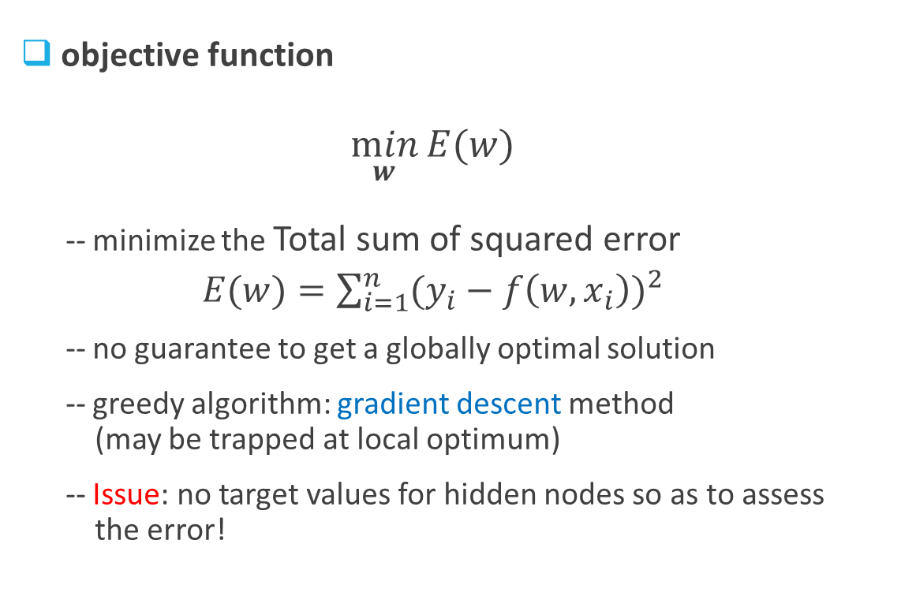
Multilayer ANN
objective function
$\min_{w}{E(w)}$
-- minimize the Total sum of squared error
$E(w)=\sum_{i=1}^{n}{{(y_{i}−f\left(w, x_{i}\right))}^{2}}$
-- no guarantee to get a globally optimal solution
-- greedy algorithm: gradient descent method
(may be trapped at local optimum)
-- Issue: no target values for hidden nodes so as to assess
the error!

Slide 27
Backpropagation
Two phases (in each iteration)
Forward phase
-- compute the output value of each neuron using the weights from previous iteration
-- computation progresses in the forward direction: level k computed prior to level k+1
Backward phase
-- weights are updated in the reverse direction:
* weights at level k+1 are updated before the weights at level k are updated
* use the errors for neurons at level k+1 to estimate the errors for neurons at level k

Slide 28
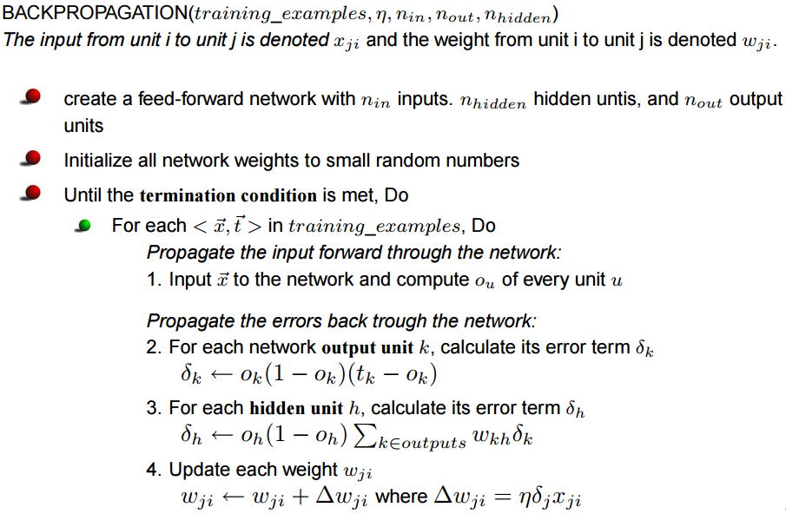

Slide 29
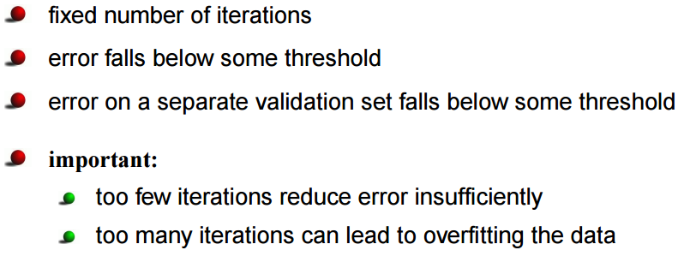
Termination condition
Another approach for complexity control is: progressively change the number of nodes in the hidden layer, repeat the model-building and evaluation procedure to find the right model complexity

Slide 30
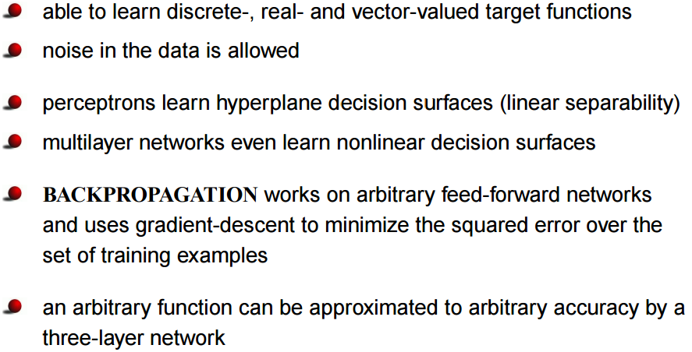
Summary
Note: missing values in the dataset should be removed or imputed

