Slide 1
Data Science
MSCI:6070 Spring 2017
Lecture 6 (2/27/17)

Slide 2
Support Vector Machine
History
-- invented as a linear discriminant by Vapnik and Chervonenkis in 1963
-- extended to create nonlinear classifiers using “kernel trick” in 1992
-- gained increasing popularity in late 1990s
-- one of the best classification models for various applications
* text/hypertext categorization
* image segmentation
* biological and environmental sciences
Types
-- linear SVMs
*original maximum-margin hyperplane
-- nonlinear SVMs
* kernel functions to create nonlinear decision boundaries

Slide 3
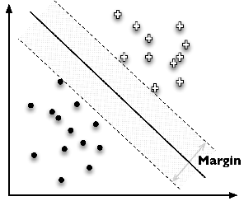


Maximum-Margin Hyperplanes
Which one is the best?
-- there may infinitely many linear discriminants that classify the training data perfectly
-- different choices affect the generalization errors!
$$d_{2}$$
$$d_{1}$$
Support vector
Maximal leeway

Slide 4
Linear SVM: separable case (1)
Goal: maximize the margin around the separating hyperplane
-- A.k.a. maximal margin classifier
The decision function is fully specified by the set of support vectors
-- other data points are ignorable
Solving SVMs is a quadratic programming problem

Slide 5
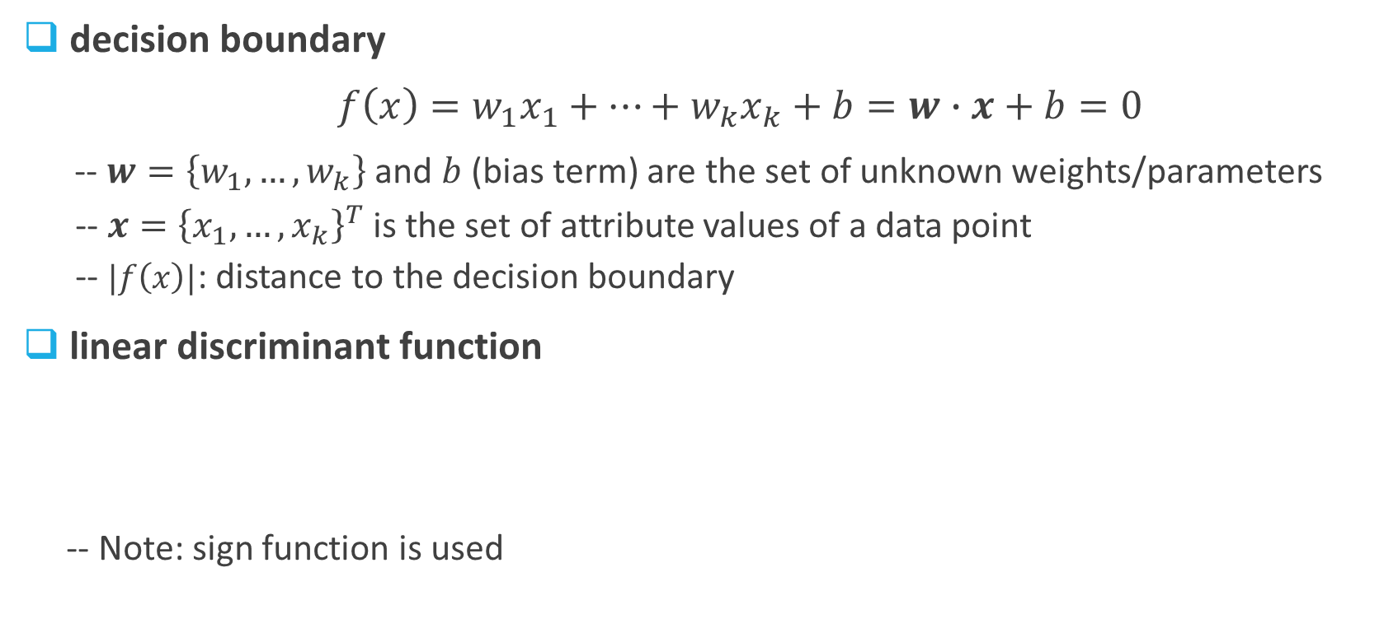
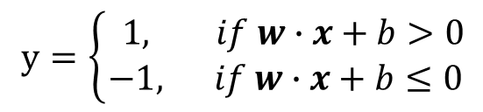
Linear SVM: separable case (2)
decision boundary
$f\left(x\right)=w_{1}x_{1}+…+w_{k}x_{k}+b=w∙x+b=0$
-- $w=\left\{w_{1},…,w_{k}\right\}$ and $b$ (bias term) are the set of unknown weights/parameters
-- $x={\left\{x_{1},…,x_{k}\right\}}^{T}$ is the set of attribute values of a data point
-- $|f\left(x\right)|$: distance to the decision boundary
linear discriminant function
-- Note: sign function is used
$y=\left\{\begin{aligned} 1, if w∙x+b>0 \\ −1, if w∙x+b≤0\end{aligned}\right.$

Slide 6
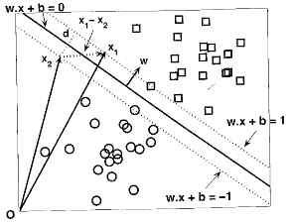

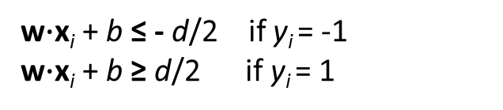
Linear SVM: separable case (3)
margin
Let training set {(x_{i}, y_{i})}_{i=1..n}, x_{i}∈R^{d}, y_{i} ∈ {-1, 1} be separated by a hyperplane with margin d. Then for each training example (x_{i}, y_{i}):
For every support vector x_{s} the above inequality is an equality. After rescaling w and b by d/2 in the equality, we obtain that distance between each x_{s} and the hyperplane is
Then the margin can be expressed through (rescaled) w and b as:
w$∙$x_{i} + b ≤ - d/2 if y_{i} = -1
w$∙$x_{i} + b ≥ d/2 if y_{i} = 1
⇔
y_{i}(w$∙$x_{i} + b) ≥ d/2

Slide 7
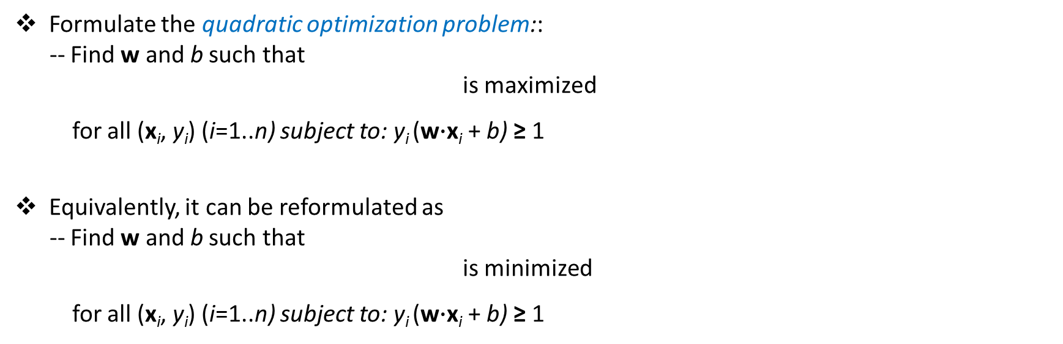
Linear SVM: separable case (4)
objective function
Formulate the quadratic optimization problem::
-- Find w and b such that
is maximized
for all (x_{i}, y_{i}) (i=1..n) subject to: y_{i} (w$∙$x_{i} + b) ≥ 1
Equivalently, it can be reformulated as
-- Find w and b such that
is minimized
for all (x_{i}, y_{i}) (i=1..n) subject to: y_{i} (w$∙$x_{i} + b) ≥ 1
optimize a quadratic function subject to linear constraints

Slide 8
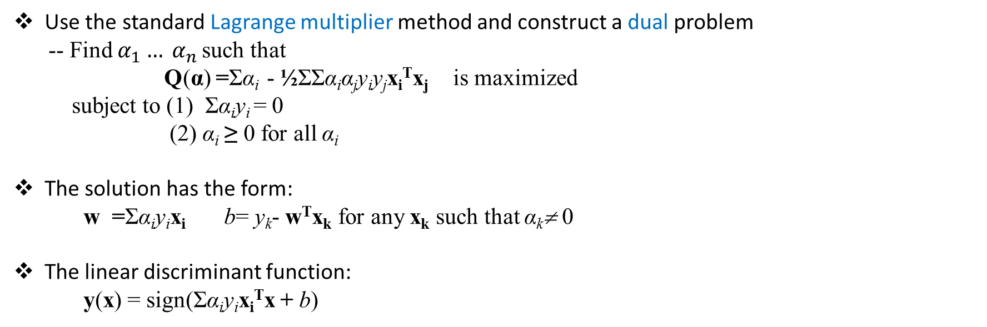
Linear SVM: separable case (5)
learn the model
-- Solve the quadratic optimization problem using the training data
Use the standard Lagrange multiplier method and construct a dual problem
-- Find $α_{1}… α_{n}$ such that
Q(α) =Σα_{i} - ½ΣΣα_{i}α_{j}y_{i}y_{j}x_{i}^{T}x_{j} is maximized
subject to (1) Σα_{i}y_{i} = 0
(2) α_{i} ≥ 0 for all α_{i}
The solution has the form:
w =Σα_{i}y_{i}x_{i} b= y_{k}- w^{T}x_{k} for any x_{k} such that α_{k}≠ 0
The linear discriminant function:
y(x) = sign(Σα_{i}y_{i}x_{i}^{T}x + b)
Note:
1. Each non-zero α_{i} indicates that corresponding x_{i} is a support vector
2. b might not be unique – take the average as the final b value
3. It involves computing inner product: x_{i}^{T}x_{j} between all pairs of training points, and x_{i}^{T}x when classifying a new data point

Slide 9
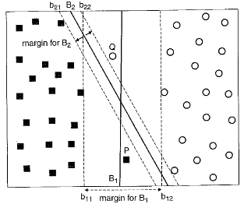
Linear SVM: nonseparable case
Case 1: which one is better, B1 or B2?
-- B1 misclassifies P and Q while
B2 is mistake-free?
Case 2: what should we do when the
classes are NOT linearly separable?

Slide 10

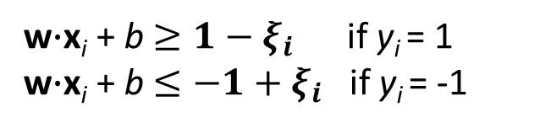
Soft Margin Approach (1)
Consider trade-off between the width of margin and the training error
Allow some errors but also penalize the misclassification
Introduce positive-valued slack variables
into the linear inequality constraints
where $∀i: ξ_{i}>0$
$ξ_{i}$ provides an estimate of the error of
the decision boundary on data point $x_{i}$
w$∙$x_{i} + b $≥1−ξ_{i}$ if y_{i} = 1
w$∙$x_{i} + b $≤−1+ξ_{i}$ if y_{i} = -1
ξ_{i}
ξ_{j}

Slide 11
Soft Margin Approach (2)
Sec. 15.2.1
The original formulation:
The modified formulation incorporating slack variables:
Find w and b such that
Φ(w) =½ w^{T}w is minimized
for all {(x_{i} ,y_{i})}: y_{i} (w^{T}x_{i} + b) ≥ 1
A regularization term
C: can be used as a
complexity
parameter for
overfitting control
Find w and b such that
Φ(w) =½ w^{T}w + CΣξ_{i} is minimized
for all {(x_{i} ,y_{i})}: y_{i} (w^{T}x_{i} + b) ≥ 1- ξ_{i} and ξ_{i} ≥ 0 for all i

Slide 12
Soft Margin Approach (3)
Sec. 15.2.1
The dual problem for soft margin classification:
Solution to the dual problem is:
Find α₁…α_{n} such that
Q(α) =Σα_{i} - ½ΣΣα_{i}α_{j}y_{i}y_{j}x_{i}^{T}x_{j} is maximized
subject to (1) Σα_{i}y_{i} = 0
(2) 0 ≤ α_{i} ≤ C for all α_{i}
The linear discriminant function:
y(x) = sign(Σα_{i}y_{i}x_{i}^{T}x + b)
w = Σα_{i}y_{i}x_{i}
b = y_{k}(1- ξ_{k}) - w^{T}x_{k} where k = argmax α_{k’}
k’
1. Each x_{i} with non-zero α_{i} is a support vector
2. It involves computing inner product

Slide 13
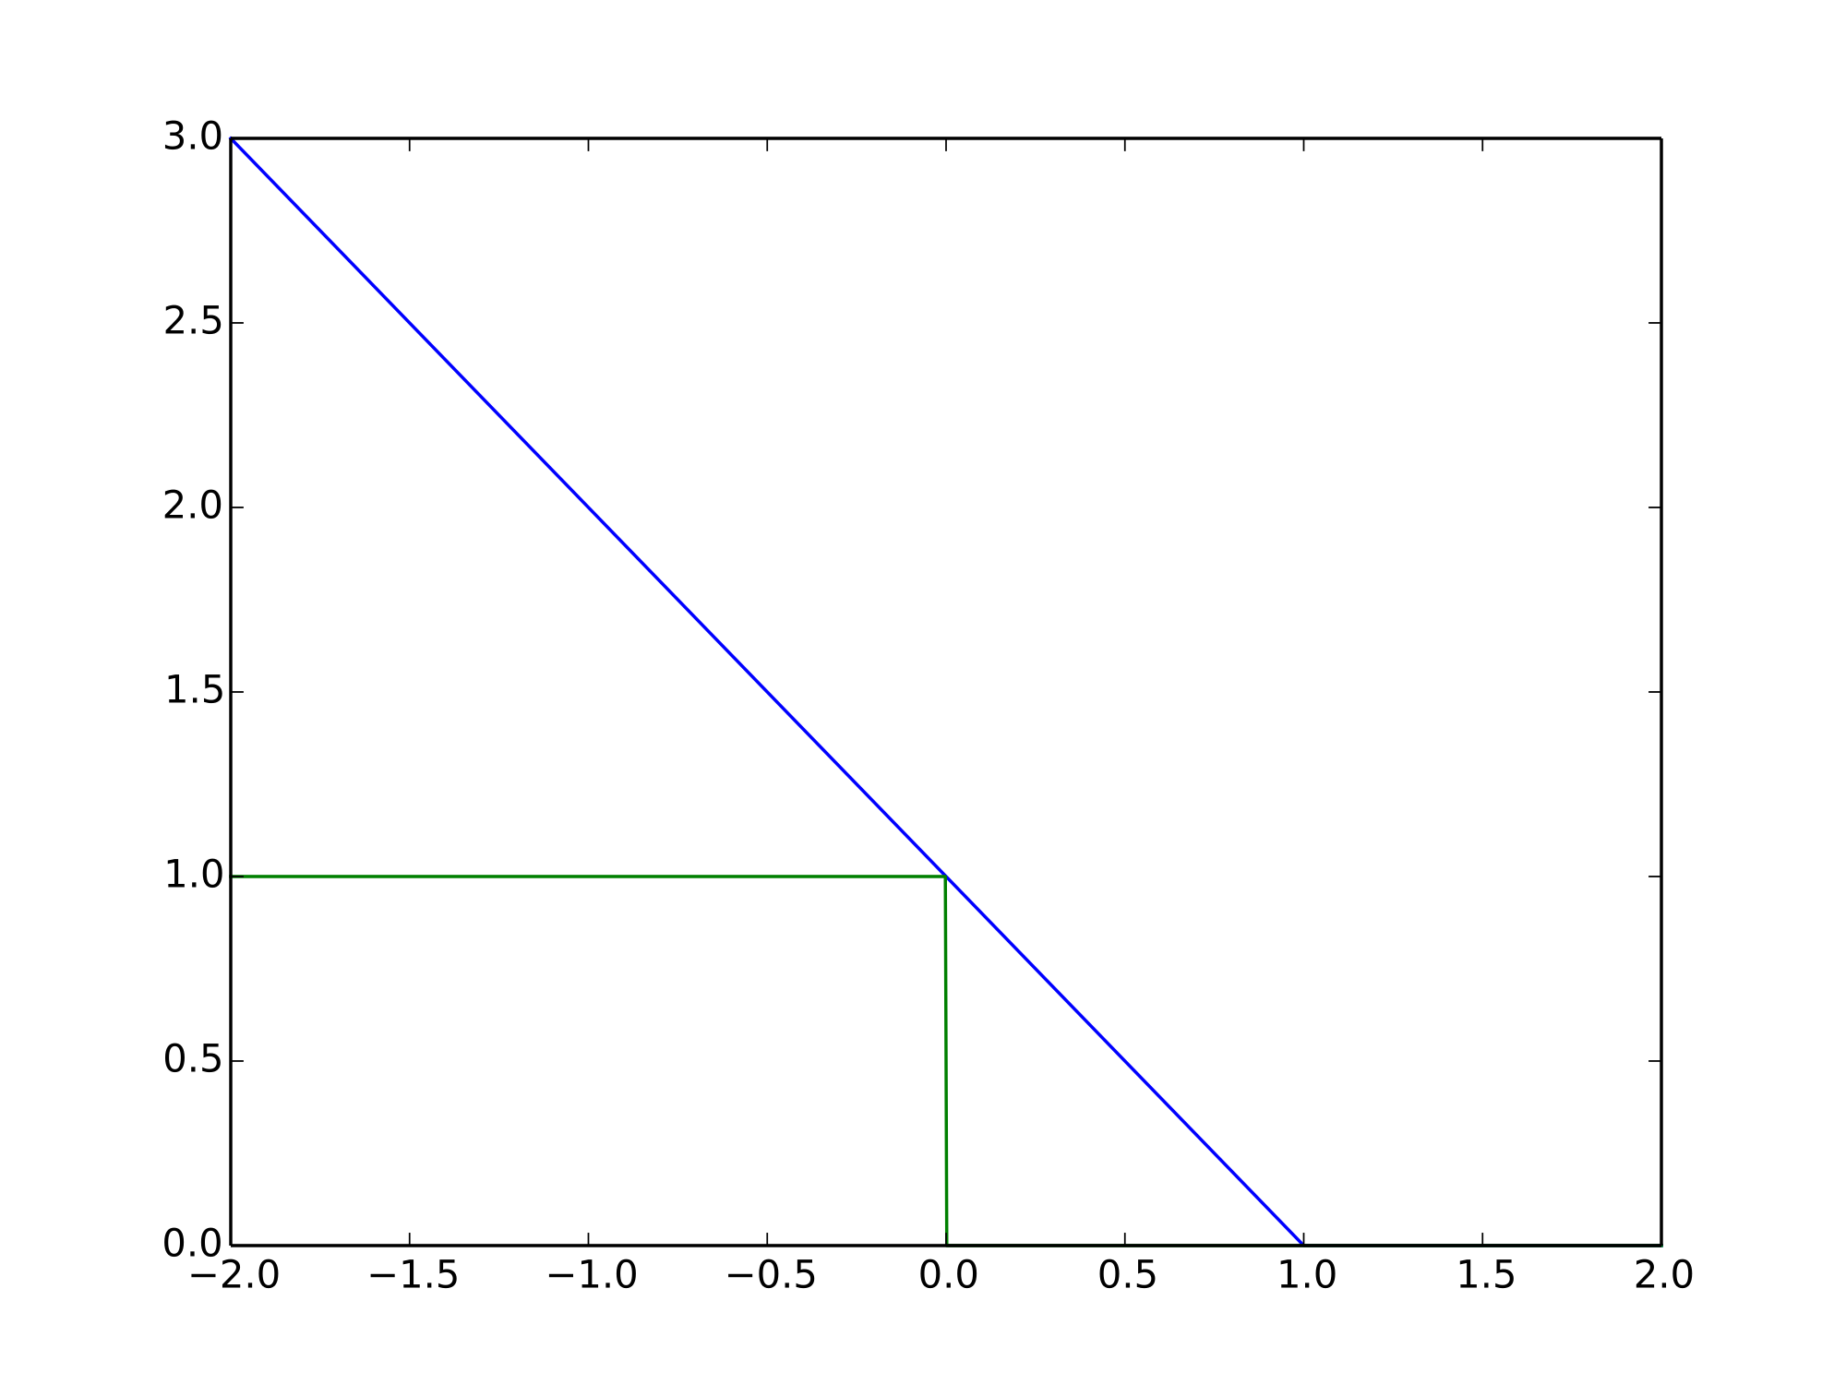
Soft Margin Approach (4)
Objective function is the hinge loss
Loss
Hinge Loss
Zero-one Loss
yf(x)
(Variation) - you may also choose to ignore a certain amount of error
Wrong side
margin
Correct side

Slide 14
Overfitting in Linear Discriminants
Yes – like decision trees, linear discriminants may overfit data as well
Original Iris dataset
Iris dataset with
a single new Setosa added
Iris dataset with
a single new Versicolor added
LR changes its function considerably to accommodate the outliers – a sign of overfitting!
Why SVM does not have this issue?
– complexity control

Slide 15
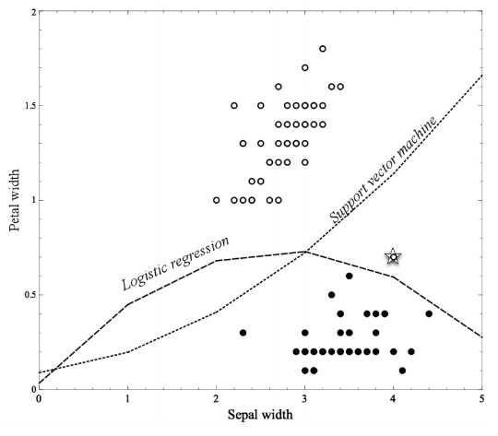


Non-linear Discriminant Functions
Linear functions can actually represent nonlinear models, if we include more complex
features in the functions
$${f\left(x\right)=w}_{0}+w_{1}×SepalWidth+w_{2}×PedalWidth$$
$${f\left(x\right)=w}_{0}+w_{1}×SepalWidth+w_{2}×PedalWidth$$
$$+w_{3}×{SepalWidth}^{2}$$
$$x_{3}$$

Slide 16
Linear SVMs: Summary
Sec. 15.2.1
The classifier is a separating hyperplane (almost always generalize better than logistic regression)
The most “important” training points are the support vectors; they define the hyperplanes
Quadratic optimization algorithms can identify which training points x_{i} are support vectors
with non-zero Lagrangian multipliers α_{i}
Both in the dual formulation of the problem and in the solution, training points appear only
inside inner products:
Find α₁…α_{N} such that
Q(α) =Σα_{i} - ½ΣΣα_{i}α_{j}y_{i}y_{j}x_{i}^{T}x_{j} is maximized and
(1) Σα_{i}y_{i} = 0
for all α_{i,}α_{i} ≥ 0 (for separable cases) or
0 ≤ α_{i} ≤ C (for nonseparable cases)
y(x) = sign(Σα_{i}y_{i}x_{i}^{T}x + b)

Slide 17
Non-linear SVMs (1)
Sec. 15.2.3
Datasets that are linearly separable
(with some noise) work out great:
But what are we going to do if the dataset
is just too hard?
How about … mapping data to a higher-
dimensional space?
0
x
0
x
x²
0
x

Slide 18
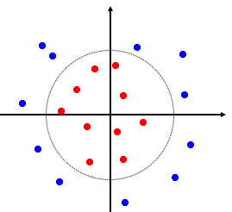

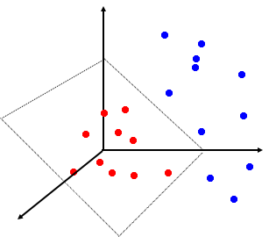
Non-linear SVMs (2)
General idea: the original feature space can always be mapped to some higher-dimensional feature space where the training set is linearly separable
Potential issue: curse of dimensionality problem often associated with high-dimensional data

Slide 19

The “Kernel Trick” (1)
Sec. 15.2.3
A method for computing dot product (similarity) in the transformed space using
the original attribute set
-- The linear classifier relies on an inner product between vectors K(x_{i},x_{j})=x_{i}^{T}x_{j}
-- If every data point is mapped into high-dimensional space via some transformation
Φ: x → φ(x), the inner product becomes:
K(x_{i},x_{j})= φ(x_{i}) ^{T}φ(x_{j})
-- A kernel function is some function that is computed in the original attribute space but
corresponds to an inner product in some expanded feature space
-- Example:

Slide 20

The “Kernel Trick” (2)
Sec. 15.2.3
Why use kernels?
Make non-separable problem separable
Map data into better representational space
Reduce computational cost
Avoid the issues associated with the curse of dimensionality
Common kernels
Linear: K(x,z) = x^{T}z
Polynomial: K(x,z) = (1+x^{T}z)^{d}
Gives feature conjunctions
Radial basis function (RBF)
infinite dimensional space

Slide 21
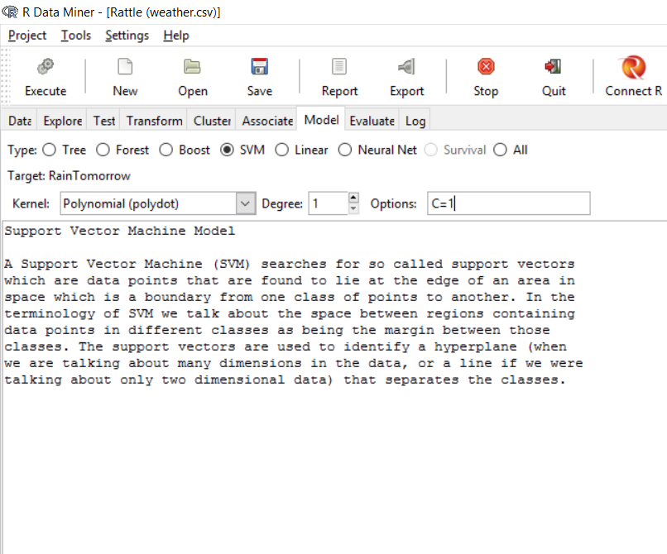
SVM in Rattle
Model|SVM
Polynomial degree 1
(In this case)
Options C=1

Slide 22
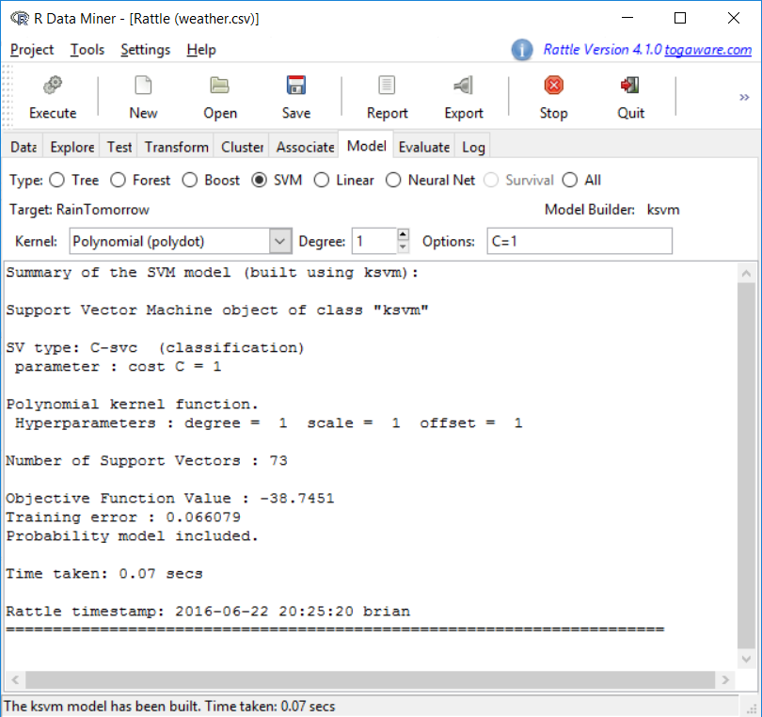
SVM in Rattle
Model|SVM
Polynomial degree 1
(In this case)
Options C=1

Slide 23
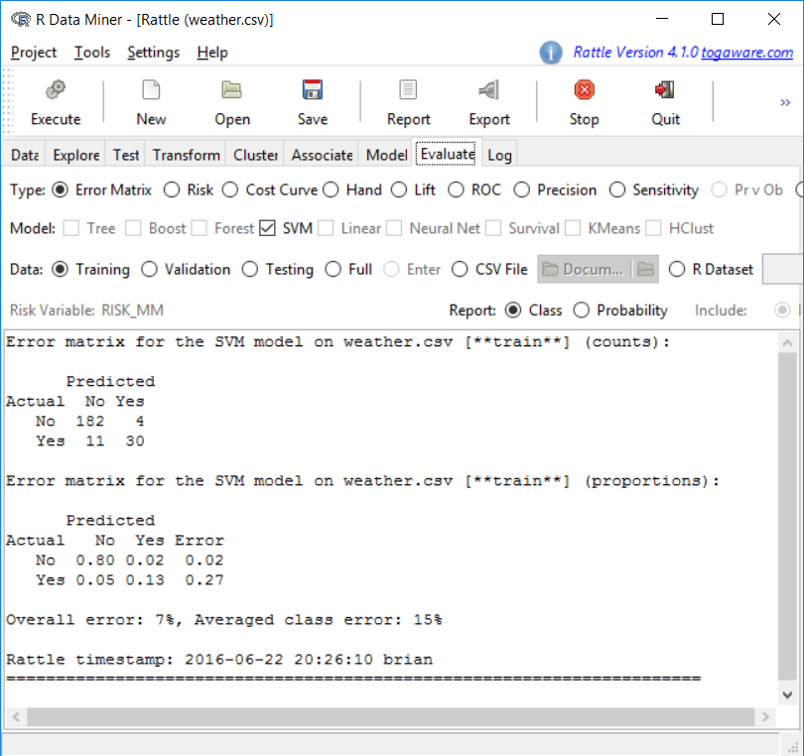
SVM in Rattle
Error Matrix Analysis
Training: 6%
Validation:

Slide 24
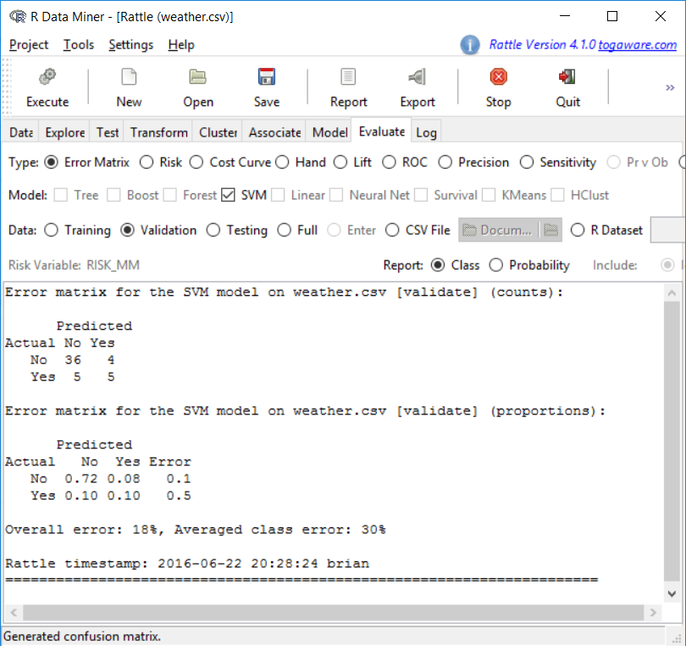
SVM in Rattle
Error Matrix Analysis (C=1)
Training: 6%
Validation: 18%

Slide 25
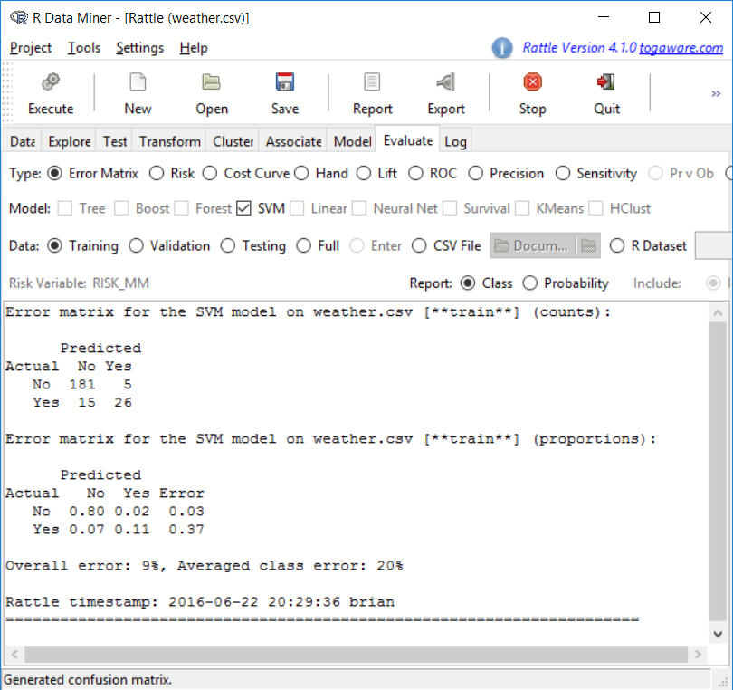

SVM in Rattle
Error Matrix Analysis (C = .1)
Training: 9%
Validation: 16%

Slide 26


SVM in Rattle
Error Matrix Analysis (C=10)
Training: 4%
Validation: 24%

Slide 27
Midterm (1)
Time
3/6/17 (Monday)
90 minutes (from 6:00 pm – 7:30 pm)
Location
In class
Format
Close book, close notes
No electronic devices except a calculator
T/F questions
Multiple-choice questions
Short-answer questions
Some computation questions

Slide 28
Midterm (2)
Introduction to DS
CRISP-DM
6 processes, a general picture of how it works…
Types of problems
Supervised vs. Unsupervised
10 different types of problems and their subcategories
Predictive Modeling Framework
Predictive models
Decision tree, logistic regression, ANN (including perceptron), SVM
Basics of how they work…
what kind of separating surface…
how do they look in the feature space…
how do you avoid overfitting…
advantages/disadvantages
For DT, train by hand and interpret

Slide 29
Midterm (3)
Overfitting
Concepts
generalization, overfitting, fitting graph
training error, validation/test error, true error
Avoidance
Holdout vs. cross-validation
complexity control
Evaluation
Confusion/benefit matrix
Accuracy, error
Precision, recall, sensitivity, specificity, F-measure
Expected profit/cost
Data transformation
Chapter 7 in DMRR
Cleanup, imputation, rescaling, transformation, etc

