Slide 1
Data Science
MSCI:6070 Spring 2017
Lecture 7 (3/6/17)

Slide 2
Visualize Model Performance

Slide 3
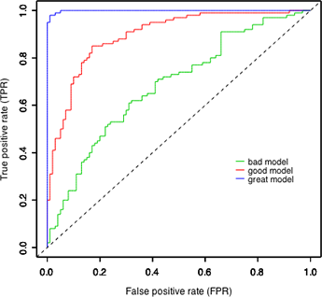
Profit Curve
ROC Curve
Lift Curve
CR Curve

Slide 4
Recall: Confusion Matrix
True Positive (TP)
-- the number of positive instances correctly
predicted as positive
False Positive (FP)
-- the number of negative instances wrongly
predicted as positive
False Negative (FN)
-- the number of positive instances wrongly
predicted as negative
True Positive (TN)
-- the number of negative instances correctly
predicted as negative
Actual
 | + | -
+ | True Positives (TP) | False Positives (FP)
- | False Negatives (FN) | True Negatives (TN)
Predicted

Slide 5
Recall: Cost-benefit Matrix
Distinguish unequal costs between FP
and FN, as well as possible unequal
benefits between TP and TN
benefit b(+|+)
-- benefit from TP
cost c(+|-)
-- cost due to FP
cost c(-|+)
-- cost due to FN
benefit b(-|-)
-- benefit from TN
Actual
 | + | -
+ | b(+|+) | c(+|-)
- | c(-|+) | b(-|-)
Predicted

Slide 6
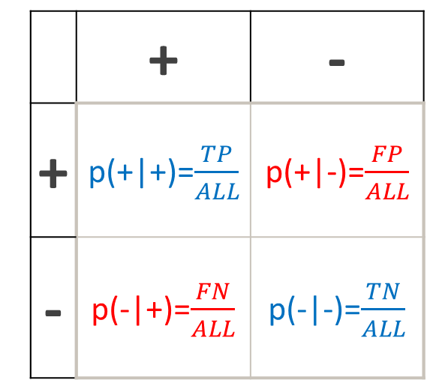
Recall: Expected Profit
This could be the comprehensive evaluation metric
Actual
Actual
 | + | -
+ | p(+|+)=$\frac{TP}{ALL}$ | p(+|-)=$\frac{FP}{ALL}$
- | p(-|+)=$\frac{FN}{ALL}$ | p(-|-)=$\frac{TN}{ALL}$
 | + | -
+ | b(+|+) | c(+|-)
- | c(-|+) | b(-|-)
Predicted
Predicted
Expected profit = $p\left(+ | +\right)∙b\left(+ | +\right)+p\left(+ | −\right)∙c\left(+ | −\right)+p\left(− | +\right)∙c\left(− | +\right)+p\left(− | −\right)∙b\left(− | −\right)$

Slide 7
Ranking Instead of Classifying
Common situation
Limited budget for a campaign
High cost + low response rate → negative profit
Targeted marketing
Target the most promising customers
Achieve the highest expected profit given the budget
Ranking classifier
A classifier that gives a score that estimates the likelihood of an instance belonging to the class of interest [the classifier that outputs only a class label is called a discrete classifier]
Sort the instances in descending order of the score
Find a proper cutoff value to get the set of targeted customers at the top of the ranked list

Slide 8
Cutoff-value: is a threshold of the score (positive-class membership probability) to classify all instances above it as positive and those below it as negative. Each threshold results in a specific confusion matrix.
Actual label | P(Y=1) | predicted (cutoff = 0.5) | predicted (cutoff = 0.7)
1 | 0.9 | 1 | 1
1 | 0.8 | 1 | 1
1 | 0.78 | 1 | 1
1 | 0.6 | 1 | 0
0 | 0.55 | 1 | 0
0 | 0.45 | 0 | 0
0 | 0.4 | 0 | 0
0 | 0.25 | 0 | 0
1 | 0.2 | 0 | 0
0 | 0.1 | 0 | 0
Cutoff-value = 0.5 (at standard .5 threshold)
Cutoff-value = 0.75 (more conservative)
Actual
Actual
 | + | -
+ | 4 | 1
- | 1 | 4
 | + | -
+ | 3 | 0
- | 2 | 5
Predicted
Predicted

Slide 9

Expected Profit: given the cost-benefit matrix, each cutoff value results in a specific expected profit value.
Cutoff-value = 0.5 (at standard .5 threshold)
 | p | n
Y | 1,000 | -100
N | -500 | 0
Cutoff-value = 0.75 (more conservative)
Actual
Actual
 | p | n
Y | 4 | 1
N | 1 | 4
 | p | n
Y | 3 | 0
N | 2 | 5
Predicted
Predicted
EP(0.5) = $0.4×1000−0.1×500−0.1×100=\$340$
EP(0.7) = $0.3×1000−0.2×500=\$200$

Slide 10
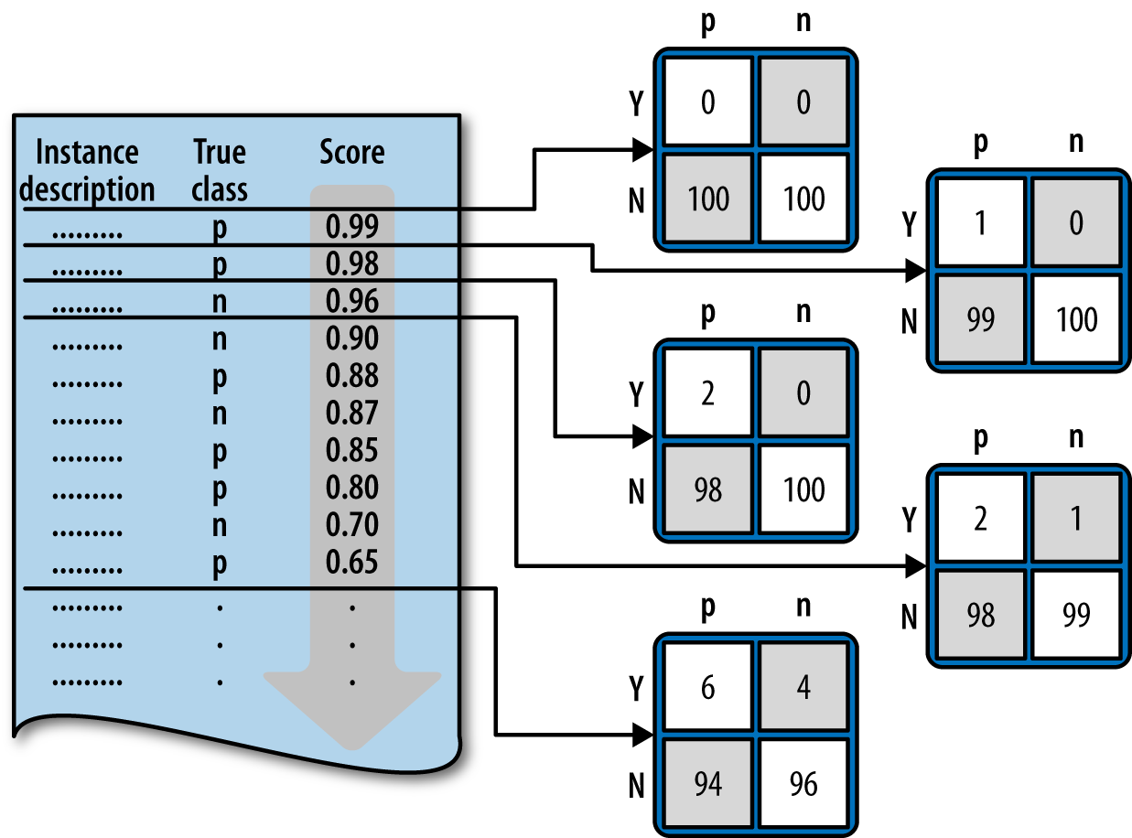
Profit Curve (1)
List ALL instances
-- ranked by decreasing score
Sweep down through the list
-- at each successive cut-point
generate the confusion matrix
If “+”, then (Y, p)+1
If “-”, then (Y, n)+1
-- each cut-point produces a
different confusion matrix
Calculate the expected profit
-- use the cost-benefit matrix

Slide 11
Profit Curve (2)
Draw the profit curve
-- each cut-point → dot (x, y)
-- x: percentage of the list predicted as “+”
i.e., percentage of targeted instances
-- y: expected profit
Evaluate different classifiers
-- Classifier 2 achieves the maximum profit
by targeting the top-ranked 50% of
customers
-- What if you have a total of 100,000
customers and a budget of $40,000, and
each offer costs $5?

Slide 12
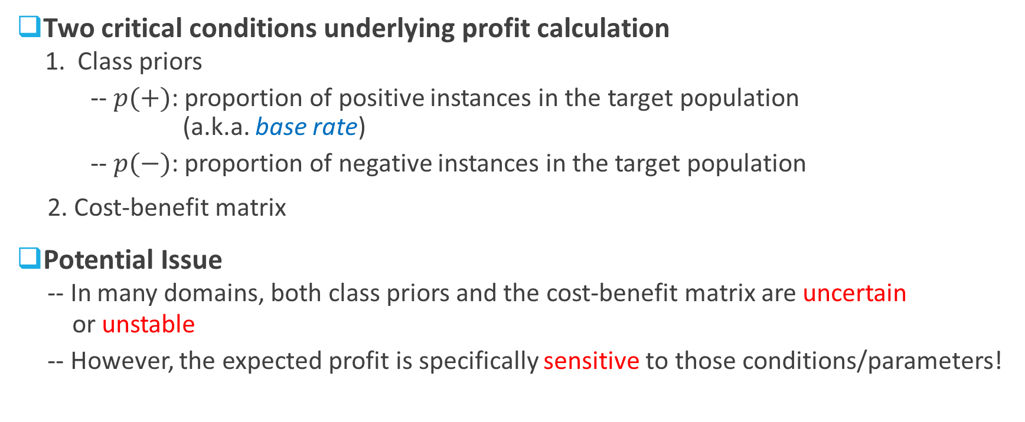
Profit Curve (3)
Two critical conditions underlying profit calculation
1. Class priors
-- $p(+)$: proportion of positive instances in the target population
(a.k.a. base rate)
-- $p(−)$: proportion of negative instances in the target population
2. Cost-benefit matrix
Potential Issue
-- In many domains, both class priors and the cost-benefit matrix are uncertain
or unstable
-- However, the expected profit is specifically sensitive to those conditions/parameters!

Slide 13
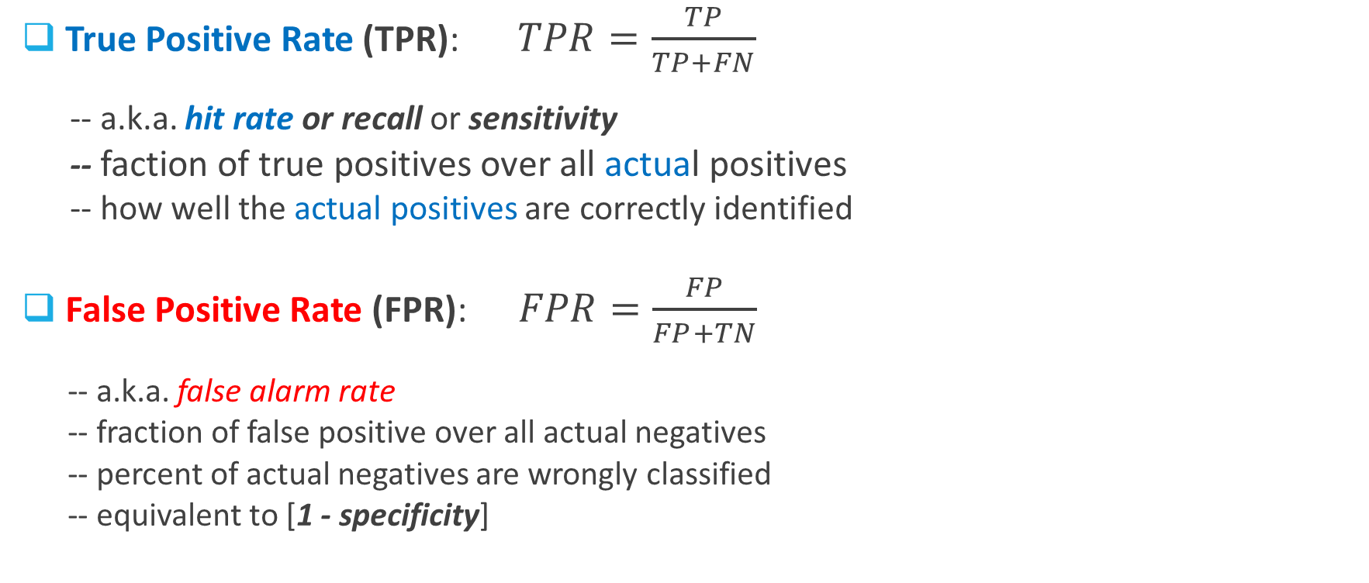
Two Important Metrics
True Positive Rate (TPR): $TPR=\frac{TP}{TP+FN}$
-- a.k.a. hit rate or recall or sensitivity
-- faction of true positives over all actual positives
-- how well the actual positives are correctly identified
False Positive Rate (FPR): $FPR=\frac{FP}{FP+TN}$
-- a.k.a. false alarm rate
-- fraction of false positive over all actual negatives
-- percent of actual negatives are wrongly classified
-- equivalent to [1 - specificity]
Actual
 | + | -
+ | True Positives (TP) | False Positives (FP)
- | False Negatives (FN) | True Negatives (TN)
Predicted

Slide 14
ROC Graph
Receiver Operating Characteristic (ROC) graph
An ROC graph is a two-dimensional plot
-- x axis: false positive rate (FPR)
-- y axis: true positive rate (TPR)
Provide a visual tool for examining the trade-off
that a classifier makes between benefits (TPR)
and costs (FPR)
Each classifier produces an (FPR, TPR) pair
corresponding to a single point in a ROC space

Slide 15
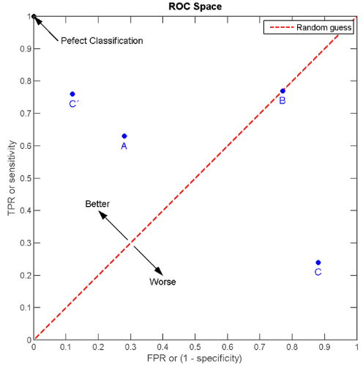
ROC Space
A unit square defined by FPR and TPR
Point (0, 0)
-- predict every instance to be negative
Point (1, 1)
-- predict every instance to be positive
Point (1, 0)
-- ideal model/classification
Diagonal line
-- random guess
Northwest direction
-- better classifiers

Slide 16
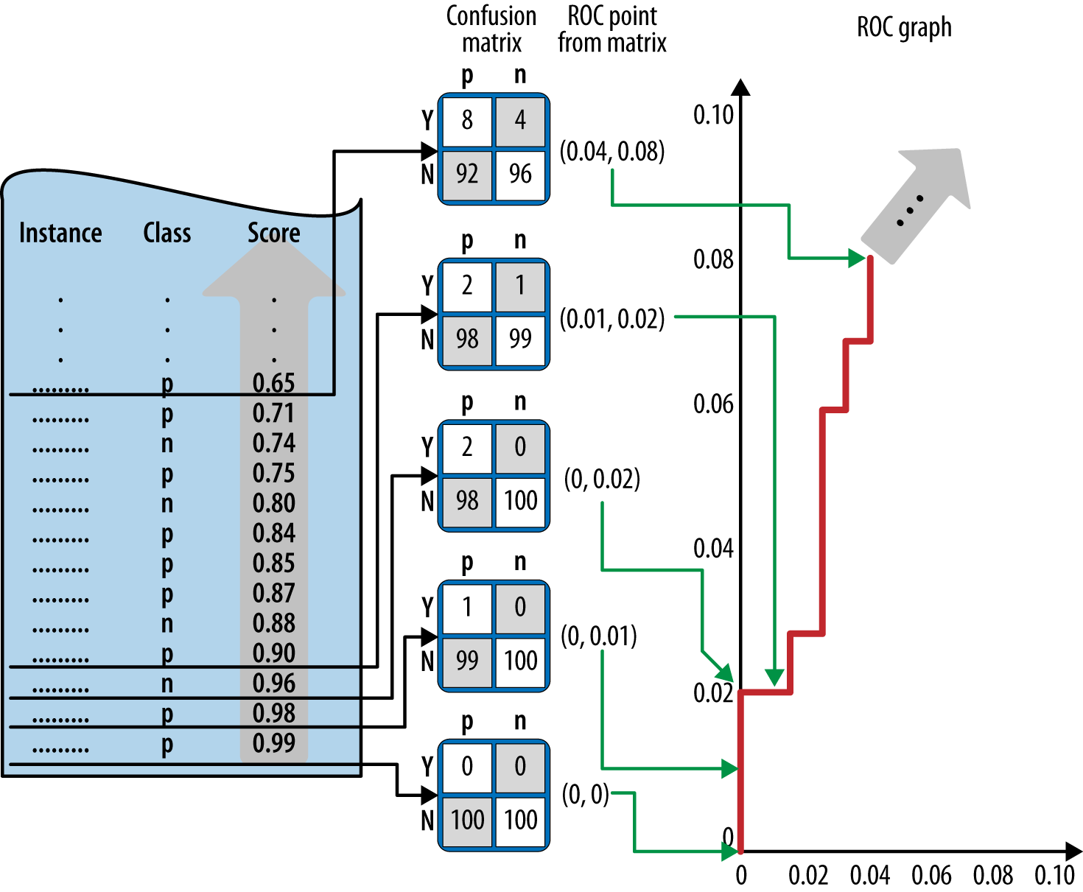
Construct a ROC Curve
List ALL instances
-- ranked by increasing score
Sweep the list (bottom up)
-- start with an initial confusion
matrix where all classified as “N”
-- move upward
If “+”, then (Y, p)+1
If “-”, then (Y, n)+1
-- each new confusion matrix maps
a (FPR, TPR) pair in ROC space
Connect those points
-- piece-wise step function

Slide 17
ROC Curves

Slide 18
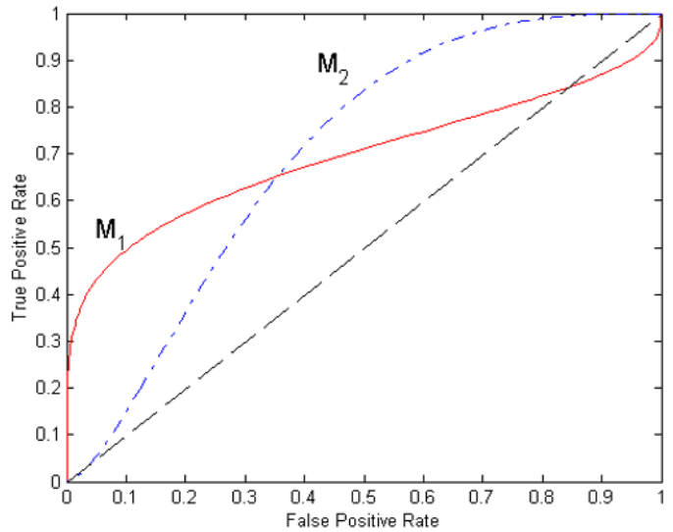
Model Evaluation
 | p | n
Y | 100 | -1,000
N | -5 | 0
Which model is better?
-- M1 performs better at smaller FPR
-- M2 performs better at larger FPR
-- No one consistently outperforms
the other
If I have the cost matrix…
-- M1 is preferred
Can I have a single number to
summarize performance?
-- YES
-- the area under the ROC curve (AUC)

Slide 19
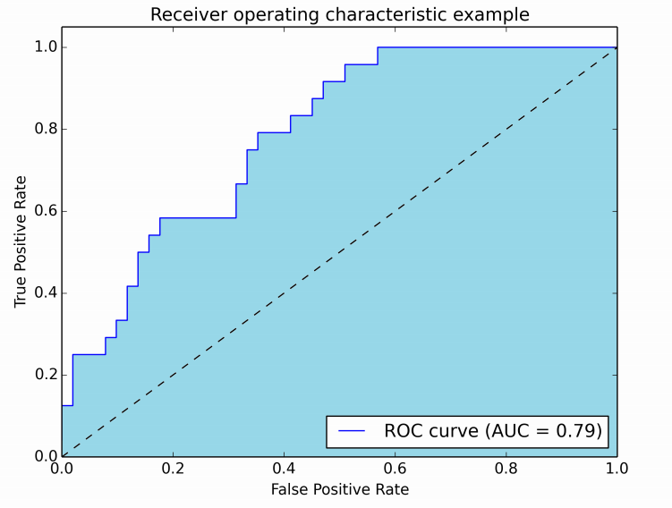
AUC
Area Under the ROC Curve
An important summary statistic
-- single number to summary performance
-- range from zero to one
perfect classifier: AUC = 1
random classifier: AUC = 0.5
-- larger AUC → better performance on average
Equivalent to the Mann-Whitney-Wilcoxon
measure
-- a well-known ordering measure in Statistics
-- probability that a randomly chosen positive
instance will be ranked ahead of a randomly
chosen negative instance

Slide 20
Exercise
 | p | n
Y | 0 | 0
N | 4 | 6
Predicted Probability of the Positive Class | Class Label
.9 | 1
.8 | 1
.7 | 0
.6 | 0
.55 | 1
.45 | 0
.4 | 1
.3 | 0
.2 | 0
.1 | 0
AUC = (1/3)(1/2) + (1/6)(3/4) +(1/2)(1) = 19/24 = 0.791
1
TP Rate
_{(sensitivity)}
0
FP Rate
_{(1-Specificity)}
MWW = (6+6+4+3)/24 = 19/24 = 0.791
0
1

Slide 21
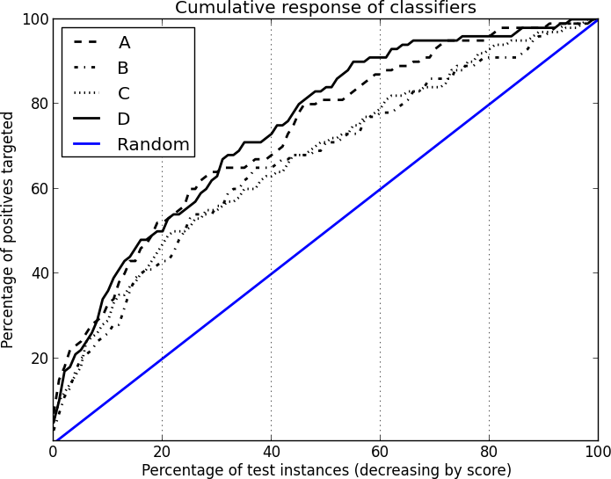

Cumulative Response Curve (CRC)
more intuitive for business stakeholders
two-dimensional plot
-- x:percentage of the list predicted as “+”
i.e., percentage of targeted instances
-- y: true positive rate (TPR)
similar to how we construct the profit curve,
we sweep down the list of instances ranked
by the classifier from high to low
calculate TPR at each cut-point →
map to a single point in a CRC space
All positive
All negative

Slide 22
Exercise
Predicted Probability of the Positive Class | Class Label
.9 | 1
.8 | 1
.7 | 0
.6 | 0
.55 | 1
.45 | 0
.4 | 1
.3 | 0
.2 | 0
.1 | 0
 | p | n
Y | 0 | 0
N | 4 | 6
100
TP Rate
_{(sensitivity)}
0
Percentage of test instances (decreasing by score)
0
100

Slide 23
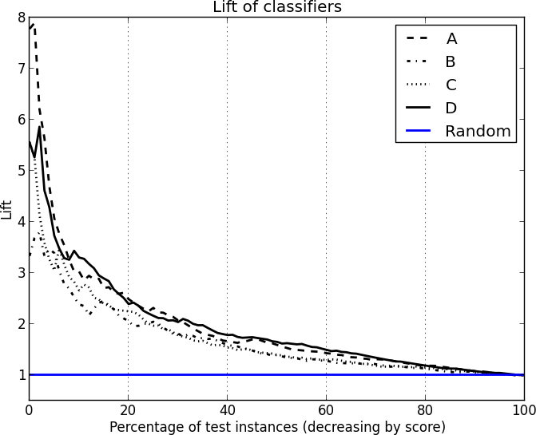
Lift Curve
lift(x) = CumulativeResponse(x)/RandomGuess(x)
= TPR(x)/x
two-dimensional plot
-- x:percentage of the list predicted as “+”
i.e., percentage of targeted instances
-- y:lift value
represent the advantage of the classifier
of interest over a random classifier
the diagonal line of the CRC becomes
a horizontal line at y=1 on the lift curve

Slide 24
Exercise
Predicted Probability of the Positive Class | Class Label
.9 | 1
.8 | 1
.7 | 0
.6 | 0
.55 | 1
.45 | 0
.4 | 1
.3 | 0
.2 | 0
.1 | 0
 | p | n
Y | 0 | 0
N | 4 | 6
3
Lift
0
Percentage of test instances (decreasing by score)
0
100

Slide 25
One Note
both CRC and lift curve are based on the assumption that:
-- the test set has exactly the same class priors as the population
if the exact proportion of positives in the population is unknown or is not represented
accurately in the test data, CRC and lift curve should be used with care

Slide 26
Rattle
Evaluation Tab
-- ROC
-- Lift
-- Risk

