Slide 1
Data Science
MSCI:6070 Spring 2017
Lecture 8 (3/20/17)

Slide 2
Outline
Review Midterm Exam
-- grade statistics
-- solutions
Ensemble Methods
-- Rationale for ensemble
-- Constructing an ensemble classifier
-- Bagging
-- Boosting
-- Random Forests

Slide 3
Run through midterm-exam solutions…
Highest score: 96
Average is: 80.5

Slide 4
Ensemble Methods

Slide 5
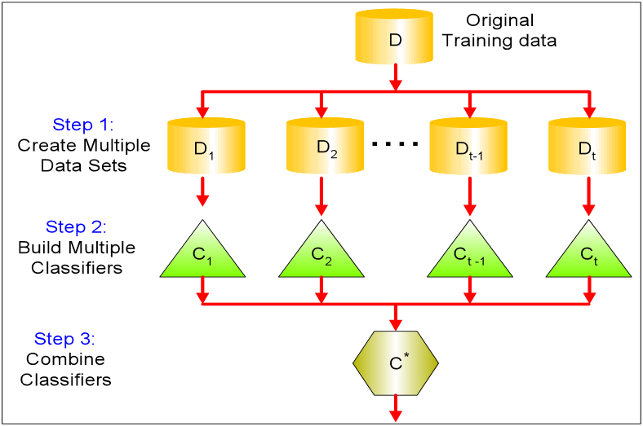
Logical View
Multiple Data Sets
-- from original training data
A set of base classifiers
-- induced from respective
data sets
Aggregate predictions
-- taking a vote on the
predictions made by each
base classifier

Slide 6
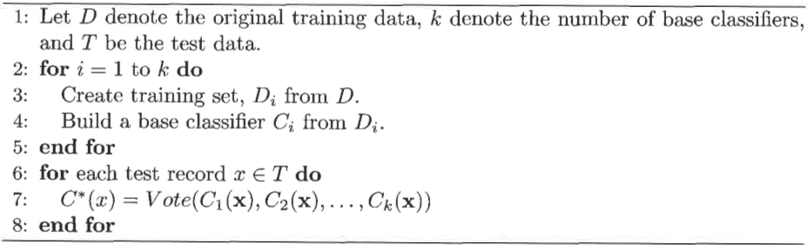
General Procedure
Voting: 1. take a majority vote on the individual predictions;
2. weight each prediction with the accuracy of the base classifier

Slide 7

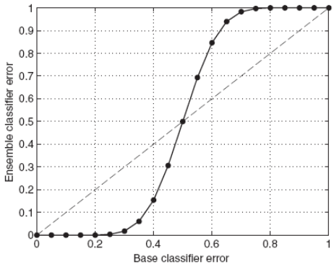
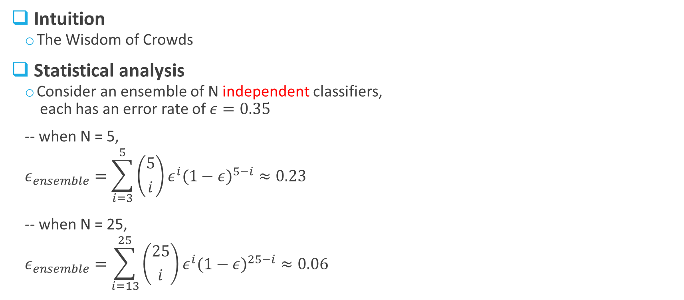
Rationale for Ensemble
Intuition
The Wisdom of Crowds
Statistical analysis
Consider an ensemble of N independent classifiers,
each has an error rate of $ε=0.35$
-- when N = 5,
$$ε_{ensemble}=\sum_{i=3}^{5}{\left({5 \atop i}\right)ε^{i}{(1−ε)}^{5−i}}≈0.23$$
-- when N = 25,
$$ε_{ensemble}=\sum_{i=13}^{25}{\left({25 \atop i}\right)ε^{i}{(1−ε)}^{25−i}}≈0.06$$

Slide 8
Construct an Ensemble Classifier
Two necessary conditions on base classifiers
independent of each other → uncorrelated errors
better than random-guess classifier
Four methods
Manipulate the training dataset
-- create multiple training datasets by resampling the original dataset (bagging and boosting)
Manipulate the input features/variables
-- choose a different subset of input features for each base classifier (random forest)
Manipulate the learning algorithm
-- e.g., for ANN, change initial weights on the links;
for DT, randomly choose one f the top-K attributes for splitting
Manipulate the class labels
-- reduce multiclass problem to binary classification

Slide 9
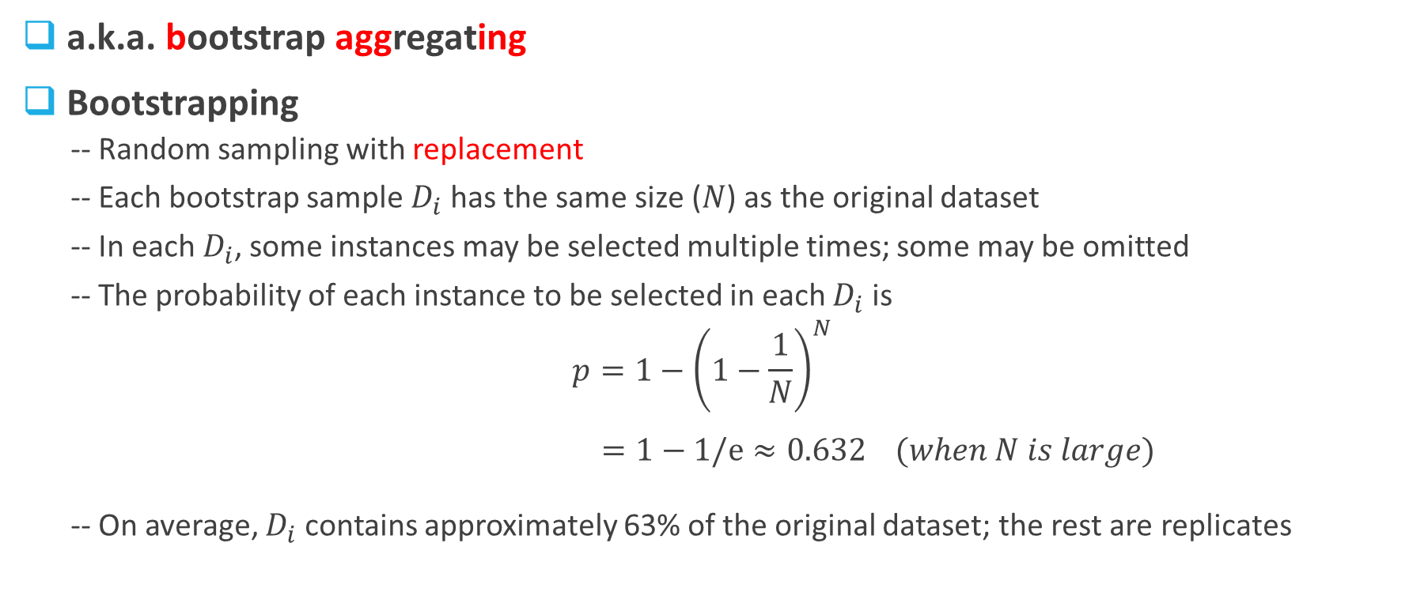
Bagging
a.k.a. bootstrap aggregating
Bootstrapping
-- Random sampling with replacement
-- Each bootstrap sample $D_{i}$ has the same size ($N$) as the original dataset
-- In each $D_{i}$, some instances may be selected multiple times; some may be omitted
-- The probability of each instance to be selected in each $D_{i}$ is
$$p=1−{\left(1−\frac{1}{N}\right)}^{N}$$
$=1−1/e≈0.632 (when N is large)$
-- On average, $D_{i}$ contains approximately 63% of the original dataset; the rest are replicates

Slide 10
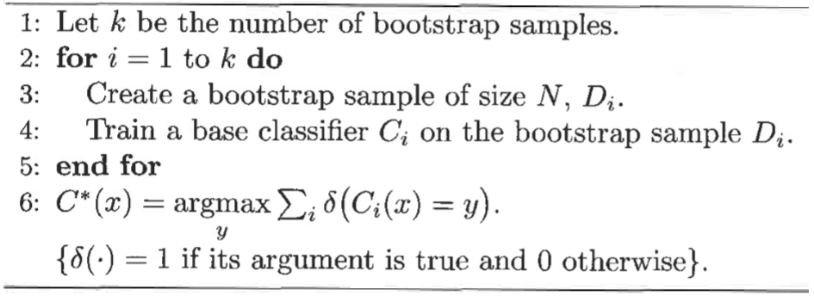
Bagging Algorithm
majority vote (i.e., a test instance is assigned to the class
that receives the highest number of votes)

Slide 11
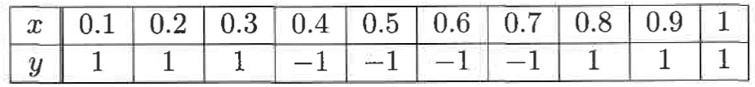
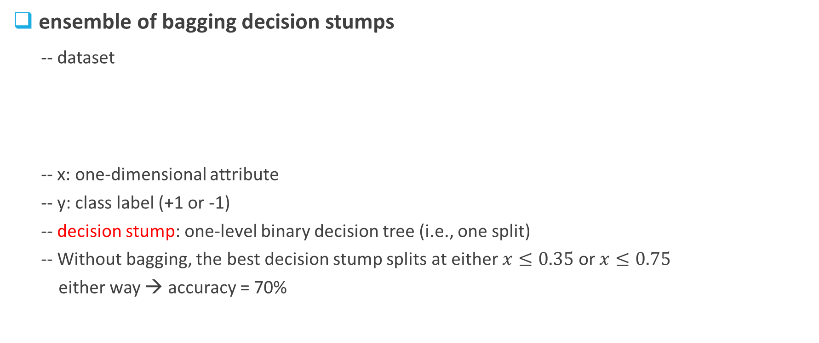
Example
ensemble of bagging decision stumps
-- dataset
-- x: one-dimensional attribute
-- y: class label (+1 or -1)
-- decision stump: one-level binary decision tree (i.e., one split)
-- Without bagging, the best decision stump splits at either $x≤0.35$ or $x≤0.75$
either way → accuracy = 70%

Slide 12
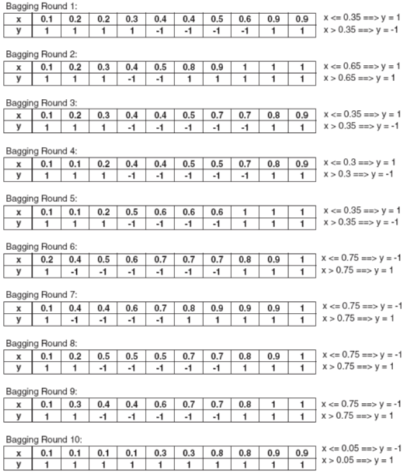
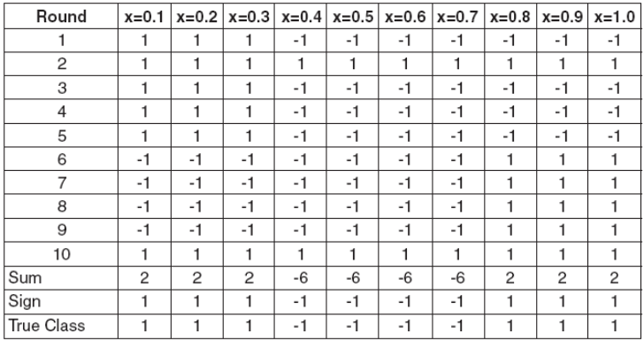
With bagging → accuracy = 100%
Summary –
Bagging improves the accuracy by reducing the variance of the base classifiers;
The performance of bagging depends on the stability of the base classifier → works well with unstable learners
Bagging is less susceptible to model overfitting

Slide 13
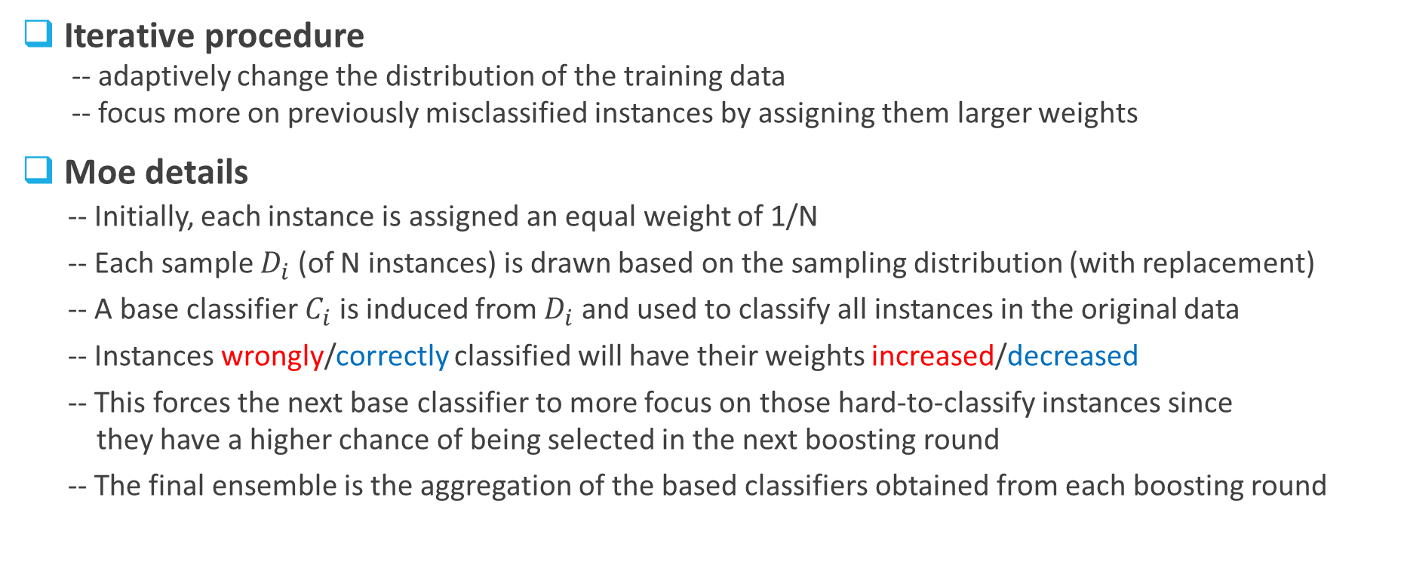
Boosting
Assume Instance 4 was wrongly classified in Rounds 1 & 2
Iterative procedure
-- adaptively change the distribution of the training data
-- focus more on previously misclassified instances by assigning them larger weights
Moe details
-- Initially, each instance is assigned an equal weight of 1/N
-- Each sample $D_{i}$ (of N instances) is drawn based on the sampling distribution (with replacement)
-- A base classifier $C_{i}$ is induced from $D_{i}$ and used to classify all instances in the original data
-- Instances wrongly/correctly classified will have their weights increased/decreased
-- This forces the next base classifier to more focus on those hard-to-classify instances since
they have a higher chance of being selected in the next boosting round
-- The final ensemble is the aggregation of the based classifiers obtained from each boosting round

Slide 14
Boosting Algorithms
Several implementations have been developed
-- how to update the weights of the training instances
-- how to aggregate the predictions made by each base classifier
AdaBoost
-- an abbreviation for adaptive boosting
-- described as the best off-the-shelf classifier in the world

Slide 15
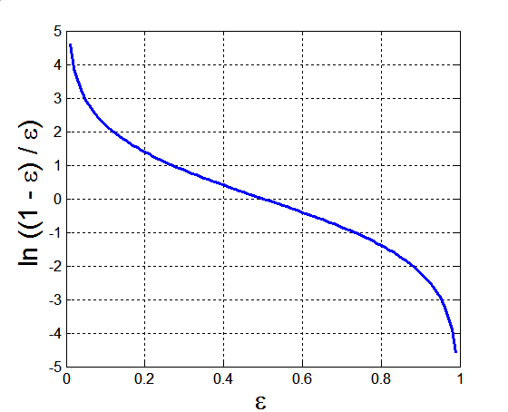

AdaBoost (1)
Let $\left\{\left(x_{j},y_{j}\right) \right| j=1,2,…,N\}$ denote a set of N training instances,
and $\left\{ C_{i}\right| i=1,2,…,T\}$ denote a set of T base classifiers
-- Error rate of $C_{i}$
-- Importance of $C_{i}$:
15

Slide 16
AdaBoost (2)
-- Weight update:
-- If any intermediate rounds produce error rate higher than 50%,
the weights are reverted back to 1/N and the resampling procedure is repeated
-- Classification:
16

Slide 17
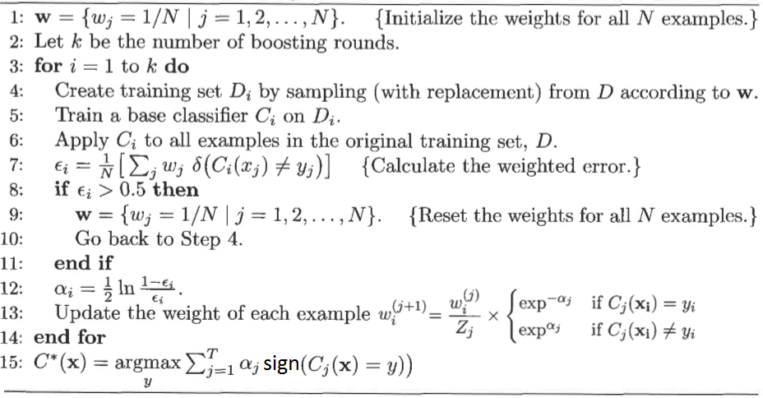
AdaBoost Algorithm

Slide 18
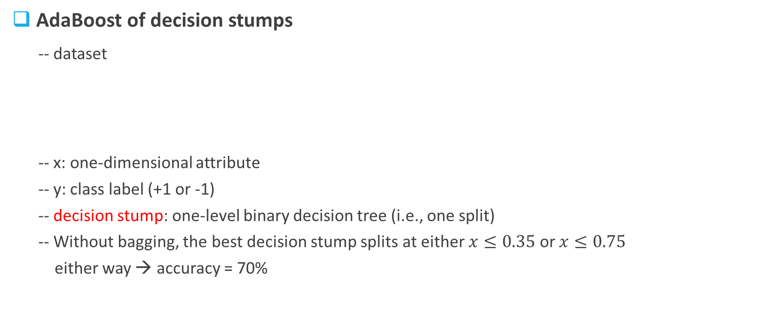
Example
AdaBoost of decision stumps
-- dataset
-- x: one-dimensional attribute
-- y: class label (+1 or -1)
-- decision stump: one-level binary decision tree (i.e., one split)
-- Without bagging, the best decision stump splits at either $x≤0.35$ or $x≤0.75$
either way → accuracy = 70%

Slide 19
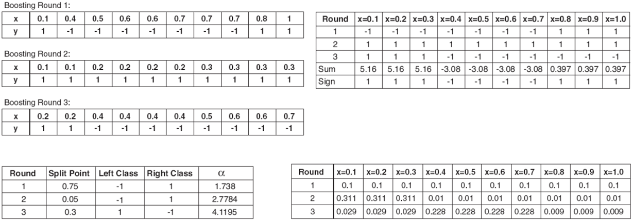
AdaBoost perfectly classifies all the instances in the training dataset after only 3 boosting rounds!

Slide 20
Bagging vs. Boosting
Bagging | Boosting
Bootstrap samples (and base classifiers) can be generated independently in a parallel manner | Bootstrap samples (and base classifiers) are generated one based upon another in a sequential manner
All training instances are equally important | Focus more on instances wrongly classified
Majority vote | Weighted sum of the votes
Works better with unstable learners | Works better with weak learners
Almost always better than base classifiers, but the improvement is usually moderate | Can be significantly better than base classifiers, or disastrous on rare occasions
Reduce the variance of base classifiers | Reduce both bias and variance
Less susceptible to overfitting/noise | Quite susceptible to overfitting/noise

Slide 21
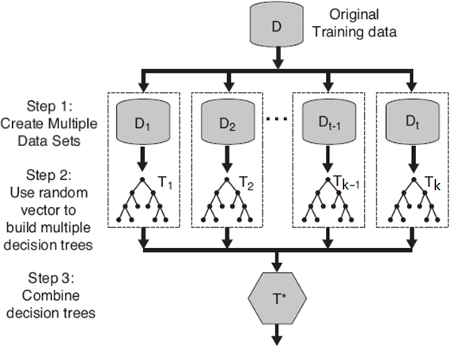
Random Forests
A class of ensemble methods
specifically designed for decision trees
State-of-the-art classifiers
accuracy comparable to AdaBoost
more robust to noise and much faster
than AdaBoost
many different implementations
At each decision node, a random and usually small, set of variable/feature is chosen to split the node

Slide 22
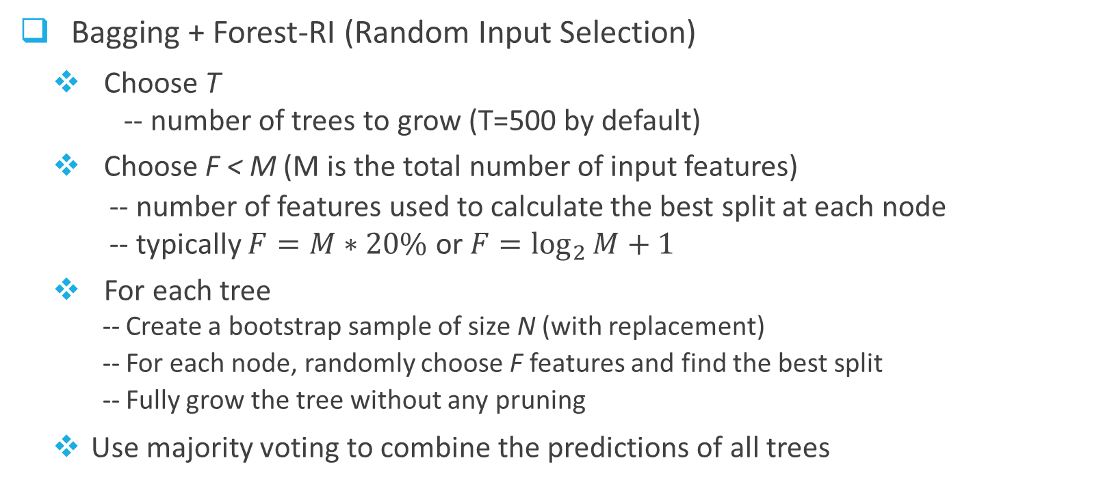
RF Algorithm
Bagging + Forest-RI (Random Input Selection)
Choose T
-- number of trees to grow (T=500 by default)
Choose F < M (M is the total number of input features)
-- number of features used to calculate the best split at each node
-- typically $F=M∗20\%$ or $F=\log_{2}{M}+1$
For each tree
-- Create a bootstrap sample of size N (with replacement)
-- For each node, randomly choose F features and find the best split
-- Fully grow the tree without any pruning
Use majority voting to combine the predictions of all trees
Incorporate diversity
Inject randomness
Inject more randomness and improve efficiency
Reduce bias

Slide 23
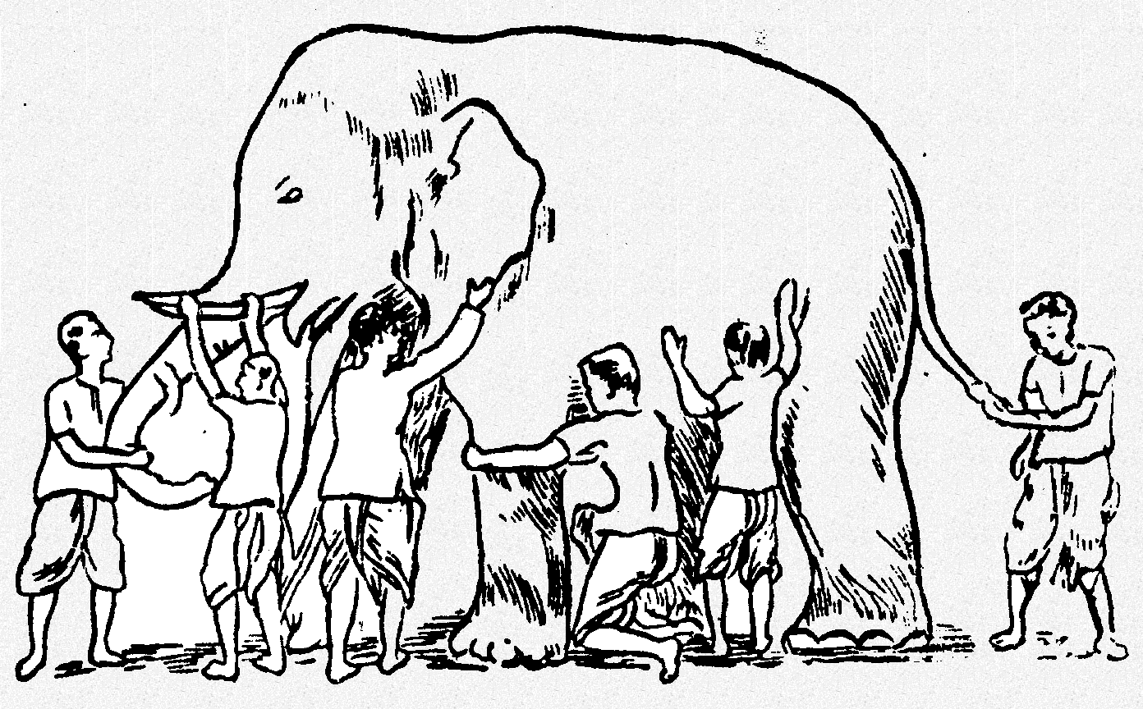
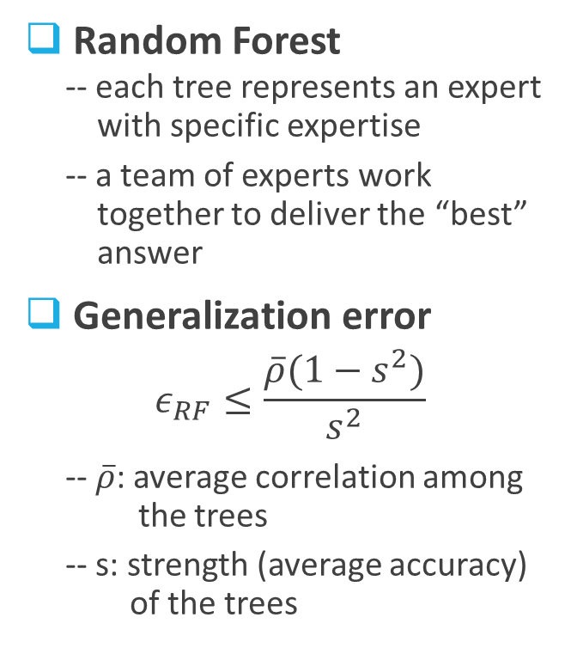
More Discussions
Random Forest
-- each tree represents an expert
with specific expertise
-- a team of experts work
together to deliver the “best”
answer
Generalization error
$$ε_{RF}≤\frac{\overline{ρ}(1−s^{2})}{s^{2}}$$
-- $\overline{ρ}$: average correlation among
the trees
-- s: strength (average accuracy)
of the trees
Is it an elephant?
DT 3
DT 1
DT 2
DT 5
DT 6
DT 4

Slide 24
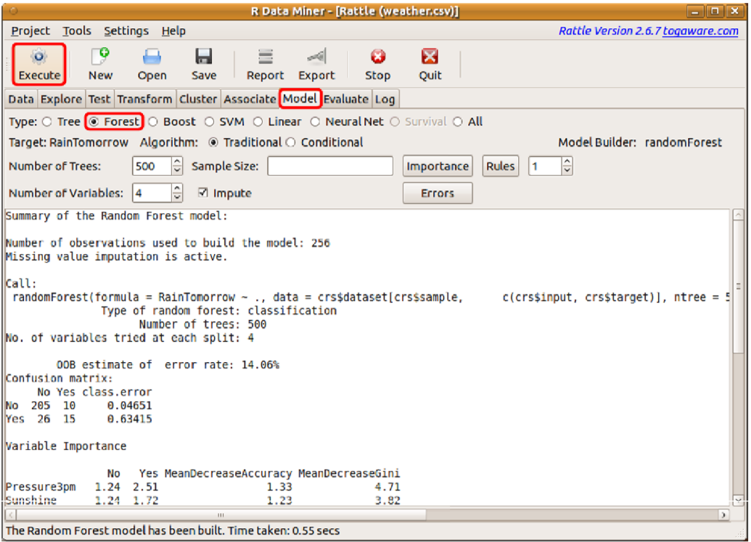

Slide 25
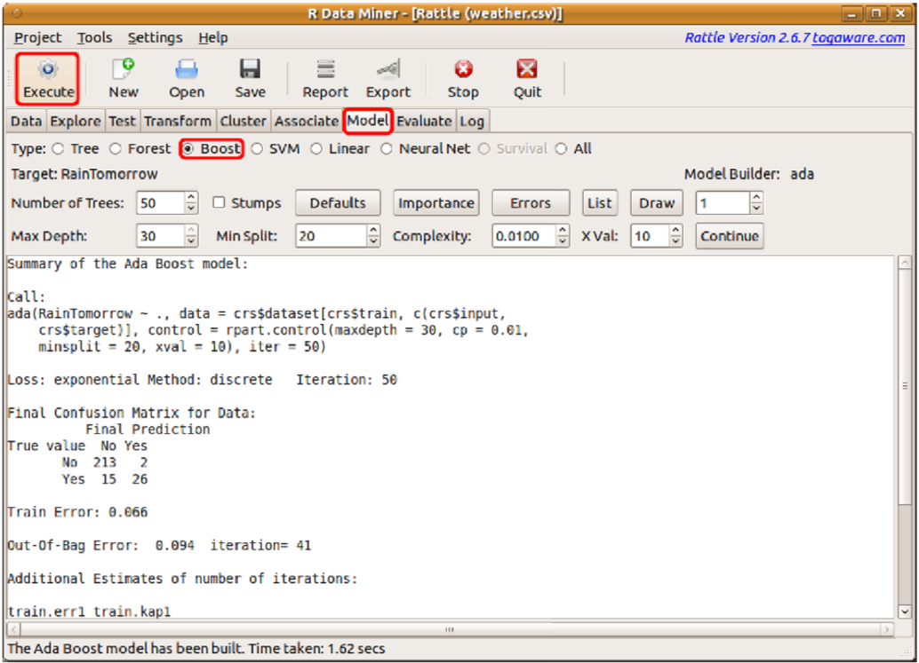

Slide 26
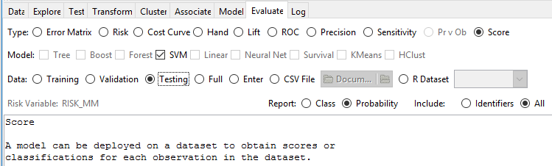
Use the test dataset (85/0/15)
Score the data and save them to a CSV file
Include the “+” class membership probabilities as the scores in the report
Include all variables (including the risk variable) in the report

Slide 27
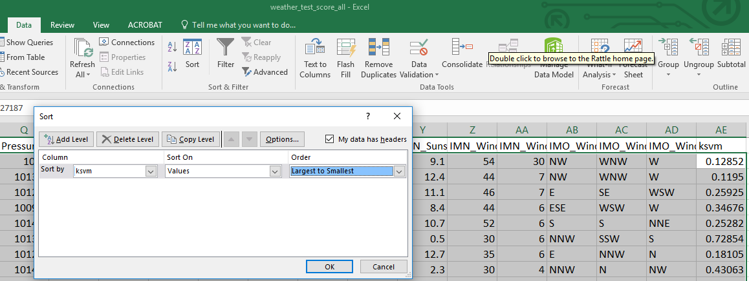
Sort the data by descending order of the “+” class membership probabilities

Slide 28
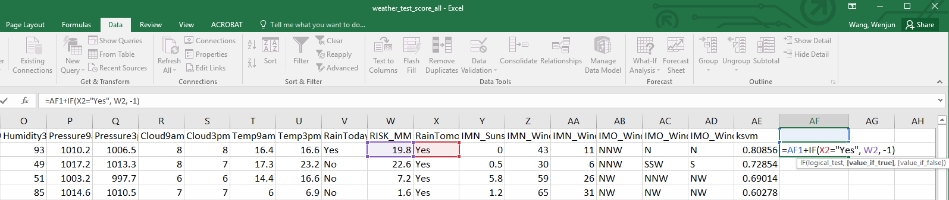
Calculate the profit values

Slide 29
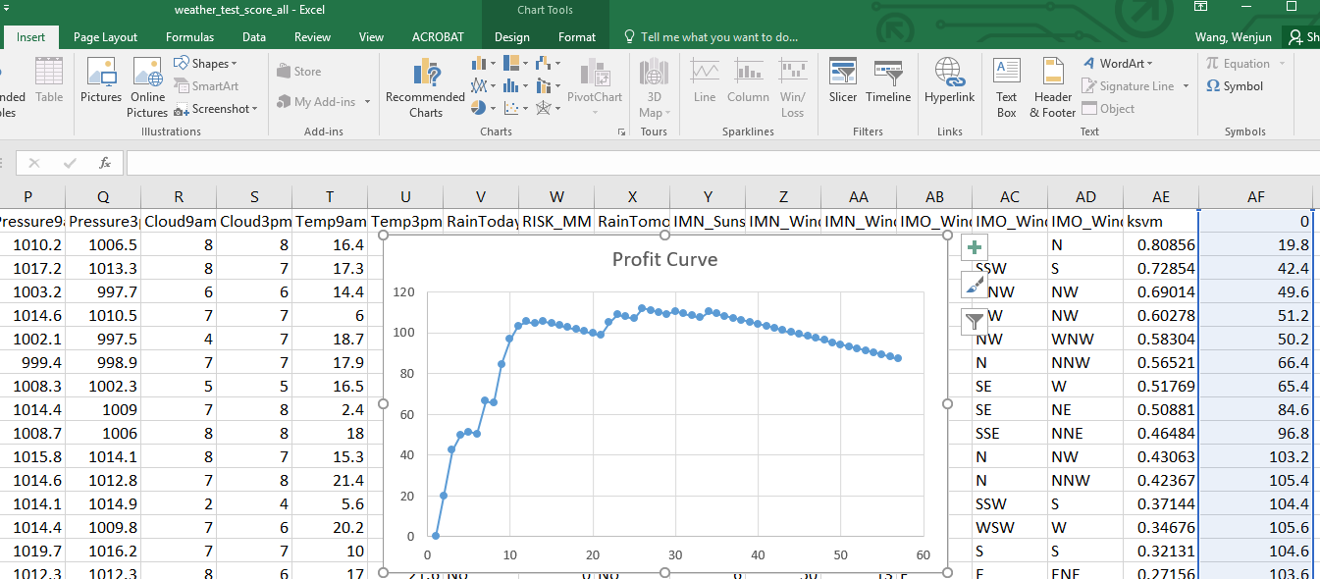
Draw the profit curve as a scatter chart

