Slide 1
Data Science
MSCI:6070 Spring 2017
Lecture 9 (3/27/17)

Slide 2
Outline
Exercise on Generating Profit Curves
-- Revenue, explicit cost
-- Audit dataset in Rattle
Cluster Analysis
-- Overview
-- K-means Algorithm
-- Hierarchical Clustering

Slide 3
Exercise on Generating Profit Curves

Slide 4
Revenue and Explicit Cost
Example: audit dataset
Revenue
-- risk variable: RISK_Adjustment
-- dollar amount of adjustment
Explicit Cost
-- c(+|-): cost for re-auditing a return
Implicit Cost
-- c(-|+): lost revenue
-- unknown for a ranking classifier
Actual
 | + | -
+ | b(+|+) [Revenue - Explicit Cost] | c(+|-) [Explicit Cost]
- | c(-|+) [0] | b(-|-) [0]
Predicted

Slide 5
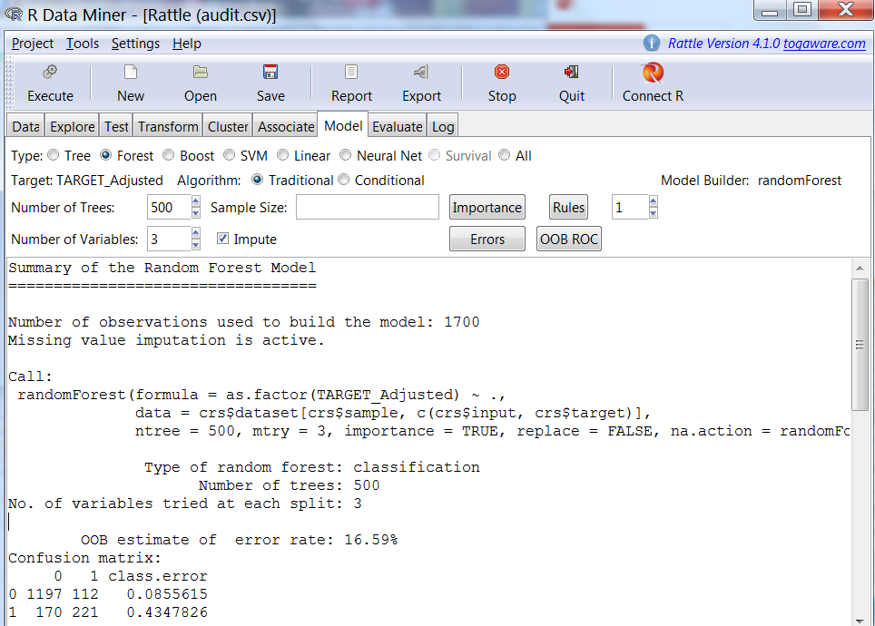

Slide 6
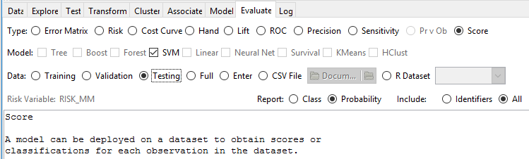
Use the test dataset (85/0/15)
Score the data and save them to a CSV file
Include the “+” class membership probabilities as the scores in the report
Include all variables (including the risk variable) in the report

Slide 7
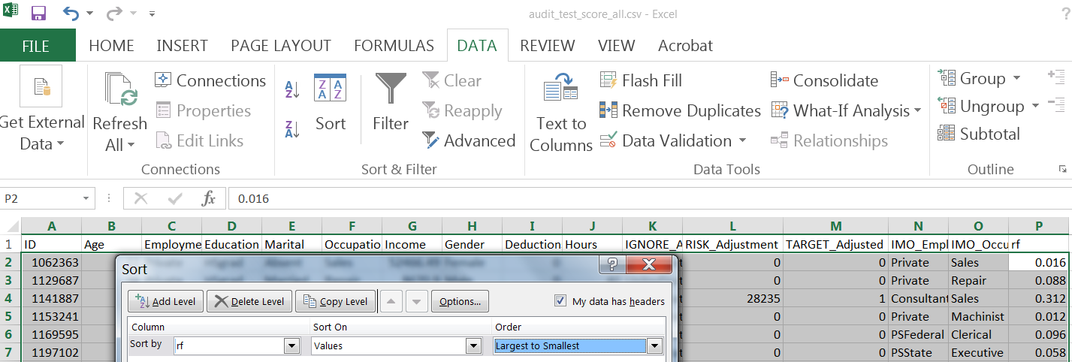
Sort the data by descending order of the “+” class membership probabilities

Slide 8
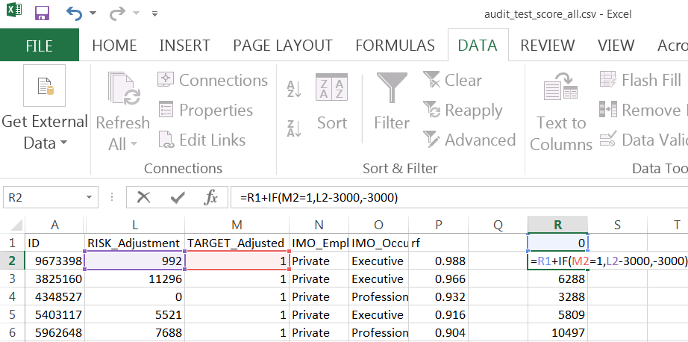
Calculate the profit values

Slide 9
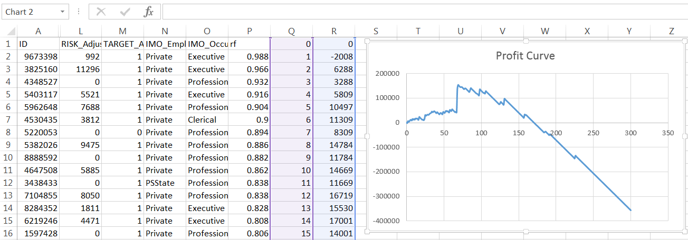
Draw the profit curve as a scatter chart

Slide 10
Cluster Analysis

Slide 11
What is Cluster Analysis? (1)
Cluster a set of objects into different groups such that
Objects in the same group are closer (or similar) to each other
Objects in different groups are far way (or dissimilar) from each other
Inter-cluster distances are maximized
Intra-cluster distances are minimized

Slide 12
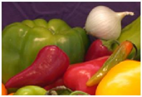
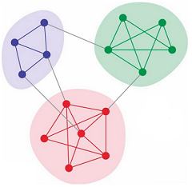

What is Cluster Analysis? (2)
Unsupervised learning/segmentation
no pre-specified target variable
no specific class label or training data
we do not even know how many groups there are
Descriptive model
divide objects into different “natural” groups
derive patterns that help us better understand the data
an important type of exploratory data analysis
require validation and interpretation of the resultant groups
Applications
Image segmentation: machine learning of recognizing images
Social Networks: find communities of users densely connected
Marketing: identify customer groups by consumer tastes/behavior

Slide 13
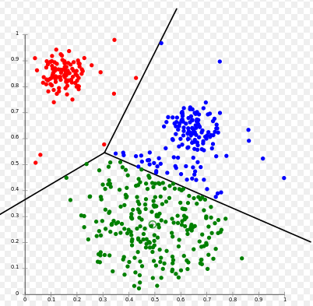
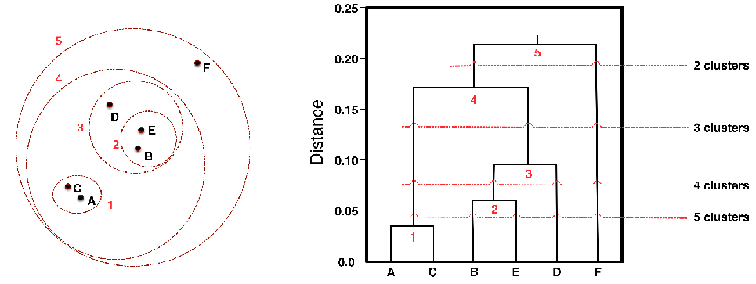
Types of Clustering (1)
Partitional vs. Hierarchical
Partitional clustering
-- mutually exclusive (unnested)
-- each object is in exactly one group
Hierarchical clustering
-- small clusters are successively
grouped together to form larger ones
-- a set of nested clusters
(a hierarchical tree – dendrogram)

Slide 14
Types of Clustering (2)
Exclusive vs. non-exclusive
Exclusive clustering
-- the same as partitional clustering; each object is in exactly one group
Non-exclusive clustering
-- overlapping (border) objects who belong to multiple clusters simultaneously
Fuzzy vs. non-fuzzy
Fuzzy clustering
-- probabilistic clustering
-- each object belongs to every cluster with a belonging factor (membership weight)
Non-fuzzy clustering
-- binary membership (Yes/No)

Slide 15
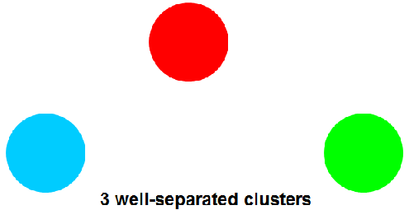
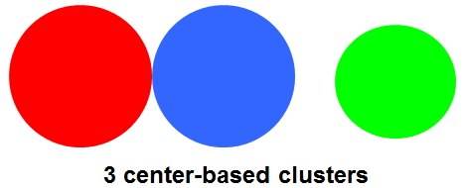
Types of Clusters (1)
Well-separated cluster
-- each object in a cluster is closer (or more
similar) to EVERY other object in its cluster
than to any object not in its cluster
Center-based cluster
-- each object in a cluster is closer (or more
similar) to the “center” of its cluster than to
the center of any other cluster
-- centroid: the average of all object in a cluster
-- medoid: the most “representative” object
of a cluster

Slide 16
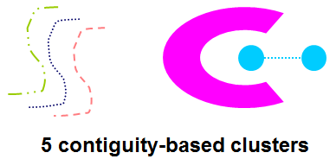
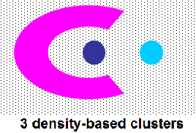
Types of Clusters (2)
Contiguity-based cluster
-- each object in a cluster is closer (or more
similar) to AT LEAST one object in its cluster
than to any object not in its cluster
density-based cluster
-- A cluster is a dense region of objects,
which is separated by low-density regions,
from other regions of high density
-- robust to noise and outliers

Slide 17
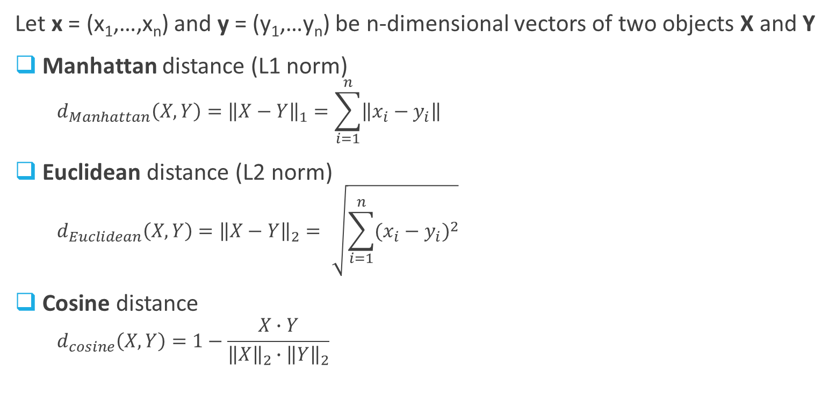
Distance Metrics
Note: Similarity is a very common proxy for closeness/distance between two objects in the instance space
Let x = (x₁,…,x_{n}) and y = (y₁,…y_{n}) be n-dimensional vectors of two objects X and Y
Manhattan distance (L1 norm)
$$d_{Manhattan}\left(X,Y\right)={\left\|X−Y\right\|}_{1}=\sum_{i=1}^{n}{\left\|x_{i}−y_{i}\right\|}$$
Euclidean distance (L2 norm)
$$d_{Euclidean}\left(X,Y\right)={\left\|X−Y\right\|}_{2}=\sqrt{\sum_{i=1}^{n}{{(x_{i}−y_{i})}^{2}}}$$
Cosine distance
$$d_{cosine}\left(X,Y\right)=1−\frac{X∙Y}{{\left\|X\right\|}_{2}∙{\left\|Y\right\|}_{2}}$$
_{Cosine}
D₂
Y
_{Euclidian}
X
_{Manhattan}
Cosine similarity
D₁

Slide 18
Exercise and Notes
E1: X=(2, 1, 0), Y=(5, 3, 1)
E2: X=(200, 1, 0), Y=(500, 3, 1)
E3: heterogeneous attributes
 | Gender | Age | Years at current address | Residential status | Income
Person A | M | 23 | 2 | Rent | 5,000
Person B | F | 40 | 10 | Own | 90,000
Notes:
Ensure all variables have comparable and approximately the same scale (0-1 scaling or recenter in Rattle);
Transform categorical variables into numeric ones (recode in Rattle)or simply ignore them;
Impute missing values

Slide 19
Clustering Algorithms (1)
K-means
pre-specify the number of clusters K
alternate two steps: assignment of objects + update of centroids

Slide 20
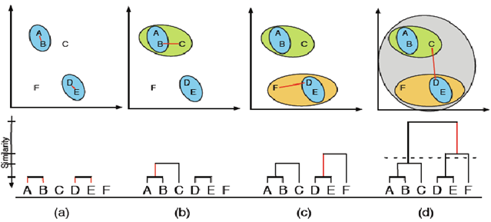
Clustering Algorithms (2)
Hierarchical clustering
Agglomerative (bottom-up) [or divisive (top-down)]
Produce a set of nested clusters
Visualized as a dendrogram (hierarchical tree)
dendrogram

Slide 21
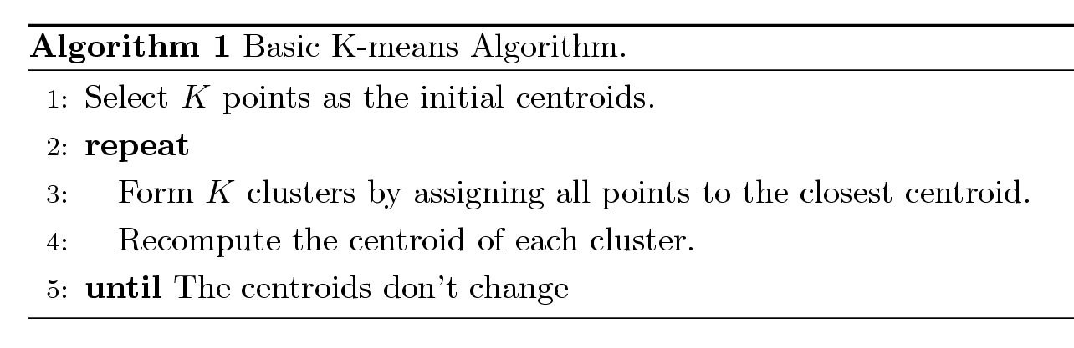
K-means
one of the oldest and most widely-used clustering algorithms
partitional clustering → center-based clusters
the number of clusters, K, is pre-specified
each cluster is associated with a centroid (center point)
each point is assigned to the cluster with the closest centroid
Algorithm

Slide 22
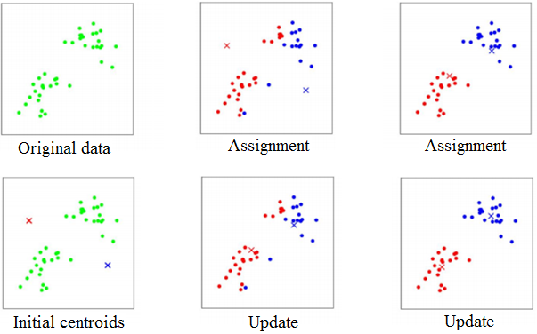
Example (1)
Initialization
1st iteration
2nd iteration

Slide 23
Example (2)
k₁
k₂
k₃

Slide 24
Example (2)
k₁
k₂
k₃

Slide 25
Example (2)
k₁
k₃
k₂

Slide 26
Example (2)
k₁
k₃
k₂

Slide 27
Example (2)
k₁
k₂
k₃

Slide 28
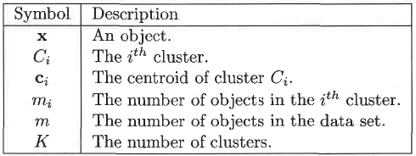

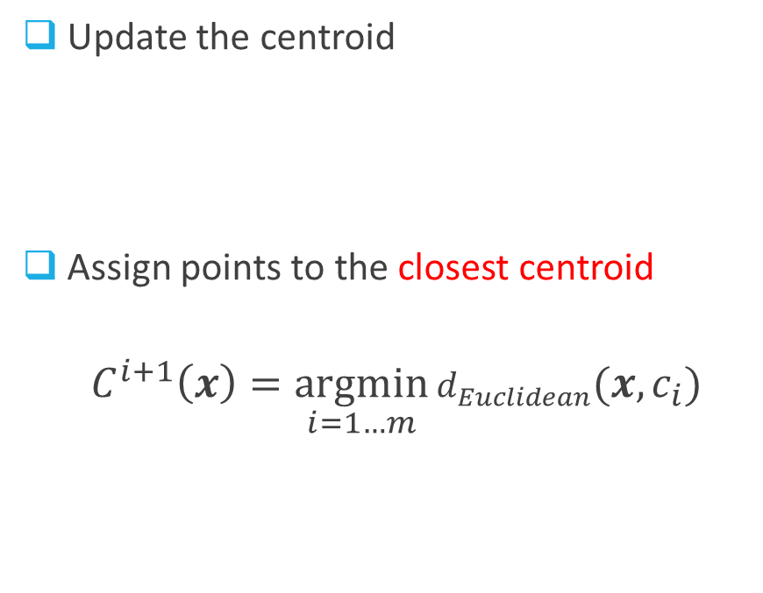
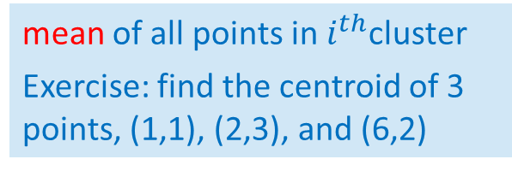

Mathematical Details
Update the centroid
Assign points to the closest centroid
$$C_{}^{i+1}\left(x\right)=\underset{i=1…m}{argmin}{d_{Euclidean}({x,c}_{i})}$$
mean of all points in $i^{th}$cluster
Exercise: find the centroid of 3 points, (1,1), (2,3), and (6,2)
Note: these formulas are based on Euclidean distance and the goal is to minimize the sum of squared error (SSE).
The centroid may vary, depending on the distance metrics and the objective function.
cluster assigned to x at ${(i+1)}^{th}$ iteration

Slide 29

Objective Function
Sum of the squared error (SSE)
$$SSE=\sum_{i=1}^{K}{\sum_{x∈C_{i}}{{[d}_{Euclidean}{(x,c_{i}^{})]}^{2}}}$$
Minimize SSE
$$C_{}^{∗}=\underset{|C|=K}{argmin}{SSE(x,C)}$$
the error is measured by the Euclidean distance of each point to the centroid of its cluster. That is why SSE is also called WSS (Within cluster Sum of Squares)
Combinatorial optimization problem with a HUGE search space; Exhaustive search is computationally infeasible;
K-means algorithm is a heuristic search using the gradient-descent technique;
K-means converges to a local minimum; SSE can be used as a quality measure

Slide 30
How to Choose Initial Centroids
Choosing the proper initial centroids is a key step of K-means algorithm
K-means is unstable w.r.t the selection of initial centroids
random initialization of centroids usually produces different clusters
Data Points with 3 natural clusters
Optimal Clustering
Sub-optimal Clustering

Slide 31
Optimal Clustering

Slide 32
Sub-Optimal Clustering

Slide 33
Approaches to Initial Centroids
Multiple runs + random initialization
select the clustering with minimum SSE
-- simple but may not work well
-- depend on the dataset and the number of clusters sought
Sequential selection
select the first centroid at random (or take the centroid of all points)
for each successive centroid, select the point that is farthest from any already-selected centroids
-- well separated but very susceptible to outliers
-- computationally expensive
Sampling + hierarchical clustering
take a sample (small subset) of points
find K clusters from the hierarchical clustering
select the centroids of those clusters as the initial centroids
-- effective, but practical only for small sample size and small K

Slide 34
How to Choose K
One significant limitation: K must be pre-specified
The correct choice of K is often ambiguous
require prior knowledge or depend on the desired clustering resolution
How many clusters?
Six Clusters
Two Clusters
Four Clusters

Slide 35
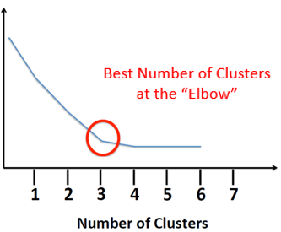
Elbow Method
It is much like a model complexity issue
While K increases, the SSE keeps decreasing
[extreme case: when K=N, SSE=0]
As K increases, SSE should eventually
stabilize or plateau
The marginal gain becomes insignificant,
giving an angle in the graph
Also called “elbow criterion”
SSE
Also consider: 1. domain knowledge
2. balance in cluster size
3. good interpretation of individual clusters

Slide 36
How to Interpret
It is important to discover interesting and/or
representative patterns/characteristics
Look at the values of centers of each cluster
along each dimension
-- find the dimensions that distinguish
each cluster
-- what makes a cluster interesting/unique
-- how different from mean of the dataset
-- how different from other clusters
Income
Older & high-income
Young & low-income
20
25
30
35
Age

Slide 37
Hierarchical Clustering
An important category of clustering methods
Two main types
Agglomerative (bottom-up)
-- Start with each point as a singleton cluster
-- At each step, merge the closest pair of clusters until only one cluster is left
[need to define a notion of cluster proximity]
Divisive (top-down)
-- Start with one, all-inclusive cluster
-- At each step, split a cluster until each cluster contains a single point
[needs to define a splitting criterion ]

Slide 38
Nested Clusters
Produce a set of nested clusters
Often displayed graphically as a dendrogram
-- A hierarchical-tree like diagram that records the sequences of merges or splits

Slide 39
Agglomerative Clustering
Algorithm
Let each data point be a cluster
Compute the proximity matrix
Repeat
Merge the two closest clusters
Update the proximity matrix
[reflect the proximity between the new cluster and the original clusters]
Until only a single cluster remains
Key operation: compute the cluster proximity
-- Different cluster proximities generate different types of clusters

Slide 40
Cluster Proximity
MIN (single link)
MAX (complete link)
Group Average
Distance Between Centroids
Ward’s Method
proximity

Slide 41
Cluster Proximity
MIN (single link)
MAX (complete link)
Group Average
Distance Between Centroids
Ward’s Method
the proximity between the closest two points that are in different clusters
tend to generate long, skinny clusters
susceptible to noise and outliers

Slide 42
Cluster Proximity
MIN (single link)
MAX (complete link)
Group Average
Distance Between Centroids
Ward’s Method
the proximity between the farthest two points that are in different clusters
favors globular-shaped clusters
less susceptible to noise and outliers

Slide 43
Cluster Proximity
MIN (single link)
MAX (complete link)
Group Average
Distance Between Centroids
Ward’s Method
the average pairwise proximities of all pairs of points in different clusters
an intermediate approach between MIN and MAX

Slide 44
Cluster Proximity
MIN (single link)
MAX (complete link)
Group Average
Distance Between Centroids
Ward’s Method
The proximity between the centroids in different clusters
→ Similar technique used in K-means
×
×

Slide 45
Cluster Proximity
MIN (single link)
MAX (complete link)
Group Average
Distance Between Centroids
Ward’s Method
measures the proximity between two clusters in terms of the increase in the SSE that results from merging the two clusters
→ Use the same objective function as K-means

Slide 46
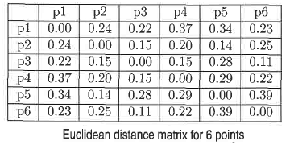
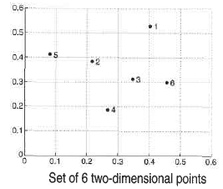
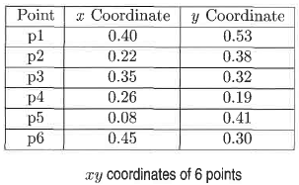
Example

Slide 47

MIN (single link)
5
1
3
5
2
1
2
3
6
4
4

Slide 48
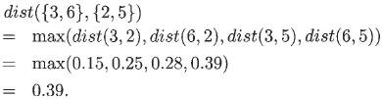
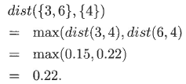
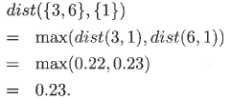
MAX (complete link)
4
1
2
5
5
2
3
6
3
1
4

Slide 49
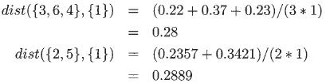

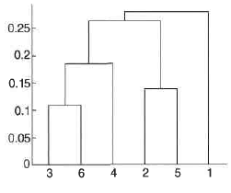
Group Average
5
1
2
5
2
3
6
3
4
1
4

Slide 50
Ward’s Method
5
4
1
2
5
2
3
6
1
4
3

Slide 51
Summary
 | Strength | Weakness
K-means Algorithm | Simple Easy to implement Quite efficient | Requires pre-specifying K Unstable w.r.t to initial centroids Unable to handle non-globular clusters Issues with clusters of different sizes and densities Susceptible to outliers Local optimal
Agglomerative Hierarchical Clustering | Produces a hierarchy of clusters No need to pre-specify K Deterministic | Lack of a global objective function Merging decisions are final High space/time complexity Not scalable for large dataset

