Slide 1
Big Data Management & Analytics
MSCI:6110 Fall 2019
Masters in Business Analytics

Slide 2
Background
Data Management
Review basic knowledge about relational databases
SQL and relational model

Slide 3
Data Management
All disciplines related to managing data as a valuable resource
Data modeling
Database & Storage management and query
Data security
Data integrity
Data warehousing and business intelligence (data mining)

Slide 4
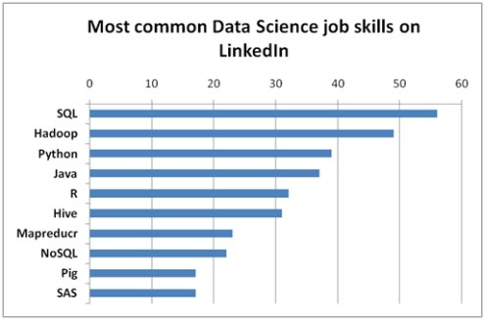
Data Management Skills
Here's LinkedIn's picks of the most promising jobs in the U.S. in 2019.
Data Scientist. Median Base Salary: $130,000. ...
Site Reliability Engineer. Enterprise Account Executive. ...
Product Designer. ...
Product Owner. ...
Customer Success Manager. ...
Engagement Manager. ...
Solutions Architect.

Slide 5

Importance of Data Management
data
data
data
Business Analytics
data → Information → Knowledge
More data → More difficult to store, manage, and query
Data Management Systems
Relational Databases
No-SQL Databases
Cloud Computing
Distributed Database
Mobile Databases
Manage all kinds of “Big Data”
Essential for all analytical tasks
data
data
data
Data Management tools
Consumer
analysis
operation

Slide 6







Database software
Personal
Microsoft Access, FoxPro
Open source/community database
MySQL
Postgres SQL
Commercial databases
SQL Server
Oracle DB
IBM DB2

Slide 7
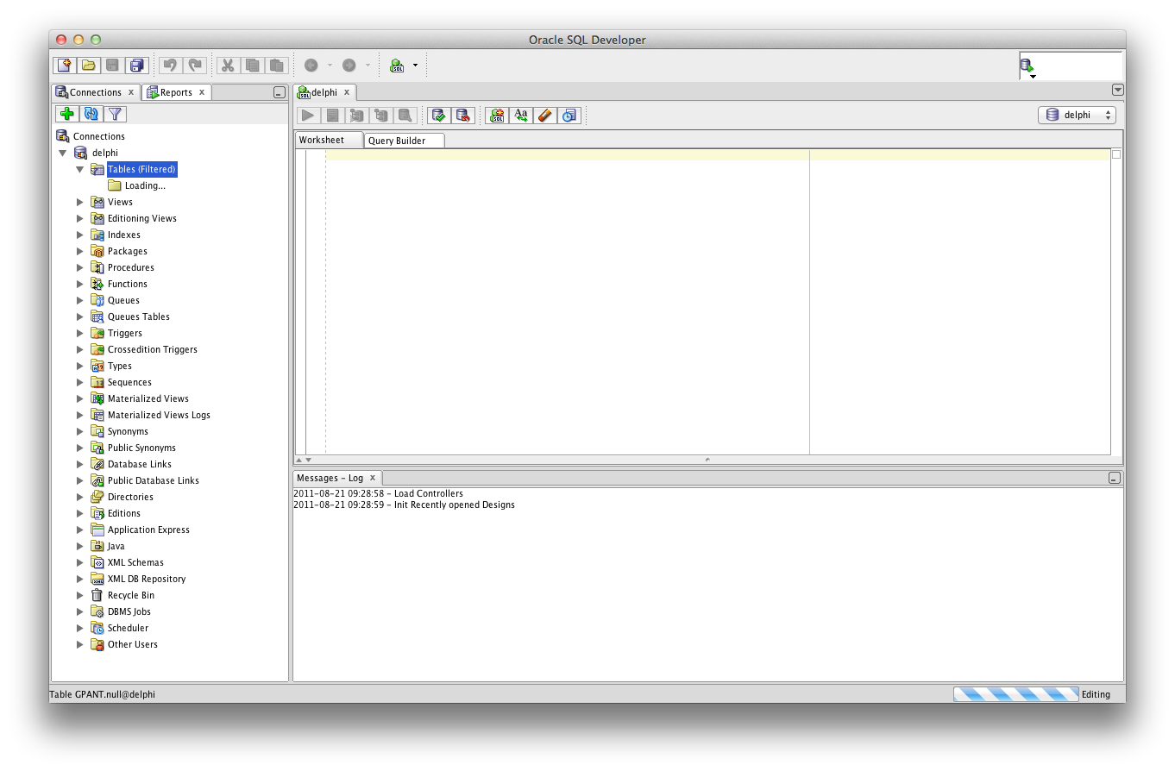
Database Management System (DBMS)
Software system used to create, maintain, and provide controlled access to the database
Act as an intermediary between applications and the database
Enable data sharing
DBMS
Database
Client computer/program/Application
Database server

Slide 8
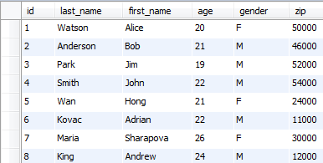
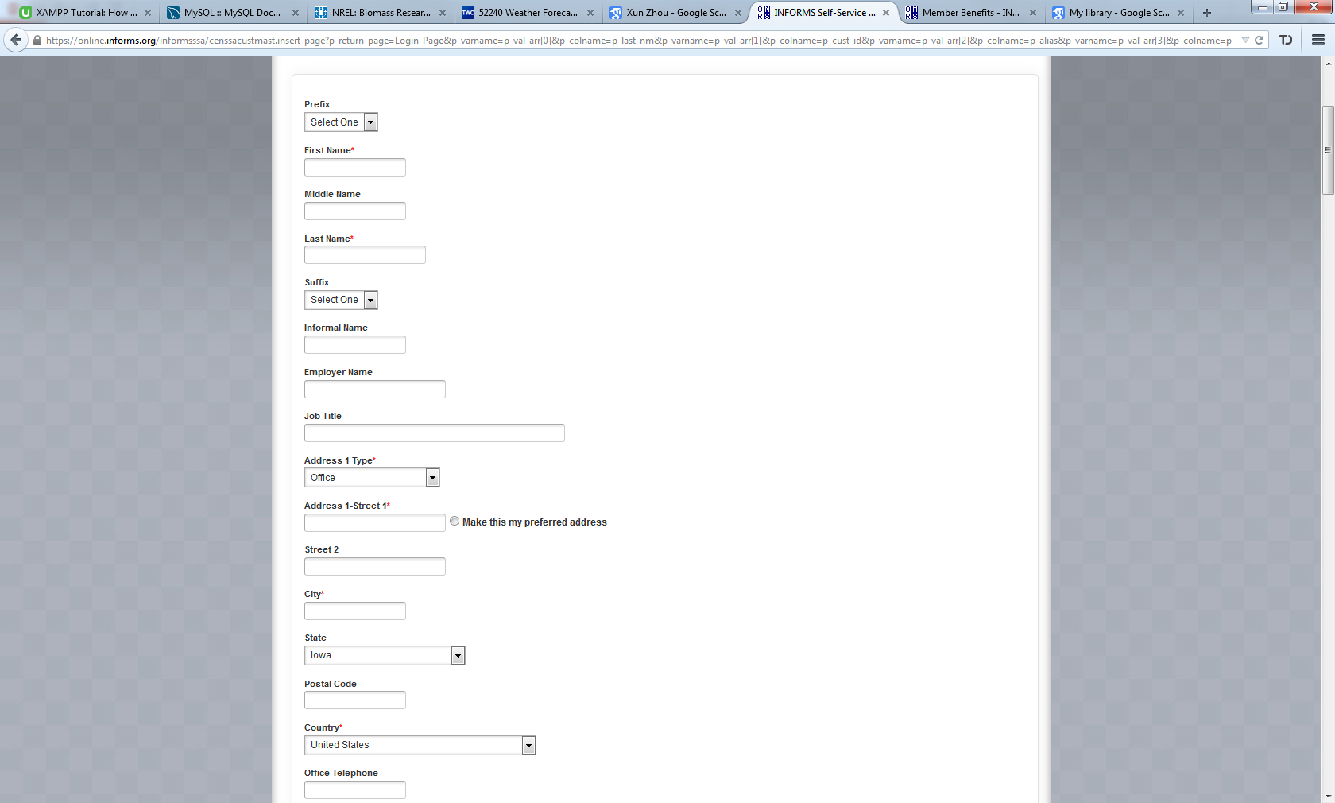

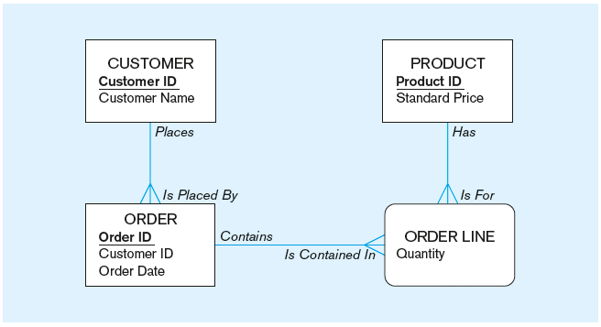
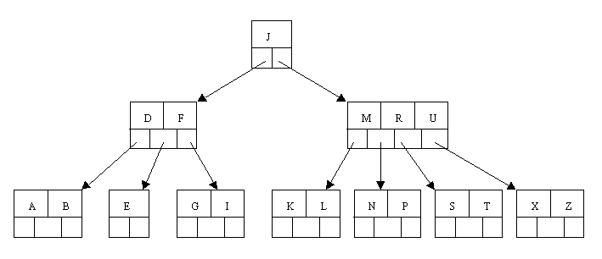
DBMS: Abstractions and Independence
External Schema
App 1
App 2
App 3
Data Model
Scope of DBMS
Conceptual
Schema
Hard Disk
Internal (logical/Physical) Schema
Index and file organization on disk

Slide 9
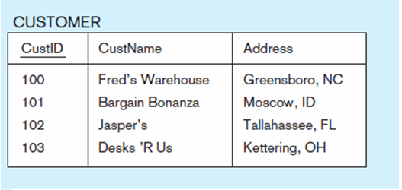
Relational Databases
Relational Data Model
Represent data in the form of relations
Relation
A named, two-dimensional table of data
Each column represents an attribute or a field
Each row corresponds to a record or an instance
Attribute/Field
Table Name
Record/Instance
Attribute Value

Slide 10
Relational Model
Employee Department
Primary Key
eid | Name | Salary | Title | Department
S001 | Alexis Sanchez | 80000 | Manager | Sales
S002 | Santi Carzola | 40000 | Sr. Sales Rep | Sales
S003 | Alex Iwobi | 30000 | Sales Rep | Sales
A001 | Luis Suarez | 80000 | Manager | Accounting
A002 | Theo Walcott | 40000 | Accountant | Accounting
Dept | Budget
Sales | 100000
Accounting | 50000
Primary Key
Foreign Key
Concepts: Primary Key, Foreign key
Tables linked by “Foreign Keys”, i.e., duplicated columns

Slide 11
SQL Review
Data Types
Create Tables,
Insert / delete data
6 clauses
Join, sub-queries

Slide 12
Common Data Types (Oracle)
Type | Description | Example
CHAR(x) | Fixed length string with x characters | char(2): ‘NY’, ‘IA’, ‘CA’, ‘FL’ …
VARCHAR2(x) | Text string with varying length up to x characters | varchar2(20): ‘abc’, ‘John Smith’ …
NUMBER | A fixed and floating-point number up to 38 digits of precision | 1,2,3, 105.2, 16384.995 …
NUMBER(p, s) | A number with precision p and scale s (p/s: number of digits before/after the decimal) | NUMBER(3, 1): 123.4, 456.9… NUMBER(5, 0): 1, 12, 123, 12345 …
DATE | Date and Time information formatted. Default format: YY-MM-DD | Today is : ’16-09-13’
TIMESTAMP | “YYYY-MM-DD HH24.MI.SS” | ’2016-01-27 15:30:00’
BOOLEAN | Truth values | TRUE, FALSE, or UNKNOWN

Slide 13
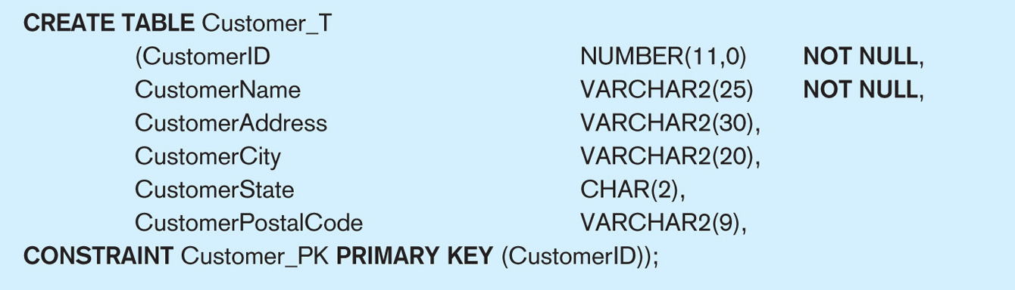
Create Tables (1)
Table Name
Column Definition
Table Constraint

Slide 14
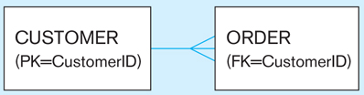
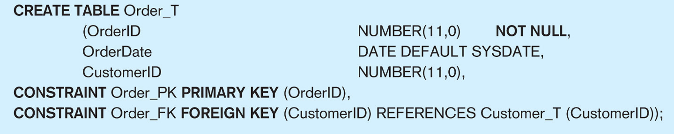
Create Table (2)
Default value
Table Constraint Name
Table Constraint Attribute
Table Constraint Type

Slide 15
Create Table
Customer_T
CustomerID | CustomerName | CustomerAddress | CustomerCity | Customer State | Customer PostalCode
PK
Order_T
FK
OrderID | OrderDate | CustomerID
PK = Primary Key
FK = Foreign Key

Slide 16
Insert Data
Add a new customer with data values for all attributes
INSERT INTO Customer_T VALUES (100, 'John Smith', '123 A Street', 'Coralville', 'IA', '52241');
Note: 1. The data values must be in the same order as the columns in the table
2. Put ' ' around data values of CHAR, VARCHAR2, and DATE
Add a new customer with data values for some (but not all) attributes
INSERT INTO Customer_T VALUES (101, ‘Matt Damon', NULL, 'Iowa City', 'IA', NULL);
INSERT INTO Customer_T (CustomerID, CustomerName, CustomerState) VALUES (102, 'Andy Boyd', 'IL');
Note: Those attributes without input values will be left with null

Slide 17
Insert Data
Customer_T
CustomerID | CustomerName | CustomerAddress | CustomerCity | Customer State | Customer PostalCode
100 | John | 123 A Street | Coralville | IA | 52241
101 | Matt Damon | NULL | Iowa City | IA | NULL
102 | Andy Boyd | NULL | NULL | IL | NULL
Order_T
OrderID | OrderDate | CustomerID

Slide 18
Delete Data
Delete rows from a table
DELETE FROM Customer_T WHERE CustomerID = 101; -- delete one row
DELETE FROM Customer_T; -- delete all rows

Slide 19
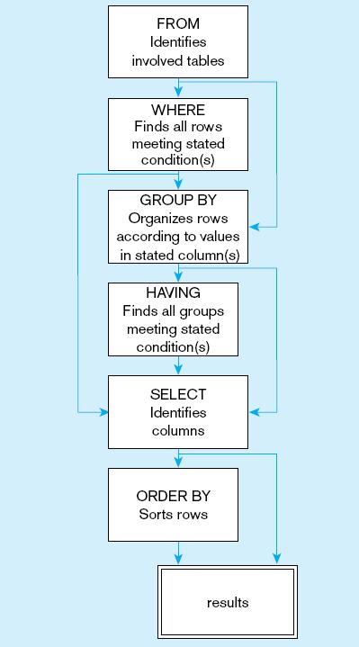
SQL Query Structure
Syntax
SELECT <list of column expressions>
FROM <list of tables and join operations>
WHERE <list of logical expressions for rows>
GROUP BY <list of grouping columns>
HAVING <list of logical expressions for groups>
ORDER BY <list of sorting specifications>
Syntax order
Processing order

Slide 20
What does this query mean?
SELECT eid, Name, Salary
FROM employee
WHERE Salary BETWEEN 30000 and 50000;
Employee
eid | Name | Salary | Title | Department
S001 | Alexis Sanchez | 80000 | Manager | Sales
S002 | Santi Carzola | 40000 | Sr. Sales Rep | Sales
S003 | Alex Iwobi | 30000 | Sales Rep | Sales
A001 | Luis Suarez | 80000 | Manager | Accounting
A002 | Theo Walcott | 40000 | Accountant | Accounting
eid | Name | Salary
S002 | Santi Carzola | 40000
S003 | Alex Iwobi | 30000
A002 | Theo Walcott | 40000

Slide 21
SQL Quick Review
Employee
Insert a new record (‘L003’, ‘John Terry’, 200000, ‘VP’)
eid | Name | Salary | Title
S001 | Alexis Sanchez | 80000 | Manager
S002 | Santi Carzola | 40000 | Sr. Sales Rep
S003 | Alex Iwobi | 30000 | Sales Rep
A001 | Luis Suarez | 80000 | Manager
A002 | Theo Walcott | 40000 | Accountant

Slide 22
Solution
INSERT INTO employee VALUES (‘A003’, ‘John Terry’, 200000, ‘VP’)
eid | Name | Salary | Title
S001 | Alexis Sanchez | 80000 | Manager
S002 | Santi Carzola | 40000 | Sr. Sales Rep
S003 | Alex Iwobi | 30000 | Sales Rep
A001 | Luis Suarez | 80000 | Manager
A002 | Theo Walcott | 40000 | Accountant
L003 | John Terry | 200000 | VP

Slide 23
GROUP BY/HAVING
Calculate the average salary of each department with 2 or more employess
eid | Name | Salary | Title | DeptName
S001 | Alexis Sanchez | 80000 | Manager | Sales
S002 | Santi Carzola | 40000 | Sr. Sales Rep | Sales
S003 | Alex Iwobi | 30000 | Sales Rep | Sales
A001 | Luis Suarez | 80000 | Manager | Accounting
A002 | Theo Walcott | 40000 | Accountant | Accounting
L003 | John Terry | 200000 | VP | NA

Slide 24
Solutions
Calculate the average salary of each department with 2 or more employees
DeptName | avg_sal
Sales | 50000
Accounting | 60000
SELECT DeptName, avg(Salary) as avg_sal
FROM employee
GROUP BY DeptName
HAVING count(*) >=2;

Slide 25
Review Concepts in SQL (used later)
1. Join operation
2. Sub-queries

Slide 26
Join
Connect rows from different tables based on foreign keys
Employee
Department
eid | Name | Salary | Title | Department
S001 | Alexis Sanchez | 80000 | Manager | Sales
S002 | Santi Carzola | 40000 | Sr. Sales Rep | Sales
S003 | Alex Iwobi | 30000 | Sales Rep | Sales
A001 | Luis Suarez | 80000 | Manager | Accounting
A002 | Theo Walcott | 40000 | Accountant | Accounting
Dept | Budget
Sales | 100000
Accounting | 50000

Slide 27
Join
Connect rows from different tables based on foreign keys Q: What is the budget of Luis Suarez’s department?
Employee
Department
eid | Name | Salary | Title | Department
S001 | Alexis Sanchez | 80000 | Manager | Sales
S002 | Santi Carzola | 40000 | Sr. Sales Rep | Sales
S003 | Alex Iwobi | 30000 | Sales Rep | Sales
A001 | Luis Suarez | 80000 | Manager | Accounting
A002 | Theo Walcott | 40000 | Accountant | Accounting
Dept | Budget
Sales | 100000
Accounting | 50000

Slide 28
Join
Q: What is the budget of Luis Suarez’s department?
SELECT Budget
FROM Employee e JOIN Department d ON e.department = d.dept
WHERE e.Name = ‘Luis Suarez’;

Slide 29
Self-Join
Q: Compare the salaries of the managers of the two different departments. Show their names, departments, and salaries.
Employee
eid | Name | Salary | Title | Department
S001 | Alexis Sanchez | 80000 | Manager | Sales
S002 | Santi Carzola | 40000 | Sr. Sales Rep | Sales
S003 | Alex Iwobi | 30000 | Sales Rep | Sales
A001 | Luis Suarez | 80000 | Manager | Accounting
A002 | Theo Walcott | 40000 | Accountant | Accounting

Slide 30
Self-Join
Q: Compare the salaries of the managers of the two different departments. Show their names, departments, and salaries.
Employee
eid | Name | Salary | Title | Department
S001 | Alexis Sanchez | 80000 | Manager | Sales
S002 | Santi Carzola | 40000 | Sr. Sales Rep | Sales
S003 | Alex Iwobi | 30000 | Sales Rep | Sales
A001 | Luis Suarez | 80000 | Manager | Accounting
A002 | Theo Walcott | 40000 | Accountant | Accounting
SELECT e1.Name, e1.Salary, e1.Department, e2.Name, e2.Salary, e2. Department
FROM Employee e1, Employee e2
WHERE e1.Title = ‘Manager’ and e2.Title = ‘Manager and e1.department <> e2.department
and e1.eid < e2.eid
e1.Name | e1.Salary | e1.Department | e2.Name | e2.Salary | e2.Department
Alexis Sanchez | 80000 | Sales | Luis Suarez | 80000 | Accounting
Luis Suarez | 80000 | Accounting | Alexis Sanchez | 80000 | Sales

Slide 31
Sub-Query
Find the employee(s) with the highest salary. Show names and salaries.
eid | Name | Salary | Title | Department
S001 | Alexis Sanchez | 80000 | Manager | Sales
S002 | Santi Carzola | 40000 | Sr. Sales Rep | Sales
S003 | Alex Iwobi | 30000 | Sales Rep | Sales
A001 | Luis Suarez | 80000 | Manager | Accounting
A002 | Theo Walcott | 40000 | Accountant | Accounting
SELECT *
FROM Employee
WHERE Salary = (SELECT Max(Salary) FROM Employee);
SELECT *
FROM Employee
WHERE Salary >= ALL (SELECT Salary FROM Employee);
eid | Name | Salary | Title | Department
S001 | Alexis Sanchez | 80000 | Manager | Sales
A001 | Luis Suarez | 80000 | Manager | Accounting

