Slide 1
Hive and HiveQL
MSCI:6110 Fall 2019
Master’s in Business Analytics

Slide 2
Load Hadoop and Hive
Do the following steps EVERY TIME when you use OnDemand again
Step 1: interact –N 3 –t 00:30:00 (or a different time length)
Step 2: load the Hadoop module
module load /opt/packages/hadoop-testing/interact-envmod.txt
Now you can do some HDFS operations if desired.
Step 3: Run Hive
hive
You should see prompt:
hive>

Slide 3
Apache HIVE
A data warehouse software on top of Hadoop for data summarization, query, and analysis
HiveQL is the “SQL” on HIVE
Make sure to type “;” after each command.
Commands are case-insensitive, just like SQL (except strings).

Slide 4
HIVE Create Table (1)
Create a new database using your hawkid or your XSEDE id
Create a table like this in HIVE
5 columns, 5 rows
eid | Name | Salary | Title | Dept
S001 | Alexis Sanchez | 80000 | Manager | Sales
S002 | Santi Carzola | 40000 | Sr. Sales Rep | Sales
S003 | Alex Iwobi | 30000 | Sales Rep | Sales
A001 | Luis Suarez | 80000 | Manager | Accounting
A002 | Theo Walcott | 40000 | Accountant | Accounting
hive> Create Database xunzhou;
hive> use xunzhou;

Slide 5
Create a Table (2)
Create table keywords
Table name
CREATE TABLE IF NOT EXISTS employee
(eid char(4),
name string,
salary decimal,
title String,
dept String)
ROW FORMAT DELIMITED
FIELDS TERMINATED BY ','
LINES TERMINATED BY '\n'
STORED AS TEXTFILE;
Column definitions
The fields are delimited in each row.
Field and Line separators
How the table is physically stored

Slide 6
Create a Table (3)
hive> CREATE TABLE IF NOT EXISTS employee
> (eid char(4),
> name string,
> salary decimal,
> title String,
> dept String)
> ROW FORMAT DELIMITED
> FIELDS TERMINATED BY ','
> LINES TERMINATED BY '\n'
> STORED AS TEXTFILE;
OK
Time taken: 0.057 seconds
hive>

Slide 7
Show Tables
show tables
hive> show tables;
OK
employee
Time taken: 0.11 seconds, Fetched: 1 row(s)
hive>

Slide 8
HIVE Data Types
Primitives
TINYINT, SMALLINT, INT, BIGINT
Decimal, or Decimal(n, d). By default decimal = decimal(n, 0)
Varchar(x): varying-length string with a maximum length
Char (x): fixed-length string with a maximum length
String: text string.
Timestamp:
Date
yyyy-mm-dd hh:mm:ss
YYYY-­MM-­DD

Slide 9
Hive Table vs. MySQL/Oracle Table
Relational Database: data validated when “written into the table”
Hive: data validated when data “read from the table”
When you define a table, you should define how the data to be read
A Hive table is simply a file containing data + metadata
Table Schema
eid | Name | Salary | Title
Linked when loading data
Whether data fits the schema or not is not checked
Data file

Slide 10
Create Table in HIVE
CREATE TABLE IF NOT EXISTS employee
(eid char(4),
name string,
salary decimal,
title String,
dept string)
ROW FORMAT DELIMITED
FIELDS TERMINATED BY ','
LINES TERMINATED BY '\n'
STORED AS TEXTFILE;
eid | Name | Salary | Title | Dept
S001, Alexis Sanchez, 80000, Manager, Sales
S002, Santi Cazorla, 40000, Sr. Sales Rep, Sales
S003, Alex Iwobi, 30000, Sales Rep, Sales
A001, Luis Suarez, 80000, Manager, Accounting
A002, Theo Walcott, 40000, Accountant, Accounting

Slide 11
Populating Data into Hive Tables
Data From a local file (e.g., txt, csv)
Data From other tables
Data From a file in HDFS

Slide 12
Populating Data Into HIVE Tables
You have saved the employee.txt file into your home folder
Use the “Load” command to load data into your table
Load data local inpath “your file path” into table <table name>;
hive> Load data local inpath "employee.txt" into table employee;
Loading data to table default.employee
Table default.employee stats: [numFiles=1, totalSize=175]
OK
Time taken: 0.736 seconds
hive>

Slide 13
Populating Data Into HIVE Tables
Hive will load the data and write it as a textfile into Hive’s data warehouse through HDFS
We can verify the data in the table
Configure to show column names
hive> set hive.cli.print.header=true;
hive> select * from employee;
OK
employee.eid employee.name employee.salary employee.title employee.dept
S001 Alexis Sanchez 80000 Manager Sales
S002 Santi Cazorla 40000 Sr. Sales Rep Sales
S003 Alex Iwobi 30000 Sales Rep Sales
A001 Luis Suarez 80000 Manager Accounting
A002 Theo Walcott 40000 Accountant Accounting
Time taken: 0.754 seconds, Fetched: 5 row(s)

Slide 14
Load Data from HDFS
You can load a file in HDFS to your table.
You have put the employee.txt into HDFS previously (outside Hive)
hdfs dfs -put employee.txt (in your home folder)
To load a file already in HDFS, remove the word “local”
hive> Load data inpath “employee.txt" into table employee;
The file will be “moved” to Hive’s HDFS directory. The file will be no longer in its original HDFS directory.

Slide 15
Load Data to Hive Tables
See what you have in your hive table now?
hive> select * from employee;
OK
employee.eid employee.name employee.salary employee.title employee.dept
S001 Alexis Sanchez 80000 Manager Sales
S002 Santi Cazorla 40000 Sr. Sales Rep Sales
S003 Alex Iwobi 30000 Sales Rep Sales
A001 Luis Suarez 80000 Manager Accounting
A002 Theo Walcott 40000 Accountant Accounting
S001 Alexis Sanchez 80000 Manager Sales
S002 Santi Cazorla 40000 Sr. Sales Rep Sales
S003 Alex Iwobi 30000 Sales Rep Sales
A001 Luis Suarez 80000 Manager Accounting
A002 Theo Walcott 40000 Accountant Accounting
Time taken: 0.073 seconds, Fetched: 10 row(s)
hive>

Slide 16
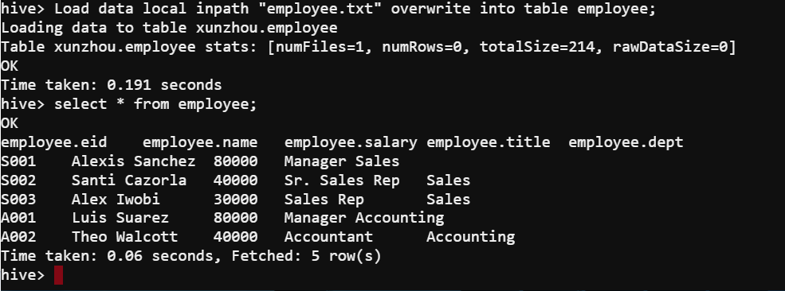
Load Data to Hive Tables
Overwrite original content in a table when loading data
hive> Load data local inpath “employee.txt" OVERWRITE into table employee;

Slide 17
Drop a table
hive> Drop Table employee;
You can also delete data from Hive tables. But directly dropping the table would be much easier. Create the table again.
Our Hive configuration does not support the DELETE/UPDATE operations (but they are available in Hive).
INSERT is supported

Slide 18
Inserting data into a table
hive> INSERT INTO employee values ('L001', 'No name', 50000, 'CEO', 'NA');
Same as SQL.
You can also insert multiple records in the same command.
hive> INSERT INTO employee values ('L002', 'No name too', 60000, 'CTO', 'NA'), ('L003', 'No name again', 70000, 'CFO', 'NA');

Slide 19
Quick Exercise
Create a new table called department with the following data.
Copy the data file from /pylon5/ever930/data to your home folder
dept.txt
CREATE TABLE IF NOT EXISTS department (name varchar(20), mgreid char(4), budget int, city varchar(30), state char(2))
ROW FORMAT DELIMITED
FIELDS TERMINATED BY ','
LINES TERMINATED BY '\n'
STORED AS TEXTFILE;
Name | MgrEid | Budget | City | State
Sales | S001 | 100000 | Cedar Rapids | IA
Accounting | A001 | 60000 | Cedar Rapids | IA
Load data local inpath "dept.txt" into table department;

Slide 20
Writing Queries
Simple Queries are the same as SQL
SELECT, FROM, WHERE, GROUP BY, HAVING, ORDER BY
LIMIT N : select the top N rows in result
SELECT * FROM employee ORDER BY salary LIMIT 2;
employee.eid employee.name employee.salary employee.title employee.dept
S003 Alex Iwobi 30000 Sales Rep Sales
A002 Theo Walcott 40000 Accountant Accounting
Time taken: 15.656 seconds, Fetched: 2 row(s)

Slide 21
Join
Almost Same as SQL
Use Keyword JOIN ON. Can do LEFT/RIGHT/FULL JOIN
select *
from employee e join department d on (e.dept = d.name);
e.eid e.name e.salary e.title e.dept d.name d.mgreid d.budget d.city d.state
A001 Luis Suarez 80000 Manager Accounting Accounting A001 60000 Cedar Rapids iA
A002 Theo Walcott 40000 Accountant Accounting Accounting A001 60000 Cedar Rapids iA
S001 Alexis Sanchez 80000 Manager Sales Sales S001 100000 Cedar Rapids IA
S002 Santi Cazorla 40000 Sr. Sales Rep Sales Sales S001 100000 Cedar Rapids IA
S003 Alex Iwobi 30000 Sales Rep Sales Sales S001 100000 Cedar Rapids IA
Time taken: 24.659 seconds, Fetched: 5 row(s)

Slide 22
Subqueries
Sub-queries are limited in HIVE
In SQL you can write subqueries in FROM, WHERE, and HAVING.
In HIVE you can (up to the recent version)
Write a SELECT subquery in the FROM Clause
The temporary table must have a new name
Not available in other form in WHERE or HAVING

Slide 23
Hive Subquery
Find which department(s) has an average salary more than 50000. Show the name and the average salary of these departments.
select * From
(select e.dept, avg(salary) as avg_sal from department d join employee_p e on (d.name=e.dept) group by e.dept) as sal_stat
where avg_sal > 50000;

Slide 24
IN keyword
The IN keyword is recently supported in HIVE
In SQL you can write this:
SELECT distinct Name
FROM department WHERE Mgreid IN (Select eid From Employee Where Salary > 50000);
In HIVE you can also do this
But you can only use a single column before the IN keyword

Slide 25
Exercise (1)
Read the data description file to understand the fields of the NYC taxi data
https://data.cityofnewyork.us/Transportation/2014-Yellow-Taxi-Trip-Data/gn7m-em8n
Draft a Hive query to create a table named nyc_taxi
Load the data into the table. You have the csv file in your home folder.
columns (see file description):
pickup_datetime, pickup_longitude, pickup_latitude,
dropoff_datetime, dropoff_longitude, dropoff_latitude,
passenger_count, trip_distance, Fare_amount, …

Slide 26
Exercise (II)
Write Hive query to calculate the total number of trips in each hour of day. Use pickup_datetime as the time of trip.
Use function “hour()” to get the hour component of a column with datetime data type.
For example:
select distinct hour(pickup_datetime) as hr from nyc_taxi order by hr;

Slide 27
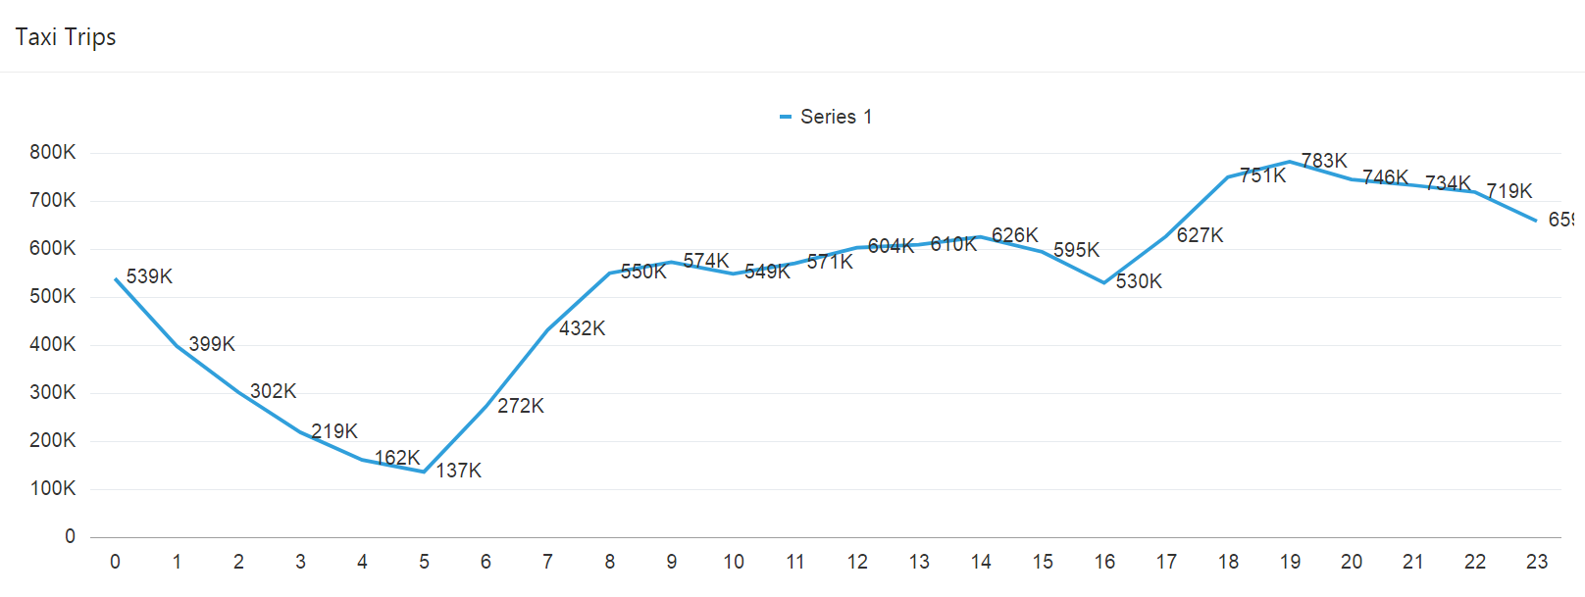
Exercise
SELECT hour(pickup_datetime) as hr, count(*) FROM nyc_taxi GROUP BY hour(pickup_datetime) ORDER BY hr;

