Slide 1
Big Data Management & Analytics
MSCI:6110 Fall 2019
Masters in Business Analytics

Slide 2
Setting Up Working Environment
Register an online XSEDE account. Submit your account on ICON today.
Login at Bridges OnDemand web portal.

Slide 3
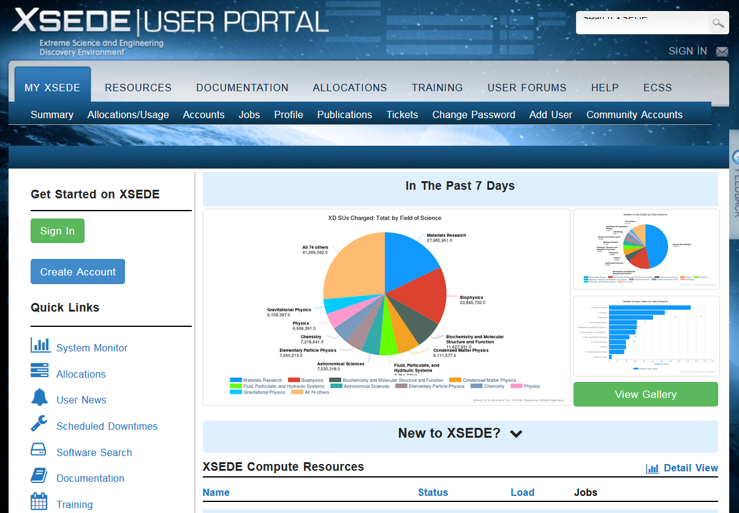
Step 1: Register XSEDE Account
Go to https://portal.xsede.org/my-xsede#/guest
Register an account
Send me your username to me via email.
Click

Slide 4
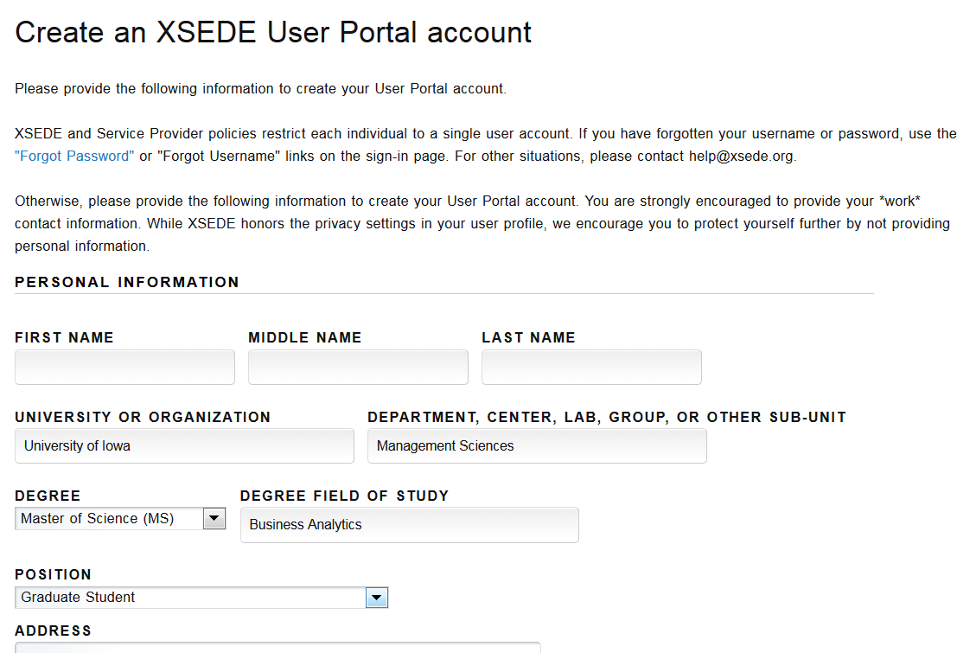
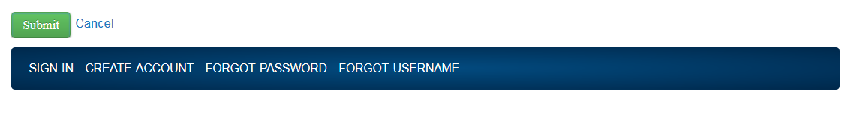
Step 1: Register XSEDE Account
Register your information

Slide 5
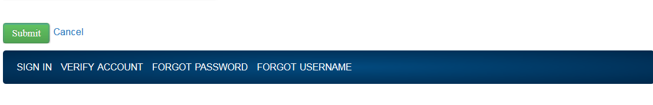
Step 1: Register XSEDE Account
Verify the account
Submit your account info on ICON under projects

Slide 6
Step 2: Set up your PSC password
PSC is a sub-division of the XSEDE organization.
We are using PSC services. Need to setup a password for them, too.
Go to https://apr.psc.edu/autopwdreset/autopwdreset.html
Use your email and XSEDE username to login
Set up a password (could be the same as the XSEDE web portal one).
XSEDE and PSC use the same username.

Slide 7
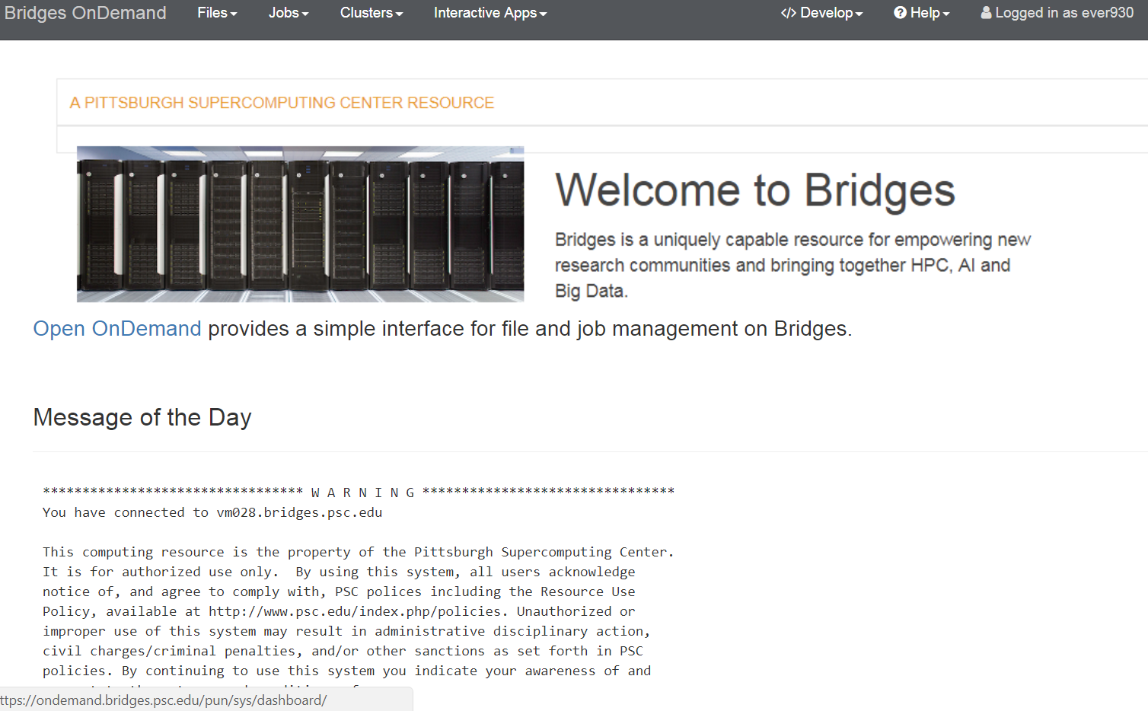
Step 2: Login at the OnDemand Web Portal
A web portal to run commands, and transfer files’
Go to https://ondemand.bridges.psc.edu
Login with your XSEDE username and PSC password

Slide 8
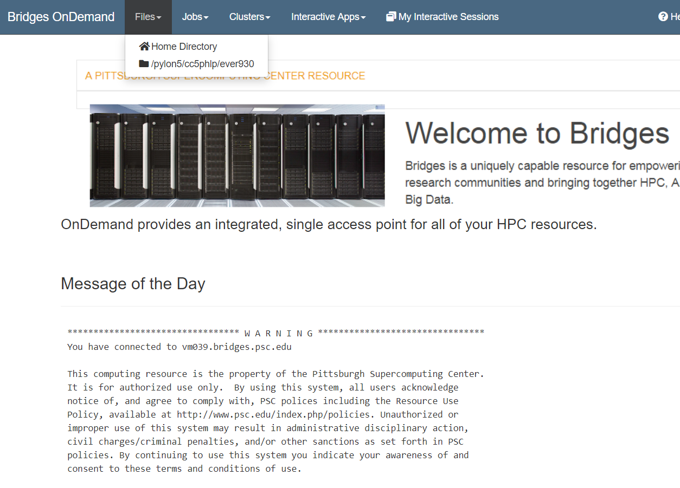
Your home directory. Put all code, results here. 10GB
Scratch space for large data, project files. Shared with other users.

Slide 9
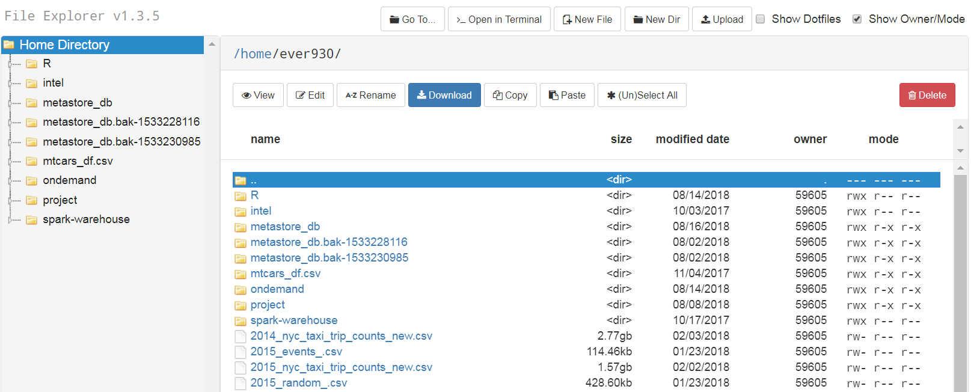
File Explorer
Your folder should be empty

Slide 10
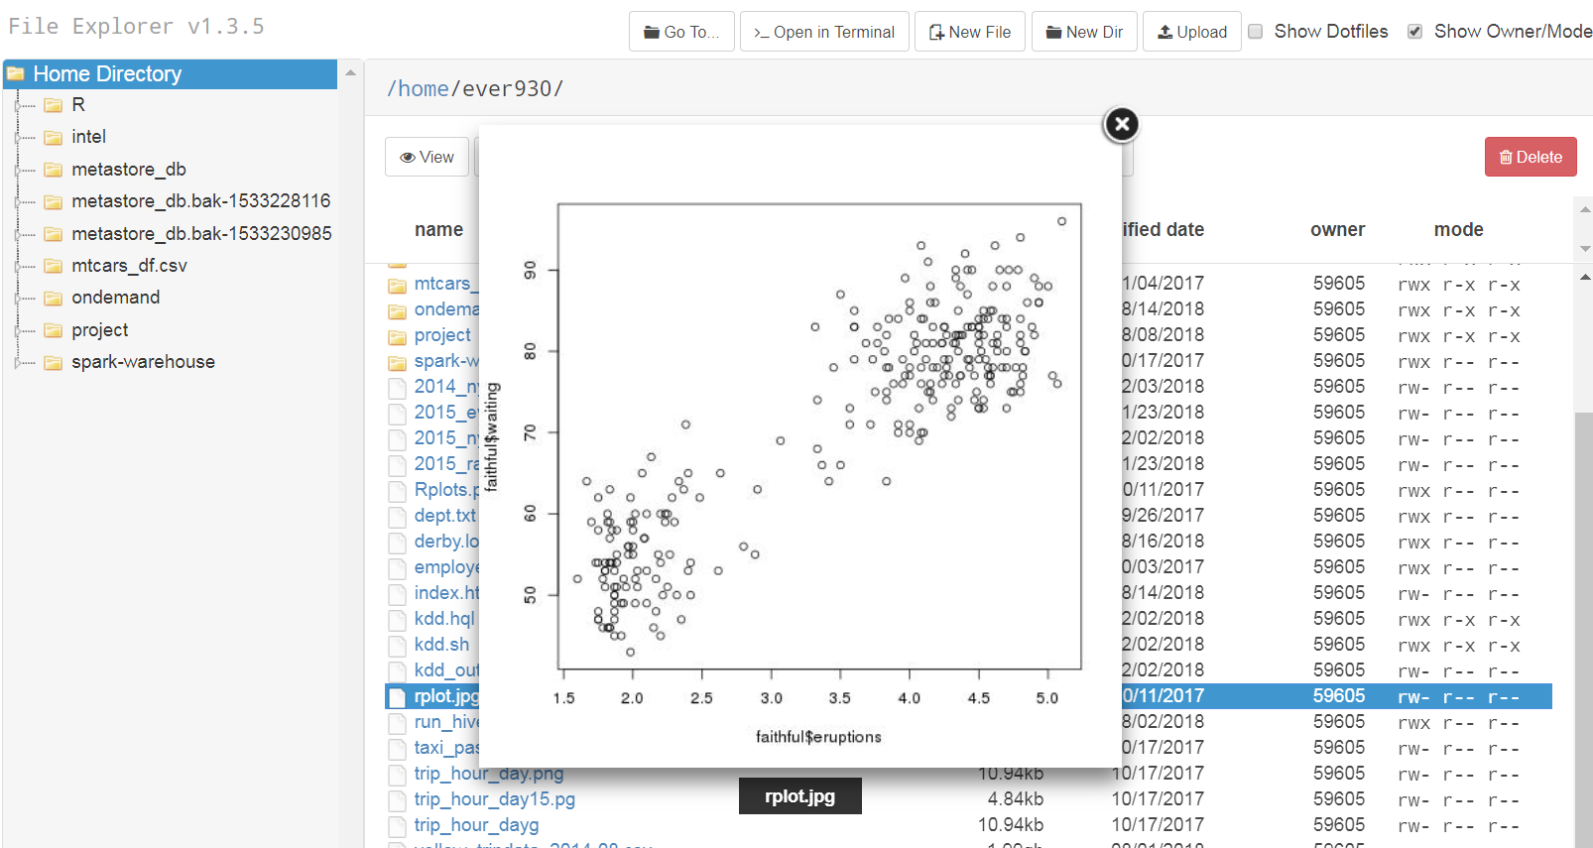
You can view file contents (text, image)
Don’t try to open very large files !!!!!!

Slide 11
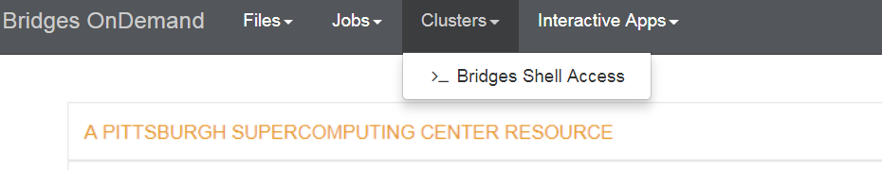
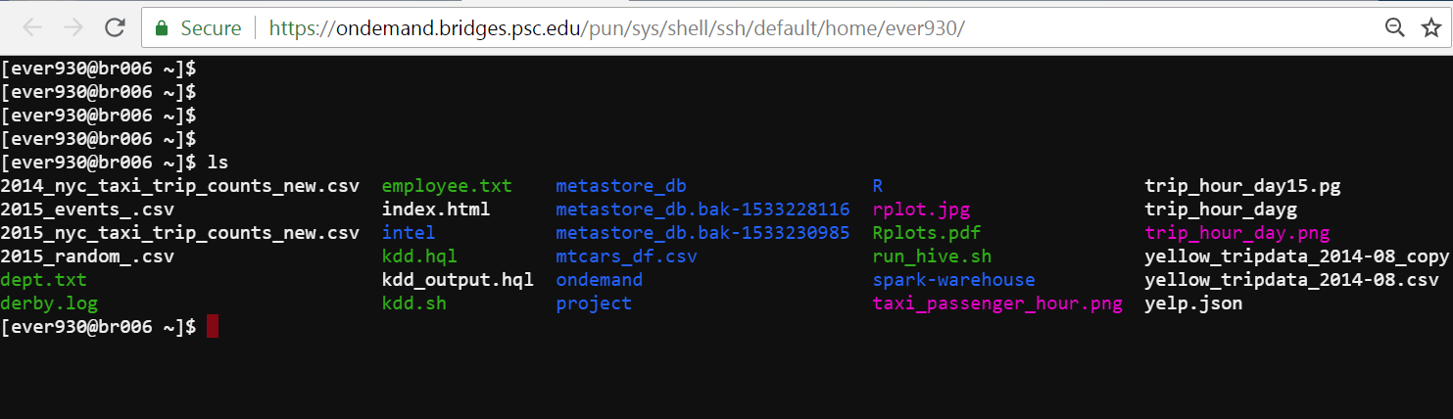
Shell Access (Command Line)
New web tab

Slide 12
XSEDE Cluster
SSH connection
A big picture
Node r006
Commands
File transfer
Node r007
user
OnDemand Web Portal
Shared Storage
Home folder
Project folder
Your laptop
Node r100
PSC sub-division
servers

Slide 13
Copy and Paste
Select a piece of text from the terminal.
Copy: Ctrl + Shift + C (Ctrl +C in some browsers)
Copy a piece of text from other windows
Paste: Ctrl + Shift + V (Ctrl + V in some browsers)

Slide 14
Basic Linux Commands (case sensitive)
cat [filename] | Display file’s contents to the standard output device (usually your monitor).
cd /directorypath | Change to directory.
chmod [options] mode filename | Change a file’s permissions.
chown [options] filename | Change who owns a file.
clear | Clear a command line screen/window for a fresh start.
cp [options] source destination | Copy files and directories.
date [options] | Display or set the system date and time.
df [options] | Display used and available disk space.
du [options] | Show how much space each file takes up.
file [options] filename | Determine what type of data is within a file.
find [pathname] [expression] | Search for files matching a provided pattern.
grep [options] pattern [filesname] | Search files or output for a particular pattern.
kill [options] pid | Stop a process. If the process refuses to stop, use kill -9 pid.
less [options] [filename] | View the contents of a file one page at a time.
ln [options] source [destination] | Create a shortcut.
locate filename | Search a copy of your filesystem for the specified filename.

Slide 15
Basic Linux Commands
lpr [options] | Send a print job.
ls [options] | List directory contents.
man [command] | Display the help information for the specified command.
mkdir [options] directory | Create a new directory.
mv [options] source destination | Rename or move file(s) or directories.
passwd [name [password]] | Change the password or allow (for the system administrator) to change any password.
ps [options] | Display a snapshot of the currently running processes.
pwd | Display the pathname for the current directory.
rm [options] directory | Remove (delete) file(s) and/or directories.
rmdir [options] directory | Delete empty directories.
ssh [options] user@machine | Remotely log in to another Linux machine, over the network. Leave an ssh session by typing exit.
su [options] [user [arguments]] | Switch to another user account.
tail [options] [filename] | Display the last n lines of a file (the default is 10).
tar [options] filename | Store and extract files from a tarfile (.tar) or tarball (.tar.gz or .tgz).
top | Displays the resources being used on your system. Press q to exit.
who [options] | Display who is logged on.

Slide 16
Directory and Path
Like in Mac OSX, you enter your home folder by default when logged in
There are other folders such as scratch space.
In any place, you can go back to your home folder by typing
cd $HOME
$HOME represents the full path of your home folder
Use “.” to represent the current folder, and “..” to represent parent folder
cd .. will take you one level up

Slide 17
Home Folder
Only you can access by default (unless you change permission)
10GB quota. Enough for homework
Don’t delete files you don’t recognize (some configuration files will be saved here)
If you need more space for project, don’t copy all the files to home !
Go to scratch space by typing “cd $SCRATCH”
Also your own territory but everyone shares 600GB. Don’t waste space!

Slide 18
Quick Exercise
1. Go to the project file folder /pylon5/cc5phlp/ever930/data/
2. See if you can visit all the data folders (don’t change or delete data)
3. Go to the NYC_Yellow_Taxi data folder
4. Find the full path to this folder using “pwd”
5. Go back to your home folder (use cd $HOME)
Create a folder called project in your home folder (mkdir project)
Copy the “yellow_tripdata_2014-01.csv” file into your home folder.

Slide 19
Solutions
There is a dot here
In your home folder:
cd /pylon5/cc5phlp/ever930/data/project/NYC_Yellow_taxi
cd $HOME
mkdir project
cd project
cp /pylon5/cc5phlp/ever930/data/project/NYC_Yellow_Taxi/yellow_tripdata_2014-01.csv .
Copy the file at this path to the current folder (.)

Slide 20
Solutions
If you are in the source file’s directory, how do you copy the file back to home folder? (/pylon5/cc5phlp/ever930/data/project/NYC_Yellow_Taxi/)
cd /pylon5/cc5phlp/ever930/data/project/NYC_Yellow_taxi
mkdir $HOME/project
cp yellow_tripdata_2014-01.csv $HOME/project
Don’t open it in OnDemand file explorer! It is too large to open.

Slide 21
View the content of a file
Command “more”
more yellow_tripdata_2014-01.csv
Press to see more lines.
“q” to quit this mode.

Slide 22
View the first /last lines of a file
Command “head” and “tail”
head -n 100 yellow_tripdata_2014-01.csv
View the first 100 lines of the file. Same for “tail”

Slide 23
Linux Permissions (use with caution)
Each folder/file has its permissions
Grant permission using +, revoke permission using -
chmod g+r yellow_tripdata_2014-01.csv
chmod g+r * (* = wildcard, all the files/sub-directories).
 | Owner (o) yourself | Users in your group (g) | Everyone (a)
Read file | u+r | g+r | a+r
Change file | u+w | g+w | a+w
Execute file (open a directory) | u+x | g+x | a+x

Slide 24
Remember to log out (close terminal )
We are given a fixed amount of SU (service units)
1 SU is 1 hour running time on 1 CPU.
If you don’t work on anything, log out to save SUs
Don’t use our course resources to do other work/project.

