Slide 1
Hadoop and MapReduce
MSCI:6110 Fall 2019
Master’s in Business Analytics

Slide 2

Hadoop
Apache Hadoop: Open-source software framework
Designed to process very large datasets using cluster of multiple computers/processing nodes
Many big companies use Hadoop to process their data

Slide 3
Motivation
Datasets becoming very large and moving them is costly
No single machine can hold so much data
Google’s web search
Hardware becomes cheap
Use many computers to store data in distributed manner
Distribute the computation tasks to where data locates
The idea of MapReduce was first proposed by Google in a paper in 2003 and later developed by other parties

Slide 4
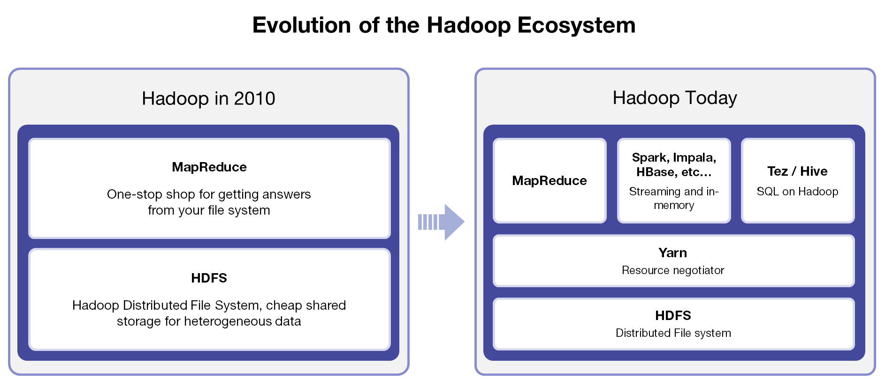
Hadoop Ecosystem
Source: http://www.marklogic.com/blog/tdwi-hadoop-readiness-assessment-and-guide/

Slide 5
Hadoop Architecture
Hadoop is a distributed data processing/management software
You can think of it as a distributed “database”
HDFS: Hadoop File Systems
Manages shared files across different computer nodes
Communicate via high-speed network
The “Physical Layer” of Hadoop

Slide 6
Hadoop File System (HDFS)
Data are stored in a distributed way (Hadoop File System, HDFS)
Each Data node (a computer) keeps a subset of the actual data
The Namenode monitors the updates and transfer of data
The Namenode also keeps track of the data distribution (only meta data)
On a single-node Hadoop (only one CPU), the namenode and the datanode are on the same machine.
Sometimes there is a secondary namenode to avoid single-point failure.
Data node 1
Data node 5
Namenode
Data node 2
Data node 4
Data node 3

Slide 7
Hadoop File System (HDFS)
Namenode periodically gather data distribution information
Who has what data blocks
Namenode also manages read/write schedules: Which nodes to read from/write to
If namenode is down, the entire HDFS is down.
File.txt = A+B+C+D
Data Block A,B
Data node 1
Data node 5
Data Block A,D
Application: read data from blocks A,C,D
NameNode: Read from datanodes 1,2,3
Data Block B,C
Namenode
Data node 2
Data node 4
Data node 3
Data Block C,D
Data Block B,D

Slide 8
Hadoop YARN
The “Operating System” of Hadoop
Manages different resources such as network bandwidth, CPU…
All the applications are built on top of YARN
YARN = Yet Another Resource Negotiator

Slide 9
The MapReduce Framework
What is MapReduce?
A computation framework
Contains two major steps: Map, and Reduce
Map: assign computation task to each node (work with local data)
Reduce: aggregate Map results to generate final output
A “Logical” component

Slide 10
The MapReduce Framework
What is MapReduce?
Count the appearances of the word “data” in file.txt
File.txt might be a huge file at 10GB level
Job Tracker assigns the tasks
Task Tracker 1: Count “data” in Block A
Task Tracker 2: Count “data” in Block B
Task Tracker 3: Count “data” in Block D
Task Tracker 4: Count “data” in Block C
Task Tracker 5: Reduce
Data Block A,B
Data Block A,D
Task Tracker1
Task Tracker 5
Data node 1
Data node 5
Job Tracker
Data Block B,C
Namenode
Task Tracker 2
Task Tracker 4
Data node 2
Data node 4
Task Tracker 3
Data Block B,D
Data node 3
Data Block C,D

Slide 11
The MapReduce Framework
What is MapReduce?
Count the appearances of the word “data” in file.txt
Job Tracker receives the output of Map tasks:
Task Tracker 1: 100 “data” in Block A
Task Tracker 2: 250 “data” in Block B
Task Tracker 3: 300 “data” in Block C
Task Tracker 4: 150 “data” in Block D
Task Tracker 5 runs the Reduce Task
100+250+300+150 = 800
Written to file
Data Block A,B
Data Block A,E
Task Tracker1
Task Tracker 5
Data node 1
Data node 5
Job Tracker
Data Block B,C
Namenode
Task Tracker 2
Task Tracker 4
Data node 2
Data node 4
Task Tracker 3
Data Block D,E
Data node 3
Data Block C,D

Slide 12
The MapReduce Framework
What is MapReduce?
Count the appearances of the word “data” in file.txt
Task Tracker on Node 5 runs the Reduce Task
100+250+300+150 = 800
Reduce result written to HDFS
In Hadoop all the inputs/outputs
are implemented as file reads/writes
The assignment and numbers of
Mappers and Reducers change
from job to job
Mapper
Reducer
Task Tracker1
Task Tracker 5
Data node 1
Data node 5
Job Tracker
Mapper
Namenode
Task Tracker 2
Task Tracker 4
Data node 2
Data node 4
Task Tracker 3
Data node 3
Mapper
Mapper

Slide 13
Another Example:
Count the appearances of each word in a set of documents
file1: “Hello world” File 2:”Hello Tom” File3: “I am Tom”
Nodes 1,2,3 are selected as Mappers. They each takes care of one file
Nodes 4, 5 are selected as Reducers
Each Mapper generates key-value pairs
Node 1: <Hello, 1>, <world 1>
Node 2: <Hello, 1>. <Tom 1>
Node 3: <I, 1>, <am, 1>, <Tom, 1>
Files 1,2
Task Tracker1
Task Tracker 5
Data node 1
Data node 5
Job Tracker
Files 2, 3
Namenode
Task Tracker 2
Task Tracker 4
Data node 2
Data node 4
Task Tracker 3
Data node 3
Files 1,3

Slide 14
Another Example:
Count the appearances of each word in a set of documents
file1: “Hello world” File 2:”Hello Tom” File3: “I am Tom”
Node 4 reduces counts for “Hello”, “World”,
Node 5 reduces counts for “I”, “am”, “Tom”
Final results
Hello:2 (node 5)
World:1 (node 5)
I: 1 (node 4)
am:1 (node 4)
Tom:2 (node 4)
Hello:2
World:1
Files 1,2
<Hello, 1>
<World,1>
Task Tracker1
Task Tracker 5
Data node 1
Data node 5
<Hello, 1>
Job Tracker
Files 2, 3
Namenode
Task Tracker 2
<Tom, 1>
Task Tracker 4
Data node 2
Data node 4
Task Tracker 3
Data node 3
<I, 1>
<am, 1>
<Tom, 1>
I:1
am:1
Tom:2
Files 1,3

Slide 15
Applications on Top of MapReduce
MapReduce requires programming in Java or other languages
Many applications have been developed on top of MapReduce
Map and Reduce functions are pre-designed and transparent to users
HIVE: the SQL-like language for Hadoop

Slide 16

HIVE
Create/Drop Tables, Insert/Delete/Update Data
SELECT… FROM… WHERE… GROUP BY… HAVING… ORDER BY
This example is from Wikipedia: Word Count by HIVE
DROP TABLE IF EXISTS docs;
CREATE TABLE docs (line STRING);
LOAD DATA INPATH 'input_file' OVERWRITE INTO TABLE docs;
CREATE TABLE word_counts AS
SELECT word, count(1) AS count
FROM (SELECT explode(split(line, '\s')) AS word FROM docs) temp GROUP BY word
ORDER BY word;
Converted to a number of MapReduce jobs transparently

Slide 17
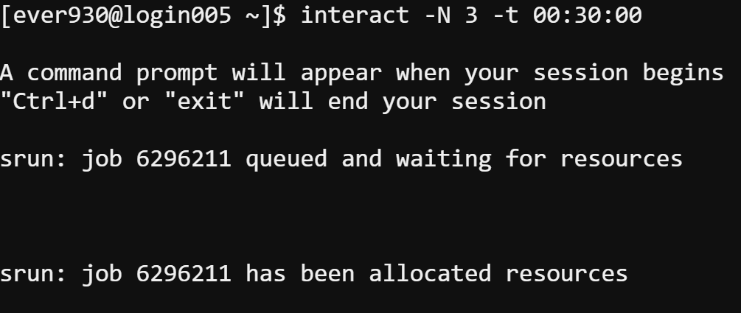
Loading Hadoop
Under Shell Access: connect interactive sessions:
interact –N 3 –t 00:30:00
-N : number of cores to request
-t : time duration to reserve
This command will reserve 3 cores for 30 minutes. Usually less cores/time will be easier to allocate. You may need to wait for 1-2 minutes to get resources.

Slide 18
Loading Hadoop
Then run the following command:
This will load Hadoop and all the necessary applications (Hive, Spark)
module load /opt/packages/hadoop-testing/interact-envmod.txt

Slide 19

Basic HDFS Operations
Command:
hdfs dfs -<option>
HDFS command
Run a file system command
Specific command, similar to Linux commands

Slide 20
Basic HDFS Operations
Command:
hdfs dfs -ls
List the files in the HDFS current directory
Note: HDFS is a different file system.

Slide 21
Hadoop File Systems (HDFS)
Move files into HDFS
Data node 1
Data node 5
HDFS:
/home/username/file.txt
Namenode
Data node 2
Data node 4
Data node 3
data
Actual Linux Directory
/home/username/file.txt
Linux Shared file system

Slide 22
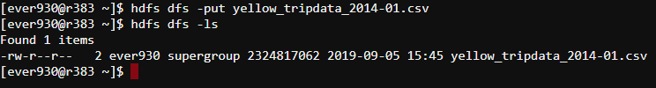
HDFS commands
Put a local file into the HDFS
hdfs dfs -put <your file path> <HDFS path>
Get a file in HDFS and save it to Linux file system
hdfs dfs -get <HDFS path> <local file path>

Slide 23
Other HDFS commands
hdfs dfs -mkdir
Make a directory in the HDFS under specified path

Slide 24
Exercise
Use the yellow_tripdata_2014-01.csv you copied from my folder
Go to the “project” folder of your home directory (Linux)
Create a new HDFS directory “project”
Put this file on to HDFS under the new “project” directory
See if you can find this file on HDFS
Then go to your Linux home folder. Download the file from HDFS to your Linux home folder.

Slide 25

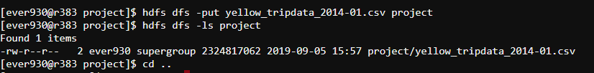
Exercise

