Slide 1
Analyzing Big Data with SparkR
MSCI:6110 Fall 2019
Master’s in Business Analytics

Slide 2
Mid-Term Presentations
Each group has 15 minutes to present their work (8-10 slides)
(1) introduce the dataset: What is it about? Source, #rows, #column, data types
(2) Some summary statistics and descriptive analysis of the dataset
Statistics on specific columns
Charts to show descriptions of the data over different columns (e.g., how many restaurants in each city/state, total liquor sales in each month of year …). Interesting ones!
Use any tool you are comfortable with to draw the charts (Excel, Tableau, R …)
(3) How did you implement the tables, and the partitions/buckets. What sample queries have you tested on the table (no need to demo them but show outputs)
(4) Next steps: propose what “predictive” or non-trivial analysis you want to do next
Submit on ICON before class.

Slide 3
Mid-Term Project Report
Each group should submit a PDF document by next Thursday 6pm.
Report your answers to all the questions in the previous slide
Well formatted, self-contained.
Include all the queries and commands
Include results (screenshots) and charts, tables, etc.

Slide 4
Mid-Term Presentations
Grading :
(1) do you have a clear picture of your dataset
(2) How much technical work done for the analysis/queries
(3) Interestingness/findings of the results
(4) Next step plan (can improve later).
(5) Control your time (15 min must stop)

Slide 5

Spark and SparkR
Spark is an application on top of HDFS for data analysis
Data analysis functions are converted to Map-Reduce algorithms
Difference between Spark and Hive
Spark allows data transfer in shared memory.
Hive only read/write data to files.
Hive is used mainly for data management. It can handle simple queries.
Spark might be more efficient for complex analysis tasks

Slide 6




Spark
Spark DataFrames
R DataFrames
Programming in Spark (API)
Java, Python, Scala, R
Spark SQL
Use SQL-like queries on data frames
Load data from HIVE tables
R package to work with Spark
Hive Tables
Data files

Slide 7
R – Quick Review
A statistical programming language
R data types:
character
numeric (real or decimal)
integer
Logical (Ture/False)
Complex
Use the class() function to show the data type.
R data structure
atomic vector: a sequence of objects of the same type (e.g., numeric or character)
List: a sequence of objects with mixed data types
Matrix: 2-D numeric vectors.
data frame: 2-D tabular data with row names and column names (optional). Mixed data types across columns.
factors

Slide 8
R – Quick Review
A statistical programming language
Use packages and functions.
R function: function_Name(input parameter list).
Load packages to use functions.
install.packages(“ggplot2”)
library(ggplot2)
call qplot() to draw a figure

Slide 9
R – Quick Review
Basic elements
sequential statements, value assignment
a = 1
m <- matrix(nrow = 2, ncol = 2)
d <- cbind(1:3, 10:12)
Control statements
if (test_expression) {
statement
}
for (val in sequence)
{
statement
}
x <- 5
if(x > 0){
print("Positive number")
}
x <- c(2,5,3,9,8,11,6)
count <- 0
for (val in x) {
if(val %% 2 == 0) count = count+1
}
print(count)

Slide 10
Working with R on PSC/Bridges
R is a module that can be loaded on very node
Login node / VM node: has access to Internet, can download/Install packages.
Reserved Hadoop nodes: can’t access Internet
If you want to install packages: load R from login node.
If you want to run Hive, Spark, go to reserved nodes (interact)
Save workspace before changing nodes.

Slide 11
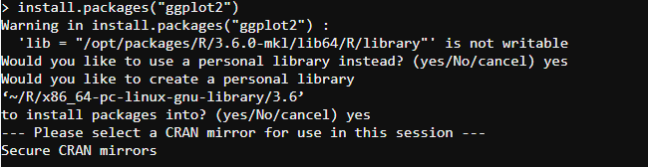
Use R on PSC Server – install packages
Before “interact”, load R from login node
module load R
R
R command line. You can install packages here.
Choose to use a personal library (files will be saved in your home folder under a directory called “R”)

Slide 12
Load SparkR
Step 1: On login node, install packages if needed.
Step 2: do the “interact” command to get access to interactive session
Step 3: Load Hadoop/Hive/Spark:
Step 4: If you want run hive, type “hive”
If you want to run sparkR, then type “sparkR”
module load /opt/packages/hadoop-testing/interact-envmod.txt

Slide 13
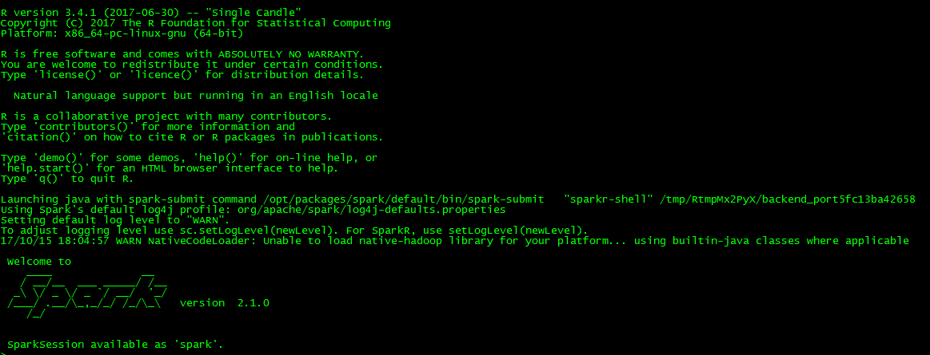
Spark in R

Slide 14
Use Spark in R
SparkR will launch R automatically (command line)
You can write R code and interact with your Hive tables in R
Perform data analysis on your Hive tables
Packages previously installed on login node will be loaded

Slide 15
Data Frame in Spark
The basic data structure of Spark and SparkR is Spark DataFrame
Different from R data frame.
Spark DataFrame is a distributed data structure on top of Hadoop
You cannot directly apply R functions on Spark dataframes

Slide 16
Creating a SparkR DataFrame
You can create a SparkR DataFrame from different sources
A local R data frame
A Hive Table
A Spark data file previously saved
> df <- as.DataFrame(mtcars)
> head(df)
> showDF(df)
Creating a Spark dataframe from a R data frame
R data frame. mtcars is a default dataset in R
head() shows the column names and the first few lines of a Spark dataframe
showDF() shows the entire data frame

Slide 17
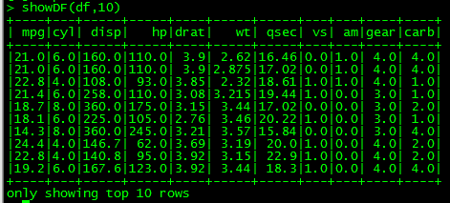
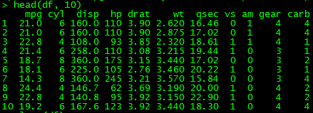
Loading Data from R Data Frame
Create a SparkR data frame from a local R data frame
> df <- as.DataFrame(mtcars)
> head(df, 10)
> showDF(df, 10)
Creating a Spark dataframe from a R data frame
> class(df)
[1] "DataFrame"
attr(,"package")
[1] "SparkR"
head(df, 10) shows the column names and the first 10 lines of a Spark dataframe
showDF(df, 10) shows the first 10 rows of the data frame

Slide 18
Loading Data From Hive Tables
Load data from a hive table
sql() command
sql(“use xunzhou”)
employee <- sql(“SELECT * FROM employee”)
showDF(employee)
Use sql() command to issue HiveQL query
Quote the query
No semi-colon “;”
df is the resulting Spark DataFrame containing the output of the SQL command
You need to use showDF() function to show its content.
By default, showDF() will only show 20 rows. Use showDF(DF, n) to show n rows.

Slide 19
Control Hive from SparkR
You can issue HiveQL from SparkR
Create tables, load data, etc. No need to put semi-colon.
sql(“Create Table ….”)
sql( “Load Data local inpath ….”)

Slide 20
Basic DataFrame functions
printSchema(df): show the structure of the columns
The schema is represented as a tree structure to accommodate json data
This is similar to the colnames() in R and DESCRIBE in Hive
> printSchema(employee)
root
|-- eid: string (nullable = true)
|-- name: string (nullable = true)
|-- salary: decimal(10,0) (nullable = true)
|-- title: string (nullable = true)
|-- dept: string (nullable = true)

Slide 21
Exercise-1
Bring Back the NYC Taxi Data. Load Jan data into a SparkR DataFrame
Find the total number of passengers during each hour
Load the result into R
Show the schema of the data, and the content of the result.
query = “SELECT hour(pickup_datetime) as hr, sum(passenger_count) FROM nyc_taxi group by hour(pickup_datetime) order by hr”
Total_passenger <- sql(query)
printSchema(Total_passenger)
showDF(Total_passenger, 24)

Slide 22
Spark DataFrame Materialization
Like Hive Tables, Spark DataFrames are not generated until queried
query = “SELECT hour(pickup_datetime) as hr, sum(passenger_count) FROM nyc_taxi group by hour(pickup_datetime) order by hr”
Total_passenger <- sql(query)
printSchema(Total_passenger)
showDF(Total_passenger, 24)
This is when the dataframe is actually generated
Need to run Hive query

Slide 23
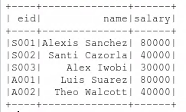
DataFrame Functions(1)
You can “query” the Spark DataFrames like database tables
“Select”, “Where” keywords can be applied on Spark DFs
Show the “eid”, “name”, and “salary” columns of the employee DF
> employee <- sql(“SELECT * FROM employee”)
> showDF(select(employee, employee$eid, employee$name, employee$salary))
The original DataFrame
Columns to “SELECT”
SELECT() will generate a new DataFrame. You still need to use showDF to display its content.

Slide 24
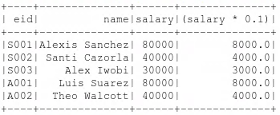
DataFrame Functions(1)
Show the “eid”, “name”, and “salary” columns of the employee DF
Also show the income tax (assuming 10%) of every employee
> showDF(select(employee, employee$eid, employee$name, employee$salary, employee$salary*0.1))
A “derived” column based on original DF
> showDF(select(employee, “eid”, “name”, “salary”))

Slide 25

DataFrame Functions(2)
Use the “where” keyword to filter data
Show the employees with salary above 50,000
here equal is “==” instead of “=”.
“==” is to test if LHS equals RHS. Outcome is True or False.
> showDF(where(employee, employee$salary>50000))
Where clause condition

Slide 26
DataFrame Functions(2)
The “filter” keyword can do the same thing
> showDF(filter(employee, employee$salary>50000))
Where clause condition

Slide 27
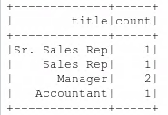
DataFrame Functions(3)
groupBy Keyword
Find the number of employees with each title.
This command is equivalent to
SELECT title, count(*) FROM employee GROUP BY title;
showDF(count(groupBy(employee, "title")))

Slide 28
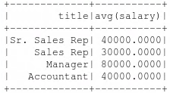
DataFrame Functions(3)
groupBy with other aggregate functions
avg(groupBy(employee, “title”))
Calculate the average of ALL the numeric columns grouped by title
In our data, there is only one numeric column: salary

Slide 29
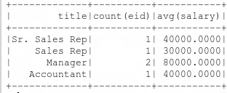
DataFrame Functions(3)
groupBy with other aggregate functions
Aggregate by more than one column
show the number of employees and the average salary of each title
showDF(agg(groupBy(employee, “title"), salary="avg", “eid" = “count") )
aggregate
List of groupby columns
Average on salary count on eid
Equivalent to:
SELECT title, count(*), avg(salary) FROM employee GROUP BY title;

Slide 30
DataFrame Functions(3)
List of aggregate functions in SparkR
Other functions to use (very similar to Hive)
Datetime functions: year, month, day, hour, minute, second, quarter,…
String functions: substr, length, instr…
Math functions: floor, ceil, round…
countDistinct, count, first, last, max, mean, min, stddev, skewness; stddev_pop, stddev_samp, sumDistinct, sum var_pop, var_samp, var, variance…
dayofmonth() instead of day()

Slide 31
Generating plots in R Command line
No graphical interface
Generate files and save the plots in the files
Transfer the file to your local computer
In Ondemand portal, use the “view” function or “download” to check plots
Create a png file, specify dimensions (pixels)
> png("sample.png", 490, 350)
> plot(x, y, pch=19, col=rgb(0.5, 0.5, 0.5, 0.5), cex=1.5)
> abline(lm(y ~ x))
> dev.off()
Do your plot
Finish the plot and close the file.

Slide 32
Exercise-II
Use SparkR to perform the following analysis on the taxi dataset
Load the Jan 2014 taxi dataset into a sparkR DataFrame.
(a) Show the total number of passengers taking taxi in each day of January.
(b) Show the total number of trips in each hour of Jan1st.

Slide 33
Exercise II Solution
Show the total number of passengers taking taxi in each day of January.
taxi_df <- sql(“select * from nyc_taxi_jan”)
passegner_day_df<-agg(groupBy(taxi_df, dayofmonth(taxi_df$ pickup_datetime)), passenger_count = "sum")
showDF(passegner_day_df)

Slide 34
Exercise II Solution
Show the total number of trips in each hour of Jan 1.
taxi_df_Jan1 <- sql(“select * from nyc_taxi_Jan where day(pickup_datetime) = 1”)
trip_hr_df <- count(groupBy(taxi_df_Jan1, hour(taxi_df_Jan1$pickup_datetime)))
showDF(trip_hr_df )

Slide 35
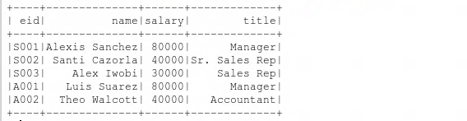
Register Temporary Tables
Register a Spark DataFrame as a temporary table
Not stored permanently in Hive. Will be dropped after you log out.
Then you can use SQL to query/filter this temporary table
> registerTempTable(employee, “employee_table”)
> showDF(sql("select * from employee_table"))
Usage: registerTempTable(x, tableName)

Slide 36
Update: Use createOrReplaceTempView
The old function registerTempTable() is depreciated
Use the substitute createOrReplaceTempView() in Spark 2.4.3
createOrReplaceTempView(employee, “employee_table”)
showDF(sql("show tables"))

Slide 37
Converting SparkR DataFrame to R data frame
Using the collect() function or directly do: as.data.frame()
employee_r <- collect(employee)
> class(employee)
[1] "DataFrame"
attr(,"package")
[1] "SparkR"
> employee_r <- collect(employee)
> class(employee_r)
[1] "data.frame"
> employee_r
eid name salary title
1 S001 Alexis Sanchez 80000 Manager
2 S002 Santi Cazorla 40000 Sr. Sales Rep
3 S003 Alex Iwobi 30000 Sales Rep
4 A001 Luis Suarez 80000 Manager
5 A002 Theo Walcott 40000 Accountant

Slide 38
Converting SparkR DataFrame to R data frame
Then you can use R functions on the data frame
Note: SparkR dataframes can be large. Be careful when you collect the entire SparkR dataframe into R
Plot the salary histogram with binwidth=20000 (number of employees with salary in each of the 20000 bin)
Make sure to check the column data type before plotting

Slide 39
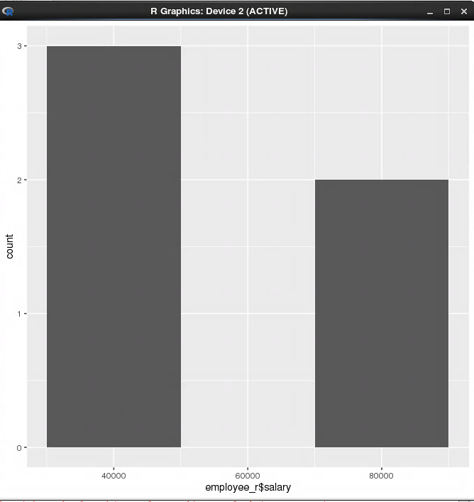
Converting SparkR DataFrame to R data frame
> class(employee_r$salary)
[1] "list"
Salary is not in numeric class
You need to do a conversion
> class(employee_r$salary)<- "numeric"
> class(employee_r$salary)
[1] "numeric"
library(ggplot2)
qplot(employee_r$salary, geom="histogram", binwidth = 20000)
Two ways to do Histogram
Use the qplot() function with geom = “histogram”. Directly generate bins from data
Aggregate data into bins in Spark DataFrame first, then plot “Bar” charts
Use 2 when the data is in Spark dataframe (can’t apply qplot directly on it).

Slide 40
Reading and Writing DataFrames
The default data format in Spark is called “parquet”: a column-based file structure
Save a Spark DataFrame into a parquet file
Load a Spark DataFrame from a parquet file
saveDF(employee,"employee.parquet", "parquet")
File name
File format
Spark DataFrame

Slide 41
Reading and Writing DataFrames
The default data format in Spark is called “parquet”: a column-based file structure
Save a Spark DataFrame into a parquet file
Load a Spark DataFrame from a parquet file
employee<- loadDF("employee.parquet") (update from last version)

Slide 42
Save DataFrame as a Hive Table
Use command “saveAsTable()
saveAsTable(DataFrame, “table name")
df <- createDataFrame(mtcars)
saveAsTable(df, "mtcars")
showDF(sql("select * from mtcars"))

Slide 43
Special case: NA
NA == NA returns true.
In aggregations all NA values are grouped together.
NA is treated as a normal value in join keys.
NA values go last when in ascending order, larger than any other numeric value.

Slide 44
Mini-Project
Use the NYC Taxi Dataset
Plot a line chart to show the number of trips during each hour of Jan. 15.
Plot a histogram to show the distribution of trip length (bin width = 1 mile) in Jan.

Slide 45
Solution Q1
taxi_day15_df <- sql(“select * from nyc_taxi_jan where day(pickup_datetime) = 15”)
trip_hr_day15_df <- count(groupBy(taxi_day15_df, hour(taxi_day15_df$pickup_datetime)))
trip_hr_day15_df_r<- collect(trip_hr_day15_df)
colnames(trip_hr_day15_df_r)[1]=“hour”
library(ggplot2)
png(“trip_hour_day15.png”)
qplot(trip_hr_day15_df_r$hour, trip_hr_day15_df_r$count, geom=“line”)
dev.off()

Slide 46
Solution Q2
Generate counts for each bin
taxi_df <- sql(“select * from nyc_taxi”)
trip_stat_df_r <- collect(count(groupBy(taxi_df, ceil(taxi_df$trip_distance))))
trip_stat_df_r_sorted <- trip_stat_df_r[order(trip_stat_df_r[1]), ]
colnames(trip_stat_df_r_sorted)[1]="distance"
png(“trip_length_Jan.png”)
barplot(trip_stat_df_r_sorted$count, names.arg = trip_stat_df_r_sorted$distance)
dev.off()
Plot (bin, count) as bars

Slide 47
Additional Things for SparkR
1. NULL values and NA
Null in Hive will become Null in Spark and NA in R
Use function isNull() and isNotNull() to test (output True/False)
new_df <- where(df, isNotNull(df$col))

Slide 48
Additional Things for SparkR
2. select() function
Select all the columns into a new data frame
select(df, colnames(df))
select(df, c(colnames(df), col1*0.1))

