Slide 1
Analyzing Big Data with SparkR
MSCI:6110 Fall 2019
Master’s in Business Analytics

Slide 2
Data Mining / Machine Learning
Prediction (classification, regression)
Clustering
Association Rule Mining
Hotspot Detection

Slide 3
Machine Learning Algorithms for SparkR
Binary Classification Problem
Given a set of independent features Xi, Predict a label Yi (0, 1)
Given age, blood pressure, height, weight, predict if has diabetes (Y/N)
Models that will be discussed today:
Random Forest
Logistic Regression

Slide 4
Training and Testing
Record Number | Age | Income | Gender | iphone
1 | 25 | 30000 | F | Y
2 | 30 | 40000 | M | N
3 | 44 | 60000 | F | Y
4 | 38 | 25000 | M | N
Do prediction
Record Number | Age | Income | Gender | iphone
5 | 33 | 70000 | F | ?
6 | 27 | 40000 | M | ?
7 | 54 | 30000 | M | ?
8 | 22 | 15000 | F | ?
Learn a Model

Slide 5

Random Forest
A set of decision trees
What is a decision tree?
Record 1: Age 20, income 30000, gender: M, Label: uses iphone
Record 2: Age 31, income 45000, gender: F, Label: not iphone
………
Record X: Age 44, income 59100, gender: F, Label: ?
Gender
F
M
Income
Age
>30000
<=30000
>40
<40
Iphone
No iphone
No iphone
iphone

Slide 6
Decision Tree
Build a tree model for prediction
Each node is a feature, and each brunch is a decision on that feature
Goal: maximize class purity at leaf nodes
A female with 25000 income → ?
A male at age 54 → ?
Gender = F ?
Y
N
Income > 30000
Age>40
Y
N
Y
N
Iphone
N/ iphone
N/ iphone
iphone

Slide 7
Decision Tree
Given the information of a business (# visits, type, location, etc)
Predict if this restaurant will close within 12 months.
Need more features and more samples to be more accurate.
100% accuracy is usually impossible in reality.

Slide 8
Random Forest
One decision tree sometimes is less accurate and may have some bias
Trees trained with different data might have different structures
Random Forest:
Training: randomly sample from training data and generate N decision trees
Testing: let each tree predict and use the result of the majority
Advantage: avoid random error, avoid over fitting
Overfitting: model too perfect for the training data (even for noise data) and can’t achieve good performance on testing set.

Slide 9
Random Forest
Tree 1
Age < 20 ?
Y
N
iphone
Income< 25000
Test data:
Gender = Male, age = 45, income = 35000
Y
N
Prediction: iphone
No iphone
iphone
Prediction: iphone
Tree 2
Tree 3
Prediction: No iphone
Gender = F ?
Income > 30000?
Y
N
Final prediction: iphone (2/3)
Y
N
Income > 30000
Age>40
Male?
Age < 30
Y
N
Y
N
Y
N
Y
N
Iphone
No iphone
No iphone
iphone
Iphone
No iphone
No iphone
iphone

Slide 10
SparkR Random Forest
Data Preparation:
The label column must be string or numeric
Use the mtcars dataset. Make a copy and replace the mpg column with a binary label: 1( mpg >= 20) and 0 (mpg <20)
mtcars_rf <- mtcars
mtcars_rf$mpg <- ifelse(mtcars_rf$mpg >=20, 1, 0)
mtcars_rf_df <- as.DataFrame(mtcars_rf)
Learn a model to predict if the mpg of a car is high (1) or low (0)

Slide 11
Learn the model
model <- spark.randomForest(mtcars_rf_df, mpg ~ . , "classification", numTrees = 20, maxDepth = 5)
Use mpg ~ cyl + disp + hp + wt to use only these four columns in the model
A list of columns to use in the model
“.” means all the other columns
The label column to predict
Max depth of each tree. Too deep may cause overfitting
The input spark DataFrame

Slide 12
Random Forest
Check the model learned from the data
summary(model)
> summary(model)
Formula: mpg ~ .
Number of features: 10
Features: cyl disp hp drat wt qsec vs am gear carb
Feature importances: (10,[0,1,2,3,4,5,6,7,9],[0.08772267853629748,0.24254907176494692,0.21080086770590203,0.01394000736106,0.36852809116070673,0.06080658547463887,0.0030303030303030307,0.004589160839160838,0.00803323412698413])
Max Depth: 5
Number of trees: 20
Tree weights: 1 1 1 1 1 1 1 1 1 1 1 1 1 1 1 1 1 1 1 1

Slide 13
Summary of the model
All the decision trees learned will be displayed.
Tree 0 (weight 1.0):
If (feature 4 <= 3.215)
If (feature 0 <= 6.0)
Predict: 1.0
Else (feature 0 > 6.0)
Predict: 0.0
Else (feature 4 > 3.215)
Predict: 0.0
Wt<=3.215
Y
N
Cyl<=6.0
Low
Y
N
high
low

Slide 14
Do Prediction
Run the prediction model on a test dataset.
Output <- predict(model, test_df)
showDF(Output)
test_df is a test dataset in spark DataFrame format.
It must have the all the columns used in the training (but not the label column)
For example: test on the original mtcars dataset
Output <- predict(model, mtcars_rf_df)
showDF(Output)

Slide 15
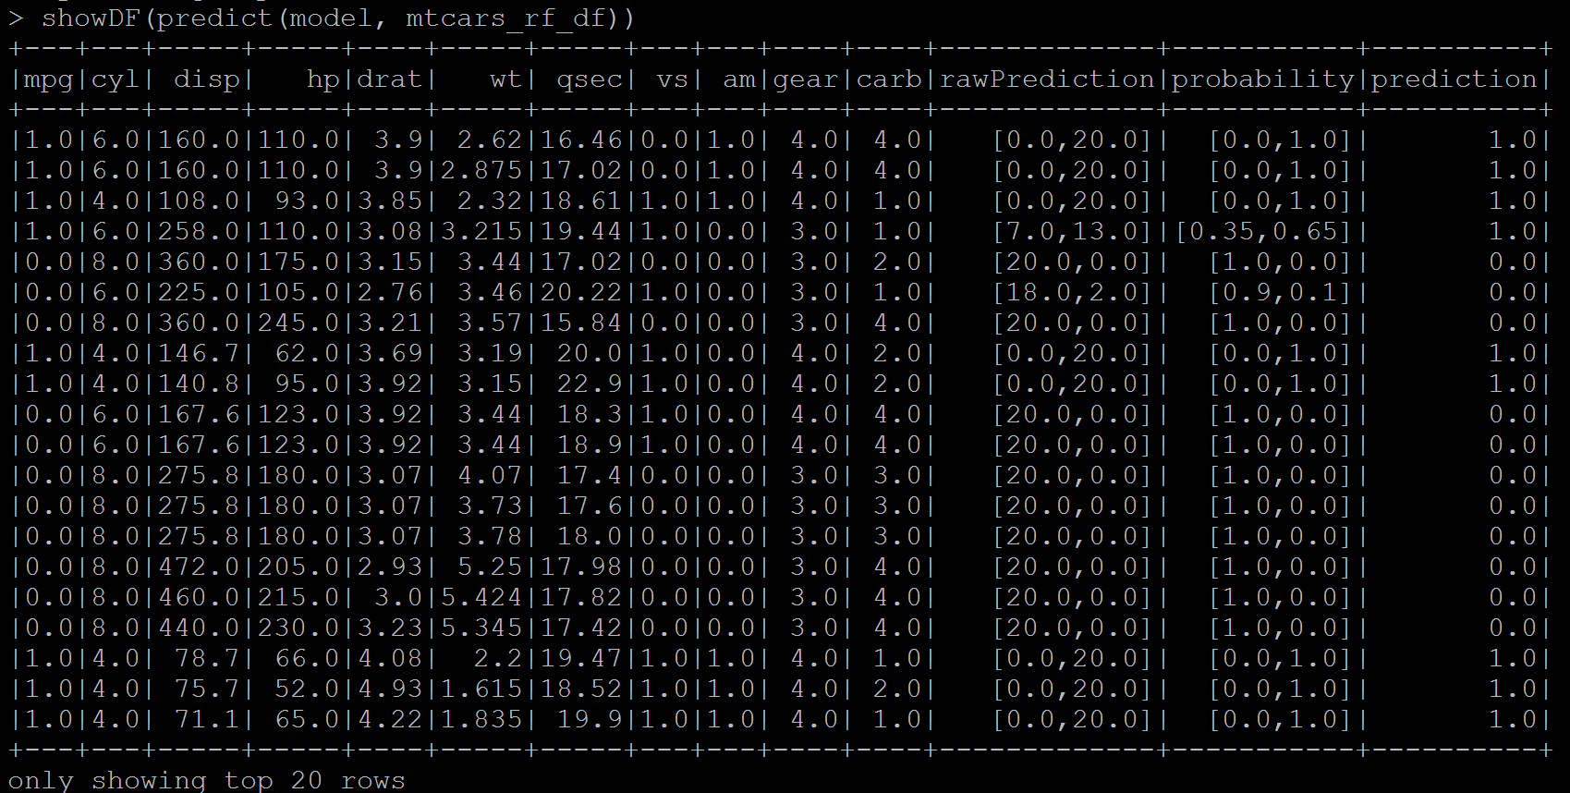
Result
This is “cheating” since the training and testing are on the same dataset

Slide 16
Evaluation
1. Training set and testing set
2. Accuracy of the model, precision, recall

Slide 17
Additional Issues for Predictive models
1. Building training vs. testing set
Randomly split the dataset into training vs. testing at a ratio.
Build a model on Training set and run prediction on Testing set
> mtcars_rf <- mtcars
> mtcars_rf$mpg <- as.numeric(mtcars_rf$mpg >=20)
> mtcars_rf_df <- as.DataFrame(mtcars_rf)
> df_list <- randomSplit(mtcars_rf_df, c(7,3), 2)
> training_df <- df_list[[1]]
> testing_df <- df_list[[2]]
Split the mtcars_DF dataframe into training (70%) and testing (30%) sets
“2” is a seed for random sampling (you could put any number)

Slide 18
Additional Issues for Predictive models
2. Selecting features to include in the model
model <- spark.randomForest(training_df, mpg ~ . , "classification", numTrees = 20, maxDepth = 5)
Use + to include features
Use – to exclude features
“.” Represents all the features
Use all the features but vs and am
model <- spark.randomForest(training_df, mpg ~ . - vs - am , "classification", numTrees = 20, maxDepth = 5)

Slide 19
Additional Issues for Predictive models
3. Evaluating Accuracy
If mpg == prediction Then
correct
Else
incorrect
Accuracy = correct/(correct + incorrect)
Correct <- nrow(where(Output, Output$mpg == Output$prediction))
Total <- nrow(Output)
Accuracy = Correct/Total
Output <- Predict(model, testing_df)
This is the “logic”
not code

Slide 20
Other measures
 | Actually Positive | Actually Negative
Predict as Positive | True Positive (TP) | False Positive (FP)
Predict as Negative | False Negative (FN) | True Negative (TN)
Precision, Recall
Precision = TP/(TP+FP)
Recall = TP/(TP+FN)
What % of your “positive” predictions are actually positive
 | Actually Positive | Actually Negative
Predict as Positive | True Positive (TP) | False Positive (FP)
Predict as Negative | False Negative (FN) | True Negative (TN)
What % of the actual positives are successfully predicted by you

Slide 21
Other measures
 | Actually Positive | Actually Negative
Predict as Positive | True Positive (TP) | False Positive (FP)
Predict as Negative | False Negative (FN) | True Negative (TN)
Precision, Recall
Confusion Matrix
Iphone = Positive
No iphone= Negative
John is using iphone but predicted as not (False Negative)
Alice is not using iphone but predicted as yes (False Positive)
High TP and TN are desired. Low FN and FP are desired.
Accuracy = (TP+TN) / (TP+FN+FP+TN)

Slide 22
Calculating Precision and Recall
TP <- nrow(where(Output, Output$mpg == 1 & Output$prediction == 1))
FP <- nrow(where(Output, Output$mpg == 0 & Output$prediction == 1))
Precision = TP/(TP+FP)
FN <- nrow(where(Output, Output$mpg == 1 & Output$prediction == 0))
Recall = TP/(TP+FN)

Slide 23
Exercise
Bring back the NYC Taxi dataset. Use trips started and ended both in between 7pm and 8pm on Jan 1. Save the data in a Spark DataFrame from Hive.
Remove any record with NA value (use dropna()) function
Add a new column called fare_label. Label trips with fare_amount above 15 as positive 1 , others as negative 0.
Split the data into training and testing at 7:3.

Slide 24
Use pickup lat/long, dropoff lat/long, rate_code, trip distance to predict this label column, use Random Forest
Tree depth = 10, number of trees = 20
calculate accuracy, precision, and recall.

Slide 25
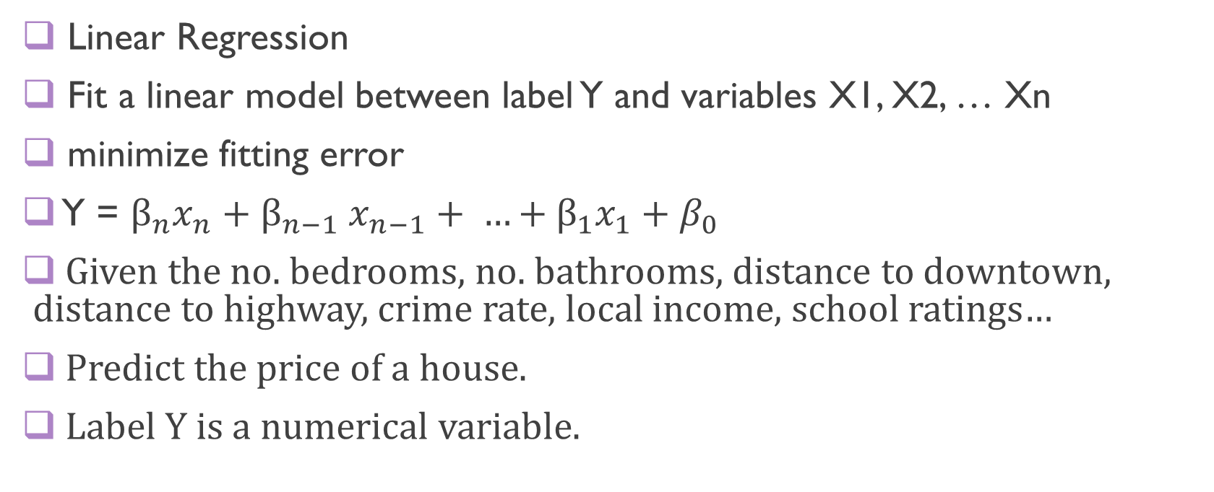
Generalized linear Model
Linear Regression
Fit a linear model between label Y and variables X1, X2, … Xn
minimize fitting error
Y = $β_{n}x_{n}{+ β}_{n−1}x_{n−1}+ …+β_{1}x_{1}+β_{0}$
Given the no. bedrooms, no. bathrooms, distance to downtown, distance to highway, crime rate, local income, school ratings…
Predict the price of a house.
Label Y is a numerical variable.

Slide 26
Example
Given all the features, predict mpg of cars (numeric)
> mtcars_DF <- as.DataFrame(mtcars)
> df_list <- randomSplit(mtcars_DF, c(7,3), 2)
> training <- df_list[[1]]
> testing <- df_list[[2]]
Training DataFrame
Gaussian: the error term of the model follows Gaussian (normal) distribution
Other options: Poisson, …
Most common type of linear regression
model <- spark.glm(training, mpg ~ ., family = "gaussian")
Equation: label ~ feature1+feature2+feature3
Use + to add features and use - to remove features
Use . to represent all the features

Slide 27
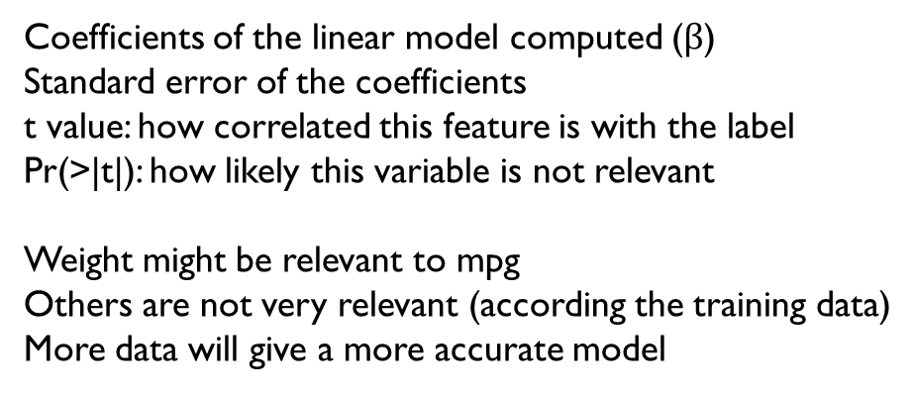
Model
summary(model)
Deviance Residuals:
(Note: These are approximate quantiles with relative error <= 0.01)
Min 1Q Median 3Q Max
-4.2275 -1.2509 -0.1709 1.6493 3.8180
Coefficients:
Estimate Std. Error t value Pr(>|t|)
(Intercept) -6.1954738 32.843652 -0.18864 0.85381
cyl 0.5996017 1.943880 0.30846 0.76350
disp 0.0179472 0.023975 0.74858 0.46981
hp -0.0093995 0.029630 -0.31723 0.75701
drat 3.1363382 2.930739 1.07015 0.30747
wt -3.0082753 2.420213 -1.24298 0.23972
qsec 0.6465848 0.849858 0.76081 0.46277
vs 2.0367272 3.173746 0.64174 0.53418
am 2.8328113 2.741496 1.03331 0.32364
gear 2.2452794 2.713227 0.82753 0.42553
carb -1.2188915 1.272100 -0.95817 0.35856
Residuals of your model on training set
Coefficients of the linear model computed ($β$)
Standard error of the coefficients
t value: how correlated this feature is with the label
Pr(>|t|): how likely this variable is not relevant
Weight might be relevant to mpg
Others are not very relevant (according the training data)
More data will give a more accurate model

Slide 28
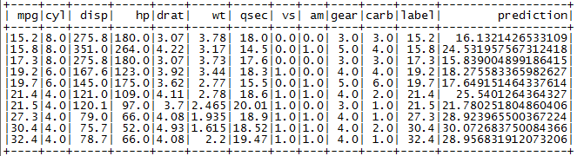
Prediction
> output <- predict(model, testing)
> showDF(output)

Slide 29
Random Forest Regression
You can also use the random forest to do regression (instead of binary classification). Each tree leaf node will give a numeric prediction.
> mtcars_rf <- mtcars
> mtcars_rf_df <- as.DataFrame(mtcars_rf)
> df_list <- randomSplit(mtcars_rf_df, c(7,3), 2)
> training_df <- df_list[[1]]
> testing_df <- df_list[[2]]
model <- spark.randomForest(mtcars_rf_df, mpg ~ . , “regression", numTrees = 20, maxDepth = 5)

Slide 30


Measuring Error
Many ways to measure the error
1. Mean Squared Error (MSE): mean of squared error in each row
$MSE= \frac{1}{N}\sum_{1}^{N}{{\left(yi−\hat{y_{i}}\right)}^{2}}$
showDF(select(output, avg((output$mpg-output$prediction)^2)))

Slide 31

Measuring Error
Many ways to measure the error
2. Root Mean Squared Error (RMSE): root square of MSE
$RMSE= \sqrt{\frac{1}{N}\sum_{1}^{N}{{\left(yi−\hat{y_{i}}\right)}^{2}}}$
showDF(select(output, sqrt(avg((output$mpg-output$prediction)^2))))

Slide 32
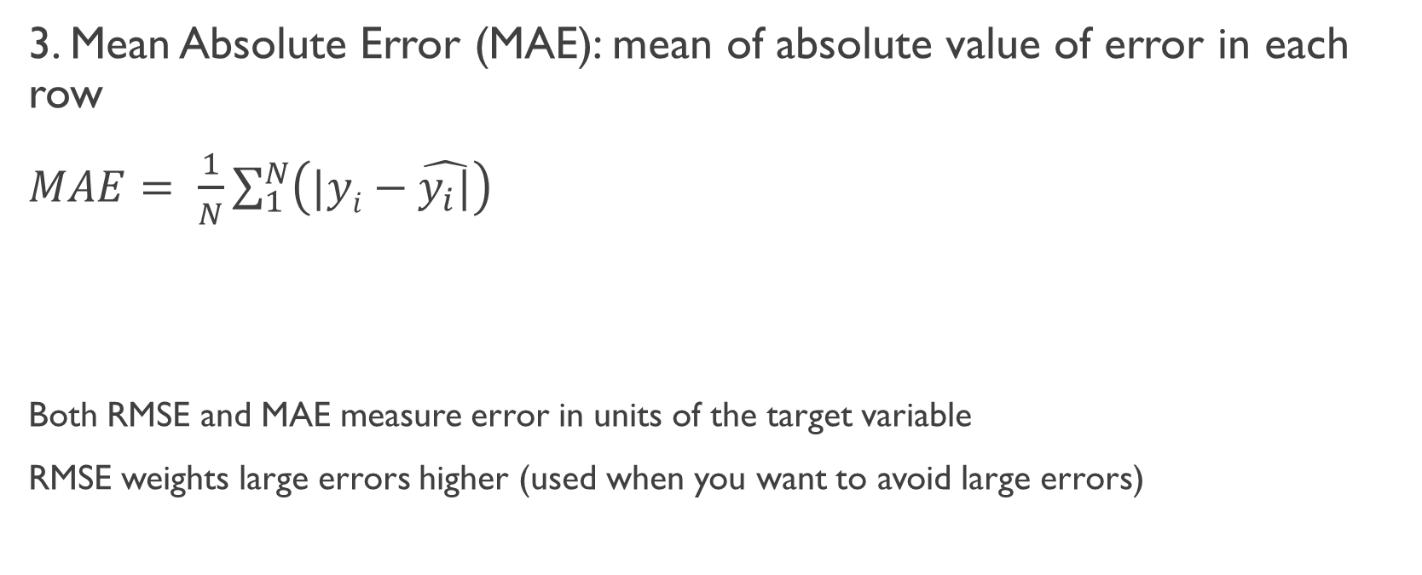
Mean Absolute Error (MAE)
3. Mean Absolute Error (MAE): mean of absolute value of error in each row
$MAE= \frac{1}{N}\sum_{1}^{N}{{\left(|yi−\hat{y_{i}|}\right)}^{}}$
Both RMSE and MAE measure error in units of the target variable
RMSE weights large errors higher (used when you want to avoid large errors)
showDF(select(output, avg(abs(output$mpg-output$prediction))))

Slide 33
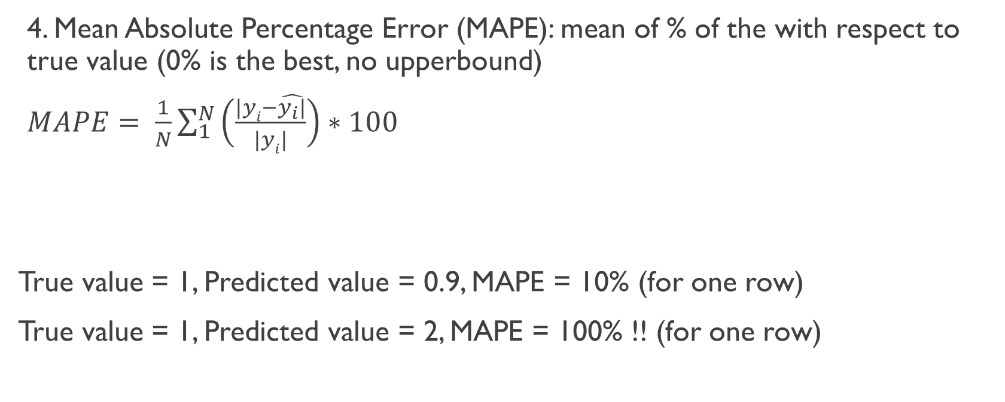
Mean Absolute Percentage Error (MAPE)
4. Mean Absolute Percentage Error (MAPE): mean of % of the with respect to true value (0% is the best, no upperbound)
$MAPE= \frac{1}{N}\sum_{1}^{N}{{\left(\frac{|yi−\hat{y_{i}|}}{|yi|}\right)∗100}^{}}$
True value = 1, Predicted value = 0.9, MAPE = 10% (for one row)
True value = 1, Predicted value = 2, MAPE = 100% !! (for one row)
showDF(select(output, avg(abs(output$mpg-output$prediction)/abs(output$mpg))))

Slide 34
Comparing the Measures
RMSE and MAE both at the target variable’s unit (error in predicted price is 10 dollars)
MSE is at the quadratic unit of target variable (error is in squared unit)
MAPE is in percentage and is not affected by the unit/scale of target variable (the error in predicted price is 5% of original value). Original value of the variable can’t be 0.

Slide 35
Exercise
Do the prediction again on the NYC_taxi dataset but this time use linear regression to predict the fare amount.
Only use the pickup lat/long, dropoff lat/long, trip_distance, and rate code. Convert them to numeric if not yet.
Calculate MSE, RMSE, MAE and MAPE on the testing set

