Slide 1
Motor Vehicle Crashes in Iowa – Group2
Sailaja Vuyyuru
Jerry JacoB
Purna Chandra Kuntla

Slide 2
Introduction to dataset
Crash Data Location - Master Table
Crash Person Data Location - Child Table
Crash Vehicle Data Location - Child Table
The tables contain both categorical and continuous variables.

Slide 3
Table Definitions
Created tables and loaded data into tables using Hive
Created actual tables by transforming the data types
Created partition tables
CREATE TABLE IF NOT EXISTS crash_location_raw
(
)
ROW FORMAT DELIMITED
FIELDS TERMINATED BY ','
LINES TERMINATED BY '\n'
STORED AS TEXTFILE
tblproperties ("skip.header.line.count"="1");
cast(from_unixtime(unix_timestamp(REST_UPDATED , "yyyy-MM-dd'T'HH:mm:ss.SSS'Z'")) as timestamp) as REST_UPDATED,
REST_UPDATE_UTC_OFFSET,
cast(from_unixtime(unix_timestamp(CRASH_DATETIME , "yyyy-MM-dd'T'HH:mm:ss.SSS'Z'")) as timestamp) as CRASH_DATETIME,

Slide 4
Data observations
The data is from 2008 to 2018 (partial year).
crash_location has 557186 records with unique attribute, casenumber
crash_person has 897413 records with multiple rows for each case number
crash_vehicle has 960406 records with multiple rows for each case number
Some of the data columns data is shifting to left after loading the csv files to hive
Frequency of Injured people
23.2 % of the people involved in crash had injuries
4% of people in crash had fatal injuries
76.8% are blank/uninjured

Slide 5
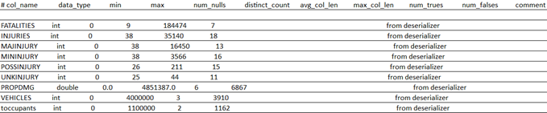
Summary statistics

Slide 6
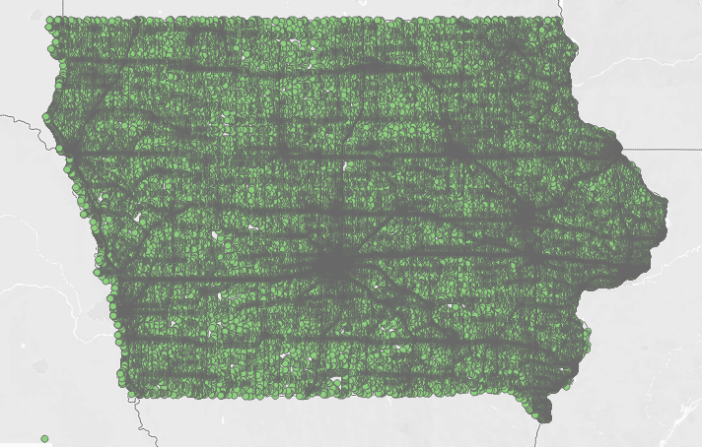
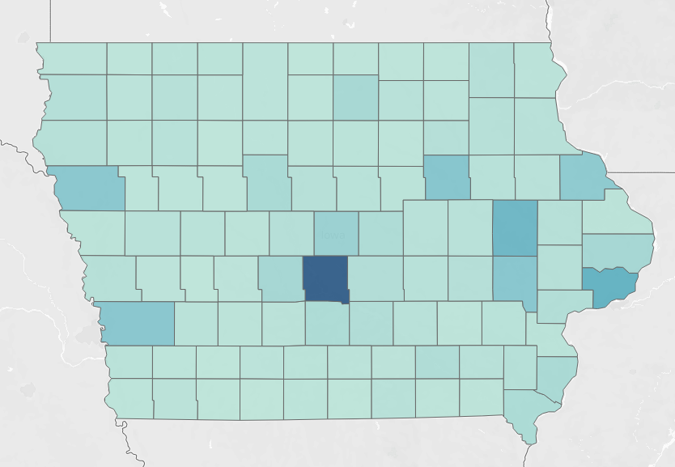
Iowa Vehicle Crash Map
Polk county has highest crashes followed by Scott and Linn counties.

Slide 7
No Protective Device Vs Injured Status
Injured status | People count | No protection used | Percentage
Fatal | 3703 | 1659 | 44.80%
Not reported | 2 |  | 0.00%
Possible (complaint of pain/injury) | 111625 | 5617 | 5.03%
Suspected minor/non-incapacitating | 65505 | 8223 | 12.55%
Suspected serious/incapacitating | 16247 | 4431 | 27.27%
Unknown | 11150 | 152 | 1.36%
44.8% people with Fatal injuries did not use a protective device
People who used a protective device have less severe injuries
People who did not use a protective device have more severe injuries
Fatal injuries has strong correlation with not using a protective device

Slide 8
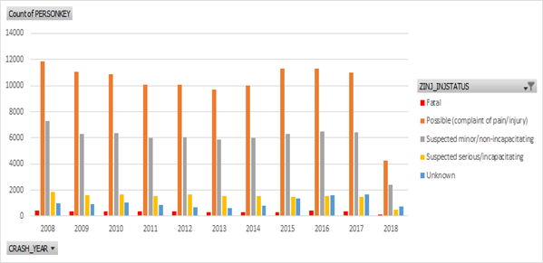
Bar Plot of Injured status for each year
The Injuries type are almost same every year
No much Fluctuations

Slide 9
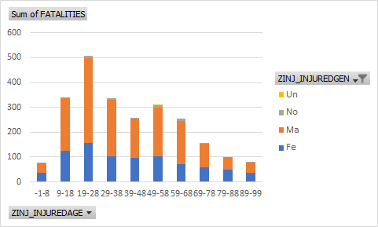
AGE GROUP: FATALITIES by GENDER
For any Age Group Male has More Fatalities than Female
Summer Months has more Fatalities than winter months

Slide 10
Crashes by Month

Slide 11
Alcohol Involvement in crashes

Slide 12
Vehicles Involved in crashes

Slide 13
Table Partitioning/ Buckets
Since most of the analysis is based on months, partitioning the hive tables based on months will be good.
We tried partitioning with month to improve the performance.
Buckets would be good in our dataset; for example, age

Slide 14
Next Steps
Data cleaning
Impute missing values
Correlation
Feature selection
Predictive Analysis based on the different features
Eg. Vehicle Type, Speed, Weather, Alcohol/ Drug, Road Condition…etc.
This would be beneficial for Insurance sector.
Performance measure

