Slide 1
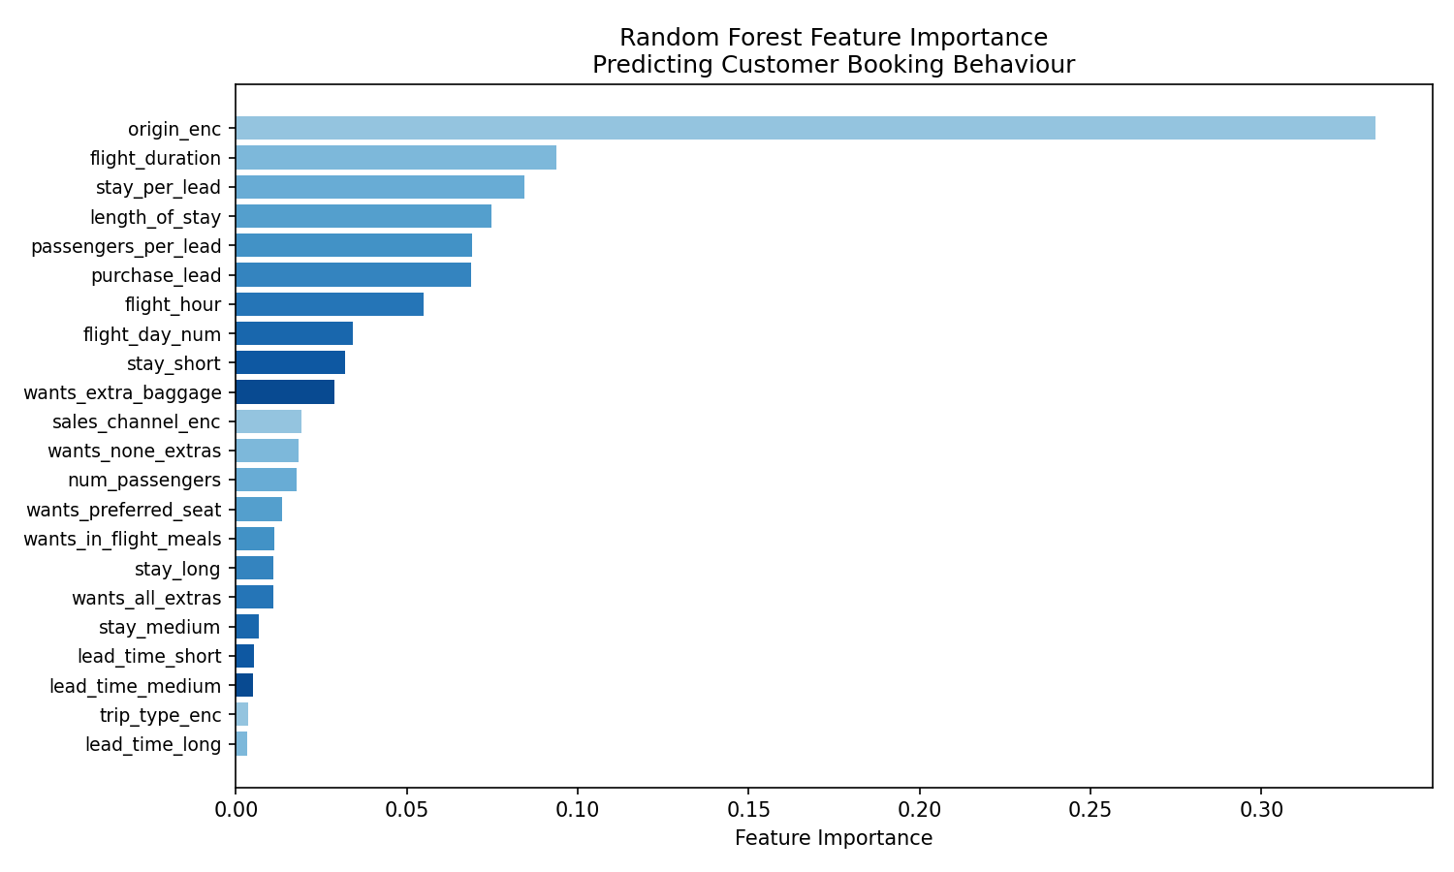
Customer Booking Prediction - Model Summary
Model: Random Forest (200 trees)
Performance
ROC-AUC: 0.755
Accuracy: 0.687
CV ROC-AUC (5-fold): 0.749 (+/- 0.003)
Top 5 Key Drivers
- Booking Origin
- Flight Duration
- Stay Per Lead
- Length of Stay
- Passengers Per Lead
Data Source: Customer Booking Dataset | Target: booking_complete | Features: 22 engineered variables

