Slide 1
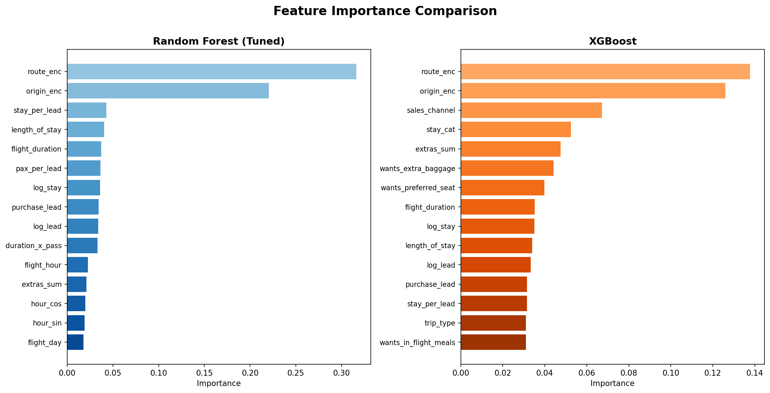
Customer Booking Prediction - Improved Model Comparison
Tuned Random Forest
XGBoost
ROC-AUC: 0.805
5-Fold CV: 0.802
Accuracy: 0.736
Best params: max_depth=12, min_samples_leaf=5
Top Drivers:
1. Route Enc: 31.6%
2. Origin Enc: 22.1%
3. Stay Per Lead: 4.3%
4. Length Of Stay: 4.0%
5. Flight Duration: 3.7%
ROC-AUC: 0.802
5-Fold CV: 0.798
Accuracy: 0.739
Params: 400 trees, lr=0.05, max_depth=6
Top Drivers:
1. Route Enc: 13.8%
2. Origin Enc: 12.6%
3. Sales Channel: 6.7%
4. Stay Cat: 5.2%
5. Extras Sum: 4.8%
Improvements: target encoding for high-cardinality features | GridSearchCV tuning | cyclical hour encoding | ratio & interaction features | class weighting

