Slide 1
Assignment 5.2
Transimpedance Amplifier

Slide 2
What's The Point?
Convert a current to a voltage often use with current based sensors like a photo diode.
Used primarily for sensors input mainly being currents to then be changed into voltage which can be measured by analog digital converters.
Common building block that helps explain the performance and stability limits of many other op-amp circuits.
The current through a diode is more stable than measuring the voltage through a diode because voltage input is less consistent when light is applied.

Slide 3
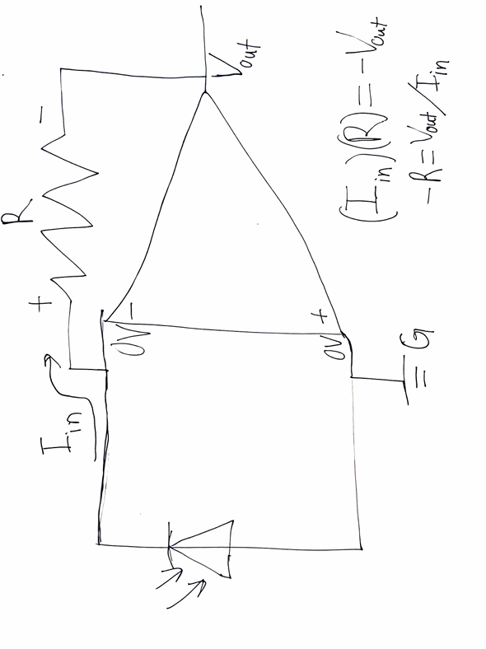

Slide 4
How's It Work
The positive is virtual 0 V so the Vout will try it’s best to maintain zero V by changing the Vout.
If the input diode receives current high Iin while the trans pittance keeps the positive side of the resistor at 0V while the current flows into the resistor the negative side will give a negative Vout voltage which can be easily found as Iin times are which is why the gain is measured in resistance.

Slide 5
The Main Advantages
The output of this stage in a circuit if done incorrectly could impact the next stage therefore the information given must be correct.
Bear current to voltage device such as the resistor will have a low frequency band with which means the output Maybe so insignificant it is ignored.

Slide 6
The Disadvantages/Improvements
A major disadvantage of this by itself would be that it would only give negative voltage which leads into The variation of the positive instead of ground being a voltage say 5V so that the Vout is less than 5V and that difference could be measured

Slide 7
References
How to Design Transimpedance Amplifier Circuits, Texas Instruments , 14 Mar. 2018, https://www.youtube.com/watch?v=Q-AZpagmtCw. Accessed 8 Mar. 2024.
“Op-Amp Transimpedance Amplifier.” Ultimate Electronics Book, 18 Mar. 2021, ultimateelectronicsbook.com/op-amp-transimpedance-amplifier/#:~:text=A%20transimpedance%20amplifier%20(TIA)%20converts,many%20other%20op-amp%20circuits.
“Trans Resistance Amplifier Explained, Implemented, and a Use Case Presented by Aleks Zosuls.” YouTube, 20 June 2020, youtu.be/PKCmLpazmCc?feature=shared.

