Slide 1

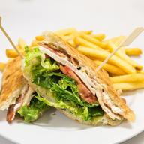
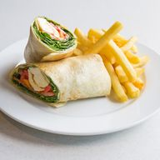
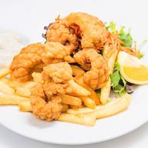
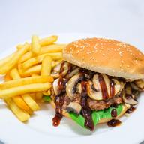
TODAY’S SPECIALS
Club Sandwich
11.00
chicken breast, bacon, tomato, lettuce, cheese, avocado & aioli on turkish with chips
Fish & Chips
11.00
beer battered fish & chips with salad & tartare sauce
Jalapeno Fish Tails & Chips
11.00
crumbed jalapeno fish tails served with chips, salad & tartare sauce
www.dawsonsespresso.com.au
ORDER ONLINE

