Slide 1
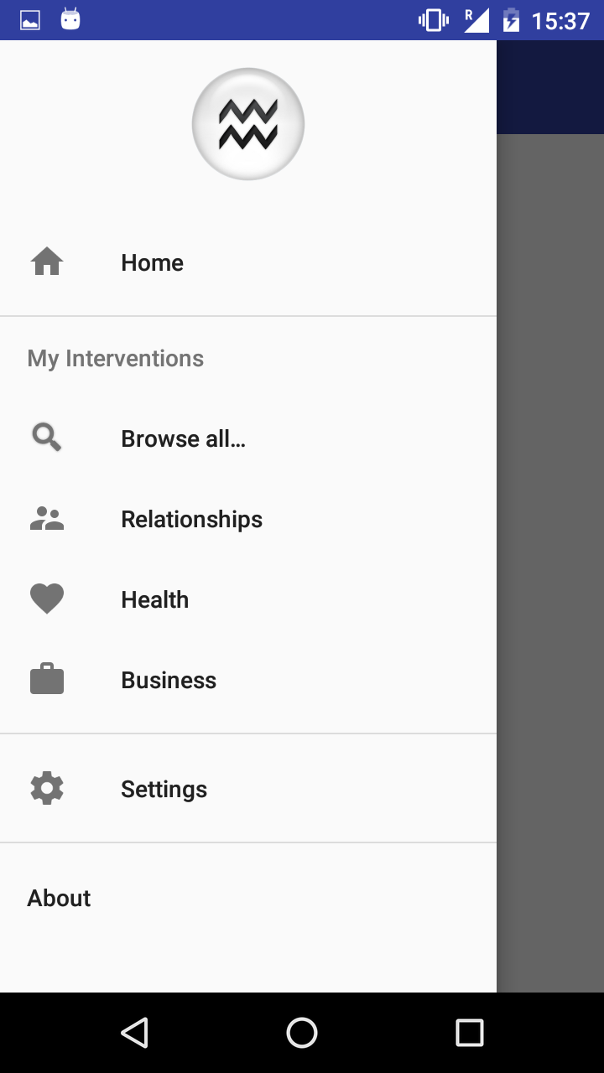
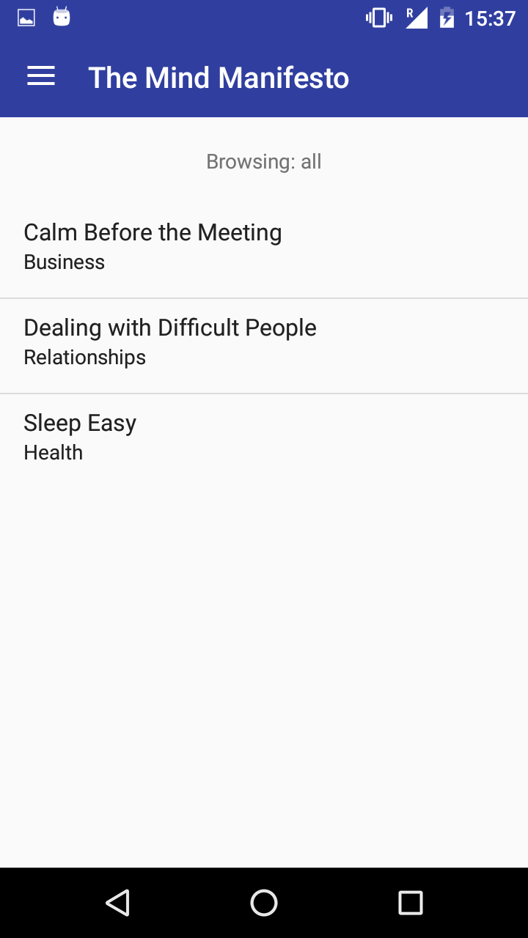
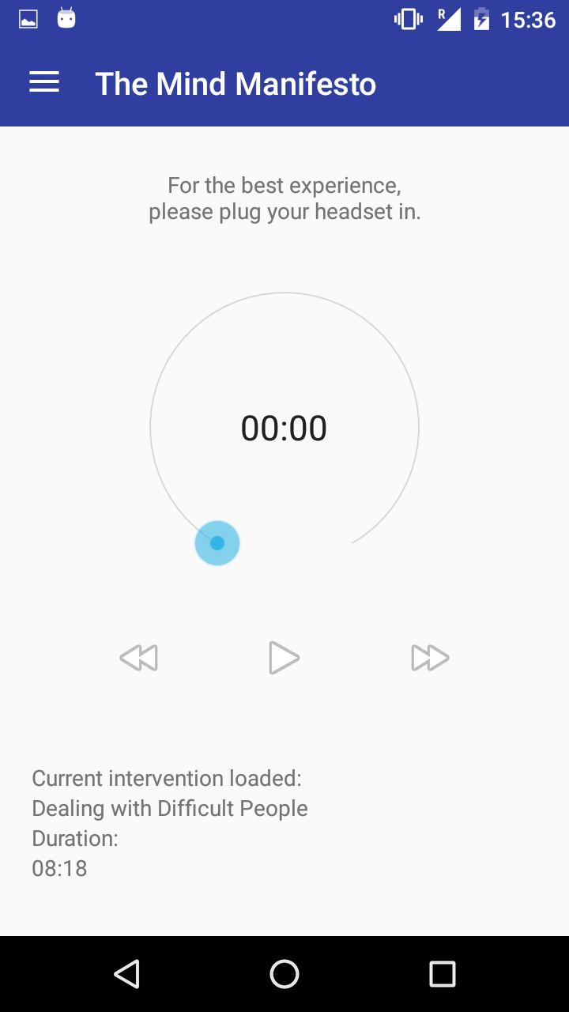
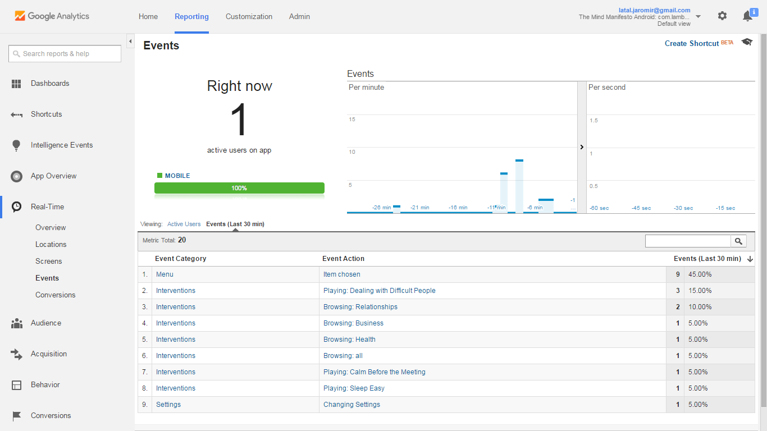
Fighting Stress Through Practicing Mindfulness Meditation
The Mind Manifesto
App by Jaromir Latal and Lambros Zannettos
jaromir.latal.15@ucl.ac.uk, lambros.zannettos.15@ucl.ac.uk (UCL Computer Science)
Can negative effects of stress be ameliorated through guided meditation?
Around 40% of people view their jobs as very or extremely stressful.
This is associated with numerous health, family or financial complaints.
Multiple studies in Europe and US have been conducted:
300 million working days lost annually are stress related and 20% of last minute no-shows are due to job stress.
Employers and governments incur losses up to £140 million pounds.
Meditation has been shown to be effective at mitigating the effects of stress.
“Meditation is a safe and effective strategy for dealing with work stress.” (Black et. al., 2011)
“Techniques of mindfulness meditation may represent a powerful cognitive behavioral coping strategy.” (Astin, 1997)
An app consisting of the guided meditations player, broken down into sections was developed by 1st year CS students (Jaromir and Lambros), with a simple but intuitive user interface, trialled for User Experience by fellow UCL students.
The application involves multiple guided meditation tracks to make practicing easier, each of them involving binaural beats – tones of different frequencies influencing brain activity to induce positive effects.
App screenshots from top left, clockwise:
Main menu of the application, hidden on the left side of the screen.
List of all meditation tracks available along with their category.
Meditation player with track loaded.
Real-time analytics for profiling success and user behaviour.
The application is about to be published for Android on Google Play Store, iOS launch is planned for the second version, involving in-app purchases as well.

