Slide 1
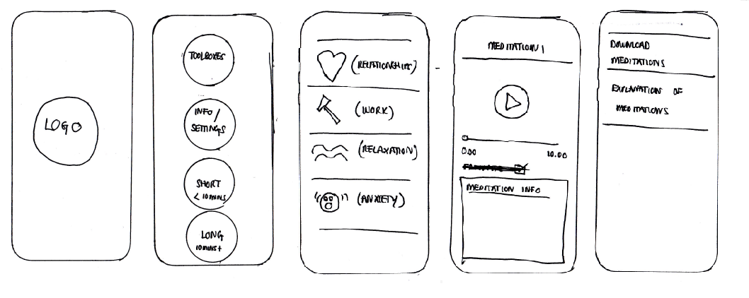
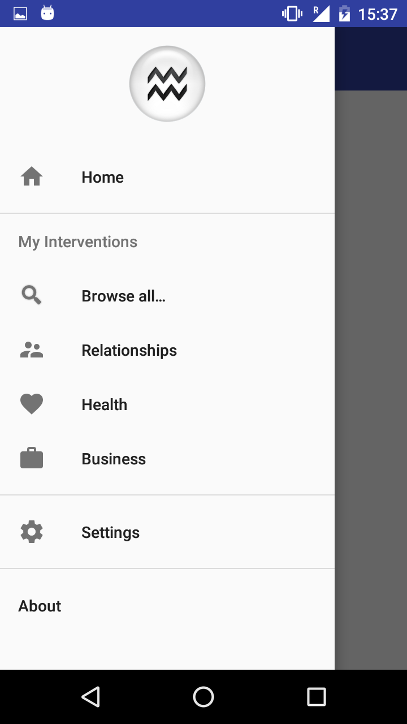
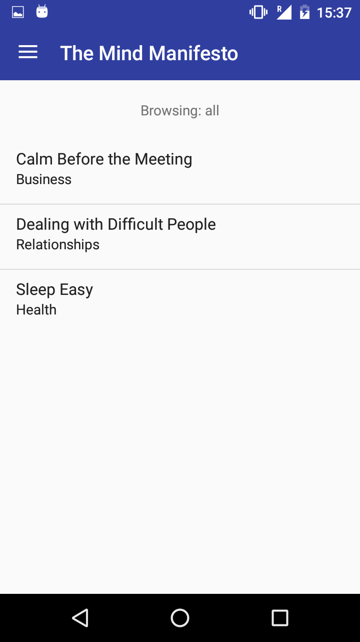
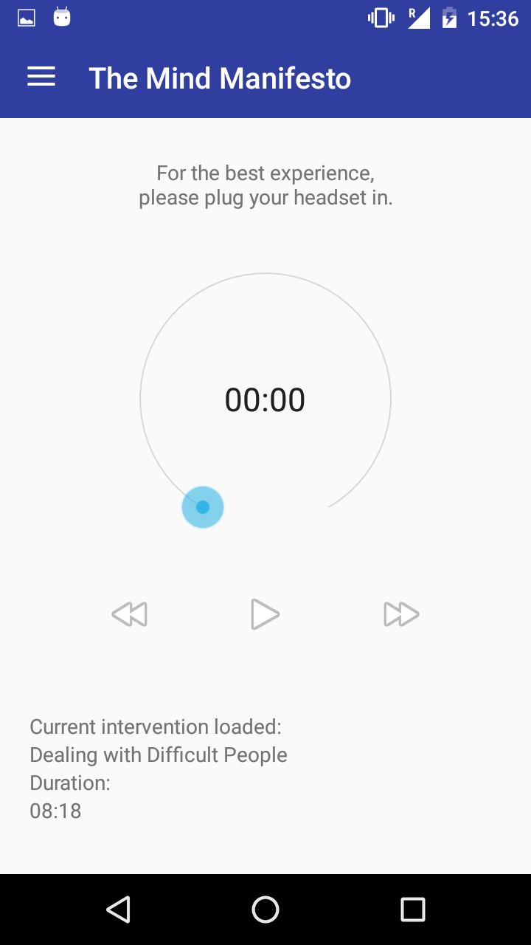
Fighting Stress Through Practicing Mindfulness Meditation
The Mind Manifesto
App by Jaromir Latal and Lambros Zannettos
jaromir.latal.15@ucl.ac.uk, lambros.zannettos.15@ucl.ac.uk (UCL Computer Science)
Can negative effects of stress be ameliorated through guided meditation?
Around 40% of people view their jobs as very or extremely stressful.
This is associated with numerous health, family or financial complaints.
Multiple studies in Europe and US have been conducted:
300 million working days lost annually are stress related and 20% of last minute no-shows are due to job stress.
Employers and governments incur losses up to £140 million pounds.
The sheer size of the data to be collected is impractical on paper forms, hence an app for tablets was designed.
An app consisting of the guided meditations player, broken down into sections was developed by 1st year CS students (Jaromir and Lambros), with a simple but intuitive user interface, trialled for User Experience by fellow UCL students.
A built in Nepali translation was also included to suit the interviewers (educated natives) and interviewers (possibly illiterate natives).
The project also involved indirectly working for Save the Children and World Food Programme, who are responsible for several roles in the trial.
App screenshots from top left, clockwise:
Designing the application from scratch.
Question from the cereals consumption sub-questionnaire.
List of sub-questionnaires for the food consumption questionnaire, with progress bars to show level of completion.
Another question from a sub-questionnaire in Nepali.
Shows the attributes for a saved member of a family.
As of 23rd April the app is now deployed and in use by researchers for data collection in the field in Nepal, from UCL’s Institute for Global Health. The data analysis will be presented in a publication study.

