Slide 1
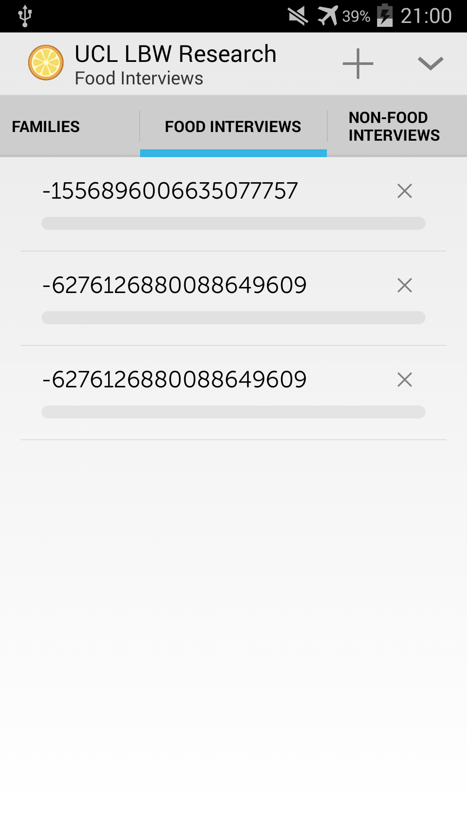
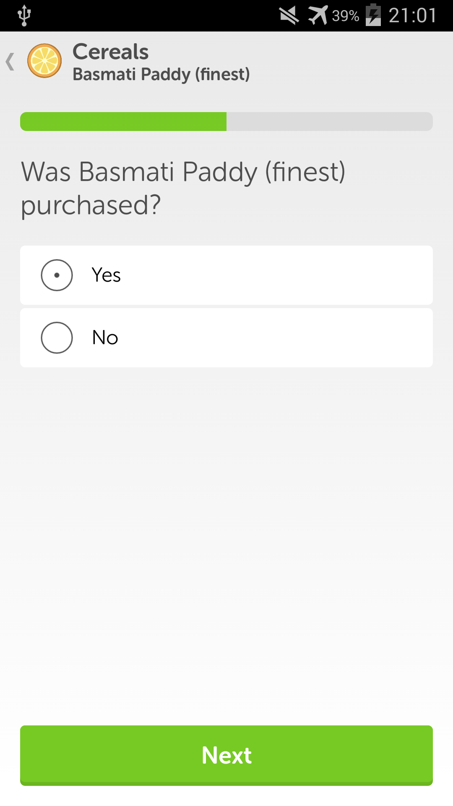
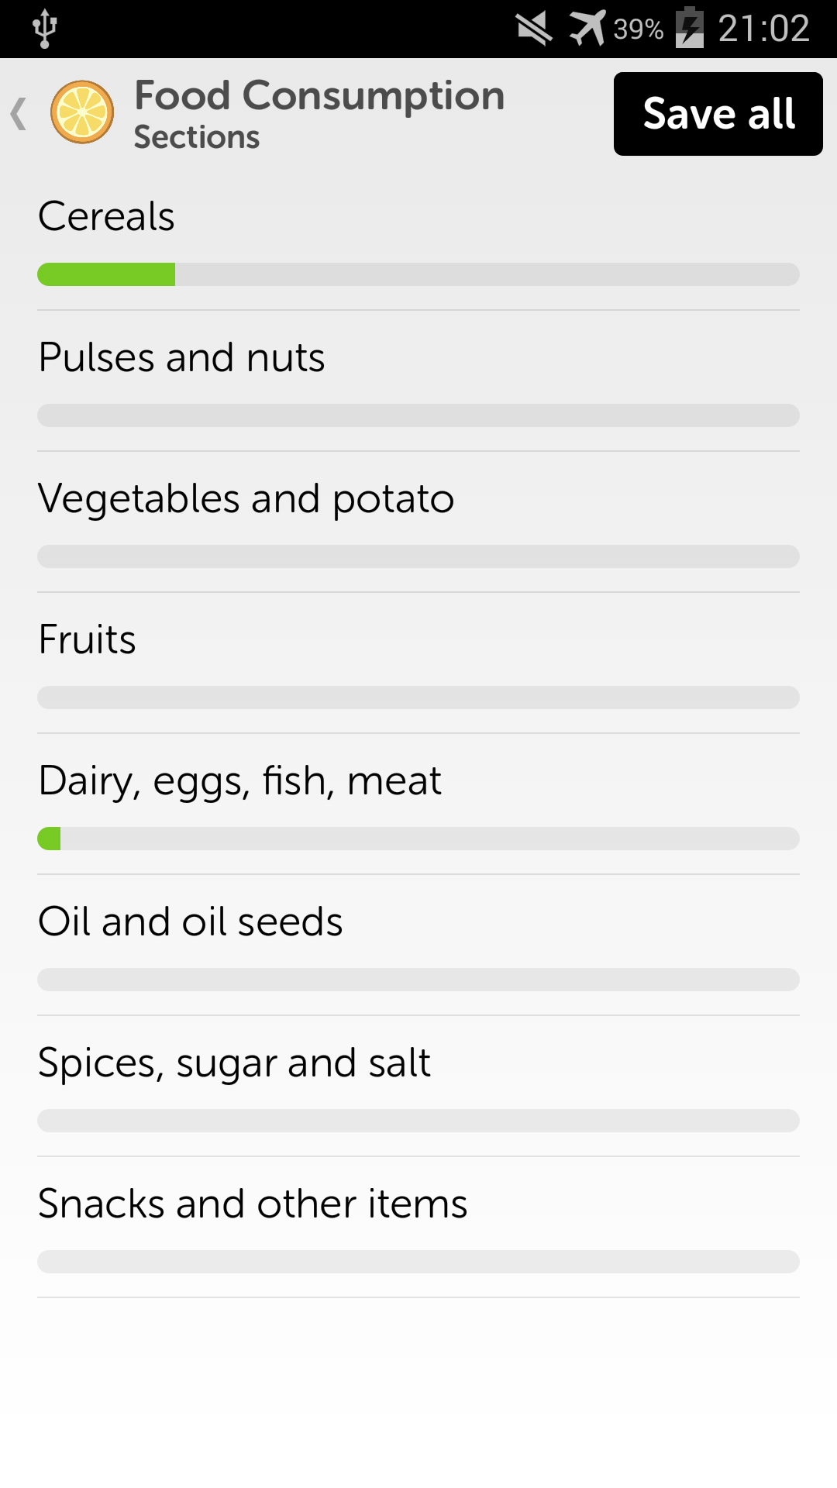
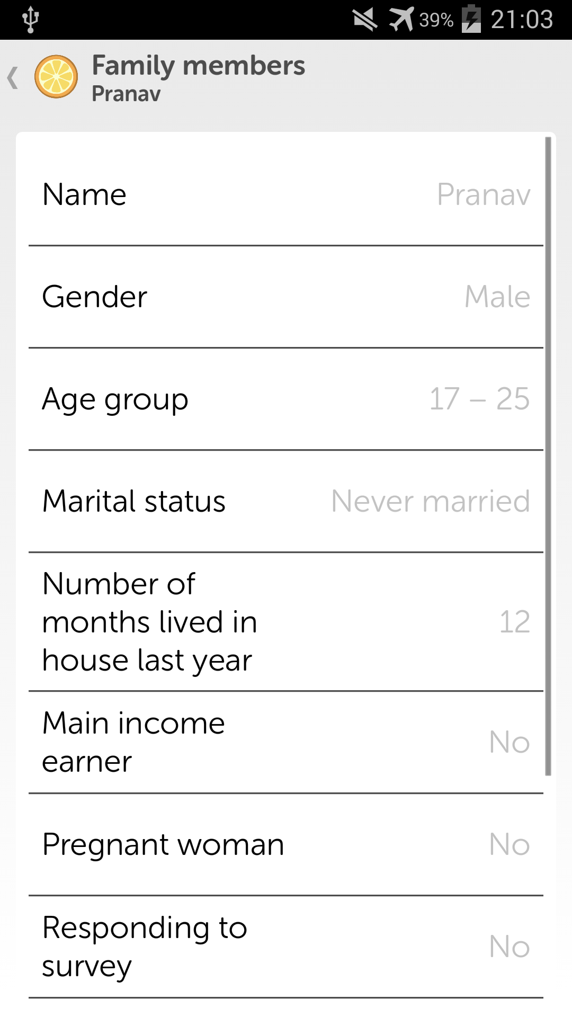
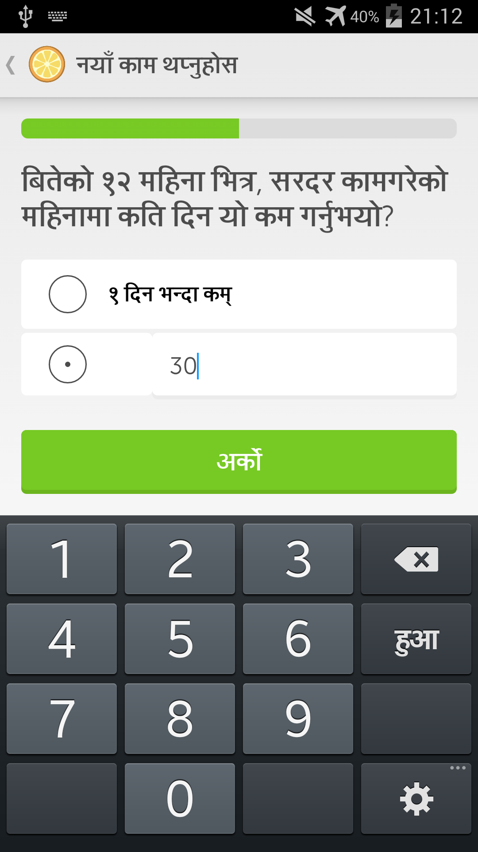
The Low Birth Weight in South Asia Trial (LBWSAT)
UCL Institute for Global Health and Mother and Infant Research Activities (Nepal)
App by Rohan Kopparapu and Pranav Murugappan
rohan.kopparapu.13@ucl.ac.uk, pranav.murugappan.13@ucl.ac.uk (UCL Computer Science)
Can birth weight in the plains of Nepal be cost effectively increased using a behaviour change strategy?
Around 28% of babies in southern Nepal are born underweight.
This poses numerous health risks (scan QR code for more).
A study consisting of 17,000 pregnant women is being conducted in two districts of Nepal.
Combinations of women empowerment, cash packages and food supplements are provided unconditionally. Data needs to be collected.
The sheer size of the data to be collected is impractical on paper forms, hence an app for tablets was designed.
An app consisting of the research questionnaire, broken down into sections was developed by 1st year CS students (Rohan and Pranav), with a simplified user interface, trialled for User Experience by fellow UCL students.
A built in Nepali translation was also included to suit the interviewers (educated natives) and interviewers (possibly illiterate natives).
The project also involved indirectly working for Save the Children and World Food Programme, who are responsible for several roles in the trial.
App screenshots from top left, clockwise:
List of interviews conducted on family food consumption.
Question from the cereals consumption sub-questionnaire.
List of sub-questionnaires for the food consumption questionnaire, with progress bars to show level of completion.
Another question from a sub-questionnaire in Nepali.
Shows the attributes for a saved member of a family.
As of 23rd April the app is now deployed and in use by researchers for data collection in the field in Nepal, from UCL’s Institute for Global Health. The data analysis will be presented in a publication study.

