Slide 1
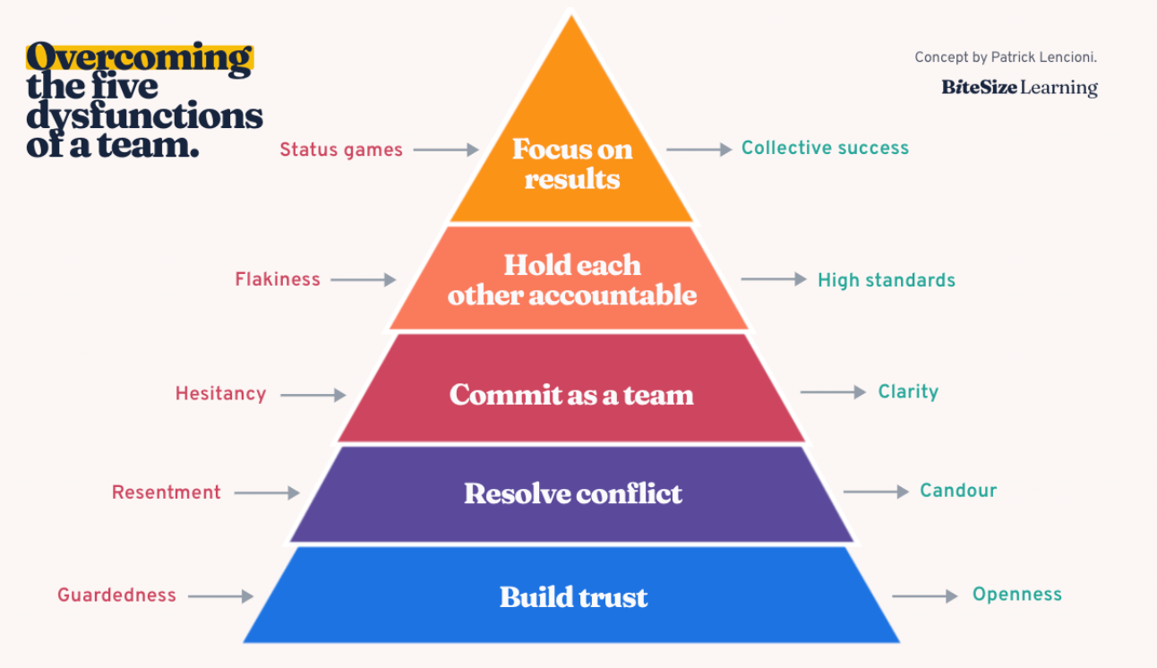
Why we're building this
THE MISSION
Helps teams think together — capturing what's said, confirming understanding, and connecting the right people.
WHY IT MATTERS
Team dysfunction stays invisible until it's already cost you something. We surface it early.
Built on Lencioni's Five Dysfunctions and Organizational Behavior Management (OBM) Academic Literature — fix trust first, or every layer above it regresses.
Why we're building this
Team Insights

Slide 2
What the software does
IN THE MEETING
AFTER THE MEETING
AFTER THE MEETING
Comes loaded with your company/community and project context
A behavioral report for each participant, across five dimensions
✓
✓
A behavioral report for each participant, across five dimensions
✓
Suggests topics to each person based on their actual work
Every score backed by concrete signals, not vague impressions
✓
✓
Every score backed by concrete signals, not vague impressions
✓
Brings in the right expert, by name, at the right moment
Each session builds on the last into a shared reference
✓
✓
Each session builds on the last into a shared reference
✓
What the software does
Team Insights

Slide 3
Claude as a team member
An AI in the room changes the room, even when silent
1
What people say
2
Who gets heard
Being captured sharpens how people phrase things. It can also make candor harder.
Calling on a quiet person by name shifts the floor away from the loudest voice.
3
What counts as a mistake
4
Who does the thinking
Treating gaps as signal rather than failure lowers the cost of admitting one.
Deferring to a confident answer erodes team judgment. Prompt, never conclude.
Presence is never neutral. The question is which dynamics it strengthens.
Claude as a team member
Team Insights

Slide 4
Two clocks, two kinds of insight
Neither works alone. The value is running both.
IN THE MOMENT
ACROSS SESSIONS
Actionable, but shallow
Nuanced, but retrospective
Real-time signal - Feedback loops
Longitudinal insight - After-action report
Catches things while they can still be changed
Sees patterns across meetings and people
Narrow window — one meeting, limited context
Flags potentially bad days from real, long-term dynamics
Can't tell a one-off from a pattern
Arrives too late to change this meeting; changes the next
Real time says act now. Over time says what the acting is for.
Real time vs. over time
Team Insights

Slide 5
Where this helps most
The same loop, three different rooms
R
I
O
Rural classrooms
Knowledge-sharing
A new hire's first meeting
TRUST
CONFLICT
RESULTS
WHAT IT SEES
WHAT IT SEES
WHAT IT SEES
A lost student stops asking questions. Nobody wants to look uninformed.
A contentious point surfaces, then the group quietly moves past it.
The new hire sits through the meeting without being included.
↓
↓
↓
WHAT IT DOES
WHAT IT DOES
WHAT IT DOES
Prompts a peer to help rather than correct.
Asks for the case against, drawing in the knowledge-holder.
Nudges a teammate to orient them, by name, right now.
Signals drawn from a 120-entry behavior taxonomy
Team Insights

