Slide 1
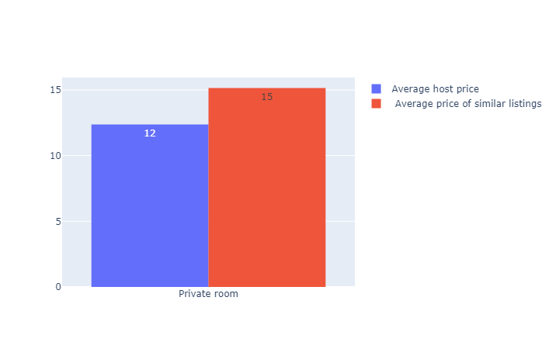
Do you charge enough per night?
We compare listings that have the same rating, are in the same price range.
An example: The listing is going for 40 € per night, we are comparing listings in the range of up to 60 € per night
Besides the rating, the two most important factors are location and the room type. An apartment in the city center will charge more than one on the outskirts.
The host can charge up to 3€ more per night, without having to improve his rating

Slide 2
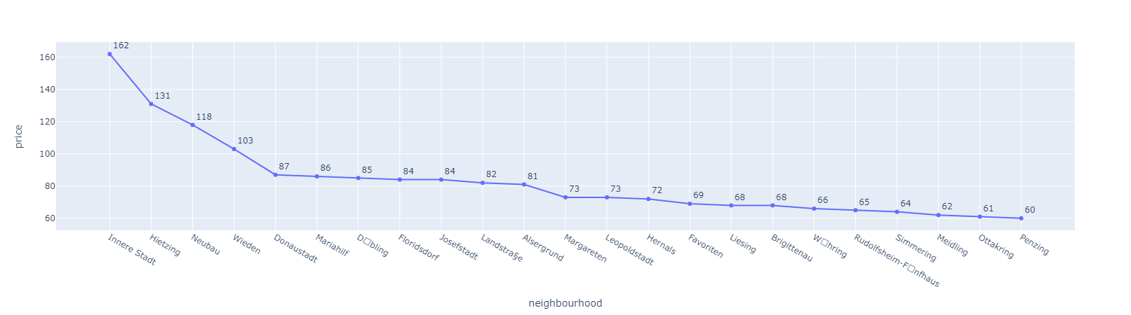
Average price per night (neighborhoods)

Slide 3
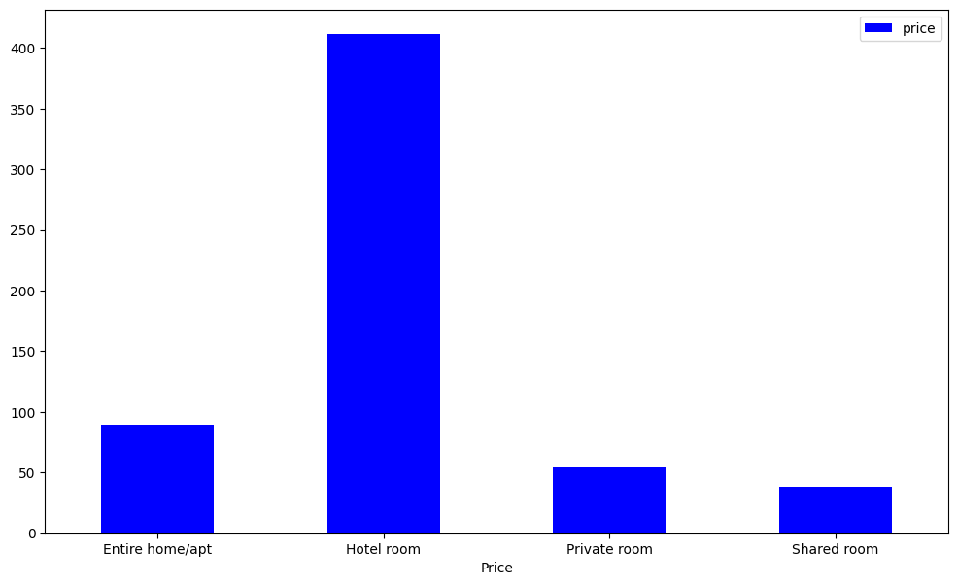
Room type price averages Vienna

Slide 4
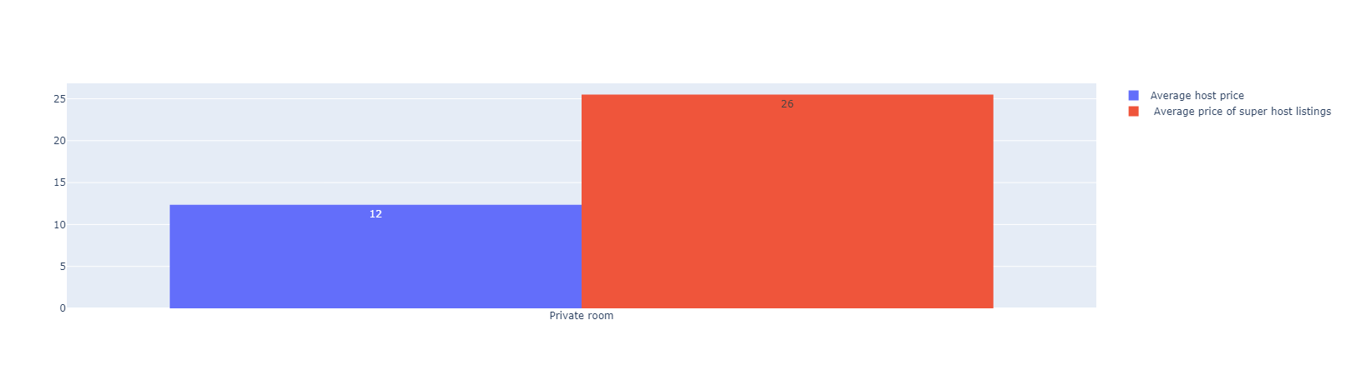
How much more can you charge if you improve your rating ?
You can charge up to 14€ more per night if you improve your rating

Slide 5
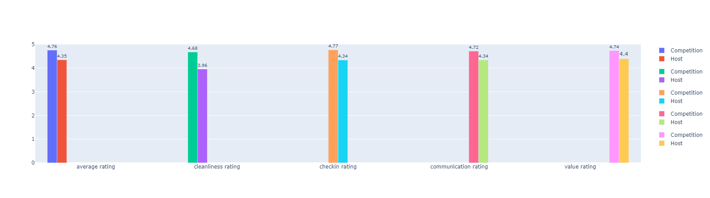
How does your rating compare to your direct competition
The rating for location is excluded, because you can’t improve the listings location

Slide 6
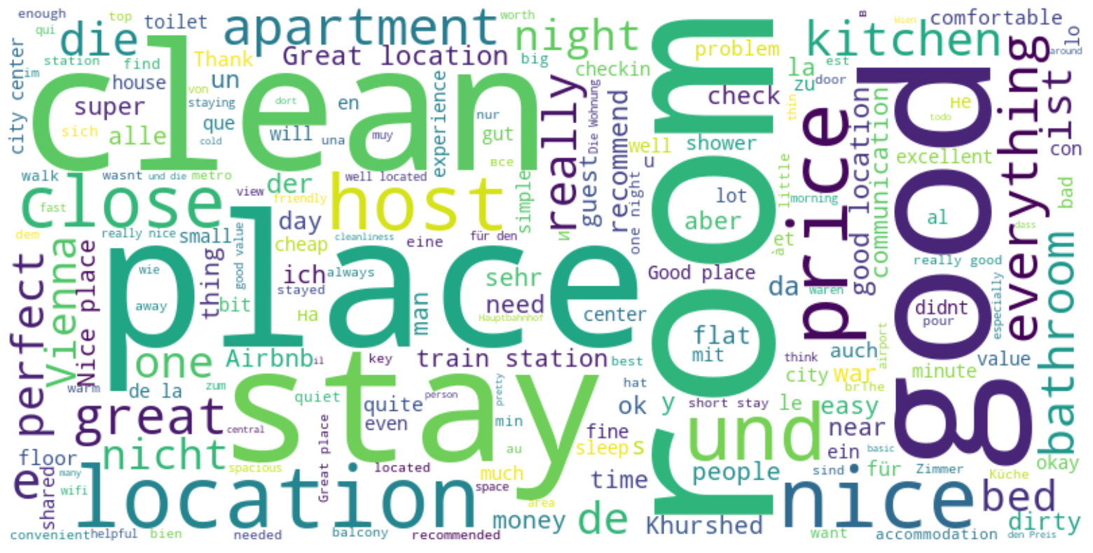
General keyword analysis for your listing (positive feedback)

Slide 7
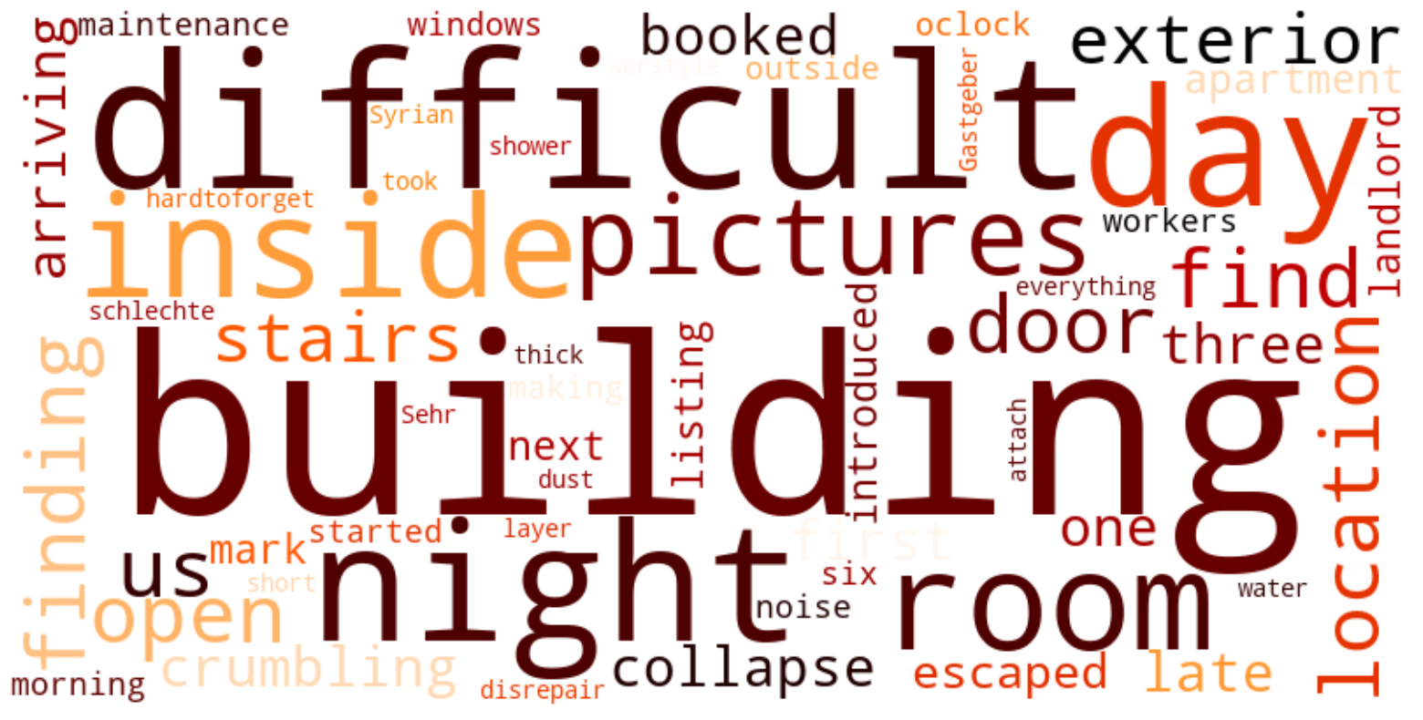
General keyword analysis for your listing (negative feedback)

Slide 8
What else do you get in the report ?
You get direct feedback on which areas in the rating you can improve more, so you can get a higher rating
Direct review analysis, what caused bad experiences for your guest (not just general keywords)
What ratings directly influence other ratings. Example: Good communication with your guests will influence the check-in rating

