Slide 1
ANALYSIS OF INFANT ACCELEROMETER DATA
November 11, 2016
Presented by
Jerneja Mislej, Msc student of Bioinformatics

Slide 2
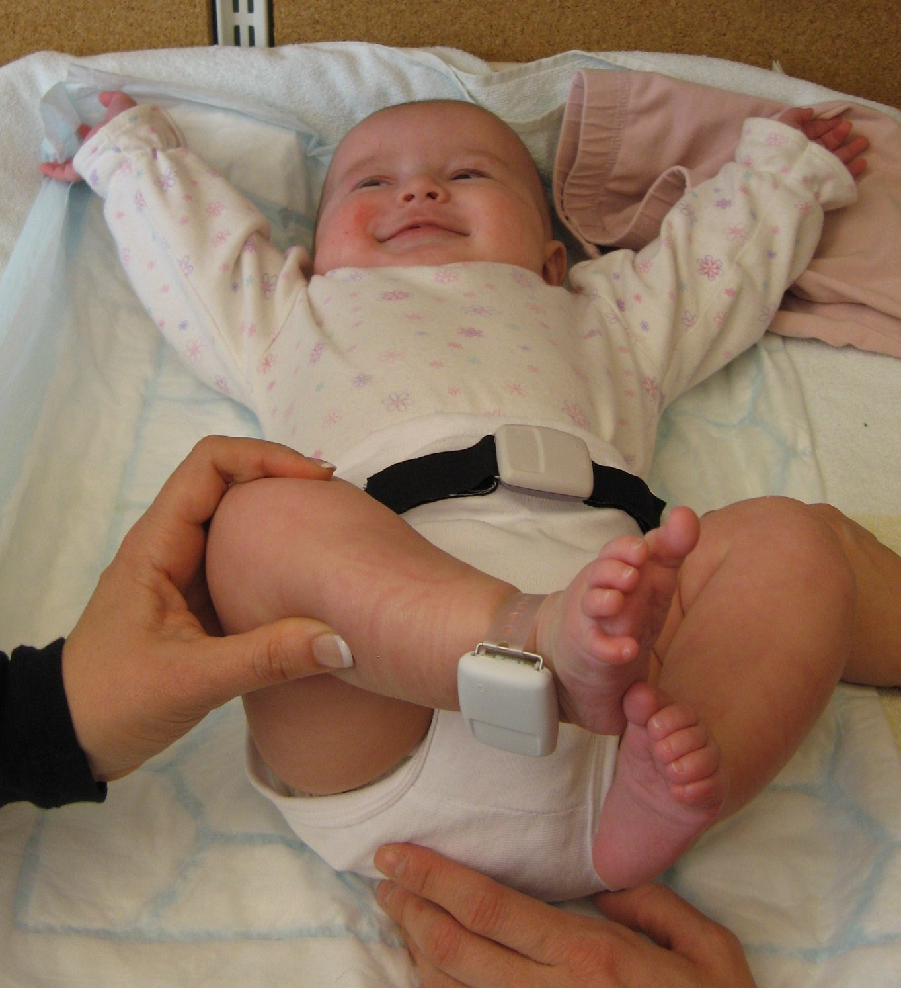
INTRODUCTION
        Data collected during a project which focused on lifestyle behaviors and pregnancy.
          Mothers pre and post-partum and infants post-partum characteristics were measured and obtained.
          Including infants accelerometer data and
          infants sleeping and feeding diaries
        Focusing on the estimation of infants physical
        activity(PA) and the feasibility of estimation

Slide 3
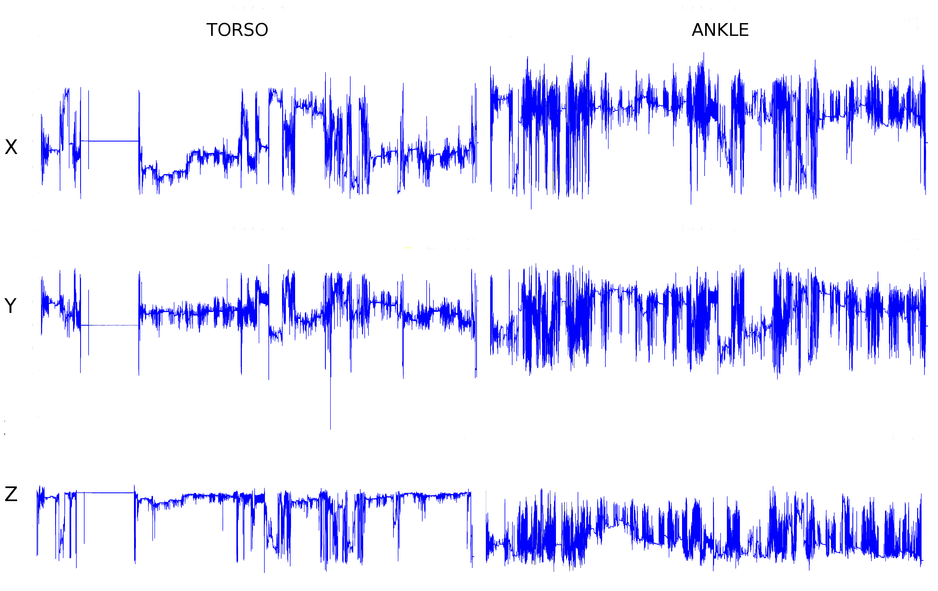
INTRODUCTION
          Tri-axial accelerometers placed on 30 infants, on the torso and ankle.
          Data sampled at 40 Hz for 48 hours in a free living environment.
          PA estimated based on increased
          acceleration.
          Measurements can contain
          contributing and lacking
          accelerations due to environment
          factors not related to infants own
          PA.

Slide 4
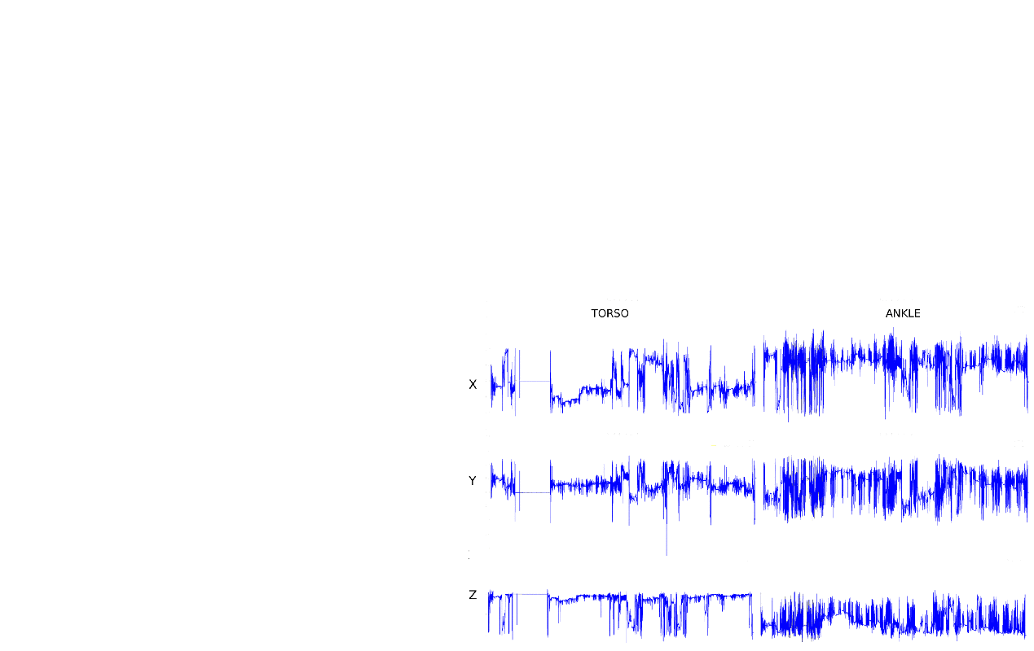

Slide 5
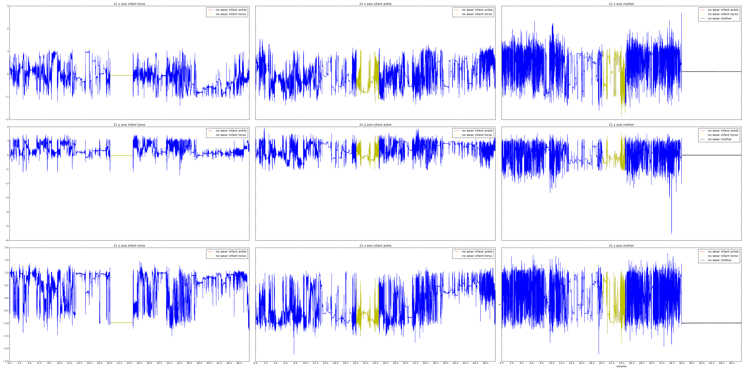
DATA PREPROCESSING
NON-WEAR DETECTION
      Non-wear detected based on
      published methods.
      Detection factors:
        standard deviation(SD)
        span from min to max
      + slope of the fitted line

Slide 6
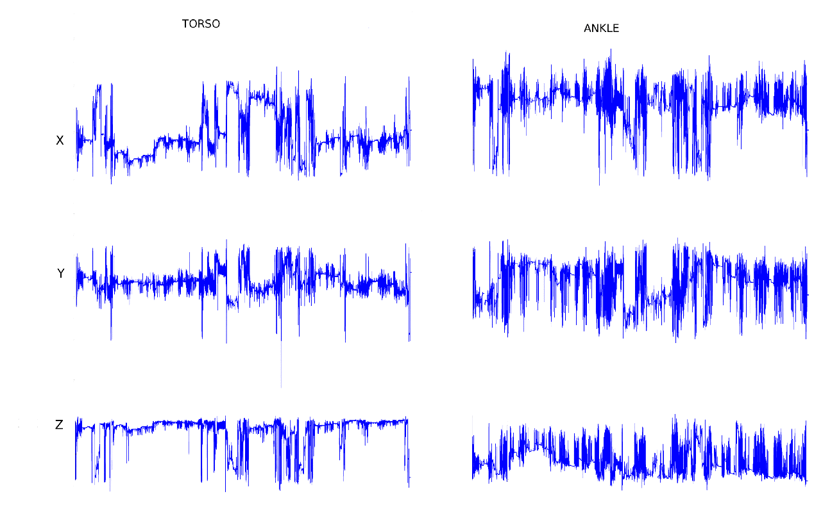
DATA PREPROCESSING
ACCELERATION SUMMARY
      Summary required due to instrumental noise, relatively high sampling rate and complications arising from multiple axis alignment.
      Commonly used summaries include Euclidean norm and/or bandpass filters.

Slide 7
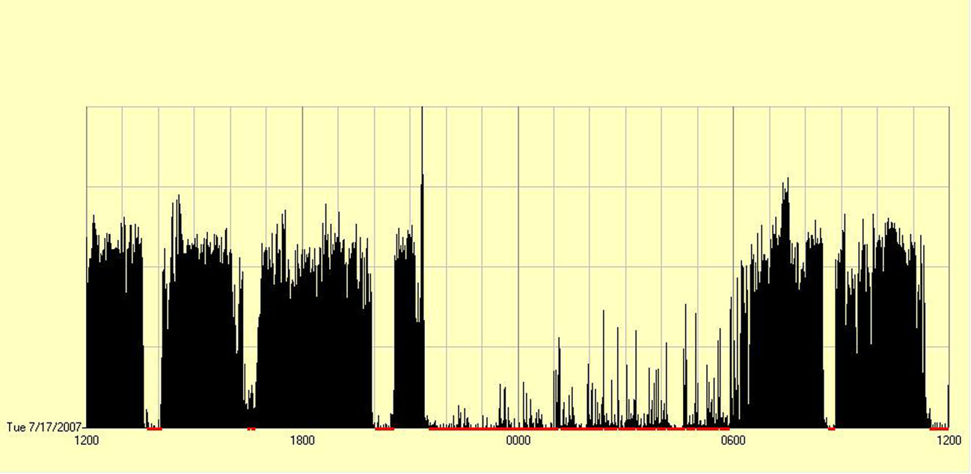
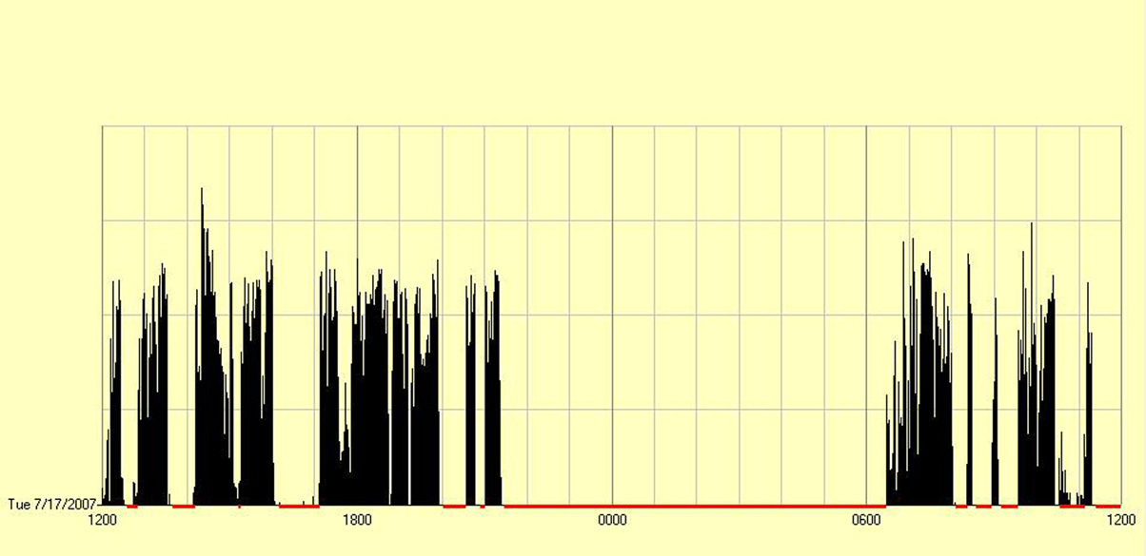
DATA PREPROCESSING
CONTRIBUTING ACCELERATIONS
                There are no published methods for removal of accelerations contributed by the caretakers.
                Issue had been addressed and published
                along with the feasibility of estimating
                infants PA.
Proportion of contributing accelerations
activity placement | stroller | carrying | Swiss ball
arm | 29% | 23% | 28%
leg | 9% | 52% | 21%
Worobey J, Vetrini NR, Rozo EM (2009) Mechanical measurement of infant activity: A cautionary note.
Christine Moir (2014) Physical activity in infancy: assessment of an intervention to increase physical activity in infants.

Slide 8
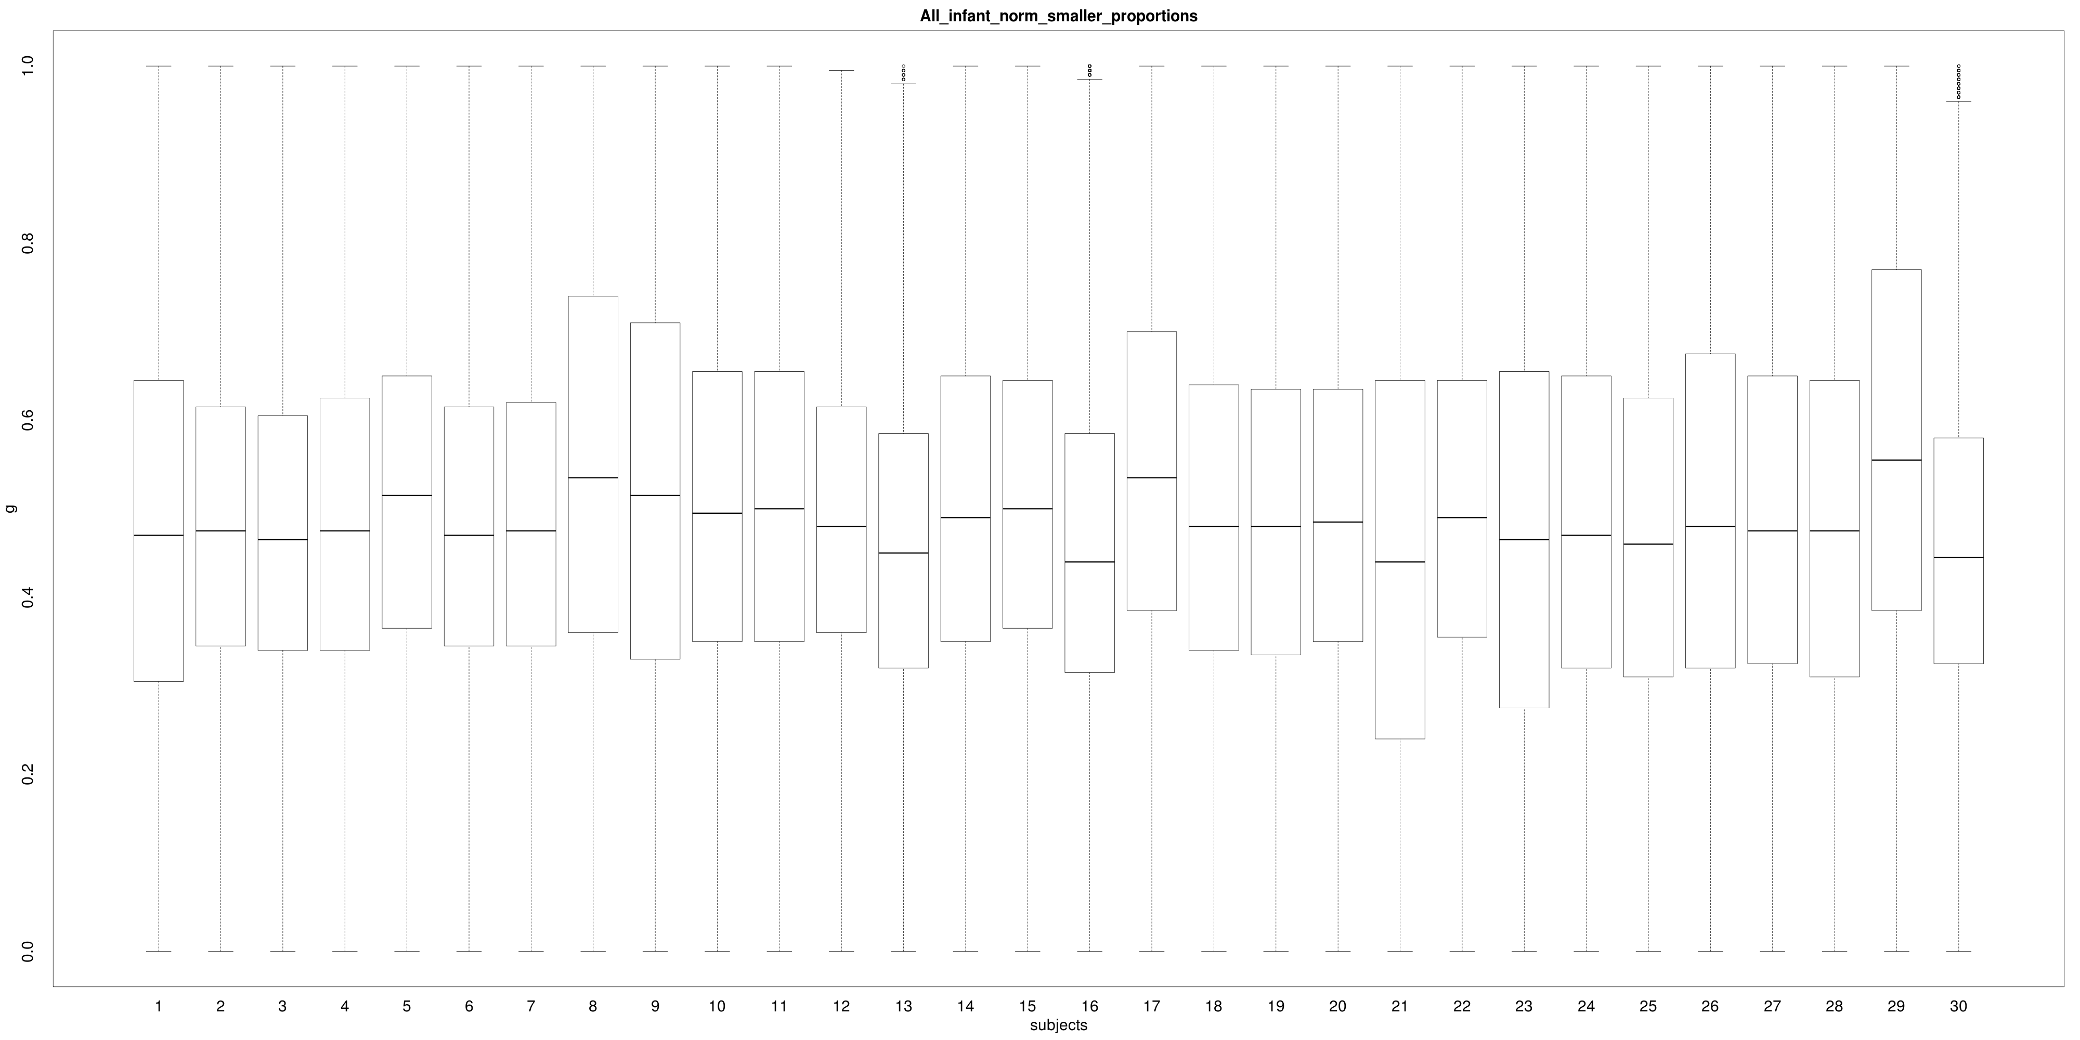
CONSIDERING VARIABILITY

Slide 9
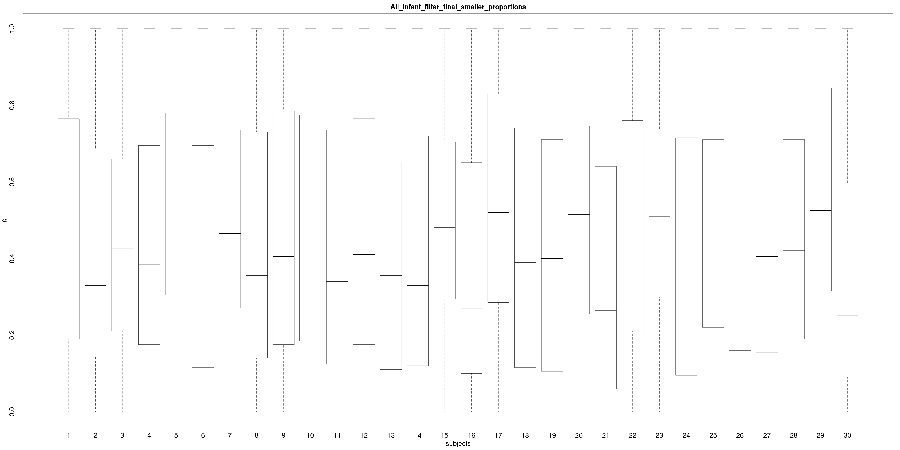
CONSIDERING VARIABILITY

Slide 10
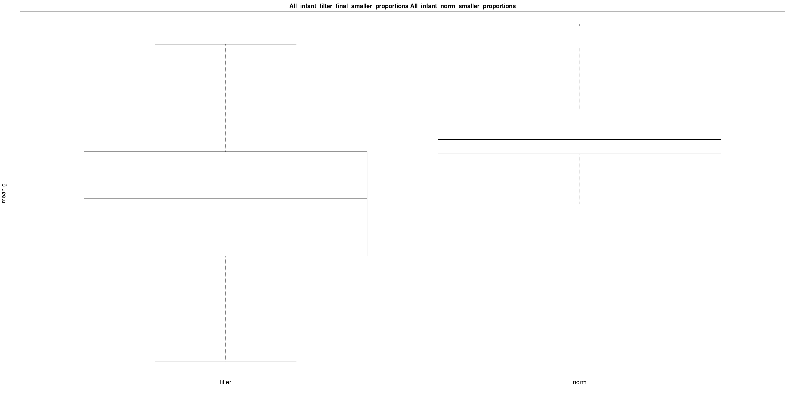
CONSIDERING VARIABILITY

Slide 11
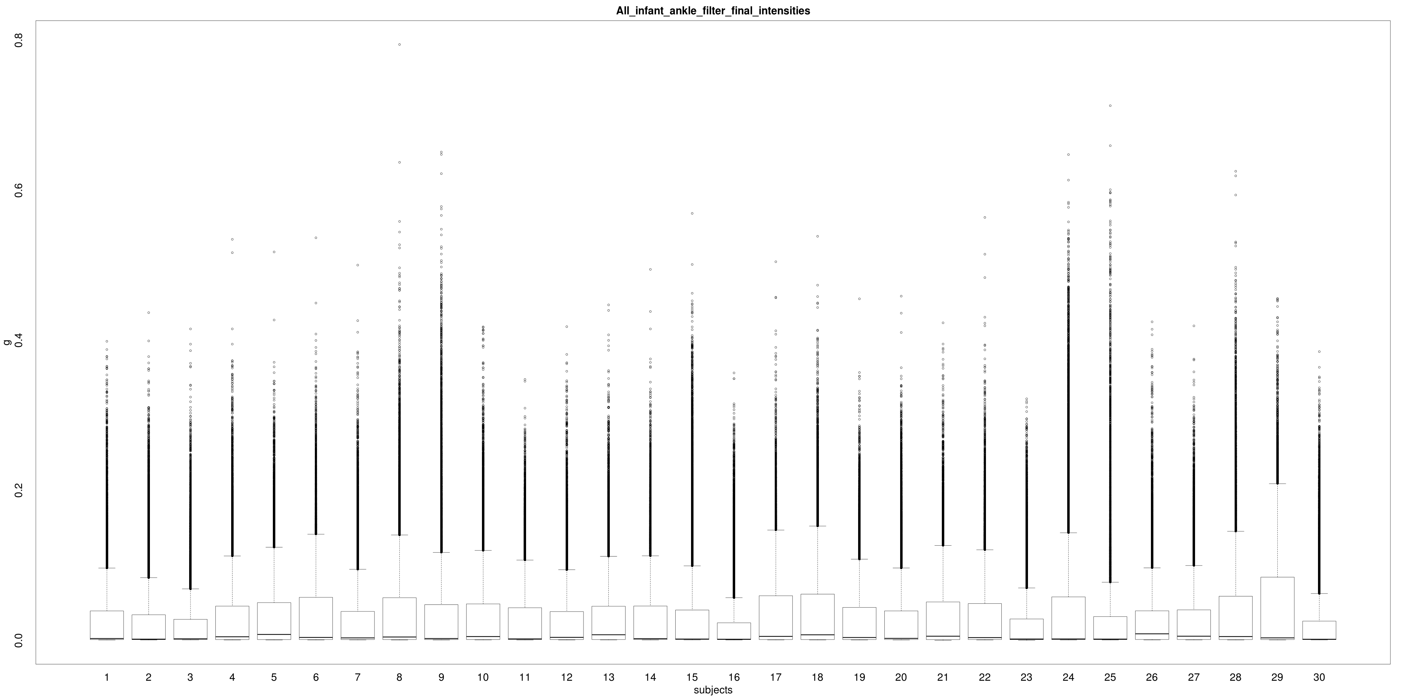
CONSIDERING VARIABILITY

Slide 12
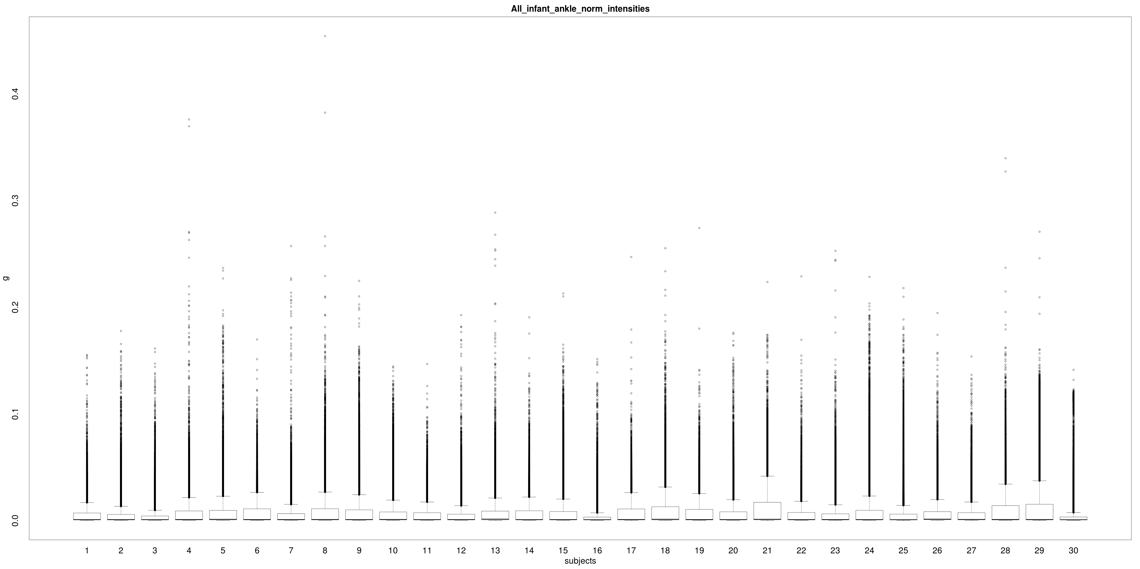
CONSIDERING VARIABILITY

Slide 13
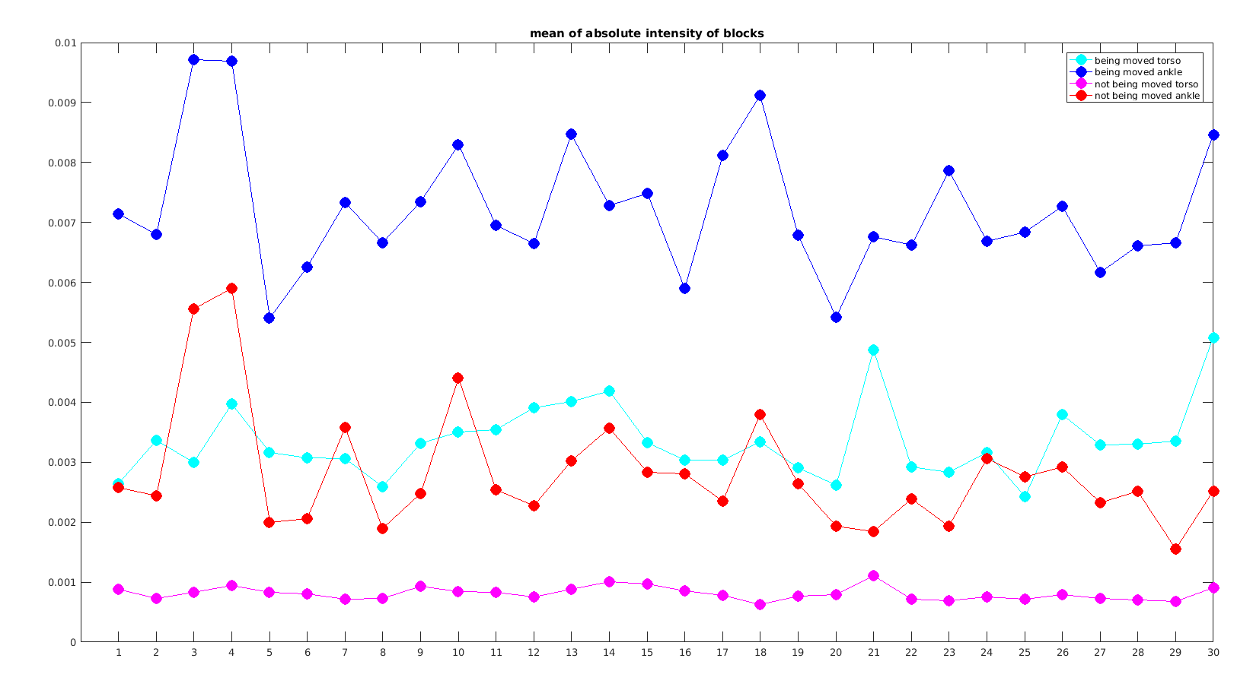
CONSIDERING VARIABILITY

Slide 14
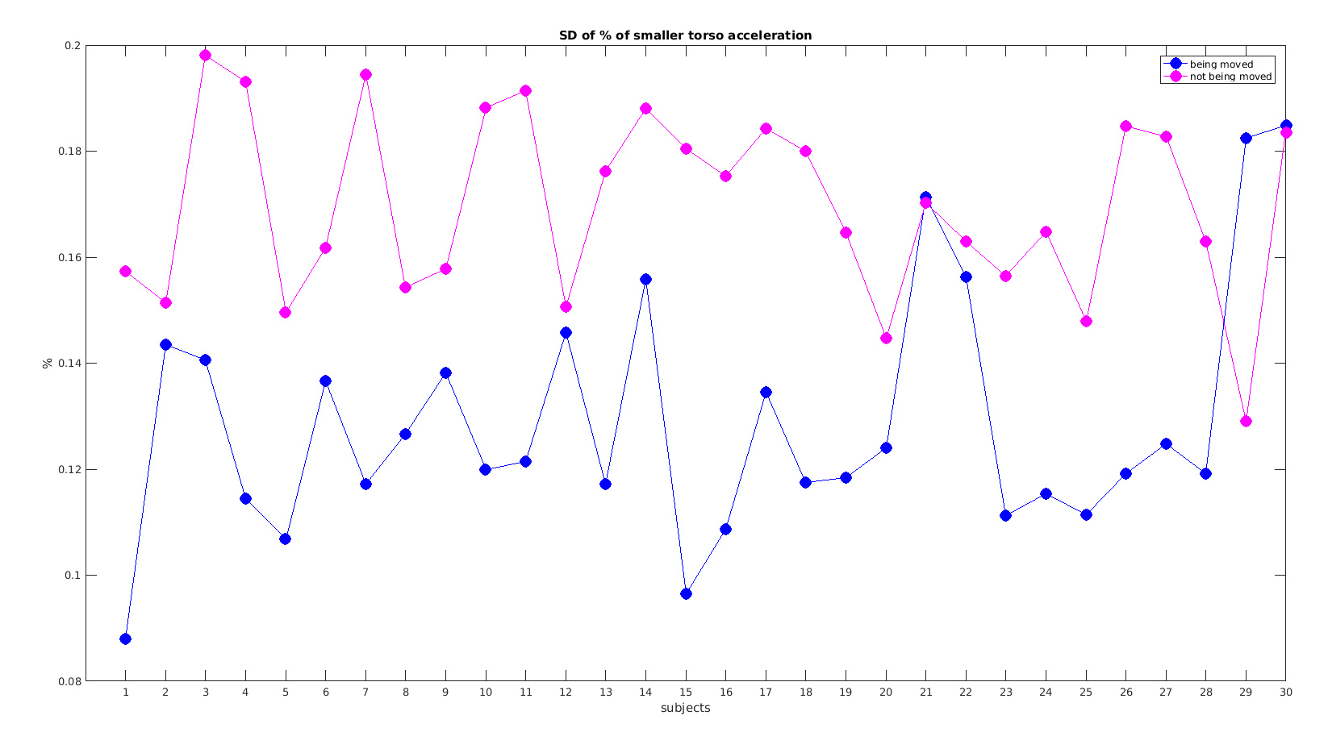
CONSIDERING VARIABILITY

Slide 15
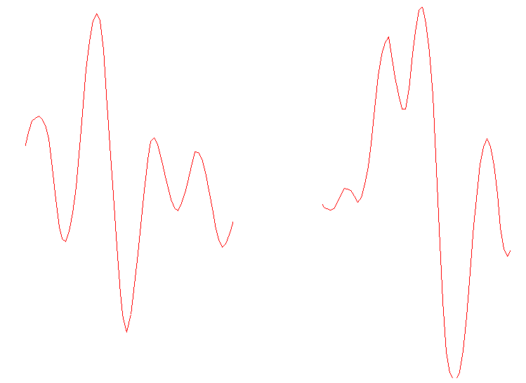
DATA PREPROCESSING
CONTRIBUTING ACCELERATIONS
                Several approaches implemented and tested:
                A) Simple subtraction of measurements
                B) Subtraction of windowed intensities
                C) Correction based on the ratio of windowed intensities
                D) Correction based on correlation of windowed intensities
                E) Complete removal of blocks where infant was moved

Slide 16
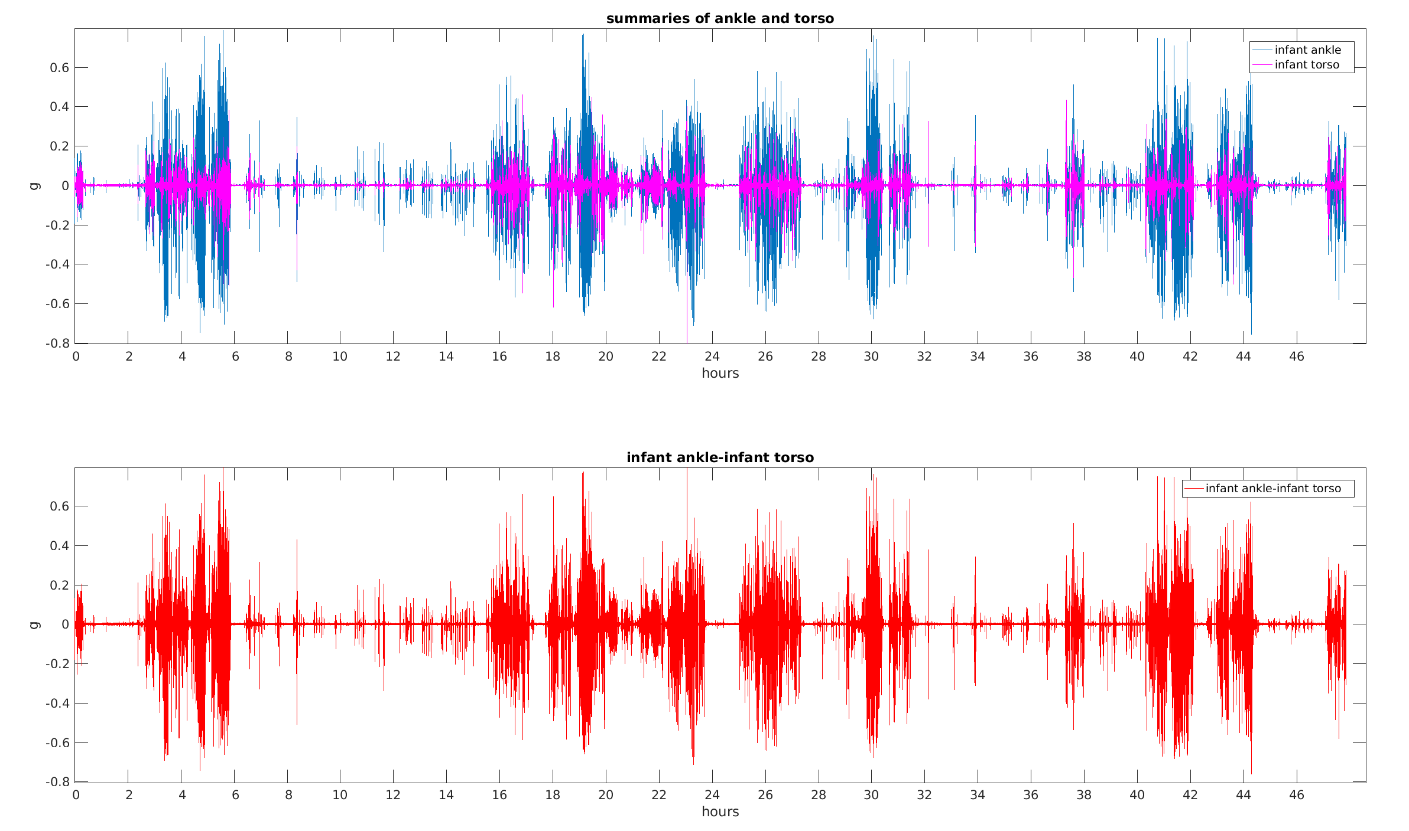
DATA PREPROCESSING
CONTRIBUTING ACCELERATIONS
                A) Simple subtraction of measurements inefficient mainly due to point to point difference between torso and ankle.
                SD increased by ~15%, absolute intensity by ~20%.

Slide 17
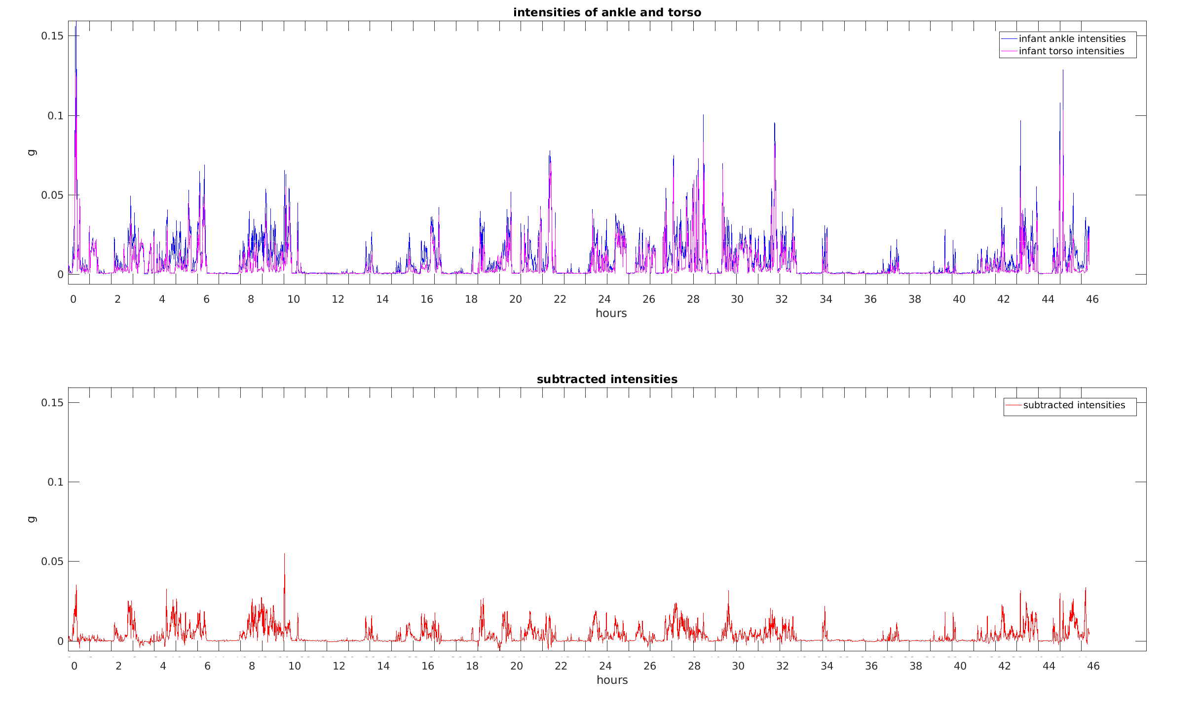
DATA PREPROCESSING
CONTRIBUTING ACCELERATIONS
                B) Subtraction of windowed intensities slightly improves results.
                Reduced point to point difference and proportion of smaller acceleration on ankle.

Slide 18
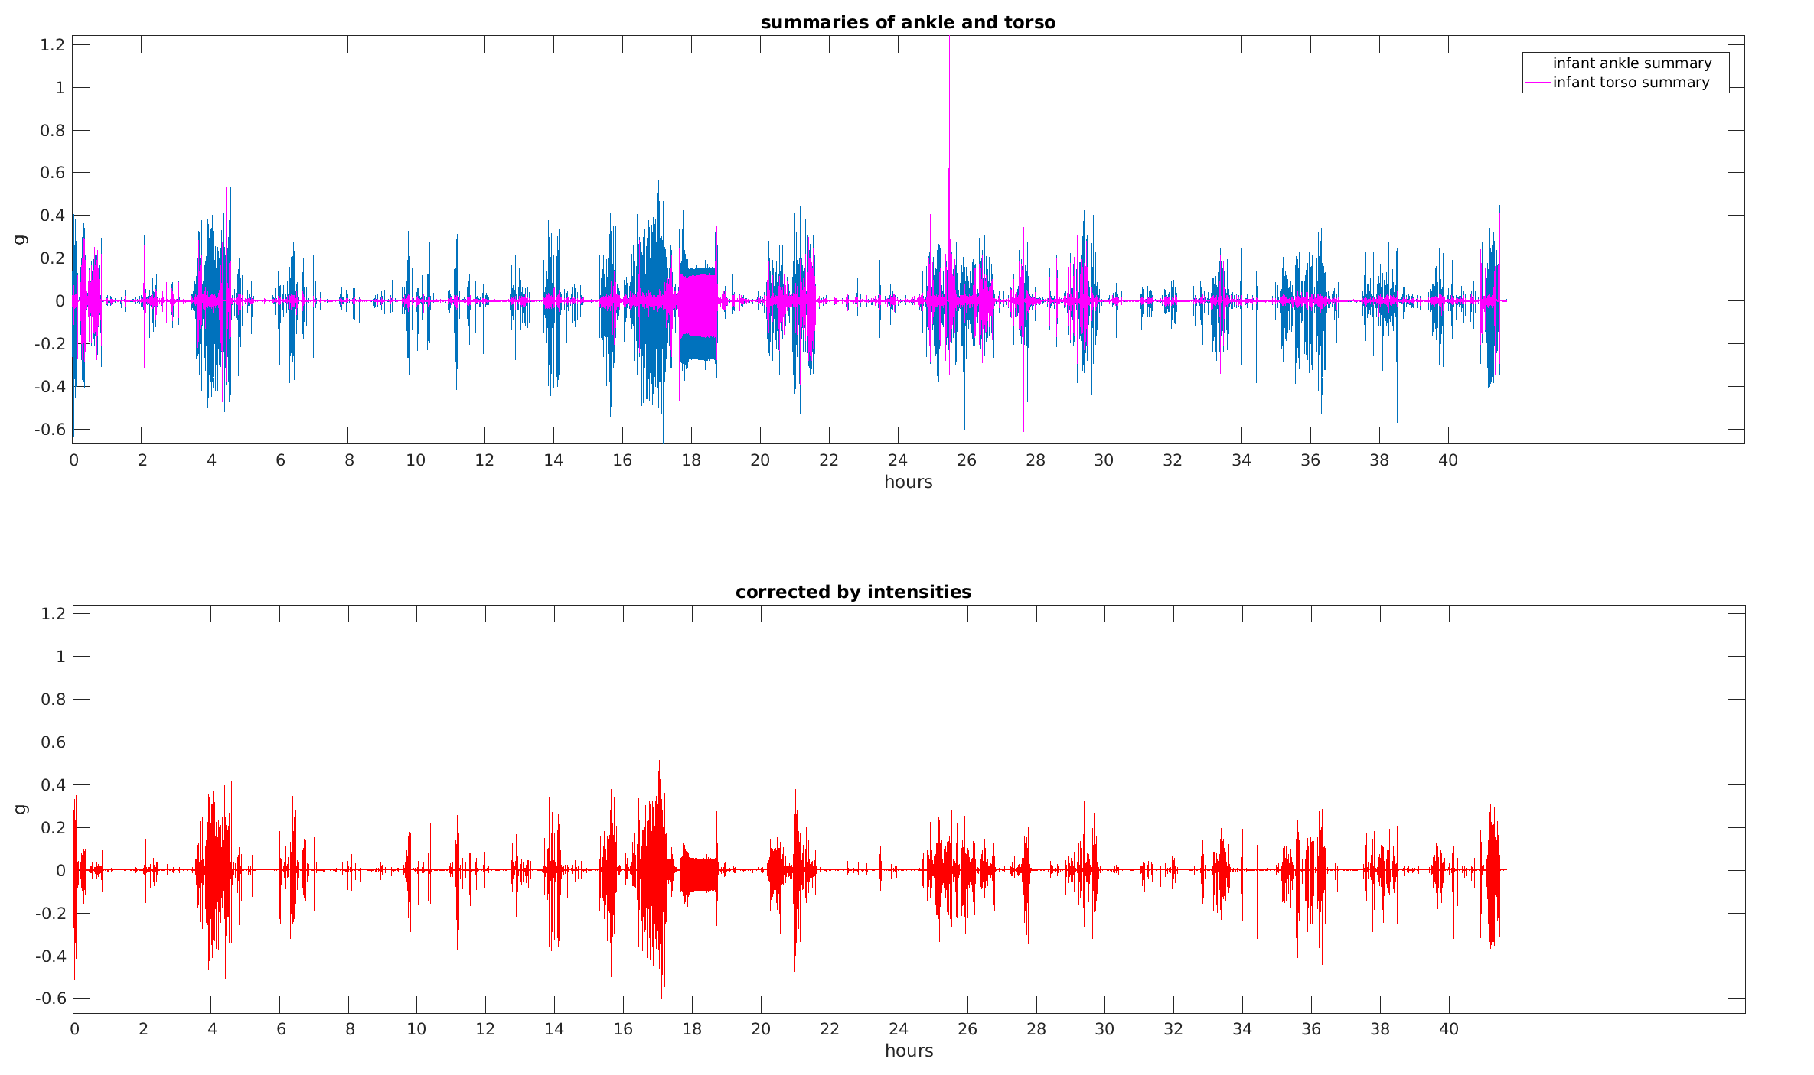
DATA PREPROCESSING
CONTRIBUTING ACCELERATIONS
            C) Correction based on the ratio of windowed intensities, where the ankle measurement is decreased by the ratio of the absolute intensities.
                SD decreased by ~44%, absolute intensity by ~47%.

Slide 19
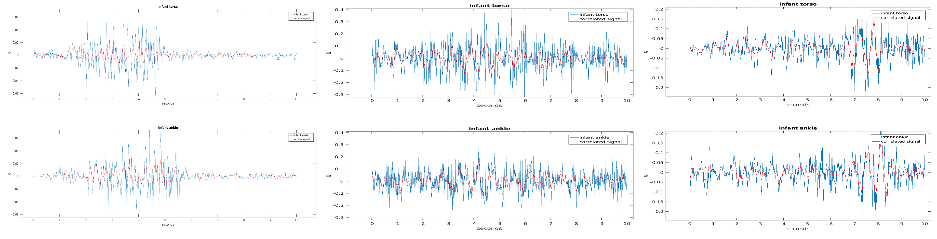
DATA PREPROCESSING
CONTRIBUTING ACCELERATIONS
              D) Correction based on correlation of windowed intensities, where the ankle measurement is decreased by the correlation coefficient of the absolute intensities.
                Correction based on similarity and allowing larger torso accelerations.
                SD and absolute intensity decreased by ~58%.

Slide 20
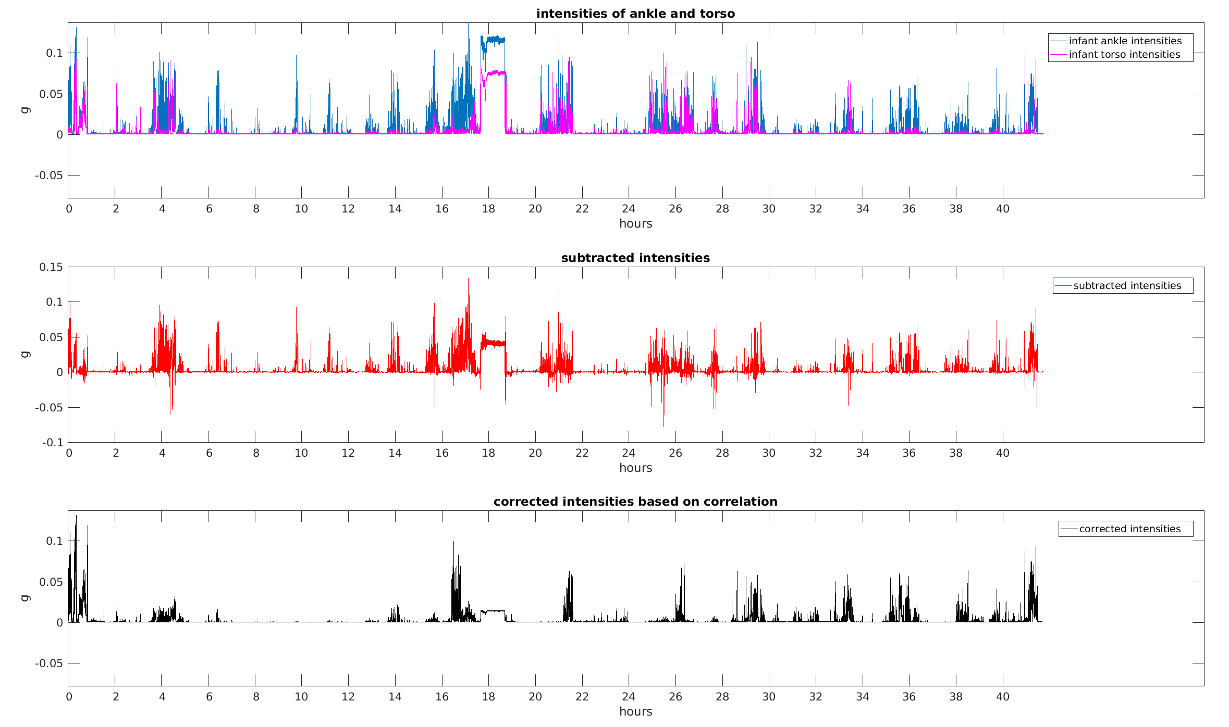
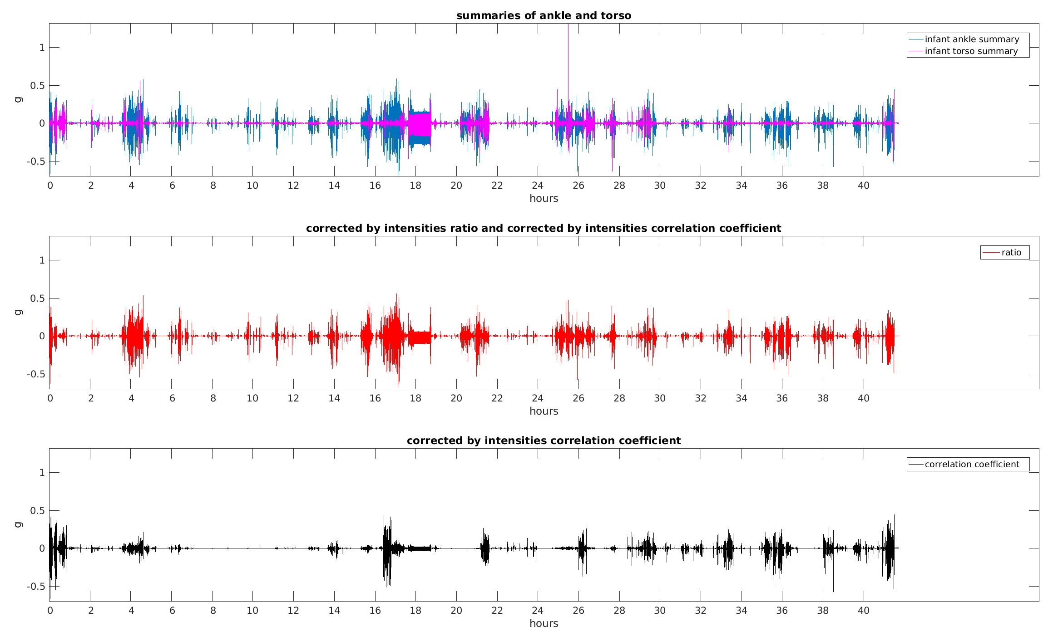
DATA PREPROCESSING
CONTRIBUTING ACCELERATIONS

Slide 21
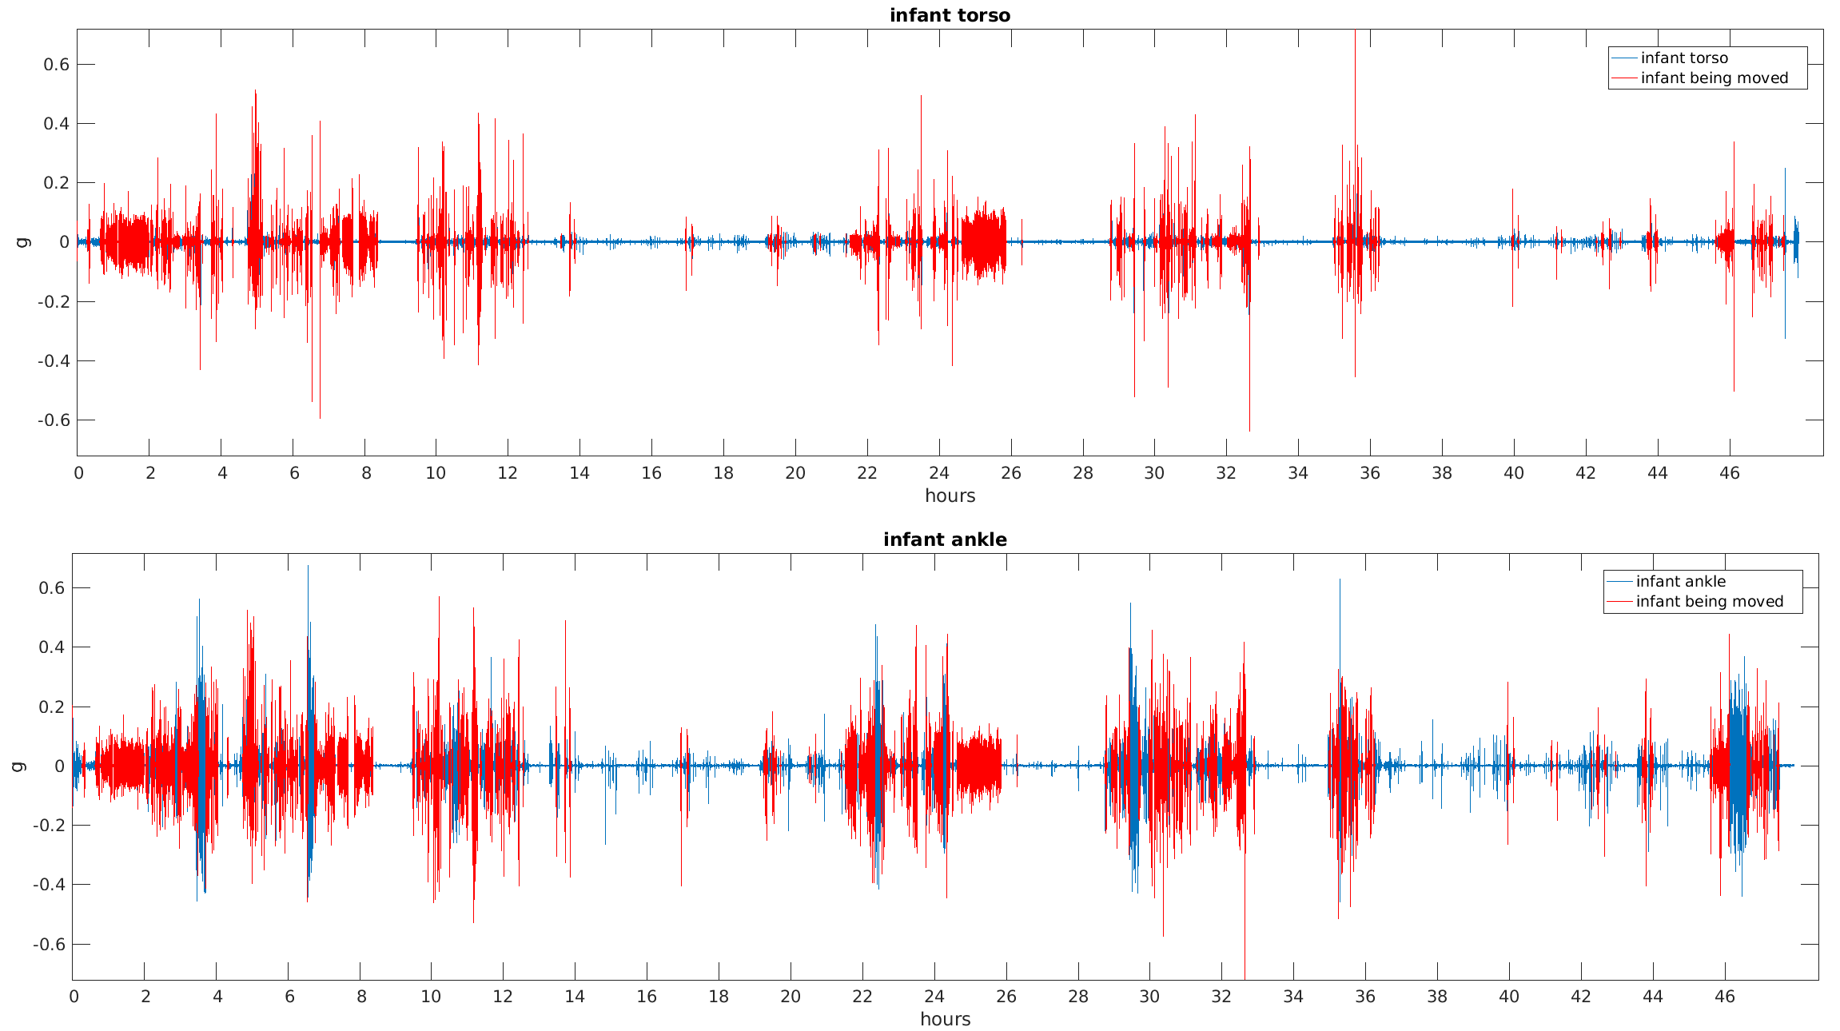
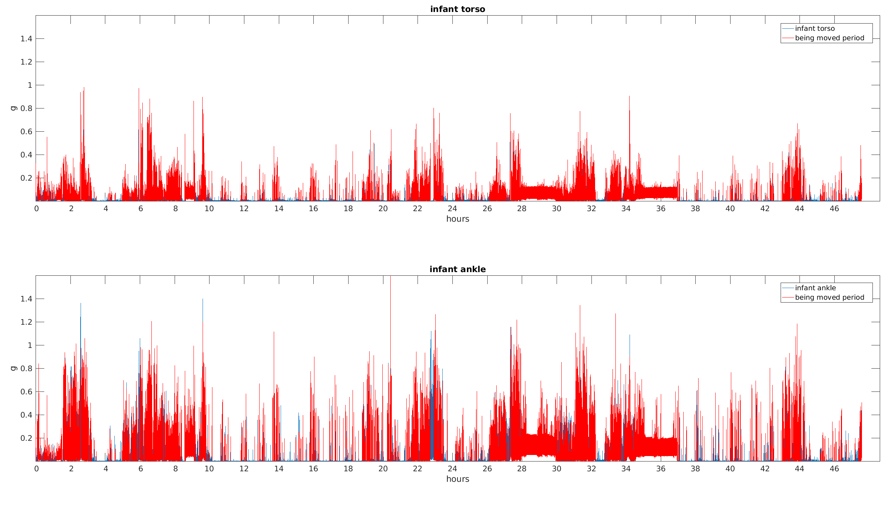
DATA PREPROCESSING
CONTRIBUTING ACCELERATIONS
                E) Complete removal of periods where the infant was moved.

Slide 22
PHYSICAL ACTIVITY
    PA extracted from the remaining or corrected ankle measurement.
    Extraction based on threshold for windowed SD, or absolute intensity size.
    Considering the assumption that infant can not move his own torso:
          PA ~ proportion of increased ankle accelerations that do not have corresponding increased torso accelerations
          → over 30 infants: from ~20% to ~50%

Slide 23
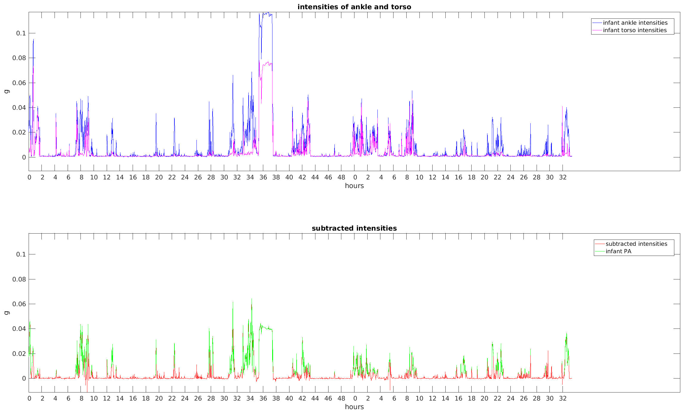
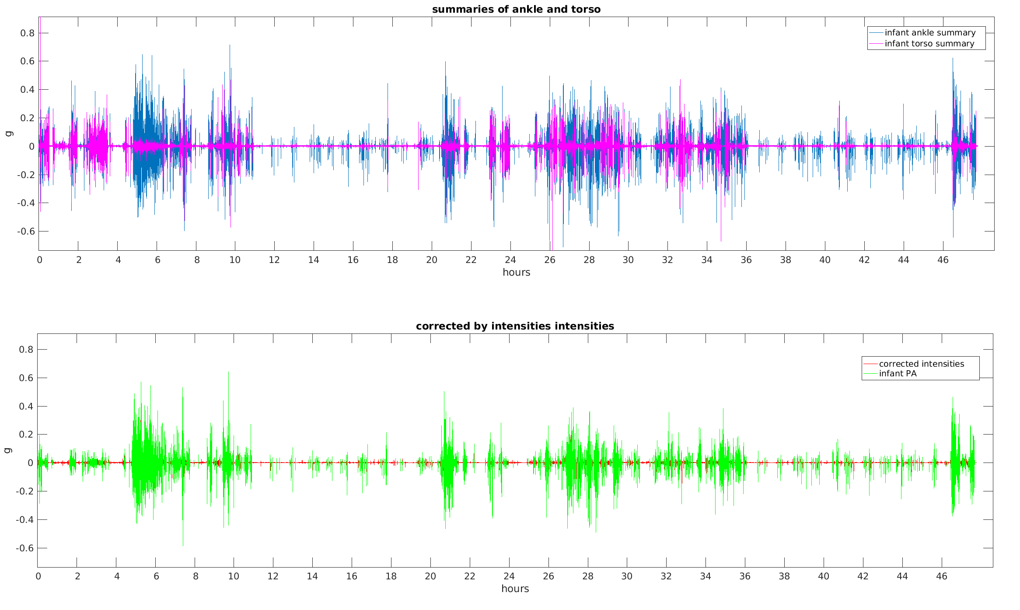
PHYSICAL ACTIVITY
    Approaches B and C:

Slide 24
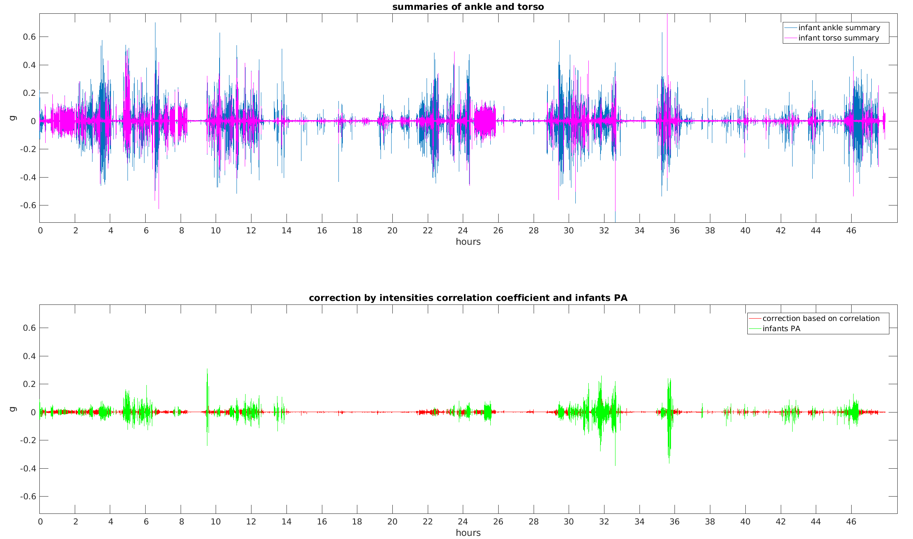
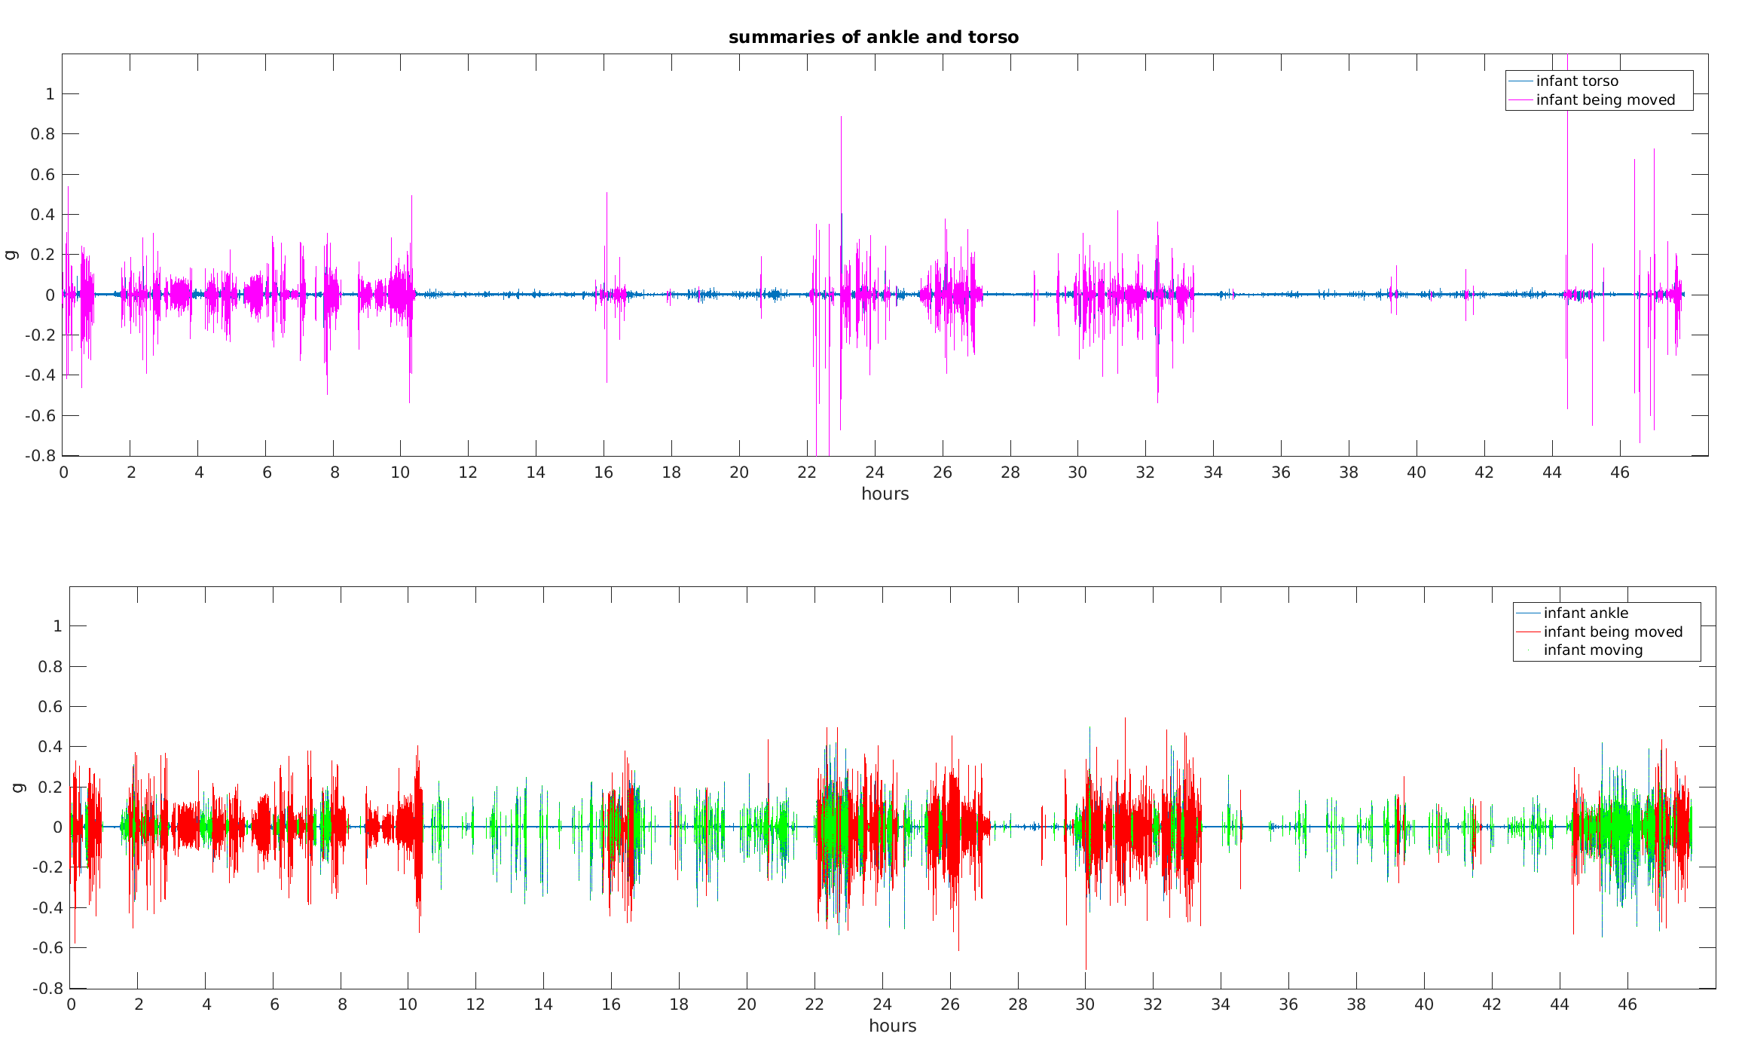
PHYSICAL ACTIVITY
    Approaches D and E:

Slide 25
PHYSICAL ACTIVITY
    Proportion of time in PA versus proportion of time being moved:
 | Spearmans rho
Approach A | 0.84***
Approach B | 0.48**
Approach C | 0.64***
Approach D | 0.41*
Approach E | -0.42*

Slide 26
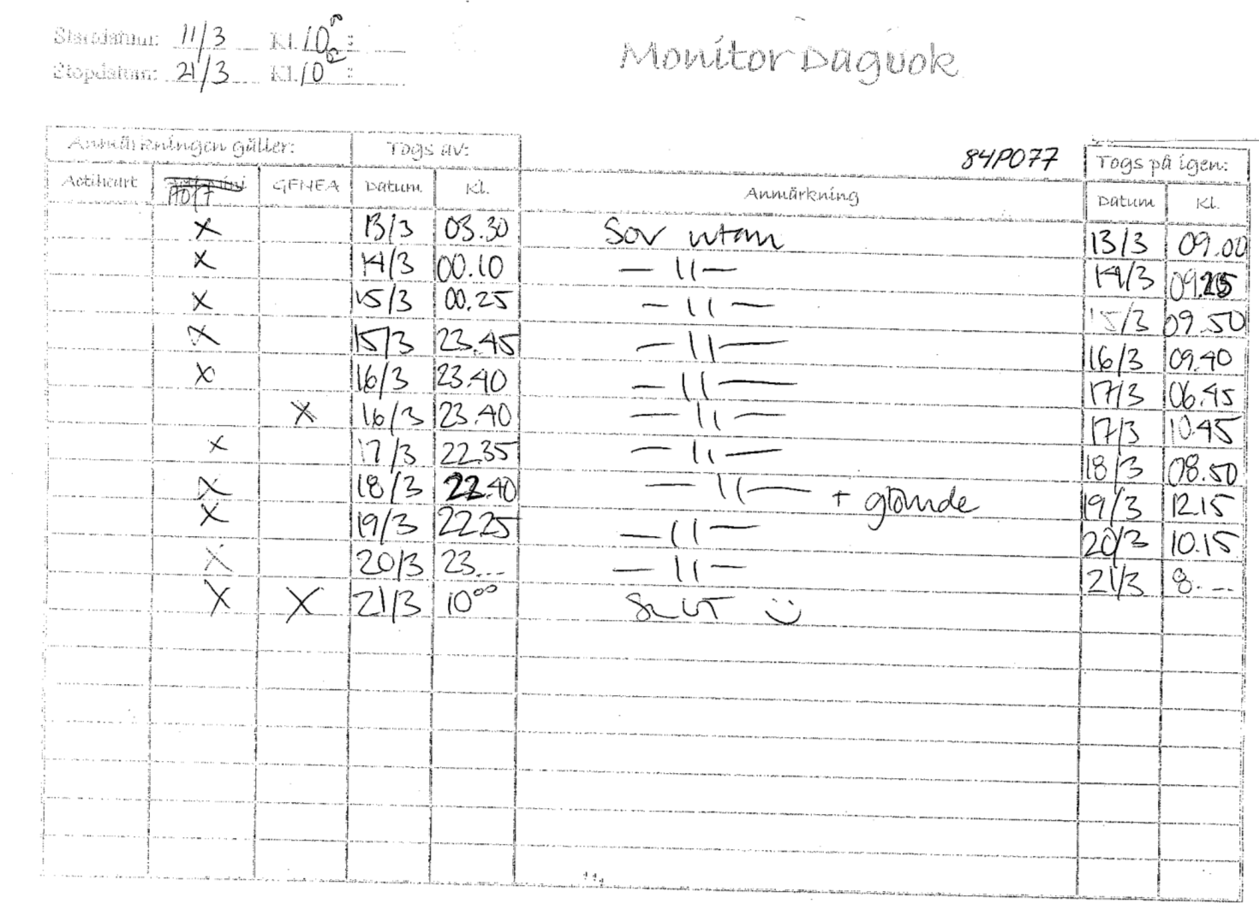
DIARIES AND VALIDATION
    During the free living experiment, the mothers were instructed to keep a diary consisting of
    printed forms:

Slide 27
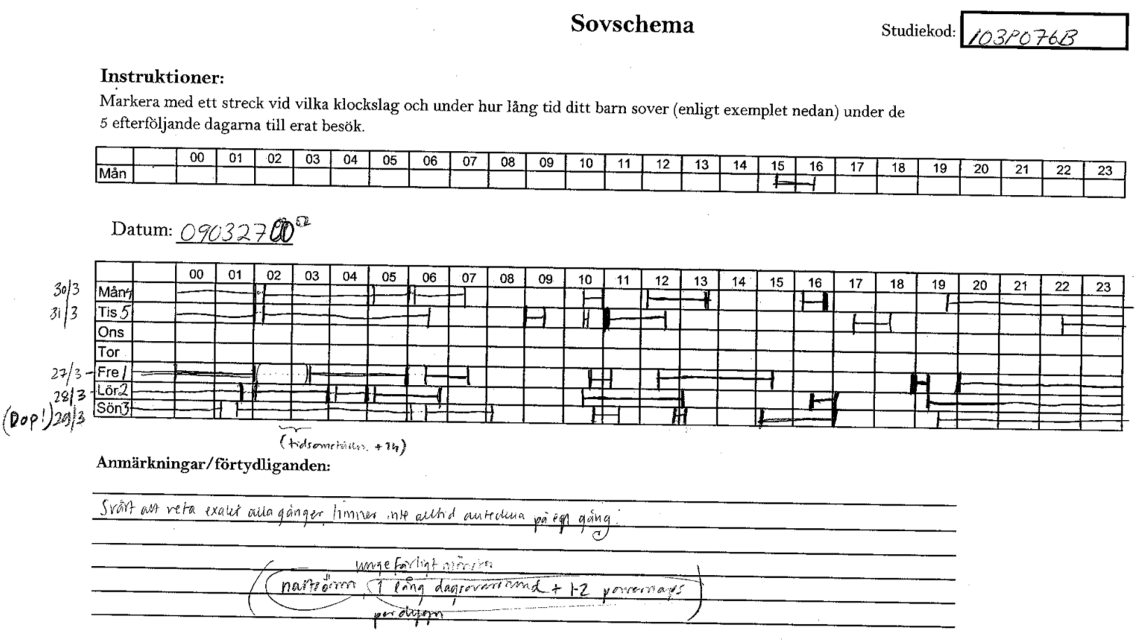
DIARIES AND VALIDATION
    During the free living experiment, the mothers were instructed to keep a diary consisting of
    printed forms:

Slide 28
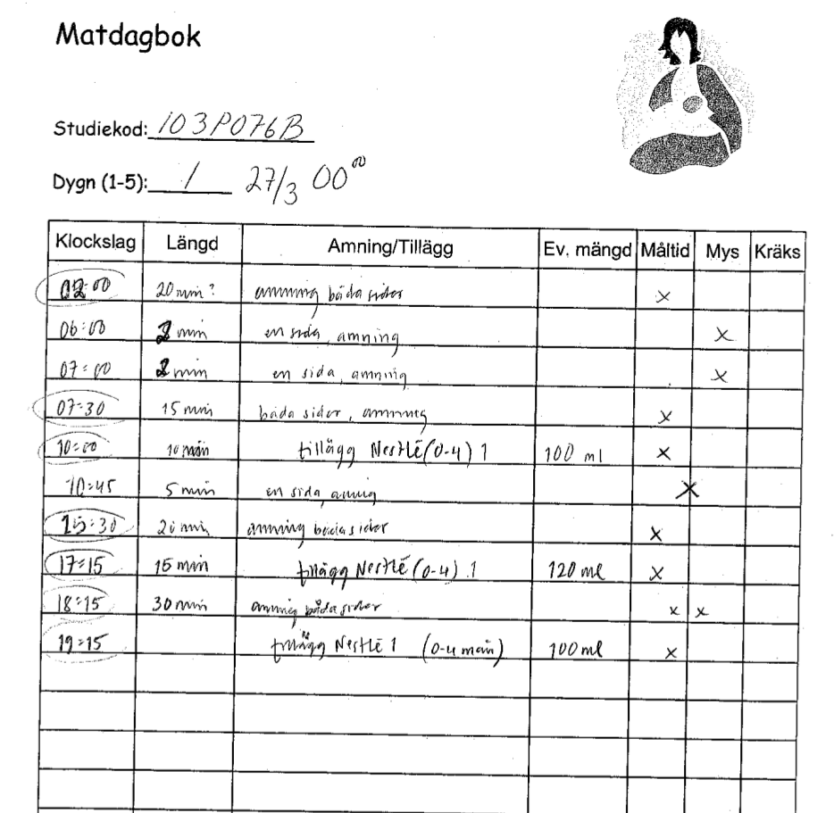
DIARIES AND VALIDATION
    During the free living experiment, the mothers were instructed to keep a diary consisting of
    printed forms:
    Diaries begins at midnight,
    second day.
    Data in the diaries needs to
    be digitized.

Slide 29
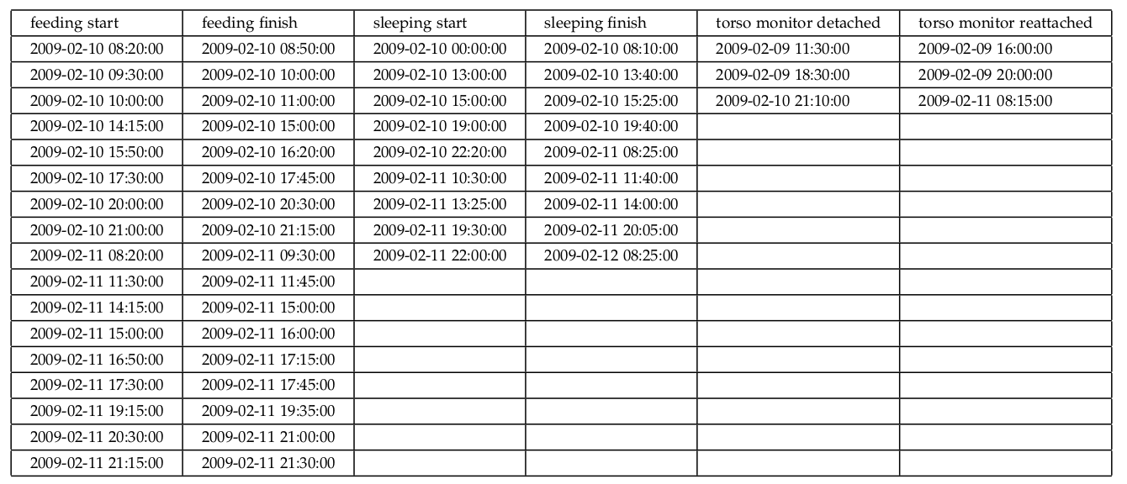
DIARIES AND VALIDATION
    Digitized data resulted as very approximate and prone to contain errors.
    Comparison and validation against such data is likely not be useful or invalid itself.

Slide 30
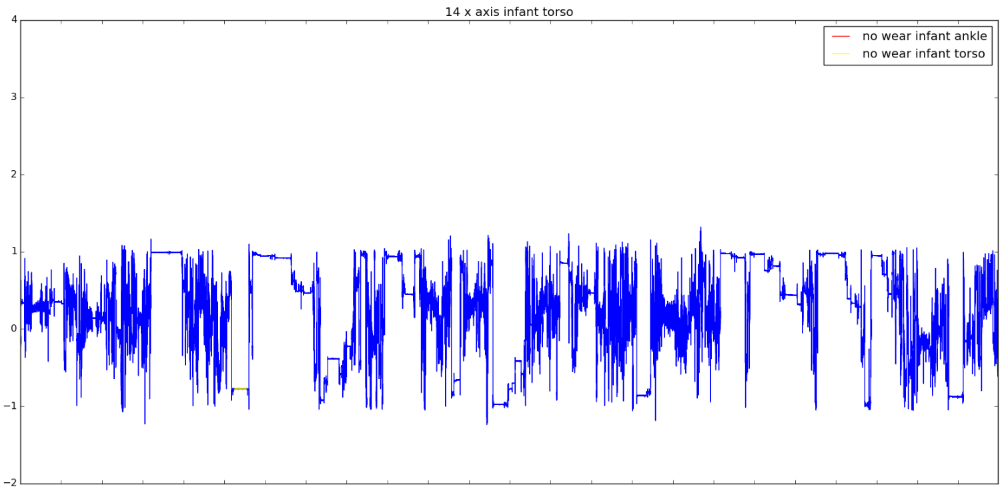
DIARIES AND VALIDATION
NON-WEAR TIME DETECTION
    Non-wear detection directly compared to the diary data.
    On average, exact times differed for an hour, while the plots showed non-wear time to be exact.
    A few blocks turned out to be false positive and false negatives, all being very short.

Slide 31
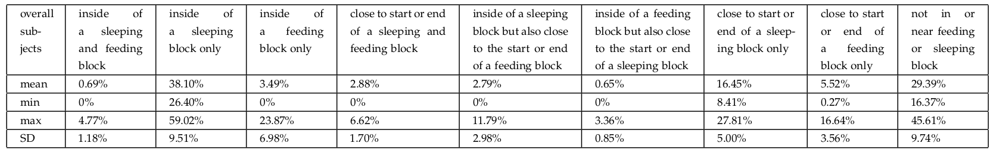
DIARIES AND VALIDATION
BEING MOVED DETECTION
    Due to the amount of error in the diaries and the frequency of sleeping and feeding, direct comparison turned to be uninformative.
    Proportions of time in different activities were extracted instead:

Slide 32
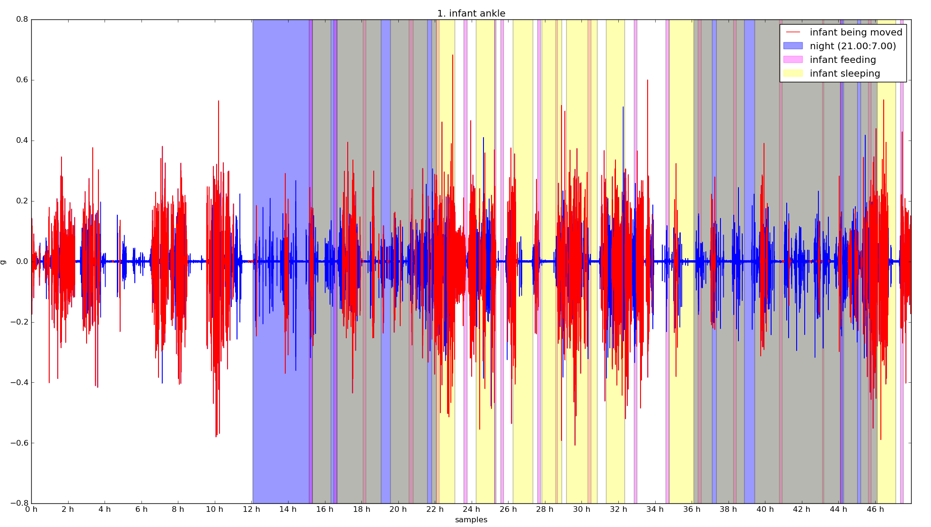
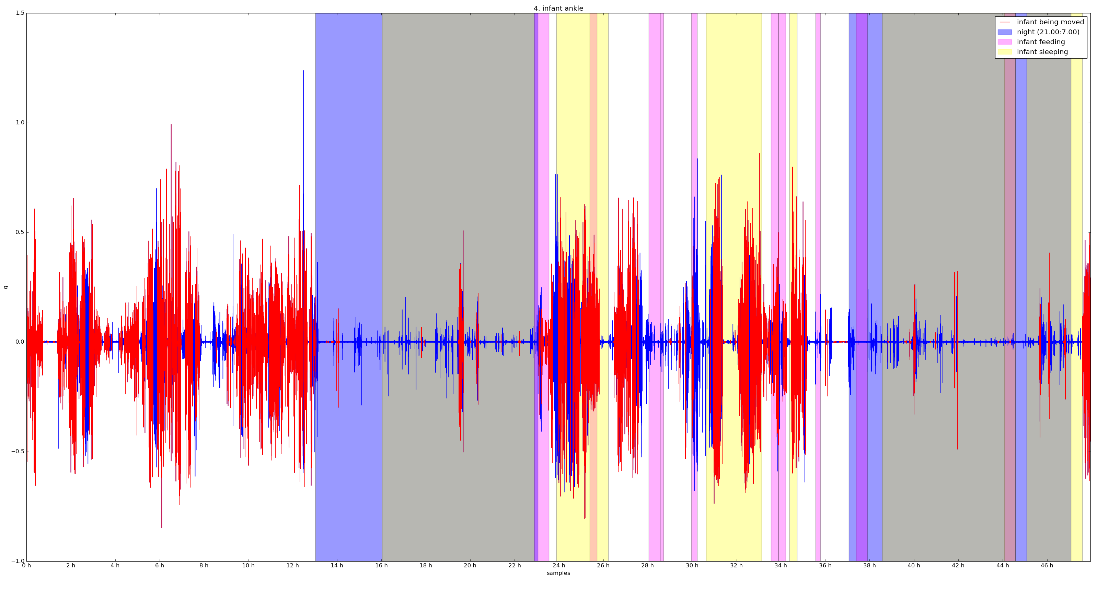
DIARIES AND VALIDATION
    Two examples of very different sleeping and feeding habits:

Slide 33
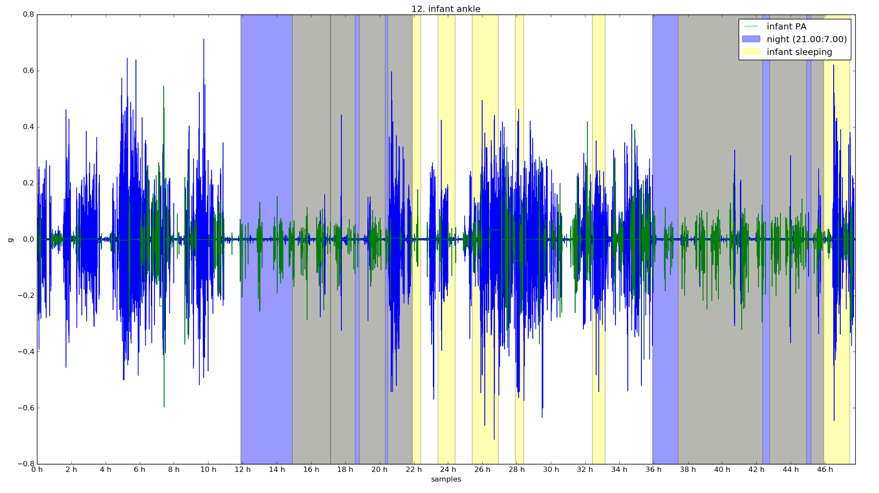
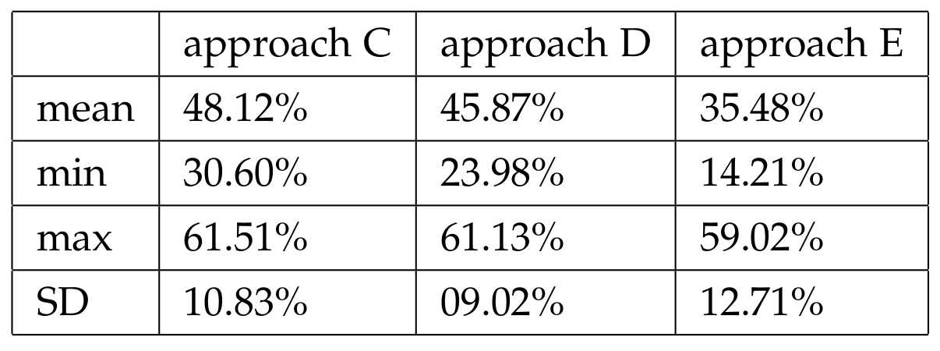
DIARIES AND VALIDATION
    Extracted PA compared against sleeping and awake blocks.
    Average proportion of PA occurring while infant awake was lower than
    expected.

Slide 34
CLOSURE
CONCLUSIONS
      Substantial difference between the torso and ankle placed measurements on a local scale → good enough summary has to be derived.
      Torso measurement is not necessary smaller then the ankle measurement → subtracting is inefficient and results in impaired further analysis.
      Correction based on signal similarities is a potentially good approach to correct contributing accelerations.

Slide 35
CLOSURE
CONCLUSIONS
      Removal of the periods where the infant might be moved can interfere with the extraction of PA.
      Variability in the data has to be considered and appropriate analysis of between and within variance applied.
      Appropriate and valid means of validation are necessary.

Slide 36
CLOSURE
DISCUSSION
      Summary derivation and variance seem to be related.
      Value of the between torso and ankle windowed correlation coefficient and its impact on the correction should be assessed.
      Is activity measured mainly during sleep an appropriate representation of infant overall activity levels?
      What is the true correlation of infant PA proportion with the proportion of infant being moved?

Slide 37
CLOSURE
POSSIBLE FUTURE WORK
      Derive several summaries and analyze variance.
      Preform clustering to separate periods where the infant is being moved from the rest.
      Use these different classes of periods to analyze the difference in the between torso and ankle correlation coefficient and its impact on the correction.

Slide 38
CLOSURE
POSSIBLE FUTURE WORK
      Maternal wrist acceleration data is still to be used.
      Tilt angle and baseline shifts can be analyzed in order to assess the detection of the infant being moved periods.
      Make everybody in the office carry a doll and analyze how well can the comparison between torso and ankle measurements result
      in zero PA.

