Slide 1
Diet score:
  What we tried
  Issues
  Final diet score
Environment score
Selecting persistently lean individuals with an obesogenic lifestyle

Slide 2
Data
All datasets consist of subjects who:
  have nationality data available and are Swedish
  have the visit variable(besok) available
  have sufficient diet data in the first place(looking at the variable exclude)
  have a plausible energy intake, based on their basal metabolic rate(looking at the variable FIL)
  have values of basic variables like height, weight, waist, etc. inside the recommended limit values
  have all the basic data and the macro and micro nutrient, PA and alcohol data available.
Two datasets were constructed, an independent dataset and a dataset containing subjects with two visits [9,11] years apart.
Out of 111505 subjects total, independent dataset has 44735 subjects, dataset with two visits has 30380 subjects.

Slide 3
Diet score
We had tried:
  constructing diet score using categorized macro and micro nutrients, based on the guidelines stated at Nordic Nutrition Recommendations, multiplied with the appropriate effect size on bmi and summed up,
  constructing diet score using combined food items based on the healthy diet score used in publications, multiplied with the appropriate effect size on bmi and summed up,
  constructing diet score using continuous macro and micro nutrient, multiplied with the appropriate effect size on bmi and summed up

Slide 4
Diet score
Issues:
  Recommendations and published diet scores do not completely fit our needs to construct an obesogenic diet score,
  Recommendations did not cover all the macro or micro nutrients,
  Recommendations, published diet scores and diet models are simple and general, not considering food synergy or antagonism and not considering nutrient effect by food source,
  Categorization of continuous variables resulted in loss of information.
  Observed unexpected directions of association with bmi,
  Many model selection and effect size estimation methods,
  Even the best model did not have very good results(low R² and AUC).

Slide 5
Diet score
Results for categorized BMI (0=Normal or underweight, 1=overweight, 2=obese):
Visit 1 | Diet effect size |  | Diet p-value | AUC | R² | AIC
Basic model | - | - | - | 0.6206 | 0.0286 | 54,872
Separate effects | 0.273 (1) | 0.556 (2) | <2e-16 | 0.6354 | 0.0365 | 54,431
Shrunken joint effects(best α = 0.2) | 1.807 (1) | 3.675 (2) | <2e-16 | 0.6471 | 0.0439 | 54,009
Joint effects | 1.263 (1) | 2.530 (2) | <2e-16 | 0.6488 | 0.0449 | 53,955
Visit 2 | Diet effect size |  | Diet p-value | AUC | R² | AIC
Basic model | - | - | - | 0.6040 | 0.0197 | 61,884
Separate effects | 0.350 (1) | 0.783 (2) | <2e-16 | 0.6259 | 0.0294 | 61,279
Shrunken joint effects(best α = 0.2) | 1.651 (1) | 3.671 (2) | <2e-16 | 0.6394 | 0.0376 | 60,757
Joint effects | 1.358 (1) | 3.005 (2) | <2e-16 | 0.6417 | 0.0392 | 60,656

Slide 6
Diet score
Final diet score was constructed using the unshrunken effect sizes where all the macro and micro nutrients were fitted together to model the residuals from modeling BMI with basic covariates.
Significant macro nutrients and TEI:
 | effect size | p-value | vif
Polyunsaturated fat | 0.172 | 2.868733e-06 | 33.072674
Saturated fat | -0.225 | 7.580582e-06 | 44.209620
Sucrose | -0.098 | 1.122240e-09 | 8.593770
Carbohydrates | -0.102 | 2.062294e-03 | 14.823591
Essential fatty acids | -0.195 | 5.187166e-10 | 25.861051
Animal proteins | 0.213 | 8.985754e-16 | 15.442719
Fiber | 0.080 | 2.030805e-05 | 10.879772
Disaccharides | 0.170 | 1.569436e-15 | 12.106861
Trans fat | -0.032 | 1.116558e-04 | 2.307944
Salt (sodium) | 0.203 | 5.061785e-35 | 3.603837
Total energy intake | 0.013 | 4.211870e-03 | 1.000033

Slide 7
Environment score
Similar was done for diet score, PA and alcohol consumption, obtaining effect sizes and using them to multiply corresponding variable and then summing all up:
*we tried to investigate confounding factors influencing the effect of alcohol on bmi, focusing on the socio-economic status, represented by the variable for education, but were not able to confirm confounding.
 | effect size | p-value | Variable summary
Diet score | 0.876992 | <2e-16 | [ -1.719 , 1.383 ]
PA | -0.081397 | <2e-16 | [ 1, 2, 3, 4, 5]
alcohol | -0.041880* | <2e-16 | [ -3.496 , 1.093 ]

Slide 8
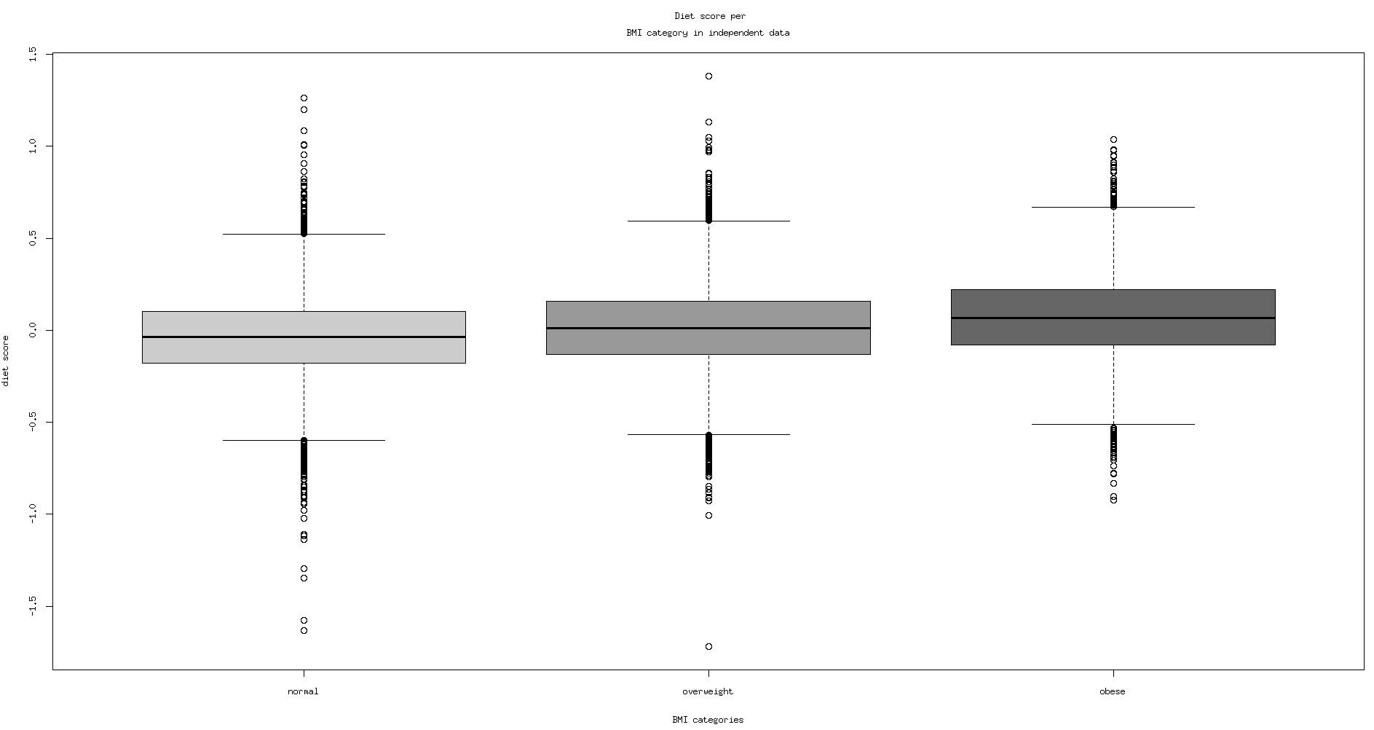

Slide 9
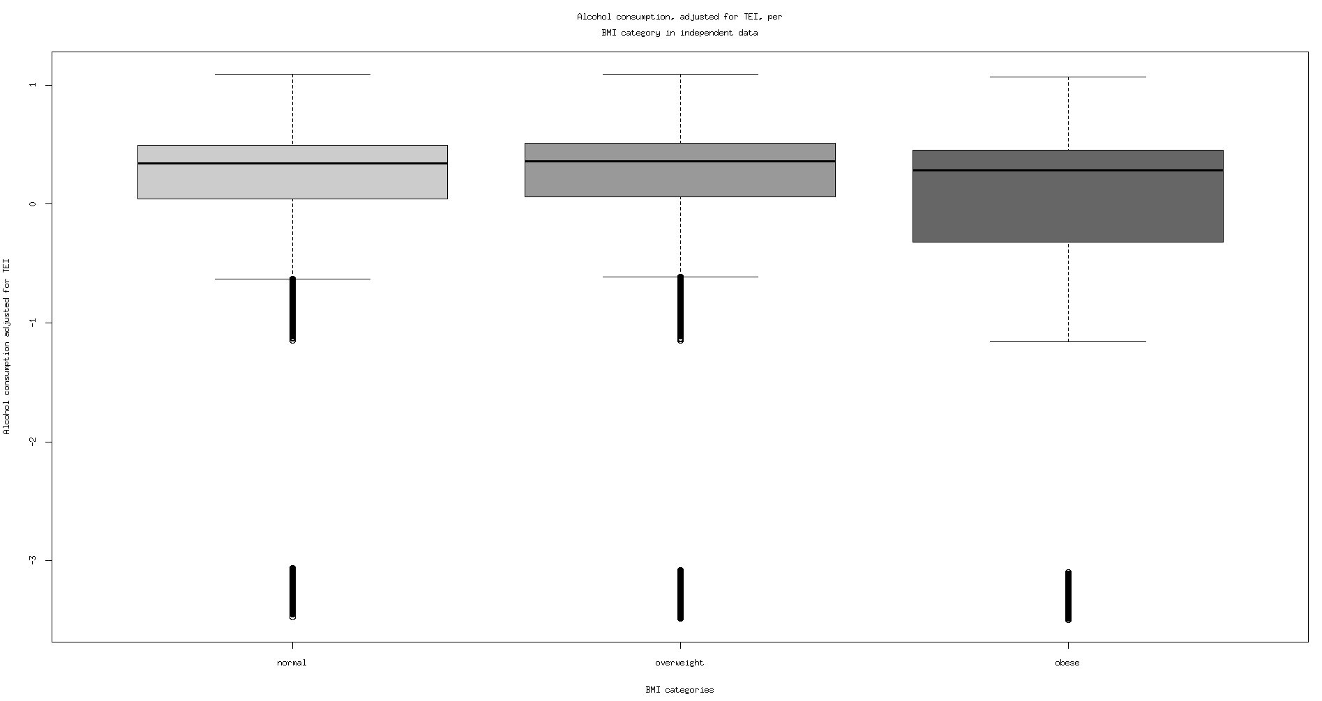

Slide 10
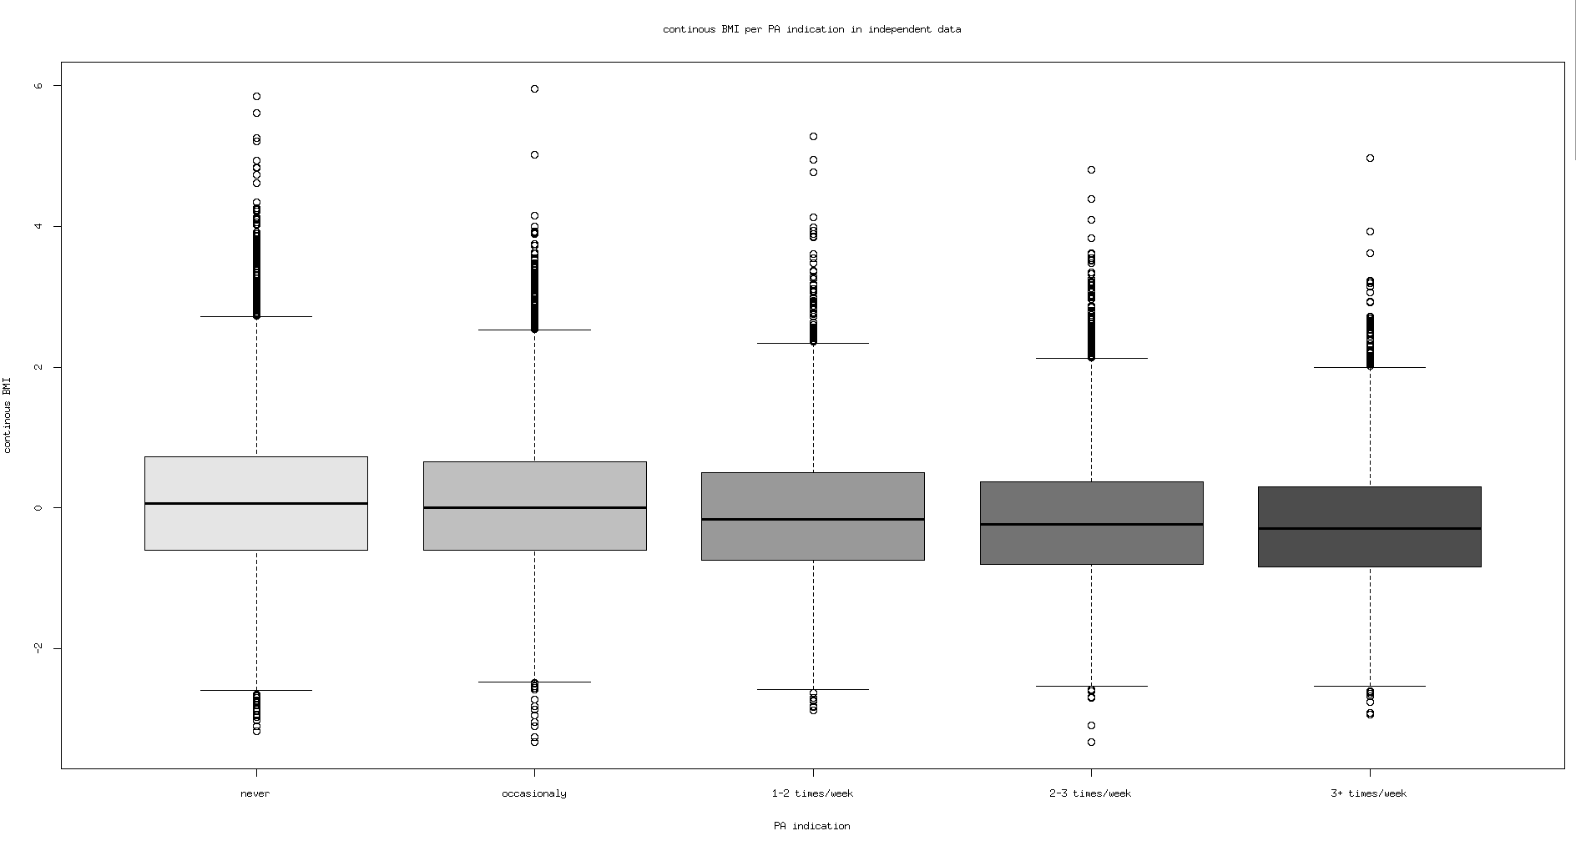

Slide 11
Environment score
Results for the model:
 | continous
 | R² | Environment effect size | p-value
Visit 1 | 0.04057 | 0.866377 | <2e-16
Visit 2 | 0.05668 | 1.002757 | <2e-16
 | discrete
 | R² | Environment effect size |  | p-value | AUC
Visit 1 | 0.0496214 | 1.369 (1) | 2.893 (2) | <2e-16 | 0.655383
Visit 2 | 0.0450873 | 1.248 (1) | 2.976 (2) | <2e-16 | 0.6491333

Slide 12
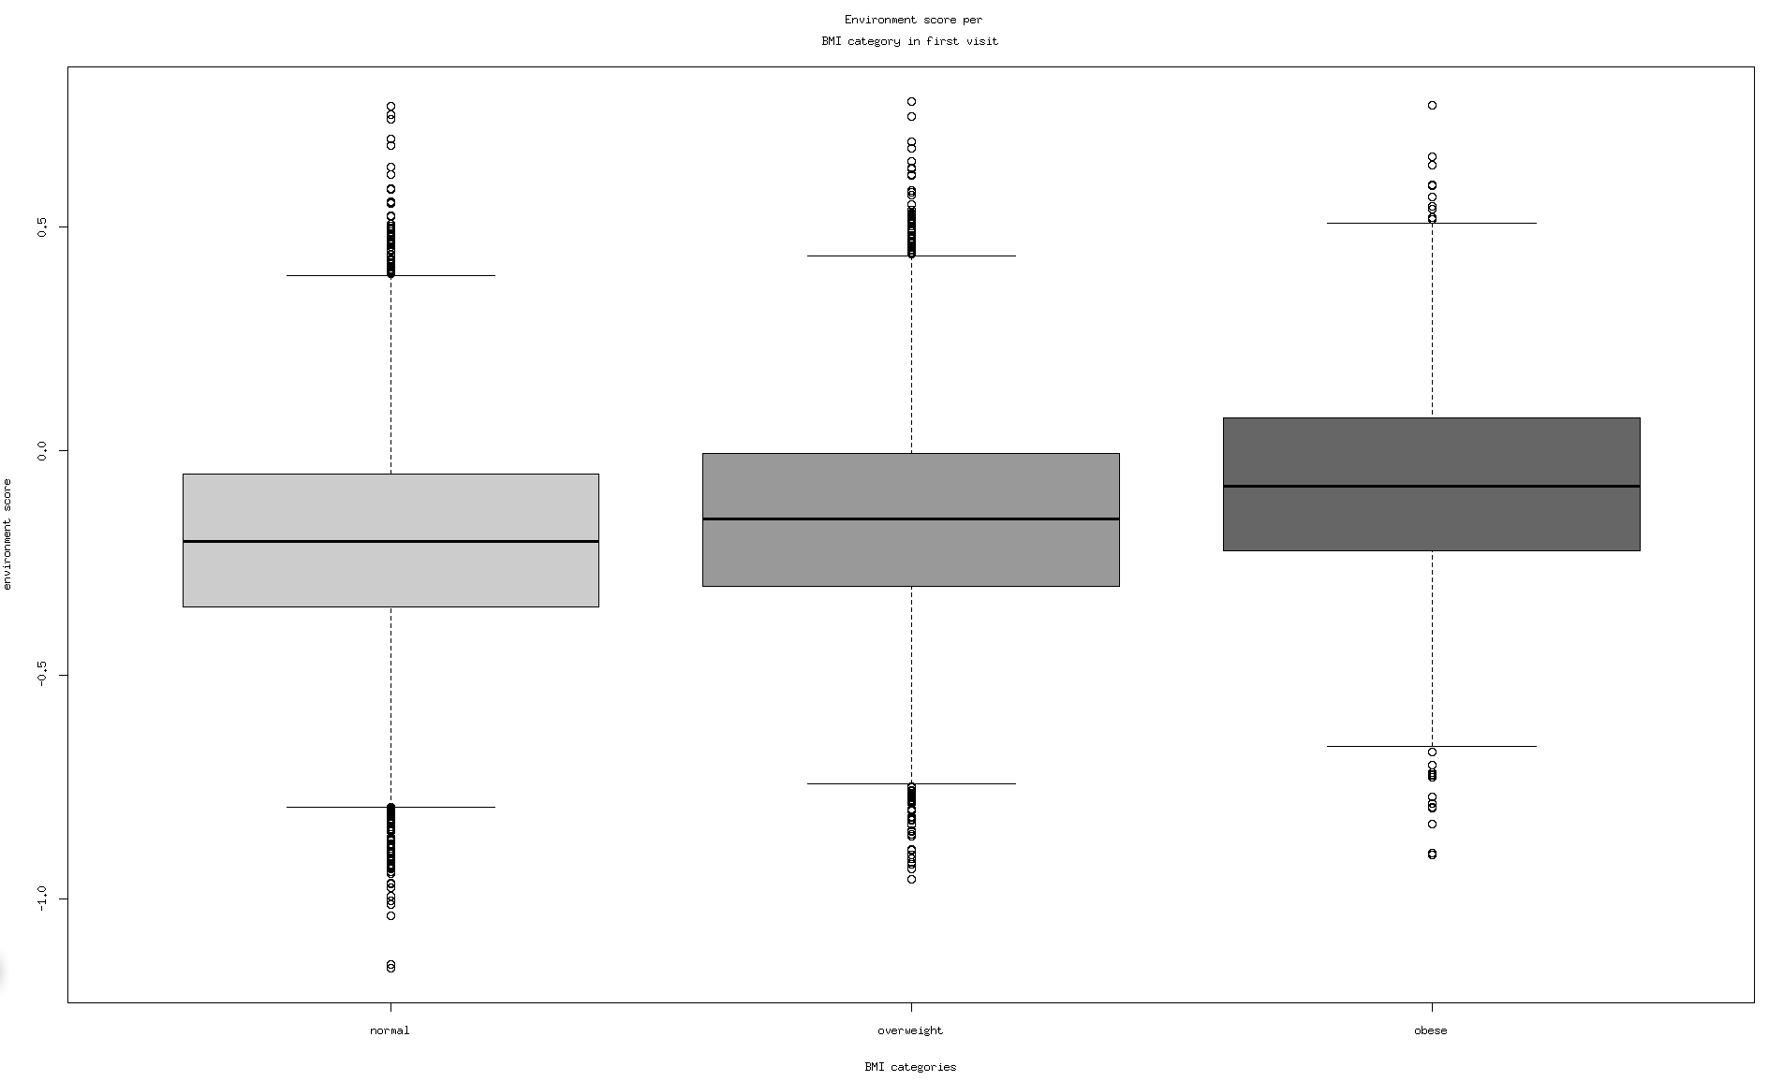

Slide 13

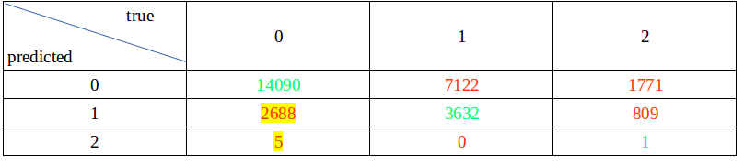
Selecting subjects of interest
Based on the environment score and bmi in both visits, we have to select subjects that are persistently lean/normal weight, despite having an obesogenic environment score.
We had considered:
  Setting a cut-off point in the environment score and defining all values above as obesogenic and select lean/normal weight subjects with the environment score above that value,
  Obtain the ratio
  and set a cut-off point somewhere below one, to select those subjects whose environment z-score is substantially larger than their bmi z-score,
  Selecting those lean/normal weight subjects that are persistently misclassified as overweight or obese.

