Slide 1
        Looking at the data from the control groups:
            Action sequence length
            Bout frequency and bout length per action sequence
            Turn proportion
            Simple motifs

Slide 2
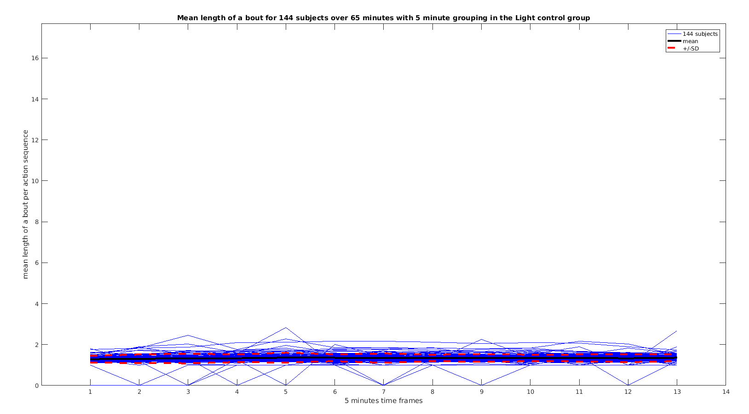
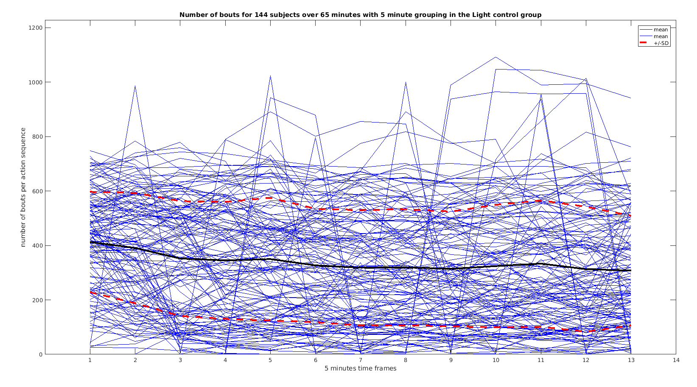
          Action sequence length per 5 minute time frame is influenced by the bout lengths and frequency.
          These characteristics have already been explored:
              Light will have constant mean bout length, SD of bout length and bout frequency:

Slide 3
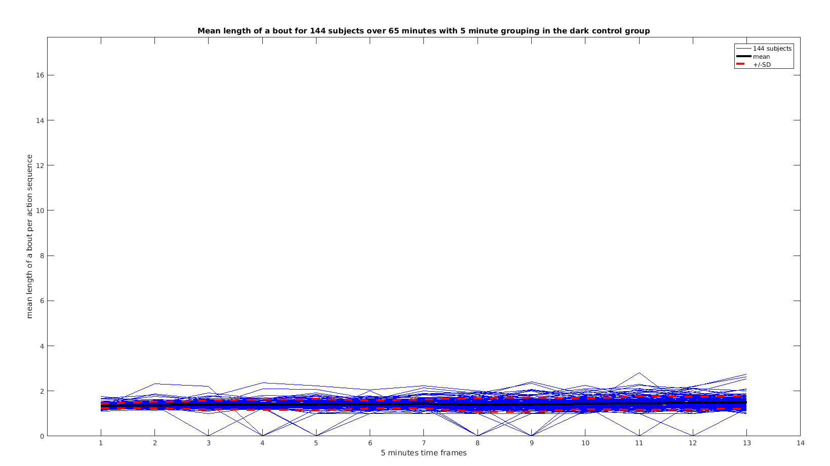
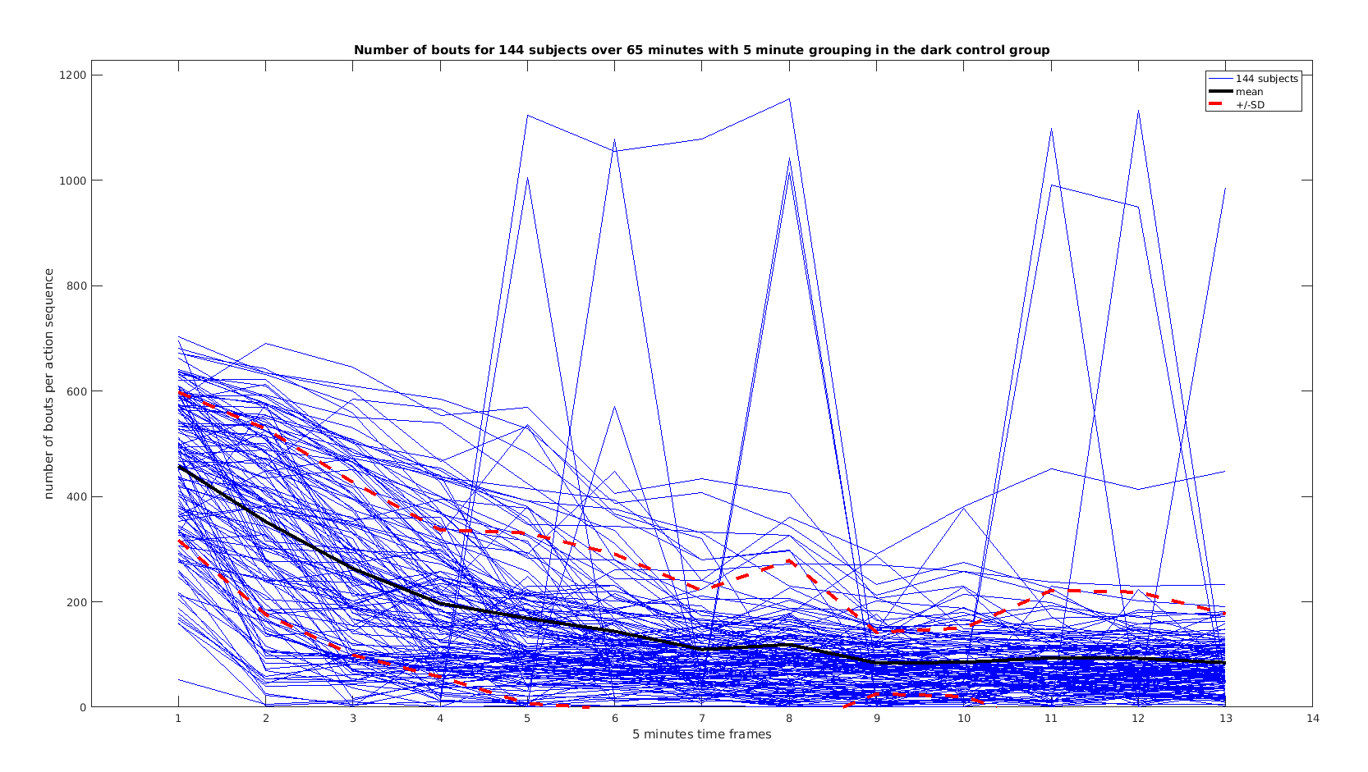
              In Dark the number of bouts will decrease, while the mean length of bout will stay the same, but the variation between the subjects increases slightly in the last time frames:

Slide 4
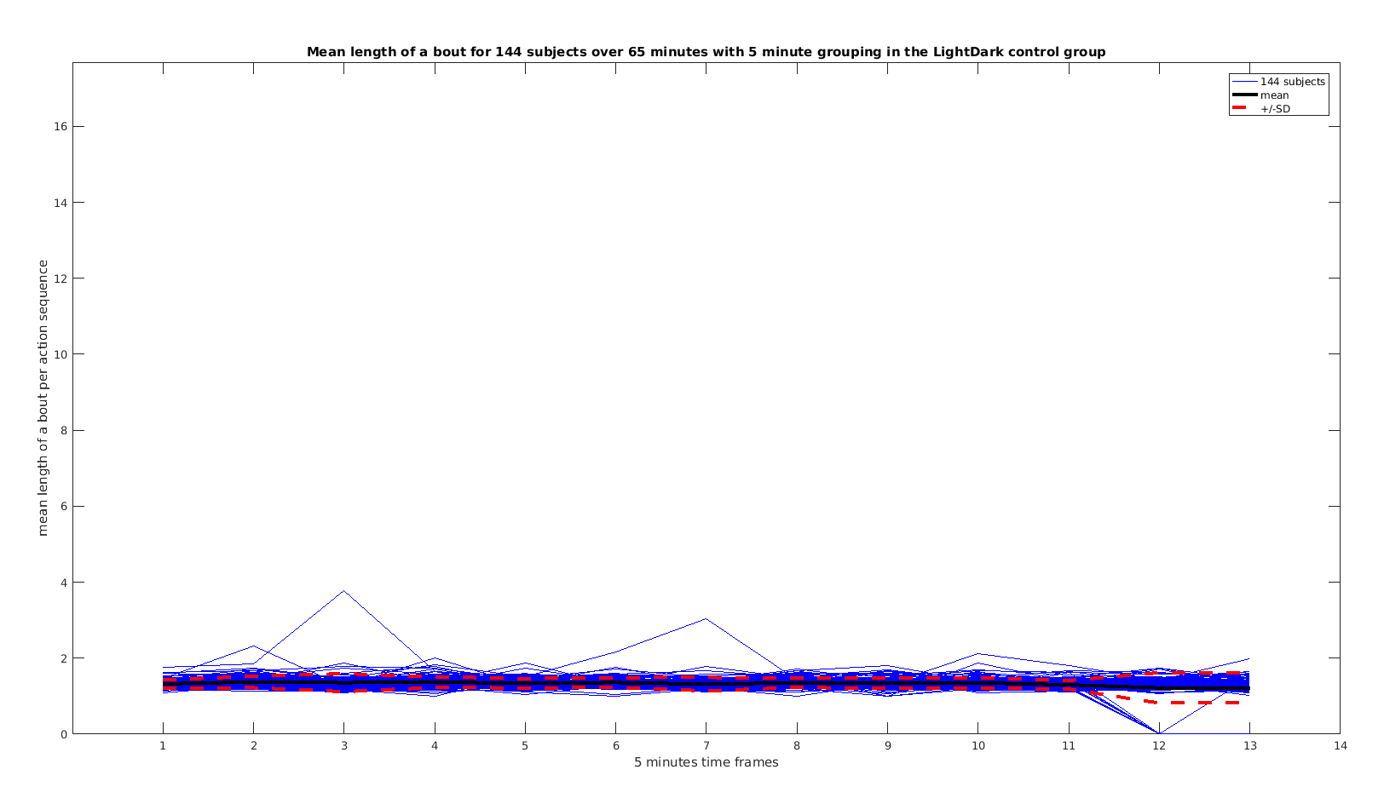
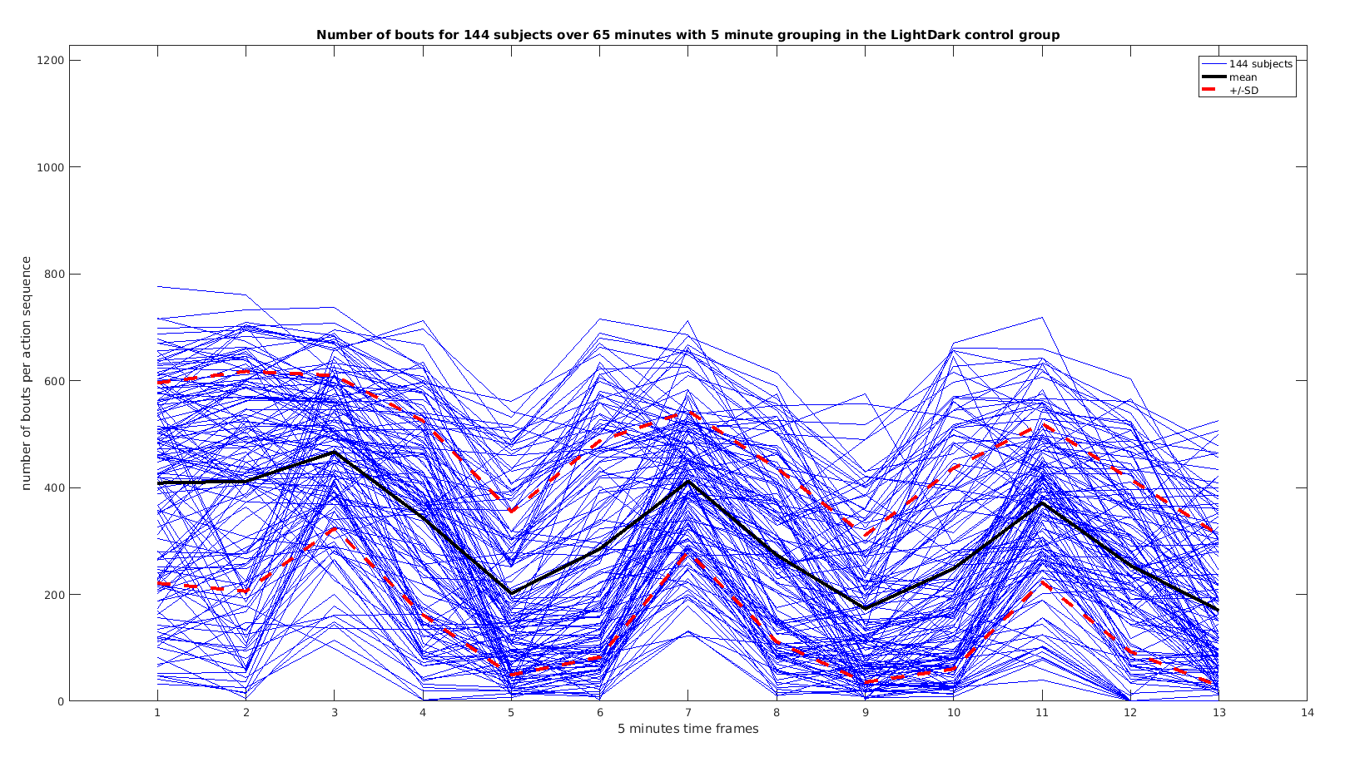
              LightDark shows the alternations in the number of bouts, while mean length of bout and SD stay the same:

Slide 5
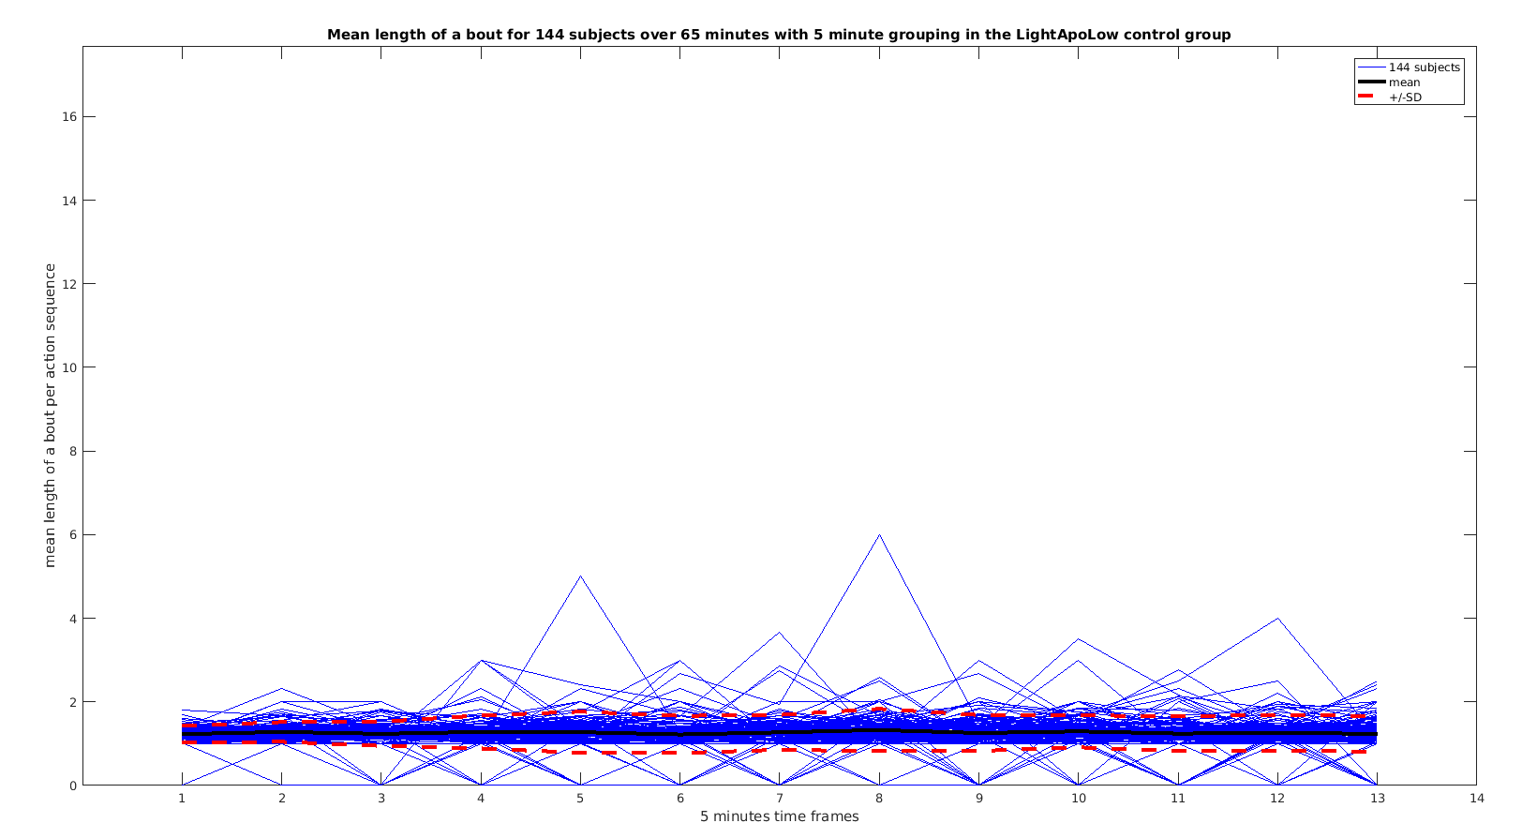
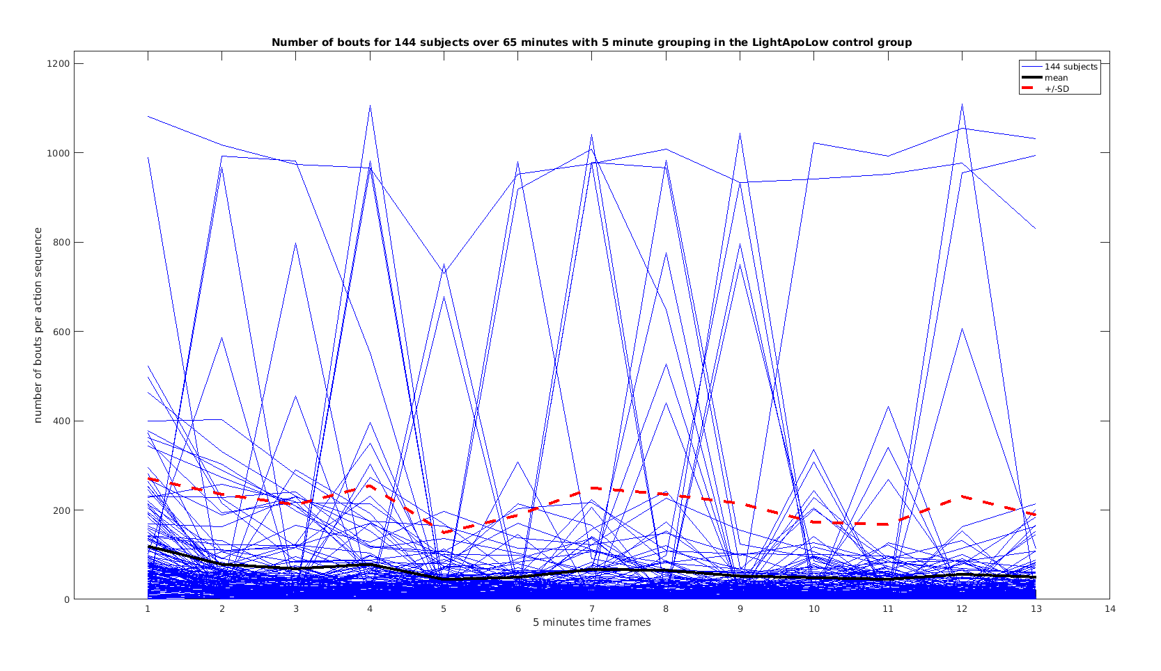
              (Dark)ApoLow will have immediately decreased number of bouts, that stay low all through the experiment. Mean length of bout seems to be the same with slightly increased SD between the subjects:

Slide 6
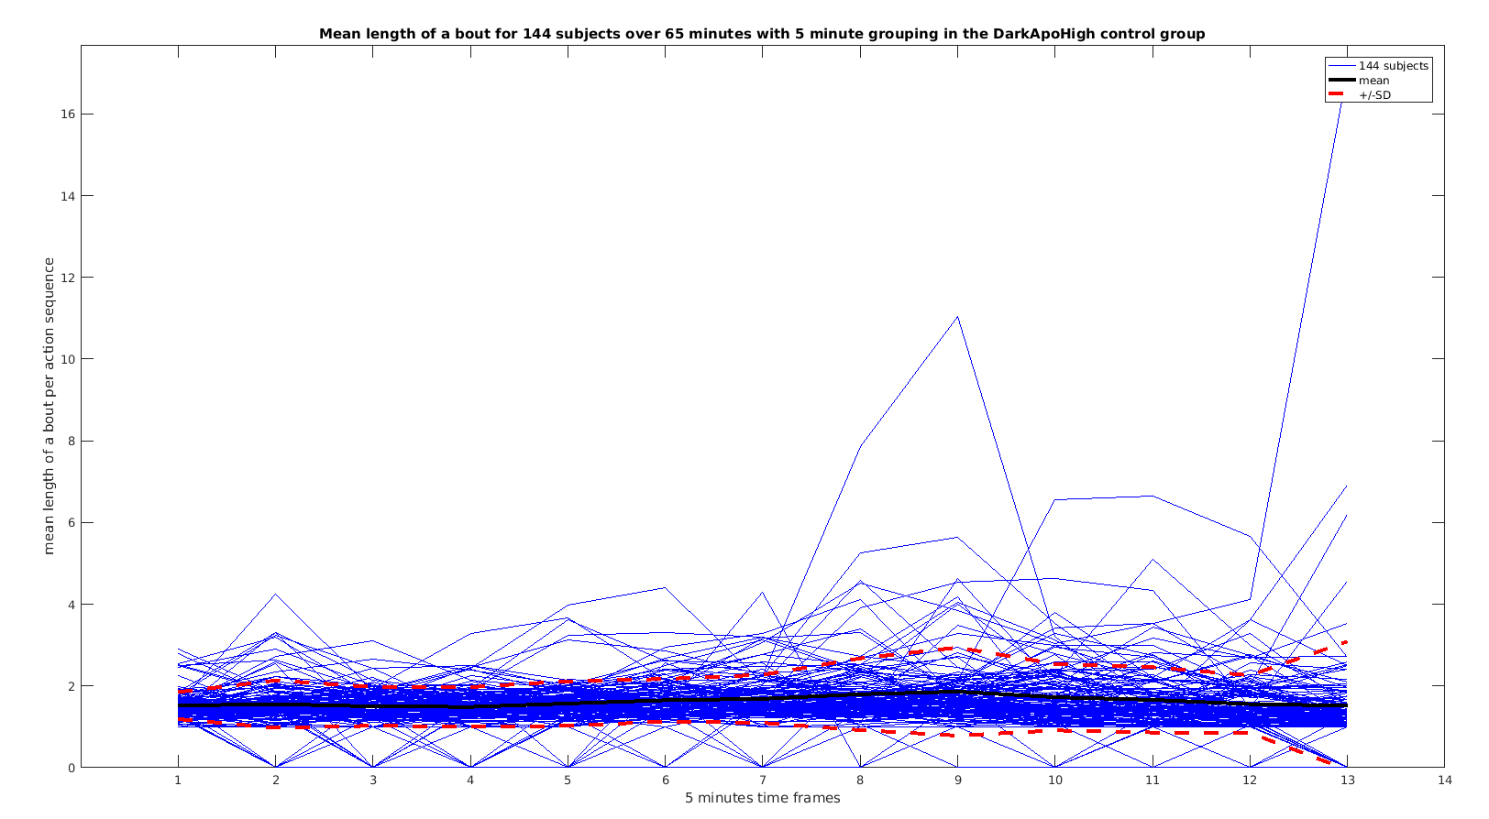
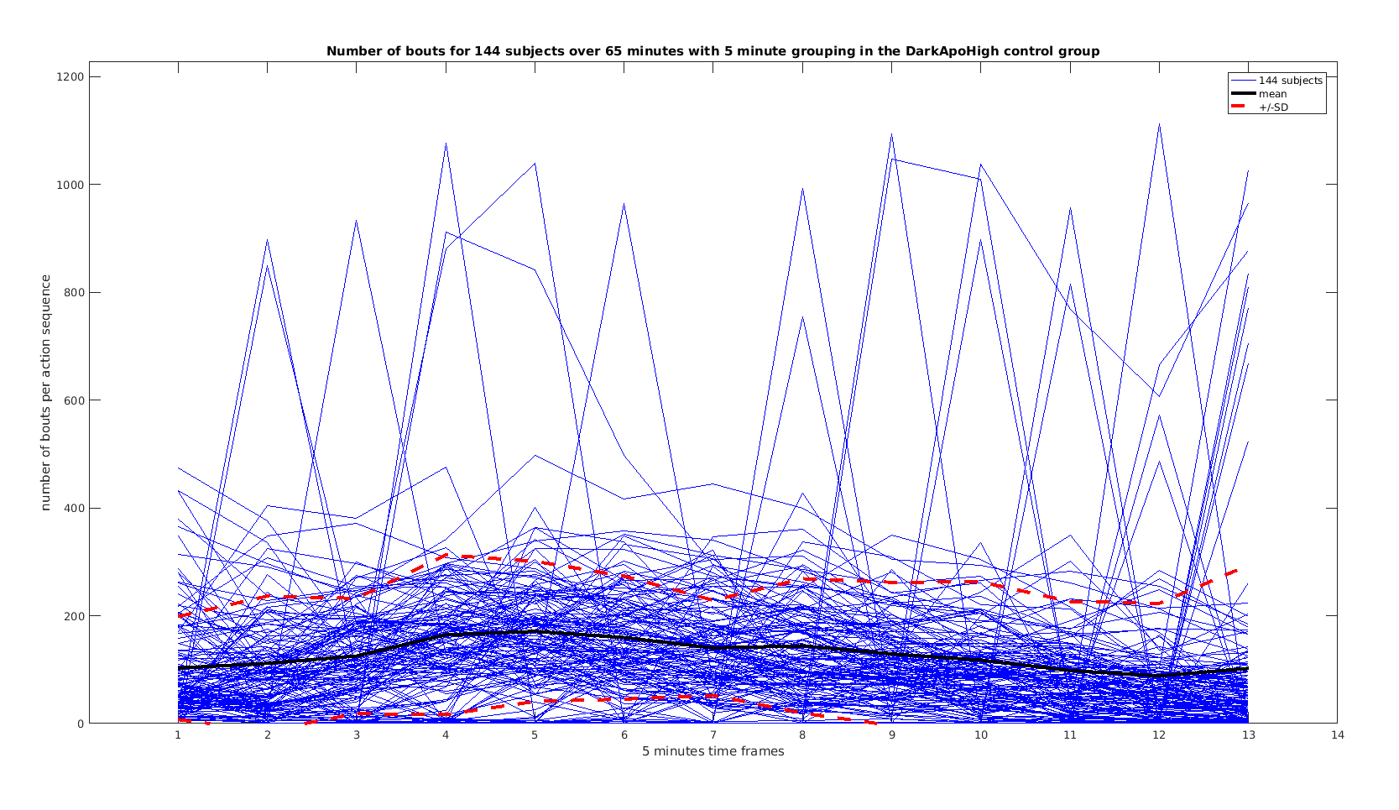
              (Dark)ApoHigh has an overall decreased number of bouts, which show the U shape response. Mean length of bout has increased variation between the subjects:

Slide 7
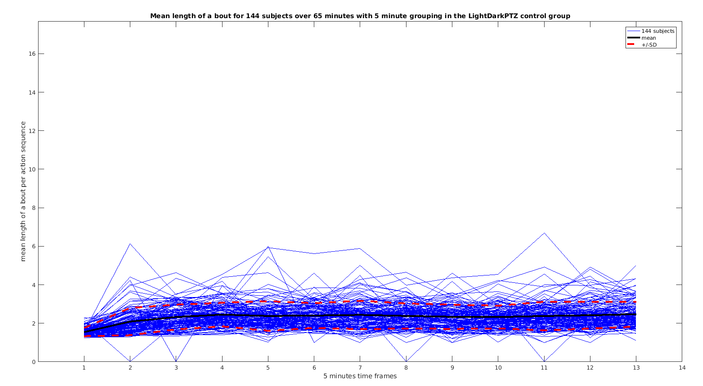
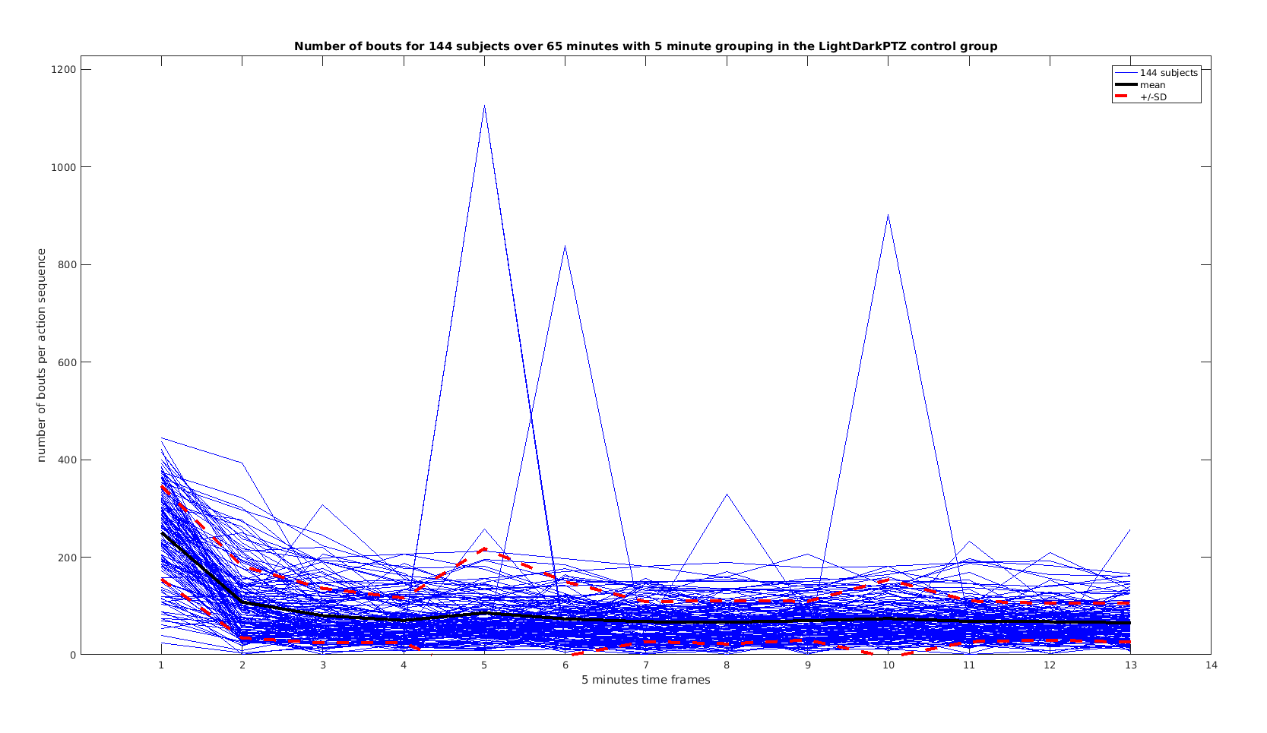
              In (Dark)PTZ the number of bouts decreases substantialy. Mean length of bout increases and so does the variation between the subjects:

Slide 8
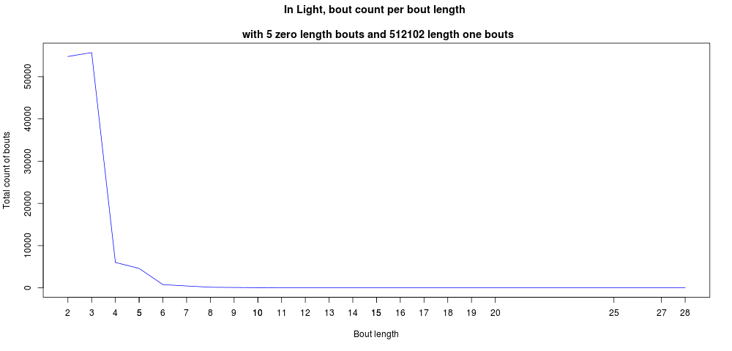
              With averaging over the action sequence a lot of information is lost, since the SD of bout length is always relatively high.
              The number of short or long bouts differs between the controls:
                Light:

Slide 9
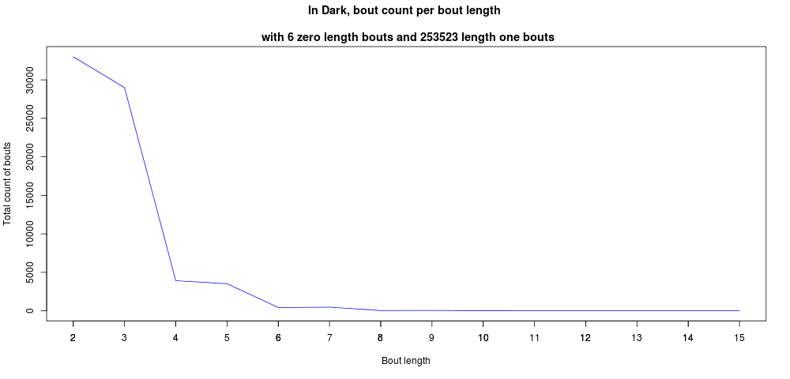
                Dark:

Slide 10
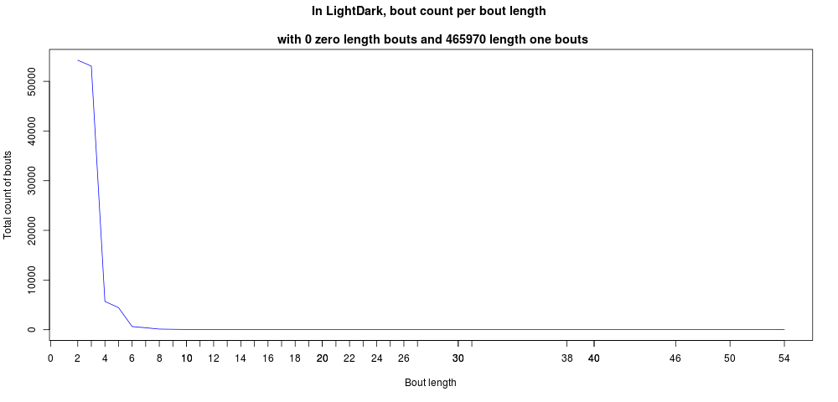
                LightDark:

Slide 11
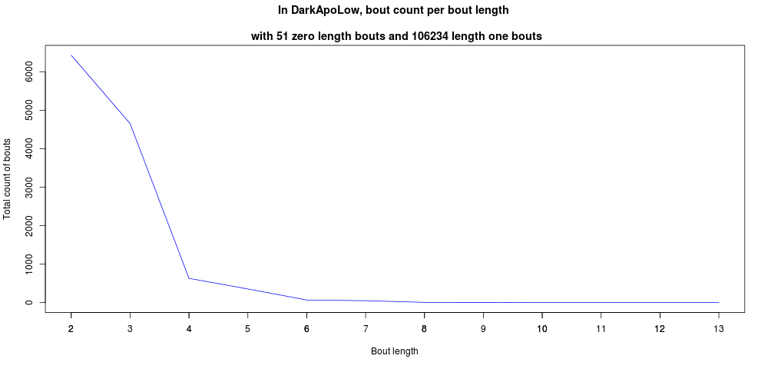
                (Dark)ApoLow:

Slide 12
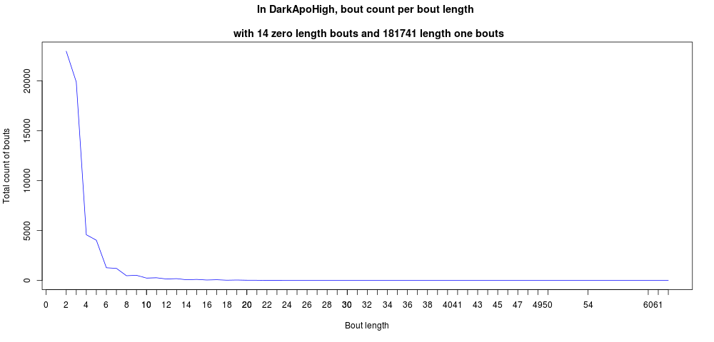
                (Dark)ApoHigh:

Slide 13
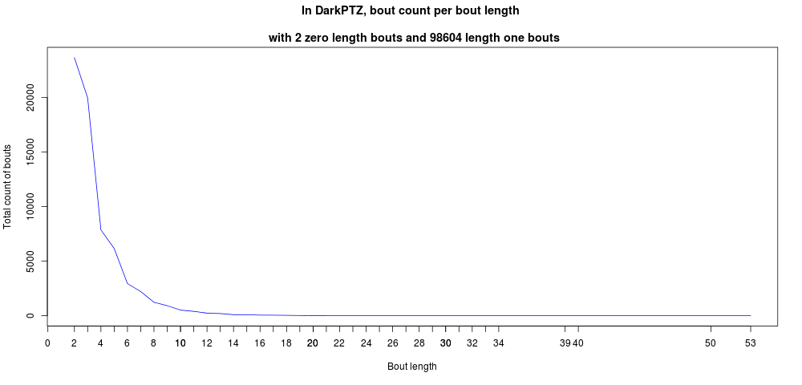
                (Dark)PTZ:

Slide 14
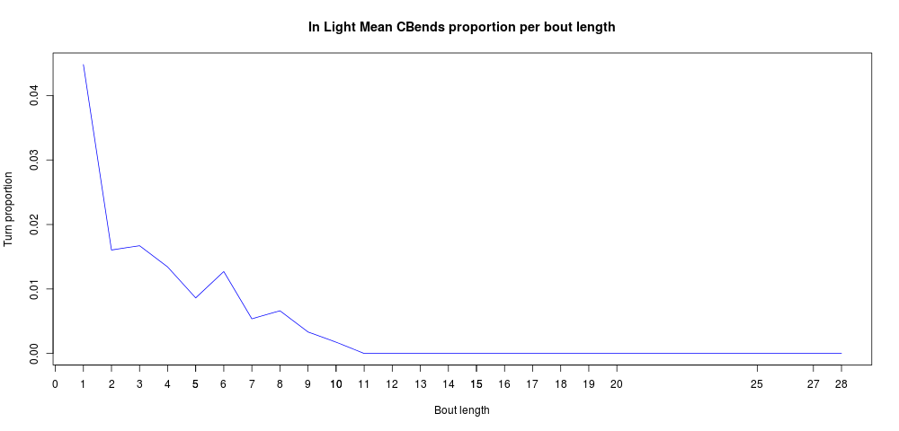
                Turn proportion per action sequence is influenced by bout length and frequency.
                Light:

Slide 15
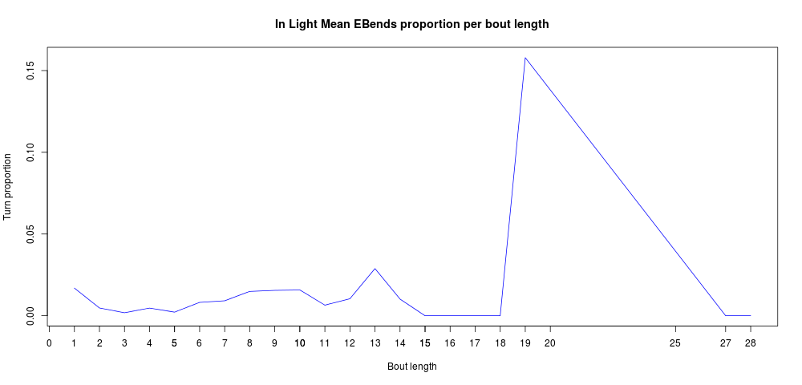
                Light:

Slide 16
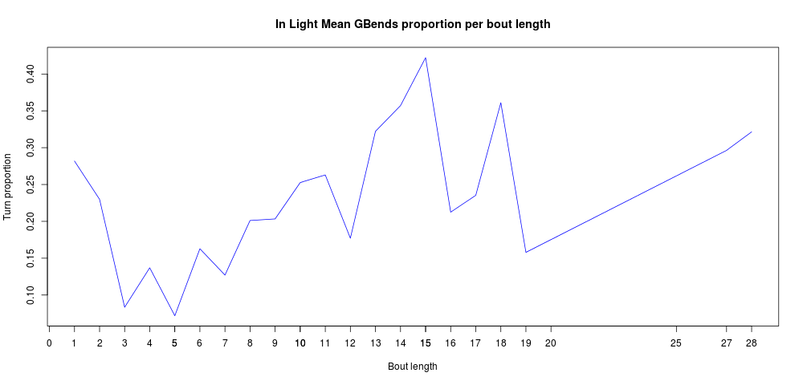
                Light:

Slide 17
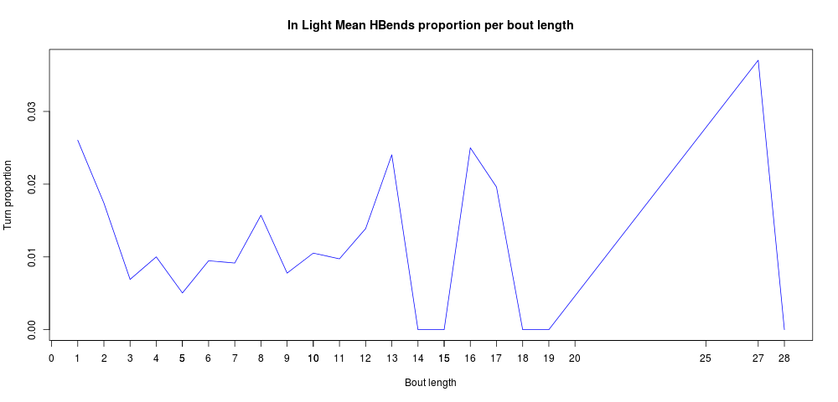
                Light:

Slide 18
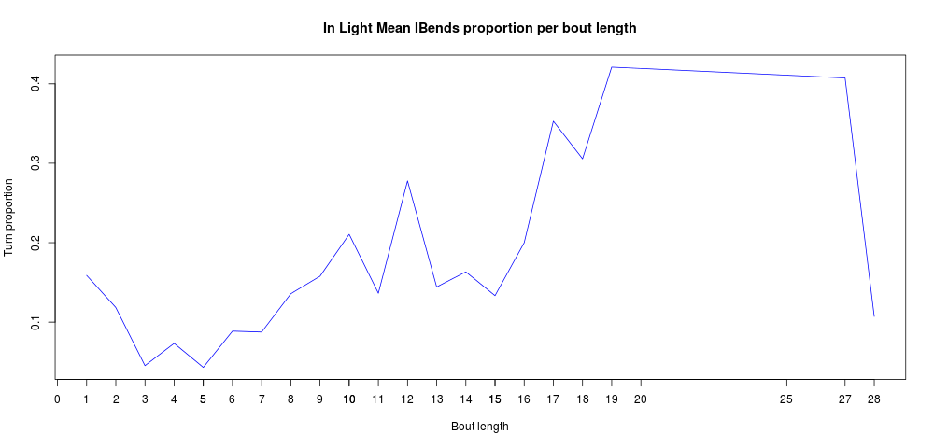
                Light:

Slide 19
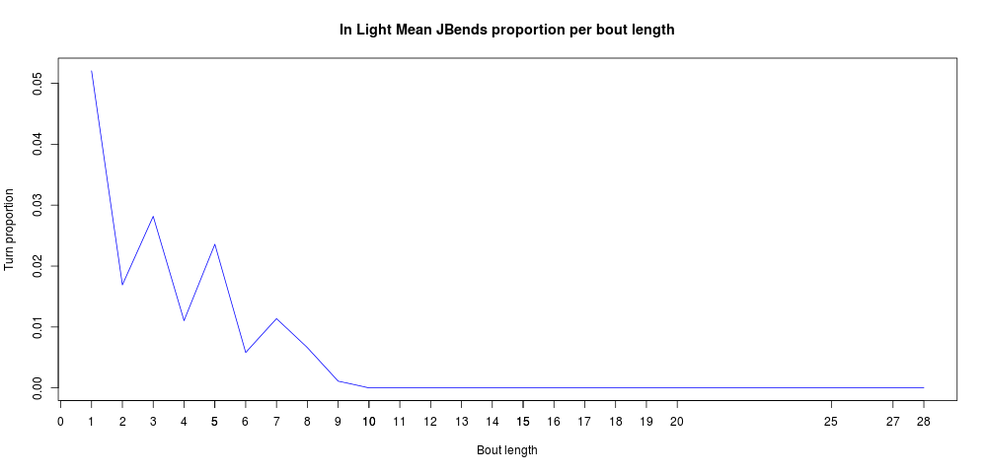
                Light:

Slide 20
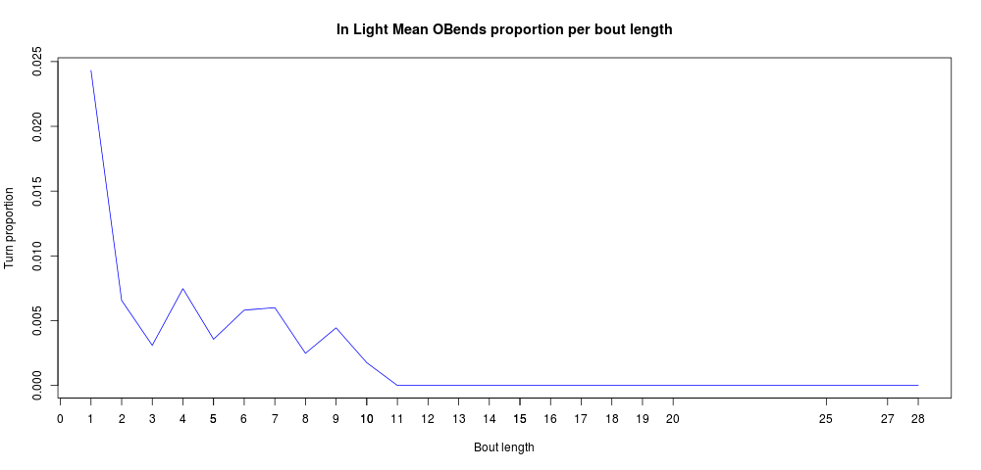
                Light:

Slide 21
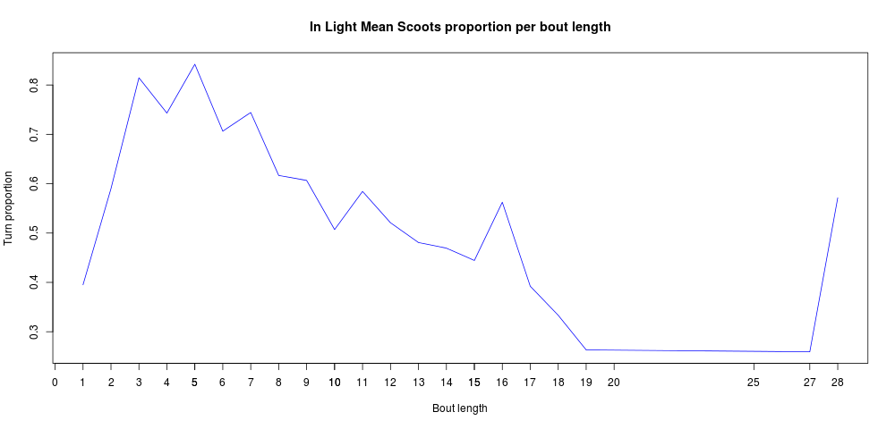
                Light:

Slide 22
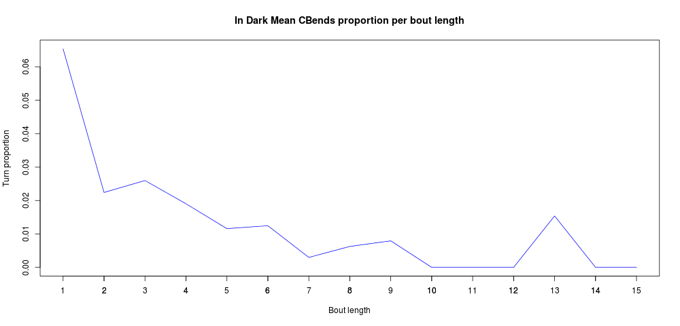
                Dark:

Slide 23
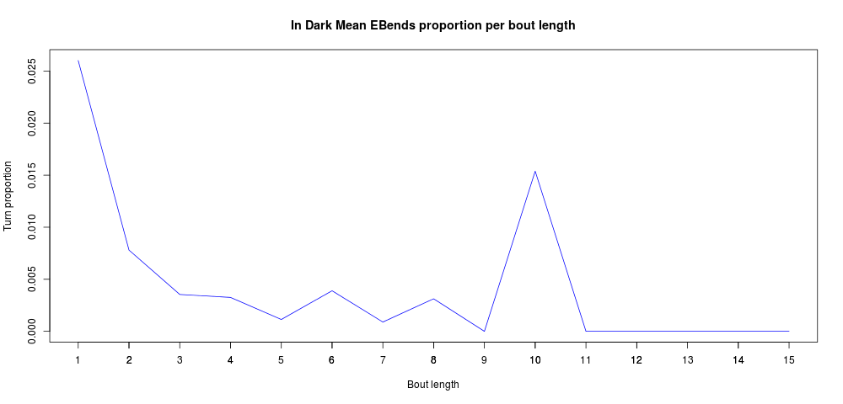
                Dark:

Slide 24
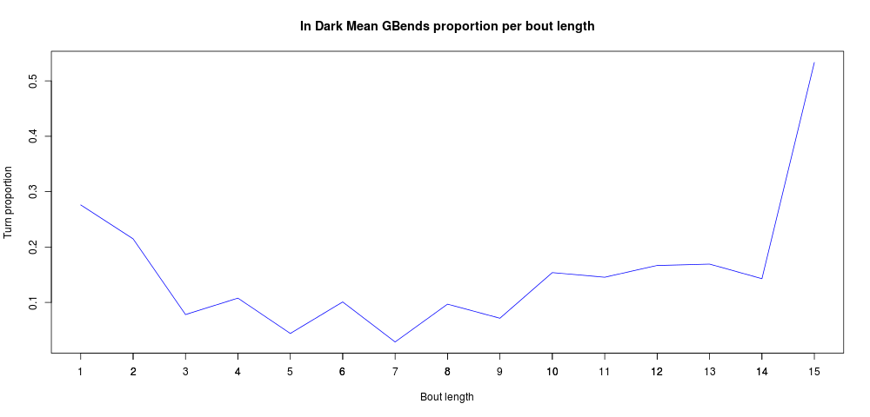
                Dark:

Slide 25
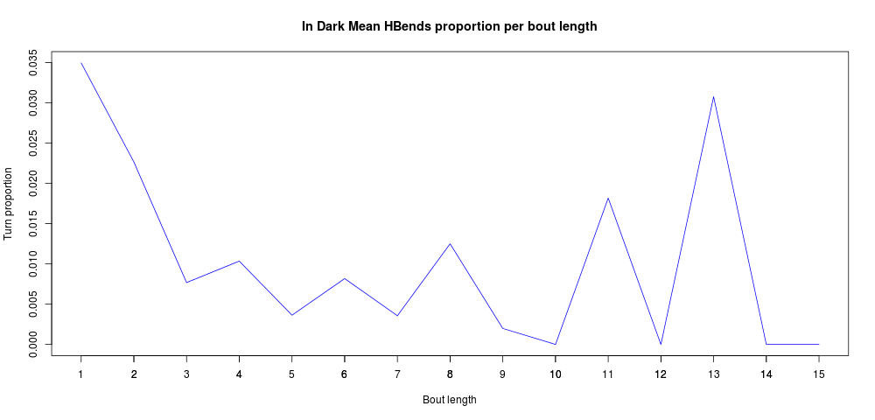
                Dark:

Slide 26
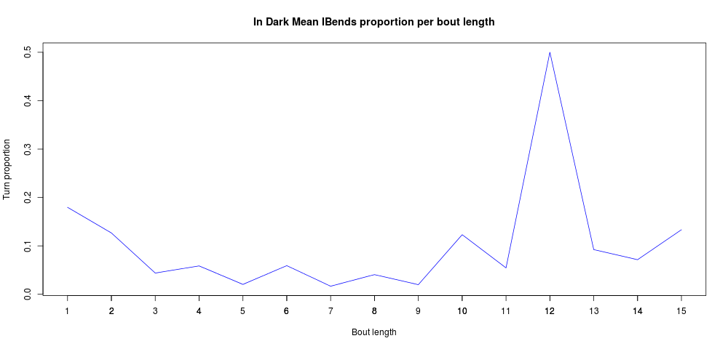
                Dark:

Slide 27
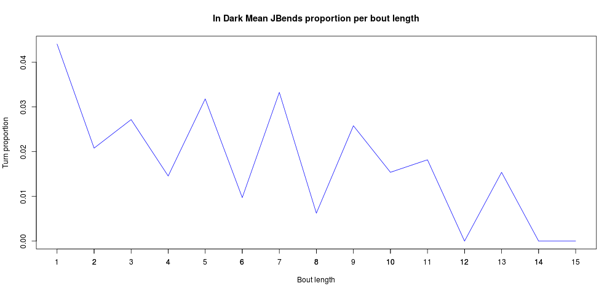
                Dark:

Slide 28
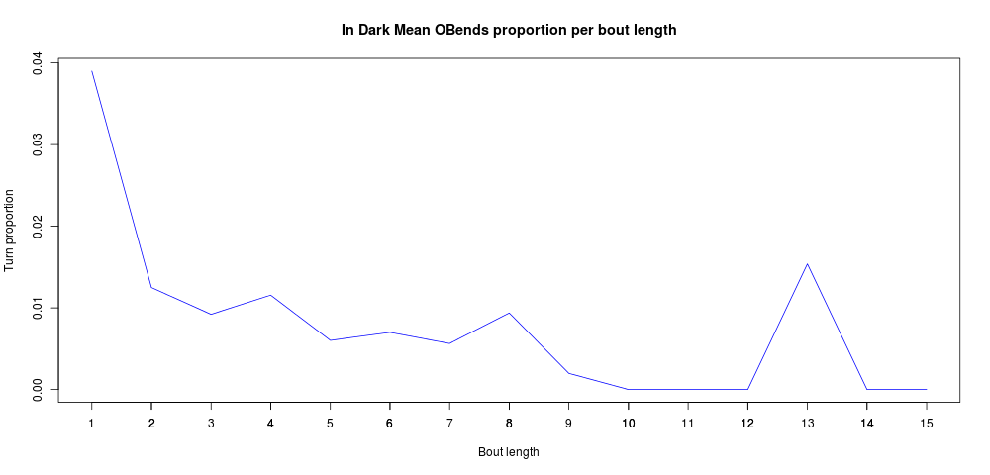
                Dark:

Slide 29
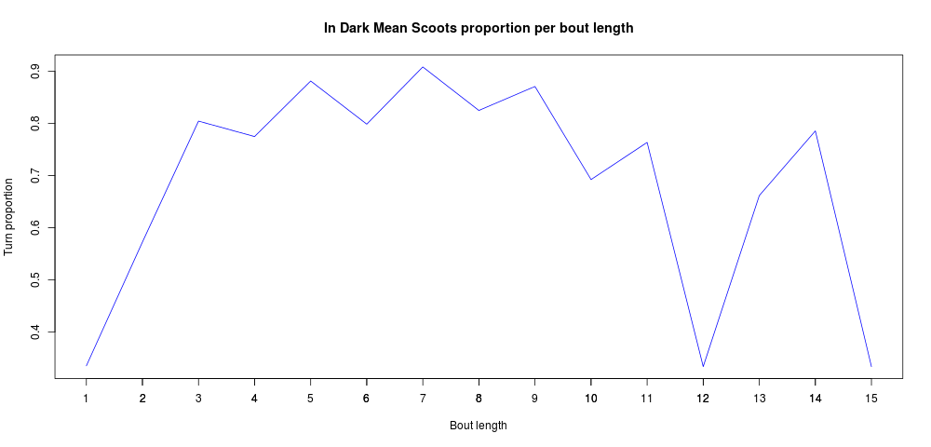
                Dark:

Slide 30
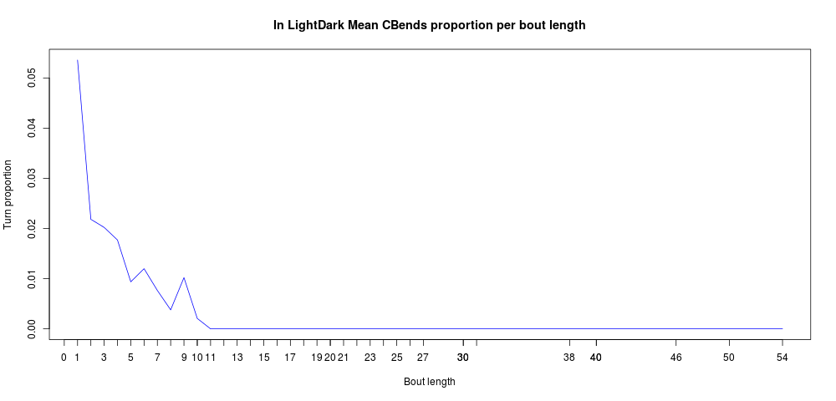
                LightDark:

Slide 31
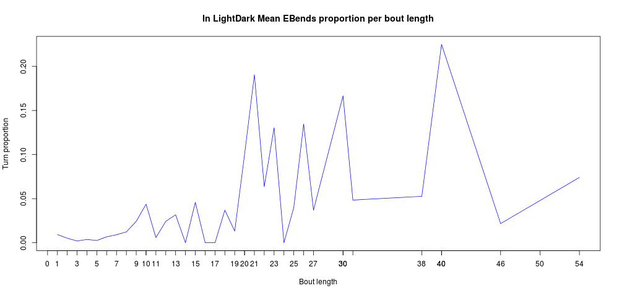
                LightDark:

Slide 32
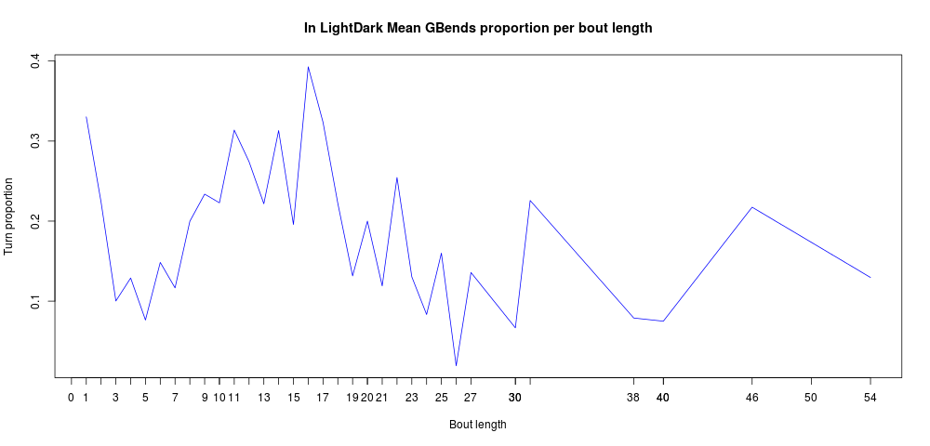
                LightDark:

Slide 33
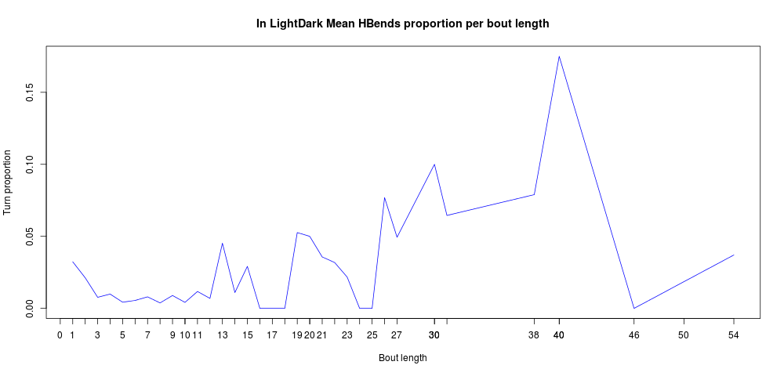
                LightDark:

Slide 34
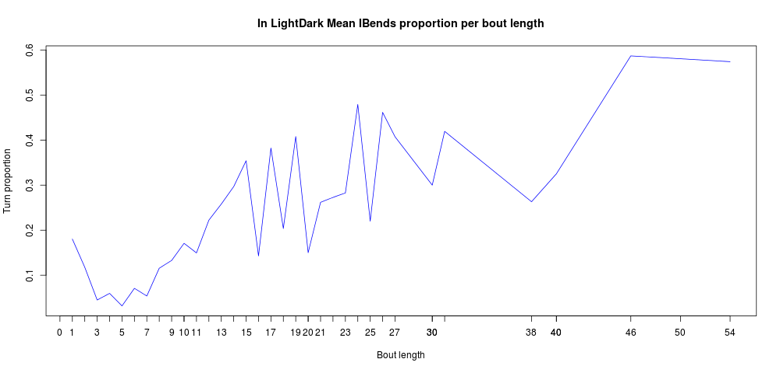
                LightDark:

Slide 35
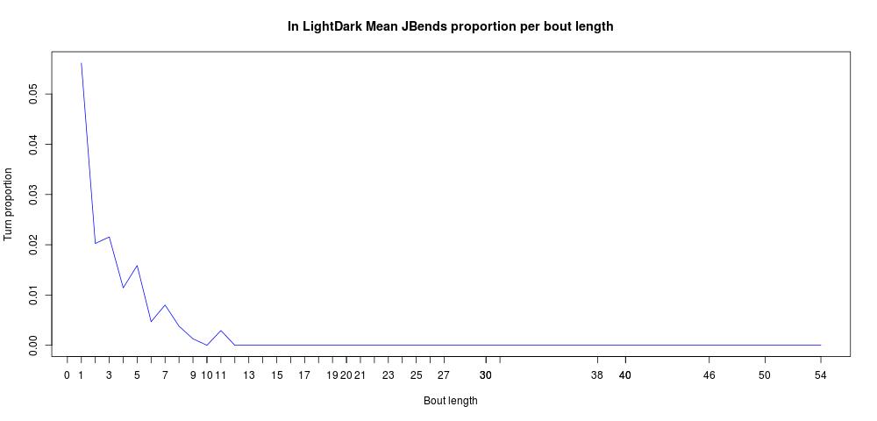
                LightDark:

Slide 36
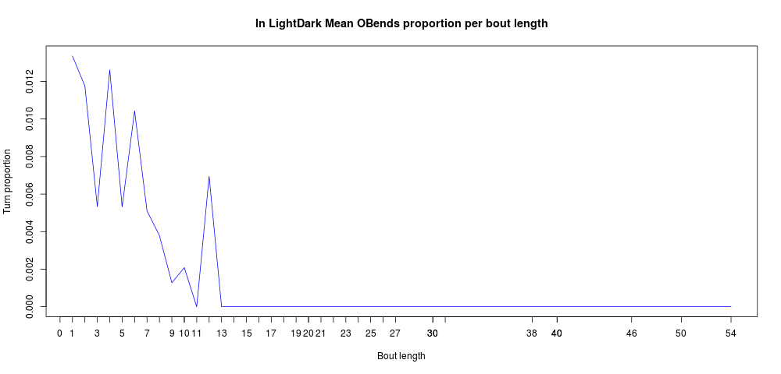
                LightDark:

Slide 37
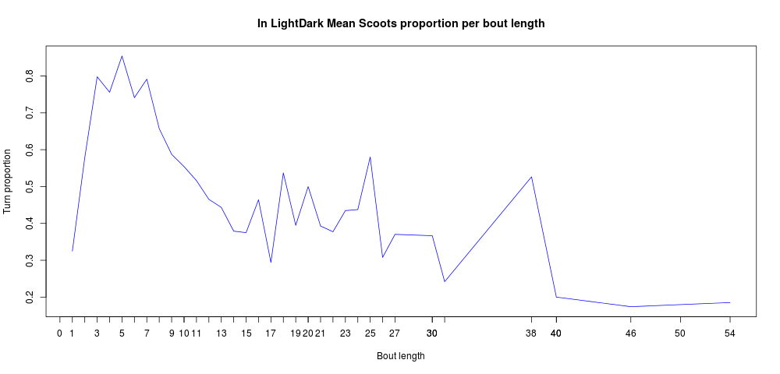
                LightDark:

Slide 38
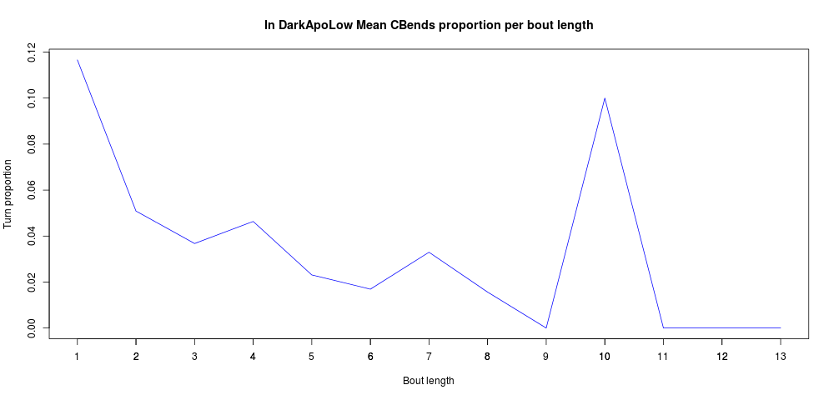
                (Dark)ApoLow:

Slide 39
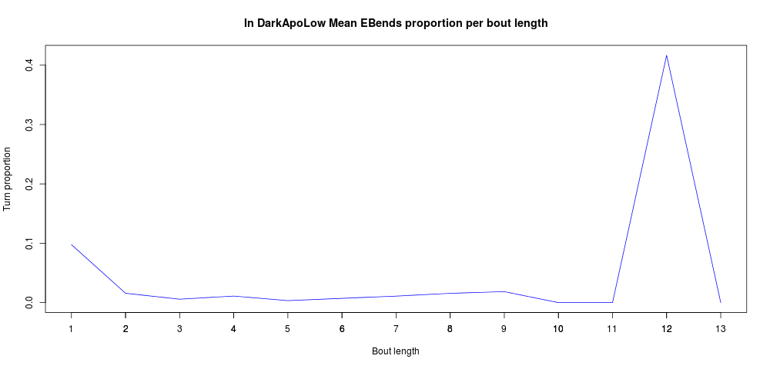
                (Dark)ApoLow:

Slide 40
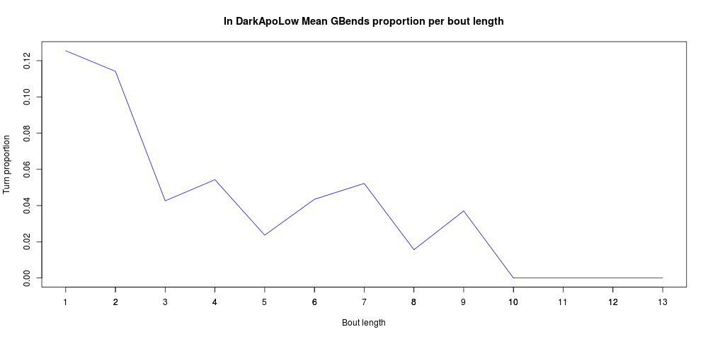
                (Dark)ApoLow:

Slide 41
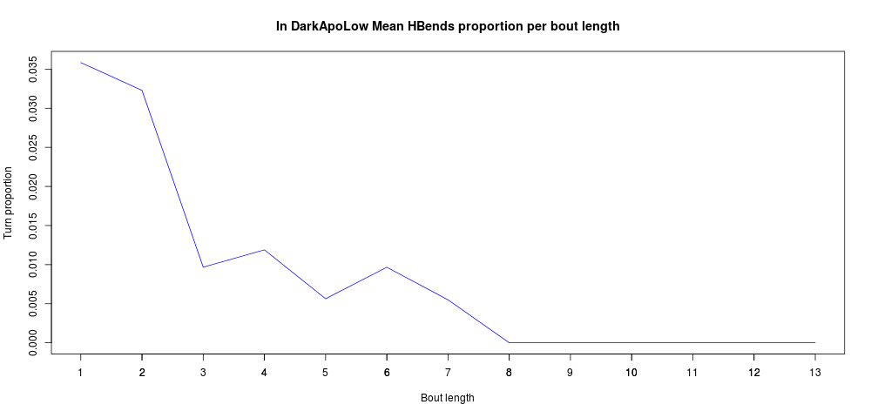
                (Dark)ApoLow:

Slide 42
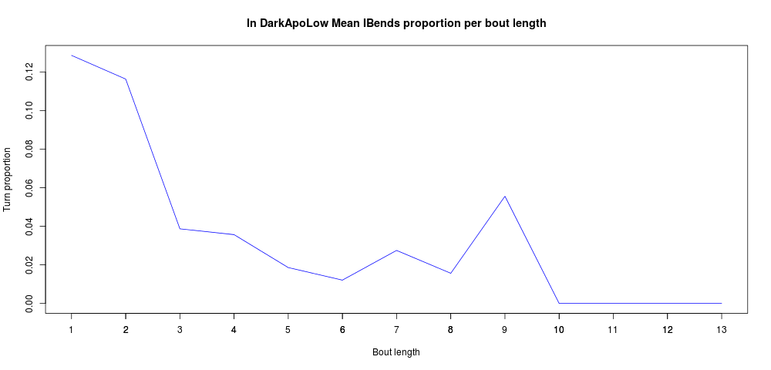
                (Dark)ApoLow:

Slide 43
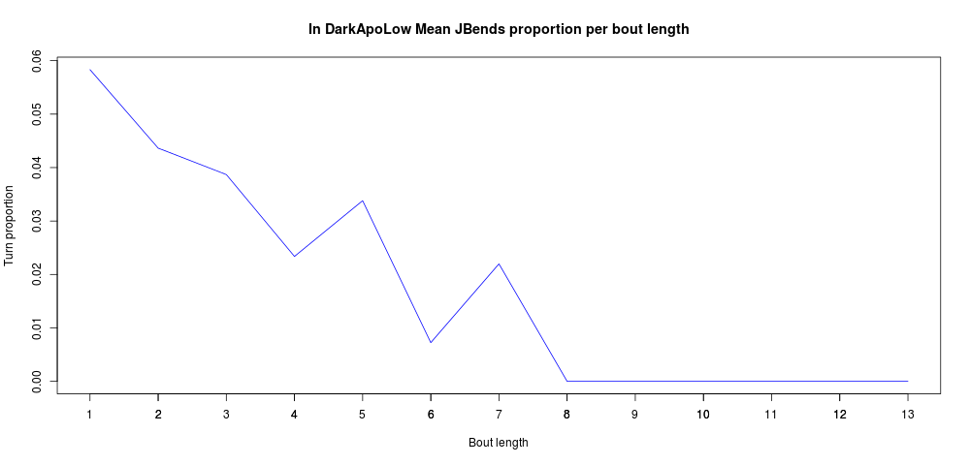
                (Dark)ApoLow:

Slide 44
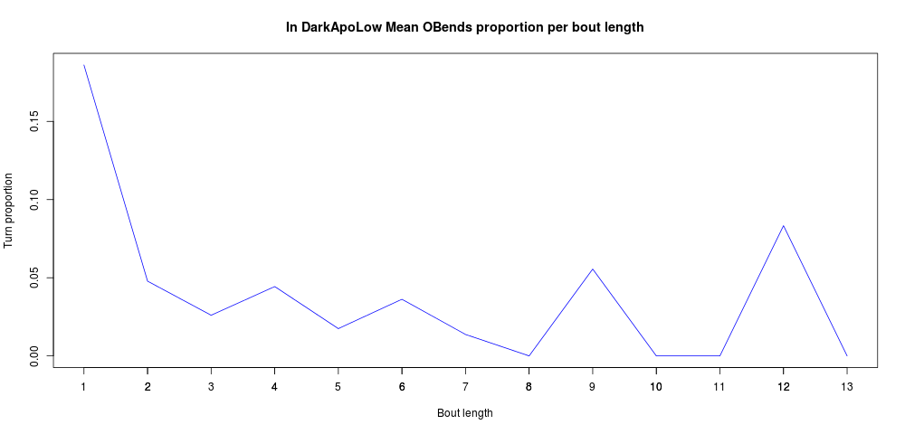
                (Dark)ApoLow:

Slide 45
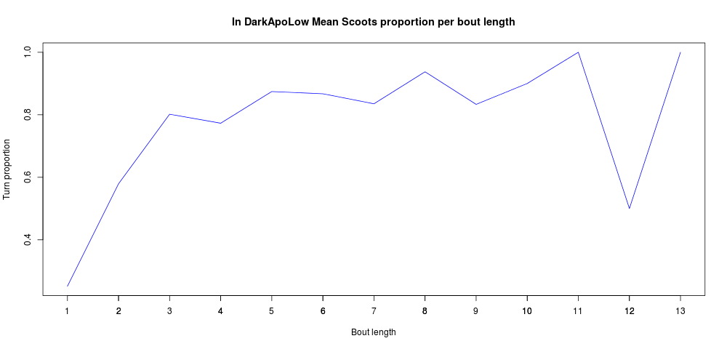
                (Dark)ApoLow:

Slide 46

                (Dark)ApoHigh:

Slide 47

                (Dark)ApoHigh:

Slide 48

                (Dark)ApoHigh:

Slide 49

                (Dark)ApoHigh:

Slide 50

                (Dark)ApoHigh:

Slide 51

                (Dark)ApoHigh:

Slide 52

                (Dark)ApoHigh:

Slide 53

                (Dark)ApoHigh:

Slide 54

                (Dark)PTZ:

Slide 55

                (Dark)PTZ:

Slide 56

                (Dark)PTZ:

Slide 57

                (Dark)PTZ:

Slide 58

                (Dark)PTZ:

Slide 59

                (Dark)PTZ:

Slide 60

                (Dark)PTZ:

Slide 61

                (Dark)PTZ:

Slide 62

                Hard to say how does the experiment condition itself (adjusted for the bout length and frequency changes) influences the turn occurrences, for example:

Slide 63

                With averaging over the subjects, action sequences or bouts, a lot of information is lost, but otherwise the data is messy, example:

Slide 64

                Simple motif search for motif lengths 2:10, confirmed the large proportion of Scoots:
                Light:

Slide 65

                Light:

Slide 66

                Light:

Slide 67

                Light:

Slide 68

                Light:

Slide 69

                Light:

Slide 70

                Light:

Slide 71

                Light:

Slide 72

                Light:

Slide 73

                Dark:

Slide 74

                Dark:

Slide 75

                Dark:

Slide 76

                Dark:

Slide 77

                Dark:

Slide 78

                Dark:

Slide 79

                Dark:

Slide 80

                Dark:

Slide 81

                Dark:

Slide 82

                LightDark:

Slide 83

                LightDark:

Slide 84

                LightDark:

Slide 85

                LightDark:

Slide 86

                LightDark:

Slide 87

                LightDark:

Slide 88

                LightDark:

Slide 89

                LightDark:

Slide 90

                LightDark:

Slide 91

                (Dark)ApoLow:

Slide 92

                (Dark)ApoLow:

Slide 93

                (Dark)ApoLow:

Slide 94

                (Dark)ApoLow:

Slide 95

                (Dark)ApoLow:

Slide 96

                (Dark)ApoLow:

Slide 97

                (Dark)ApoLow:

Slide 98

                (Dark)ApoLow:

Slide 99

                (Dark)ApoLow:

Slide 100

                (Dark)ApoHigh:

Slide 101

                (Dark)ApoHigh:

Slide 102
                (Dark)ApoHigh:

Slide 103

                (Dark)ApoHigh:

Slide 104

                (Dark)ApoHigh:

Slide 105

                (Dark)ApoHigh:

Slide 106

                (Dark)ApoHigh:

Slide 107

                (Dark)ApoHigh:

Slide 108

                (Dark)ApoHigh:

Slide 109

                (Dark)ApoHigh:

Slide 110

                (Dark)PTZ:

Slide 111

                (Dark)PTZ:

Slide 112

                (Dark)PTZ:

Slide 113

                (Dark)PTZ:

Slide 114

                (Dark)PTZ:

Slide 115

                (Dark)PTZ:

Slide 116

                (Dark)PTZ:

Slide 117

                (Dark)PTZ:

Slide 118

                (Dark)PTZ:

