Slide 1

Making ML model deployment easy by using your favourite tool with ONNX
Patrick Zhao
AI Hack Day Melbourne

Slide 2









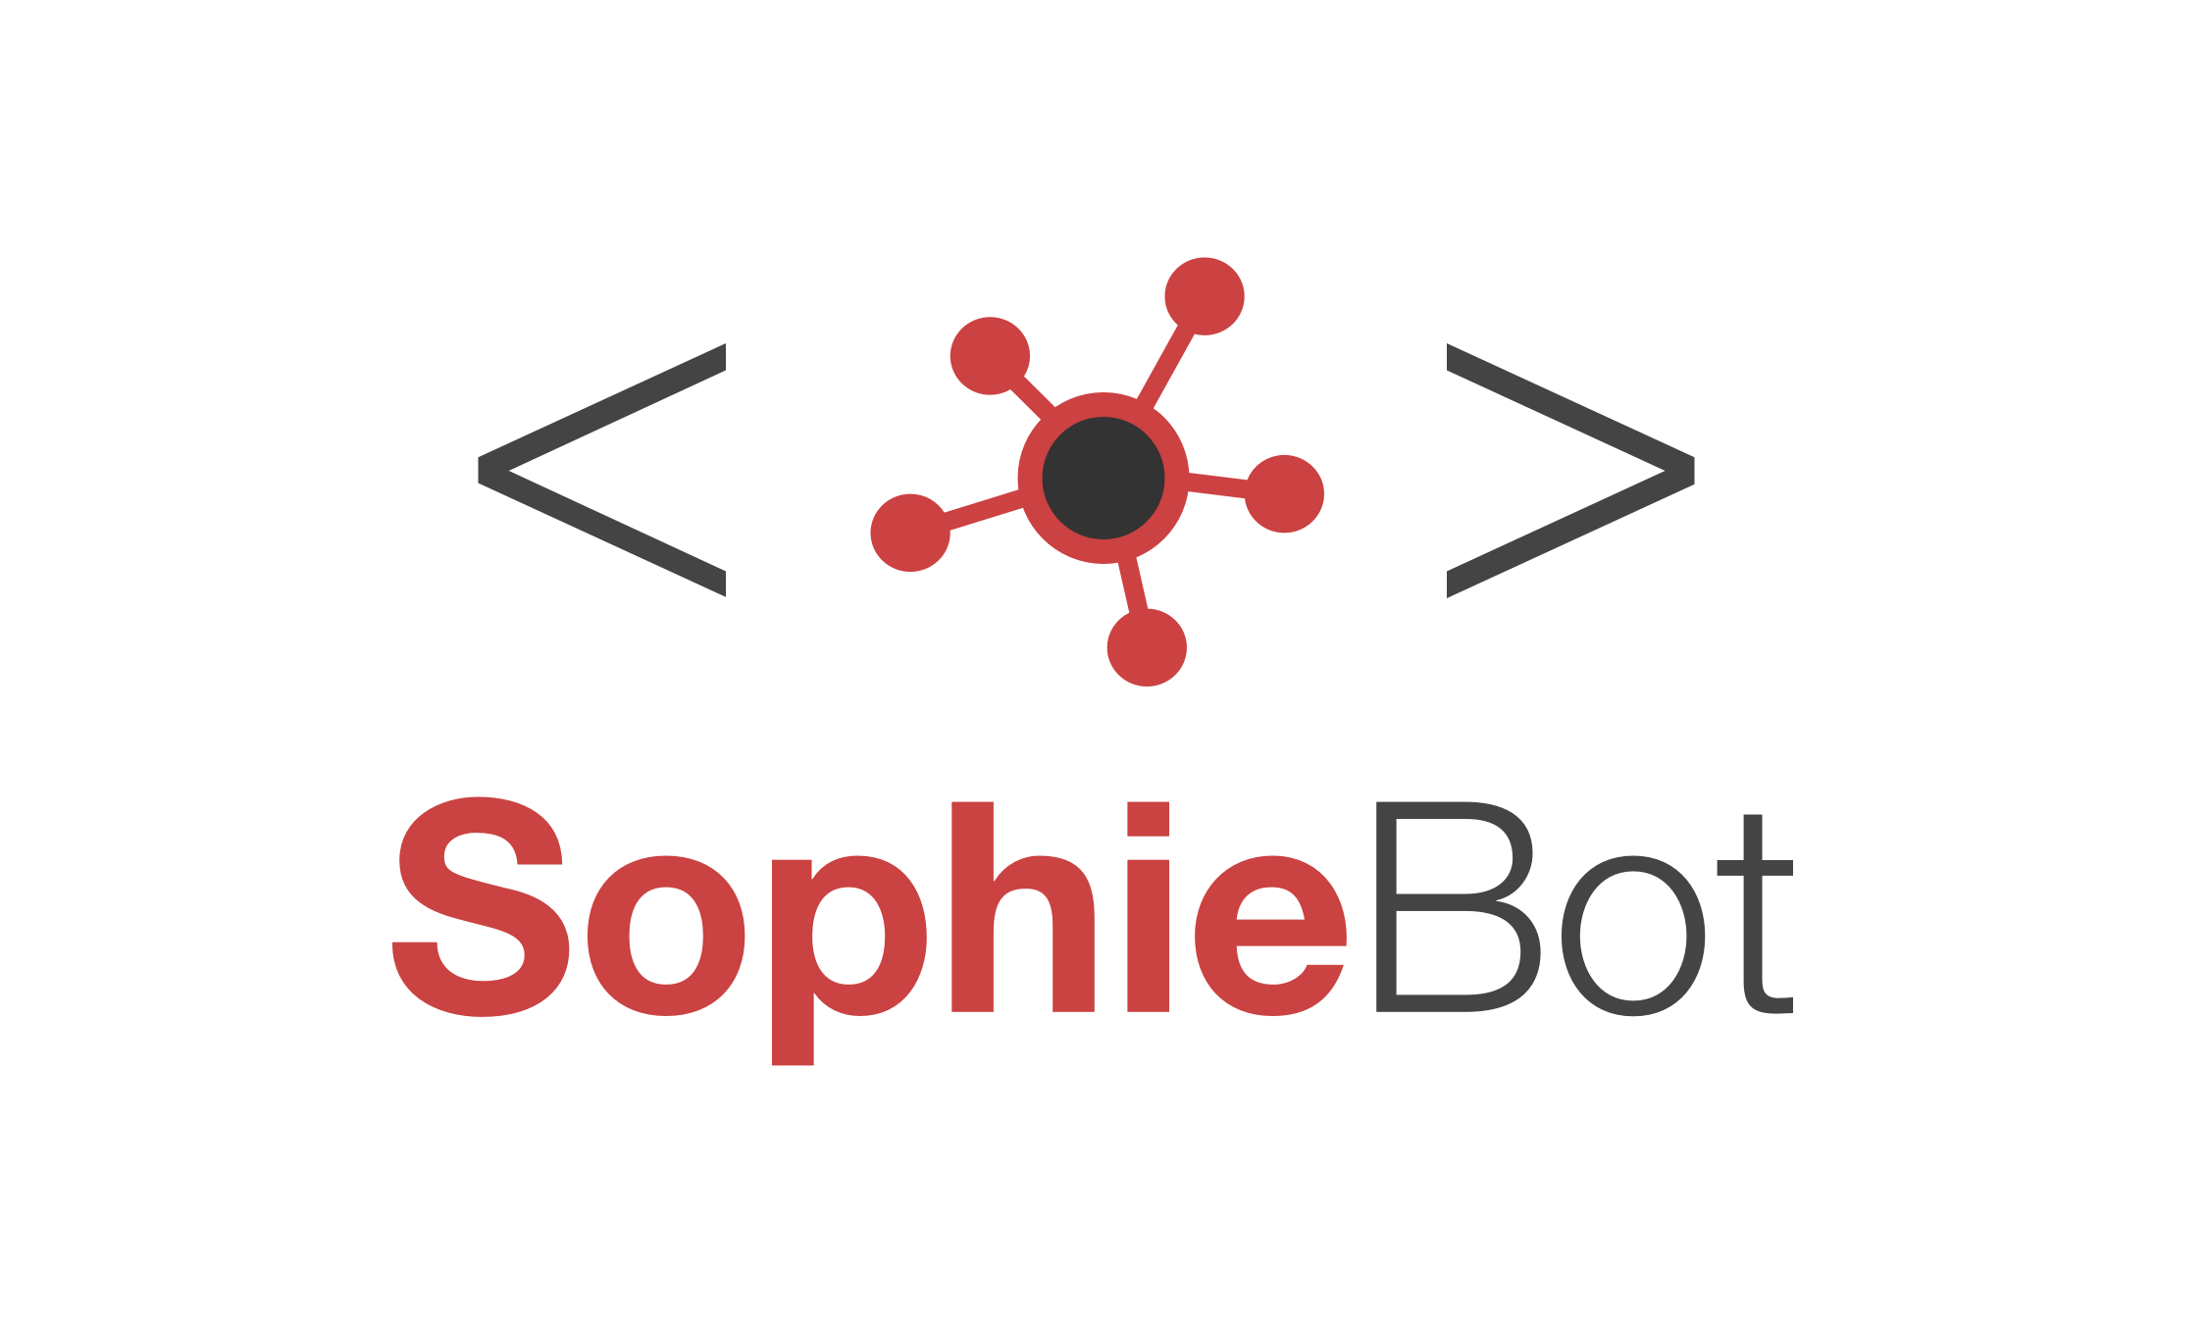


Patrick Zhao
SSW Solution Architect
Full stack engineer and speaker
twitter.com/paladinapay
linkedin.com/in/patrickzhao1989
ssw.com.au/people/patrick-zhao
github.com/PatrickZhao1989
patrickzhao.co
Notes:
1. Slow down

Slide 3

Machine Learning Workflow
Model Format
Agenda
ONNX
Demo
Notes:
Introduce JK
JK takes over screen sharing
Stay on this slide until JK has completed talk and Q&A

Slide 4
AI applications
Chat bot
Cognitive service
Voice recognition
Image recognition
Form recognition
OCR
Sentiment analysis

Slide 5
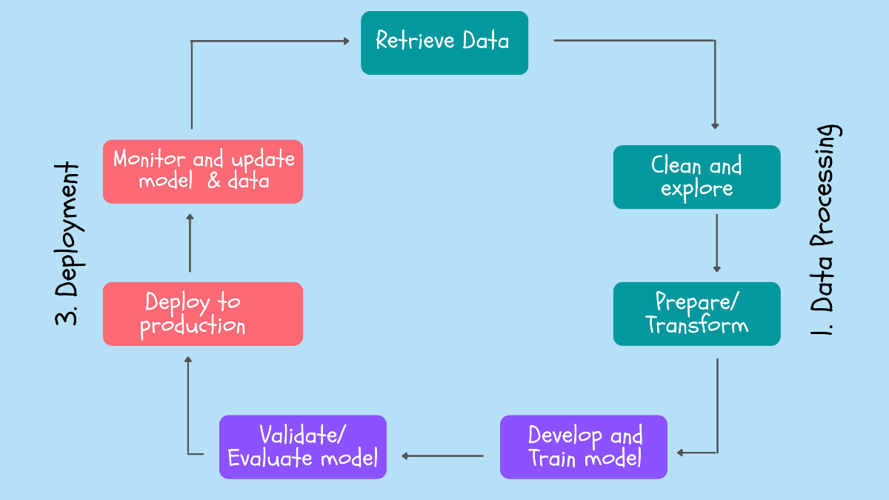

Slide 6
ML Tool and Model fomat
TensorFlow & Keras
Checkpoint
HDF5
PyTorch
Checkpoint
.pt & .pth
Scikit-Learn
Python Pickle
Spark-MLLib
Parquet

Slide 7
Challenges
Interoperability
Hardware access (cross-platform)

Slide 8
Open Neural Network Exchange
Universal
Community support

Slide 9
ONNX runtime
https://onnxruntime.ai/
https://onnxruntime.ai/docs/get-started/with-javascript.html#onnx-runtime-web

Slide 10

Demo
Notes:
Existing frontend
Azure Wep app deployment slot
Rolling based strategy
Show API Management
Swap slot

Slide 11
Machine Learning Workflow
Model Format
Summary
ONNX
Demo
Notes:
Introduce JK
JK takes over screen sharing
Stay on this slide until JK has completed talk and Q&A

Slide 12
Reference
https://www.youtube.com/watch?v=ZHtQT6EzYk0
https://www.youtube.com/watch?v=hPaFA4PyMRk
https://www.youtube.com/watch?v=NBzJu-vR68U
https://onnxruntime.ai/docs/get-started/with-javascript.html#onnx-runtime-web

Slide 13
Thank you! patrickzhao@ssw.com.au www.ssw.com.au Sydney | Melbourne | Brisbane

