Slide 1
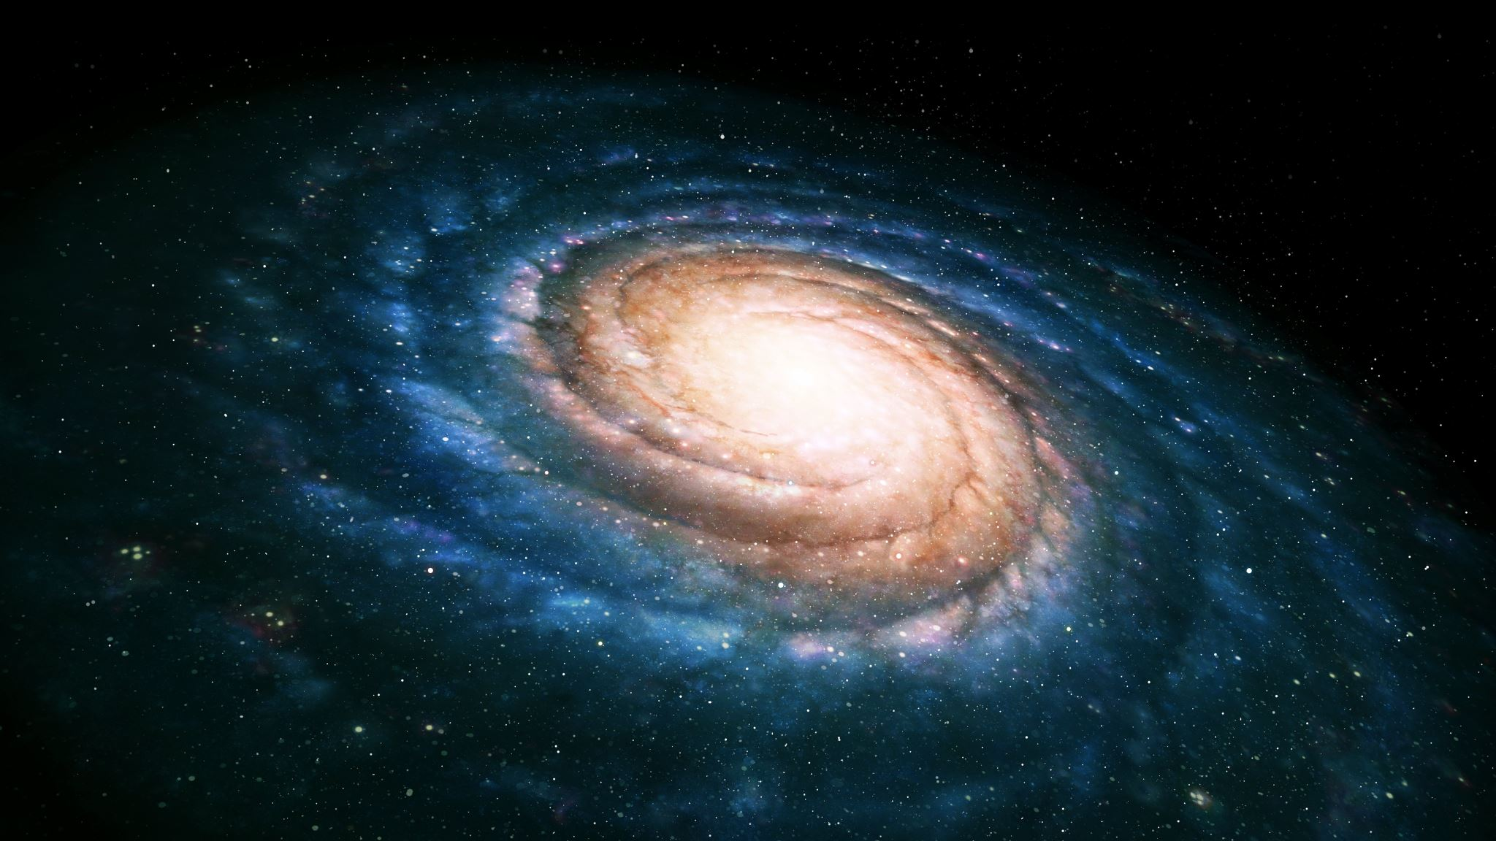
Create prograiming languages with python
(jero98772)

Slide 2
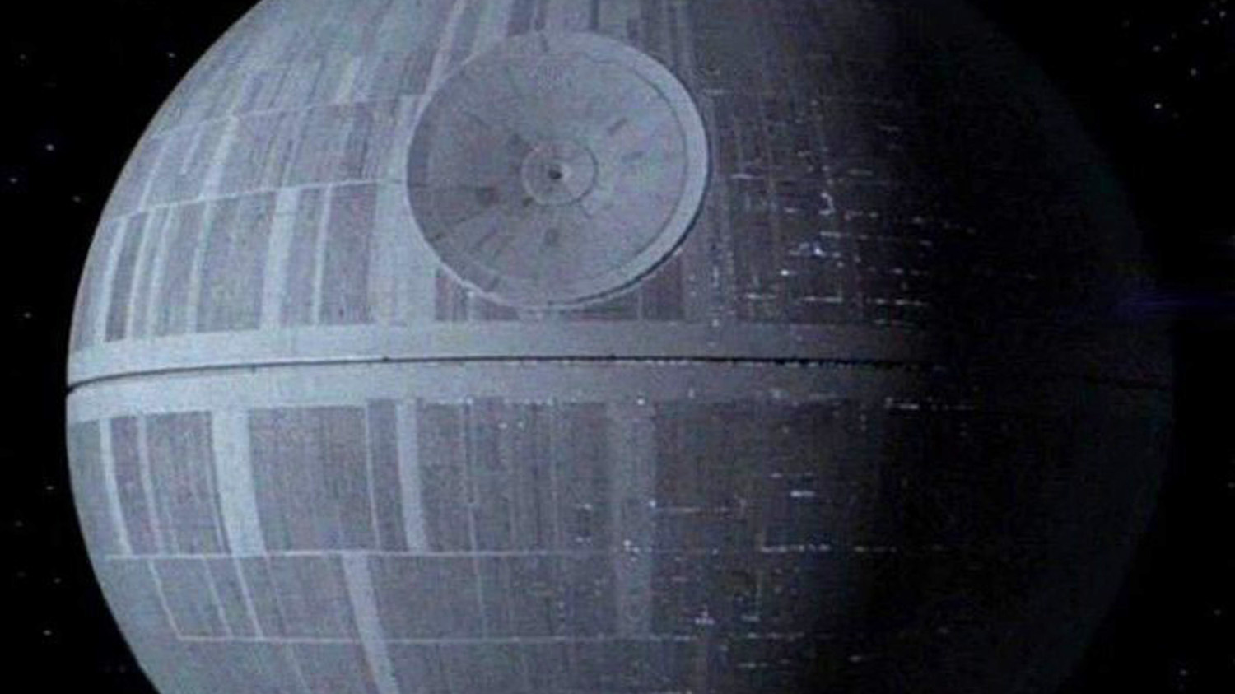

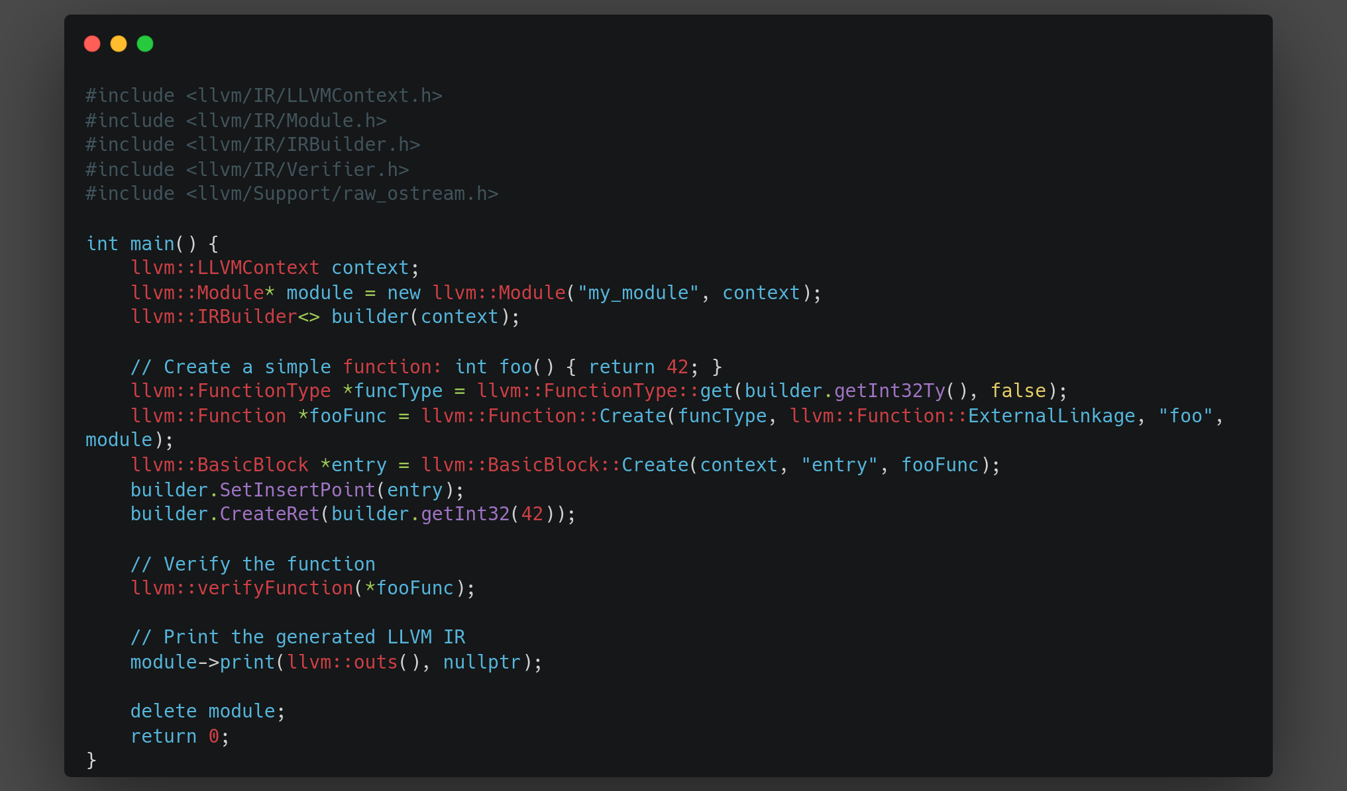
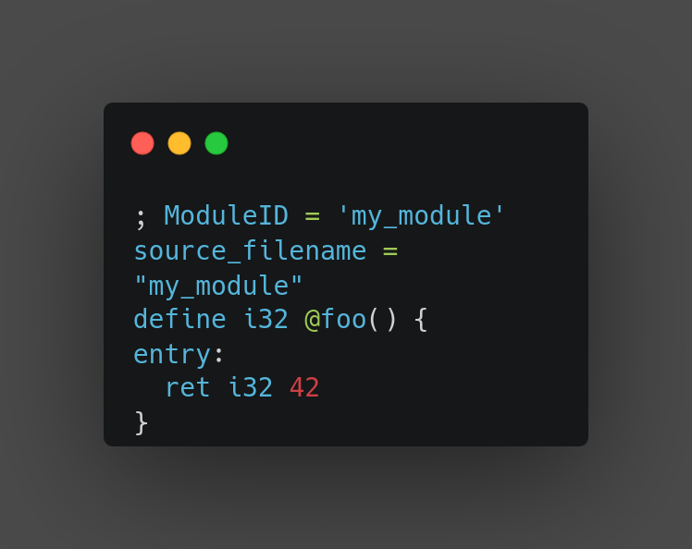
LLvm
tool for create compiler frontend, because it otimizes the backend

Slide 3

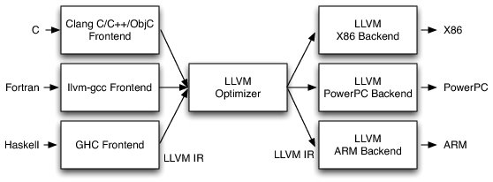
PYLLvm & numba

Slide 4
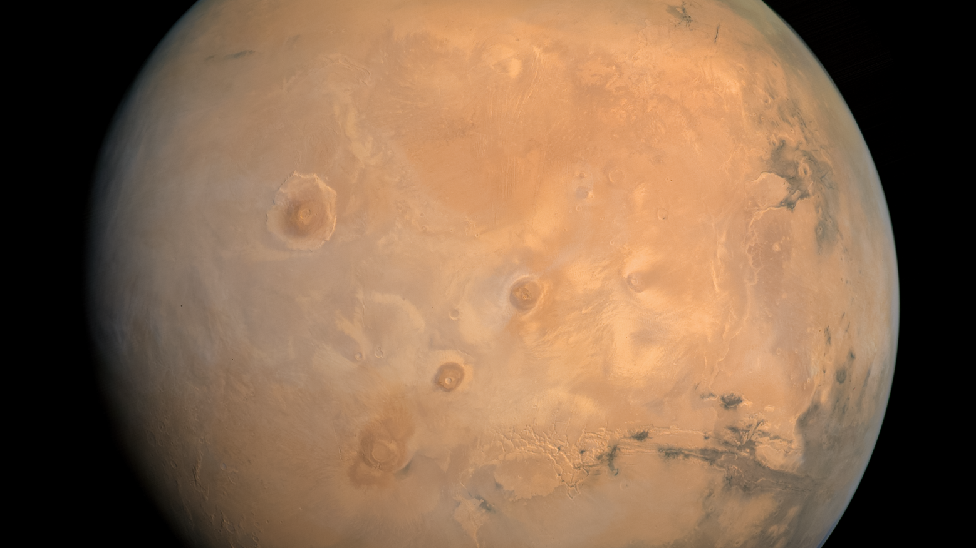
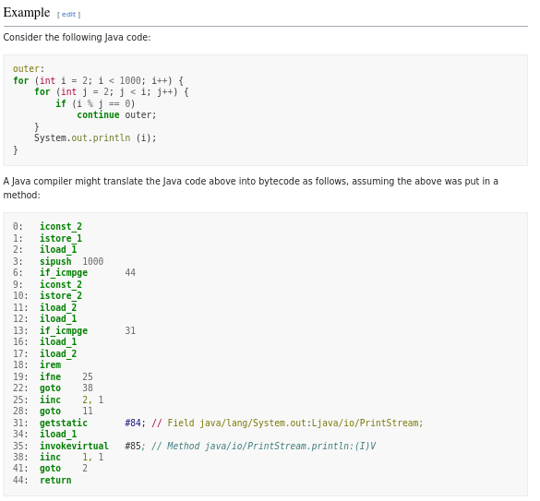

Pushdown automata for stack arimetic
principle of 1 time code , excutable in all computers

Slide 5
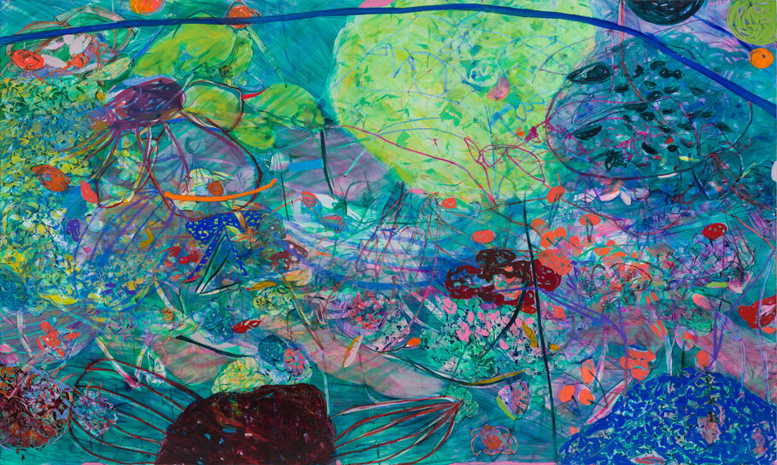
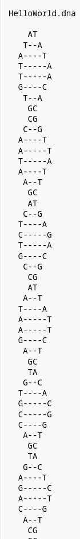
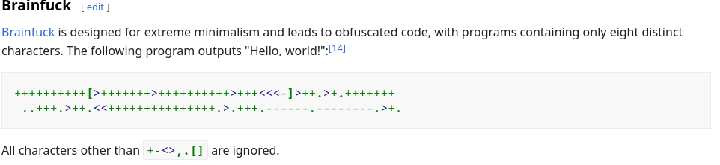
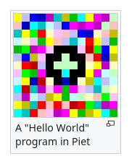
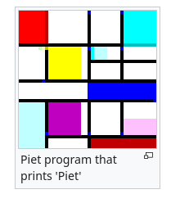
Esoteric programing languages
https://esolangs.org/wiki/Main_Page

Slide 6

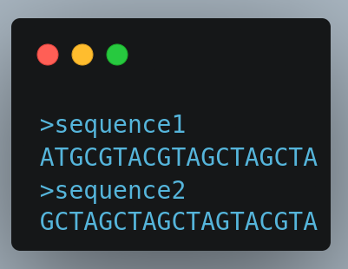
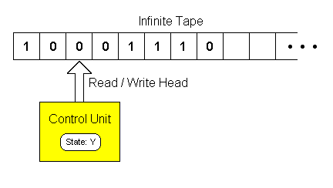
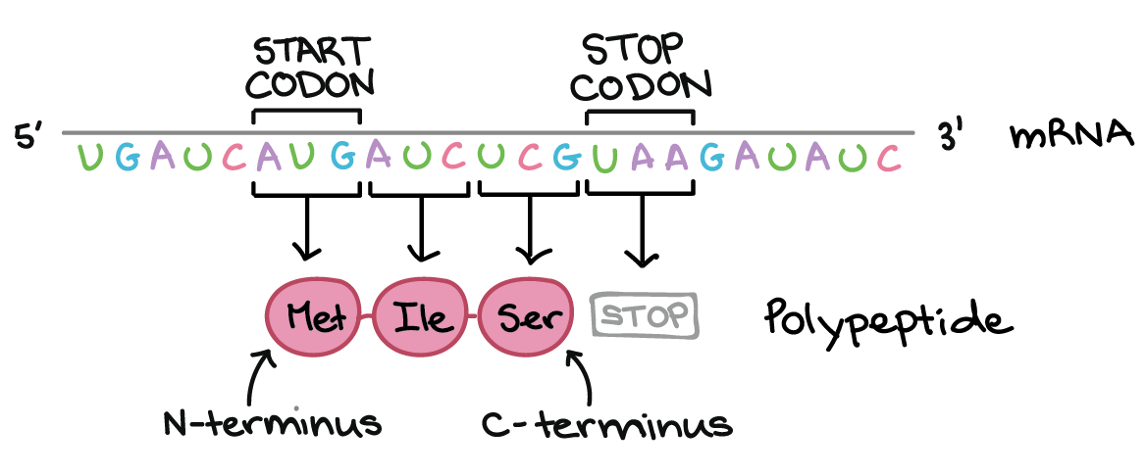
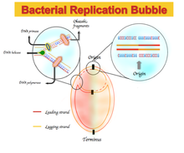
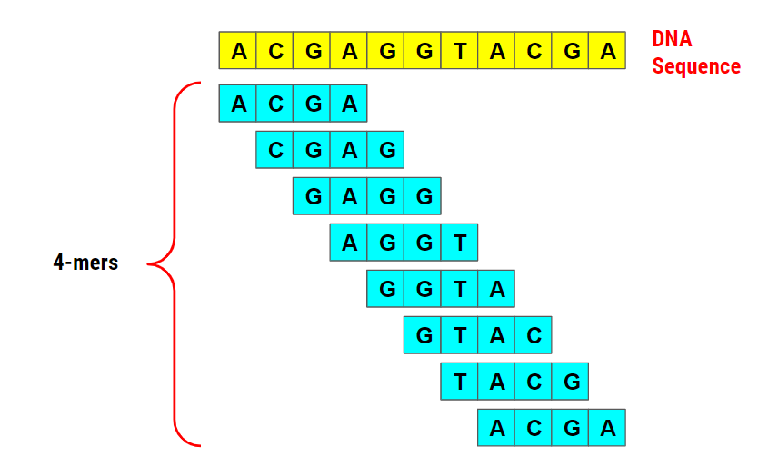
Turing-Machine-Genome-Processor
https://esolangs.org/wiki/RNA#DNA
this programing language let you know the replication position of bacteria with:
If g +=1
if c -=1
programing language for dna & rna

Slide 7
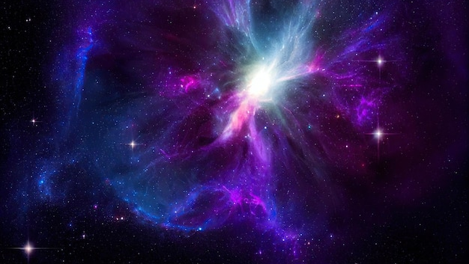
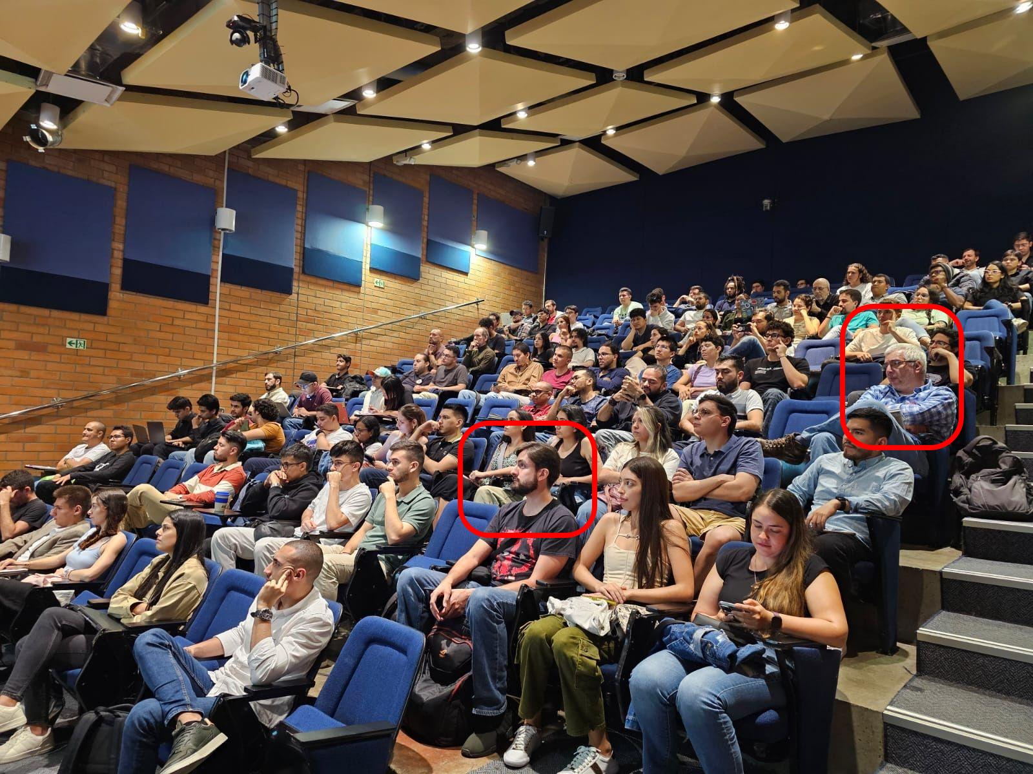
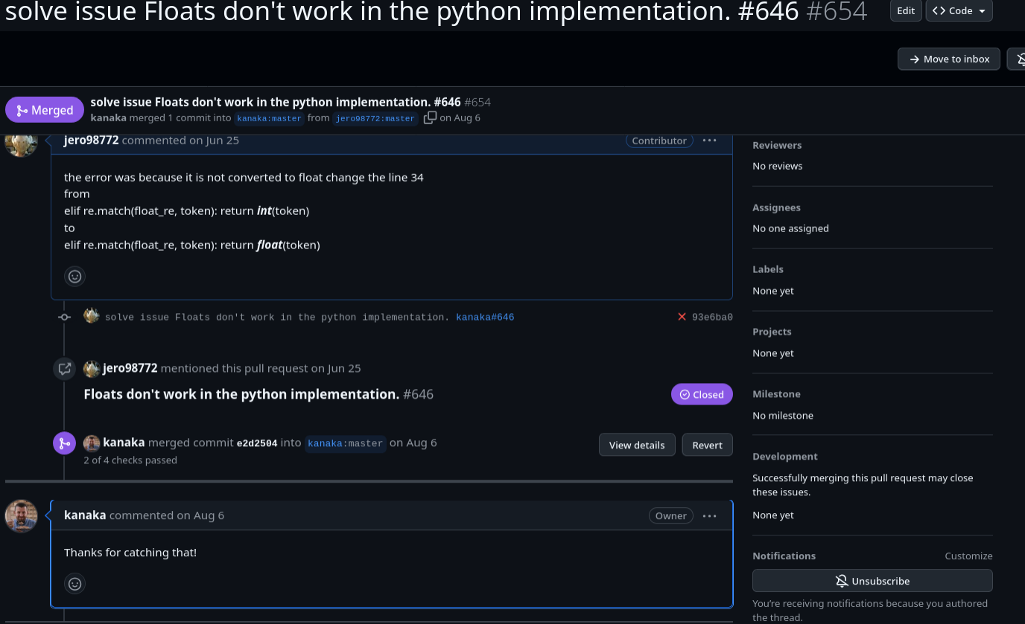
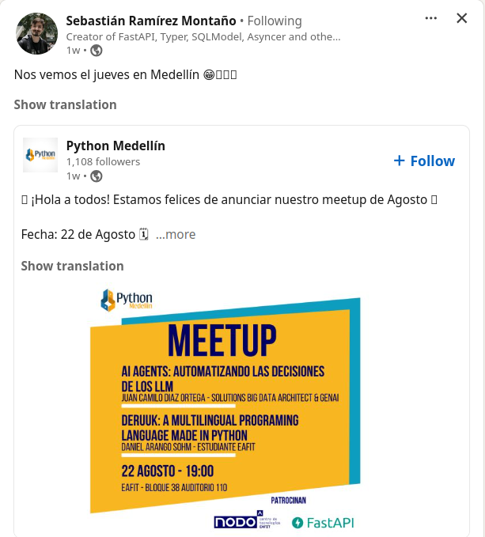

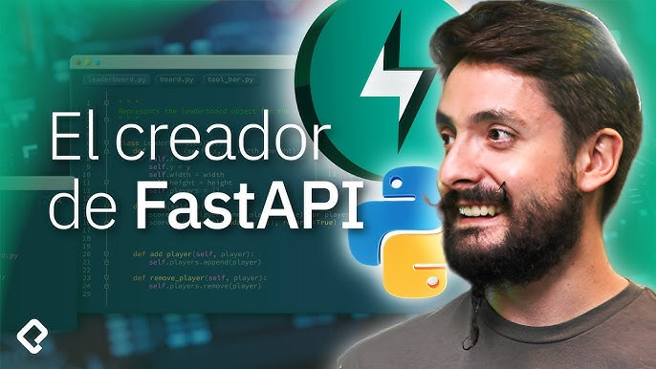
Context of the importance of this speak

Slide 8
Deruuk a multilingual programing language made python
(jero98772)

Slide 9
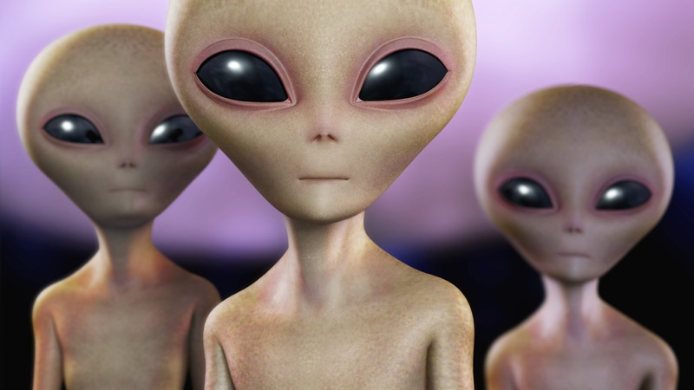
What is Deruuk
Lisp dialect in
De-> Deustche Spreche (german language)
Ru->русский язык
(russian language)
Uk->Українська мова (ukraine language)
Notes:
Interpreted
no hay problema por usar el alfabeto cilirico o umblaut
I know you dont going to understend everything, no because is in german and russian is becasue is not a commun topic and is dificult

Slide 10

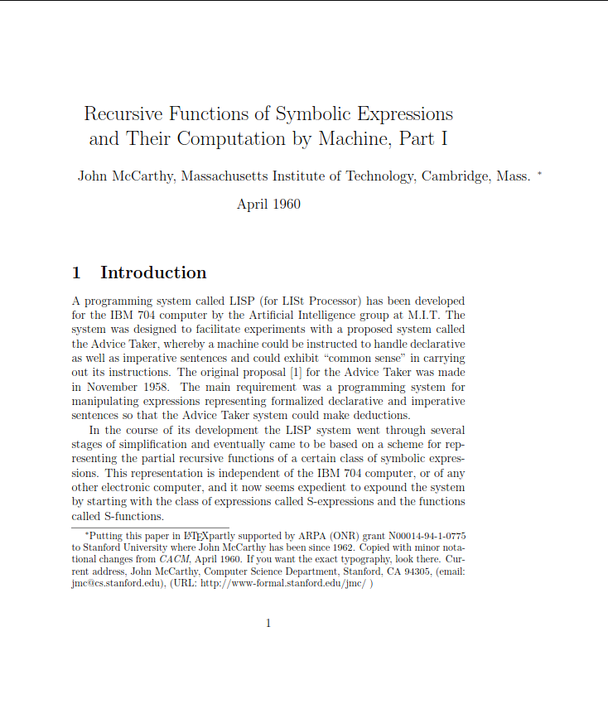
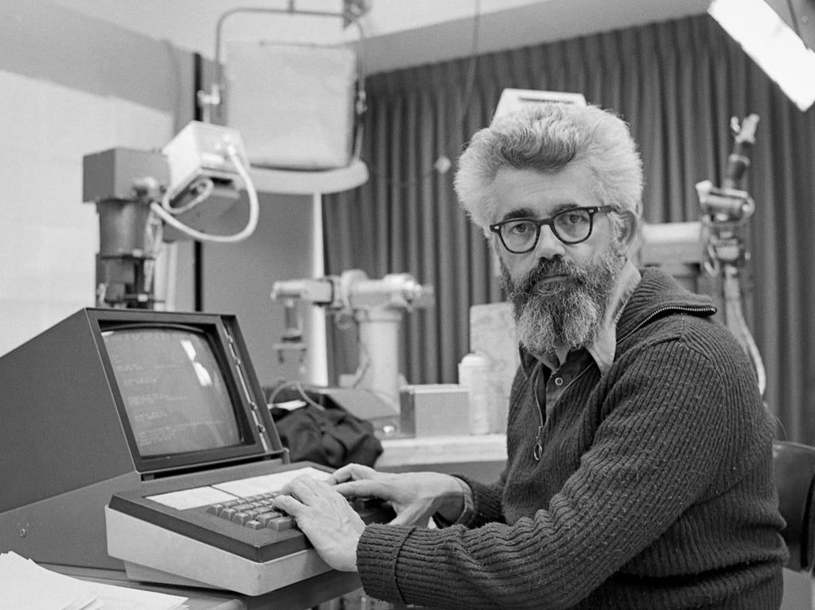
What is lisp? Not a programing Language
Notes:
Jhon mackarty padre de la IA
Multiples dialectos
Es un metalenguaje
Lisp-list processing
Emacs , editing macros
Lips -> list processing todo es una lista o un atomo

Slide 11
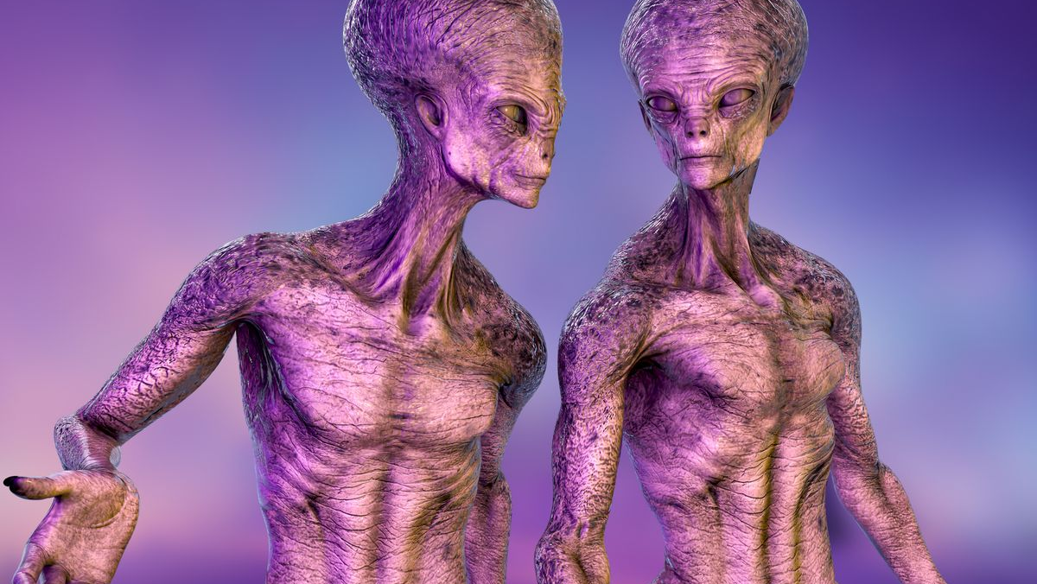
How people see programers of deruuk
(drucken "hallo" (eingabe "wie heisst du\n"))
print("hello word")
(печать "привет Мир")
print("hello word")
print("hello",input("how is your name"))
Notes:
La idea no es que aprendan a programar en deruuk pero si que vean lo que puede ahacer

Slide 12

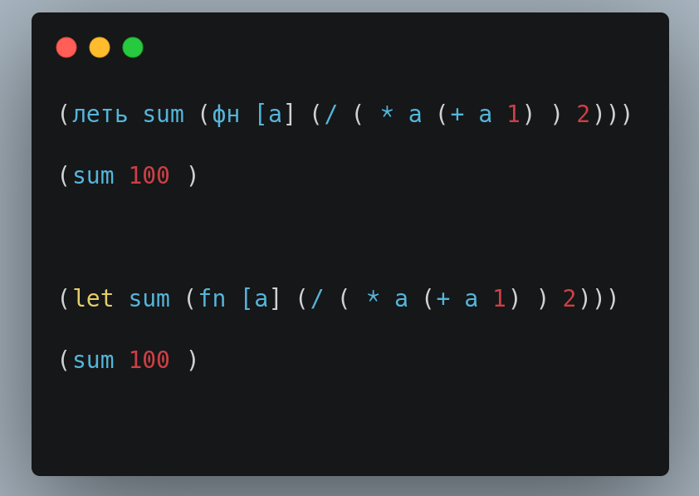
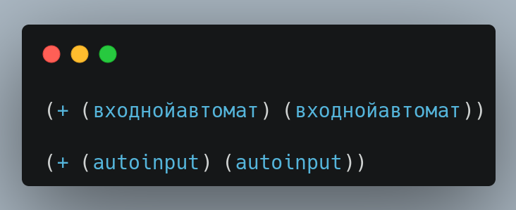
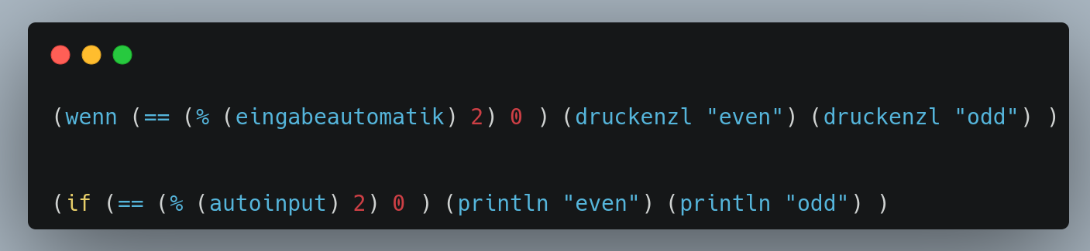
Examples of Deruuk
Notes:
Todo trabaja dentro de parecntecis
Funcion primero , y luego argumentos
Es un lenguaje casi funcional, interpretado y no complicado
no es un lenguaje esoterico
Peter norvig 150 lineas de codigo

Slide 13

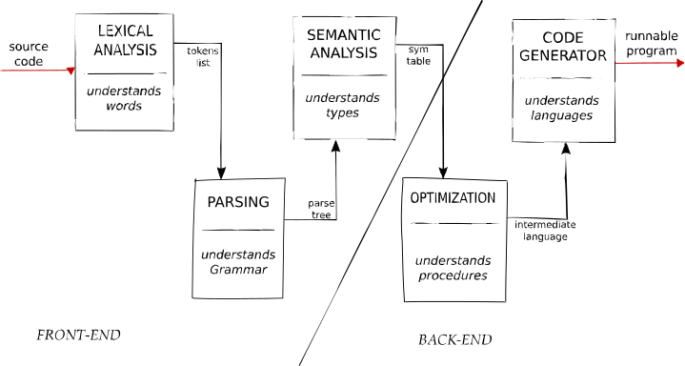
How can i do a lisp Dialect in python
step1_read_print
step2_eval ...
step3_env
step4_if_fn
Extra features
https://github.com/kanaka/mal
Notes:
Existe un repo en github mal, make a lisp donde pueden hacer este lenguaje en mas de 50 lenguajes de programacion
en python se puede hacer en menos lineas de codigo que en otros lenguajesm, alrededor de 100 lineas de codigo sin el enviroment
Algunos tienen errores
4 pasos para hacer este lenguaje de programacion

Slide 14

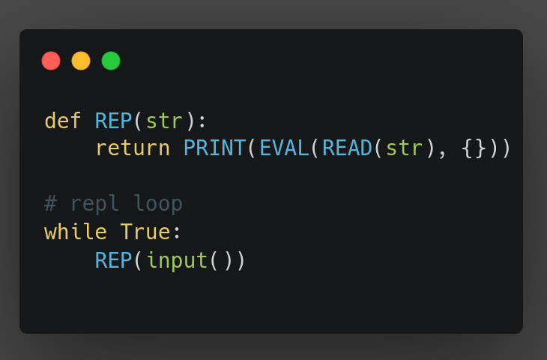
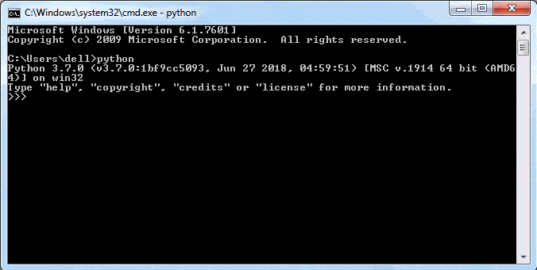
Repl (Read-Eval-Print Loop)
Notes:
El repl de python es cuando ejecutan python
Es lo que da la entrada y salida del lenguaje de programacion

Slide 15
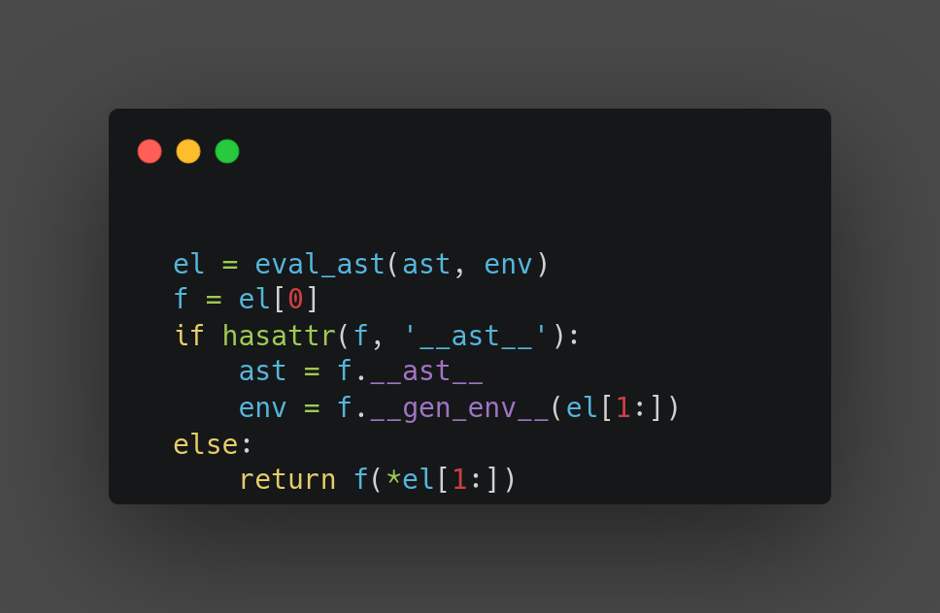
Eval
Eval is where is defined control structures than chooses a direction to go based on given parameters
Notes:
Al evaluar es donde sucede toda la magia
Este eval es diferente al de python, el eval de python es muy bueno para implementar lisp por que ayuda a automatizar el proceso semantico
observece que f(el[1:]) es funcion resto de argumentos

Slide 16
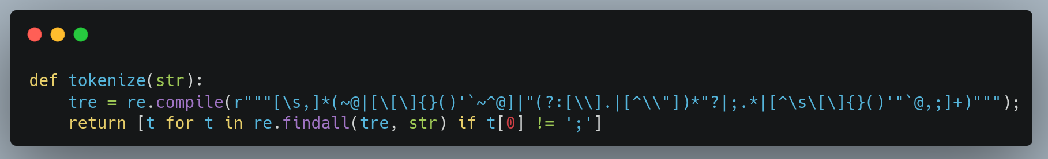
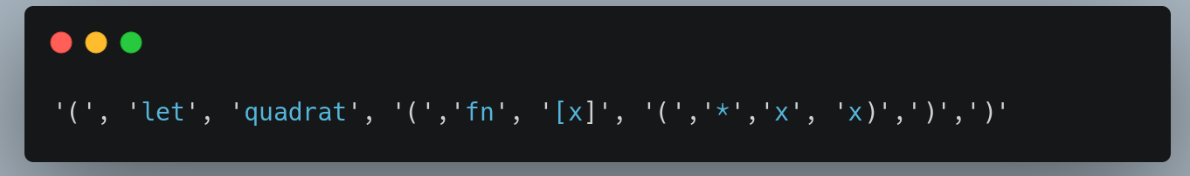
Tokenizing
Procces to separate the string in substrings (called token), but each substring have a meaning , it can be a data type, operator or a list
Notes:
Esto estructura la informacion para pasarla al parser

Slide 17

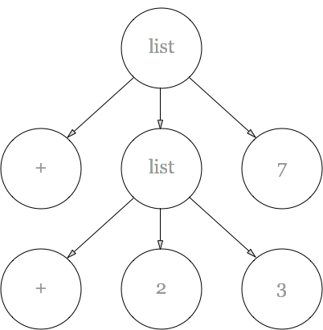
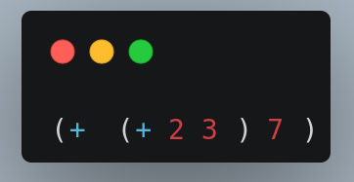
Sintaxcs analys
the process for verifying that our grammar is being followed
Notes:
code is a ast
El parser construye el abstract syntaxt tree de esos tokens
Nuestro codigo genera ese ast con la recursion
A grammar is a set of rules that describe how tokens can be combined to form valid statements and expressions in the language.

Slide 18
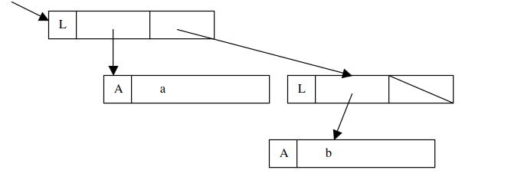
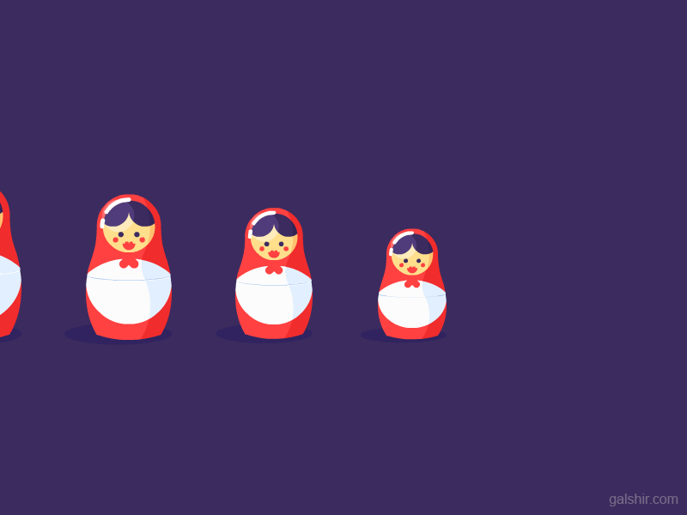
S-expresions
There are two kinds of S-expression, atoms and lists.
S-expressions express your program and manipulate it the same way a interpreter would. This lets you add your own language features without modifying the compiler or interpreter.
Notes:
S- expresions son la gramatica de nuestro lenguaje
A grammar is a set of rules that describe how tokens can be combined to form valid statements and expressions in the language.
Backus-Naur Form (BNF) is a formal notation used to define the syntax of programming languages and other formal languages.
other languages like python uses context free grammars

Slide 19
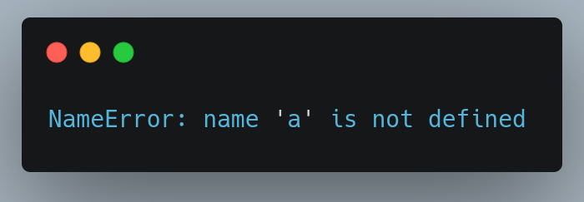
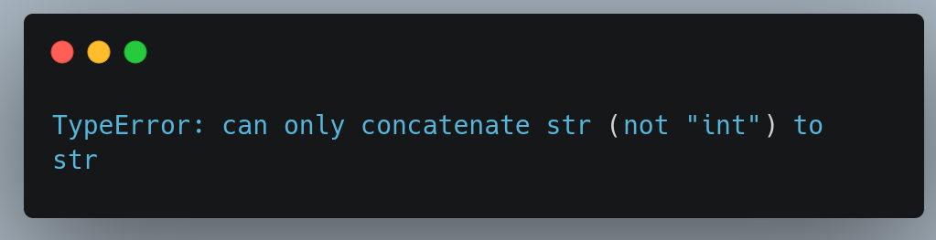
Semantics
PRoceses of giving Mean to the sentence
Notes:
How code know what is the meaning of each think?
A regular language is when it can create a finite automaton that match with his regular expresion
We know what is a
integer, because it have only characters in a set of digits,
Float because it have only characters in a set of digits , and in the second position there is an .
String = because it start with " and end "
Variable if is not of before
but how program know it
with regular expresions/regular languages of automatas
it ensures variables are declared before use, types are compatible, and functions are called with the correct number of arguments.

Slide 20
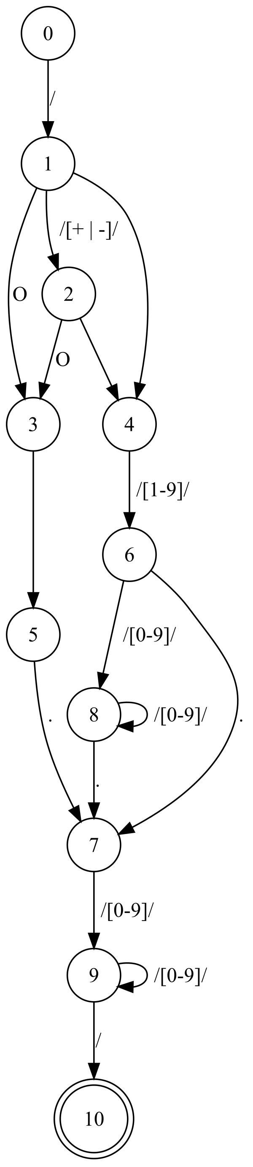
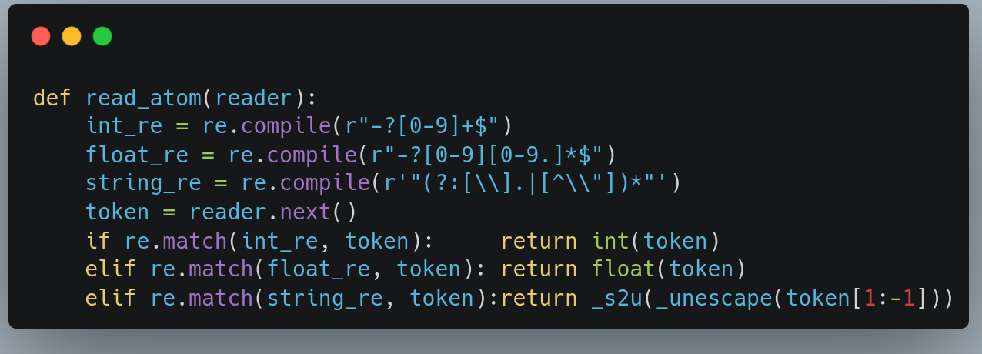
Power of automatas
Modeling Ram
Grammar Checking
Speed algorithms
Lexical Analysis
Type Checking
Parsing

Slide 21
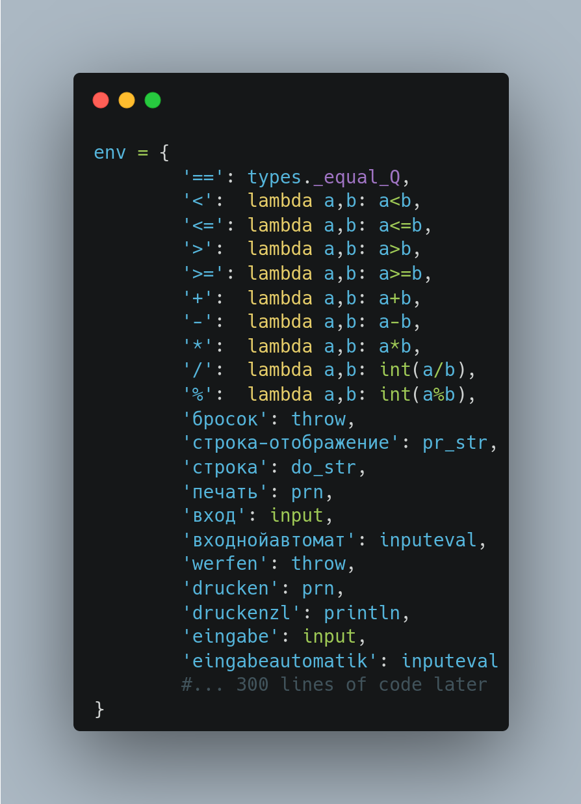
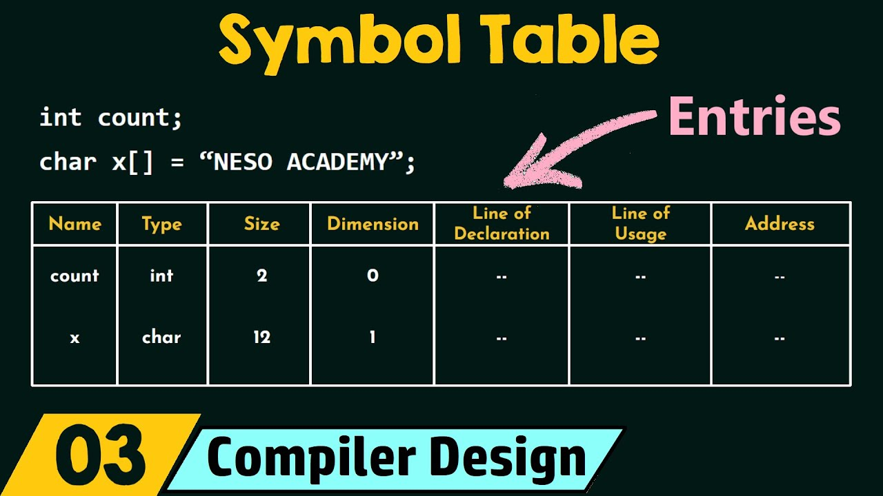
ENViroment
Notes:
El enviroment es un hashmap o tambien conocido como diccionario de python que nos va permitir cambiar casi todo el lenguaje por que tenemos los operadores y funciones en ese hashmap
Todo en lisp es una macro
cuando creamos una variable, una funcion la añadimos al enviroment
entonces podemos cambiar todo el lenguaje con las macros
Enviroment is not a simbol satble
Si ven en el envrioment se puede lograr hacer un lenguaje de programacion que se ejecute en cualquier idioma

Slide 22
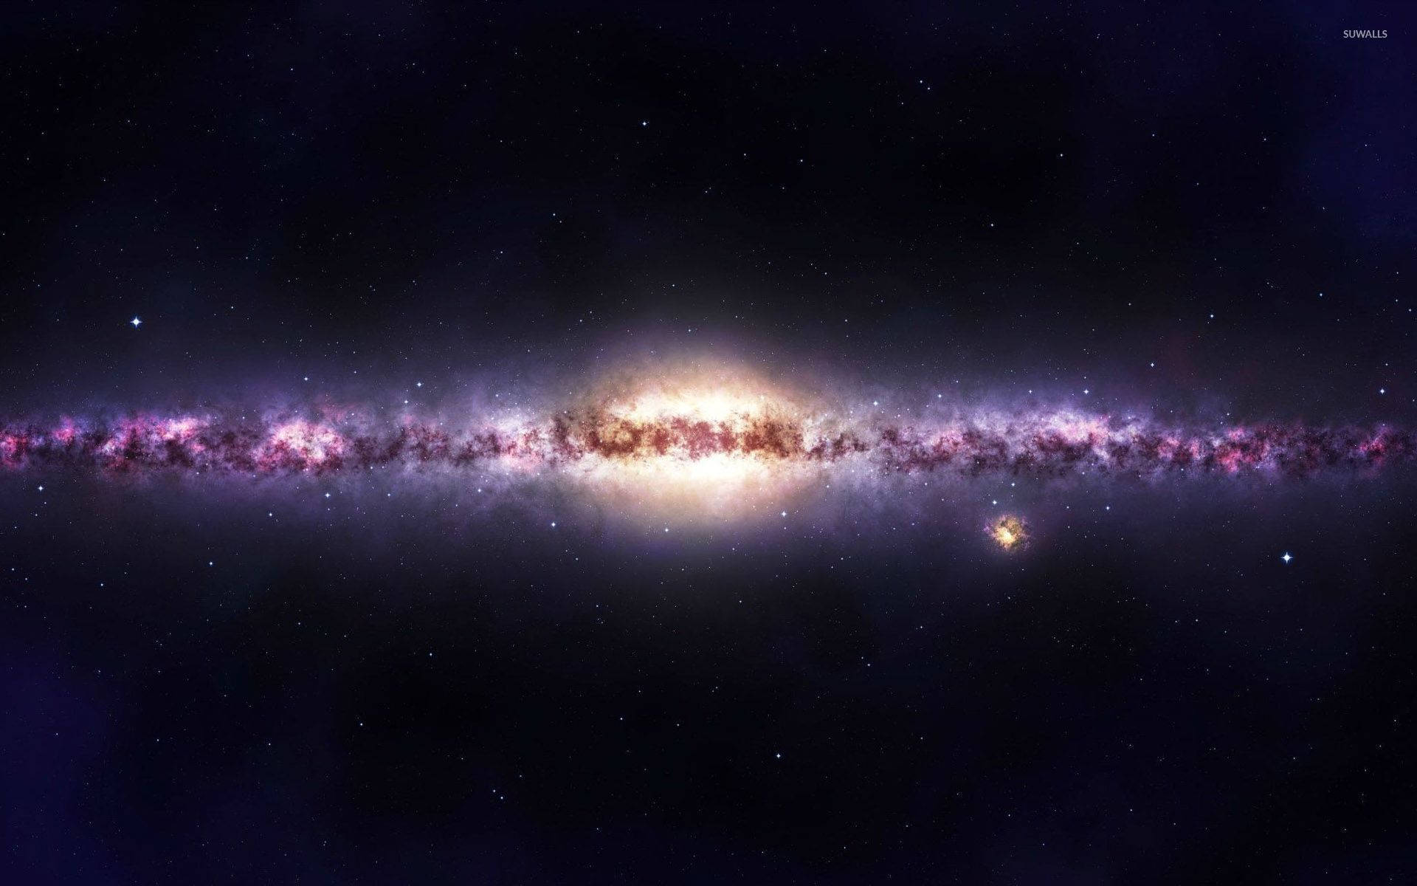
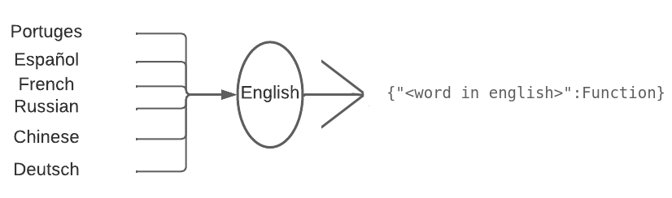
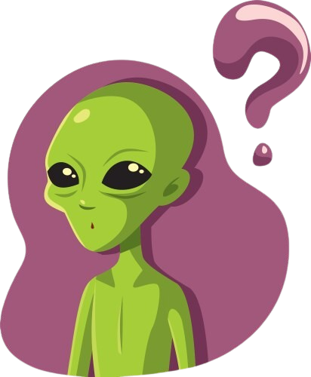
A programing language for all languages?

Slide 23
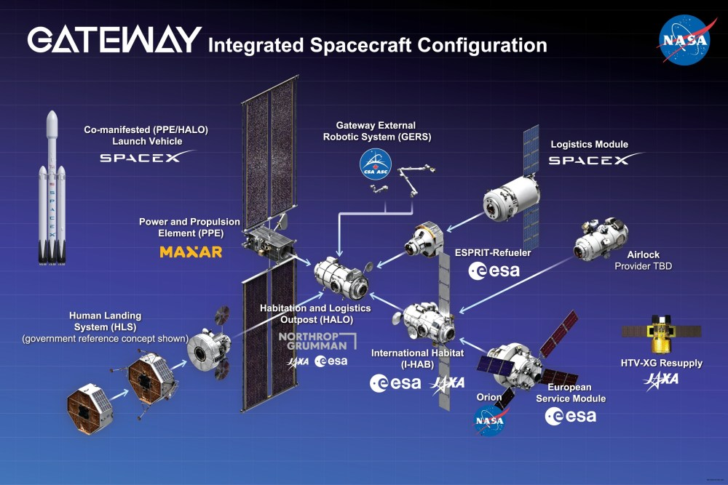
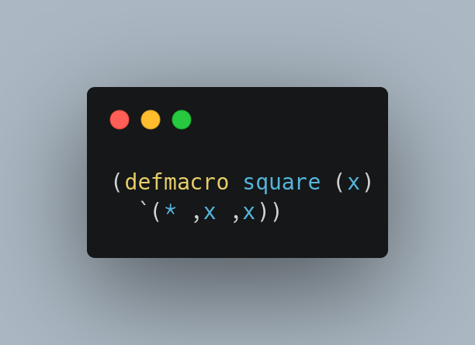

macros
Rule or pattern that specifies how a certain input should be mapped to a replacement output.
python dont have macros but we can create it with eval()
Notes:
Todo en lisp es una macro "Lisp is a homoiconic language, which means that code itself can be processed as data"
cuando creamos una variable, una funcion la añadimos al enviroment
entonces podemos cambiar todo el lenguaje con las macros
macro instruction", and such expansions were originally used in generating assembly language code.
Macros in C/C++ are preprocessor directives. They perform simple text substitution before the actual compilation.
Enviroment is not a simbol satble
Si ven en el envrioment se puede lograr hacer un lenguaje de programacion que se ejecute en cualquier idioma
acros in Lisp are written in Lisp itself and operate on the abstract syntax tree (AST) before the code is evaluated.
acros in Lisp are written in Lisp itself and operate on the abstract syntax tree (AST) before the code is evaluated.

Slide 24



Control structures
Notes:
We need to declare the control structures not in the enviroment because we need to change the destiny of our program
Las estructuras de control como if, else,def... are declarated in low level with instruccions that alu allow like jump

Slide 25


WHere is the for or while?

Slide 26

WHere is the for or while?

Slide 27

Finally we have a programing language

Slide 28


Slide 29


Slide 30


TCO (Tail call optimization)
Beneficts:
avoids unnecessary stack manipulation operations.
No stack overflow
Improved Performance
Notes:
Podemos aumentar el limite de recursion en python but this isnt a solution but we can use TCO

Slide 31
TCO (Tail call optimization)
Tail call optimizationin Python is not natively supported due to Python's recursion limit and the lack of tail call optimization in its interpreter. However, it can be simulated using a loop to replace recursive calls with iterative ones.

Slide 32



"TCO (Tail call optimization)" siumalted

Slide 33



¿HOW to archive real TCO?
ctypes
Notes:
Rust macro didn’t work
Ctypes work because it give stack overflow we can see if it work or not cheaking the compilations

Slide 34


Extra features
Try catch
quotes
Notes:
Comments, and quotes
Try , catch

Slide 35


Extra features
Quotes and comments
quotes
Notes:
Comments, and quotes
Try , catch

Slide 36

Commun Problems when we made a programing language
Notes:
Specify all with if
is better to create special clases to handles data types
Don’t mix your language with the language when you are programing it, (create clases for that)
Web ide need work
Mathematics of this can be very very hevy for this
border between lexical analisis, syntaxic analisis and semanantic analisis is very tingh

Slide 37
Finally we have a programing langue

Slide 38


Slide 39


end
https://github.com/jero98772/deruuk/
jero98772
Follow me as

