Slide 1
Final project – Deep Learning and neural networks
Jorge Rodriguez – 200711501
German Carvajal – 201313516
Universidad de los Andes
July 23rd - 2018

Slide 2
Project aim and tools
AIM: Predict movie genres based on the plot and the artwork.
Tools:
One vs. rest classifier with base RandomForest model
Train, Test, Validation splitting training
5-fold cross validation training
Neural networks
Multiple input model – Transfer learning
Single input models and stacking - transfer learning

Slide 3
One vs. rest classifier with base RandomForest model
Models trained using two strategies for validation ad randomized parameter optization. All model inputs were a mixture of lemmatized text and grayscale images.
Sppliting of data
Validation AUC: 0.6208
Kaggle AUC: 0.7602
5-Fold cross validation
Validation AUC: 0.6674
Kaggle AUC: 0.6802

Slide 4
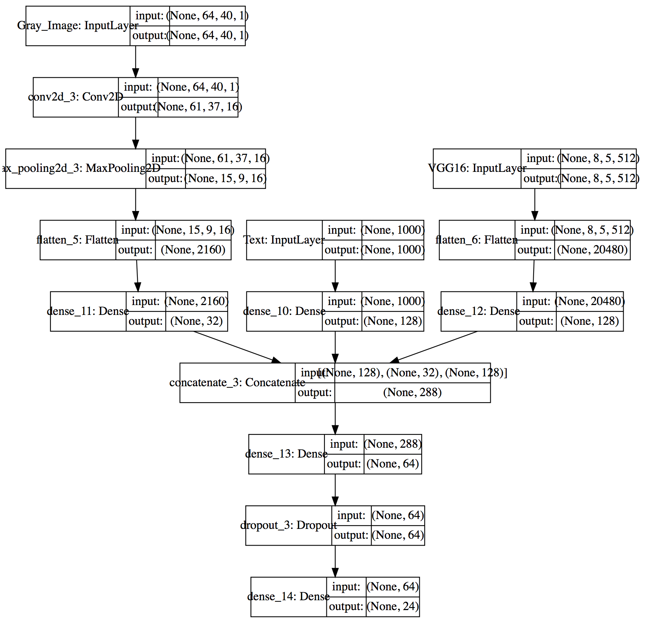
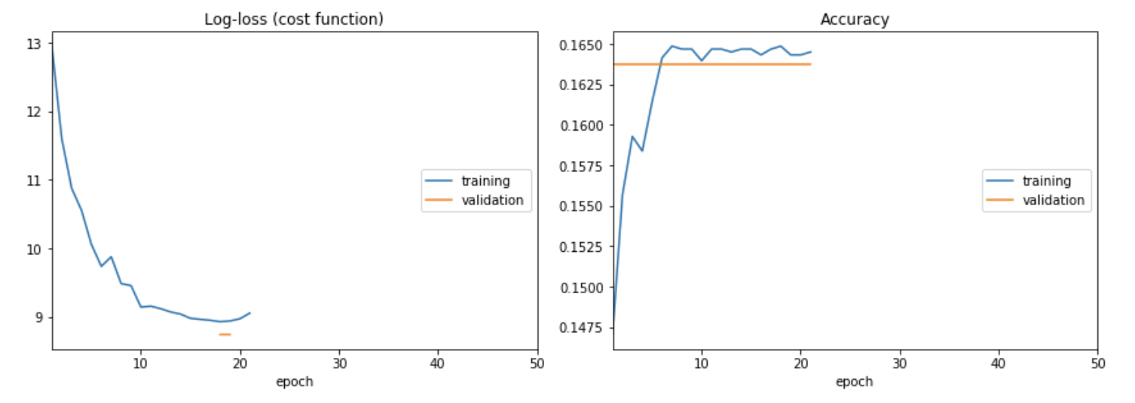
Neural networks: multiple input
Model with 3 inputs: Lemmatized text, Grayscale images and VGG16 output for color images
Parameters: 2’839.176
Computationaly complex model: no final computations due to computational limitations
Partial results:

Slide 5
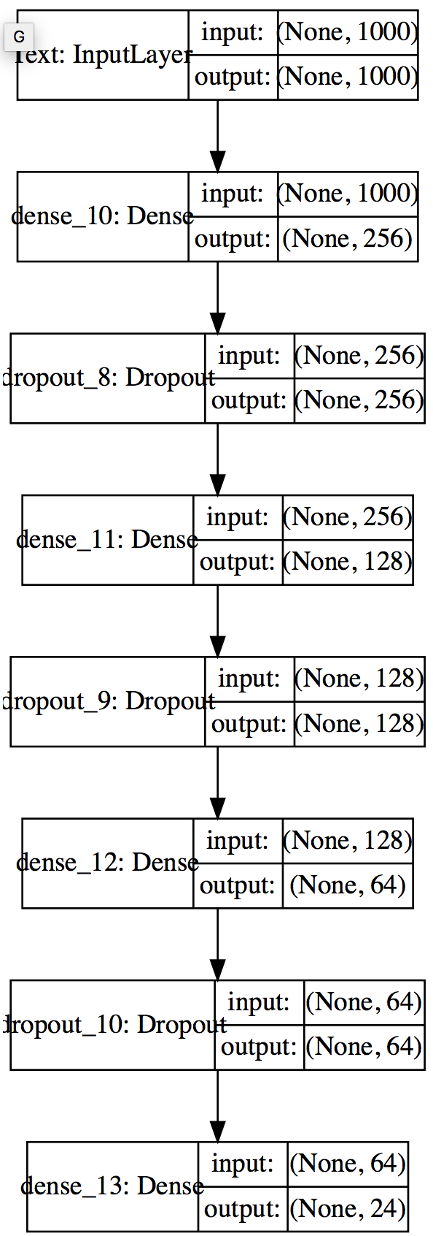
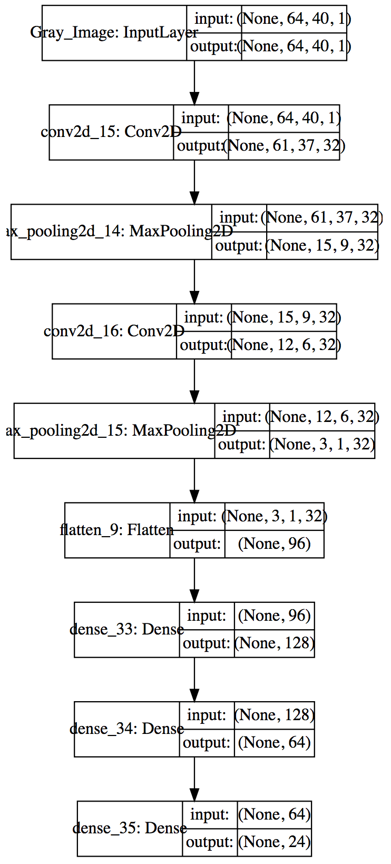
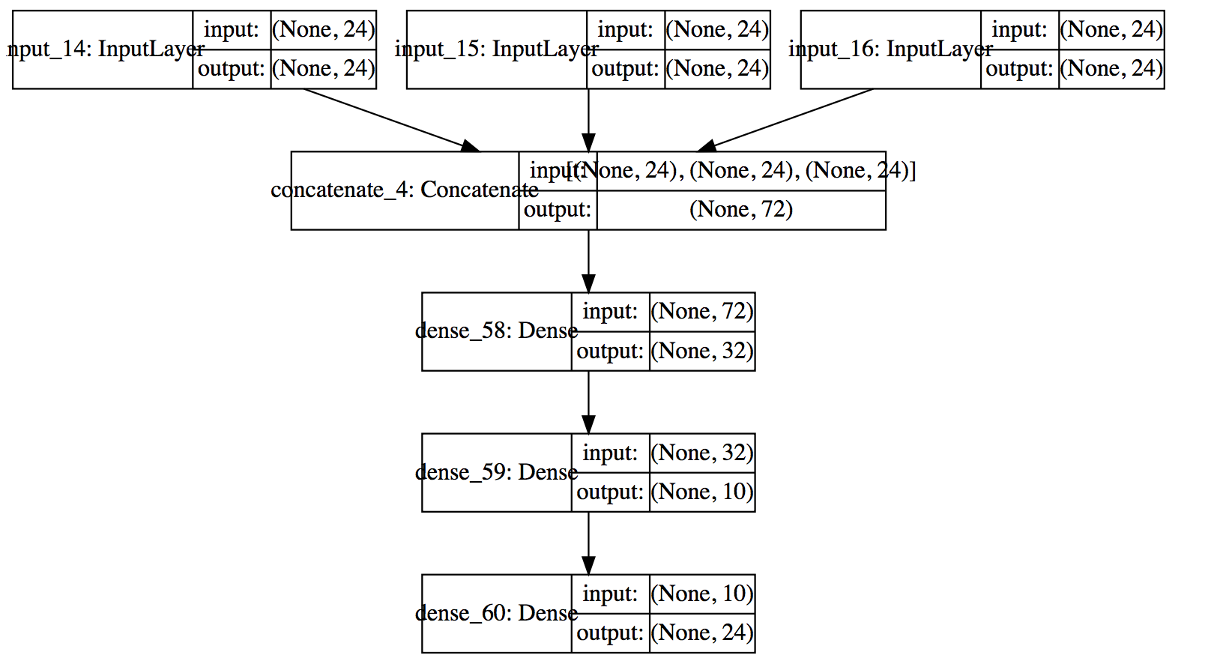
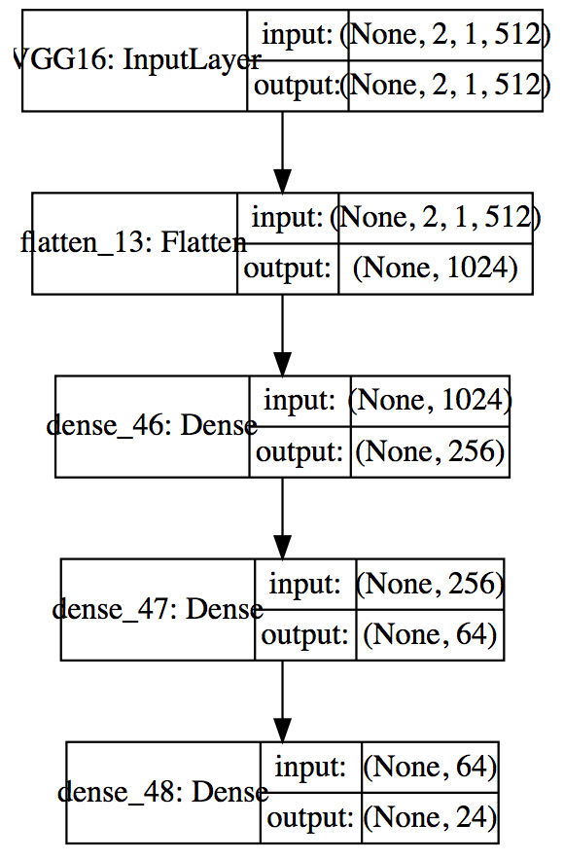
Neural networks: stacking
Text
Grayscale
Color
Individual models for each input
VGG16
+
AUC: 0.7978
AUC: 0.8177
AUC: 0.5139
AUC: 0.5169

Slide 6
conclusion
Neural networks are good performing classification tools but require intense computational tasks that prevent fast generalizations or training of models. Even predictions with pre-trainig applications such as VGG16 need time to get predictions for feature extractions.

