Slide 1
Layout
Flexbox
Responsive
flex-container (oj-flex)
(oj-)flex-item
(oj-)flex-item
(oj-)flex-item

Slide 2
Layout
Flex-direction: row (default)
Flex-direction: column
Main Axis
Cross Axis
Cross Axis
Flexcontainer
Main Axis
Flexcontainer

Slide 3
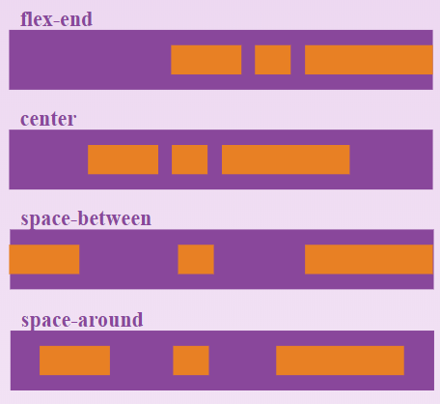
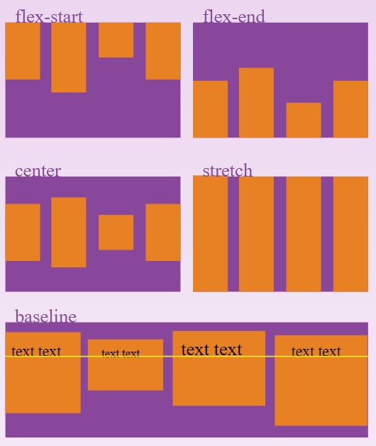
Layout
Alignment
Justify-content: align items along Main Axis
Flex-end
Center
Space-around
Space-between
Align-items: align items along Cross Axis
Center
Flex-start
Flex-end
Baseline

Slide 4
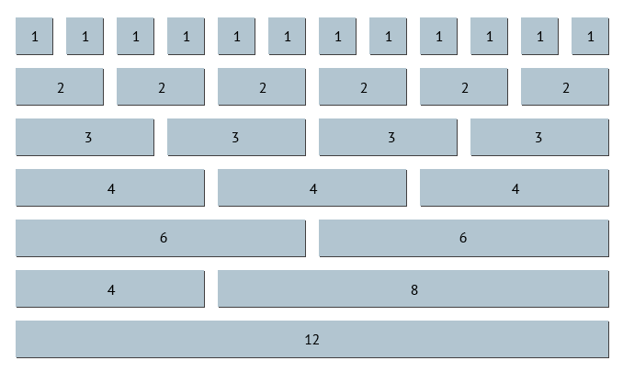
Layout
12 column Grid
Notes:
JET also uses the 12 column Grid layout where the parent element is divided in 12 equal columns.
You can set a child element to be a certain amount (width) of columns in order to make sure some elements are shown on the same row (or not).

Slide 5
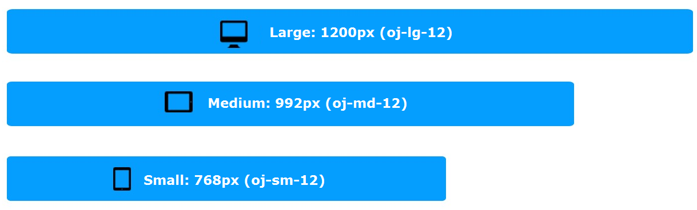
Layout
Responsive sizing

