Slide 1
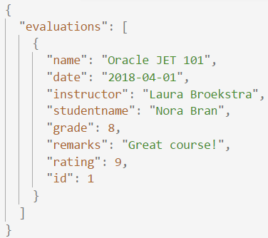
REST
REST
JSON
REpresentational State Transfer
Acces web services
HTTP calls (GET / POST / DELETE / ..)
Call with URL
Response code
JSON output
JavaScript Object Notation
Easy to use for humans and computers
Name/value pairs
List of values
Notes:
Explain the different types of requests in short
Further explain the JSON-format: what are the pairs?

Slide 2
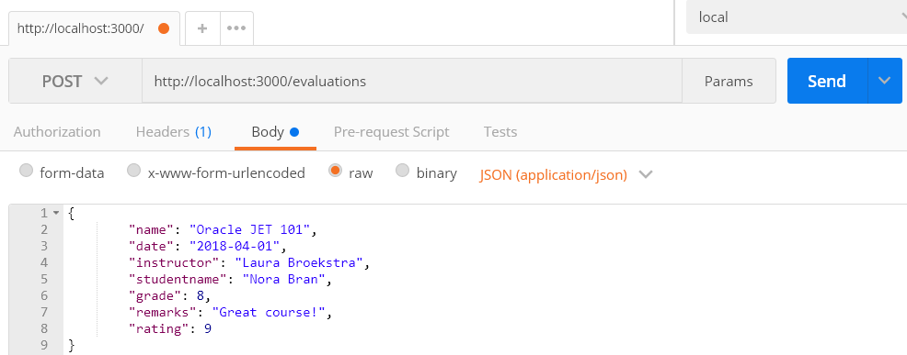
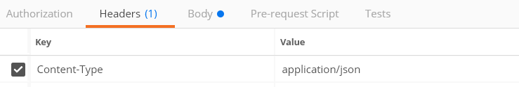
REST
POST(man)
POST-request to save data
Test requests with Postman
Notes:
Showing Postman here as it is a good tool to have in your toolbox.
It is enough to know the basics of request and request body.
But also possible to add headers (in case of this request necessary)
Authorization added
Testing.

Slide 3
REST
JSON-(mock)server
JSON-file
localhost:
3000
App
Exposes data
Request
Notes:
For the assignments in this course we will use json-server as an easy way to get and post data

