Slide 1
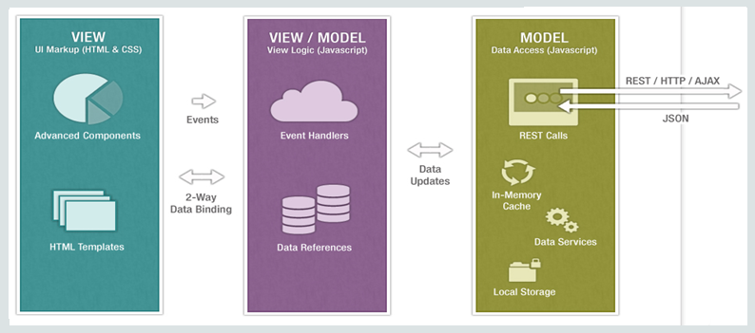
Architecture
MVVM

Slide 2
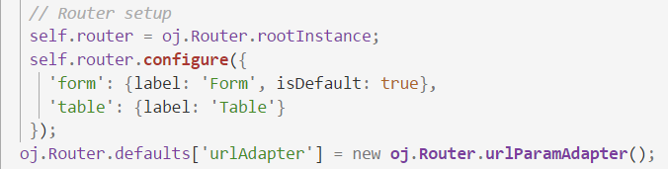
Architecture
Routing
SPA
Module navigation
Router state

Slide 3

Architecture
Routing
Store information

Slide 4
Architecture
ojModule
Composite Component
“Manages content replacement”
Used by router for navigation
“Reusable piece of UI”
Has own html / JS / CSS
Works on it’s own or with input from parent-application

Slide 5
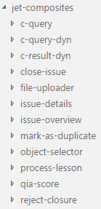
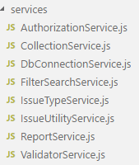
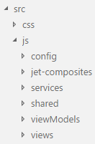
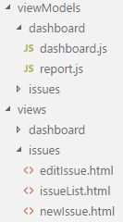
Architecture
Clean codebase

