Slide 1
Installing JET
JET current version 4.2.0
Get Started page: http://www.oracle.com/webfolder/technetwork/jet/globalGetStarted.html
Install Oracle JET CLI from NPM
npm -g install @oracle/ojet-cli
ojet create <applicationName>
Optional: Use a template:
ojet create <applicationName> --template=navdrawer

Slide 2
JET templates
http://www.oracle.com/webfolder/technetwork/jet/globalExamples.html
Basic Starter – no navigation
Nav Bar Starter – a navigation bar
Nav Drawer Starter – a navigation drawer

Slide 3
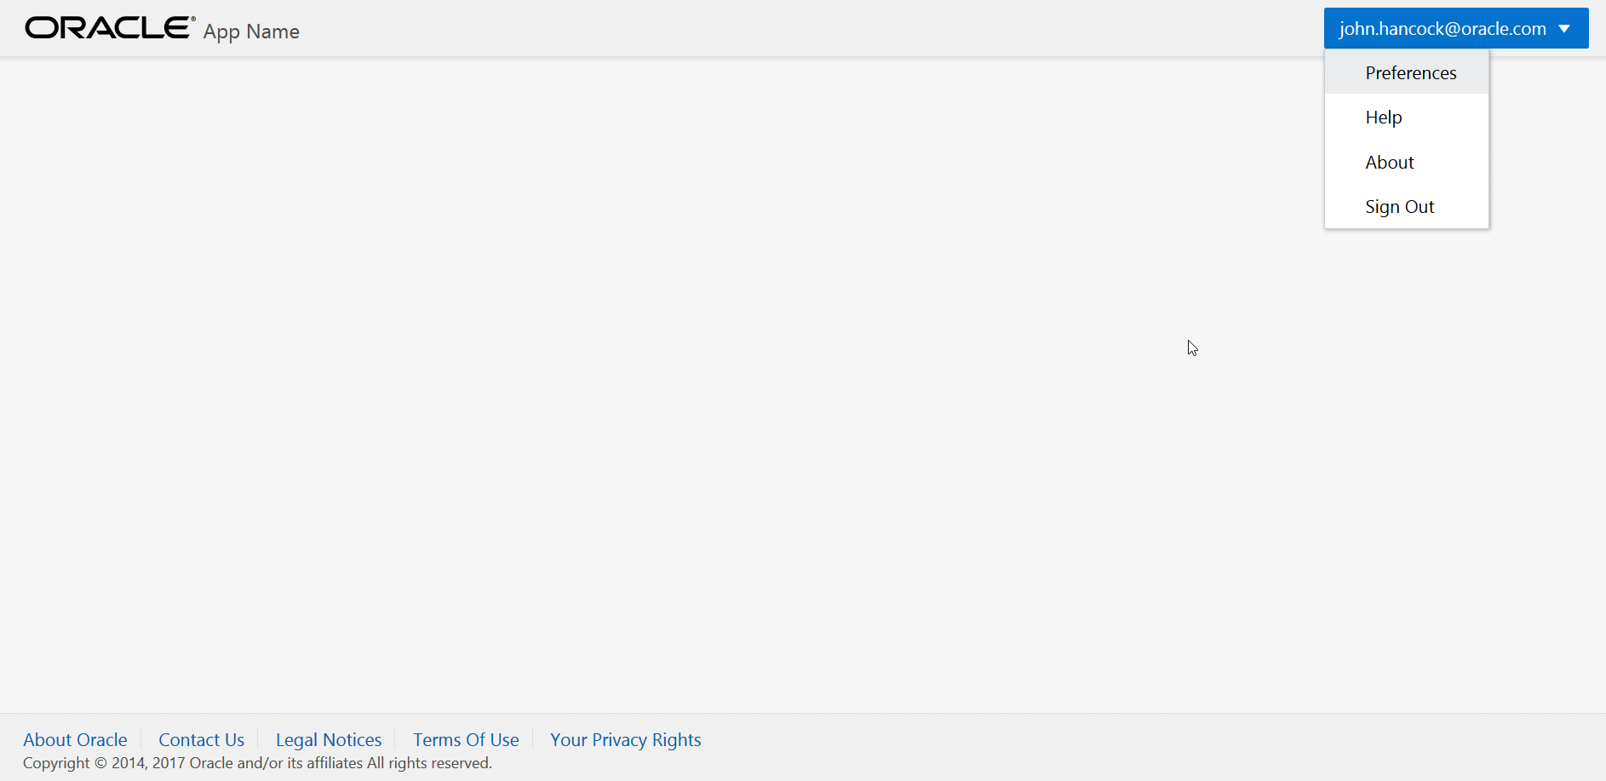
Basic starter

Slide 4
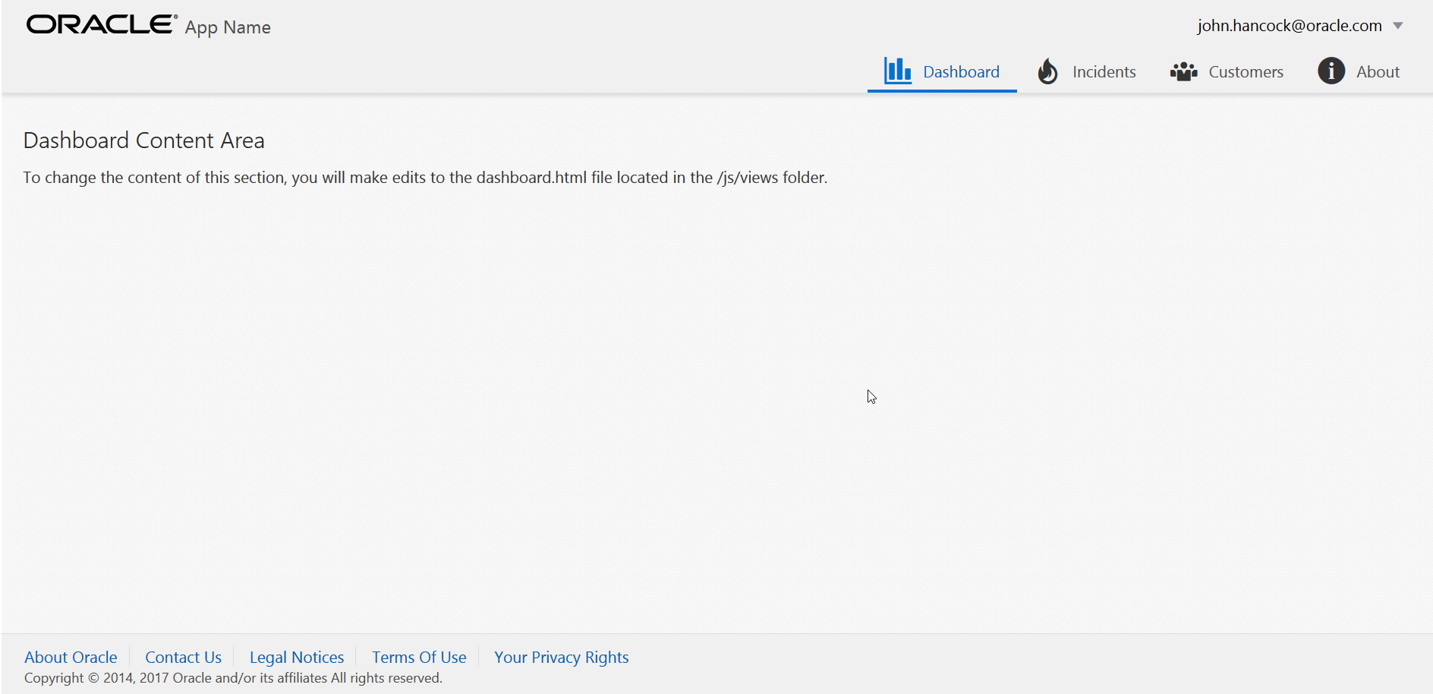
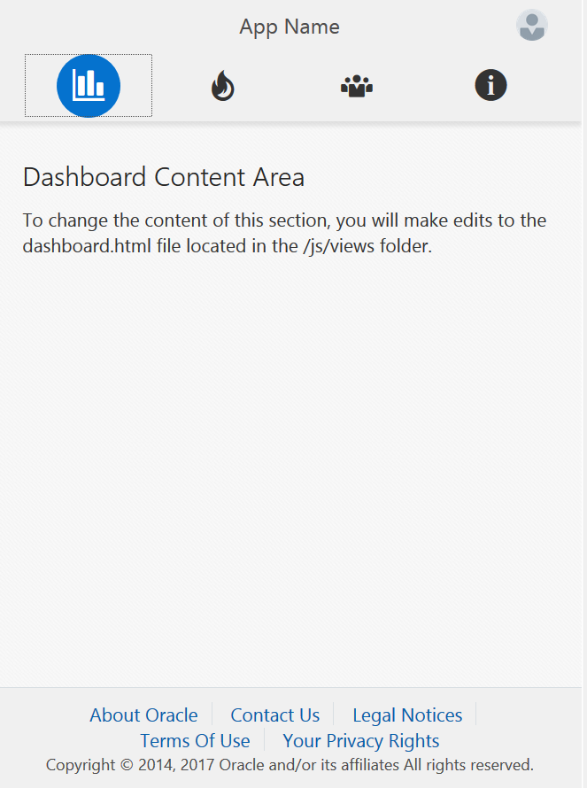
Navbar

Slide 5
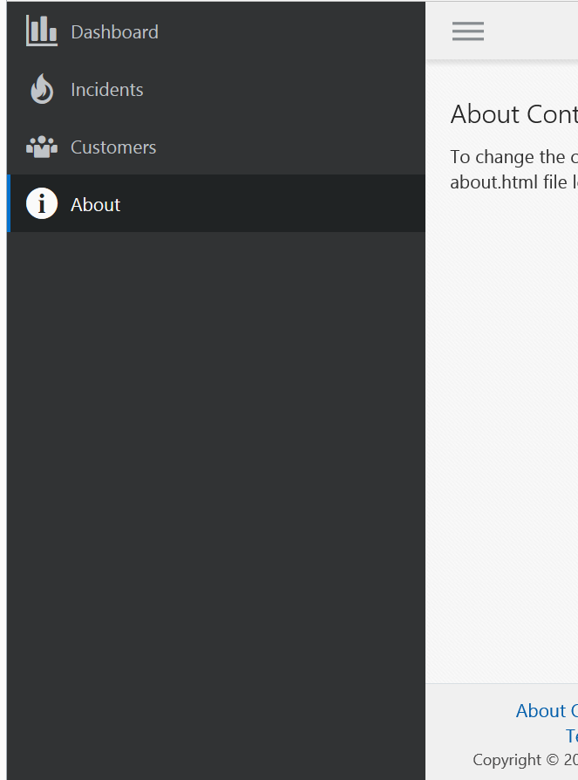
Navdrawer

