Slide 1

Oracle JET Talent Launch April 2018 Jeroen Rijnboutt & Laura Broekstra

Slide 2
Oracle JET

Slide 3

Facts
Oracle JET announced on OOW 2015
Open Source Release (v2.0.0) February 2016
Version 3 - March 2017
Version 4 - September 2017
Version 5 - April 2018

Slide 4
What is JET?
JET is an JavaScript Extensible Toolkit.
Not to be confused with a framework.
Oracle chooses open-source modularity over a framework with possible deprecation.
What is a toolkit?
Collection of proven (adult) libraries.
Together they provide all needed functionality.

Slide 5
Advantages toolkit
Easier to add libraries.
Easier to throw out libraries and choose different solution.
Easy for Oracle to change configuration of toolkit in later versions.
Good documentation for separate libraries

Slide 6
Disadvantages toolkit
Not the most modern. (No TypeScript, ES5 source code)
Possible faster EOL for older versions
No concise documentation

Slide 7

What is in the toolkit?
RequireJS – Lazy-loading of modules
KnockoutJS – Databinding
jQuery
Cordova – Mobile applications

Slide 8

Oracle JET and AMIS
Darling - begin 2017 (POC)
Follow-up Darling – october 2017
IHC – summer 2017 (2 small portals)
Follow-up IHC – november 2017 (1 big portal)
Grown to 5 developers (+2 architects)

Slide 9
Agenda – Day 1
General JET
First installation
RequireJS
KnockoutJS
JET Cookbook
Working with REST
JET Common Model

Slide 10
Agenda – Day 2
Finish assignments day 1
Visualization components
Layout
JET architecture
Composite Components

Slide 11
Installing JET
JET current version 5.0.0
Get Started page: http://www.oracle.com/webfolder/technetwork/jet/globalGetStarted.html
Install Oracle JET CLI from NPM
npm -g install @oracle/ojet-cli
ojet create <applicationName>
Optional: Use a template:
ojet create <applicationName> --template=navdrawer

Slide 12
JET templates
http://www.oracle.com/webfolder/technetwork/jet/globalExamples.html
Basic Starter – no navigation
Nav Bar Starter – a navigation bar
Nav Drawer Starter – a navigation drawer

Slide 13
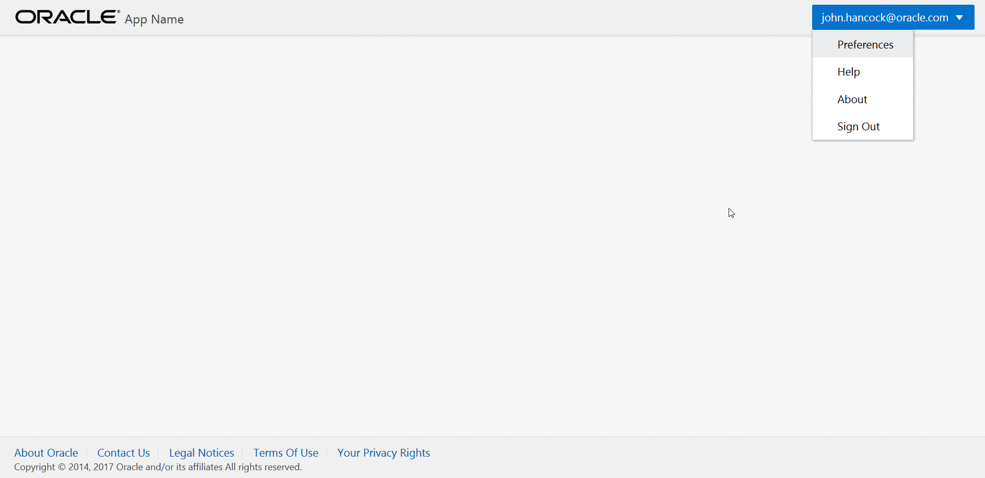
Basic starter

Slide 14
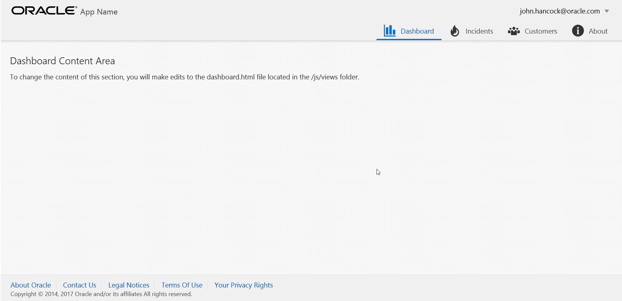
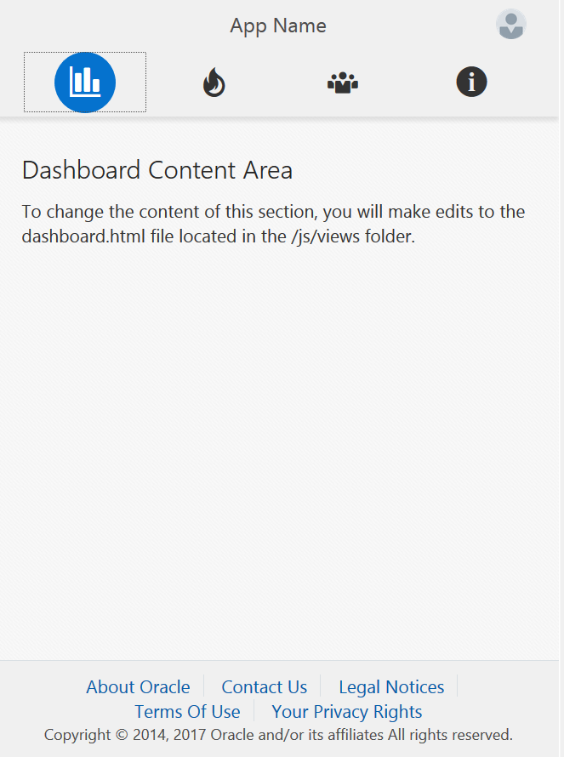
Navbar

Slide 15
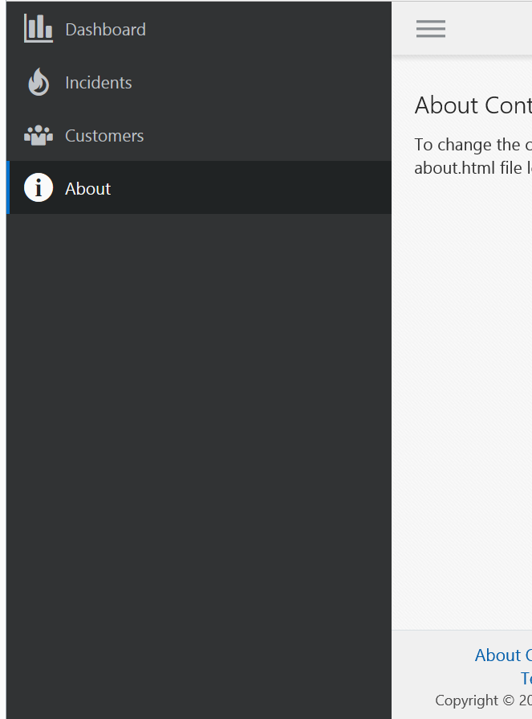
Navdrawer

Slide 16
Assignment - First application
https://github.com/jeroenRX/AmisJetTraining

Slide 17
Require & Knockout

Slide 18
RequireJS
Week 1 - part 2: https://www.youtube.com/watch?v=yznhGmE9VEg
Week 1 - part 3: https://www.youtube.com/watch?v=it9EvsNEPMw

Slide 19
KnockoutJS
Library for databinding
Good tutorials: http://knockoutjs.com/
Start with: Introduction & Working with Lists and collections

Slide 20
Observables
Declare an emtpy observable:
var dynamicValue = ko.observable();
Declare and instantiate an observable:
var dynamicValue = ko.observable(“option1”);
Instantiate an existing observable:
dynamicValue(“option2”);
Retrieve the value of an observable:
var value2 = dynamicValue();
Subscribe to an observable:
dynamicValue.subscribe(function(newValue){
console.log(“Value changed to: ” + newValue);
}

Slide 21
Observable Arrays
Declare the array:
var niceArray = new ObservableArray([“String1”, “String2”]);
Add a new item:
niceArray.push(“String3”);
Remove last item:
niceArray.pop();
Remove specific item:
niceArray.remove(“String2”);
Read more in documentation: http://knockoutjs.com/documentation/observableArrays.html

Slide 22
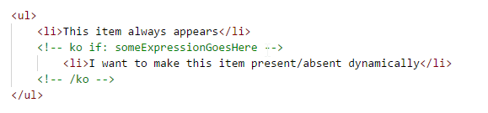
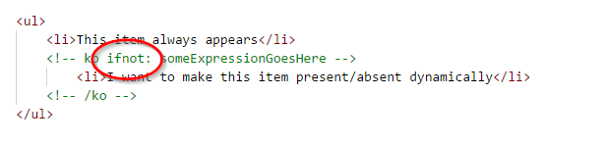
Ko if and if not
Easy way to dynamically show and hide divs in your view
Use comment syntax:

Slide 23
New databinding syntax since JET 4.0
Oracle takes a small step towards Angular
<span data-bind="text: id"></span>
<span data-bind="text: name"></span>
Becomes:
<p>{{id}} {{name}}</p>
This is two-way databinding (write changes back to observable)
One-way binding (no write-back) goes like this:
<p>[[id]] [[name]]</p>

Slide 24
JET Cookbook

Slide 25

JET Cookbook
JET Components
Shows all available JET components
Code examples
Adjust and test code in browser
JS Doc
Demo
Notes:
Short demo of JET Cookbook, show different categories
Short demo of how to include component in code

Slide 26
JET Cookbook
Checklist
Use HTML
Use JavaScript
Include component in define-block
Notes:
Checklist to remember when using components from cookbook

Slide 27
Assignment - JET Cookbook

Slide 28
REST

Slide 29
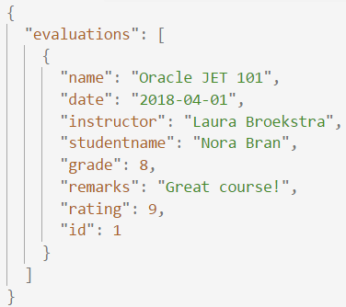
REST
REST
JSON
REpresentational State Transfer
Acces web services
HTTP calls (GET / POST / DELETE / ..)
Call with URL
Response code
JSON output
JavaScript Object Notation
Easy to use for humans and computers
Name/value pairs
List of values
Notes:
Explain the different types of requests in short
Further explain the JSON-format: what are the pairs?

Slide 30
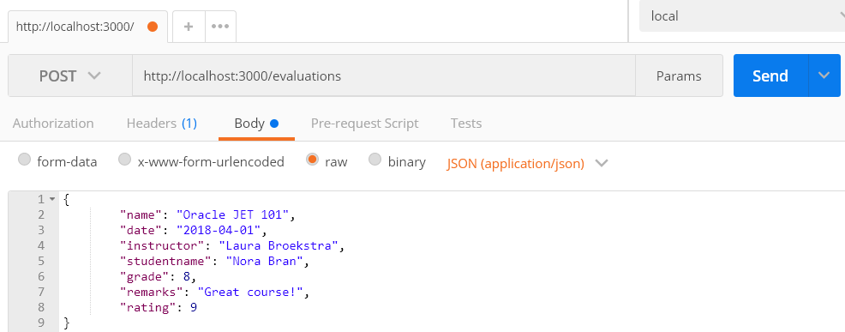
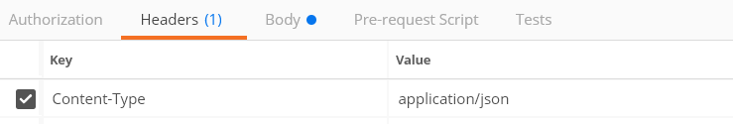
REST
POST(man)
POST-request to save data
Test requests with Postman
Notes:
Showing Postman here as it is a good tool to have in your toolbox.
It is enough to know the basics of request and request body.
But also possible to add headers (in case of this request necessary)
Authorization added
Testing.

Slide 31
REST
JSON-(mock)server
JSON-file
localhost:
3000
App
Exposes data
Request
Notes:
For the assignments in this course we will use json-server as an easy way to get and post data

Slide 32
Assignment - JSON Server & POST

Slide 33
Common Model

Slide 34

Common Model
Framework
Perform operations on data in backend
Add headers and customize request-URL
Format data for JET collection components
Standard methods to apply to data (get, filter, metadata, transform)
Notes:
Methods to apply: get a specific record, filter the data, get indexnumbers and fetchsizes, transform data to JSON

Slide 35
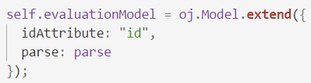
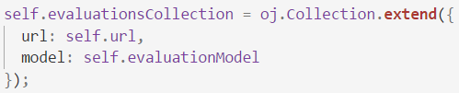
Common Model
Model
Collection
Tabel
Record
Record
Record
Record

Slide 36
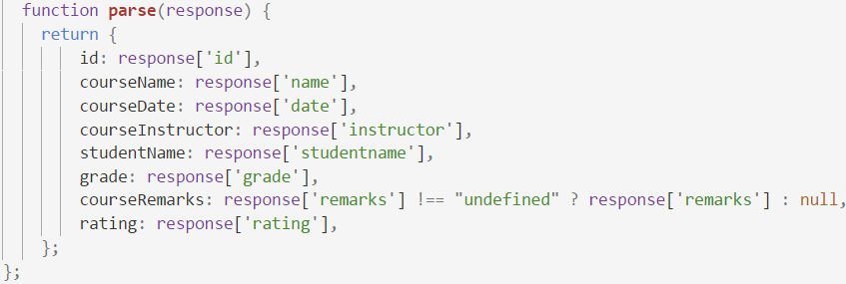
Common Model
REST
GET
JSON
Parse to easy to use object

Slide 37
Common Model
Datasource
Representation of data usable by components
CollectionTableDataSource can be used by Table
Notes:
Can depend on representation of data (collection or array) and the jet component

Slide 38
Assignment - Collection & Table

Slide 39
End of Oracle JET Day 1

Slide 40
Recap Day 1

Slide 41
Recap day 1
What is JET?
First application
RequireJS
KnockoutJS
Cookbook
REST
Common Model

Slide 42
Program day 2
Finish excercises day 1
Visualization components
Layout
Application architecture
Composite Component
Create your own Component!
Wrap-up

Slide 43
Visualisations

Slide 44
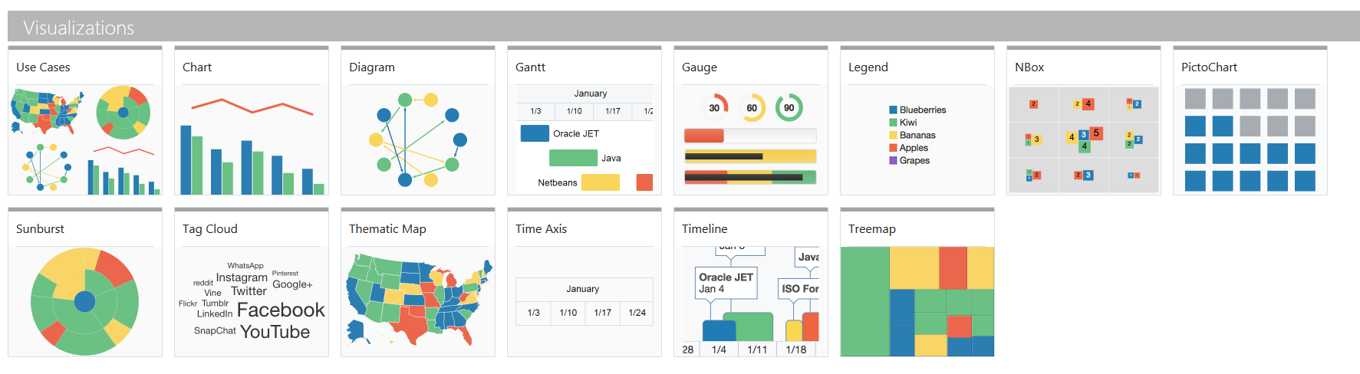
Visualization Components
JET provides numerous nice components in the Cookbook
One of the key features of Oracle JET

Slide 45
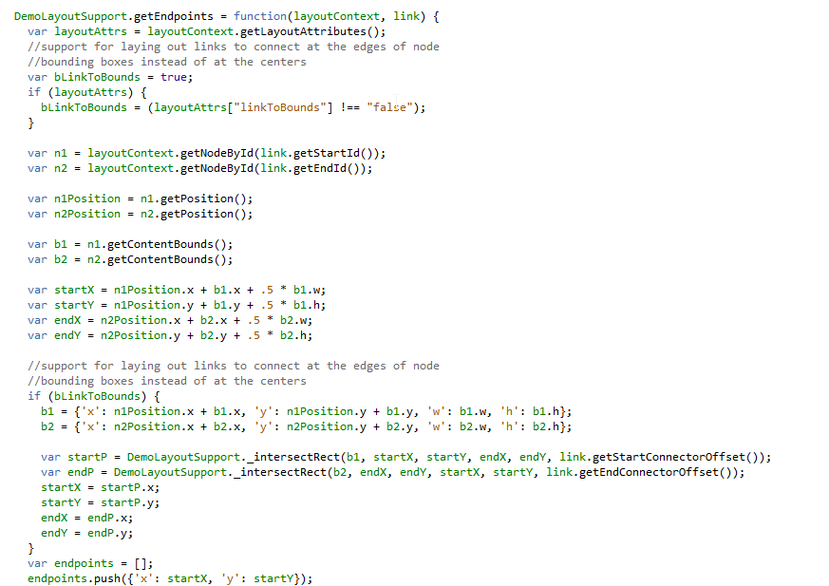
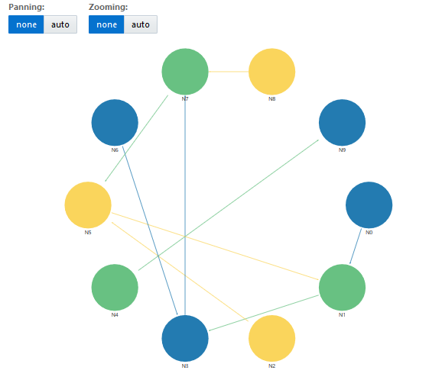
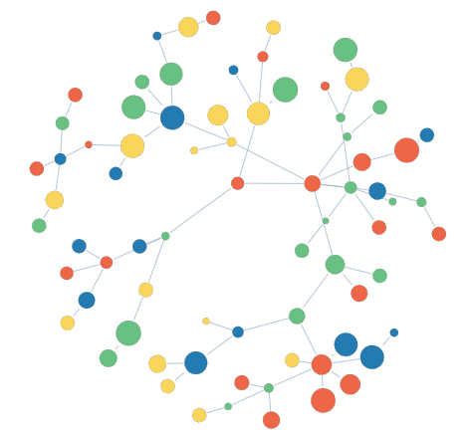
Cookbook caution
Required data structure can be complex

Slide 46
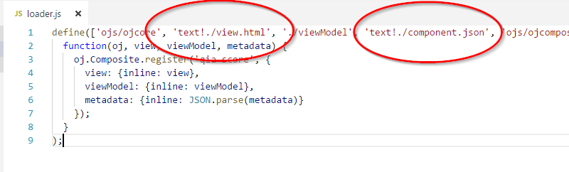
RequireJS text plugin
Standard part of JET
Used for inserting non-JavaScript files
Used in all Composite Components:

Slide 47
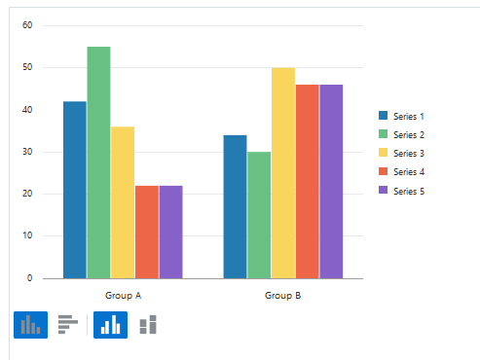
Assignment - Chart
We start easy: Bar Chart
Extra excercises for more complexity
Use the JSdocs! Some options are not used in the cookbook

Slide 48
Layout

Slide 49
Layout
Flexbox
Responsive
flex-container (oj-flex)
(oj-)flex-item
(oj-)flex-item
(oj-)flex-item

Slide 50
Layout
Flex-direction: row (default)
Flex-direction: column
Main Axis
Cross Axis
Cross Axis
Flexcontainer
Main Axis
Flexcontainer

Slide 51
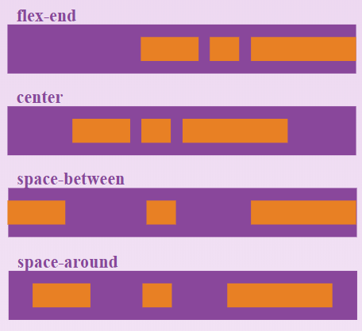
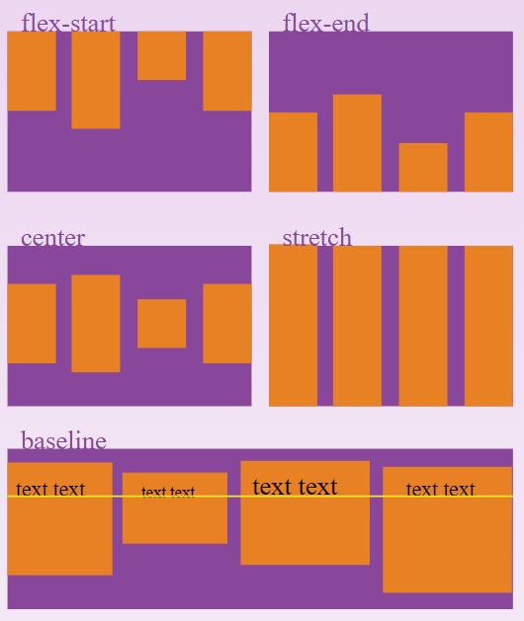
Layout
Alignment
Justify-content: align items along Main Axis
Flex-end
Center
Space-around
Space-between
Align-items: align items along Cross Axis
Center
Flex-start
Flex-end
Baseline

Slide 52
Assignment - Flex Layout

Slide 53
Architecture

Slide 54
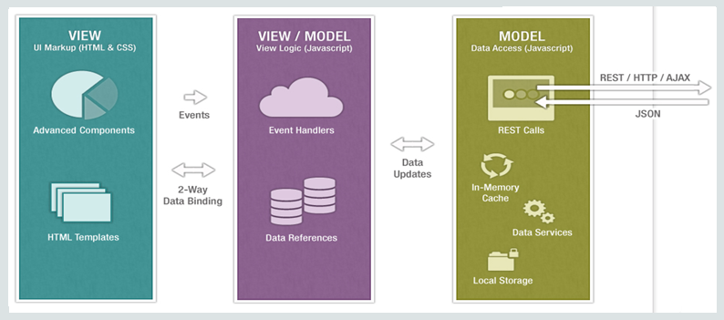
Architecture
MVVM

Slide 55
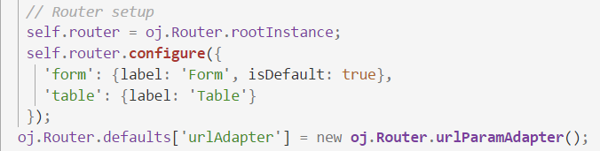
Architecture
Routing
SPA
Module navigation
Router state

Slide 56

Architecture
Routing
Store information

Slide 57
Architecture
ojModule
Composite Component
“Manages content replacement”
Used by router for navigation
“Reusable piece of UI”
Has own html / JS / CSS
Works on it’s own or with input from parent-application

Slide 58
Architecture
Clean codebase
How to structure code when an application gets bigger? <example deleted>

Slide 59
Composite Component

Slide 60
Composite Components
What is it?
Encapsulated piece of functionality
Why use it?
Decreases size of files
Ready to distribute
Ready for re-use
Creating the component:
ojet create component <component-name>

Slide 61
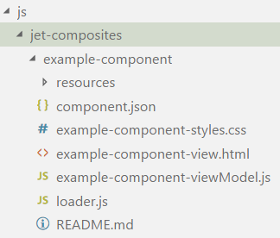
Structure
HTML file (view)
JavaScript file (viewModel)
Loader file (starting point)
JSON configuration file (parameters)
CSS file (styling)
Resources folder
Readme

Slide 62
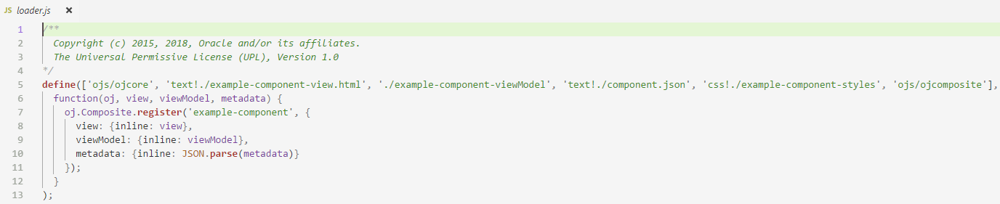
Loader.js

Slide 63
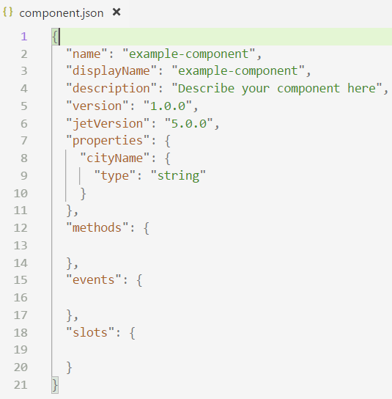
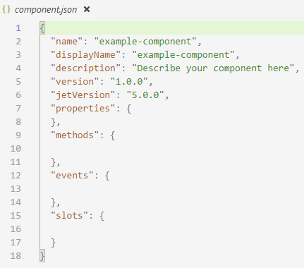
Component.json

Slide 64
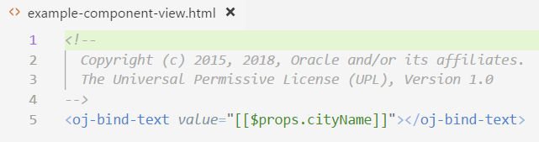
View.html

Slide 65
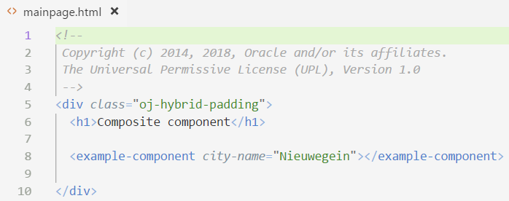

Using the component
Camel-case property names are converted into case-insensitive HTML element attributes with hyphens at the camel-case break point of the original name.

Slide 66
Assignment - Composite Component

Slide 67
Recap

Slide 68




Wrap-up
Thank you!
What have we done?
Oracle JET and the UI Practice

Slide 69
Sources and further reading
http://www.oracle.com
http://knockoutjs.com
https://github.com/nklasens/amis-course-2018.git (Nico Klasens, Lucas Jellema)
Duncan Mills blogs: https://blogs.oracle.com/groundside/cca
http://blog.iangilman.com/2015/02/self-this.html

Slide 70

Feedback

Slide 71
DIY Extra
SIG Lucas Jellema JET and OpenLayers
https://github.com/lucasjellema/sig-meetup-jet-openlayers-composite-components.git
Other Knockout tutorials
http://knockoutjs.com
jQuery tutorials
https://www.w3schools.com/jquery/default.asp
http://jqfundamentals.com/chapter/jquery-basics
JET MOOC

Slide 72
End of Oracle JET Day 2

